Slide 1
A Practical Guide to
Linux® Commands, Editors,
and Shell Programming
^{Chapters 1–3}
Mark G. Sobell with Matthew Helmke
A Practical Guide to Linux® Commands, Editors, and Shell Programming, Fourth Edition, © 2017 Mark G. Sobell (Pearson, ISBN: 978-0-13-477460-2)

Slide 2
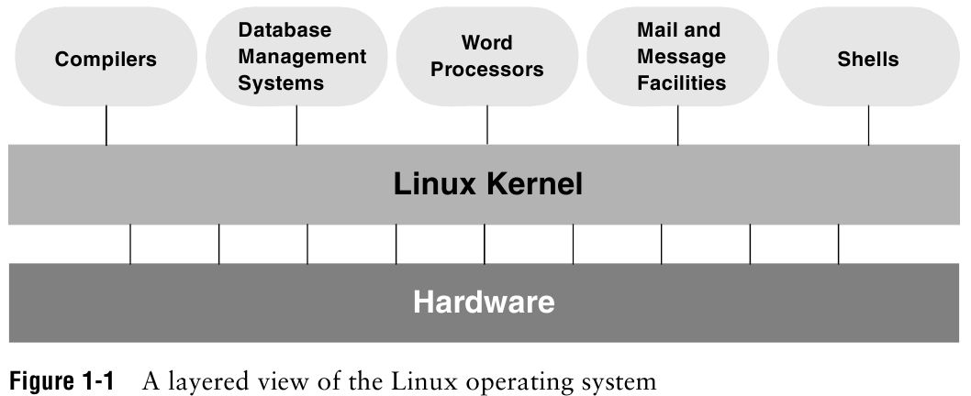
A Practical Guide to Linux® Commands, Editors, and Shell Programming, Fourth Edition, © 2017 Mark G. Sobell (Pearson, ISBN: 978-0-13-477460-2)

Slide 3
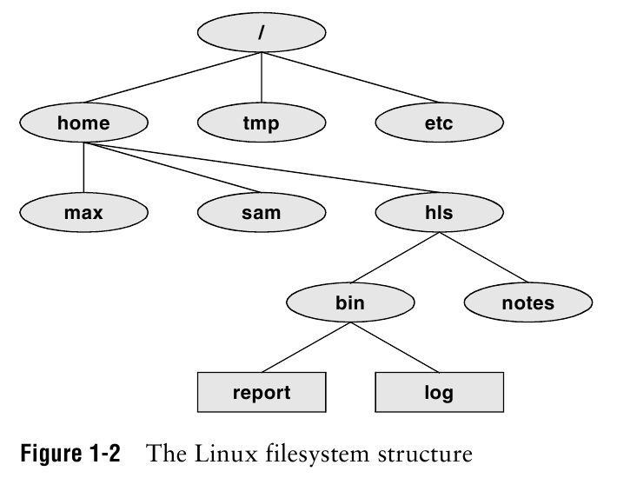
A Practical Guide to Linux® Commands, Editors, and Shell Programming, Fourth Edition, © 2017 Mark G. Sobell (Pearson, ISBN: 978-0-13-477460-2)

Slide 4
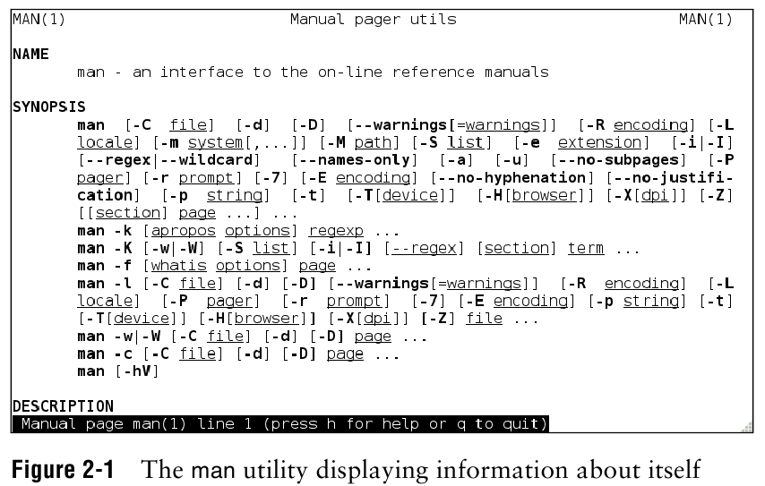
A Practical Guide to Linux® Commands, Editors, and Shell Programming, Fourth Edition, © 2017 Mark G. Sobell (Pearson, ISBN: 978-0-13-477460-2)

Slide 5
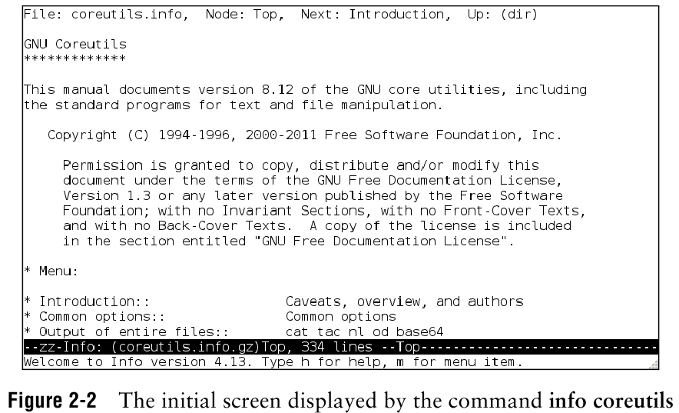
A Practical Guide to Linux® Commands, Editors, and Shell Programming, Fourth Edition, © 2017 Mark G. Sobell (Pearson, ISBN: 978-0-13-477460-2)

Slide 6
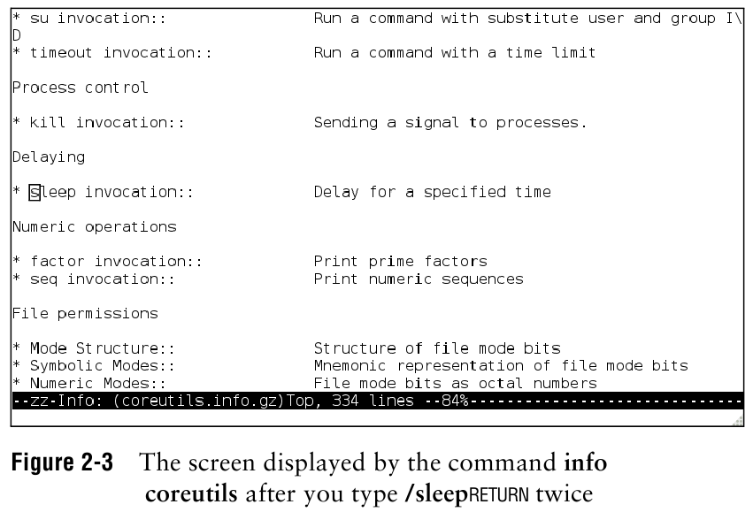
A Practical Guide to Linux® Commands, Editors, and Shell Programming, Fourth Edition, © 2017 Mark G. Sobell (Pearson, ISBN: 978-0-13-477460-2)

Slide 7
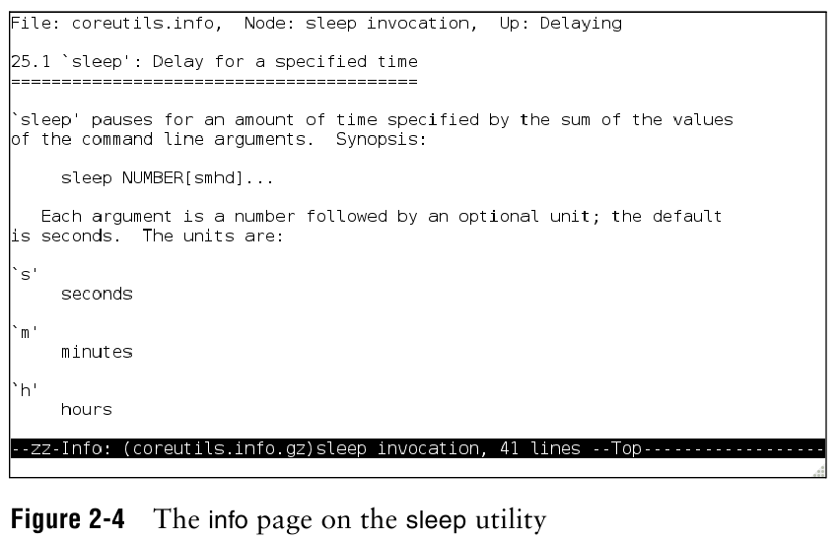
A Practical Guide to Linux® Commands, Editors, and Shell Programming, Fourth Edition, © 2017 Mark G. Sobell (Pearson, ISBN: 978-0-13-477460-2)

Slide 8
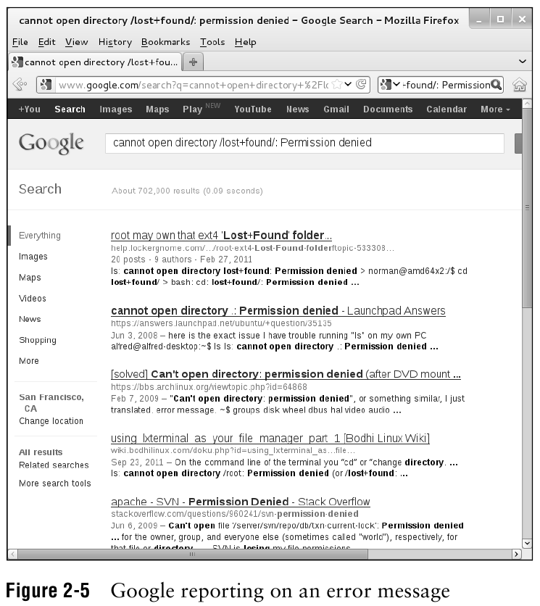
A Practical Guide to Linux® Commands, Editors, and Shell Programming, Fourth Edition, © 2017 Mark G. Sobell (Pearson, ISBN: 978-0-13-477460-2)

Slide 9
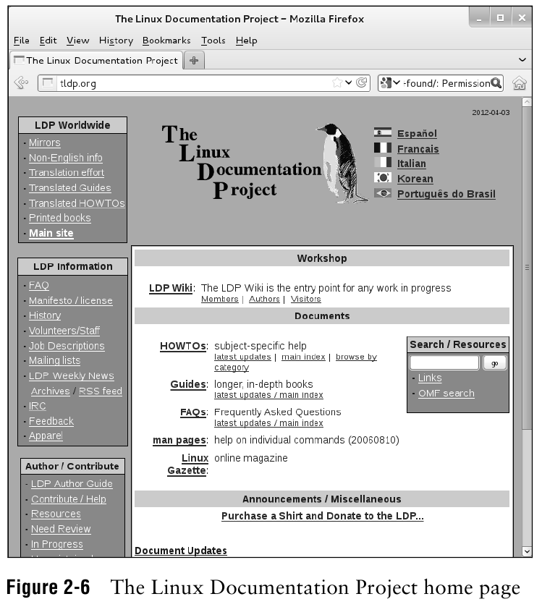
A Practical Guide to Linux® Commands, Editors, and Shell Programming, Fourth Edition, © 2017 Mark G. Sobell (Pearson, ISBN: 978-0-13-477460-2)

Slide 10
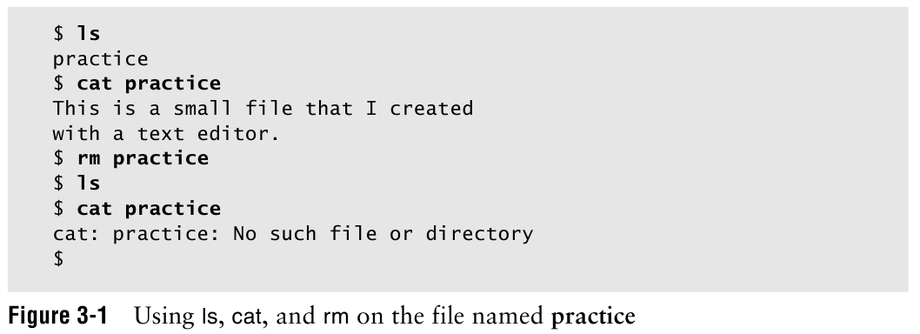
A Practical Guide to Linux® Commands, Editors, and Shell Programming, Fourth Edition, © 2017 Mark G. Sobell (Pearson, ISBN: 978-0-13-477460-2)

Slide 11
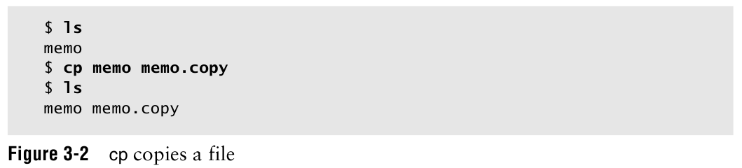
A Practical Guide to Linux® Commands, Editors, and Shell Programming, Fourth Edition, © 2017 Mark G. Sobell (Pearson, ISBN: 978-0-13-477460-2)

Slide 12
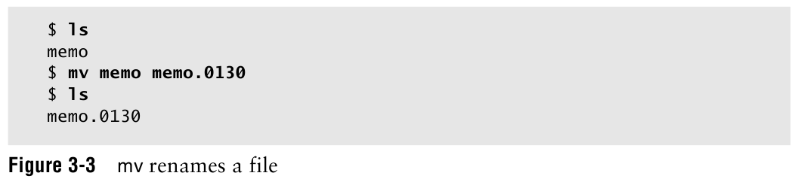
A Practical Guide to Linux® Commands, Editors, and Shell Programming, Fourth Edition, © 2017 Mark G. Sobell (Pearson, ISBN: 978-0-13-477460-2)

Slide 13
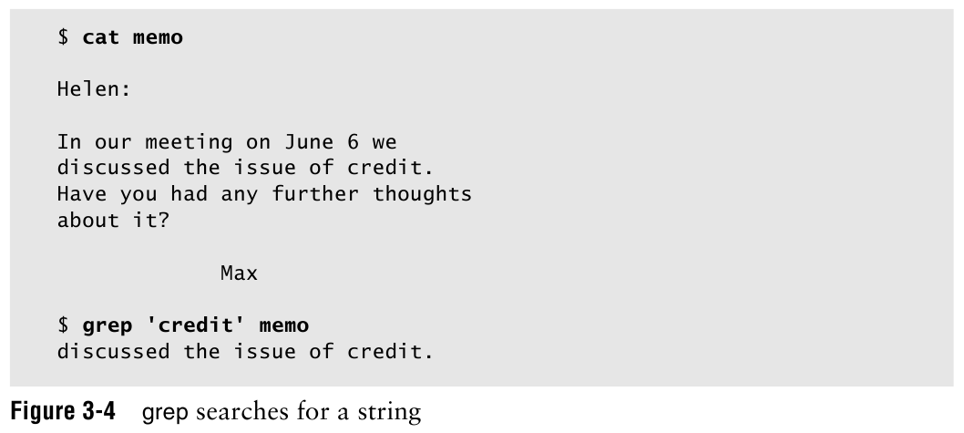
A Practical Guide to Linux® Commands, Editors, and Shell Programming, Fourth Edition, © 2017 Mark G. Sobell (Pearson, ISBN: 978-0-13-477460-2)

Slide 14
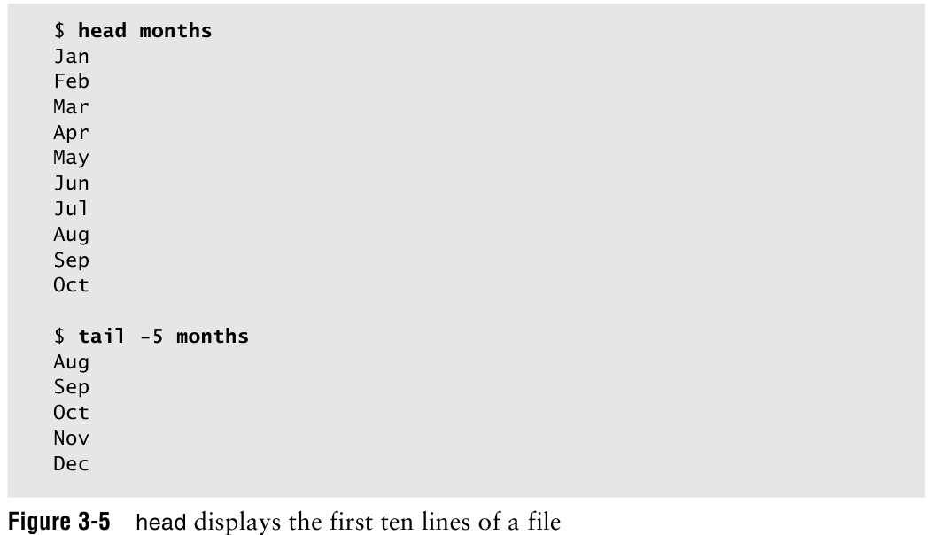
A Practical Guide to Linux® Commands, Editors, and Shell Programming, Fourth Edition, © 2017 Mark G. Sobell (Pearson, ISBN: 978-0-13-477460-2)

Slide 15
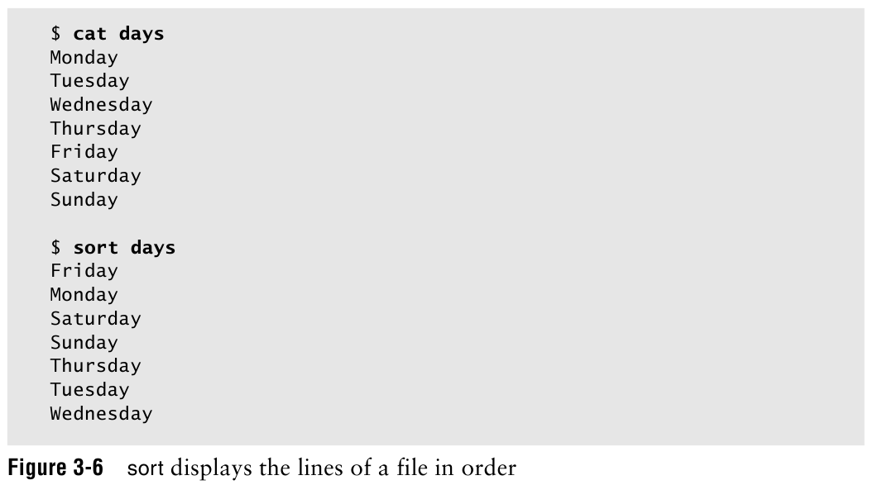
A Practical Guide to Linux® Commands, Editors, and Shell Programming, Fourth Edition, © 2017 Mark G. Sobell (Pearson, ISBN: 978-0-13-477460-2)

Slide 16
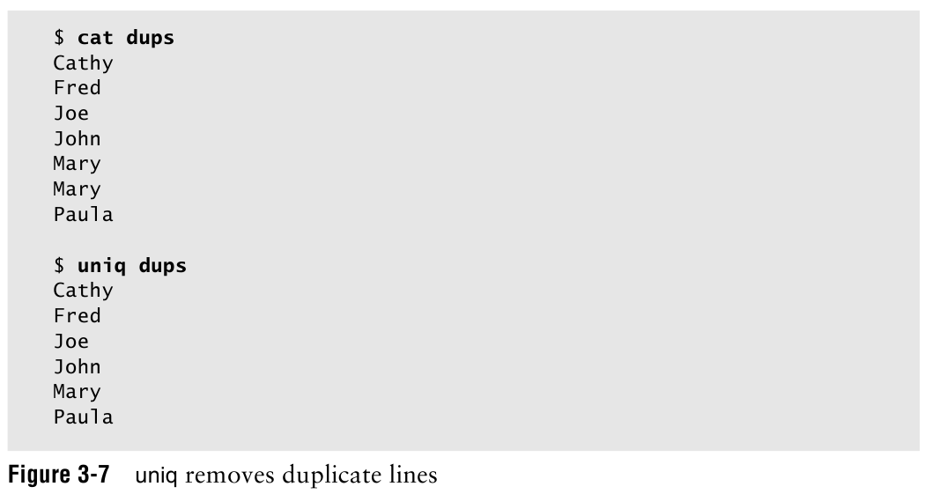
A Practical Guide to Linux® Commands, Editors, and Shell Programming, Fourth Edition, © 2017 Mark G. Sobell (Pearson, ISBN: 978-0-13-477460-2)

Slide 17
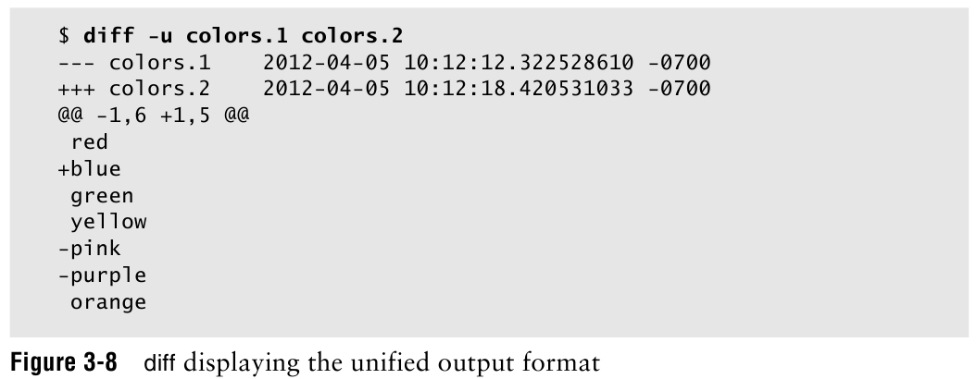
A Practical Guide to Linux® Commands, Editors, and Shell Programming, Fourth Edition, © 2017 Mark G. Sobell (Pearson, ISBN: 978-0-13-477460-2)

Slide 18
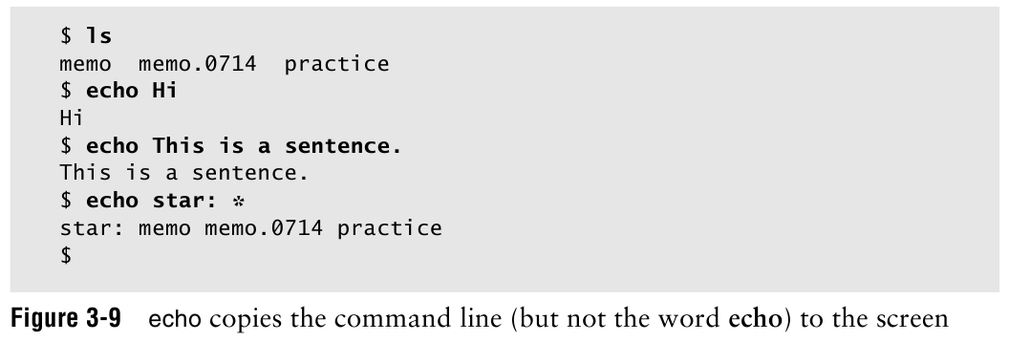
A Practical Guide to Linux® Commands, Editors, and Shell Programming, Fourth Edition, © 2017 Mark G. Sobell (Pearson, ISBN: 978-0-13-477460-2)

Slide 19
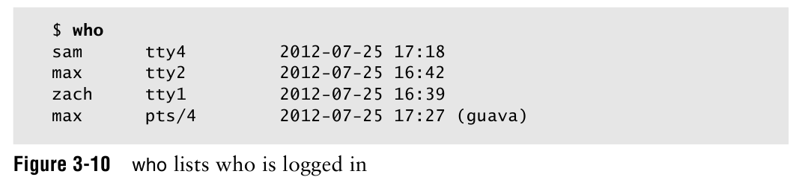
A Practical Guide to Linux® Commands, Editors, and Shell Programming, Fourth Edition, © 2017 Mark G. Sobell (Pearson, ISBN: 978-0-13-477460-2)

Slide 20
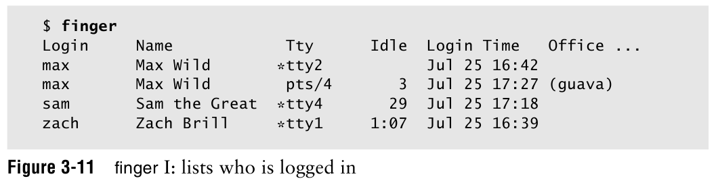
A Practical Guide to Linux® Commands, Editors, and Shell Programming, Fourth Edition, © 2017 Mark G. Sobell (Pearson, ISBN: 978-0-13-477460-2)

Slide 21
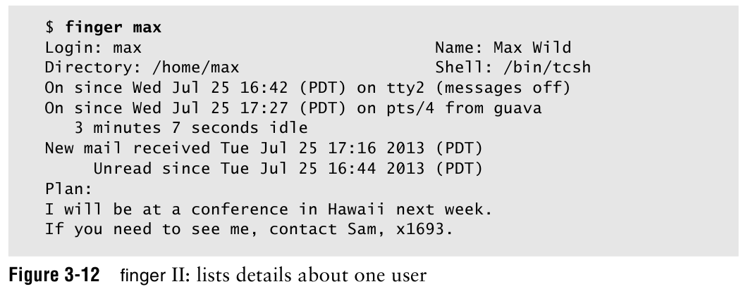
A Practical Guide to Linux® Commands, Editors, and Shell Programming, Fourth Edition, © 2017 Mark G. Sobell (Pearson, ISBN: 978-0-13-477460-2)

Slide 22
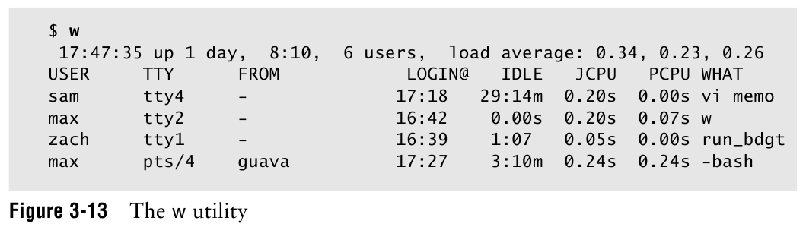
A Practical Guide to Linux® Commands, Editors, and Shell Programming, Fourth Edition, © 2017 Mark G. Sobell (Pearson, ISBN: 978-0-13-477460-2)

Slide 23

A Practical Guide to Linux® Commands, Editors, and Shell Programming, Fourth Edition, © 2017 Mark G. Sobell (Pearson, ISBN: 978-0-13-477460-2)

Slide 24

A Practical Guide to Linux® Commands, Editors, and Shell Programming, Fourth Edition, © 2017 Mark G. Sobell (Pearson, ISBN: 978-0-13-477460-2)

