Slide 1
Medium-Term Planning
Planning
Strategy
Short-Term Operations
Market
Profits
(a). The traditional open-loop process for S-CHPs.
Contextual Information
Medium-Term Planning
Planning
Strategy
Short-Term Operations
Market
Profits
(b). The presented closed-loop process for VS-CHPs.

Slide 2
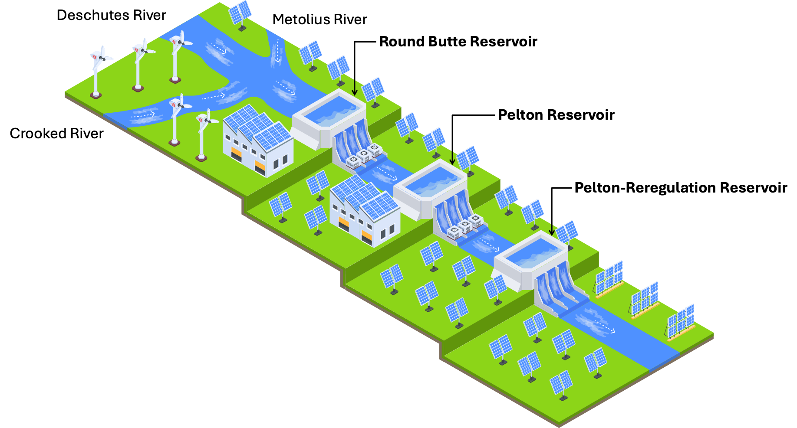
Deschutes River
Metolius River
Round Butte Reservoir
Crooked River
Pelton Reservoir
Pelton-Reregulation Reservoir

