Slide 1
Stock Trend Prediction with Reddit Posts
Team: mcmc

Slide 2
Problem Statement
Financial institutions use sentiment analysis for stock trend prediction regularly
However, they use highly financially specialized data(financial news, annual financial reports)
What kind of prediction can we make from an active, public anonymous forum of a business?

Slide 3
Data Source
All post history of reddit r/apple
Stock price of Apple(AAPL)
Analyze from 2014 to 2017(Four years).
Why this time interval?

Slide 4
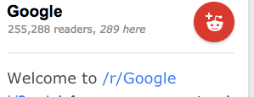
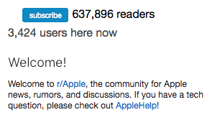
Why Apple?
Very active reddit population (compared to other tech companies)
Hardware products that are widely used(currently)
High brand recognition

Slide 5
Why Reddit?
Each subreddit focuses on one topic.
Easy for sharding data...
Sufficient public data set from 2004.
Personal Crawler can only access 25 pages submissions...about 20,000 items or 8 days...
Beautiful structure ---- JSON.
Less work for parsing...

Slide 6
Data Processing
As mentioned, we collect three-year data
Size: over 250Gb compressed data → over 1Tb raw data in total
“Error: There is not enough space on the cluster…”
“Error: Files exceed hdfs...”
“SHUTDOWN!!!”

Slide 7
Data Processing
How?
Download one month data → Uncompress → copyFromLocal → Filter → Ready…
Repeat 48 times…Wait!!! Uncompressing will cost 20 minutes...
Wrote a bash script to download and parse reddit data automatically

Slide 8
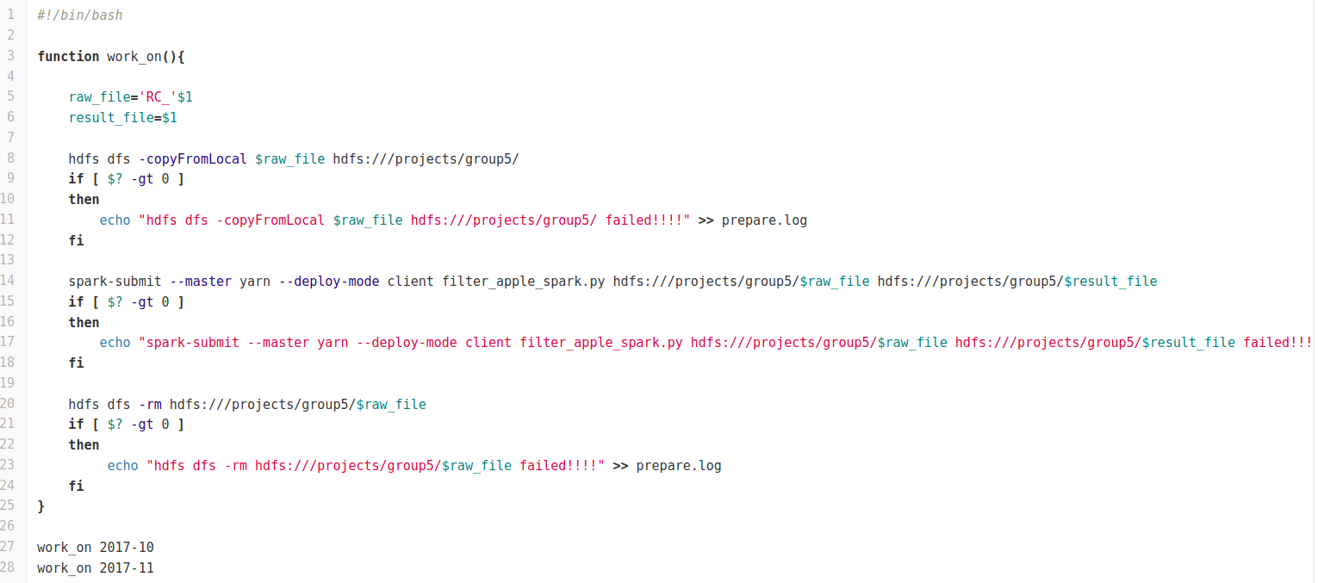
Data Processing
How?
Download one month data → Uncompress → copyFromLocal → Filter → Ready…
Repeat 48 times…Wait!!! Uncompressing will cost 20 minutes...
Wrote a bash script to download and parse reddit data automatically

Slide 9
Data Processing
Spark
Filter by Subreddit
We don’t want irrelated data
Revise the time(convert from UTC epoch to datetime)
It is important to match the comment date to the stock price.

Slide 10
Model Training
Package: Pyspark.ml
Package: pyspark.ml

Slide 11
Uniqueness
Previous study | Our Research
label data by hand learn a model to predict the sentiment predict based on how many positive and negative post in one day | aggregate all text from one day train model with stock status as labels predict directly from all the text in one day
Source: twitter, news | Source: subreddit
 | label today’s text with next day’s stock status include previous day’s stock status as feature

Slide 12
Subreddit (feature)
{'subreddit': 'apple’,
'author_flair_text': None,
'author_flair_css_class': None,
'distinguished': None,
'is_submitter': True,
'permalink': '/r/apple/comments/7afkse/apply_at_apple_store/dp9kso8/’,
'subreddit_id': 't5_2qh1f’,
'subreddit_type': 'public’,
'parent_id': 't1_dp9jeal’,
'stickied': False,
'controversiality': 0,
'id': 'dp9kso8’,
'can_gild': True,
'score': 2,
'edited': False,
'body': 'How would I email Tim? I don’t know his email address??’,
'created_utc': '2017-11-03’,
'author': 'Profaniter’,
'retrieved_on': 1512067724,
'link_id': 't3_7afkse'}

Slide 13
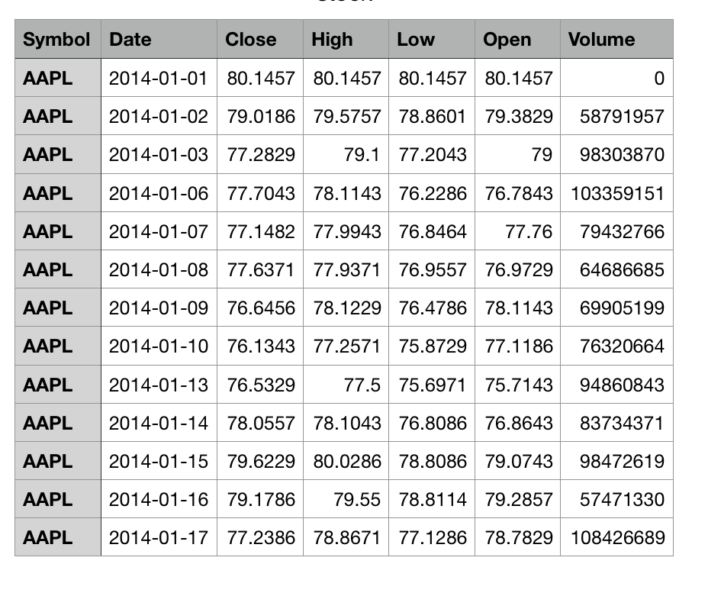
Stock (label)

Slide 14
Model
Feature extraction:
Tokenizer
Word2vec
remove common words
HashingTF + IDF
other tricks
1. Group by day
(too many text)
2. Filter
3. Merge text
Subreddit data
(date, string)
Feature
(date, vector)
Logistic
Model
Stock data
Bool (close – Open > 0)
Label
(date,bool)
Binary classification
Evaluator

Slide 15
Test, evaluate and Improve the model
Each test contains two models, with difference on a part of the model and all other steps the same
the model which performs better in the previous test will be the base setting of the next model
Test on current model
improve according to the observation
Analysis the result

Slide 16
Split data to training set and testing set
Usually we randomly split data into two size of 0.8 and 0.2
However, we have a time stamp for each data. (an attempt to simulate training the past data and predict the future)
we tried keep the time order. Use the older data as the training set and, more recent data as the test set.
Found at the start: the accuracy of different models not different much. reduce the randomness of testing data.

Slide 17
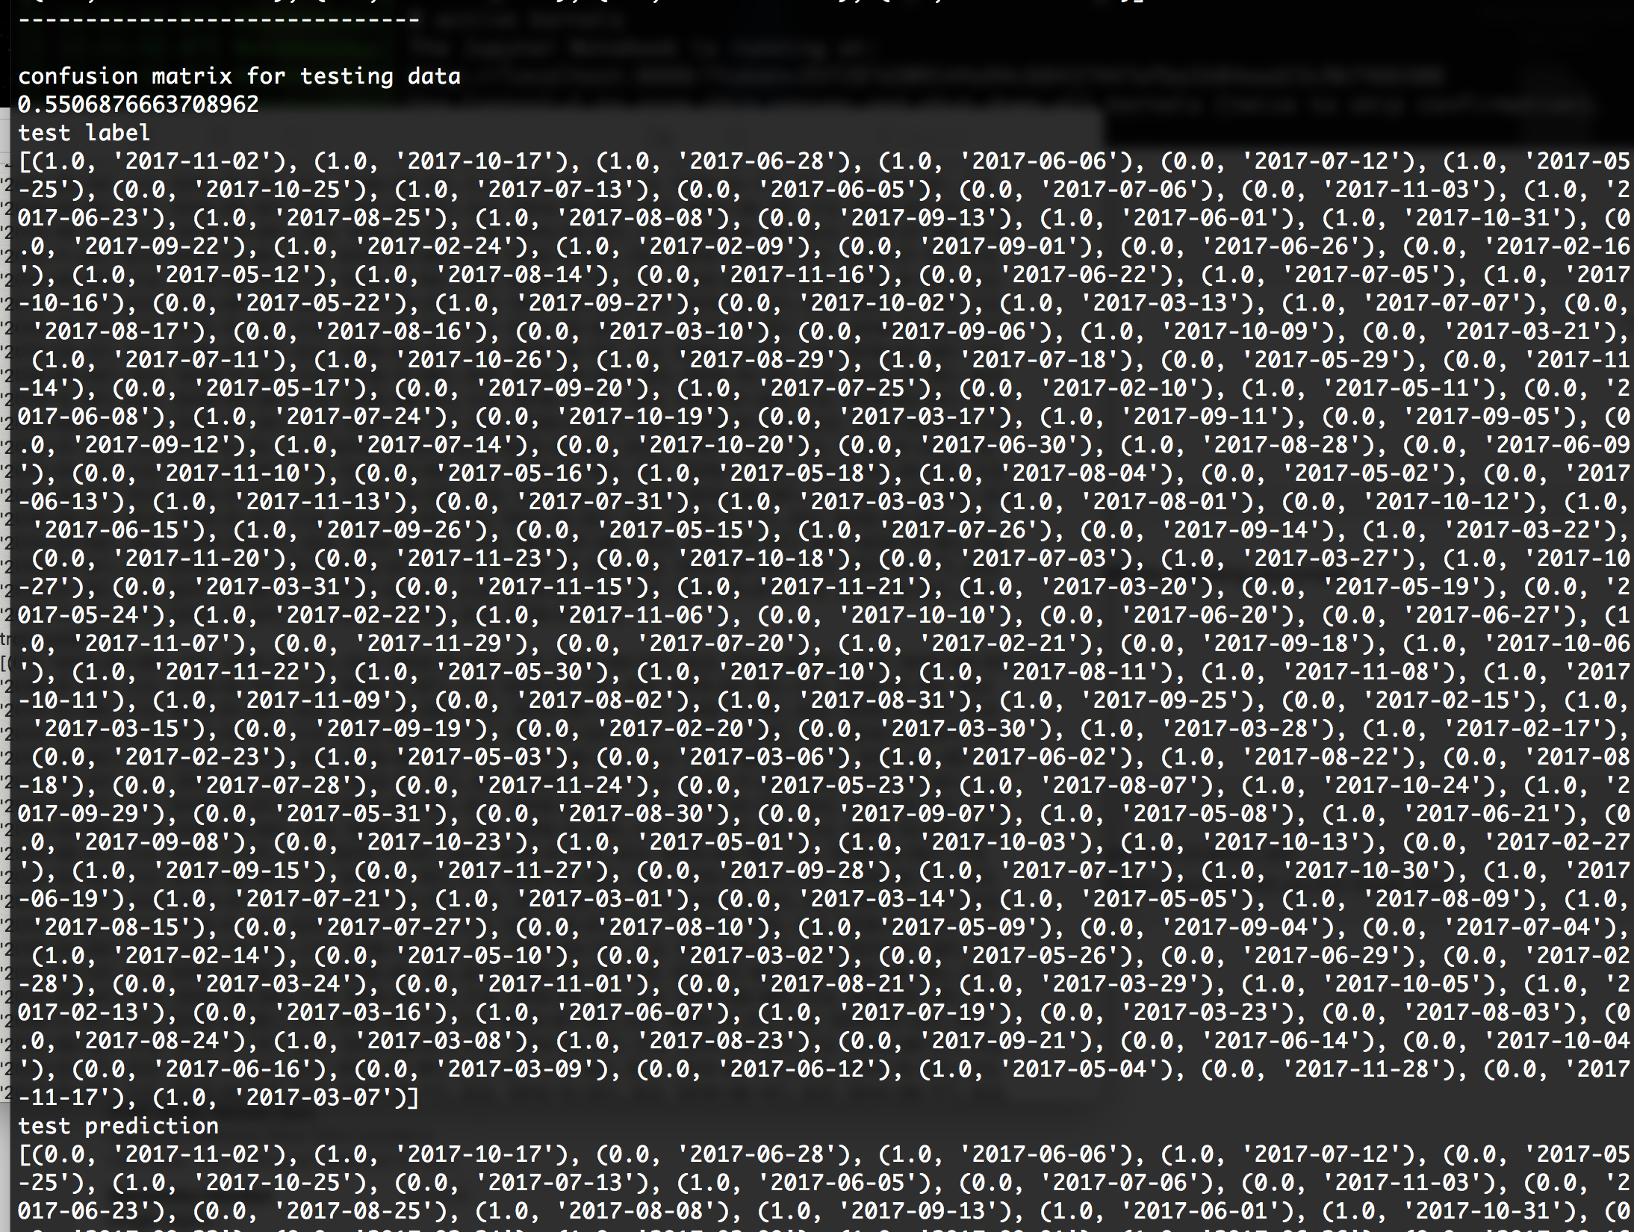
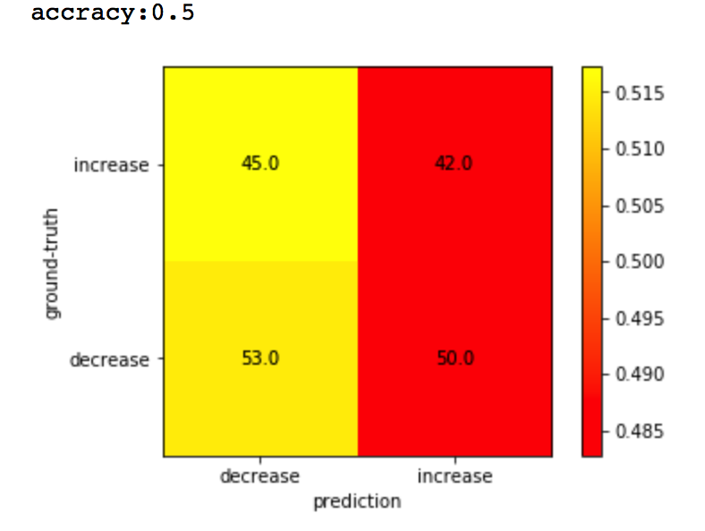
Evaluation

Slide 18
First experiment: Word2vec VS. TF-IDF
Our hypothesis: word2vec proform better than TF-IDF.
Word2vec: take co-occurrence into account.
IDF: Simplest measure of word frequency
(cannot reflect the relationship between words)

Slide 19
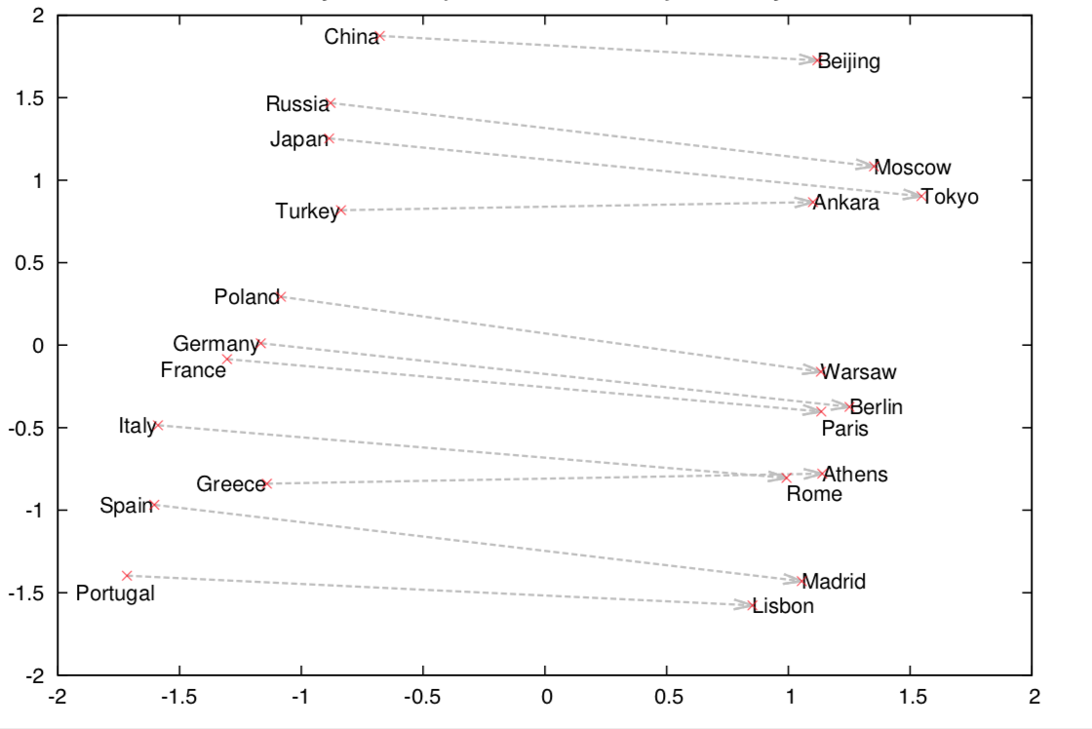

Slide 20
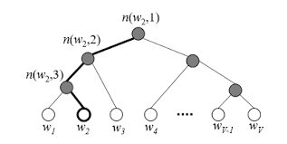
Word2vec is fast.

Slide 21
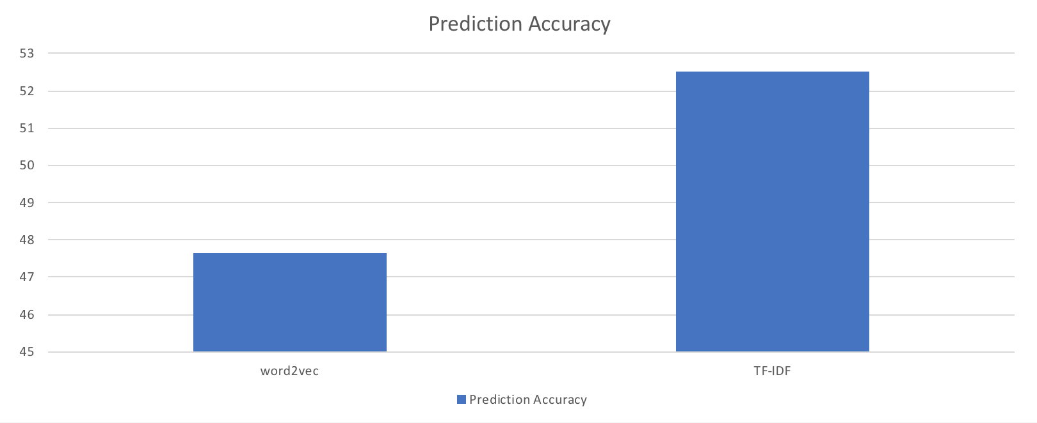
Word2vec VS. TF-IDF

Slide 22
Second Experiment:
Modification: introduce the delay factor.
Delay between posted Reddits and stock price fluctuation

Slide 23
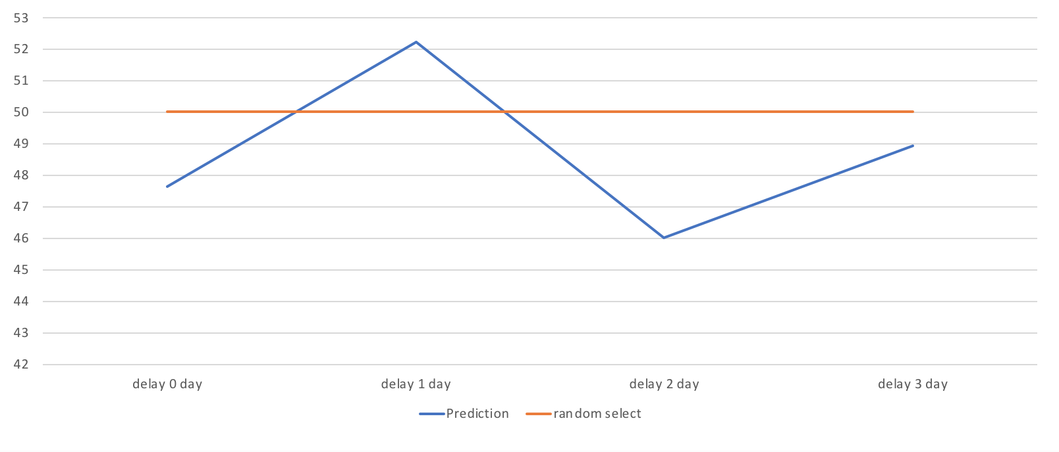
Second Experiment: Add delay to data

Slide 24
Word2vec and logistic model
Prediction Accuracy: 52.6% is still not good enough.

Slide 25
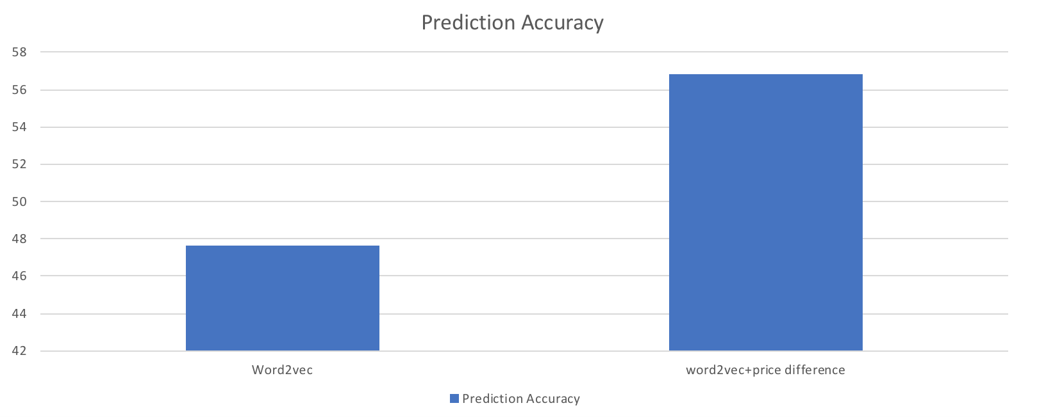
Third Experiment: Include price difference

Slide 26
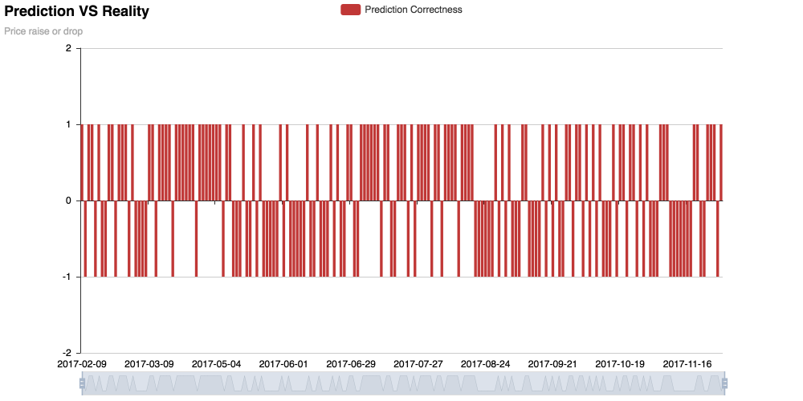
Why our model doesn’t have a higher accuracy

Slide 27
Questions

