Slide 1
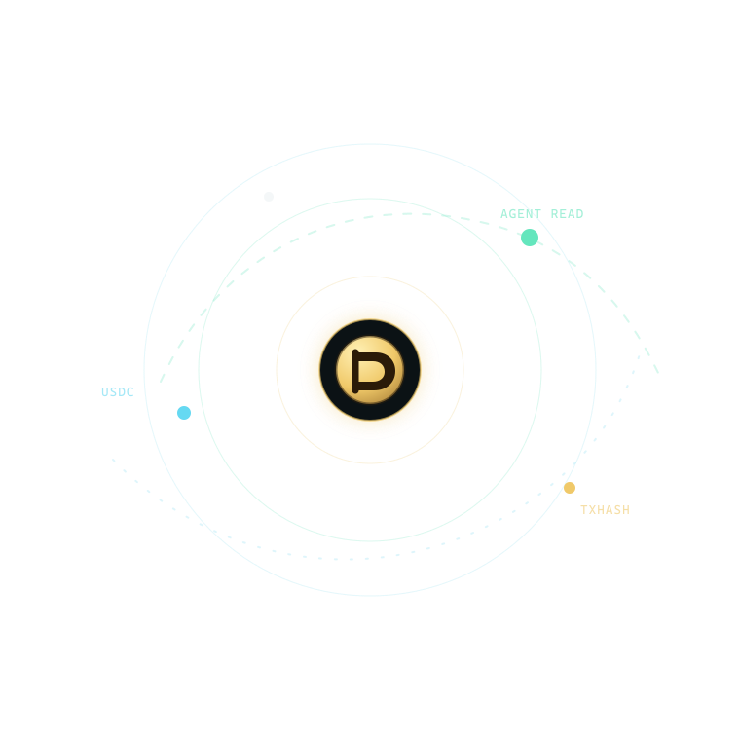
ARC · AGENTIC ECONOMY
PUBLIC DEMO · SAFE MOCK MODE
Obol
Programmable pay-per-read for AI agents
Notes:
AI agents already consume paid knowledge, but today there is no native way to price one read, protect a budget, pay the creator, and explain the decision. Obol makes that transaction programmable.
[Sources]
- https://github.com/xiangchengzilema/obol-programmable-money
- Local product artwork: frontend/assets/obol-orbit.svg

Slide 2
AI can buy information — but it needs rules, not a blank cheque
The missing primitive
Creators cannot price a single machine read. Agents cannot prove why a source was worth paying for. Ordinary subscriptions hide both marginal value and accountability.
Obol turns each read into a policy-governed USDC decision.
PRICE
Creators set a per-read price as low as one cent.
DECIDE
The agent buys, reuses, skips, or stops under explicit guardrails.
PROVE
Every choice carries a human-readable audit and settlement mode.
2
Notes:
The innovation is not a prettier checkout. It is accountable agency: the buyer has a bounded budget, a relevance threshold, a price cap, and a complete decision trace.
[Sources]
- https://github.com/xiangchengzilema/obol-programmable-money

Slide 3
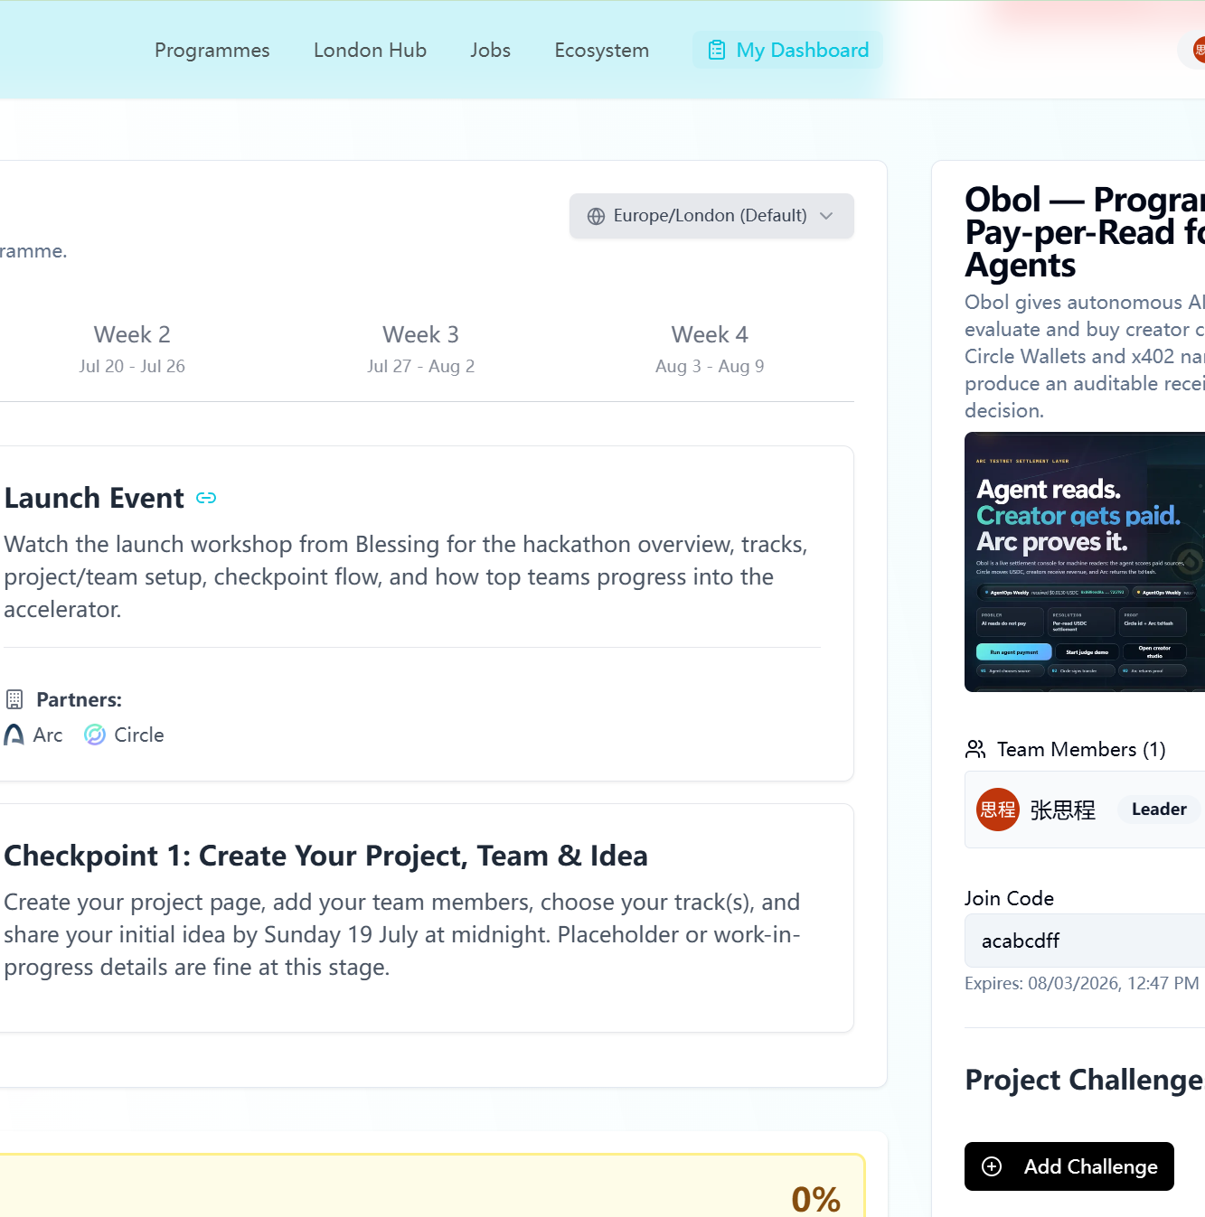
One URL. Full agent flow.
Ask once. Inspect everything.
Set a USDC budget and policy, run the agent, then inspect sources, receipts, remaining budget, and the exact rule behind every buy or skip.
The browser is a judge-friendly surface; the same system is callable through the native Agent API and an x402 endpoint.
LIVE: obol-programmable-money.onrender.com
3
Notes:
The public site is deliberately safe: it has no Circle or OpenAI secret and clearly reports mock settlement. Judges can still exercise the full policy, x402, receipt, and creator-revenue experience.
[Sources]
- https://obol-programmable-money.onrender.com
- User-supplied Encode project-page screenshot

Slide 4
One request becomes a priced, explainable, auditable transaction
01 · SCORE
02 · SETTLE
03 · RECEIPT
Rank value
Score relevance per dollar and detect redundant coverage.
Apply policy
Enforce reserve, max price, min relevance, and purchase count.
Explain outcome
Return answer, receipt, balances, rule ID, and stop reason.
4
Notes:
The agent ranks sources, authorizes only the reads that pass policy, settles them, and leaves a record a person can audit. Reuse is explicit and does not create fake creator revenue.
[Sources]
- https://github.com/xiangchengzilema/obol-programmable-money

Slide 5
The policy protected 80% of the test budget while still buying evidence
Verified public run · 2026-07-28
Query: Arc testnet predictable fees for AI paid reads. The agent bought one high-relevance source, skipped redundant or low-value candidates, and stopped with a complete audit.
RESERVE PROTECTED · $0.005
$0.050
$0.010
$0.040
Starting budget
Authorized spend
Budget remaining
5
Notes:
This is a verified demo run, not fabricated traction. Under a five-cent budget, the agent spent one cent on the strongest source and preserved four cents. Every skip explains the policy rule that fired.
[Sources]
- https://obol-programmable-money.onrender.com/api/agent/run
- Local smoke-test result captured 2026-07-28

Slide 6
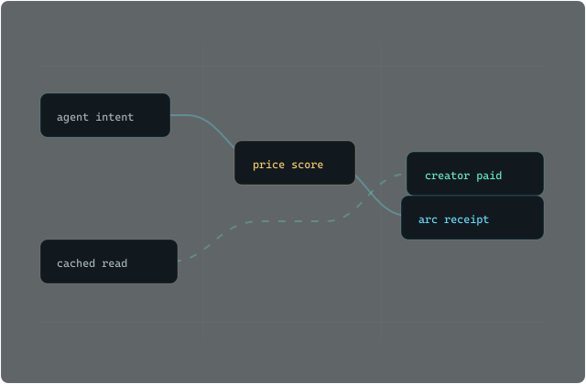
Arc and Circle make one-cent machine purchases economically legible
26/26 backend tests passed
HTTP 200 health · x402 402→200 · Agent 201
Agent policy
A deterministic policy authorizes spend before any settlement call.
Circle Wallets
The live path creates USDC transfers; the public judge deployment is fail-closed in mock mode.
Arc + x402
Predictable USDC fees and HTTP 402 make paid machine resources composable.
6
Notes:
The public demo is intentionally labelled mock and carries no spend authority. The repository also implements the credentialed Circle Wallet path for Arc Testnet. The important property is that the mode is explicit rather than inferred from a transaction-shaped string.
[Sources]
- https://obol-programmable-money.onrender.com/api/settlement/status
- https://obol-programmable-money.onrender.com/x402/articles/1
- Local product artwork: frontend/assets/agent-route.svg
- Local test run: 26 passed on 2026-07-28

Slide 7
SHIP STATUS
PUBLIC · NO LOGIN REQUIRED
Agents read.
Creators get paid.
LIVE DEMO
PUBLIC CODE
AGENTIC ECONOMY
obol-programmable-money.onrender.com
github.com/xiangchengzilema/obol-programmable-money
Arc Programmable Money Hackathon
Notes:
Obol gives agents a programmable budget and creators a verifiable reason to be paid. The demo and repository are public, and the project is submitted to Agentic Economy.
[Sources]
- https://obol-programmable-money.onrender.com
- https://github.com/xiangchengzilema/obol-programmable-money

