Slide 1
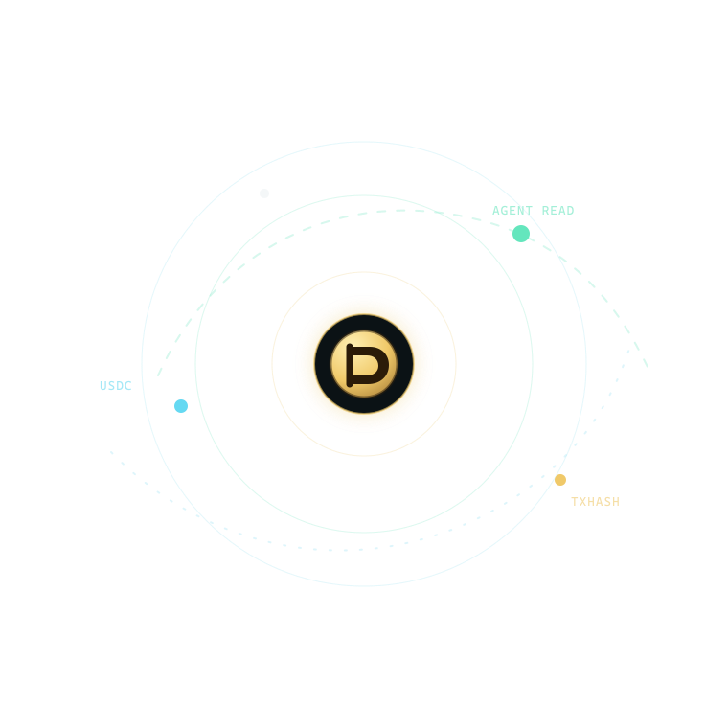
ARC · AGENTIC ECONOMY
PUBLIC DEMO · ARC PROOF READY
Obol
Programmable pay-per-read for AI agents
Notes:
Obol turns each paid read into a programmable decision: authorize, settle, and prove.
[Sources]
- https://obol-programmable-money.onrender.com
- https://github.com/xiangchengzilema/obol-programmable-money
- https://github.com/xiangchengzilema/obol-programmable-money/blob/main/evidence/arc-testnet-agent-run-20260806.json
[/Sources]

Slide 2
AI can buy information — but it needs rules, not a blank cheque
The missing primitive
Creators cannot price a single machine read. Agents cannot prove why a source was worth paying for. Ordinary subscriptions hide both marginal value and accountability.
Obol turns each read into a policy-governed USDC decision.
PRICE
Creators set a per-read price as low as one cent.
DECIDE
The agent buys, reuses, skips, or stops under explicit guardrails.
PROVE
Every choice carries a human-readable audit and settlement mode.
2
Notes:
The innovation is not a prettier checkout. It is accountable agency: the buyer has a bounded budget, a relevance threshold, a price cap, and a complete decision trace.
[Sources]
- https://github.com/xiangchengzilema/obol-programmable-money

Slide 3
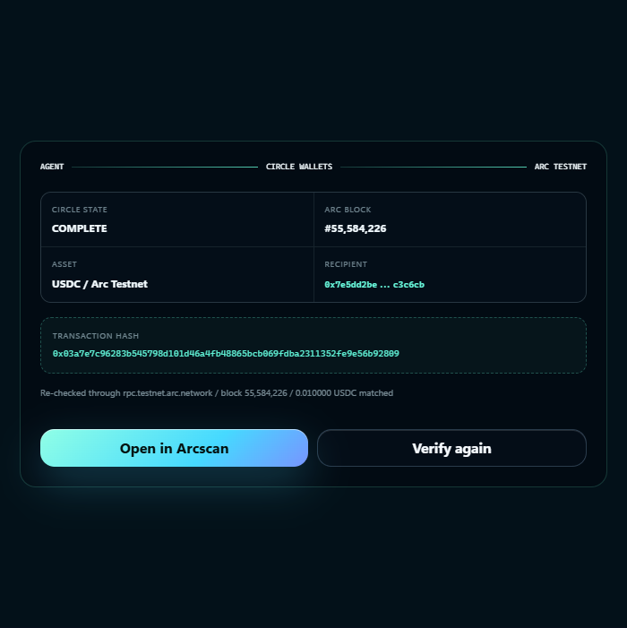
The proof lives inside the product.
Run it. Verify it.
Set a $0.05 budget, then inspect every buy, skip, and stop decision alongside the receipt.
The server checks the transaction hash, payer, USDC contract, recipient, amount, block, and block hash against Arc RPC.
ARC TESTNET · LIVE RPC CONFIRMED
3
Notes:
The screenshot is a real capture from the current Obol build. The public playground stays fail-closed in mock mode; the published evaluation receipt is re-verified server-side against Arc Testnet RPC.
[Sources]
- https://obol-programmable-money.onrender.com
- https://github.com/xiangchengzilema/obol-programmable-money/blob/main/evidence/arc-testnet-agent-run-20260806.json
- https://testnet.arcscan.app/tx/0x03a7e7c96283b545798d101d46a4fb48865bcb069fdba2311352fe9e56b92809
[/Sources]

Slide 4
One request becomes a priced, explainable, auditable transaction
01 · SCORE
02 · SETTLE
03 · RECEIPT
Rank value
Score relevance per dollar and detect redundant coverage.
Apply policy
Enforce reserve, max price, min relevance, and purchase count.
Explain outcome
Return answer, receipt, balances, rule ID, and stop reason.
4
Notes:
The agent ranks sources, authorizes only the reads that pass policy, settles them, and leaves a record a person can audit. Reuse is explicit and does not create fake creator revenue.
[Sources]
- https://github.com/xiangchengzilema/obol-programmable-money

Slide 5
One cent bought the evidence; four cents stayed under policy
Verified Arc Testnet run · 2026-08-06
0x03a7e7c9…2809 settled 0.010000 USDC in block 55,584,226. The agent bought one high-relevance source, skipped 20 weak or redundant candidates, and stopped at 67% coverage.
ARC CONFIRMED · BLOCK 55,584,226
$0.050
$0.010
$0.040
Budget
Arc-settled
Preserved
5
Notes:
This is a disclosed testnet evaluation transfer, not organic usage, production revenue, or a mainnet payment. The policy spent one cent, preserved four cents, and met its 60% coverage target.
[Sources]
- https://github.com/xiangchengzilema/obol-programmable-money/blob/main/evidence/arc-testnet-agent-run-20260806.json
- https://testnet.arcscan.app/tx/0x03a7e7c96283b545798d101d46a4fb48865bcb069fdba2311352fe9e56b92809
[/Sources]

Slide 6
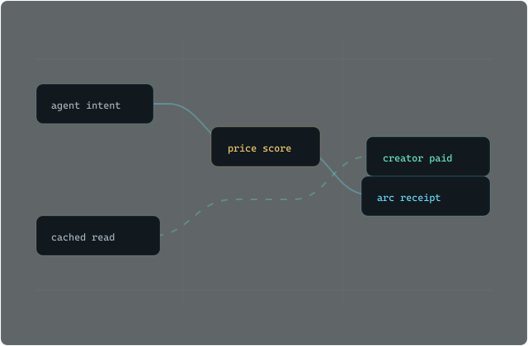
Arc proof binds the receipt to one exact USDC transfer
46 backend tests passed
Strict evidence match · health 200 · x402 402→200
Agent policy
A deterministic policy authorizes spend and preserves a $0.005 reserve.
Circle Wallets
A COMPLETE transaction settled 0.010000 USDC from the agent payer to the creator.
Arc verifier
Server-side RPC binds payer, USDC contract, recipient, amount, block, block hash, and transaction hash.
6
Notes:
The verifier does more than check for a successful transaction. It requires the published evidence to match the Arc transaction payer and token contract, the USDC Transfer recipient and amount, and the receipt block and hash.
[Sources]
- https://docs.arc.io/arc/references/connect-to-arc
- https://developers.circle.com/stablecoins/usdc-contract-addresses
- https://github.com/xiangchengzilema/obol-programmable-money/blob/main/backend/arc_verifier.py
- https://github.com/xiangchengzilema/obol-programmable-money/blob/main/evidence/arc-testnet-agent-run-20260806.json
[/Sources]

Slide 7
SHIP STATUS
PUBLIC · ARC PROOF VERIFIED
Agents read.
Creators get paid.
LIVE DEMO
PUBLIC CODE
AGENTIC ECONOMY
obol-programmable-money.onrender.com
github.com/xiangchengzilema/obol-programmable-money
Pitch video: final upload pending
Notes:
The demo and repository are public. Add the final pitch-video URL to the submission form after recording; none is fabricated in this deck.
[Sources]
- https://obol-programmable-money.onrender.com
- https://github.com/xiangchengzilema/obol-programmable-money
[/Sources]

