Slide 1
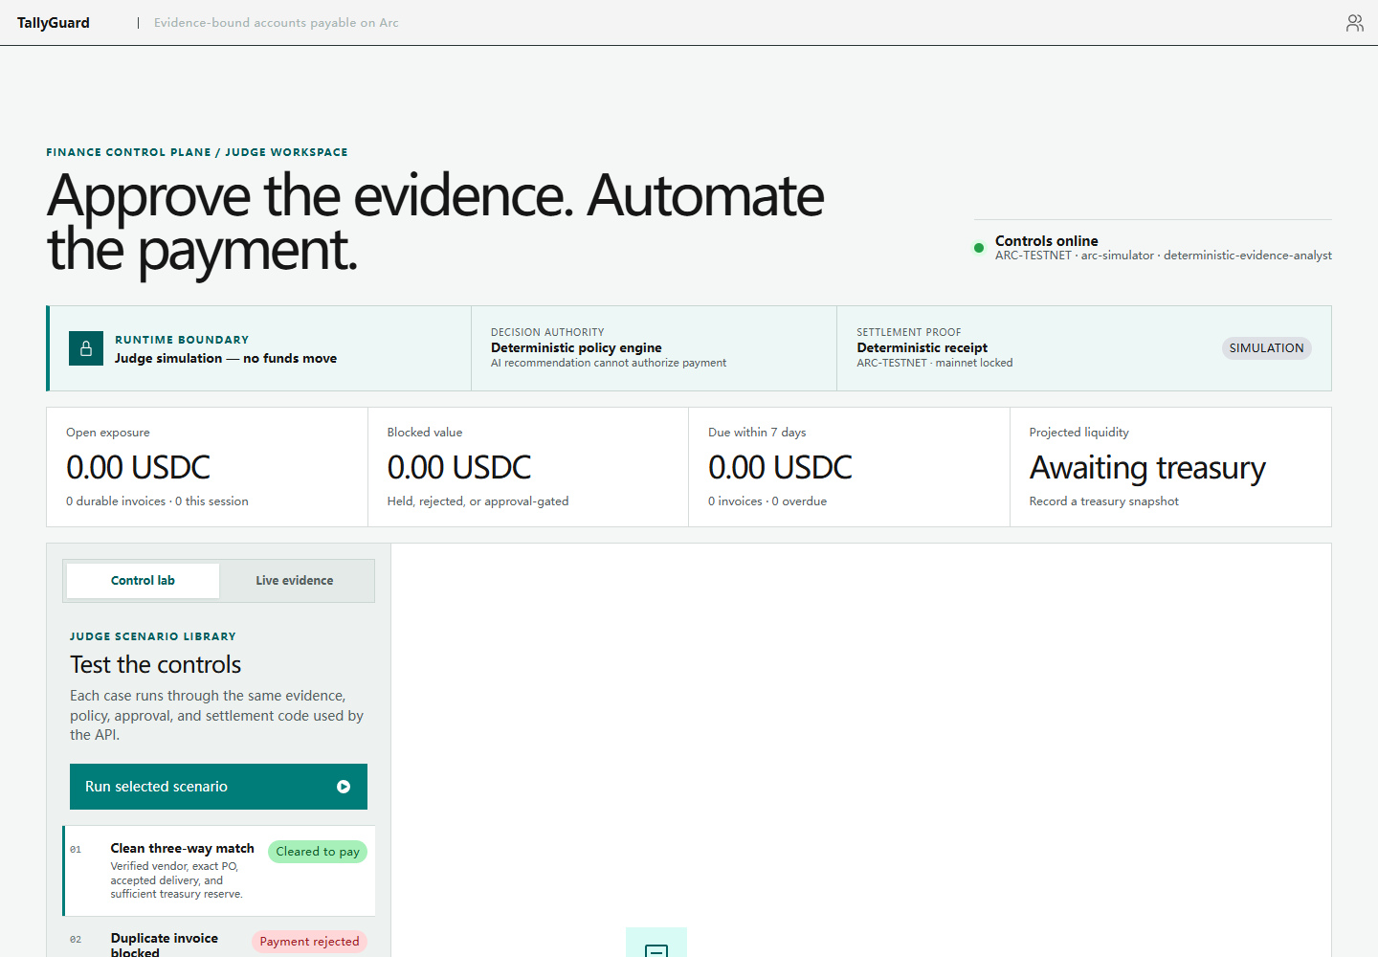
TALLYGUARD
Proof before
payment.
Evidence-bound autonomous accounts payable
for AI-operated businesses on Arc.
PRIMARY RFB · AP / AR AUTOMATION
COMPLIANCE INTELLIGENCE
DETERMINISTIC AUTHORITY
AI explains. Policy authorizes. Arc proves.
Canteen × Circle × Arc / September 2026
Notes:
Product screenshot: local TallyGuard judge workspace. Project sources: docs/HACKATHON_CONTEXT.md and docs/ARCHITECTURE.md.

Slide 2
THE CONTROL GAP
Agents can move faster than finance can verify
Accounts payable needs machine speed without surrendering financial authority.
01
UNTRUSTED INPUT
02
AMBIGUOUS AUTHORITY
03
WEAK SETTLEMENT PROOF
Invoices, emails, PDFs, prompts, and wallet-change requests can all carry conflicting or manipulated instructions.
A model recommendation is useful context, but it cannot decide whether company funds are legally or operationally authorized.
A provider status alone does not prove the exact USDC transfer landed on the intended Arc network and recipient.
The missing primitive
A verifiable decision boundary between evidence and money movement.
TALLYGUARD / TAMEION AGENTS HACKATHON 2026
02
Notes:
Problem framing derived from docs/SECURITY_MODEL.md and docs/BACKEND_PRODUCT_SPEC.md. No market-size claim is made.

Slide 3
ONE BOUNDED WORKFLOW
From source evidence to independently verified settlement
Every step produces an immutable record. Every fund-moving action is revalidated.
01
02
03
04
05
Seal evidence
Apply policy
Plan actions
Move USDC
Prove on Arc
PDF, image, or JSON
with field provenance
13 deterministic
financial controls
PAY, schedule, hold,
reject, or escalate
Circle wallet with
idempotent intent
Exact Transfer event,
network, asset, recipient
AUTHORITY NEVER COMES FROM THE MODEL
The AI may classify and explain. Deterministic controls, human approvals, and sealed records decide whether funds can move.
TALLYGUARD / TAMEION AGENTS HACKATHON 2026
03
Notes:
Architecture source: docs/ARCHITECTURE.md. Settlement source: docs/CIRCLE_ARC_SETTLEMENT.md.

Slide 4
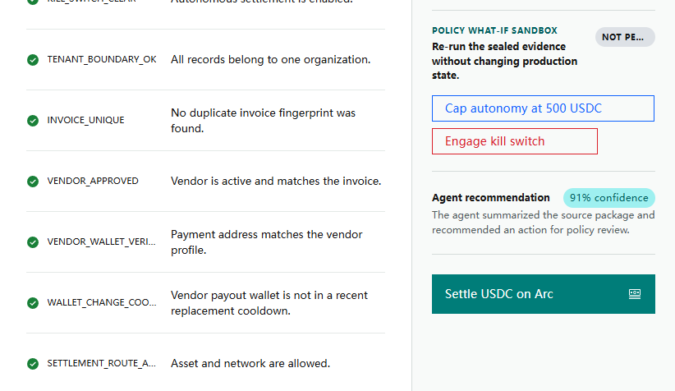
DETERMINISTIC DECISION
The judge can inspect why an invoice is payable
The result is replayable from sealed evidence, policy version, and treasury state.
13 / 13
CONTROLS CLEAR
Vendor, wallet, PO, delivery, route, limits, reserve, wallet-change cooldown, and timing.
SHA-256
SOURCE BINDING
The decision carries the evidence manifest, policy hash, and replay snapshot.
0
AI PAYMENT AUTHORITY
The agent can recommend and explain, but cannot set amount, recipient, or authorization.
TALLYGUARD / TAMEION AGENTS HACKATHON 2026
04
Notes:
Screenshot captured from the local product. Supporting implementation: src/tallyguard/decisions.py, src/tallyguard/policies.py, src/tallyguard/evidence.py.

Slide 5
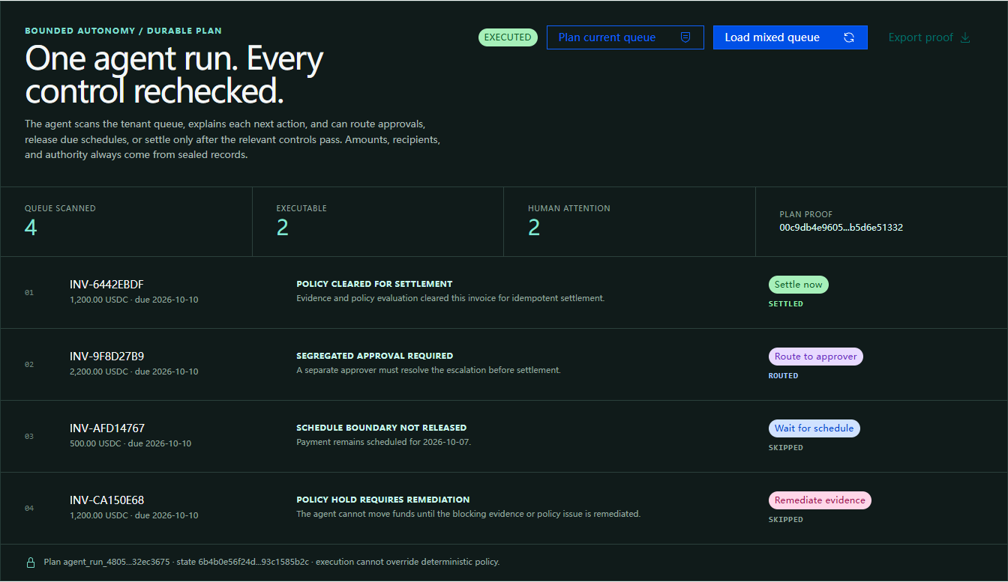
AGENTIC SOPHISTICATION
One agent run. Every control rechecked.
A durable plan hashes observed state and proposed actions before any execution.
SETTLED
Policy-cleared payment
ROUTED
Segregated approval
SKIPPED
Schedule and hold preserved
TALLYGUARD / TAMEION AGENTS HACKATHON 2026
05
Notes:
Screenshot captured from the local product. Implementation: src/tallyguard/autonomy.py and src/tallyguard/persistence.py. The execution lease prevents multiple workers from executing the same durable plan.

Slide 6
NATIVE CONTROL MATRIX
Five outcomes. Only one grants immediate
payment authority.
The decision engine fails closed and tells the operator exactly what happens next.
OUTCOME | TRIGGER | SYSTEM ACTION | WHO CAN RELEASE
PAY | All mandatory controls pass | Create an idempotent payment intent and settle | Policy engine
SCHEDULE | Valid invoice, future payment window | Wait, then revalidate against current policy | Policy engine at due time
HOLD | Evidence, wallet, or treasury risk | Block settlement and request remediation | Operator after correction
REJECT | Duplicate or prohibited condition | Permanently deny this payment request | No automatic release
ESCALATE | Valid evidence above autonomy limit | Bind a separate human approval to the intent | Independent approver
Editable control matrix
Non-PAY outcomes never call the settlement provider.
TALLYGUARD / TAMEION AGENTS HACKATHON 2026
06
Notes:
Decision semantics are implemented in src/tallyguard/models.py, src/tallyguard/policy.py, and src/tallyguard/autonomy.py.

Slide 7
CIRCLE AND ARC
Settlement is accepted only after independent Arc
verification
Provider completion is necessary, then TallyGuard verifies the exact onchain result.
1
2
3
4
PAY intent
Circle wallet
Arc RPC
Exact Transfer proof
Sealed amount, recipient, asset, network, idempotency key
Submit USDC transfer and poll provider lifecycle
Fetch the transaction receipt from the expected chain
Match contract, topic, sender, recipient, amount, and success
CURRENT GATE
Adapter, offline verifier, and isolated wallet-pair setup are ready. Credentials and funded Testnet USDC remain the external gate.
TALLYGUARD / TAMEION AGENTS HACKATHON 2026
07
Notes:
Implementation: src/tallyguard/circle_arc.py and src/tallyguard/settlement.py. Technical reference: docs/CIRCLE_ARC_SETTLEMENT.md. The slide intentionally labels the real Testnet transfer as pending.

Slide 8
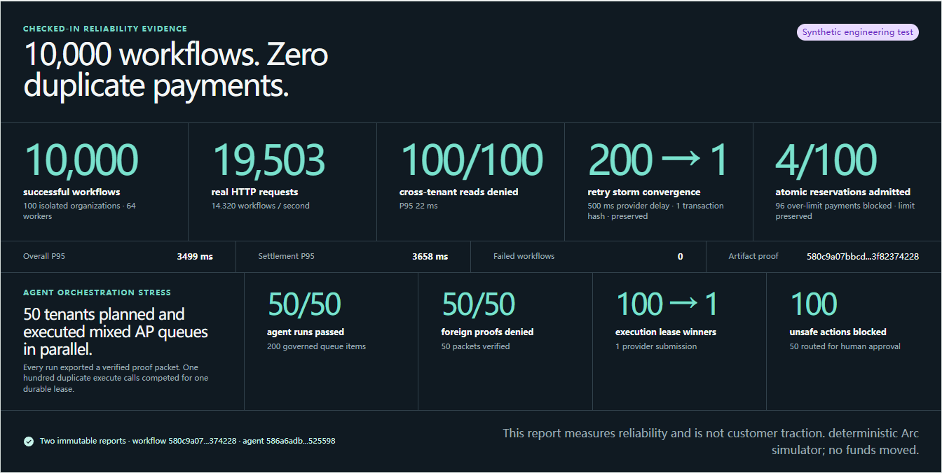
CHECKED-IN ENGINEERING EVIDENCE
The safety invariants survive concurrency
Two stress suites plus a production-shaped HTTP gate ship as content-addressed reports.
10,000 / 10,000 workflows
200 retries · 500 ms → 1 submit
100 / 100 tenant breaches denied
7 / 7 deployment checks
TALLYGUARD / TAMEION AGENTS HACKATHON 2026
08
Notes:
Sources: docs/reports/load-test-10000.json, docs/reports/agent-run-load-50.json, and docs/reports/deployment-smoke.json. The workflow run injected a 500 ms provider delay while 200 duplicate calls competed; all converged on one provider submission and one transaction hash. These are synthetic engineering tests, not customer traction. Settlement used the deterministic Arc simulator and moved no funds.

Slide 9
TRACTION WITHOUT THEATER
Turn one real AP workflow into judge-verifiable evidence
The pilot binds real operator behavior to a verified Payment Evidence Packet.
01
READY
02
NEXT
03
BEFORE SUBMISSION
Self-operated pilot
External review
Real Arc proof
Run an actual invoice, PO, delivery record, wallet, and treasury snapshot through the product.
Ask 2–3 finance or crypto operators to complete the judge path and record structured feedback.
Execute a capped Testnet transfer, reconcile the receipt, and publish the proof packet and demo clip.
MEASURE
MEASURE
MEASURE
Attestation hash, packet hash, operator time
Completion rate, time to decision, risk recall
Circle status, Arc transaction, exact Transfer match
TALLYGUARD / TAMEION AGENTS HACKATHON 2026
09
Notes:
This is the honest traction plan for the current build. Synthetic reliability data remains separately labeled. Deadline source: docs/HACKATHON_CONTEXT.md.

Slide 10
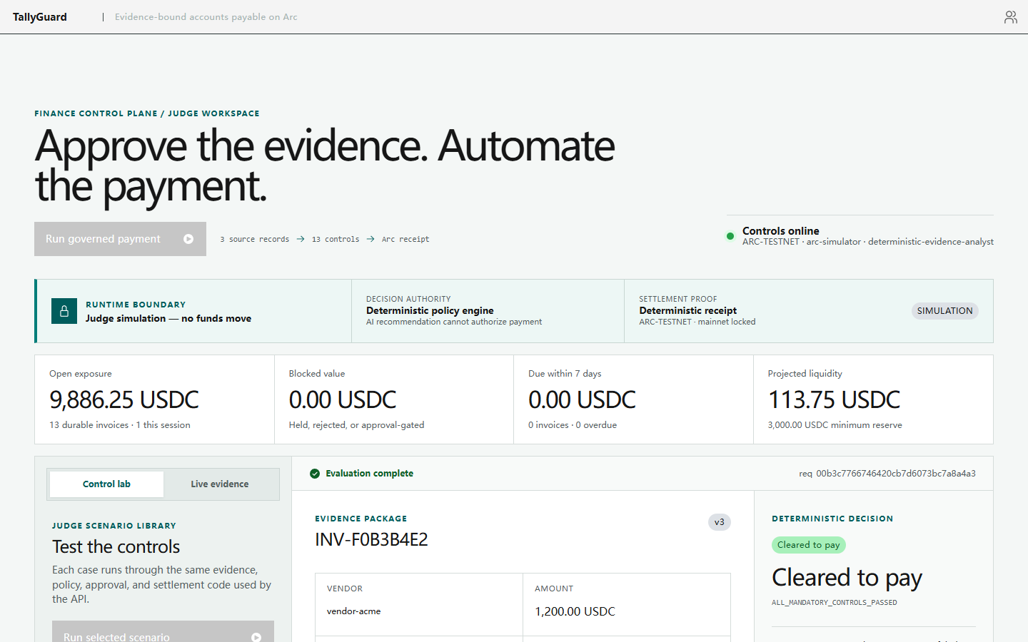
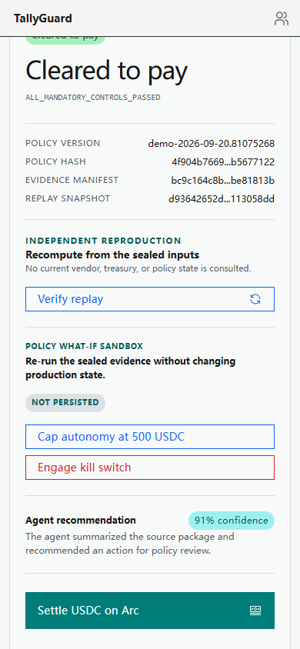
TALLYGUARD
Approve the evidence.
Automate the payment.
DESKTOP / 1440 PX
One responsive finance control plane for Circle USDC on Arc — desktop-first, operable at 390 px.
ONE RESPONSIVE WEB APP
Same evidence
Same 13 controls
Same Arc settlement path
READY
MOBILE / 390 PX
Multi-tenant controls · bounded agent runs · offline verifier · stress evidence
The decision remains inspectable without horizontal overflow.
NEXT PROOF
Capped Arc Testnet transfer + external operator feedback
Submission deadline · October 10, 2026 11:59 PM ET
TALLYGUARD / TAMEION AGENTS HACKATHON 2026
10
Notes:
The desktop and 390 px captures show the same responsive React application and governed-payment path, not separate clients. Captured locally from the current product. Event information: https://tameion.thecanteenapp.com/ and docs/HACKATHON_CONTEXT.md. GitHub and live-demo links should be added only after the user approves publication and deployment.

