Slide 1
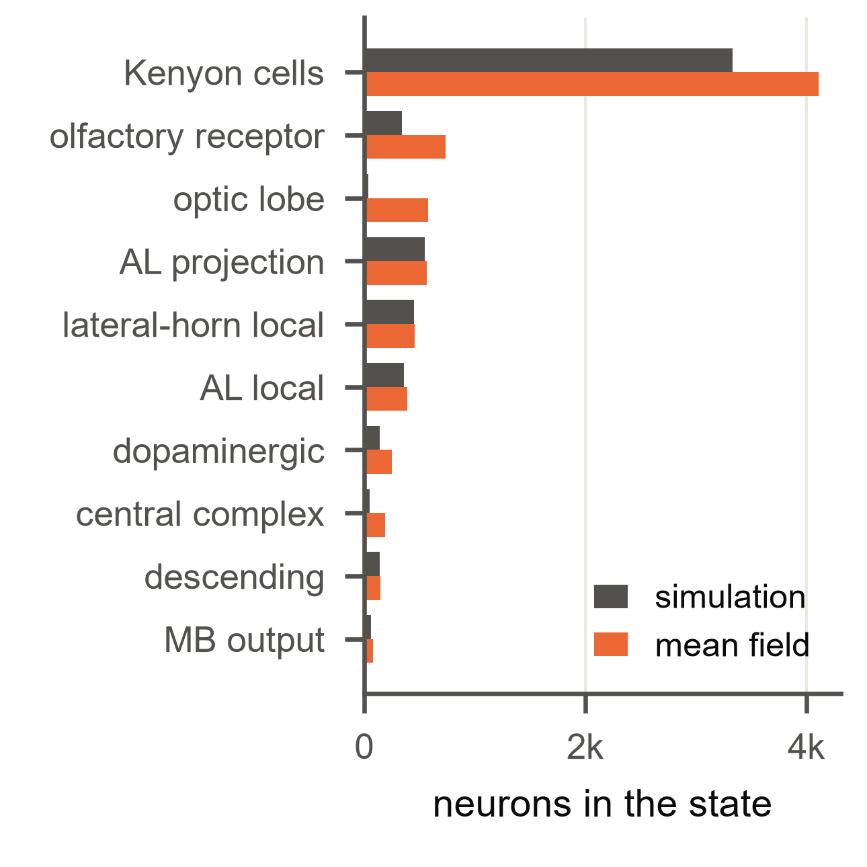
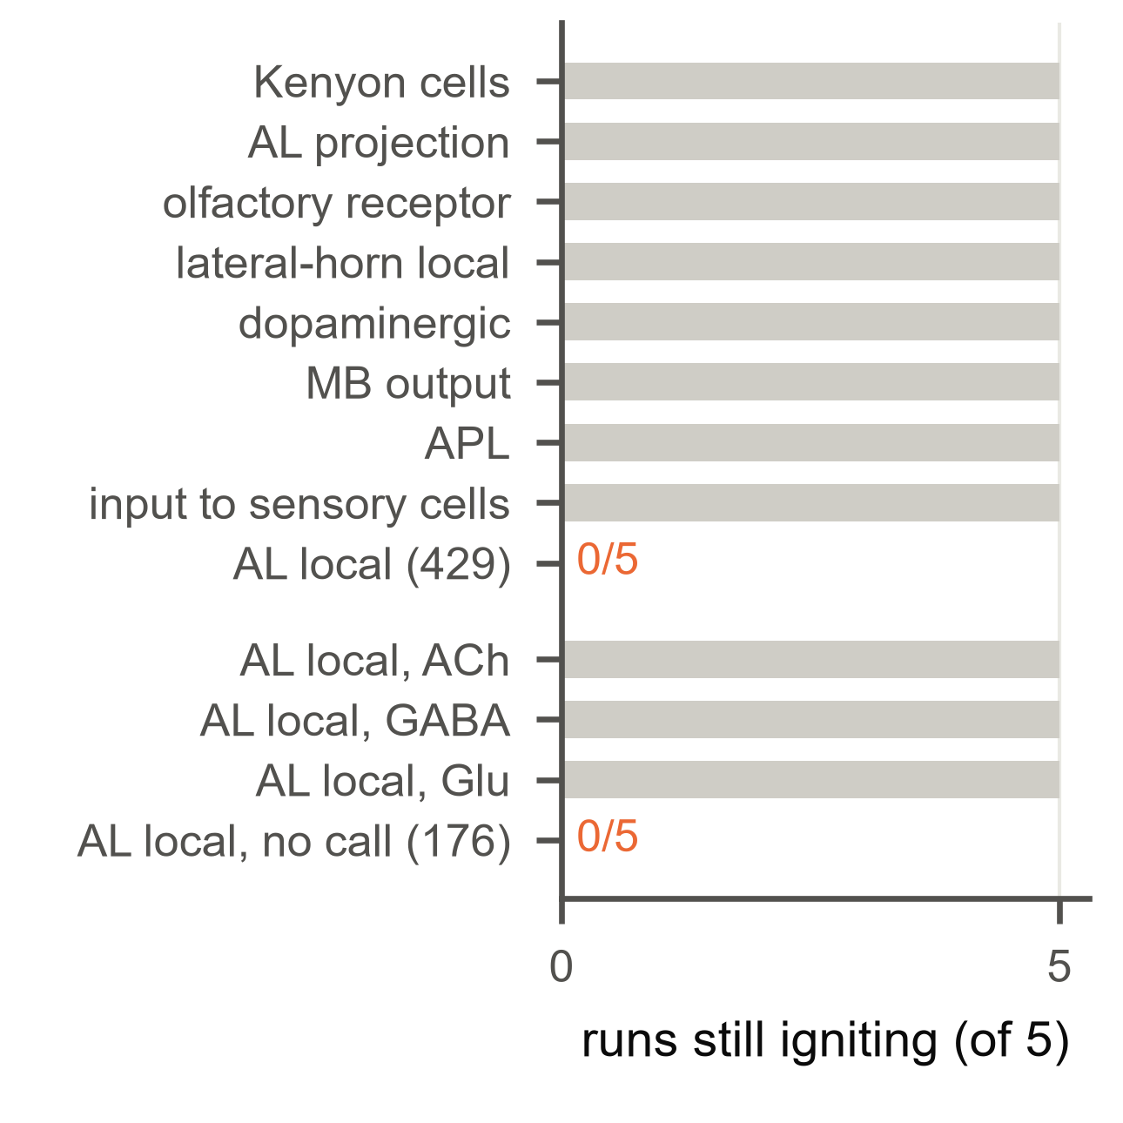
a
Membership from the mean field
b
Outputs removed
c
The loop that sustains it
PN
PN
ORN
ORN
KC
KC
Jaccard 0.70
(random sets 0.06)
core LN
core LN
model signs
λ = 2.98
core re-signed
λ = 0.65
orange excitatory, blue inhibitory; node area: share of the leading mode; edge width: summed weight

