Slide 1
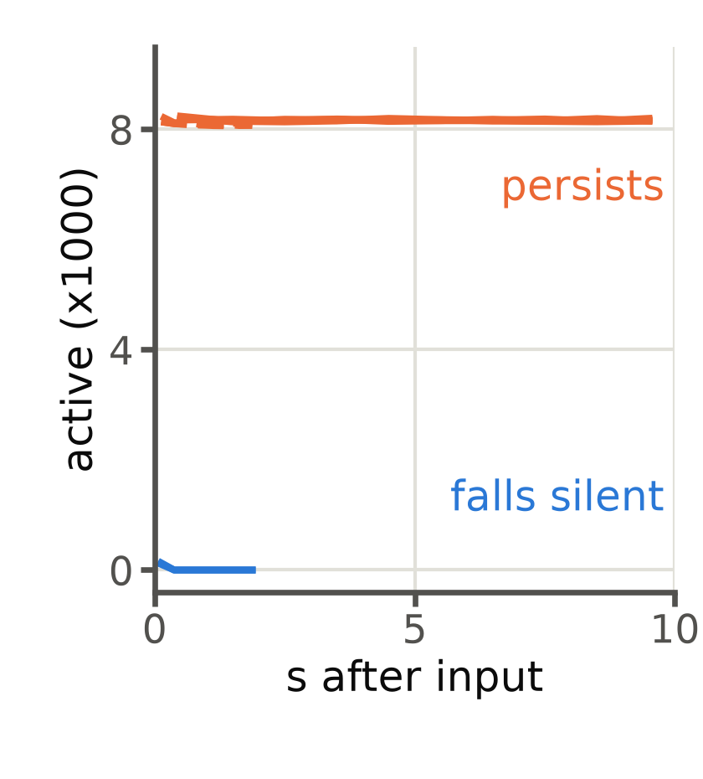
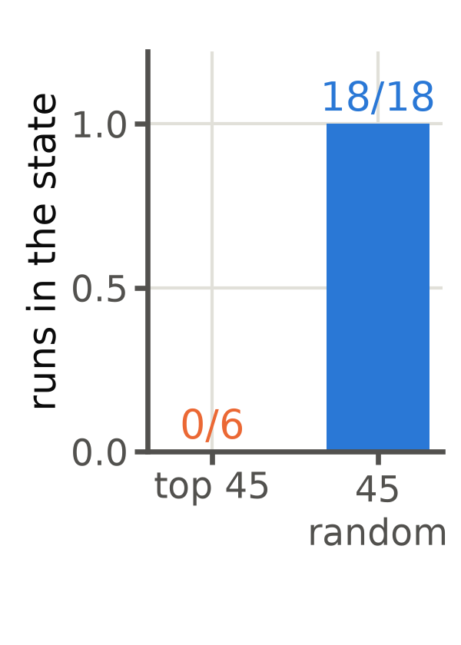
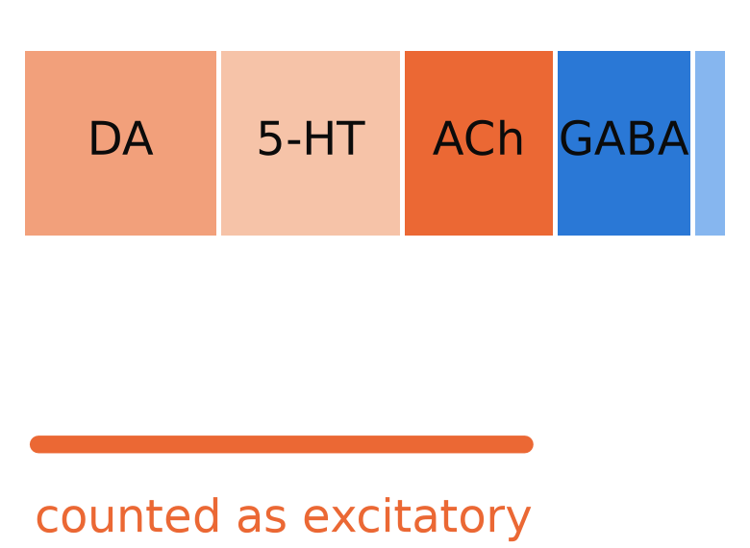
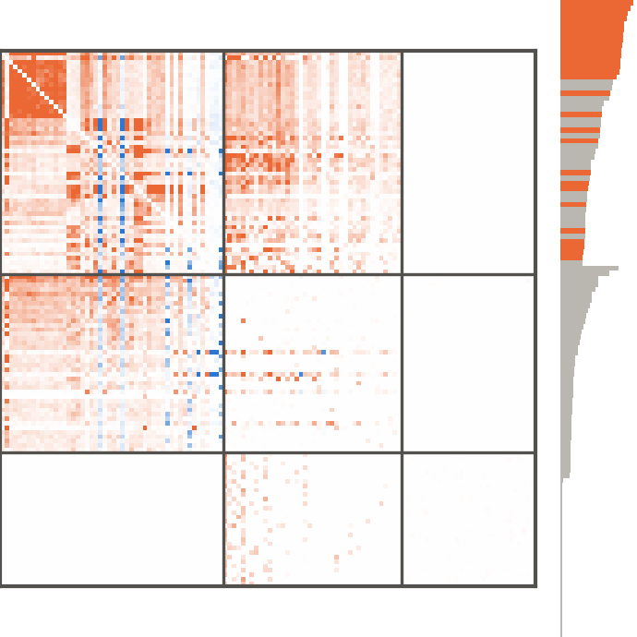

a
An uncertain sign
b
A hidden attractor
c
The screen, from wiring only
d
Check
synapse-level transmitter votes,
cell type lLN1_bc
1 persistent set P;
signed wiring τW
2 leading
mode
3 rank by Δλ
model sign: +
re-signed cells;
validated MN9
responses unchanged
AL local
AL proj.
KC
orange: core cells
(the top 66 of 376)
19,042 neurons have no
transmitter call; a convention
sets their sign
same input, two outcomes;
the state lasts > 10 s
excitation is shown in orange, inhibition in blue; core cells carry
24% of the leading mode

