Slide 1
Chapter 3 Defining, Measuring, and Manipulating Variables

Slide 2
Topics
Defining Variables
Properties of Measurement
Scales of Measurement
Discrete and Continuous Variables

Slide 3
Topics (cont’d.)
Types of Measures
Reliability
Validity
The Relationship Between Reliability and Validity

Slide 4
Defining Variables

Slide 5
Defining Variables
Operational definition
A definition of a variable in terms of the operations a researcher uses to measure or manipulate it
Specifies the activities of the researcher in measuring and/or manipulating a variable (Kerlinger, 1986)
Operational definition of hunger: hunger occurs when 12 hours have passed with no food intake

Slide 6
Properties of Measurement

Slide 7
Properties of Measurement
Identity
Objects that are different receive different scores
Example: if subjects in a study had different political affiliations, they would receive different scores
Magnitude: ordering of numbers reflects the ordering of the variable

Slide 8
Properties of Measurement (cont’d.)
Equal unit size: a difference of 1 is the same amount throughout the entire scale
Absolute zero
Assigning a score of zero indicates an absence of the variable being measured
Example: time spent studying

Slide 9
Scales of Measurement

Slide 10
Nominal Scale
Objects or individuals are assigned to categories that have no numerical properties
Characteristic of identity
Categorical variables: variables measured on a nominal scale
Examples: ethnicity, gender, political affiliation

Slide 11
Ordinal Scale
Objects or individuals are categorized, and the categories form a rank order along a continuum
Properties of identity and magnitude
Ordinal data: referred to as ranked data
Example: reporting how students did on an exam based on their rank

Slide 12
Interval Scale
Intervals between the numbers on the scale are all equal in size
Criteria of identity, magnitude, and equal unit size are met
Example: Fahrenheit temperature scale

Slide 13
Ratio Scale
A scale in which, in addition to order and equal units of measurement, an absolute zero indicates an absence of the variable being measured
Ratio data have all properties of measurement
Examples: weight, time, height

Slide 14
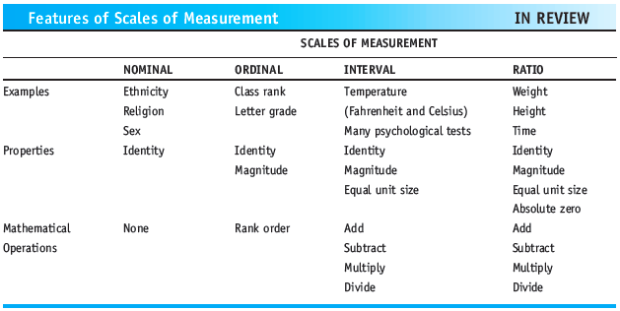
Features of Scales of Measurement

Slide 15
Discrete and Continuous Variables

Slide 16
Discrete Variables
Consist of whole number units or categories
Made up of chunks or units that are detached and distinct from one another
Most nominal and ordinal data are discrete
Examples: gender, political party, ethnicity
Some interval or ratio data can be discrete
Example: number of children in a family

Slide 17
Continuous Variables
Usually fall along a continuum and allow for fractional amounts
Examples: age (22.7 years), height (64.5 inches), weight (113.25 pounds)
Most interval and ratio data are continuous in nature

Slide 18
Types of Measure

Slide 19
Self-Report Measures
Questionnaires or interviews that measure how people report that they act, think, or feel
Behavioral self-report measures: ask people to report how often they do something
Cognitive self-report measures: ask individuals to report what they think about something
Affective self-report measures: ask individuals to report how they feel about something

Slide 20
Tests
Measurement instruments used to assess individual differences in various content areas
Personality tests: designed to measure aspects of an individual’s personality and feelings about certain things
Ability tests
Not self-report measures
Aptitude tests and achievement tests

Slide 21
Behavioral Measures
Measures taken by carefully observing and recording behavior
Often referred to as observational measures
Reactivity: a possible reaction by participants in which they act unnaturally because they know they are being observed

Slide 22
Physical Measures
Measures of bodily activity
May be taken with a piece of equipment
Example: weight is measured with a scale

Slide 23
Reliability

Slide 24

Reliability
Reliability: an indication of the consistency or stability of a measuring instrument
Formula for observed score:
Formula for reliability:

Slide 25
Reliability (cont’d.)
Correlation coefficient
Measure of the degree of relationship between two sets of scores
Varies between -1.00 and +1.00
Positive correlation
Direct relationship between two variables in which an increase in one is related to an increase in the other, and a decrease in one is related to a decrease in the other

Slide 26
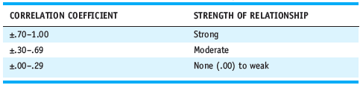
Reliability (cont’d.)
Negative correlation
An inverse relationship between two variables in which an increase in one variable is related to a decrease in the other and vice versa
Table 3.1 Values for Weak, Moderate, and Strong Correlation Coefficients

Slide 27
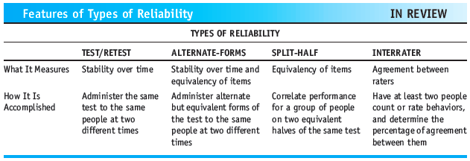
Reliability (cont’d.)
Features of Types of Reliability

Slide 28
Validity

Slide 29
Validity
Validity: a measure of the truthfulness of a measuring instrument
Content validity: the extent to which a measuring instrument covers a representative sample of the domain of behaviors to be measured
Face validity: the extent to which a measuring instrument appears valid on its surface

Slide 30
Validity (cont’d.)
Criterion validity: the extent to which a measuring instrument accurately predicts behavior or ability in a given area
Construct validity: the degree to which a measuring instrument accurately measures a theoretical construct or trait that it is designed to measure

Slide 31
The Relationship Between Reliability and Validity

Slide 32
The Relationship Between Reliability and Validity
Can a test be reliable without being valid?
Can a test be valid without being reliable?
A test can be reliable and not valid
If a test is valid, it is by default reliable

Slide 33
Summary
Importance of operationally defining variables
Level of measurement helps determine the appropriate statistics to be used with the data
Data can be discrete or continuous
Several types of measures: self-report, test, behavioral, and physical measures
Various types of reliability and validity in measures

