Slide 1
Chapter 4 Descriptive Methods

Slide 2
Topics
Observational Methods
Qualitative Methods
Survey Methods

Slide 3
Observational Methods

Slide 4
Naturalistic Observation
Involves watching people or animals in their natural habitats
Ecological validity
The extent to which research can be generalized to real-life situations
Undisguised observation
Studies in which the participants are aware that the researcher is observing their behavior

Slide 5
Naturalistic Observation (cont’d.)
Nonparticipant observation
Studies in which the researcher does not participate in the situation in which the research participants are involved
Participant observation
Studies in which the researcher actively participates in the situation in which the research participants are involved

Slide 6
Naturalistic Observation (cont’d.)
Disguised observation
Studies in which the participants are unaware that the researcher is observing their behavior
Expectancy effects
The influence of the researcher’s expectations on the outcome of the study

Slide 7
Laboratory Observation
Involves observing behavior in a more contrived setting and focusing on a small number of carefully defined behaviors
Narrative records: full narrative descriptions of a participant’s behavior
Checklist
A tally sheet on which the researcher records attributes of the participants and whether particular behaviors were observed

Slide 8
Laboratory Observation (cont’d.)
Static item
A type of item used on a checklist on which attributes that will not change are recorded
Action item
A type of item used on a checklist to note the presence or absence of behaviors

Slide 9
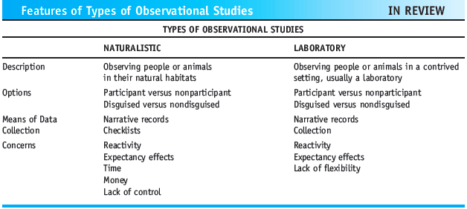
Observational Methods (cont’d.)
Features of Types of Observational Studies

Slide 10
Qualitative Methods

Slide 11
Qualitative Methods
Qualitative research: a type of social research based on field observations that is analyzed without statistics
Case study method: an in-depth study of one or more individuals, groups, social settings, or events in the hope of revealing things that are true of all of us

Slide 12
Qualitative Methods (cont’d.)
Archival method: a descriptive research method that involves describing data that existed before the time of the study
Interview: a method that typically involves asking questions in a face-to-face manner that may be conducted anywhere
Focus group interview: involves interviewing six to ten individuals at the same time

Slide 13
Qualitative Methods (cont’d.)
Field studies
Involve observing everyday activities as they happen in a natural setting; the observer is directly involved with those that are being observed
Action research
Research is conducted by a group of people to identify a problem, attempt to resolve it, and then assess how successful their efforts were

Slide 14
Qualitative Data Analysis
Main difference between qualitative and quantitative data analyses
Statistics and mathematical formulas are not used with qualitative analyses
Data are verbal in nature

Slide 15
Survey Methods

Slide 16
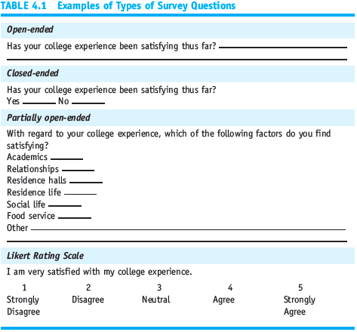
Table 4.1 Examples of Types of Survey Questions

Slide 17
Survey Methods (cont’d.)
Open-ended questions: questions for which participants formulate their own responses
Closed-ended questions: questions for which participants choose from a limited number of alternatives
Partially open-ended questions: closed-ended questions with an open-ended “Other” option

Slide 18
Survey Methods (cont’d.)
Rating scale: a numerical scale on which survey respondents indicate the direction and strength of their response
Likert rating scale: a type of numerical rating scale developed by Renis Likert in 1932
Loaded question: a question that includes nonneutral or emotionally laden terms

Slide 19
Survey Methods (cont’d.)
Leading question: a question that sways the respondent to answer in a desired manner
Double-barreled question: a question that asks more than one thing
Response bias: the tendency to consistently give the same answer to almost all of the items on a survey

Slide 20
Survey Methods (cont’d.)
Demographic questions: questions that ask for basic information, such as age, gender, ethnicity, or income
Mail survey: a written survey that is
self-administered
Sampling bias: a tendency for one group to be overrepresented in a sample

Slide 21
Survey Methods (cont’d.)
Interviewer bias: the tendency for the person asking the questions to bias the participants’ answers
Telephone survey: questions are read to participants over the telephone
Socially desirable response: a response that is given because a respondent believes it is deemed appropriate by society

Slide 22
Survey Methods (cont’d.)
Personal interview: a survey in which the questions are asked face-to-face
Representative sample
A sample that is like the population
Probability sampling
A sampling technique in which each member of the population has a known probability of being selected to be part of the sample

Slide 23
Survey Methods (cont’d.)
Random selection
A method of generating a random sample in which each member of the population is equally likely to be chosen as part of the sample
Stratified random sampling
A sampling technique designed to ensure that subgroups or strata are fairly represented

Slide 24
Survey Methods (cont’d.)
Cluster sampling
A sampling technique in which clusters of participants that represent the population are used
Nonprobability sampling
A sampling technique in which the individual members of the population do not have an equal likelihood of being selected to be a member of the sample

Slide 25
Survey Methods (cont’d.)
Convenience sampling
A sampling technique in which participants are obtained wherever they can be found and typically wherever is convenient for the researcher
Quota sampling
A sampling technique that involves ensuring that the sample is like the population on certain characteristics but uses convenience sampling to obtain the participants

Slide 26
Summary
Ways of conducting a descriptive study:
Observational method (naturalistic vs. laboratory)
Qualitative methods (case study, archival, inter- views, field studies, or action research)
Survey method (mail, telephone, or personal interview)
These methods do not allow you to make accurate predictions or determine cause-and-effect relationships

