Slide 1
Chapter 7 Probability and Hypothesis Testing

Slide 2
Topics
Probability
Hypothesis Testing
Single-Sample Research and Inferential Statistics

Slide 3
Probability

Slide 4
Basics Probability Concepts
Probability
The number of ways a particular outcome (event) can occur divided by the total number of outcomes (events)
Often presented as proportions

Slide 5


Basics Probability Concepts (cont’d.)
What is the probability of getting a “head” when tossing a coin?
How likely would it be to roll a 2 in one roll of a die?

Slide 6
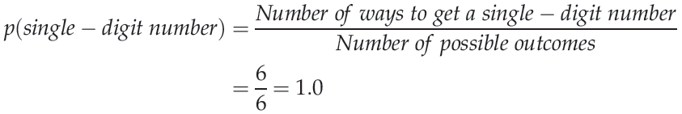
Basics Probability Concepts (cont’d.)
What is the probability of rolling an odd number in a single roll of a die?
What is the probability of rolling a single-digit number in a single roll of a die?

Slide 7
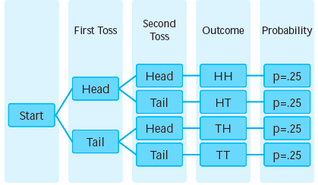
The Rules of Probability
Figure 7.1 Tree diagram of possible coin toss outcome.

Slide 8
The Rules of Probability (cont’d.)
Multiplication rule
A probability rule stating that the probability of a series of outcomes occurring on successive trials is the product of their individual probabilities when the sequence of outcomes is independent

Slide 9
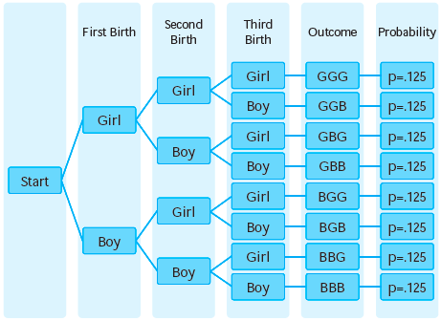
The Rules of Probability (cont’d.)
Figure 7.2 Tree diagram of possible birth orders.

Slide 10
The Rules of Probability (cont’d.)
Addition rule
A probability rule stating that the probability of one outcome or another outcome occurring on a particular trial is the sum of their individual probabilities, when the outcomes are mutually exclusive

Slide 11
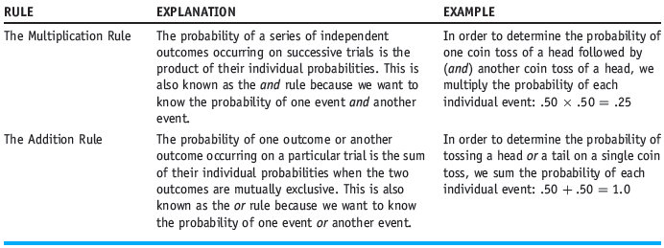
The Rules of Probability (cont’d.)
The Rules of Probability

Slide 12
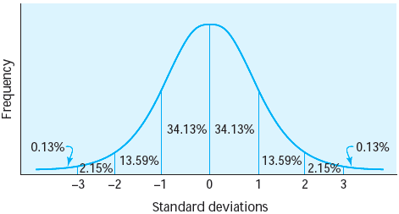
Probability and the Standard Normal Distribution
Figure 7.3 Area under the standard normal curve.

Slide 13
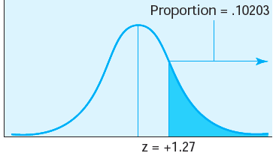
The Standard Normal Distribution (cont’d.)
Figure 7.4 Standard normal curve with z = +1.27 indicated.

Slide 14
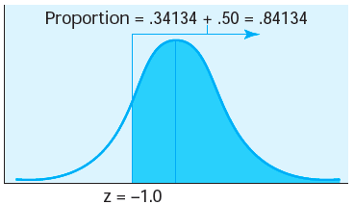
The Standard Normal Distribution (cont’d.)
Figure 7.5 Standard normal curve with z = - 1.0 indicated.

Slide 15
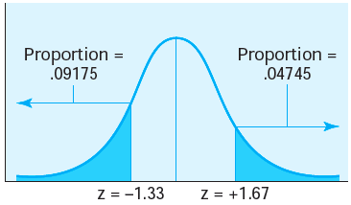
The Standard Normal Distribution (cont’d.)
Figure 7.7 Standard normal curve with z = - 1.33 and z = + 1.67 indicated.

Slide 16
Hypothesis Testing

Slide 17
Null and Alternative Hypotheses
Null hypothesis
The hypothesis predicting that no difference exists between the groups being compared
Statistical notation:

Slide 18
Null and Alternative Hypotheses (cont’d.)
Alternative hypothesis (research hypothesis)
The hypothesis that the researcher wants to support, predicting that a significant difference exists between the groups being compared
Statistical notation:

Slide 19
One- and Two-Tailed Hypothesis Tests
One-tailed hypothesis (directional hypothesis)
An alternative hypothesis in which the researcher predicts the direction of the expected difference between the groups
Null hypothesis:

Slide 20

One- and Two-Tailed Hypothesis Tests (cont’d.)
Two-tailed hypothesis (nondirectional hypothesis)
An alternative hypothesis in which the researcher predicts that the groups being compared differ but does not predict the direction of the difference
Statistical notation:

Slide 21
Type I and II Errors in Hypothesis Testing
Type I error: an error in hypothesis testing in which the null hypothesis is rejected when it is true
Type II error: an error in hypothesis testing in which there is a failure to reject the null hypothesis when it is false

Slide 22
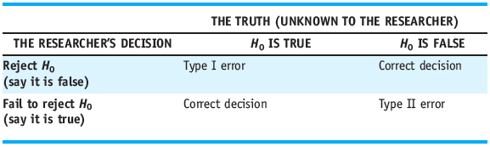
Type I and II Errors in Hypothesis Testing (cont’d.)
Table 7.1 The Four Possible Outcomes in Statistical Decision Making

Slide 23
Statistical Significance and Errors
Statistical significance
An observed difference between two descriptive statistics (such as means) that is unlikely to have occurred by chance
Which type of error is considered more serious by researchers?
Type I error

Slide 24
Single-Sample Research and Inferential Statistics

Slide 25
Single-Sample Research and Inferential Statistics
Single-group design: a research study in which there is only one group of participants
Inferential statistics: procedures for drawing conclusions about a population based on data collected from a sample

Slide 26
Single-Sample Research and Inferential Statistics (cont’d.)
Parametric test
A statistical test that involves making assumptions about estimates of population characteristics, or parameters
Nonparametric test
A statistical test that does not involve the use of any population parameters
μ and σ are not needed
The underlying distribution does not have to be normal

Slide 27
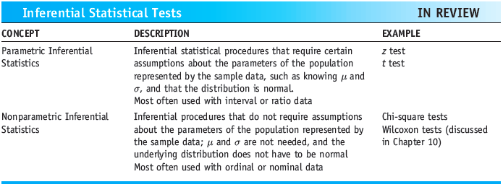
Single-Sample Research and Inferential Statistics (cont’d.)
Inferential Statistical Tests

Slide 28
Summary
Calculate basic probabilities
Use the multiplication and addition rules
Null and alternative hypotheses
One- and two-tailed hypothesis tests
Type I and Type II errors
Single-group design: the performance of a sample is compared with that of the general population

