Slide 1
Chapter 8 Introduction to Inferential Statistics

Slide 2
Topics
The z Test: What It Is and What It Does
Confidence Intervals Based on the z Distribution
The t Test: What It Is and What It Does
Confidence Intervals Based on the t Distribution

Slide 3
Topics (cont’d.)
The Chi-Square (χ²) Goodness-of-Fit Test: What It Is and What It Does
Correlation Coefficients and Statistical Significance

Slide 4
The z Test: What It Is and What It Does

Slide 5
The z Test: What It Is and What It Does
z test: a parametric inferential statistical test of the null hypothesis for a single sample where the population variance is known
Sampling distribution: a distribution of sample means based on random samples of a fixed size from a population
Standard error of the mean: the standard deviation of the sampling distribution

Slide 6

The z Test: What It Is and What It Does (cont’d.)
Central limit theorem
States that for any population with a mean μ and a standard deviation σ, the distribution of sample means for sample size N:
Will have a mean of μ
Will have a standard deviation of
Will approach a normal distribution as N approaches infinity

Slide 7
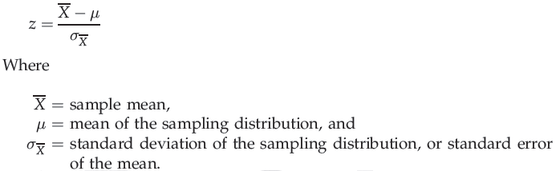
The z Test: What It Is and What It Does (cont’d.)
Formula for z:

Slide 8

Calculations for the One-Tailed z Test
Suppose the mean IQ score for the sample of 75 children enrolled in after-school programs is 103.5
We can calculate :

Slide 9

Calculations for the One-Tailed z Test
We now use (1.73) in the z-test formula:
Note to editor: Please verify whether x needs a bar in equations

Slide 10
Interpreting the One-Tailed z Test
Critical value
The value of a test statistic that marks the edge of the region of rejection in a sampling distribution
Values equal to it or beyond it fall in the region of rejection
Region of rejection
The area of a sampling distribution that lies beyond the test statistic’s critical value
When a score falls within this region, H₀, is rejected

Slide 11
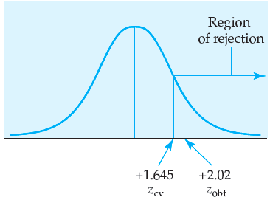
Interpreting the One-Tailed z Test (cont’d.)
Figure 8.2 The z-critical value and the z-obtained for the z test example

Slide 12
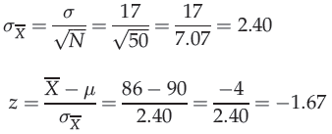
Calculations for the Two-Tailed z Test
Suppose that in the previous example, we used a two-tailed test
All of the measurements are the same:

Slide 13
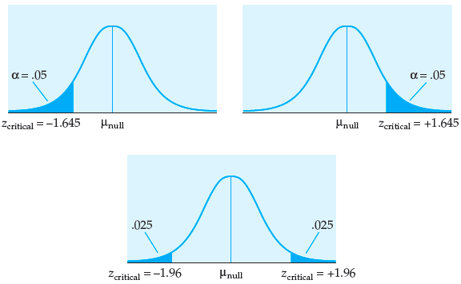
Interpreting the Two-Tailed z Test
Figure 8.3 Regions of rejection and critical values for one-tailed versus two-tailed tests

Slide 14
Interpreting the Two-Tailed z Test (cont’d.)
One-tailed test: statistically a more powerful test than a two-tailed test
Statistical power: the probability of correctly rejecting a false H₀
With a one-tailed test, we are more likely to reject H₀
z_{obt} does not have to be as large to be considered significantly different from the population mean

Slide 15

The z Test: What It Is and What It Does (cont’d.)
As the sample size increases:
The standard error of the mean decreases
The z test is appropriate to use:
If the parameters, such as μ and σ, are known
With interval or ratio data
The t test is appropriate to use:
In cases where the sample size is small or
Where σ is not known

Slide 16
Confidence Intervals Based on the z Distribution

Slide 17
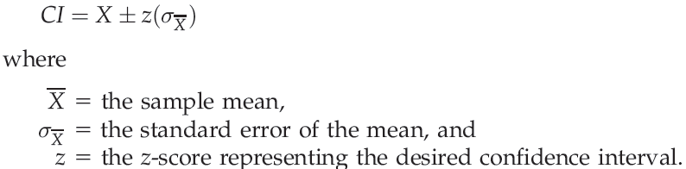
Confidence Intervals Based on the z Distribution
Confidence interval: an interval of a certain width that we feel confident will contain μ
Formula for the confidence interval:
Statisticians recommend a 95% or a 99% confidence interval

Slide 18
The t Test: What It Is and What It Does

Slide 19
The t Test: What It Is and What It Does
t test
A parametric inferential statistical test of the null hypothesis for a single sample where the population variance is not known
Student’s t distribution: a set of distributions that, although symmetrical and bell-shaped, are not normally distributed
Degrees of freedom (df): the number of scores in a sample that are free to vary

Slide 20


The t Test: What It Is and What It Does (cont’d.)
Null and alternative hypotheses:
Formula for the t test:

Slide 21


The t Test: What It Is and What It Does (cont’d.)
Estimated standard error of the mean: an estimate of the standard deviation of the sampling distribution
Formula for :
In APA style, the result is reported as

Slide 22

Calculations for the Two-Tailed t Test
In a two-tailed test, the null and alternative hypotheses are:
We end up with the same t-test score of ±2.06
What is the difference between the two-tailed t tests?
The critical values differ

Slide 23
Interpreting the Two-Tailed t Test
With a two-tailed alternative hypothesis
The region of rejection is divided evenly between the two tails of the sampling distribution
With exactly the same data
We rejected H₀ with a one-tailed test but failed to reject H₀ with a two-tailed test
One-tailed tests are more powerful than two-tailed tests

Slide 24
The t Test: What It Is and What It Does (cont’d.)
Assumptions of the t test
Data are interval or ratio
Population distribution of scores is symmetrical
The t test is used in situations in which:
Population mean is known
But the population standard deviation (σ) is not known
If these criteria are not met:
A non-parametric test is more appropriate

Slide 25
Confidence Intervals Based on the t Distribution

Slide 26

Confidence Intervals Based on the t Distribution
For a one-sample t test, the confidence interval is determined by:
Typically, statisticians recommend using either the 95% or 99% confidence interval

Slide 27
The Chi-Square (χ²) Goodness-of-Fit Test: What It Is and What It Does

Slide 28
The Chi-Square (χ²) Goodness-of-Fit Test
Chi-square (χ²) goodness-of-fit test
A nonparametric inferential procedure that determines how well an observed frequency distribution fits an expected distribution
Observed frequency: the frequency with which participants fall into a category
Expected frequency: the frequency expected in a category if the sample data represent the population

Slide 29


The Chi-Square (χ²) Goodness-of-Fit Test (cont’d.)
Formula for chi-square:
where
O is the observed frequency
E is the expected frequency
In APA style, the result is reported as:

Slide 30
The Chi-Square (χ²) Goodness-of-Fit Test (cont’d.)
Assumptions and appropriate use
Appropriate for nominal (categorical) data
The frequencies in each expected frequency cell should not be too small
The sample should be randomly selected and the observations must be independent

Slide 31
Correlation Coefficients and Statistical Significance

Slide 32
Correlation Coefficients and Statistical Significance
A one-tailed test of a correlation coefficient
Means that we have predicted the expected direction of the correlation coefficient
A two-tailed test
Means that we have not predicted the direction of the correlation coefficient
Degrees of freedom for the Pearson product: N – 2, where N represents the total number of pairs of observations

Slide 33
Summary
Parametric tests: the z test and the t test
The distributions should be bell-shaped
Certain parameters should be known
Data should be interval or ratio
Nonparametric test: chi-square test
Population parameters are not needed
The underlying distribution of scores is not assumed to be normal
Data are most commonly nominal or ordinal

