Slide 1
Chapter 9 The Logic of Experimental Design

Slide 2
Topics
Between-Subjects Experimental Designs
Correlated-Groups Designs
Parametric Statistics
Nonparametric Tests

Slide 3
Between-Subjects Experimental Designs

Slide 4
Between-Subjects Experimental Designs
Between-subjects design: an experiment in which different subjects are assigned to each group
Experimentation involves control
Control who is in the study
Random sampling
Random assignment of subjects to the conditions

Slide 5
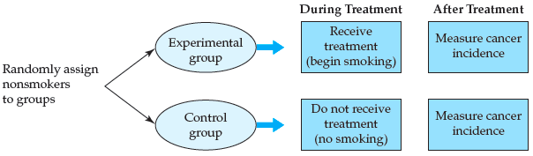
Between-Subjects Experimental Designs (cont’d.)
Figure 9.1 Experimental study of the effects of smoking on cancer rates

Slide 6
Between-Subjects Experimental Designs (cont’d.)
Posttest-only control group design
An experimental design in which the dependent variable is measured after the manipulation of the independent variable
Pretest/posttest control group design
An experimental design in which the dependent variable is measured both before and after manipulation of the independent variable

Slide 7
Between-Subjects Experimental Designs (cont’d.)
Disadvantages of the pretest/posttest control group design:
Possibility of increasing demand characteristics and
Experimenter effects
Subjects might guess before the posttest what is being measured in the study
With multiple testings, more opportunity for an experimenter to influence the subjects

Slide 8
Control and Confounds
Confound: an uncontrolled extraneous variable or flaw in an experiment
Internal validity
The extent to which the results of an experiment can be attributed to the manipulation of the independent variable rather than to some confounding variable

Slide 9
Threats to Internal Validity
Nonequivalent control group
History effect
An outside event that is not a part of the manipulation of the experiment could be responsible for the results
Maturation effect: naturally occurring changes within the subjects could be responsible for the observed results

Slide 10
Threats to Internal Validity (cont’d.)
Testing effect
Repeated testing leads to better or worse scores
Practice effect
Fatigue effect
Regression to the mean: extreme scores, upon retesting, tend to be less extreme, moving toward the mean

Slide 11
Threats to Internal Validity (cont’d.)
Instrumentation effect: changes in the dependent variable may be due to changes in the measuring device
Mortality (attrition)
Differential dropout rates may be observed in the experimental and control groups
Lead to inequality between the groups

Slide 12
Threats to Internal Validity (cont’d.)
Diffusion of treatment
Observed changes in the behaviors or responses of subjects may be due to information received from other subjects in the study
Experimenter effect
The experimenter, consciously or unconsciously, affects the results of the study
Experimenter bias or expectancy effect

Slide 13
Threats to Internal Validity (cont’d.)
Single-blind experiment
An experimental procedure in which either the subjects or the experimenters are blind to the manipulation being made
Double-blind experiment
An experimental procedure in which neither the experimenter nor the subject knows the condition to which each subject has been assigned
Both parties are blind to the manipulation

Slide 14
Threats to Internal Validity (cont’d.)
Subject effect: the subject, consciously or unconsciously, affects the results of the study
Placebo group: a group or condition in which subjects believe they are receiving treatment but are not
Placebo: an inert substance that subjects believe is a treatment

Slide 15
Threats to Internal Validity (cont’d.)
Floor effect
A limitation of the measuring instrument that decreases its capability to differentiate between scores at the bottom of the scale
Ceiling effect
A limitation of the measuring instrument that decreases its capability to differentiate between scores at the top of the scale

Slide 16
Threats to External Validity
External validity: the extent to which the results of an experiment can be generalized
College sophomore problem: results from using mainly college sophomores as subjects in research studies
Exercise some caution
When generalizing from the laboratory setting to the real world

Slide 17
Threats to External Validity (cont’d.)
Exact replication
Repeating a study using the same means of manipulating and
Measuring the variables as in the original study
Conceptual replication
A study based on another study that uses:
Different methods
A different manipulation or a different measure

Slide 18
Threats to External Validity (cont’d.)
Systematic replication
A study that varies from an original study in one systematic way
For example, by using:
A different number or type of subjects
A different setting or more levels of the independent variable

Slide 19
Correlated-Groups Designs

Slide 20
Correlated-Groups Designs
Correlated-groups design
An experimental design in which the subjects in the experimental and control groups are related in some way
Within-subjects design: a type of correlated-groups design in which the same subjects are used in each condition

Slide 21
Correlated-Groups Designs (cont’d.)
Advantages of within-subjects designs:
Require fewer subjects than between-subjects designs
Require less time to conduct than between-subjects designs
Increase statistical power

Slide 22
Correlated-Groups Designs (cont’d.)
Order effects
A problem for within-subjects designs in which the order of the conditions has an effect on the dependent variable
Counterbalancing
A mechanism for controlling order effects either:
By including all orders of treatment presentation or
By randomly determining the order for each subject

Slide 23
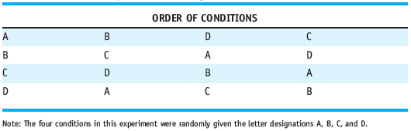
Correlated-Groups Designs (cont’d.)
Latin square: a counterbalancing technique to control for order effects without using all possible orders
Table 9.1 A Latin Square for a Design with Four Conditions

Slide 24
Correlated-Groups Designs (cont’d.)
Matched-subjects design
A type of correlated-groups design in which subjects are matched between conditions on variable(s) that the researcher believes is (are) relevant to the study
A within-subjects design has perfect matching
Why do we not simply use a within-subjects design?
Carryover effects

Slide 25
Correlated-Groups Designs (cont’d.)
Advantages of matched-subjects designs
Testing effects and demand characteristics are minimized in comparison to a within-subjects design
Groups are more equivalent than those in a between-subjects design and
Almost as equivalent as those in a within-subjects design

Slide 26
Correlated-Groups Designs (cont’d.)
Same types of statistics used for the within-subjects designs are used for the matched-subjects designs
Weaknesses of matched-subjects designs
More subjects are needed than in a within-subjects design
Mortality is more of an issue
Difficult to find enough subjects who are matches

Slide 27
Summary
Consider several factors when designing and evaluating a true experiment:
Address the issues of control and possible confounds
External validity
Use the most appropriate design

Slide 28
Parametric Statistics

Slide 29


Parametric Statistics
Null hypothesis tested in a two-group design using a two-tailed test:
Alternative hypothesis:

Slide 30

Parametric Statistics (cont’d.)
For a one-tailed test, the null hypothesis is
Depending on which alternative hypothesis is being tested:
Alpha is typically set at .05 (α= .05)

Slide 31
Parametric Statistics (cont’d.)
Parametric tests
The data fit a bell-shaped distribution
Certain parameters are known
Mean (μ)
Standard deviation (σ)
Use interval-ratio data

Slide 32

Parametric Statistics (cont’d.)
Independent-groups t test: a parametric inferential test for comparing sample means of two independent groups of scores
Example:

Slide 33

Parametric Statistics (cont’d.)
Formula for an independent-groups t test
Standard error of the difference between means
The standard deviation of the sampling distribution of mean differences between dependent samples in a two-group experiment

Slide 34

Parametric Statistics (cont’d.)
Formula for converting the mean differences to standard errors

Slide 35
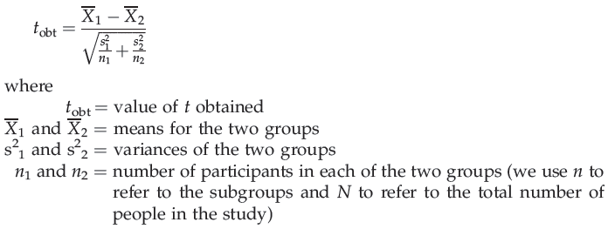
Parametric Statistics (cont’d.)
Putting all of this together, the formula for determining t is:

Slide 36

Parametric Statistics (cont’d.)
In APA style the result is reported as:
When a result is significant
The p value is reported as less than (<) .05
p value or alpha level: indicates the probability of a Type I error
We want this probability to be small

Slide 37
Parametric Statistics (cont’d.)
Three aspects of a study can increase power:
Greater differences produced by the independent variable
Less variability of raw scores in each condition
Increased sample size

Slide 38
Parametric Statistics (cont’d.)
Effect size
The proportion of variance in the dependent variable that is accounted for by the manipulation of the independent variable
Cohen’s d: inferential statistic for measuring effect size

Slide 39
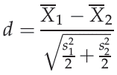
Parametric Statistics (cont’d.)
Formula for Cohen’s d
Report Cohen’s d with the t-score:

Slide 40

Parametric Statistics (cont’d.)
Measure effect size for the independent-groups t test using r²
Use the formula:
If r² is .01, the effect size is small
If r² is .09, it is medium
If r² is .25, it is large

Slide 41

Parametric Statistics (cont’d.)
Formula for the 95% confidence interval:
Assumptions of the independent-groups t test:
The data are interval-ratio scale
The underlying distributions are bell-shaped
The observations are independent
Homogeneity of variance

Slide 42
Parametric Statistics (cont’d.)
Correlated-groups t test
A parametric inferential test used to compare the means of two related (within- or matched- subjects) samples
Difference scores
Scores representing the difference between subjects’ performance in one condition and their performance in a second condition

Slide 43

Parametric Statistics (cont’d.)
Standard error of the difference scores
The standard deviation of the sampling distribution of differences between the means of independent samples in a two-sample experiment
For the correlated-groups t test, the formula for Cohen’s d is:

Slide 44
Parametric Statistics (cont’d.)
Assumptions for the correlated-groups t test:
Same as those for the independent- groups t test except the observations are correlated

Slide 45
Nonparametric Tests

Slide 46
Nonparametric Tests
Wilcoxon rank-sum test: a nonparametric inferential test for comparing sample medians of two independent groups of scores
Highest rank should be equal to n₁ + n₂
First sum the ranks
For the group expected to have the smaller total

Slide 47
Nonparametric Tests (cont’d.)
Assumptions of the Wilcoxon rank-sum test:
The data are ratio, interval, or ordinal in scale
All of which must be converted to ranked (ordinal) data
The underlying distribution is not normal
The observations are independent
Wilcoxon matched-pairs signed-ranks T test
Similar to the correlated-groups t test
Except that it is nonparametric and compares medians rather than means

Slide 48
Nonparametric Tests (cont’d.)
Assumptions of the Wilcoxon matched-pairs signed-ranks T test:
The data are ratio, interval, or ordinal in scale
All of which must be converted to ranked (ordinal) data
The underlying distribution is not normal
The observations are dependent or related

Slide 49

Nonparametric Tests (cont’d.)
Chi-square (χ²) test of independence
A nonparametric inferential test used when frequency data have been collected to determine
How well an observed breakdown of people over various categories fits some expected breakdown
Formula:

Slide 50

Nonparametric Tests (cont’d.)
Phi coefficient: an inferential test used to determine effect size for a chi-square test
For a 2 X 2 contingency table, we use the phi coefficient, where:

Slide 51
Nonparametric Tests (cont’d.)
Assumptions of the χ² test of independence
The sample is random
The observations are independent
The data are nominal

Slide 52
Summary
Use the appropriate statistic to analyze data
Consider whether the statistic should be a parametric or nonparametric
Based on:
The type of data collected
The type of distribution to which the data conform
Whether any parameters of the distribution are known
Consider whether a between-subjects or correlated-groups design has been used

