Slide 1
Chapter 1 Thinking Like a Scientist

Slide 2
Topics
Areas of Psychological Research
Sources of Knowledge
The Scientific (Critical Thinking) Approach and Psychology
Basic and Applied Research
Goals of Science
An Introduction to Research Methods in Science

Slide 3
Topics (cont’d.)
Doing Science
Proof and Disproof
The Research Process

Slide 4
Areas of Psychological Research

Slide 5
Areas of Psychological Research
Psychobiology: combines biology and psychology
Cognition: how humans solve problems, etc.
Human development: physical, social, and cognitive development
Social psychology: how we view and affect one another
Psychotherapy: assess effectiveness of therapy

Slide 6
Sources of Knowledge

Slide 7
Sources of Knowledge
Superstition: knowledge that is based on subjective feelings, interpreting random events as nonrandom events, or believing in magical events
Intuition: knowledge gained without being consciously aware of its source
Authority: knowledge gained from those viewed as authority figures

Slide 8
Sources of Knowledge (cont’d.)
Tenacity: knowledge gained from repeated ideas that are stubbornly clung to despite evidence to the contrary
Rationalism: knowledge gained through logical reasoning
Empiricism: knowledge gained through objective observations of organisms and events in the real world

Slide 9
Sources of Knowledge (cont’d.)
Science: knowledge gained through a combination of empirical methods and logical reasoning
Hypothesis: prediction regarding the outcome of a study
Theory: organized system of assumptions and principles that attempts to explain certain phenomena and how they are related

Slide 10
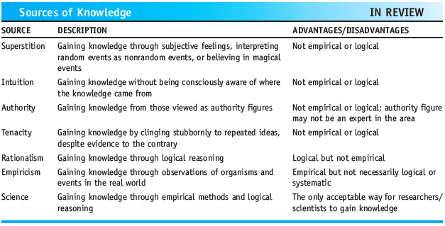
Sources of Knowledge (cont’d.)
Sources of Knowledge

Slide 11
The Scientific (Critical Thinking) Approach and Psychology

Slide 12
The Scientific (Critical Thinking) Approach and Psychology
Skeptic: person who questions the validity or truth of something purporting to be factual
Systematic empiricism: making observations in a systematic manner to test hypotheses and refute or develop a theory
Publicly verifiable knowledge: presenting research so that it can be criticized and tested

Slide 13
The Scientific (Critical Thinking) Approach and Psychology (cont’d.)
Empirically solvable problems: questions that are potentially answerable by means of currently available research techniques
Principle of falsifiability: a scientific theory must be stated in such a way that it is possible to refute or disconfirm it
Pseudoscience: appear to be scientific but that actually violate the criteria of science

Slide 14
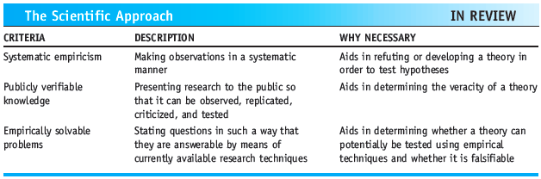
The Scientific (Critical Thinking) Approach and Psychology (cont’d.)
The Scientific Approach

Slide 15
Basic and Applied Research

Slide 16
Basic and Applied Research
Basic research
Seek knowledge for its own sake
Example: identifying whether cognitive maps can be mentally rotated
Applied research
Practical significance and potential solutions
Example: identifying factors associated with weight gain

Slide 17
Goals of Science

Slide 18
Goals of Science
Description: observing behavior in order to describe it
Prediction: identifying the factors that indicate when an event will occur
Explanation: identifying the causes that determine when and why a behavior occurs

Slide 19
An Introduction to Research Methods in Science

Slide 20
Descriptive Methods
Observational method: making observations of human or animal behavior
Naturalistic observation: observing behavior of humans or animals in their natural habitat
Laboratory observation: observing behavior in a more controlled situation
Case study method: in-depth study of one or more individuals

Slide 21
Descriptive Methods (cont’d.)
Survey method: questioning individuals on a topic and then describing their responses
Sample: group who participate in a study
Population: all of the people about whom a study is meant to generalize
Random sample: achieved through random selection in which each member of the population is equally likely to be chosen

Slide 22
Predictive (Relational) Methods
Correlational method: assesses the degree of relationship between two variables
Correlation does not imply causation
Positive relationship: an increase in one variable is accompanied by an increase in the other variable

Slide 23
Predictive (Relational) Methods (cont’d.)
Negative relationship: an increase in one variable is accompanied by a decrease in the other variable
Quasi-experimental method: compares naturally occurring groups of individuals; the variable of interest cannot be manipulated
Subject (participant) variable: a characteristic inherent in subjects that cannot be changed

Slide 24
Predictive (Relational) Methods (cont’d.)
Alternative explanation: possible that some extraneous variable may be responsible for the observed relationship

Slide 25
Explanatory Method
Allows a researcher to establish a cause-and-effect relationship
Through manipulation of a variable and
Control of the situation
Independent variable: variable that is manipulated
Dependent variable: variable that is measured

Slide 26
Explanatory Method (cont’d.)
Control group: group that does not receive any level of the independent variable
Experimental group: group that receives some level of the independent variable

Slide 27
Explanatory Method (cont’d.)
Random assignment: assigning subjects to conditions in such a way that every participant has an equal probability of being placed in any condition
Control: manipulating the independent variable or any other extraneous variables that could affect the results

Slide 28
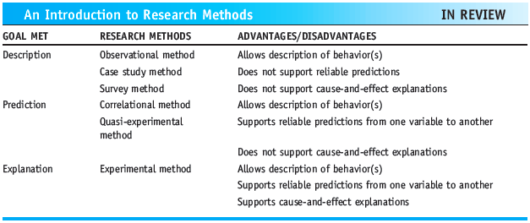
Explanatory Method (cont’d.)
An Introduction to Research Methods

Slide 29
Doing Science

Slide 30
Doing Science
We cannot accept a conclusion from only one study because:
There may be control problems
Study may be limited by available technical equipment
A single study cannot tell us everything about a theory
Science is not static
Theories evolve and change over time

Slide 31
Proof and Disproof

Slide 32

Proof and Disproof
Proof of a theory is logically impossible
Example: “If a person is drinking alcohol, then the person is 21 or over”
Test a hypothesis
By attempting to falsify or disconfirm it

Slide 33
The Research Process

Slide 34
The Research Process
Identify a problem
Review the literature
Generate hypotheses
Design and conduct the study
Analyze the data and interpret the results
Communicate the results

Slide 35
Summary
Scientific method is a combination of empiricism and rationalism
Goals of science: description, prediction, explanation
Experimental method allows for explanation of cause-and-effect relationships
Testing a hypothesis involves attempting to falsify it

