Slide 1
Chapter 2 Getting Started: Ideas, Resources, and Ethics

Slide 2
Topics
Selecting a Problem
Reviewing the Literature
Reading a Journal Article: What to Expect
Ethical Standards in Research with Human Subjects
Ethical Standards in Research with Children
Ethical Standards in Research with Animals

Slide 3
Selecting a Problem

Slide 4
Selecting a Problem
Look at completed research
Gives you a firm foundation
May help suggest a hypothesis
Find a cursory review of theories
Identify an interesting class
Look at the textbook
Narrow it down to a topic

Slide 5
Selecting a Problem (cont’d.)
Observe
Example: you may believe that listening to a specific affects a person’s mood
Base ideas on practical problems
Example: does art therapy improve the general well-being of those recovering from surgery?

Slide 6
Reviewing the Literature

Slide 7
Reviewing the Literature
Literature review: searching the published studies on a topic
Begin your research at the library
Important resource: library staff
Published research appears in journals
Peer review: each paper published is first submitted to the editor, who sends the paper out for review by other scientists

Slide 8
Reviewing the Literature (cont’d.)
Psychological (Psych) abstracts: reference resource published by the APA that contains abstracts of articles
PsycINFO: electronic database that provides abstracts and citations to the literature in the behavioral sciences and mental health

Slide 9
Reviewing the Literature (cont’d.)
Social Science Citation Index (SSCI)
Can help you to work from a given article and see what has been published on that topic since the key article was published
Includes social and behavioral sciences
Science Citation Index (SCI)
Includes biology, chemistry, and medicine

Slide 10
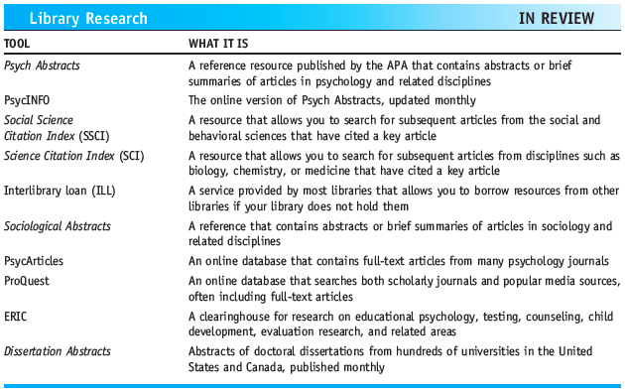
Library Research

Slide 11
Reading a Journal Article: What to Expect

Slide 12
Abstract
Brief description of the entire paper
Introduction, method, results, and discussion
Between 150 and 250 words
Describes the problem under investigation and the purpose of the study
Participants and general methodology; findings; and conclusions of the study

Slide 13
Introduction
Introduction to the problem
Review of relevant previous research
Not works of marginal significance
Purpose and rationale for the study

Slide 14
Method
Describes how the study was conducted
Subsections
Subjects: description of the subjects and how they were obtained
Materials: describes any testing materials used
Apparatus: describes any specific equipment used
Procedure: summarizes each step in the execution of the research

Slide 15
Results
Summarizes data and type of statistic(s) used
Reported with respect to the variables measured and/or manipulated
Should not include an explanation of results
Depict results in tables and graphs or figures

Slide 16
Discussion
Restatement of the predictions
Whether or not the predictions were supported
Relationship between the results and past research
Criticisms of the study
Implications for future research

Slide 17
Ethical Standards in Research with Human Subjects

Slide 18
Ethical Standards in Research with Human Subjects
Researcher is responsible for the welfare of the subjects
What harm could a participant suffer in a research study?
Nuremberg code
Basis of ethical guidelines we use today
Lists 10 principles for the Nazi war crimes trials following World War II

Slide 19
Ethical Standards in Research with Human Subjects (cont’d.)
Nazi doctors used Jews for inhumane research
Determining the effects on humans of viruses, poisons, toxins, and drugs
Tuskegee syphilis study (1932-1972)
Examined the course of the disease in untreated individuals
Subjects were approximately 400 black men

Slide 20
Ethical Standards in Research with Human Subjects (cont’d.)
In 1953, APA developed ethical guidelines for research with human participants
Stanley Milgram
Research on obedience to authority (1963)
Was it an ethical use of human subjects?

Slide 21
Ethical Standards in Research with Human Subjects (cont’d.)
Institutional review board (IRB)
Made up of faculty members, usually from diverse backgrounds, and members of the community
Oversees all federally funded research involving human participants
Informed consent: form given to individuals before they participate in a study to inform them of the general nature of the study and to obtain their consent to participate

Slide 22
Ethical Standards in Research with Human Subjects (cont’d.)
Subjects classified as “at minimal risk”
Placed under no more physical or emotional risk than would be encountered in daily life
Example: paper-and-pencil tests, research on memory processes
Subjects classified as “at risk”
Studies in which the subjects are at risk for physical or emotional harm, or
If their privacy is compromised

Slide 23
Ethical Standards in Research with Human Subjects (cont’d.)
Deception: lying to the participants concerning the true nature of a study because knowing the true nature of the study might affect their performance
Debriefing: providing information about the true purpose of a study as soon after the completion of data collection as possible

Slide 24
Ethical Standards in Research with Children

Slide 25
Ethical Standards in Research with Children
How does informed consent work with children?
How do researchers properly debrief a child?
Informed consent must be obtained from the parents or legal guardians for all persons under the age of 18

Slide 26
Ethical Standards in Research with Animals

Slide 27
Ethical Standards in Research with Animals
Controversial issue
Some believe that no research should be conducted on animals
Other believe that research with animals is advantageous
Guidelines for Ethical Conduct in the Care and Use of Animals (1996)

Slide 28
Ethical Standards in Research with Animals (cont’d.)
Researcher must ensure that:
Care and housing of the animals meet federal regulations
All experimental procedures are humane
Treatments involving pain are used only when necessary
Alternative procedures that minimize discomfort are used when available

Slide 29
Summary
Psych Abstracts, PsycINFO, SSCI, and SCI
APA’s ethical guidelines for using humans for research purposes
Importance of IRBs and informed consent
Use of deception in research and debriefing
Considerations when using children as subjects and APA guidelines on the use of animals in research

