Slide 1
Chapter 5 Data Organization and Descriptive Statistics

Slide 2
Topics
Organizing Data
Descriptive Statistics

Slide 3
Organizing Data

Slide 4
Organizing Data
Frequency distribution: a table in which all of the scores are listed along with the frequency with which each occurs
Class interval frequency distribution
A table in which the scores are grouped into intervals and listed along with the frequency of scores in each interval

Slide 5
Organizing Data (cont’d.)
Qualitative variable: a categorical variable for which each value represents a discrete category
Quantitative variable: a variable for which the scores represent a change in quantity

Slide 6
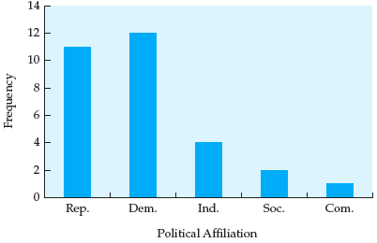
Organizing Data (cont’d.)
Figure 5.1 Bar graph representing political affiliation for a distribution of 30 individuals

Slide 7
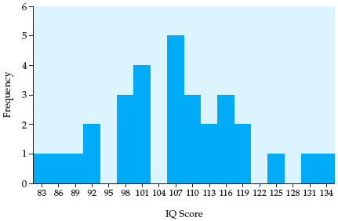
Organizing Data (cont’d.)
Figure 5.2 Histogram representing IQ score data for 30 individuals

Slide 8
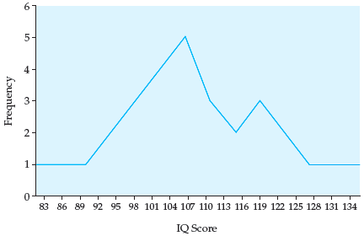
Organizing Data (cont’d.)
Figure 5.3 Frequency polygon of IQ score data for 30 individuals

Slide 9
Descriptive Statistics

Slide 10
Descriptive Statistics
Numerical measures that describe a distribution by providing:
Information on the central tendency of the distribution
The width of the distribution
The shape of the distribution
Measure of central tendency: a number that characterizes the “middleness” of an entire distribution

Slide 11
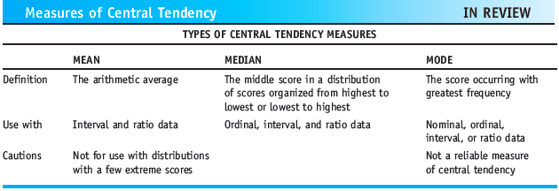
Descriptive Statistics (cont’d.)
Types of Central Tendency Measures

Slide 12
Descriptive Statistics (cont’d.)
Measure of variation: a number that indicates the degree to which scores are either clustered or spread out in a distribution
Range: the difference between the lowest and the highest scores in a distribution

Slide 13
Descriptive Statistics (cont’d.)
Standard deviation
The average difference between the scores in the distribution and the mean or central point of the distribution, or the square root of the average squared deviation from the mean
Average deviation
Like the standard deviation, indicates the average difference between the scores in a distribution and the mean of the distribution

Slide 14
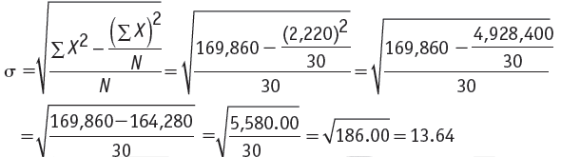
Descriptive Statistics (cont’d.)
Standard Deviation Raw-Score Formula

Slide 15
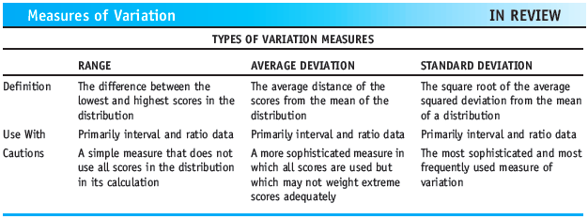
Descriptive Statistics (cont’d.)
Variance: the standard deviation squared
Types of Variation Measures

Slide 16
Descriptive Statistics (cont’d.)
Normal curve: a symmetrical, bell-shaped frequency polygon representing a normal distribution
Normal distribution: a theoretical frequency distribution that has certain special characteristics
Kurtosis: how flat or peaked a normal distribution is

Slide 17
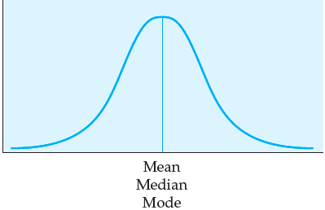
Descriptive Statistics (cont’d.)
Figure 5.4 A Normal Distribution

Slide 18
Descriptive Statistics (cont’d.)
Mesokurtic: normal curves that have peaks of medium height and distributions that are moderate in breadth
Leptokurtic: normal curves that are tall and thin, with only a few scores in the middle of the distribution having a high frequency
Platykurtic: normal curves that are short and more dispersed (broader)

Slide 19
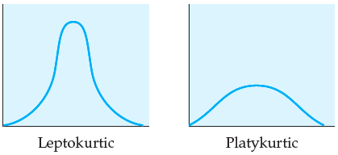
Descriptive Statistics (cont’d.)
Figure 5.5 Types of distributions: leptokurtic and platykurtic

Slide 20
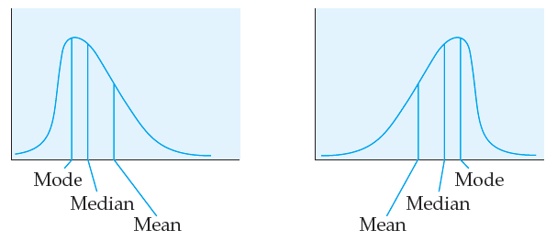

Descriptive Statistics (cont’d.)
Positively Skewed Distribution
Negatively Skewed Distribution
Figure 5.6 Positively and negatively skewed distributions

Slide 21


Descriptive Statistics (cont’d.)
z-score (standard score): a number that indicates how many standard deviation units a raw score is from the mean of a distribution
Formulas for a z-score transformation:

Slide 22
Descriptive Statistics (cont’d.)
Standard normal distribution: a normal distribution with a mean of 0 and a standard deviation of 1
Probability: the expected relative frequency of a particular outcome

Slide 23
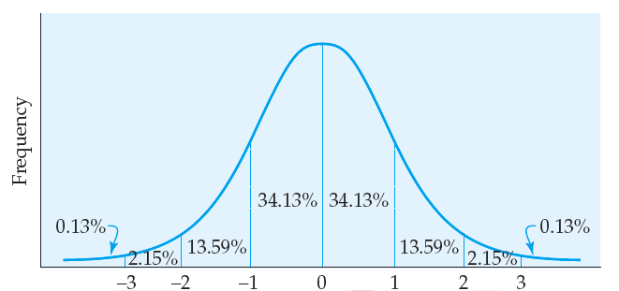

Descriptive Statistics (cont’d.)
Standard Deviations
Figure 5.7 Area under the standard normal curve

Slide 24
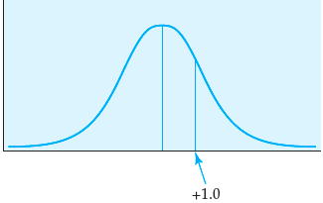
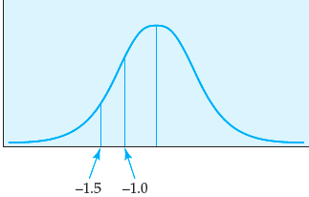
Descriptive Statistics (cont’d.)
Figure 5.8 Standard normal curve
with z-score of +1.00 indicated
Figure 5.9 Standard normal curve with
z-scores of –1.0 and –1.5 indicated

Slide 25
Descriptive Statistics (cont’d.)
Percentile rank: a score that indicates the percentage of people who scored at or below a given raw score

Slide 26
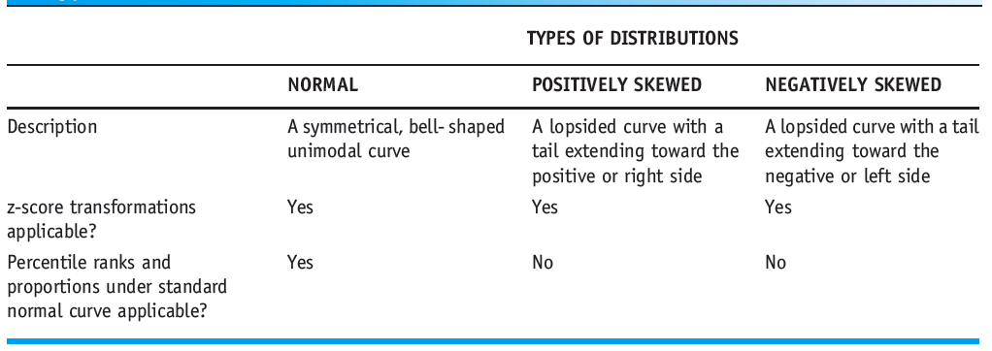
Descriptive Statistics (cont’d.)
Types of Distributions

Slide 27
Summary
Measures of central tendency: mean, median, and mode
Measures of variation: range, average deviation, and standard deviation
A distribution may be normal, positively skewed, or negatively skewed
Calculation of z-score transformations as a means of standardizing raw scores

