Slide 1
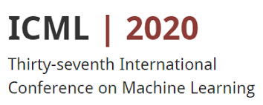

Tunable Subnetwork Splitting for Model-parallelism of Neural Network Training
Junxiang Wang, Zheng Chai, Yue Cheng and Liang Zhao
ICML 2020 Workshop “Beyond First-Order Methods in ML systems”
Presented by Junxiang Wang
Notes:
NOTE:
To change the image on this slide, select the picture and delete it. Then click the Pictures icon in the placeholder to insert your own image.

Slide 2
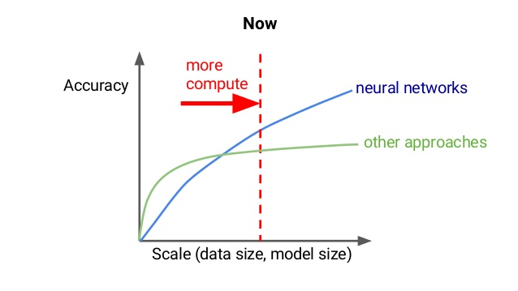
Why Distributed Deep Learning
The increase of data volume and size of deep neural networks model requires scalable and efficient training algorithms.
Notes:
NOTE:
To change the image on this slide, select the picture and delete it. Then click the Pictures icon in the placeholder to insert your own image.

Slide 3
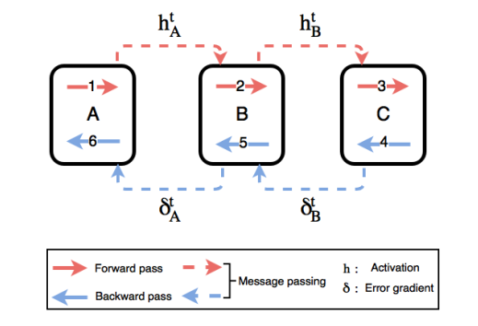
The Drawback of Backpropagation
The backpropagation algorithm is the state-of-the-art training algorithm. However, it suffers from
Layer 4
Locked
Layer 3
Locked
Layer 2
Updated
Layer 1
Updated
Poor Concurrency
Backward Locking
Notes:
NOTE:
To change the image on this slide, select the picture and delete it. Then click the Pictures icon in the placeholder to insert your own image.

Slide 4
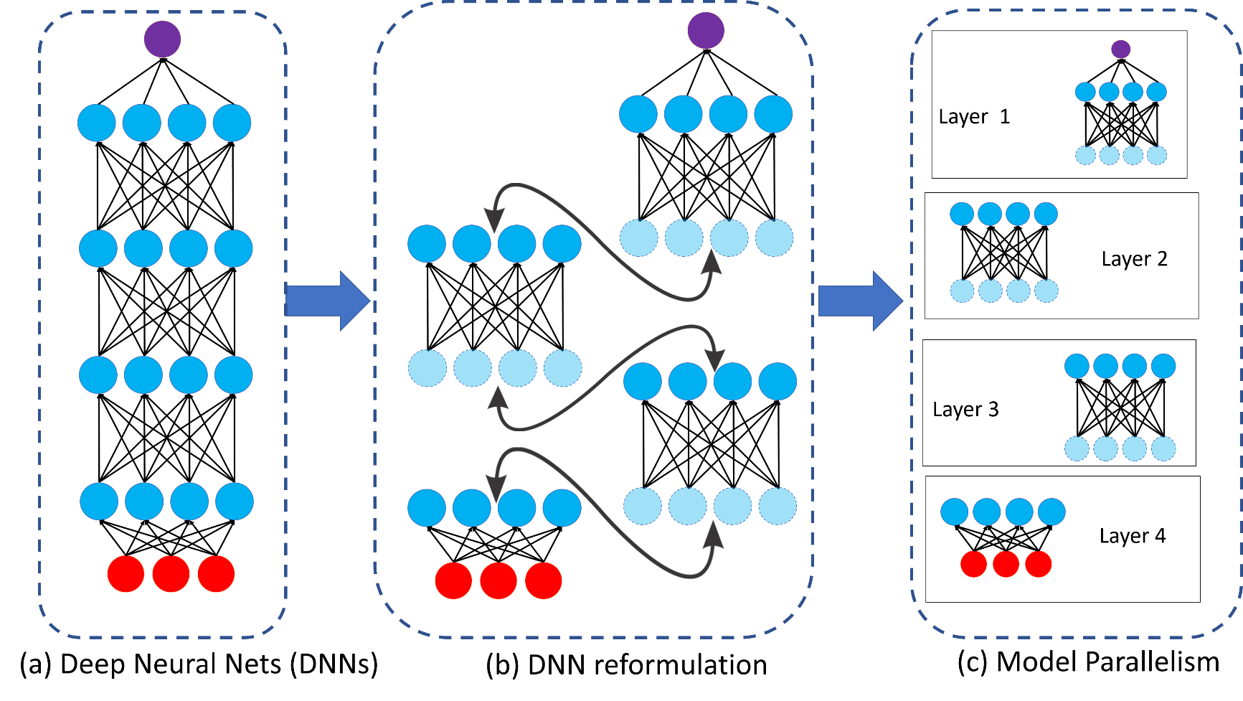
Alternating Minimization as an Alternative
Alternating minimization decomposes a neural network into layerwise components
Notes:
NOTE:
To change the image on this slide, select the picture and delete it. Then click the Pictures icon in the placeholder to insert your own image.

Slide 5
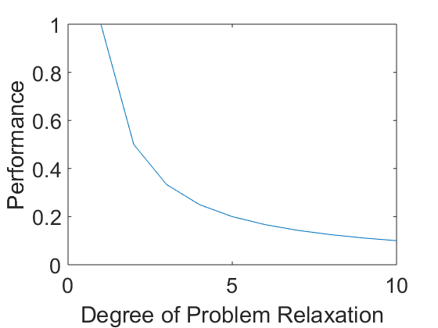
The Challenges of Alternating Minimization
Deeper neural network requires more problem relaxation, which leads to inferior performance.
Notes:
NOTE:
To change the image on this slide, select the picture and delete it. Then click the Pictures icon in the placeholder to insert your own image.

Slide 6

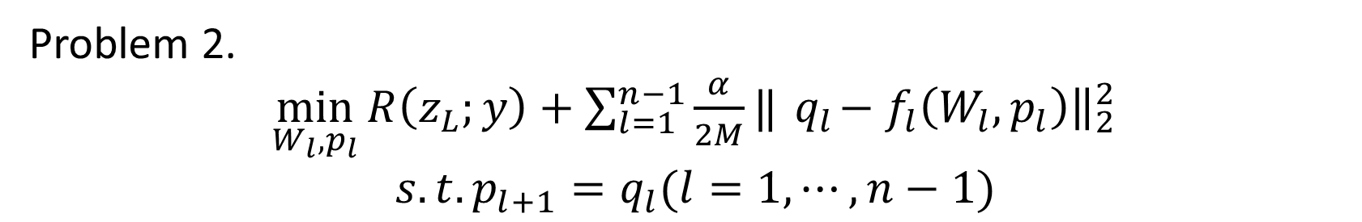
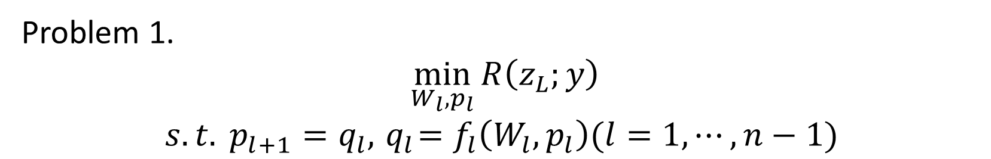
Tunable Subnetwork Splitting Method(TSSM)
Problem 1.
$\min_{W_{l},p_{l}}{R\left(z_{L};y\right)}$
$$s.t. p_{l+1}=q_{l}, { q}_{l}=f_{l}\left(W_{l},p_{l}\right)(l=1,⋯,n−1)$$
loss function
$l$-th subnetwork
Problem 2.
$\min_{W_{l},p_{l}}{R\left(z_{L};y\right)+\sum_{l=1}^{n−1}{\frac{α}{2M}‖{ q}_{l}−f_{l}\left(W_{l},p_{l}\right){\left.​\right\|}_{2}^{2}}}$
${s.t. p}_{l+1}=q_{l}(l=1,⋯,n−1)$
loss function
penalty term
Problem 2 can be solved by gradient splitting Alternating Direction Method
of Multipliers(gsADMM) or gradient splitting Alternating Minimization (gsAM).
Notes:
NOTE:
To change the image on this slide, select the picture and delete it. Then click the Pictures icon in the placeholder to insert your own image.

Slide 7
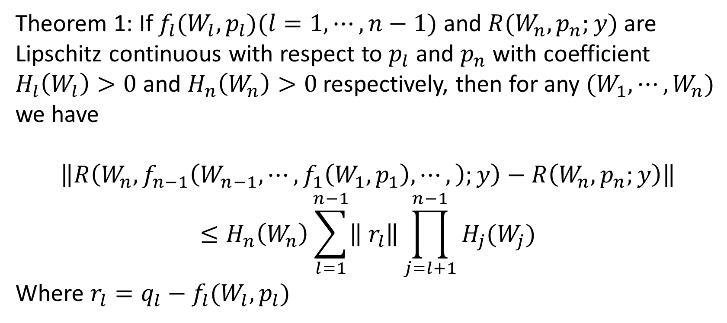
A Compelling Performance-Parallelism Tradeoff
Theorem 1: If $f_{l}(W_{l},p_{l})(l=1,⋯,n−1)$ and $R(W_{n},p_{n};y)$ are Lipschitz continuous with respect to $p_{l}$ and $p_{n}$ with coefficient $H_{l}\left(W_{l}\right)>0$ and $H_{n}\left(W_{n}\right)>0$ respectively, then for any ${(W}_{1},⋯,W_{n})$ we have
$$\left\|R\left(W_{n},f_{n−1}\left(W_{n−1},⋯,f_{1}\left(W_{1},p_{1}\right),⋯,\right);y\right)−R\left(W_{n},p_{n};y\right)\right\|$$
$$≤H_{n}\left(W_{n}\right)\sum_{l=1}^{n−1}{\left\| r_{l}\right\|\prod_{j=l+1}^{n−1}{H_{j}(W_{j})}}$$
Where $r_{l}=q_{l}−f_{l}(W_{l},p_{l})$
approximation error
The more parallelism TSSM can achieve, the
worse performance it has.
Notes:
NOTE:
To change the image on this slide, select the picture and delete it. Then click the Pictures icon in the placeholder to insert your own image.

Slide 8
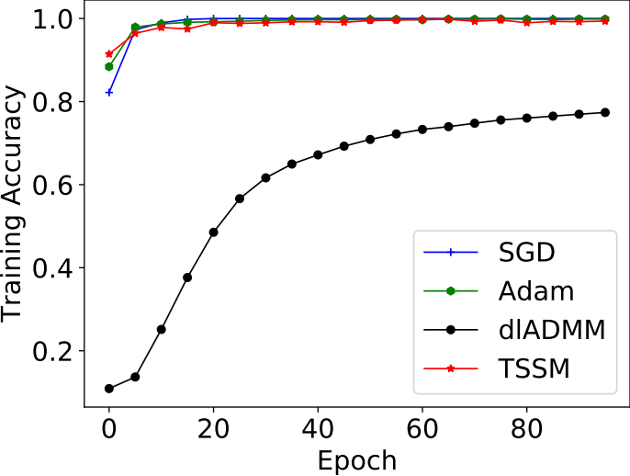
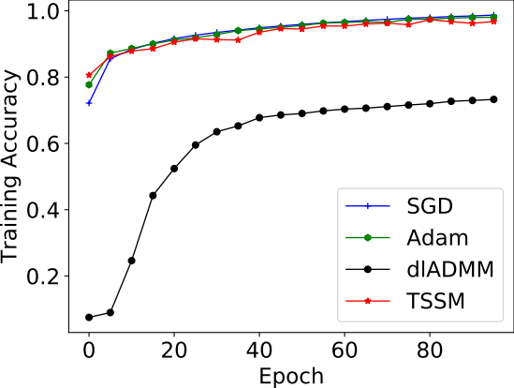
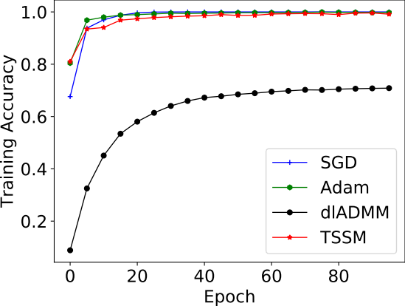
Experiments: Multi-layer Perceptron
(a). MNIST
(b). Fashion MNIST
TSSM can reach the same training accuracy
as SGD and Adam, while the dlADMM
degrades performance.
(c). kMNIST

Slide 9
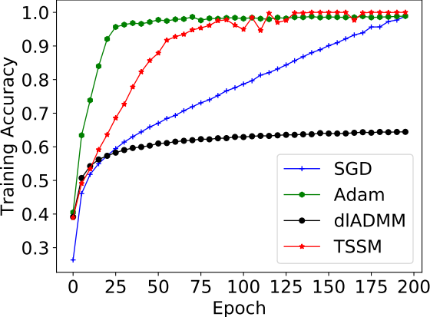
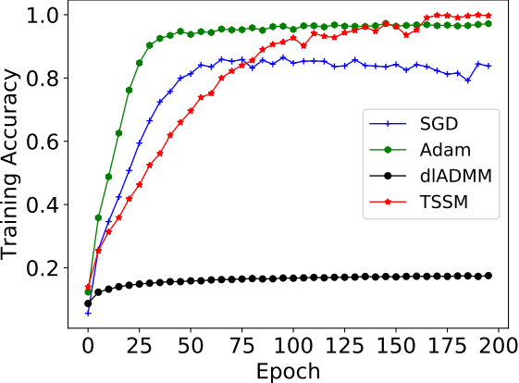
Experiments: Convolutional Neural Network
(a). CIFAR10
(b). CIFAR100
TSSM can reach the same training accuracy
as SGD and Adam, while the dlADMM
degrades performance.

Slide 10
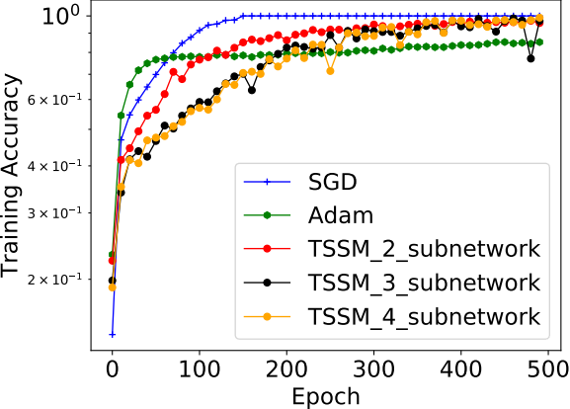
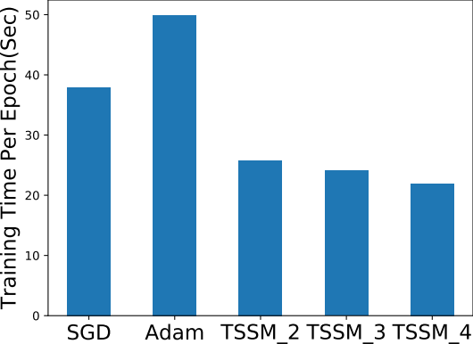
Experiments: A Resnet-like Architecture
(a). Training accuracy on CIFAR10.
(b). Training time: TSSM_2, TSSM_3, and TSSM_4
Represent 2 subnetworks, 3 subnetworks and
4 subnetworks split by TSSM, respectively.
Same training accuracy
Less training time

Slide 11
Thank you !
Our code has been available at:
https://github.com/xianggebenben/TSSM
Feel free to contact jwang40@gmu.edu.

