Slide 1

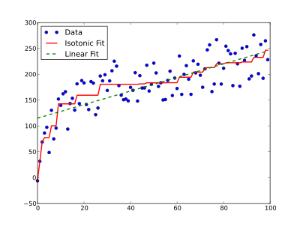
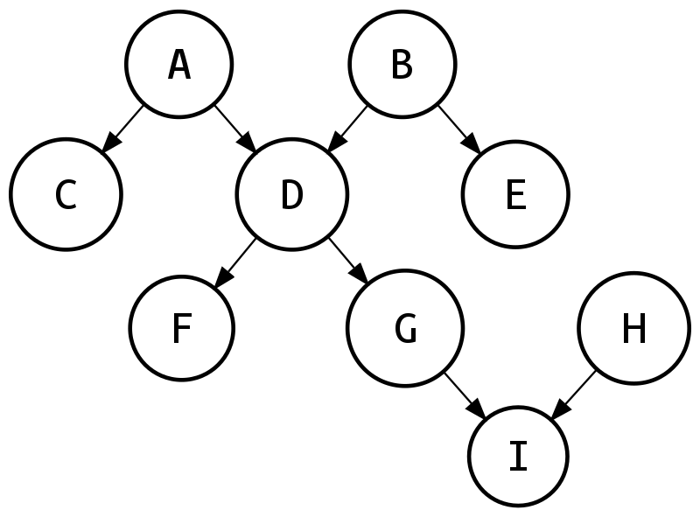
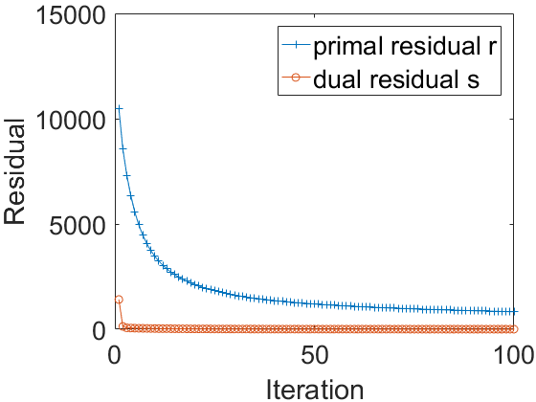
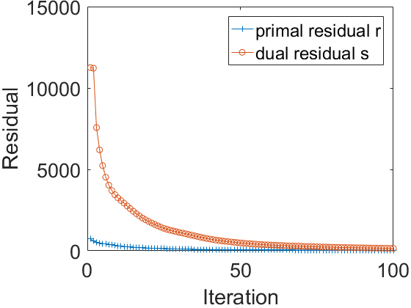
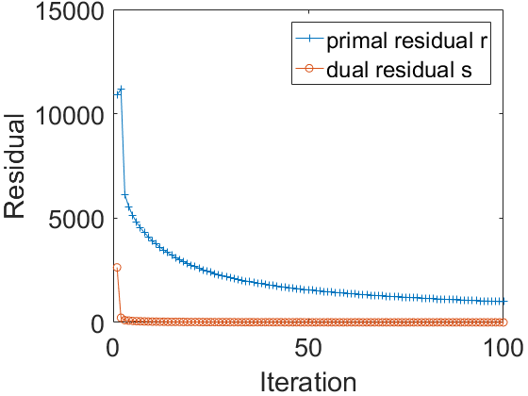
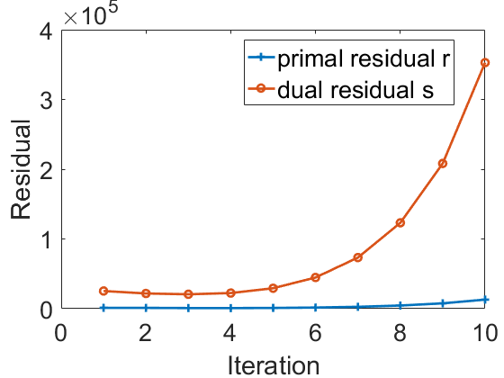
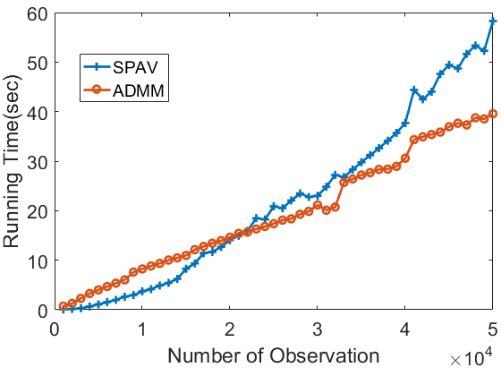
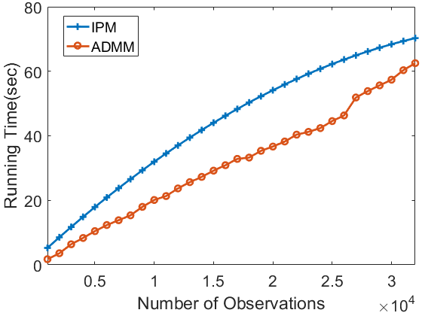
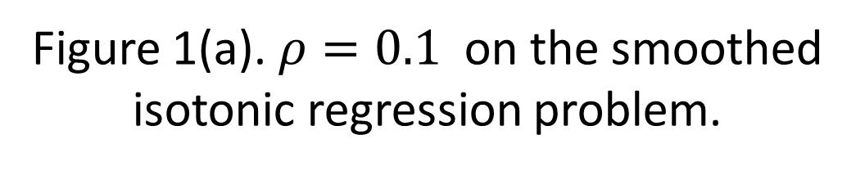
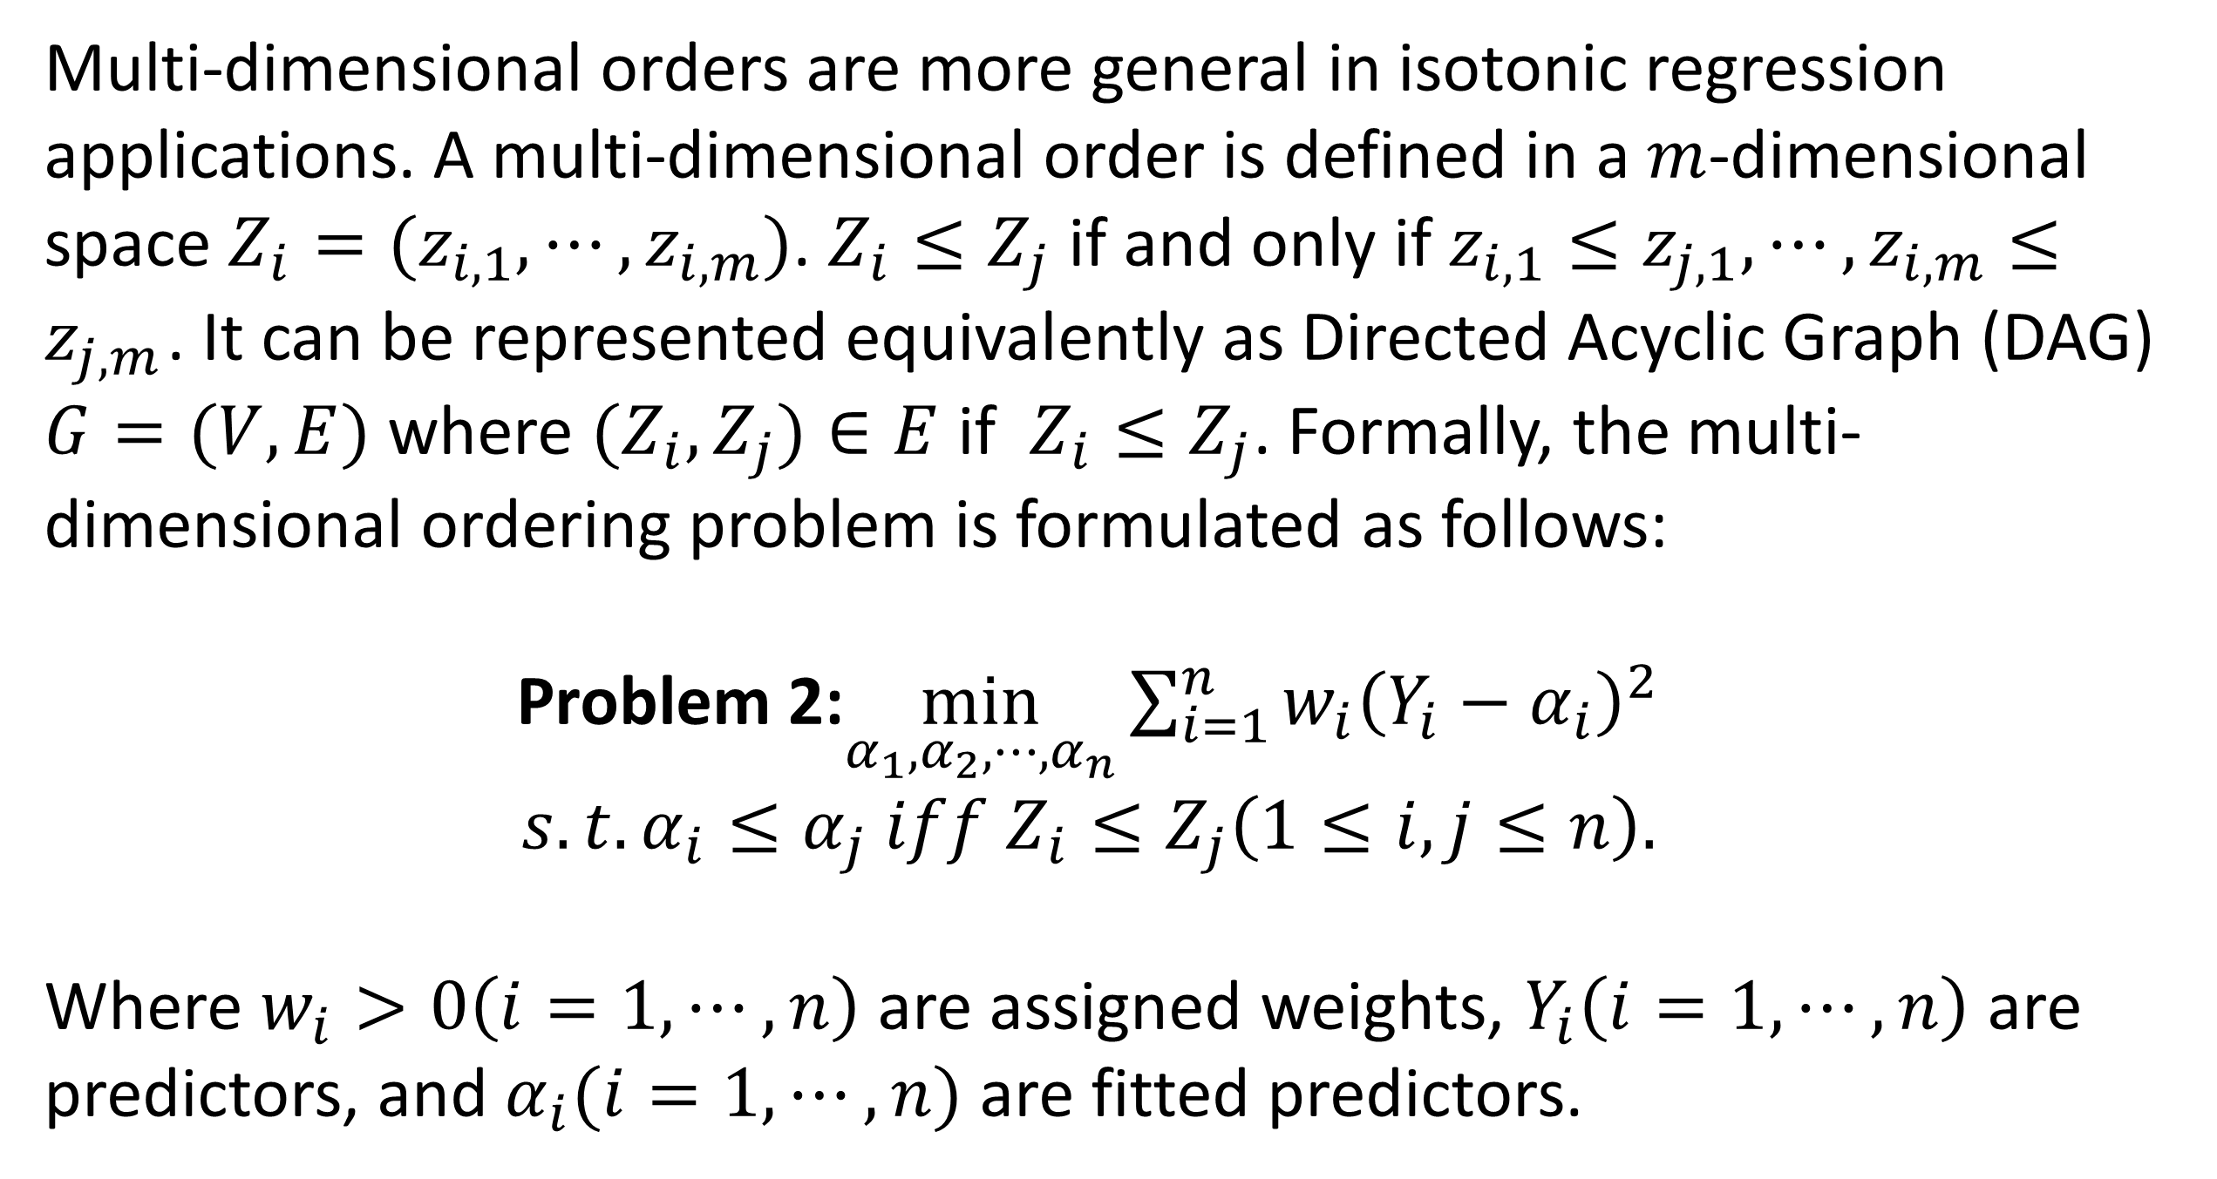
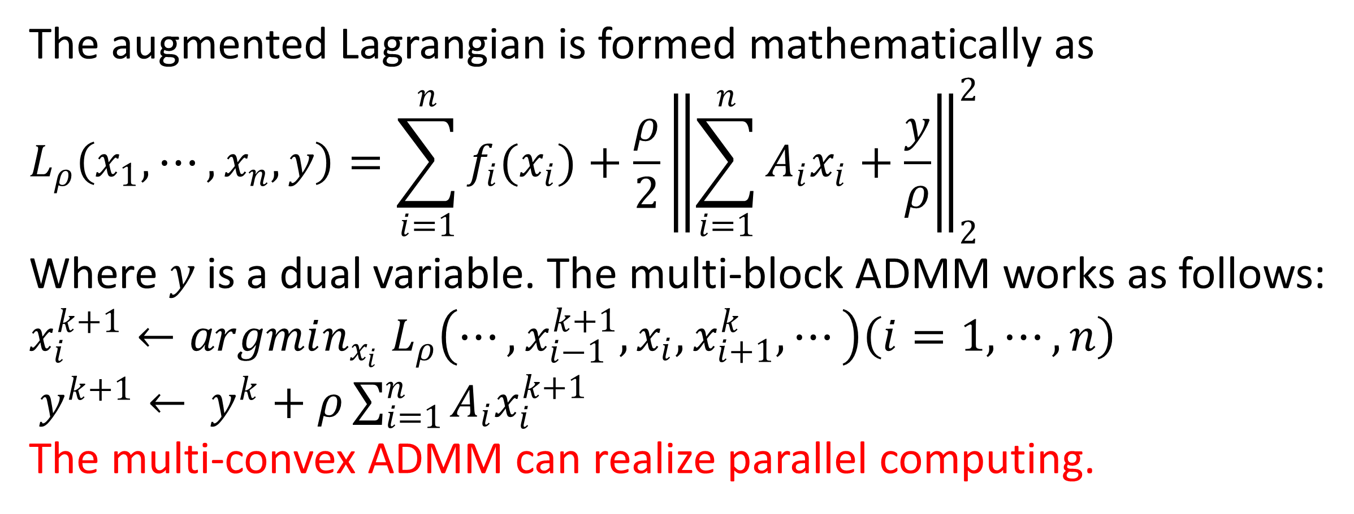
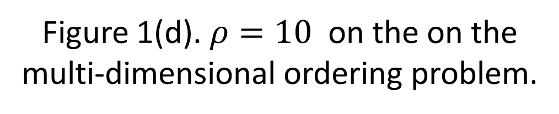
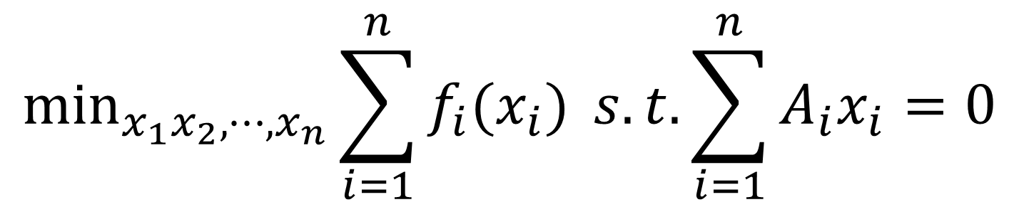
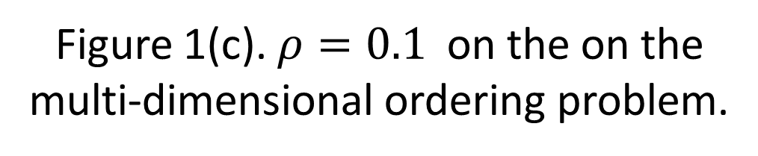
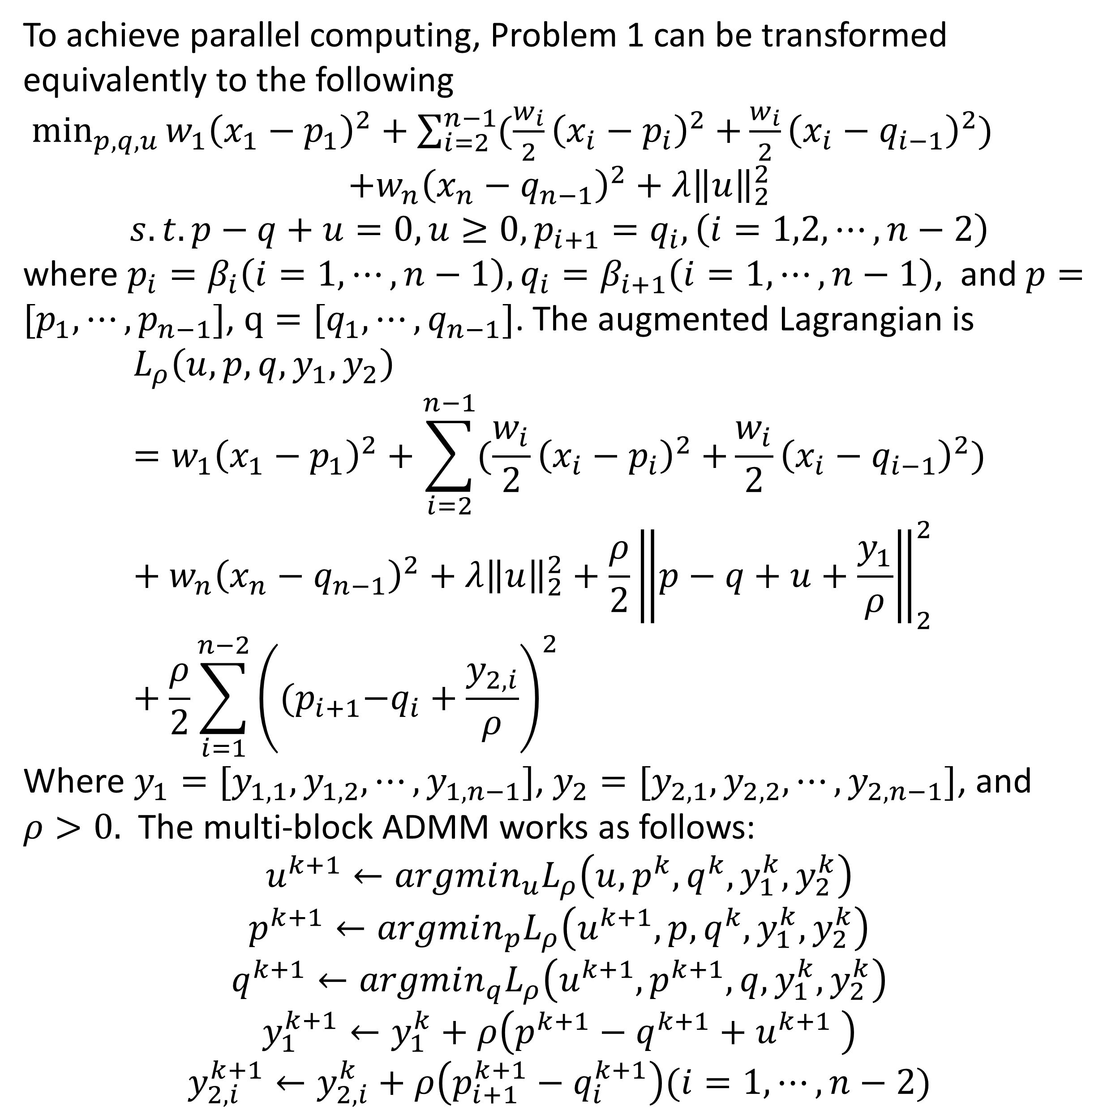
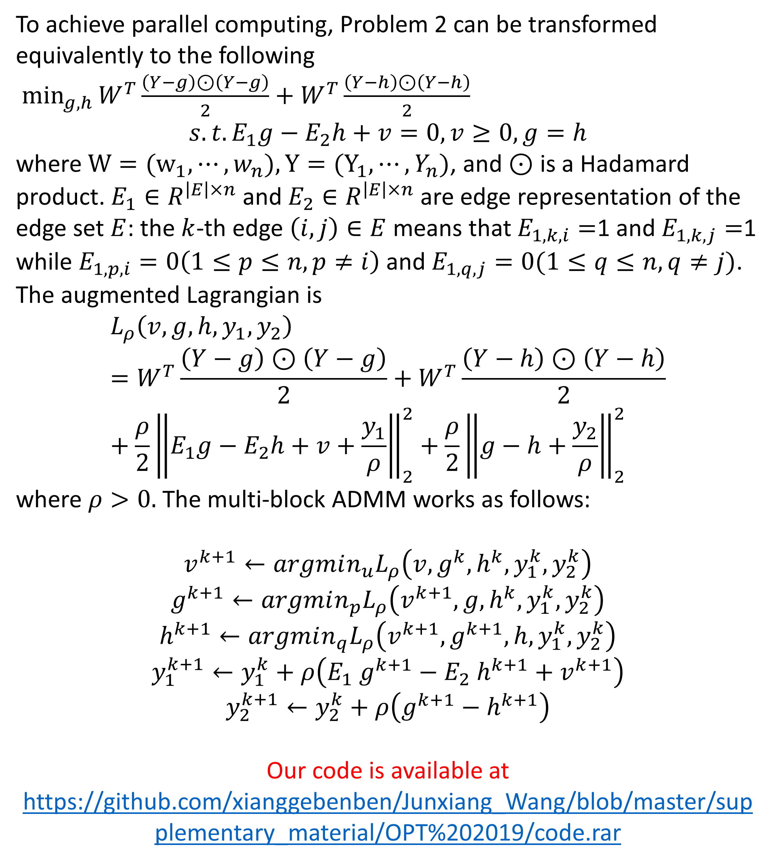
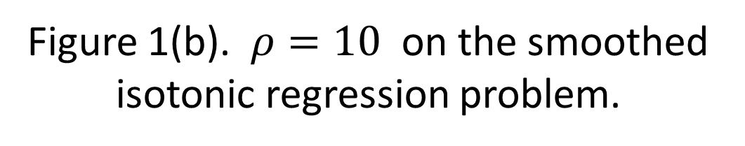
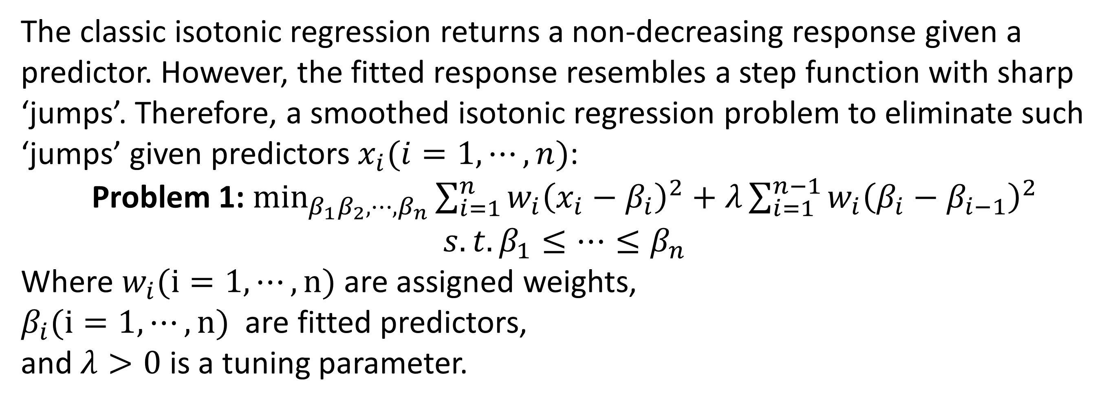
The Application of Multi-block ADMM
on Isotonic Regression Problems
Junxiang Wang and Liang Zhao
The Formulation of Multi-block ADMM
Smoothed Isotonic Regression Problem
The multi-block ADMM is the ADMM with at least three variables.
Given the following convex problem
The classic isotonic regression returns a non-decreasing response given a predictor. However, the fitted response resembles a step function with sharp ‘jumps’. Therefore, a smoothed isotonic regression problem to eliminate such ‘jumps’ given predictors $x_{i}(i=1,⋯,n)$:
Problem 1: $\min_{β_{1}β_{2},⋯,β_{n}}\sum_{i=1}^{n}{w_{i}{\left(x_{i}−β_{i}\right)}^{2}}+λ\sum_{i=1}^{n−1}{w_{i}{\left(β_{i}−β_{i−1}\right)}^{2}}$
$$s.t. β_{1}≤⋯≤β_{n}$$
Where $w_{i}(i=1,⋯,n)$ are assigned weights,
$β_{i}(i=1,⋯,n)$ are fitted predictors,
and $λ>0$ is a tuning parameter.
$$\min_{x_{1}x_{2},⋯,x_{n}}\sum_{i=1}^{n}{f_{i}(x_{i})} s.t. \sum_{i=1}^{n}{A_{i}x_{i}=0}$$
The augmented Lagrangian is formed mathematically as
$$L_{ρ}\left(x_{1},⋯, x_{n},y\right)=\sum_{i=1}^{n}{f_{i}(x_{i})}+\frac{ρ}{2}{\left\|\sum_{i=1}^{n}{A_{i}x_{i}}+\frac{y}{ρ}\right\|}_{2}^{2}$$
Where $y$is a dual variable. The multi-block ADMM works as follows:
$$x_{i}^{k+1}←argmin_{x_{i}} L_{ρ}\left(⋯,x_{i−1}^{k+1},x_{i},x_{i+1}^{k},⋯\right)\left(i=1,⋯, n\right)$$
$y^{k+1}← y^{k}+ρ\sum_{i=1}^{n}{A_{i}x_{i}^{k+1} }$
The multi-convex ADMM can realize parallel computing.
The red curve denotes
smoothed step functions.
Multi-block ADMM to Solve Problem 1
Multi-dimensional Ordering Problem
To achieve parallel computing, Problem 1 can be transformed equivalently to the following
$\min_{p,q,u}{w_{1}{\left(x_{1}−p_{1}\right)}^{2}+\sum_{i=2}^{n−1}{(\frac{w_{i}}{2}{\left(x_{i}−p_{i}\right)}^{2}+}}\frac{w_{i}}{2}{\left(x_{i}−q_{i−1}\right)}^{2})$
$$+w_{n}{\left(x_{n}−q_{n−1}\right)}^{2}+λ{\left\|u\right\|}_{2}^{2}$$
$$s.t. p−q+u=0, u≥0, p_{i+1}=q_{i}, \left(i=1,2,⋯,n−2\right)$$
where $p_{i}=β_{i}\left(i=1,⋯,n−1\right), q_{i}=β_{i+1}\left(i=1,⋯,n−1\right)$, and $p=[p_{1},⋯,p_{n−1}]$, $q=[q_{1},⋯,q_{n−1}]$. The augmented Lagrangian is
$$L_{ρ}\left(u,p,q,y_{1},y_{2}\right)=w_{1}{\left(x_{1}−p_{1}\right)}^{2}+\sum_{i=2}^{n−1}{(\frac{w_{i}}{2}{\left(x_{i}−p_{i}\right)}^{2}+}\frac{w_{i}}{2}{\left(x_{i}−q_{i−1}\right)}^{2})+w_{n}{\left(x_{n}−q_{n−1}\right)}^{2}+λ{\left\|u\right\|}_{2}^{2}+\frac{ρ}{2}{\left\|p−q+u+\frac{y_{1}}{ρ}\right\|}_{2}^{2}+\frac{ρ}{2}\sum_{i=1}^{n−2}{{\left({(p}_{i+1}−q_{i}+\frac{y_{2,i}}{ρ}\right)}^{2}}$$
Where $y_{1}=[y_{1,1},y_{1,2},⋯,y_{1,n−1}]$, $y_{2}=[y_{2,1},y_{2,2},⋯,y_{2,n−1}]$, and $ρ>0.$ The multi-block ADMM works as follows:
$$u^{k+1}←argmin_{u}L_{ρ}\left(u,p^{k},q^{k},y_{1}^{k},y_{2}^{k}\right)$$
$$p^{k+1}←argmin_{p}L_{ρ}\left(u^{k+1},p,q^{k},y_{1}^{k},y_{2}^{k}\right)$$
$$q^{k+1}←argmin_{q}L_{ρ}\left(u^{k+1},p^{k+1},q,y_{1}^{k},y_{2}^{k}\right)$$
$$y_{1}^{k+1}←y_{1}^{k}+ρ\left(p^{k+1}−q^{k+1}+u^{k+1} \right)$$
$$y_{2,i}^{k+1}←y_{2,i}^{k}+ρ\left(p_{i+1}^{k+1}−q_{i}^{k+1}\right)(i=1,⋯,n−2)$$
Multi-dimensional orders are more general in isotonic regression applications. A multi-dimensional order is defined in a $m$-dimensional space $Z_{i}=(z_{i,1},⋯,z_{i,m})$. $Z_{i}≤Z_{j}$ if and only if $z_{i,1}≤z_{j,1},⋯,z_{i,m}≤z_{j,m}$. It can be represented equivalently as Directed Acyclic Graph (DAG) $G=(V,E)$ where ${(Z}_{i},Z_{j})∈E$ if $Z_{i}≤Z_{j}$. Formally, the multi-dimensional ordering problem is formulated as follows:
Problem 2:$\min_{α_{1},α_{2},⋯,α_{n}}\sum_{i=1}^{n}{w_{i}{\left(Y_{i}−α_{i}\right)}^{2}}$
$$s.t. α_{i}≤α_{j} iff Z_{i}≤Z_{j}\left(1≤i,j≤n\right).$$
Where $w_{i}>0\left(i=1,⋯,n\right)$ are assigned weights, $Y_{i}\left(i=1,⋯,n\right)$ are predictors, and $α_{i}(i=1,⋯,n)$ are fitted predictors.
There may be no orders
between two predictors in the multi-dimensional order problem, like E and H in the figure.
Multi-block ADMM to Solve Problem 2
Experiments Results
To achieve parallel computing, Problem 2 can be transformed equivalently to the following
$\min_{g,h}{W^{T}\frac{\left(Y−g\right)⊙\left(Y−g\right)}{2}+W^{T}\frac{\left(Y−h\right)⊙\left(Y−h\right)}{2}}$
$$s.t. E_{1}g−E_{2}h+v=0, v≥0, g=h$$
where$W=(w_{1},⋯,w_{n}),Y=(Y_{1},⋯,Y_{n})$, and $⊙$ is a Hadamard product. $E_{1}∈R^{\left|E\right|×n}$ and $E_{2}∈R^{\left|E\right|×n}$ are edge representation of the edge set $E$: the $k$-th edge $\left(i,j\right)∈E$ means that $E_{1,k,i}=$1 and $E_{1,k,j}=$1 while $E_{1,p,i}=0\left(1≤p≤n,p≠i\right)$ and $E_{1,q,j}=0(1≤q≤n,q≠j)$. The augmented Lagrangian is
$$L_{ρ}\left(v,g,h,y_{1},y_{2}\right)=W^{T}\frac{\left(Y−g\right)⊙\left(Y−g\right)}{2}+W^{T}\frac{\left(Y−h\right)⊙\left(Y−h\right)}{2}+\frac{ρ}{2}{\left\|E_{1}g−E_{2}h+v+\frac{y_{1}}{ρ}\right\|}_{2}^{2}+\frac{ρ}{2}{\left\|g−h+\frac{y_{2}}{ρ}\right\|}_{2}^{2}$$
where $ρ>0.$ The multi-block ADMM works as follows:
$$v^{k+1}←argmin_{u}L_{ρ}\left(v,g^{k},h^{k},y_{1}^{k},y_{2}^{k}\right)$$
$$g^{k+1}←argmin_{p}L_{ρ}\left(v^{k+1},g,h^{k},y_{1}^{k},y_{2}^{k}\right)$$
$$h^{k+1}←argmin_{q}L_{ρ}\left(v^{k+1},g^{k+1},h,y_{1}^{k},y_{2}^{k}\right)$$
$$y_{1}^{k+1}←y_{1}^{k}+ρ\left(E_{1} g^{k+1}−E_{2} h^{k+1}+v^{k+1}\right)$$
$$y_{2}^{k+1}←y_{2}^{k}+ρ\left(g^{k+1}−h^{k+1}\right)$$
Our code is available at
https://github.com/xianggebenben/Junxiang_Wang/blob/master/supplementary_material/OPT%202019/code.rar
The multi-block ADMM converges in Figure 1(a)(b)(c), but diverges in Figure 1(d).
Figure 1(a). $ρ=0.1$ on the smoothed isotonic regression problem.
Figure 1(b). $ρ=10$ on the smoothed isotonic regression problem.
Figure 1(c). $ρ=0.1$ on the on the multi-dimensional ordering problem.
Figure 1(d). $ρ=10$ on the on the multi-dimensional ordering problem.
The multi-block ADMM demonstrates excellent scalability.
Figure 2(a).Scalability on the smoothed isotonic regression problem
Figure 2(b).Scalability on the
multi-dimensional ordering problem

