Slide 1

CEO Incentives and Acquisitions: Evidence from the Pay Ratio Disclosure Mandate*
Xianghan Cao & Benedict Schmitt
A Writing Critique of
2025 Working Paper by Sudipto Dasgupta, Tao Shu & Yuxuan Zhu
*Presented at several venues, including SFS Cavalcade Asia-Pacific 2025

Slide 2
The Paper in a Nutshell
Xianghan Cao & Benedict Schmitt
Setting: 2017 SEC mandate forcing firms to disclose CEO-to-median-worker pay ratio
Question: Did the mandate change CEO pay sensitivity, and thus CEO behavior (M&A)?
Identification: DiD — high vs. low pay-ratio firms, before vs. after 2018
Finding 1: High-ratio firms cut pay-size and upside pay-performance sensitivity
Finding 2: These firms do fewer but better large Acquisitions, and more but worse small Acquisitions

Slide 3
The Title
Xianghan Cao & Benedict Schmitt
What’s working:
“Topic:Setting” format, is established and professional
“Evidence from…” format, signals an exogenous shock and credible identification
What’s not working:
Punchline, Title neither has thesis nor tension
But: Paper has two linked findings, hard to compress into one line
Precision, “CEO Incentives” is too generic and might trigger wrong expectations
Notes:
“CEO Incentives and Acquisitions: Evidence from the Pay Ratio Disclosure Mandate”
CEO Incentives and Acquisitions could fit at least 10 other papers as well – way too generic
Titles are also expectation management. Given only the title, the paper could easily be about other incentives than pay (e.g. in the Coles/Daniel/Naveen Delta/Vega-Tradition but it is actually in the Jensen/Murphy flow-pay tradition).

Slide 4
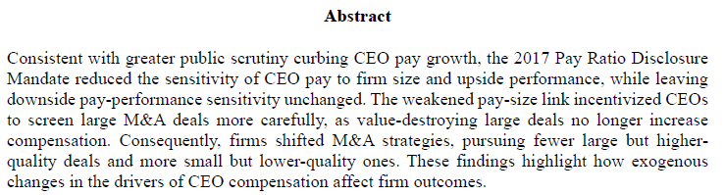
The Abstract
Xianghan Cao & Benedict Schmitt
What’s working:
Results-only, direct opening is catchy
One-sentence spelled out mechanism (S2), cause → behavior → reason
Symmetric contrast (S3), makes the four statements easy memorable
What’s not working:
Hedging opener (S1), makes the paper look boring
Overloading (S1), makes it impossible to remember all claims
Notes:
++:
Results-only or results-first style makes the implicit assumption that the audience has already knowledge about managerial incentives and M&As -> leaving unnecessary text out makes the abstract more catchy
"The weakened pay-size link incentivized CEOs to screen large M&A deals more carefully, as value-destroying large deals no longer increase compensation.“ Compresses the causal framework / the main story into one sentence.
"Consequently, firms shifted M&A strategies, pursuing fewer large but higher-quality deals and more small but lower-quality ones.“ They put 4 statements into one sentence and make it memorable by using a symmetric contrast.
--:
The “consistent with…” opening reads like a hedge to overclaiming the papers results. This makes the results look less important and is a boring start.
"Consistent with greater public scrutiny curbing CEO pay growth, the 2017 Pay Ratio Disclosure Mandate reduced the sensitivity of CEO pay to firm size and upside performance, while leaving downside pay-performance sensitivity unchanged.“ The first sentence contains more than 1/3 of the words of the whole abstract and several different claims. The sentence is too long and complicated to remember the whole content.

Slide 5
The Abstract
Xianghan Cao & Benedict Schmitt
What’s working:
Results-only, direct opening is catchy
One-sentence spelled out mechanism (S2), cause → behavior → reason
Symmetric contrast (S3), makes the four statements easy memorable
What’s not working:
Hedging opener (S1), makes the paper look boring
Overloading (S1), makes it impossible to remember all claims
Notes:
++:
Results-only or results-first style makes the implicit assumption that the audience has already knowledge about managerial incentives and M&As -> leaving unnecessary text out makes the abstract more catchy
"The weakened pay-size link incentivized CEOs to screen large M&A deals more carefully, as value-destroying large deals no longer increase compensation.“ Compresses the causal framework / the main story into one sentence.
"Consequently, firms shifted M&A strategies, pursuing fewer large but higher-quality deals and more small but lower-quality ones.“ They put 4 statements into one sentence and make it memorable by using a symmetric contrast.
--:
The “consistent with…” opening reads like a hedge to overclaiming the papers results. This makes the results look less important and is a boring start.
"Consistent with greater public scrutiny curbing CEO pay growth, the 2017 Pay Ratio Disclosure Mandate reduced the sensitivity of CEO pay to firm size and upside performance, while leaving downside pay-performance sensitivity unchanged.“ The first sentence contains more than 1/3 of the words of the whole abstract and several different claims. The sentence is too long and complicated to remember the whole content.

Slide 6
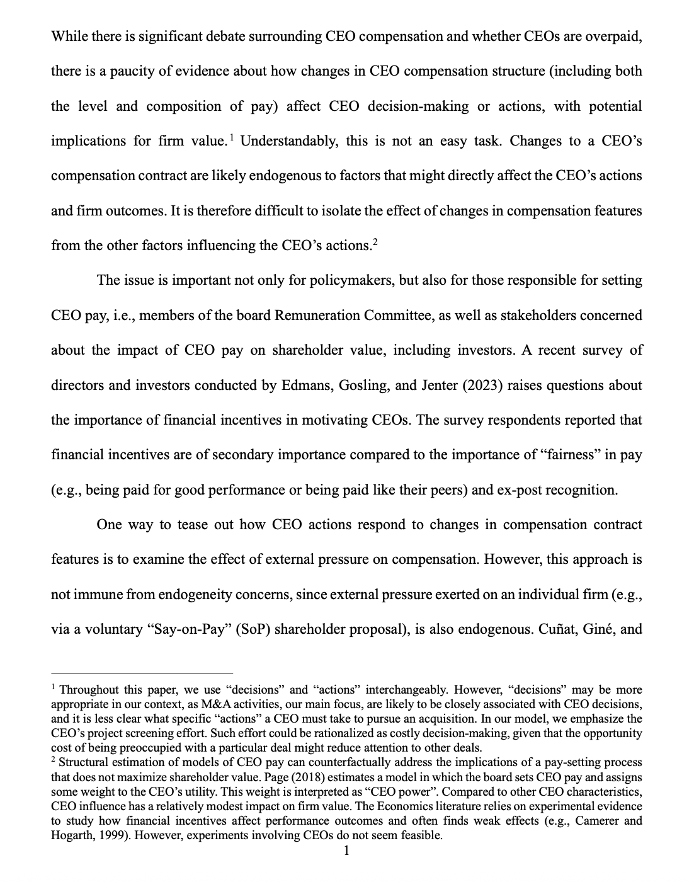
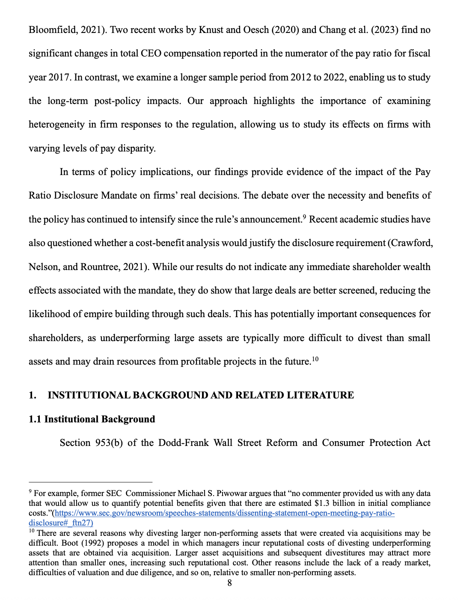
An Unnamed Intro
Xianghan Cao & Benedict Schmitt
What’s not working:
Page 1-7: Not heading, unnamed， text, actually is an introduction
Page 8: first heading, "1. Institutional Background And Related Literature"
1.1 Institutional Background
1.2 Related Literature
Notes:
Now let me show you something strange about the structure of this paper.
Please look at the slide. The paper has seven pages of text before the first heading. Seven pages with no name, no section number, no sub-titles. The reader opens the paper and reads seven pages without any map.
Then on page 8, the first heading finally appears. It says "1. Institutional Background and Related Literature". With two sub-sections: 1.1 and 1.2.
So here is the question: what were those first seven pages? They are the introduction. But the author never calls it that. Section 1 is not the introduction. Section 1 is the background. The introduction is the unnamed seven pages before Section 1.
This is a writing problem. Section heading is the simplest tool a writer has. It tells the reader where they are. This paper gives no heading for its most important seven pages.

Slide 7
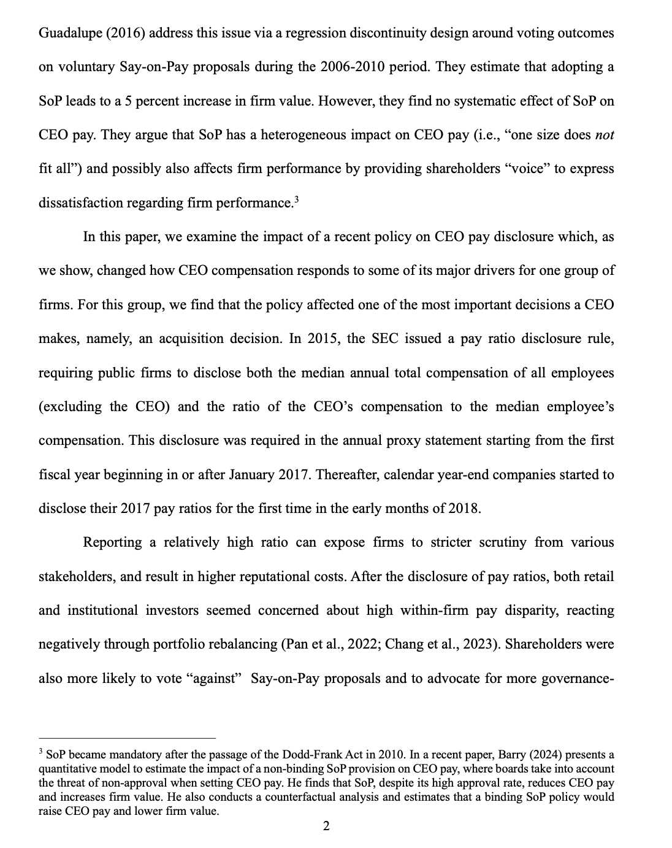
The Introduction
Xianghan Cao & Benedict Schmitt
P1
What’s not working:
P1: Detour, endogeneity issue
P2: Detour, Edmans-Gosling-Jenter Suvey
P3: Detour, Say-on-Pay
P4: Hit the topic, “In this paper, we examine...”
P4
P2
P3
Notes:
Now let me show you the first four paragraphs of this introduction.
Please look at the slide. P1 is a detour. P2 is a detour. P3 is a detour. P4 finally hits the topic.
Let me walk you through.
P1 opens with "While there is significant debate surrounding CEO compensation..." The author talks about a general debate, then says evidence is missing, then mentions the endogeneity problem. This is a detour. The reader does not need to know about endogeneity in the first paragraph. The reader needs to know what the paper does.
P2 is another detour. The author goes to a survey by Edmans, Gosling, and Jenter. The survey says financial incentives are less important than fairness. But wait — if financial incentives are less important, why is this paper studying financial incentives? The author never answers this question. The detour just sits there.
P3 is a third detour. The author goes to Say-on-Pay and a paper by Cuñat, Giné, and Guadalupe. SoP is a different policy, not the policy this paper studies. Why is this here? The reader does not know.
Finally, in P4, the author writes: "In this paper, we examine..." This is the punchline. This is what the reader has been waiting for. But the reader had to walk through three detours to get here.
Three detours before the topic. Three pages before the reader knows what the paper does. That is a writing problem.
A good introduction tells the reader the topic in P1, not P4. Detours can come later, as part of the literature review. Putting them upfront makes the reader lost and impatient.

Slide 8
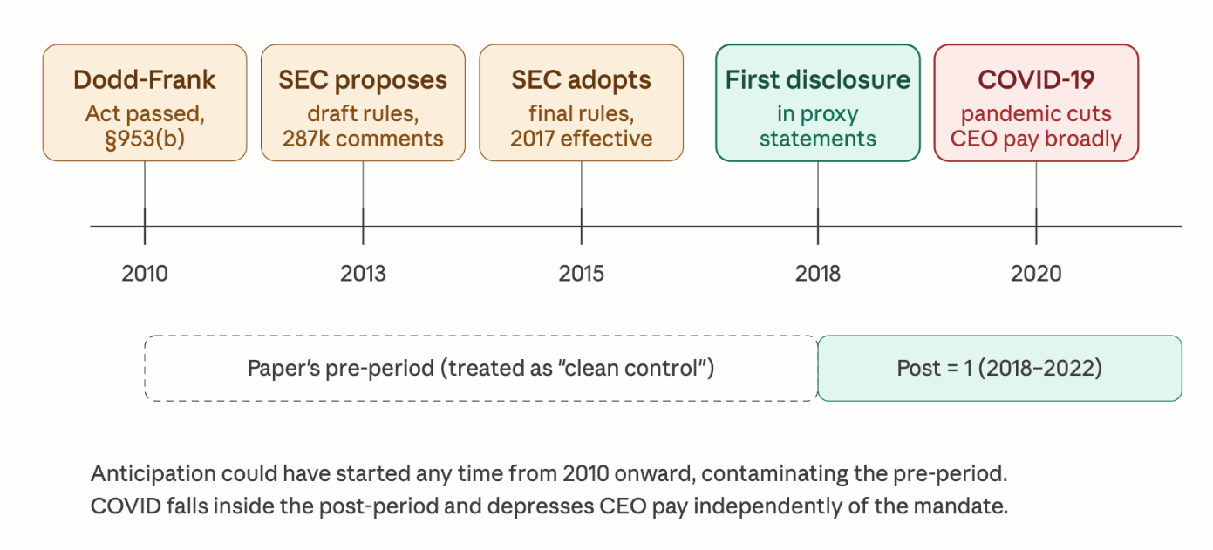
Timeline as writing problem
Xianghan Cao & Benedict Schmitt
Preperiod:
2010: Dodd-Frank
2013: SEC proposes
2015: SEC adopts
2017: Rule effects
2018: 1st Disclosure
Post-period:
2020: COVID-19
2022: ESG
Figure 1: Timeline of Pay Ratio Disclosure Mandate
Major 'landmines’:
Anticipation & COVID-19 Effect
Notes:
"Now, I would like to talk about the background of this policy. Before we analyze the writing, we must understand the timeline, which is actually full of potential problems.
Please look at this figure. It shows several key events from 2010 to 2020.
In 2010, the U.S. Congress passed the Dodd-Frank Act, and Section 953(b) required companies to show the pay ratio between the CEO and workers.
However, the SEC was very slow. It took five years to adopt the final rules in 2015, and they only became effective in 2017.
The first disclosure happened in 2018. This is why the authors chose 2018 as the start of their 'Post-period'.
However, there are two major 'landmines' here:
Anticipation Effect: There was a 7-year gap between the law passing and it becoming effective. This means companies had plenty of time to change their CEO pay before 2017. Therefore, the 'Pre-period' might not be a 'clean control' group.
COVID-19: The pandemic started in 2020 and it significantly reduced CEO pay across all industries. This event covers 60% of the authors' post-period. Surprisingly, the paper only mentions this in a small footnote on page 3 and does not discuss its impact in detail.
This suggests that the authors might be ignoring external factors that could change their results."

Slide 9
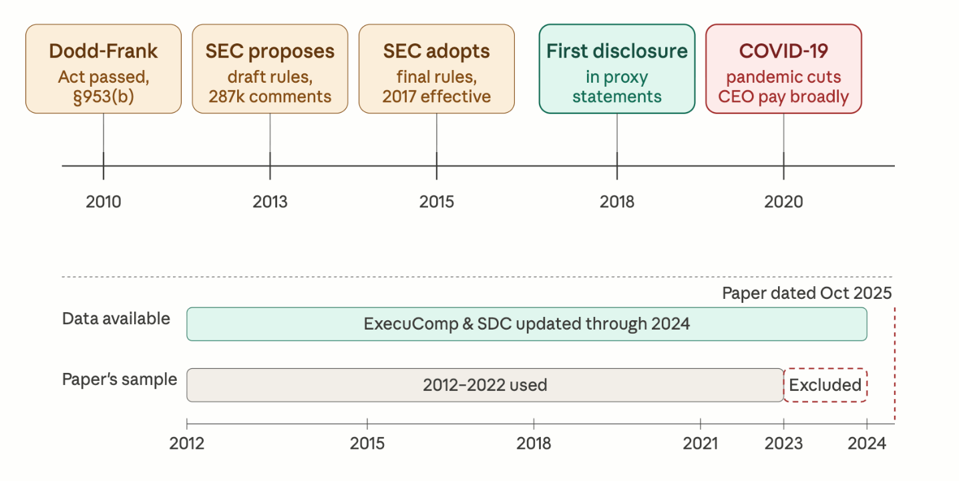
Silence on 2023-2024
Xianghan Cao & Benedict Schmitt
Data Sample:
2012-2022
ExecuComp, SDC
As a reader:
Why is this a writing problem?
Why did they stop at 2022?
Did the results from the later years not support their story?
Figure 2: Timeline of Pay Ratio Disclosure Mandate and Paper’s sample selection
Notes:
"Next, let’s look at the data section.
Please look at the bottom part of this figure. It compares the data available in the market with the data used in this paper.
The green bar shows that the main databases, ExecuComp and SDC, are updated until 2024.
But look at the grey bar. The authors only used a sample from 2012 to 2022.
This means there is a two-year gap (2023 and 2024) that is completely missing from the study.
Why is this a writing problem? The paper is dated October 2025. This means when the authors were finishing the paper, the data for 2023 and 2024 was already available.
As a reader, I have to ask:
Why did they stop at 2022?
Did the results from the later years not support their story?
The authors did not provide any explanation for this choice in the text. In good academic writing, you should address the reader's concerns. By remaining silent, the authors leave a gap in their logic and make the reader doubt the reliability of their findings."

