Slide 1
A Writing Critique of “CEO Incentives and Acquisitions: Dasgupta, Shu & Zhu (2025)”
Schmitt, Benedict Rainer (University of Göttingen)
Cao, Xianghan (University of Oulu)

Slide 2
The Paper in 30 Seconds
Setting: 2017 SEC mandate forcing firms to disclose CEO-to-median-worker pay ratio
Question: Did the mandate change CEO pay structure, and did that change CEO behavior?
Identification: DiD — high vs. low pay-ratio firms, before vs. after 2018
Finding 1: High-ratio firms cut pay-size and upside pay-performance sensitivity
Finding 2: Those firms then did fewer-but-better large M&A deals, and more-but-worse small ones

Slide 3
Title
What’s working
What’s not working
“Topic:Setting” format, is established and professional
“Evidence from…” format, signals an exogenous shock and credible identification
Punchline, Title neither has thesis nor tension
But: Paper has two linked findings, hard to compress into one line
Precision, “CEO Incentives” is too generic and might trigger wrong expectations
Notes:
“CEO Incentives and Acquisitions: Evidence from the Pay Ratio Disclosure Mandate”
CEO Incentives and Acquisitions could fit at least 10 other papers as well – way too generic
Titles are also expectation management. Given only the title, the paper could easily be about other incentives than pay (e.g. in the Coles/Daniel/Naveen Delta/Vega-Tradition but it is actually in the Jensen/Murphy flow-pay tradition).

Slide 4
Abstract
What’s working
What’s not working
Results-only, direct opening is catchy
One-sentence spelled out mechanism (S2), cause → behaviour → reason
Symmetric contrast (S3), makes the four statements easy memorable
Hedging opener (S1), makes the paper look boring
Overloading (S1), makes it impossible to remember all claims
Notes:
Results-only or results-first style makes the implicit assumption that the audience has already knowledge about managerial incentives and M&As -> leaving unnecessary text out makes the abstract more catchy
"The weakened pay-size link incentivized CEOs to screen large M&A deals more carefully, as value-destroying large deals no longer increase compensation.“ Compresses the causal framework of one major into one sentence in plain English.
"Consequently, firms shifted M&A strategies, pursuing fewer large but higher-quality deals and more small but lower-quality ones.“ They put 4 statements into one sentence and make it memorable by using a symmetric contrast.
The “consistent with…” opening reads like a hedge to overclaiming the papers results. This makes the results look less important and is a boring start.
"Consistent with greater public scrutiny curbing CEO pay growth, the 2017 Pay Ratio Disclosure Mandate reduced the sensitivity of CEO pay to firm size and upside performance, while leaving downside pay-performance sensitivity unchanged.“ The first sentence contains more than 1/3 of the words of the whole abstract and several different claims. The sentence is too long and complicated to remember the whole content.

Slide 5
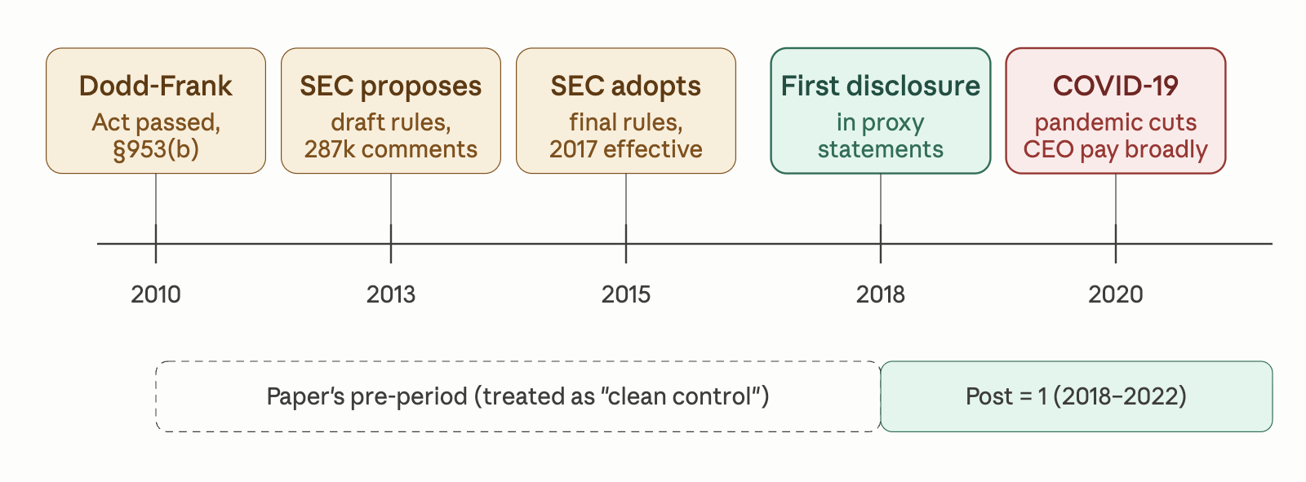
Background
Preperiod:
2010: Dodd-Frank
2013: SEC proposes
2015: SEC adopts
2017: Rule effects
2018: 1st Disclosure
Post-period:
2020: COVID-19
2022: ESG
Major 'landmines’:
Anticipation Effect
COVID-19
Figure 1. Timeline of Pay Ratio Disclosure Mandate.
Generated by Claude (Anthropic)
Notes:
论文只花了1页快速陈述了这个时间线，但是往往时间线里埋了很多地雷，当作者拿着手稿去宣讲或者投稿时，同行就会触碰和讨论这条时间线上的地雷，然后有些就会爆炸💥
7 年的实施延迟意味着 anticipation effect 不可忽视
作者的 Post = 2018 是一个人为选择，不是唯一合理的定义
Pre-period 可能已经被"早期治疗"污染
整个post-period(2018-2022) 60%时间都是COVID时期，文章只在第3页的脚注中陈述了，完全没有详细讨论对本文的影响
同时，ESG的兴起，是否同时影响了本文的因变量，作者也没有讨论

Slide 6
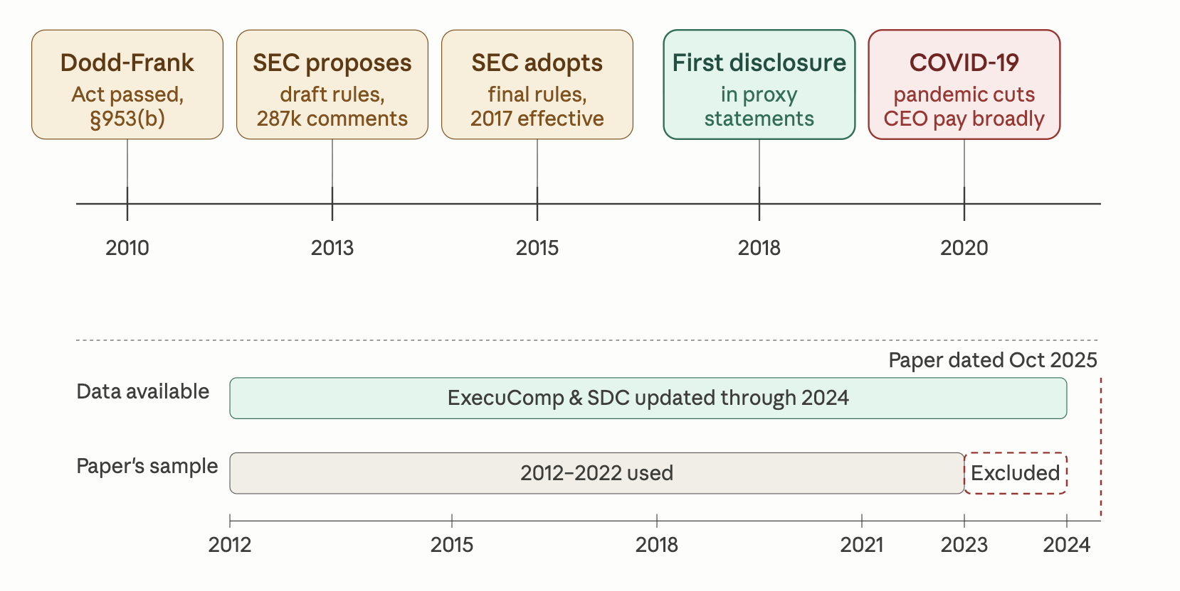
Data
Data Sample
Data Length: 2012-2022
Databases: ExecuComp, SDC
As a reader:
Why did they stop at 2022?
Did the results from the later years not support their story?
Figure 2. Timeline of Pay Ratio Disclosure Mandate and Paper’s sample selection.
Generated by Claude (Anthropic)

Slide 7
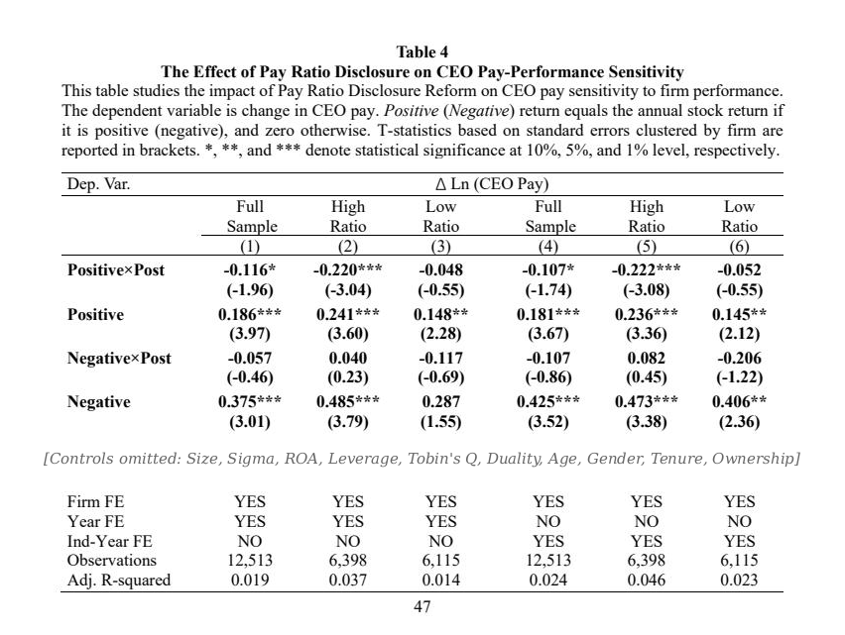
What the paper does well
The paper is well-referenced
Figures and tables that follow academic standards
The explanation of data sources is very thorough

Slide 8
On AI use
We used Claude (Anthropic) to generate the timeline figures (slides 5 and 6)
We asked Gemini (Google) whether the absence of a Discussion section is unusual in empirical finance — Gemini said no. We are unsure whether to trust this, and welcome the class's view.
All judgments and writing choices on these slides are our own

Slide 9
Thank you!

