Slide 1
what is the significance of Presentation 2014J in Module BBB
Xiang Li
Data Analyst
Open University
13/12/2023
Kuzilek J., Hlosta M., Zdrahal Z. Open University Learning Analytics dataset Sci. Data 4:170171 doi: 10.1038/sdata.2017.171 (2017).

Slide 2

TABLE OF Contents
01. Overview in Module BBB
02. Student Persona
03. Overview of Final Results
04. Relationship
05. Wrap-up
06. Future Work
07. Q&A

Slide 3
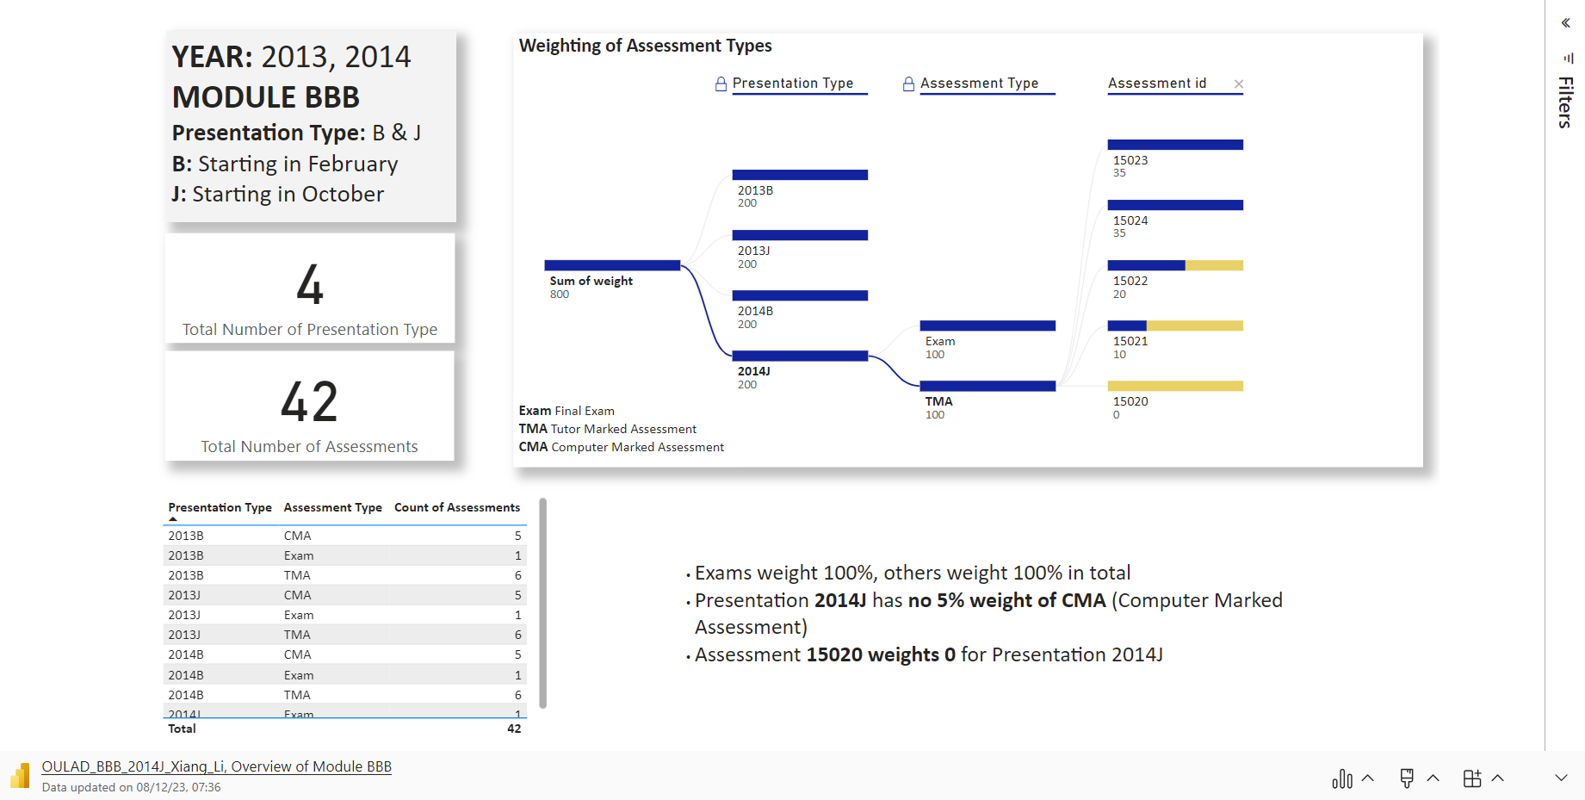

Slide 4
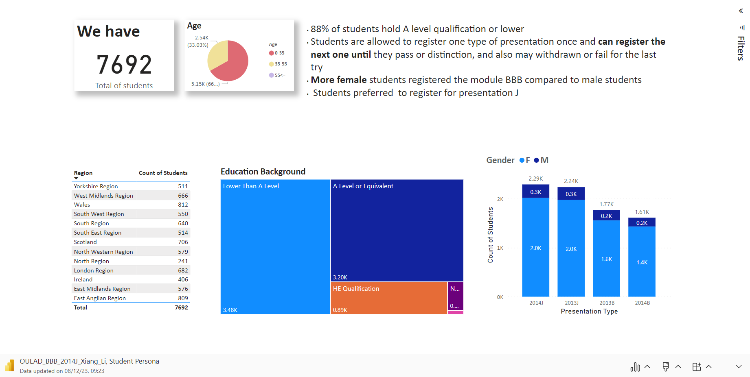

Slide 5
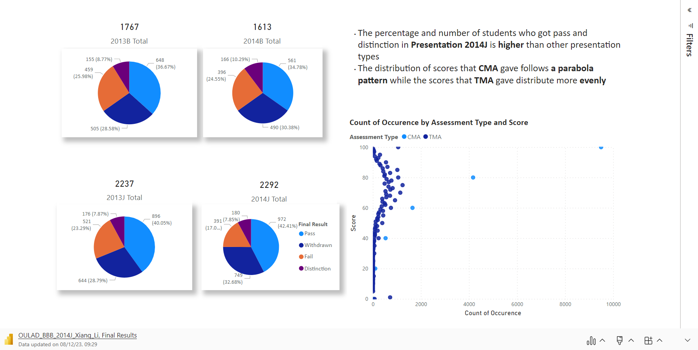

Slide 6
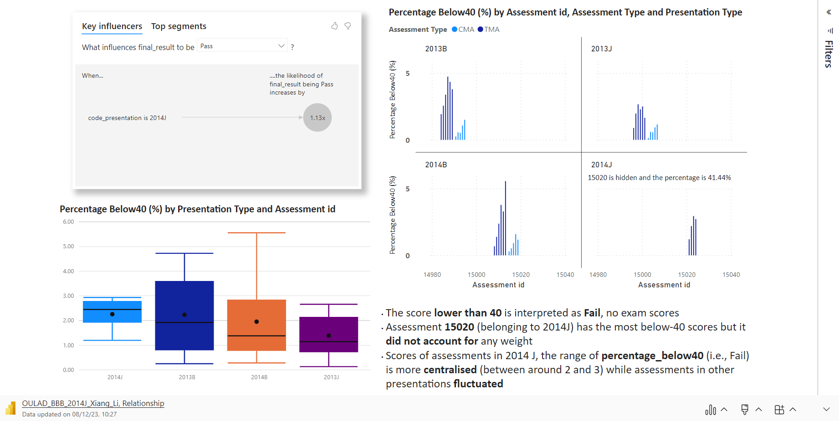

Slide 7
Wrap UP
Presentation 2014J has no CMA while others hold 5% CMA assessments
Students registered J more than B (2292+2237 vs. 1767+1613)
Female students more like module BBB ( 6797 vs. 895)
Presentation 2014J has a higher pass/distinction rate (50.26% vs. 45.44%, 45.07%, 47.92%)
Assessments in 2014 J, the range of percentage below40 (i.e., Fail) is more focused (between around 2 and 3) while assessments in other presentations fluctuated

Slide 8
Future work
The interactions with material in VLE (Virtual Learning Environment)
Presentation 2013B has no VLE
sum_click matters?
Date
Final submission date (the length of the assessment)
Registration Date
Date of interactions with material in VLE
Student Persona
…

Slide 9
Q&A

