Slide 1
Scanner sop
Producer ：bojay software team
Bojay Electronics Co., Ltd.
www.zhbojay.com

Slide 2
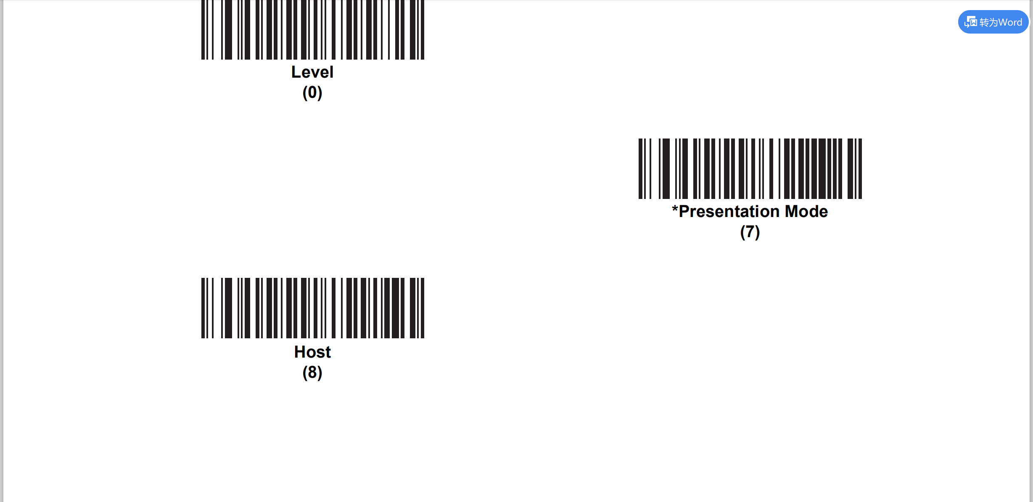
As first time,maybe you should scan “Host” code(I tried it is ok!)

Slide 3
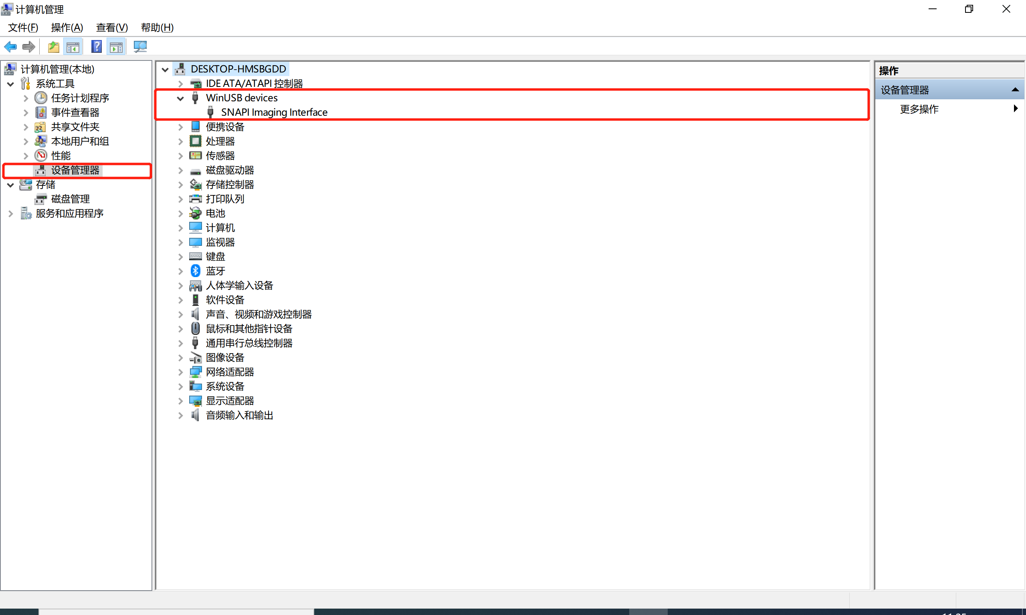
Install environments
(1)configure environments.
1.install python package pythonnet
2.install Zebra_123Scan_(64bit)_v5.01.0004.exe
(2)run the 123Scan application,then we can find below windows usb devices.

Slide 4
Scanner API usage
please refer the attach ScannerAPI.pdf

Slide 5

End
Thank you

