Slide 1
Linear Regression
Xiangli Chen

Slide 2
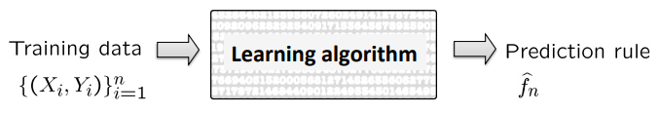
Regression algorithm
Linear regression
Regularized linear regression – ridge, lasso regression
Polynomial regression
Kernel regression
Regression trees, splines, wavelet estimators, …

Slide 3
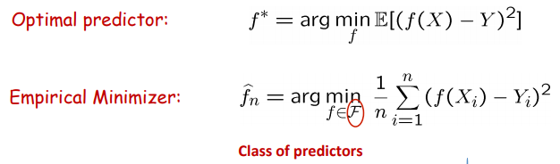
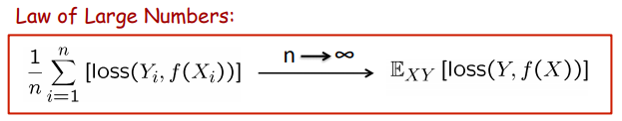
Restrict class of predictors
Restrict class to avoid overfitting
Class of linear functions
Class of polynomial functions
Class of nonlinear functions

Slide 4
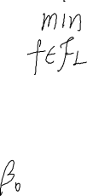
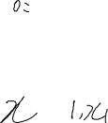



Linear regression

Slide 5
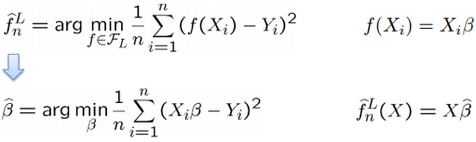

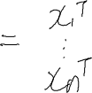
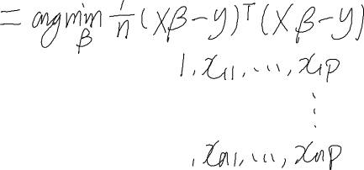
Least squares estimator

Slide 6
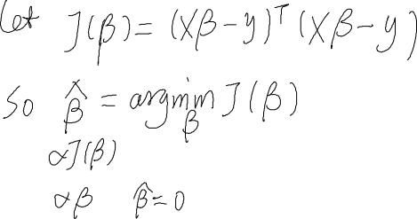
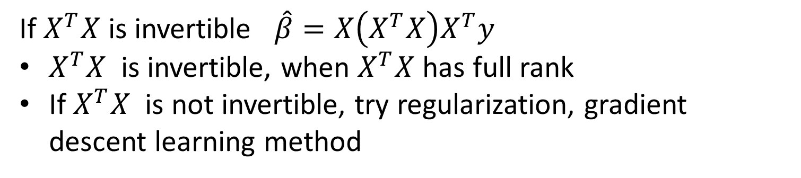


Least Square Estimator
If $X^{T}X$ is invertible $\hat{β}=X\left(X^{T}X\right)X^{T}y$
$X^{T}X$ is invertible, when $X^{T}X$ has full rank
If $X^{T}X$ is not invertible, try regularization, gradient descent learning method

Slide 7
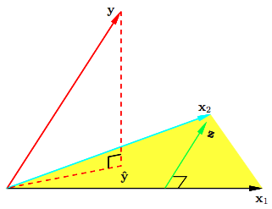
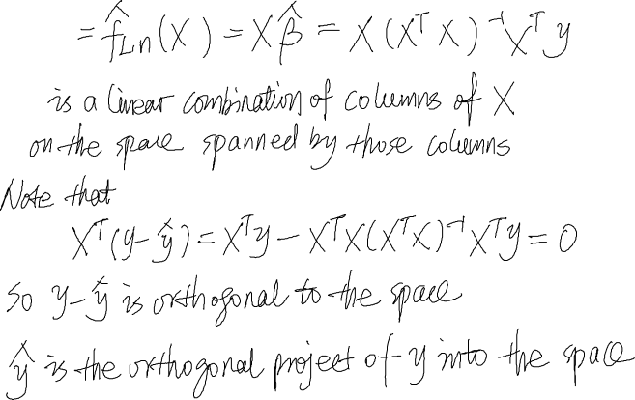

Geometric Interpretation of LS

Slide 8
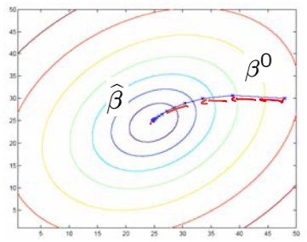

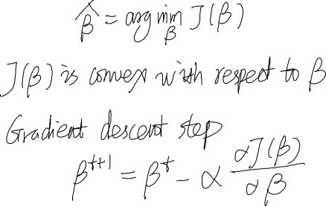
Gradient Descent
When $X^{T}X$is invertible or computationally expensive if $X$ is huge

Slide 9






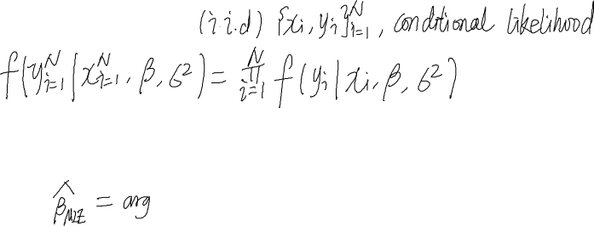
Gaussian Assumption and Likelihood
Maximize conditional log likelihood (minimize empirical conditional log loss)
Least square estimation is same as maximize conditional log likelihood estimate under a Gaussian model

Slide 10


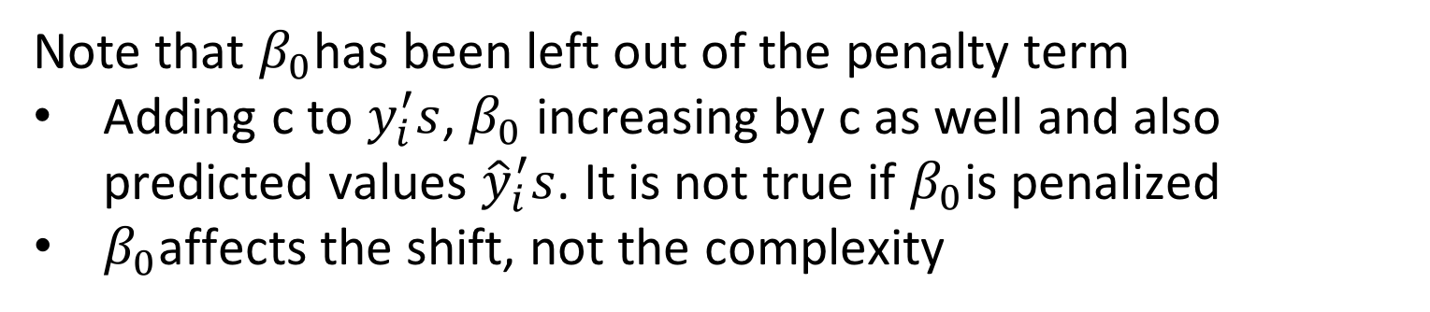
Shrinkage Methods
Ridge regression – regularized by $L_{2}$penalty
Note that $β_{0}$has been left out of the penalty term
Adding c to $y_{i}^{′}s$, $β_{0}$ increasing by c as well and also predicted values ${\hat{y}}_{i}^{′}s$. It is not true if $β_{0}$is penalized
$β_{0}$affects the shift, not the complexity

Slide 11






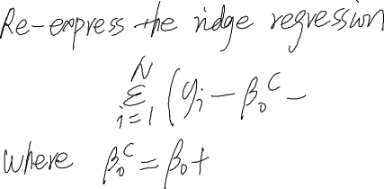



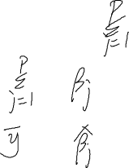
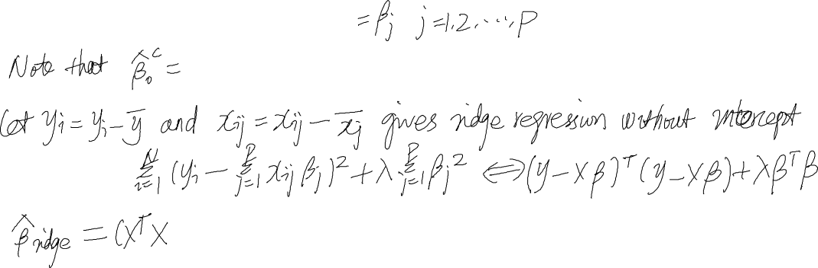
Same Problem

Slide 12
SVD Decomposition

Slide 13
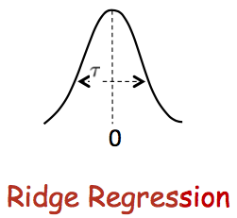



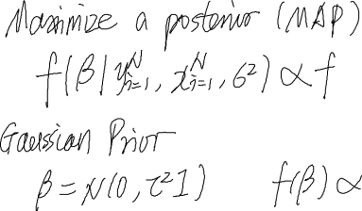
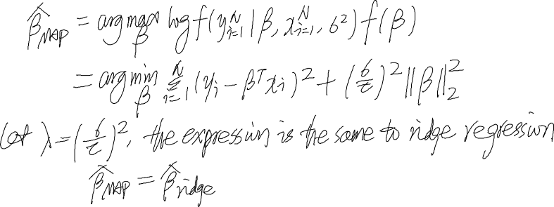
MAP Interpretation

Slide 14
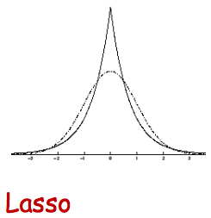

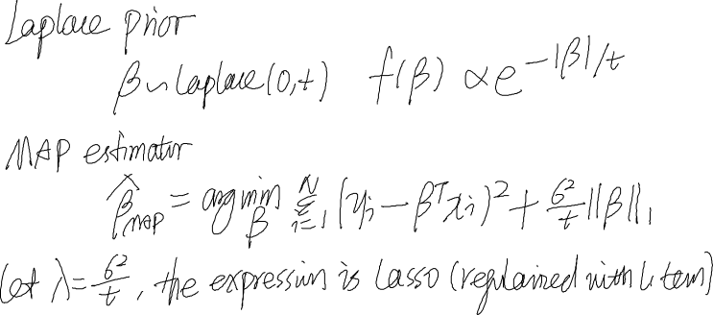
Lasso

Slide 15
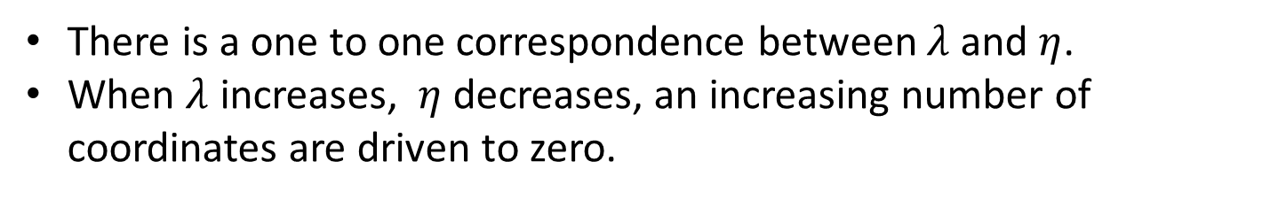
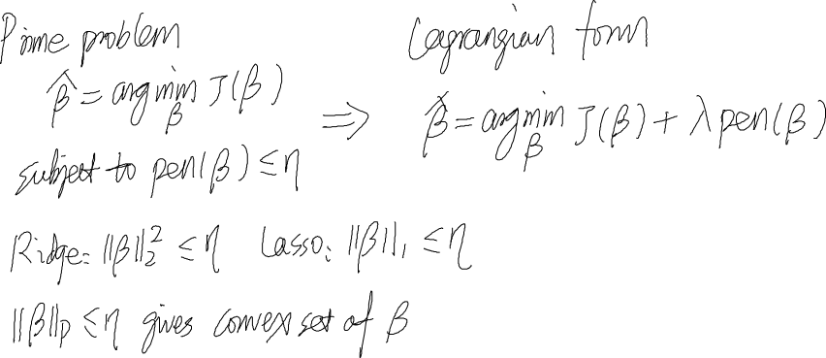
Prime Problem
There is a one to one correspondence between $λ$and $η$.
When $λ$ increases, $η$ decreases, an increasing number of coordinates are driven to zero.

Slide 16
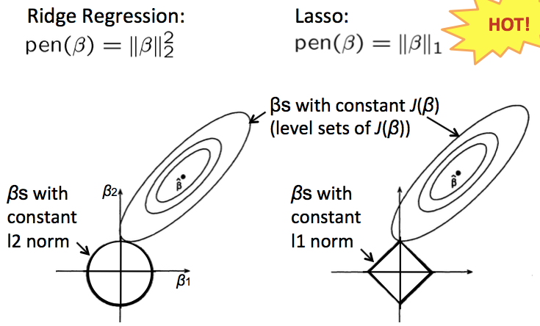




Ridge regression vs lasso
Lasso results in sparse solution – more zero coordinates, good for high dimension

Slide 17
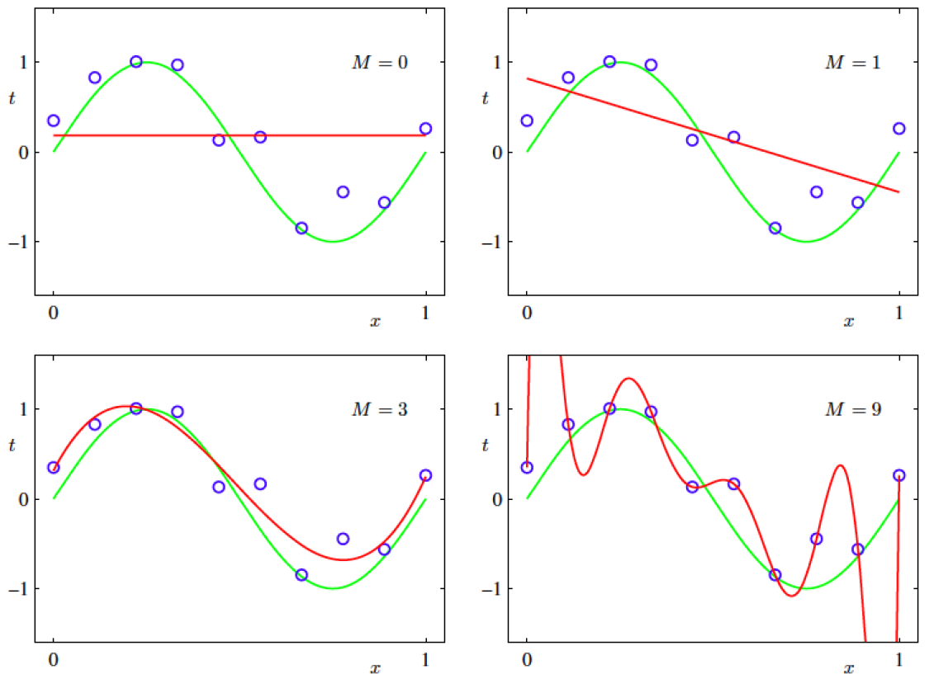





Polynomial Regression

