Slide 1
Support vector machine
Xiangli Chen

Slide 2
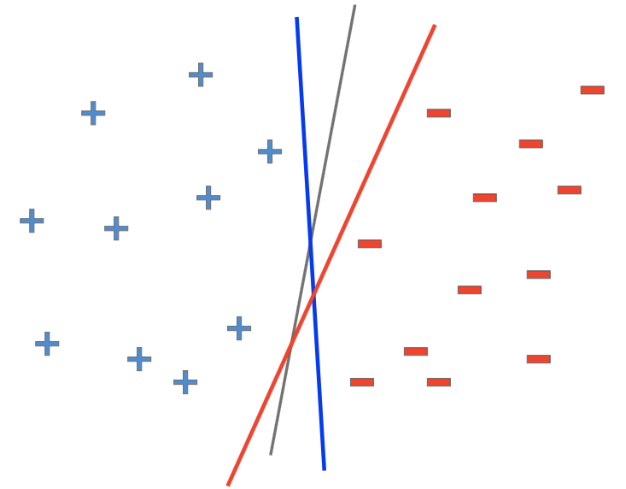
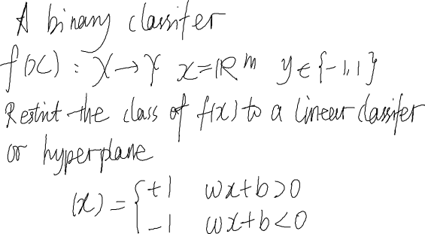
A Binary Linear Classifier

Slide 3
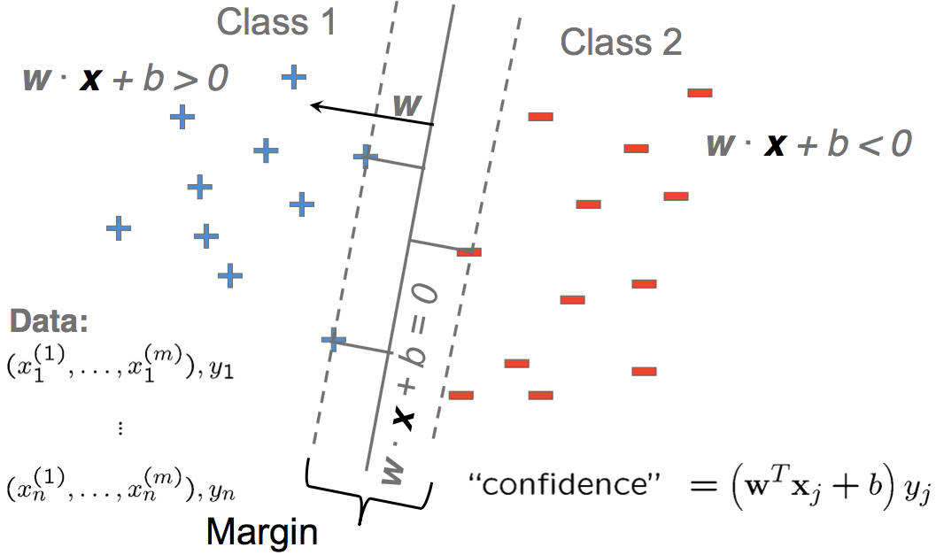
Largest Margin

Slide 4
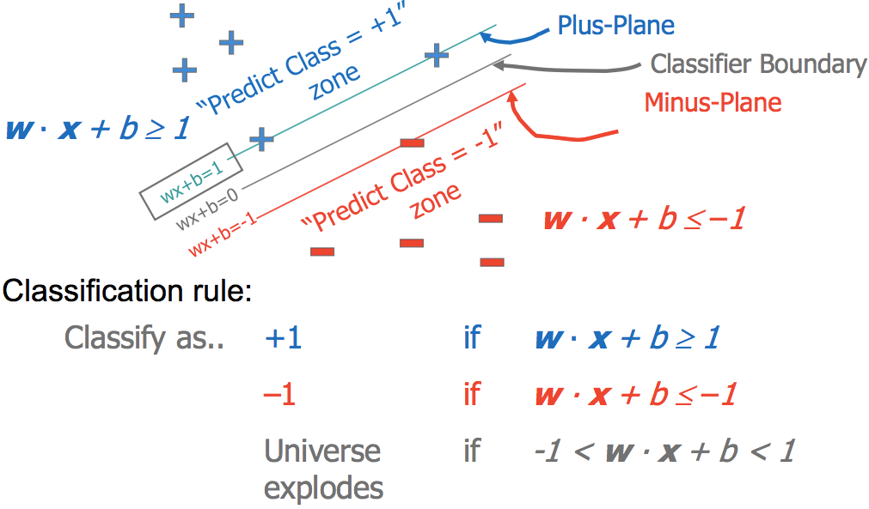
Scaling
Scaling $(w,b)$, the hyperplane maximizing the margin still exists

Slide 5
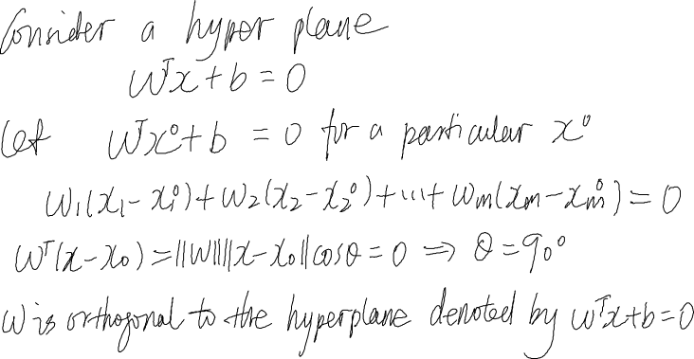


Hyper Plane and its Normal

Slide 6
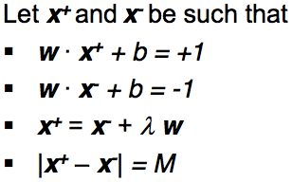
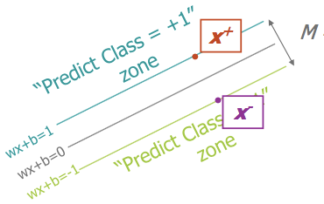


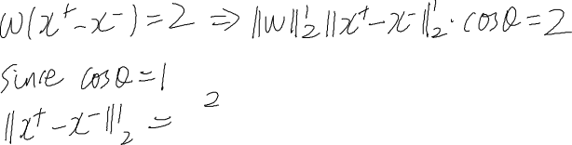
Computing the Margin

Slide 7
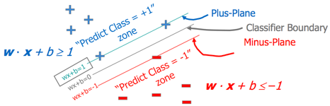

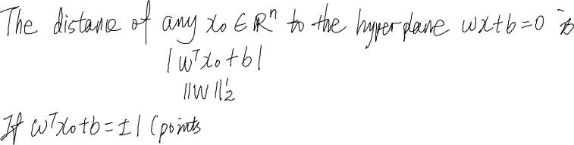

Maximize Margin

Slide 8
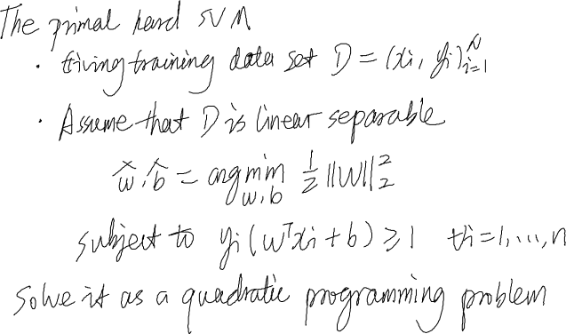
The Primal Hard SVM

Slide 9
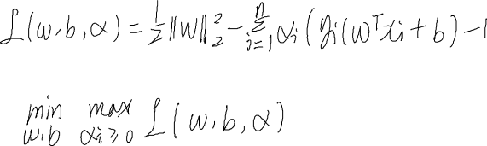


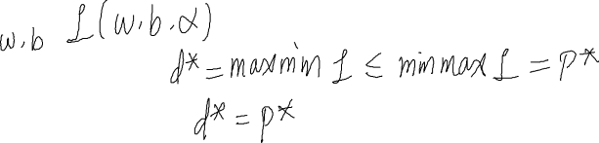
Lagrange Duality
The Lagrange form
The primal problem given by Lagrange form
The dual form
Theorem (weak duality)
Theorem (string duality)
For convex optimization problem, such as SVM (if a saddle point exits), strong duality usually exists

Slide 10
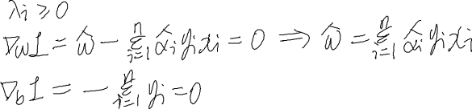
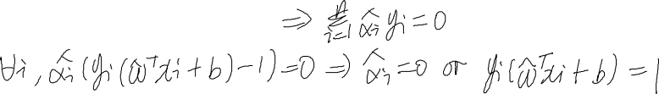
KKT Optimality Conditions
For any optimization problem
Differentiable objective and constraint functions
Strong duality obtains
Any pair of primal and dual optimal points must satisfy KKT condition
KKT condition of SVM

Slide 11

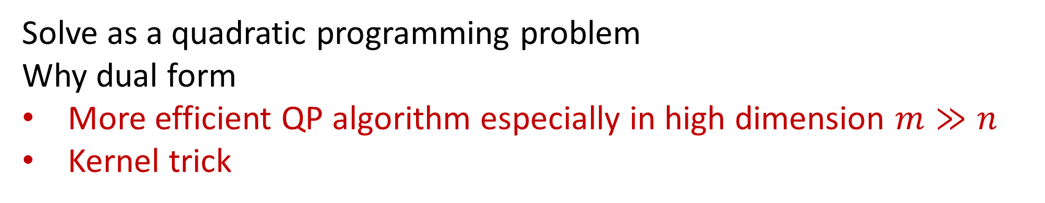
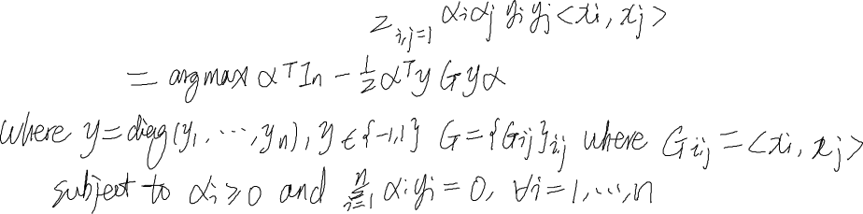

The Dual Hard SVM
The dual problem
Solve as a quadratic programming problem
Why dual form
More efficient QP algorithm especially in high dimension $m≫n$
Kernel trick

Slide 12
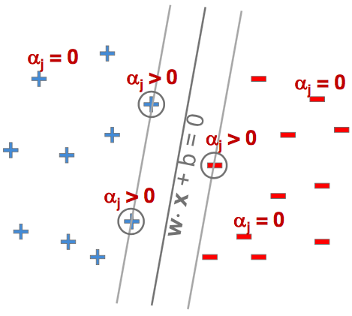


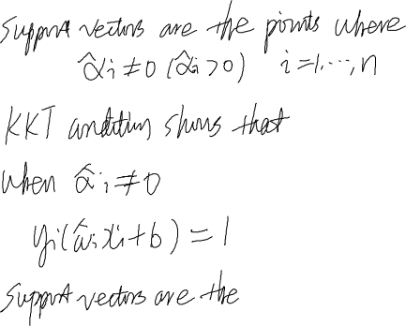


Support Vector

Slide 13
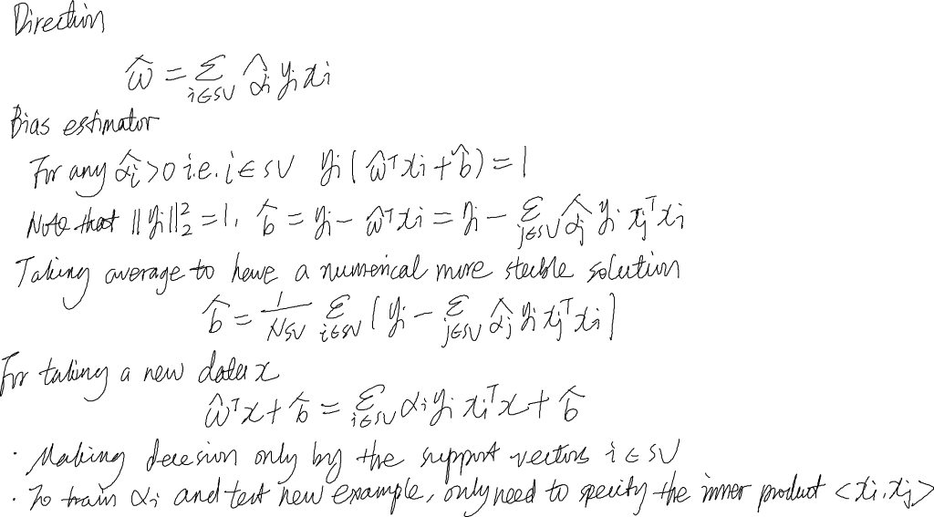


SVM Predictor

Slide 14



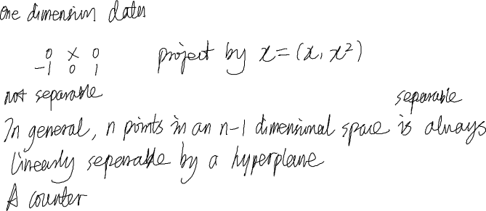
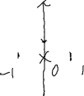


Non-linearly Separable
Feature Projection
Feature projection will result in overfitting

Slide 15
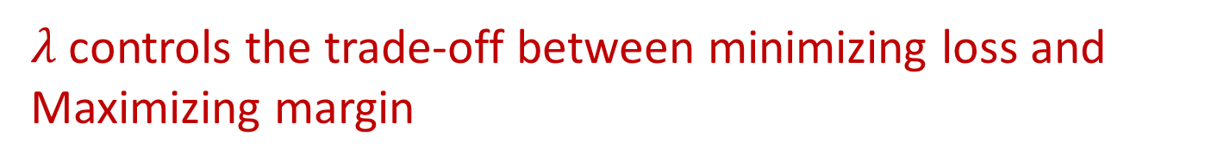

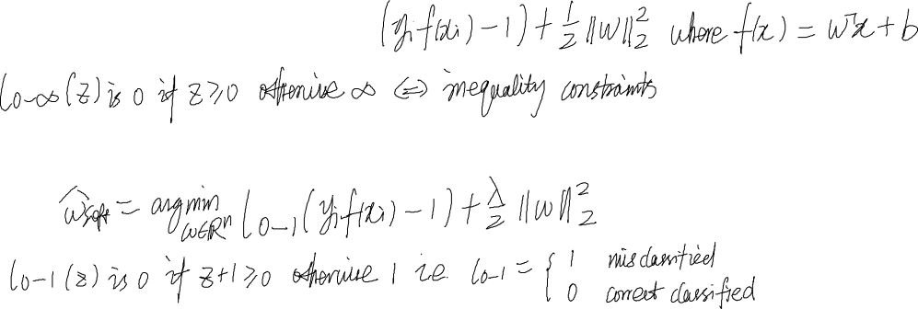
Soft Constraint
Recall the hard SVM
Relax the hard version to a soft version
$λ$ controls the trade-off between minimizing loss and
Maximizing margin

Slide 16
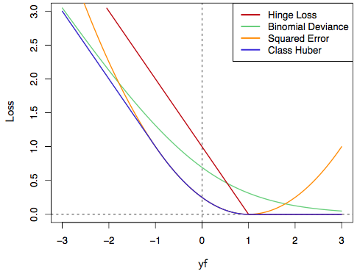
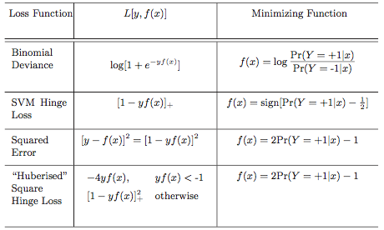
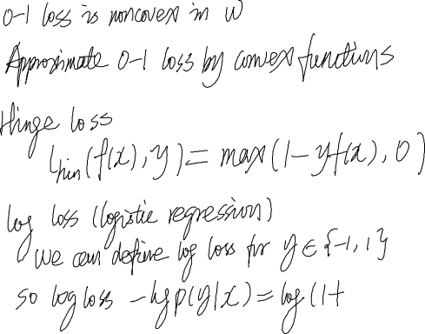

Hinge Loss

Slide 17

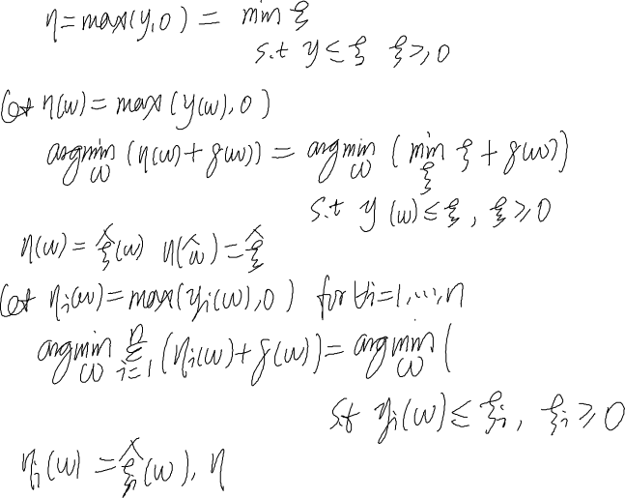
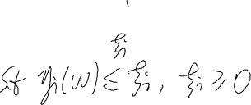

Equivalent Problem

Slide 18
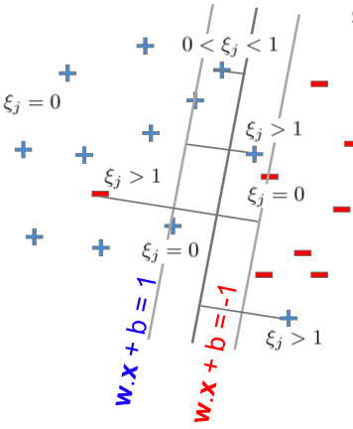
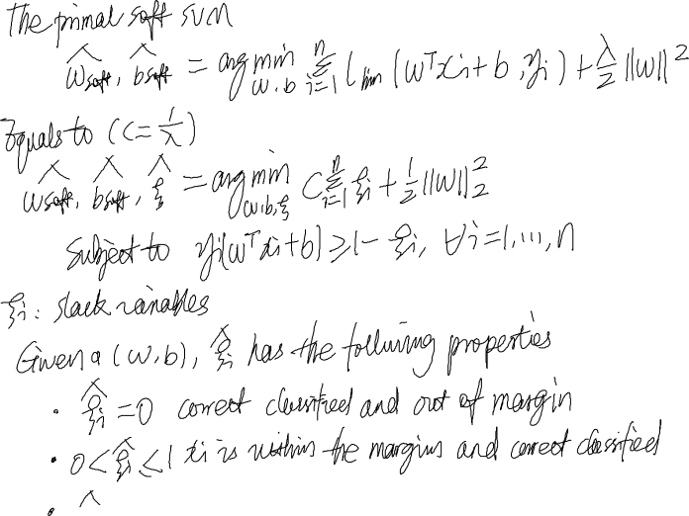

The Primal Soft SVM

Slide 19


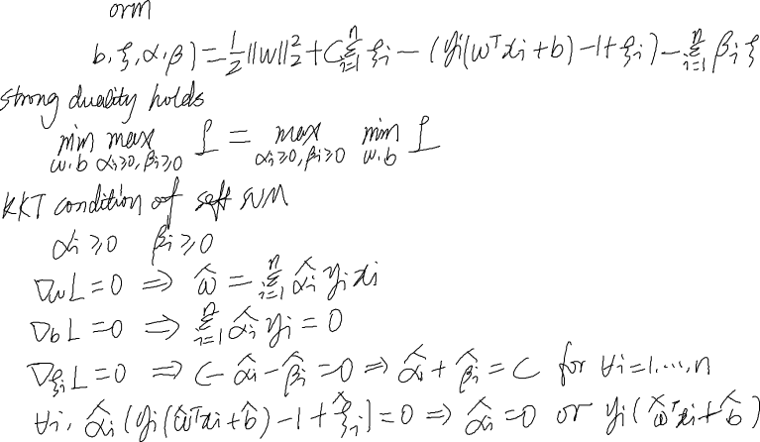



Lagrange Form and KTT

Slide 20



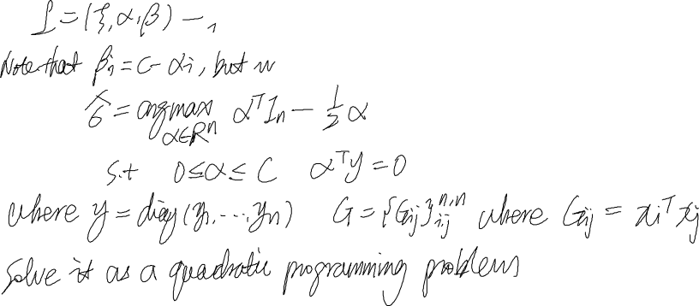

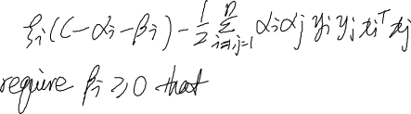
The Dual Hard SVM

Slide 21
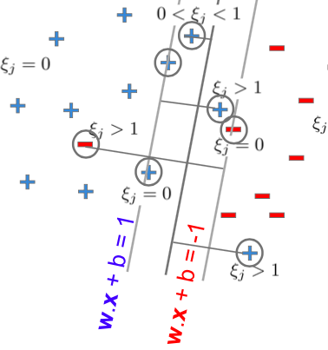



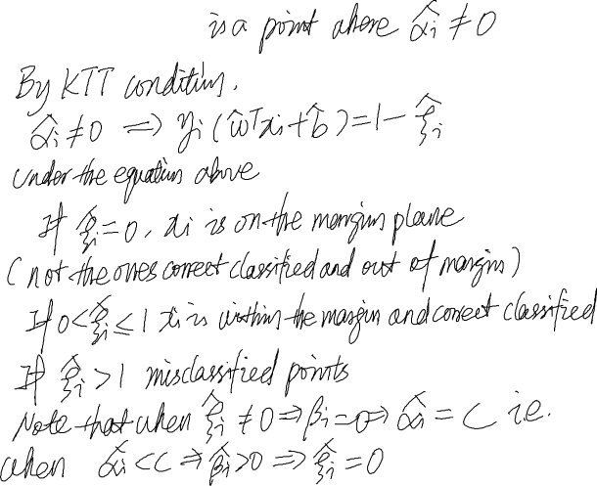
Support Vector

Slide 22

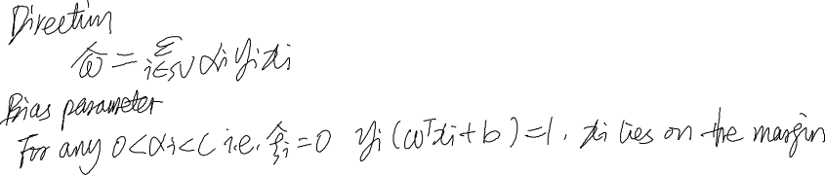


Soft SVM Predictor

Slide 23
SVM for Regression

Slide 24
Multi-class SVM

