Slide 1
Paper Discussion: Estimating Number of Factors by Adjusted Eigenvalues Thresholding
Xiang Lu
CRTC, Millennium
2022/11/17

Slide 2
Content
Background
Methodology and Assumptions
Simulation and Empirical Results

Slide 3
1. Background
Determining the number of common factors in high dimensional factor models
Existing literatures are mainly based on eigenvalues of covariance matrix
The heterogeneous scales of observed variables makes it difficult to give an accurate relationship between these evalues and the number of common factors, and can easily be inconsistent
3 different perspectives: model selection; hypothesis testing or confidence intervals; estimation
This paper looks at corr matrix, whic overcomes the scaling drawback of the cov matrix

Slide 4
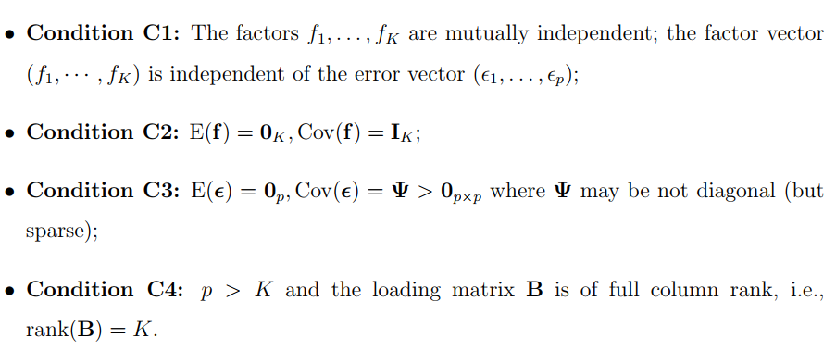

2. Methodology and Assumption
Factor Model
$y,α,ε∈R^{p}, B∈R^{p×K}, f∈R^{K}$

Slide 5
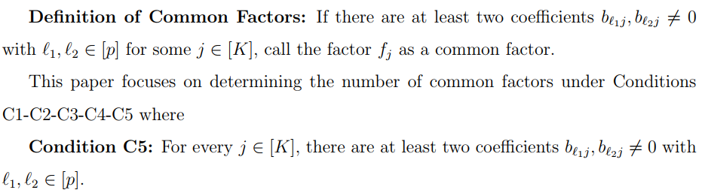
2. Methodology and Assumption
Factor Model

Slide 6



2. Methodology and Assumption
Factor Model

Slide 7
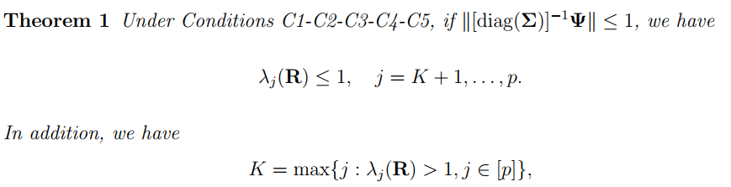
2. Methodology and Assumption
Factor Model
Below theorem shows how to determine the number of factors from population corr matrix

Slide 8
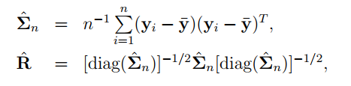
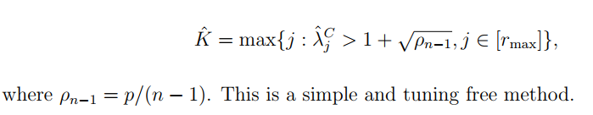
2. Methodology and Assumption
Factor Model
Estimation from sample

Slide 9
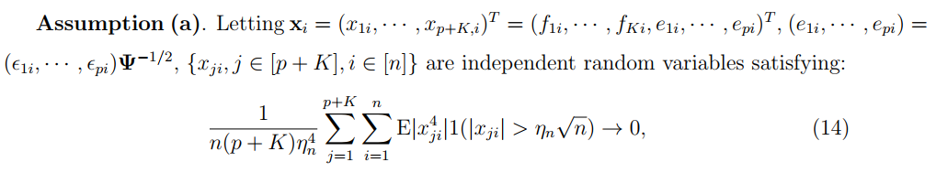
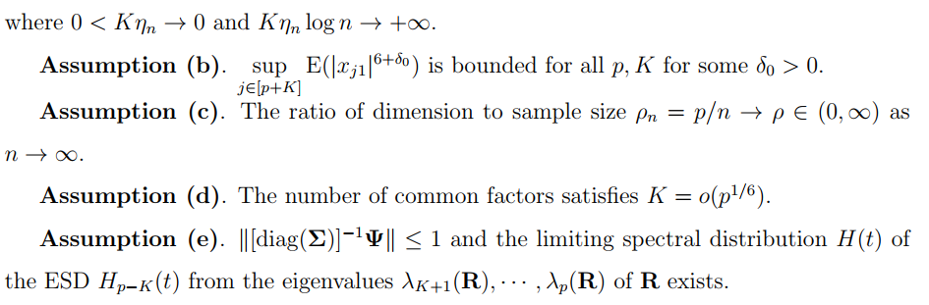
2. Methodology and Assumption
Factor Model
Additional assumptions

Slide 10
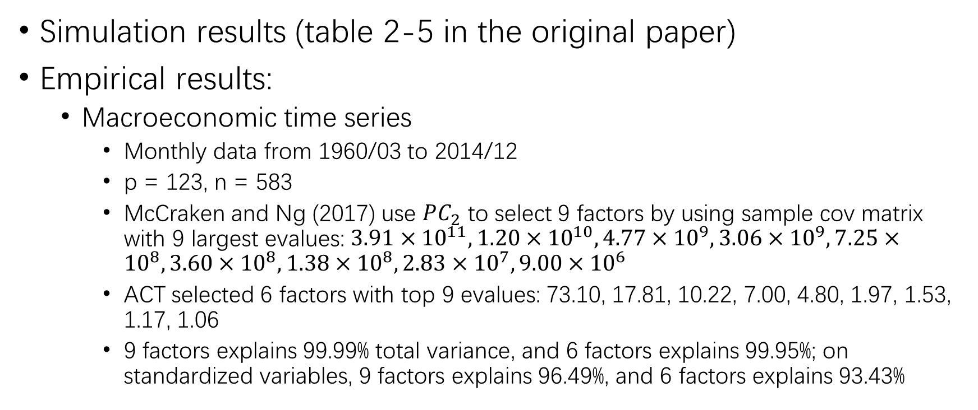
3. Simulation and Empirical Results
Simulation results (table 2-5 in the original paper)
Empirical results:
Macroeconomic time series
Monthly data from 1960/03 to 2014/12
p = 123, n = 583
McCraken and Ng (2017) use $PC_{2}$ to select 9 factors by using sample cov matrix with 9 largest evalues: $3.91×{10}^{11}, 1.20×{10}^{10}, 4.77×{10}^{9}, 3.06×{10}^{9}, 7.25×{10}^{8}, 3.60×{10}^{8}, 1.38×{10}^{8}, 2.83×{10}^{7}, 9.00×{10}^{6}$
ACT selected 6 factors with top 9 evalues: 73.10, 17.81, 10.22, 7.00, 4.80, 1.97, 1.53, 1.17, 1.06
9 factors explains 99.99% total variance, and 6 factors explains 99.95%; on standardized variables, 9 factors explains 96.49%, and 6 factors explains 93.43%

Slide 11
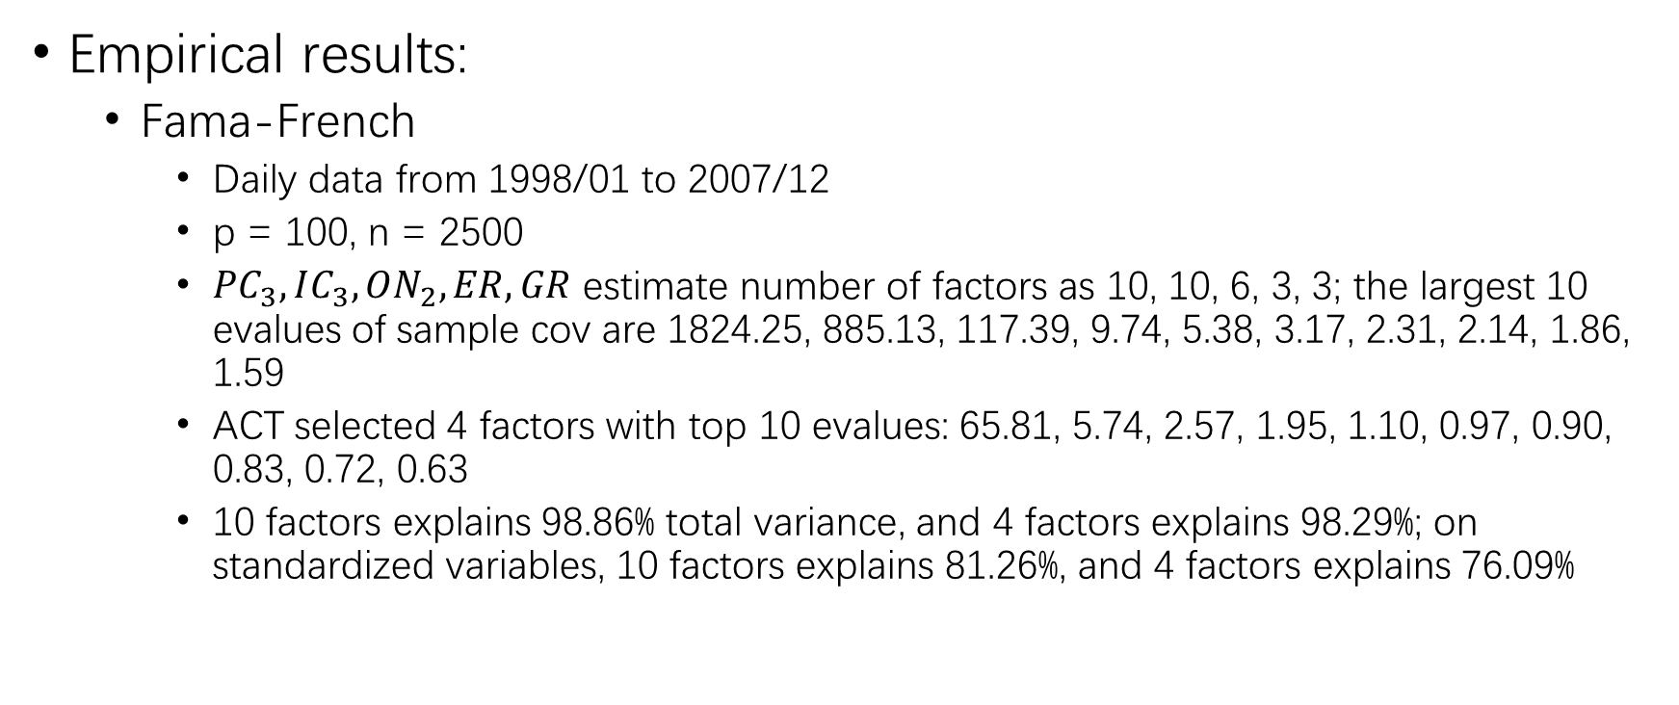
3. Simulation and Empirical Results
Empirical results:
Fama-French
Daily data from 1998/01 to 2007/12
p = 100, n = 2500
$PC_{3}, IC_{3}, ON_{2}, ER, GR$ estimate number of factors as 10, 10, 6, 3, 3; the largest 10 evalues of sample cov are 1824.25, 885.13, 117.39, 9.74, 5.38, 3.17, 2.31, 2.14, 1.86, 1.59
ACT selected 4 factors with top 10 evalues: 65.81, 5.74, 2.57, 1.95, 1.10, 0.97, 0.90, 0.83, 0.72, 0.63
10 factors explains 98.86% total variance, and 4 factors explains 98.29%; on standardized variables, 10 factors explains 81.26%, and 4 factors explains 76.09%

Slide 12
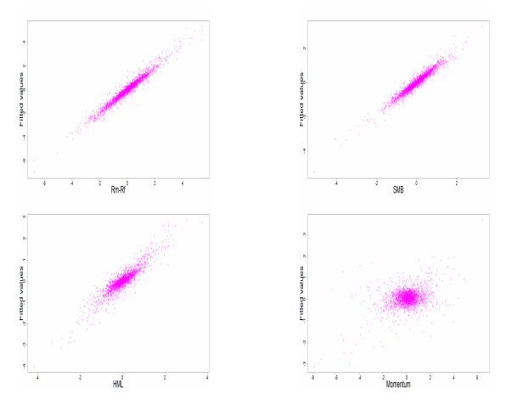
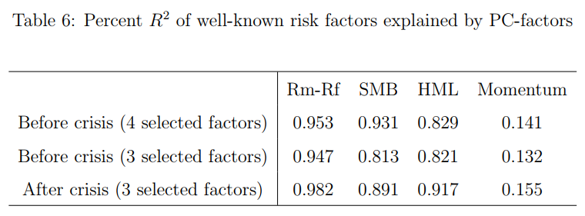
3. Simulation and Empirical Results
Empirical results:
Fama-French

Slide 13
Thoughts
How to get the principal components corresponding to the leading evalues/evectors of the corr matrix? We need to standardize variables ahead, just like inputs to a lot of ML models
How to deal with dynamic factor model with time varying number of factors? This may be a tougher task

Slide 14
Reference

