Slide 1
Data Mining for Business Analytics
Lecture 4: Discriminant Functions Stern School of Business New York University Spring 2014

Slide 2
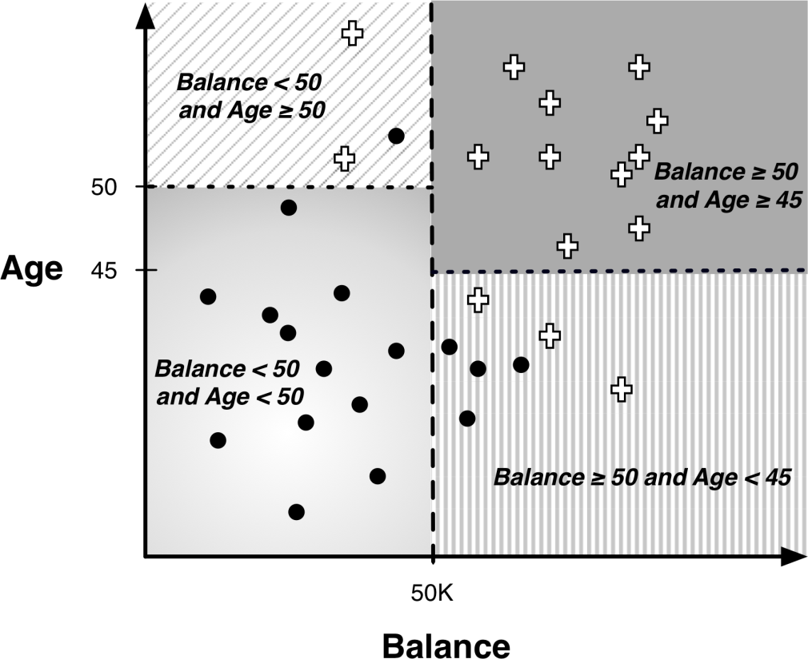
Decision Boundaries

Slide 3
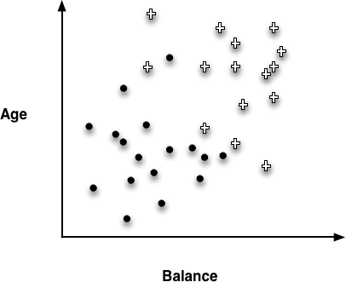
Instance Space

Slide 4
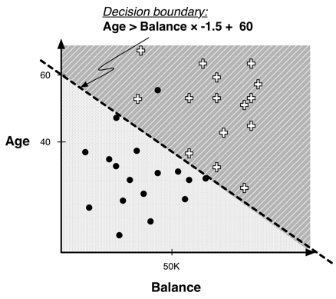
Linear Classifier

Slide 5
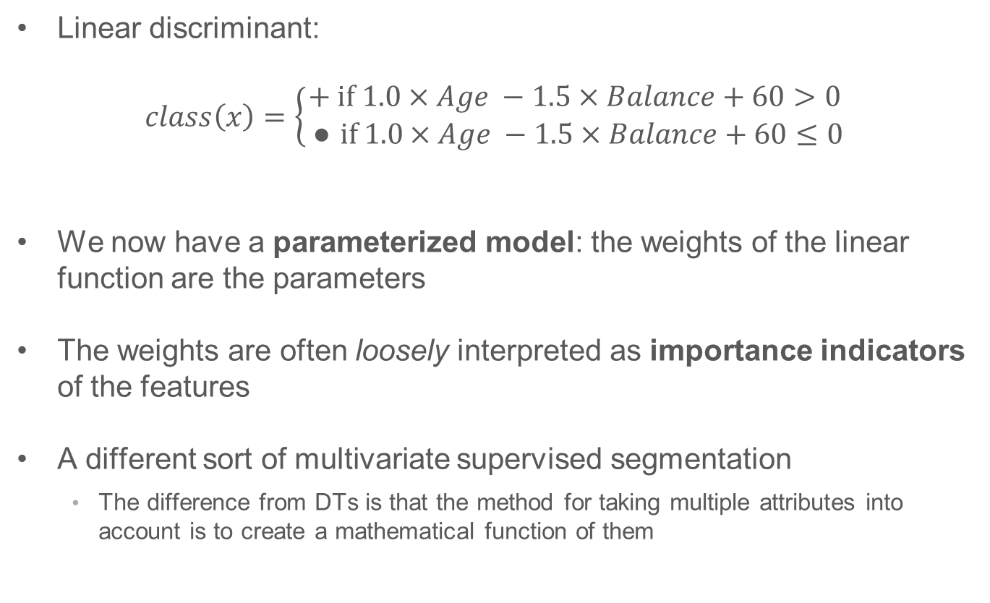
Example of Classification Function
Linear discriminant:
$$class\left(x\right)=\left\{\begin{aligned}+ \text{if} 1.0×Age −1.5×Balance+60>0 \\ ● \text{if} 1.0×Age −1.5×Balance+60≤0\end{aligned}\right.$$
We now have a parameterized model: the weights of the linear function are the parameters
The weights are often loosely interpreted as importance indicators of the features
A different sort of multivariate supervised segmentation
The difference from DTs is that the method for taking multiple attributes into account is to create a mathematical function of them

Slide 6
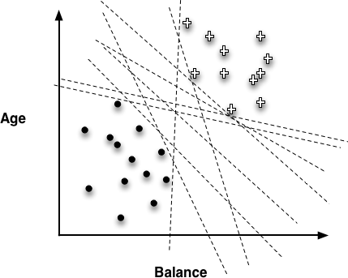
Choosing the “best” line

Slide 7
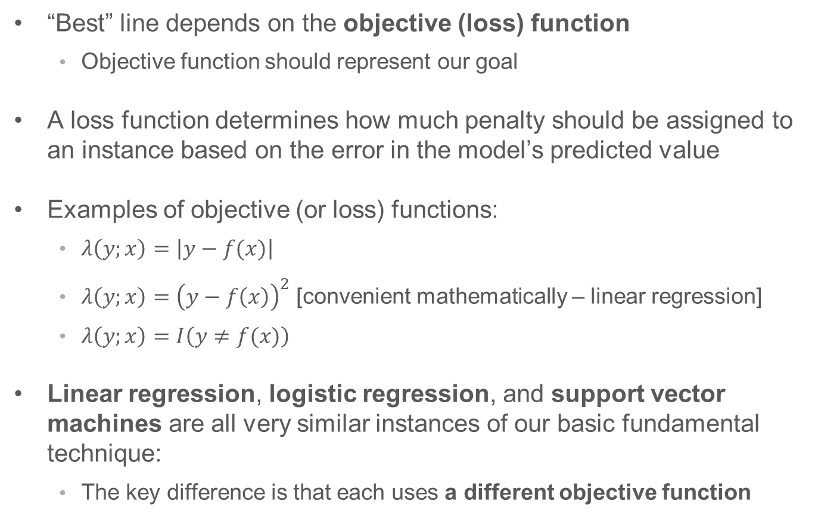
Objective Functions
“Best” line depends on the objective (loss) function
Objective function should represent our goal
A loss function determines how much penalty should be assigned to an instance based on the error in the model’s predicted value
Examples of objective (or loss) functions:
$λ\left(y;x\right)=\left|y−f(x)\right|$
$λ\left(y;x\right)={\left(y−f\left(x\right)\right)}^{2}$ [convenient mathematically – linear regression]
$λ\left(y;x\right)=I\left(y≠f(x)\right)$
Linear regression, logistic regression, and support vector machines are all very similar instances of our basic fundamental technique:
The key difference is that each uses a different objective function

Slide 8
Logistic regression is a misnomer
The distinction between classification and regression is whether the value for the target variable is categorical or numeric
For logistic regression, the model produces a numeric estimate
However, the values of the target variable in the data are categorical
Logistic regression is estimating the probability of class membership (a numeric quantity) over a categorical class
Logistic regression is a class probability estimation model and not a regression model

Slide 9
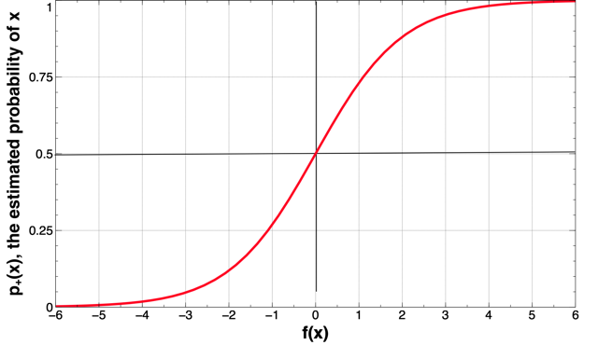
Logistic regression (“sigmoid”) curve

Slide 10
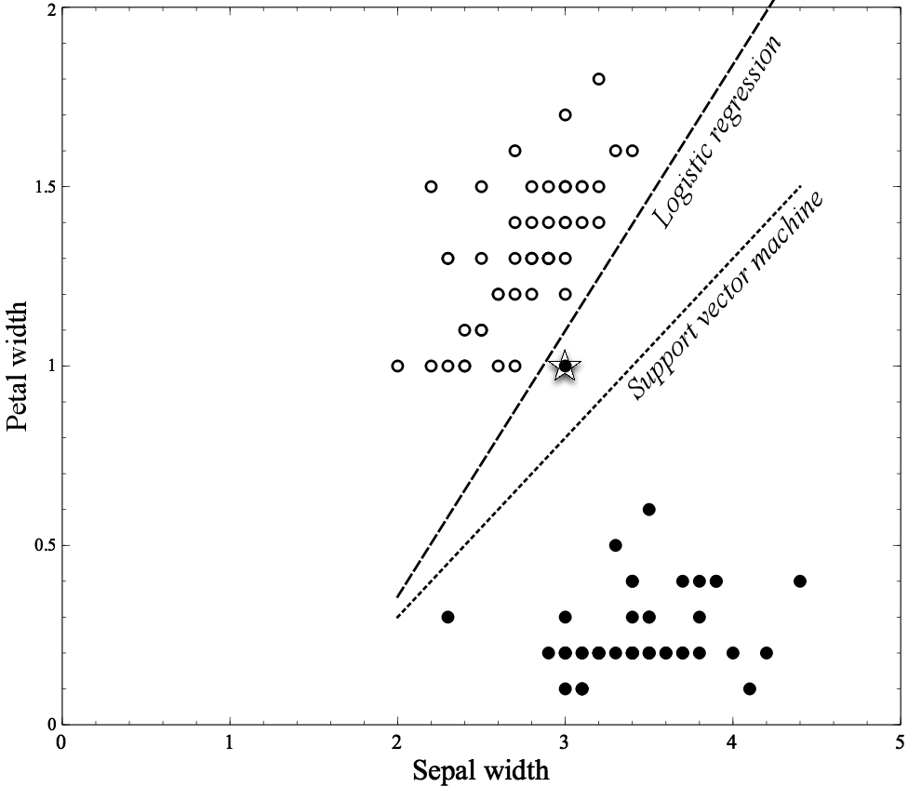
Classifying Flowers

Slide 11
Choosing the “best” line

Slide 12
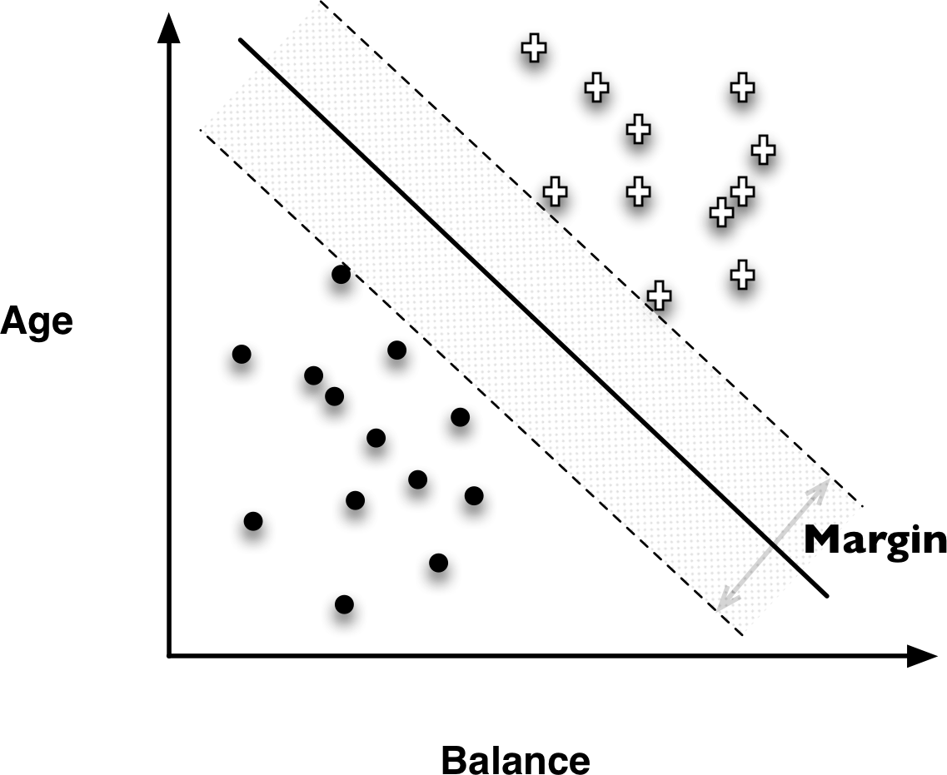
Support Vector Machines (SVMs)

Slide 13
Support Vector Machines (SVMs)
Linear Discriminants
Effective
Use “hinge loss”
Also, non-linear SVMs

Slide 14
Hinge Loss functions
Support vector machines use hinge loss
Hinge loss incurs no penalty for an example that is not on the wrong side of the margin
The hinge loss only becomes positive when an example is on the wrong side of the boundary and beyond the margin
Loss then increases linearly with the example’s distance from the margin
Penalizes points more the farther they are from the separating boundary

Slide 15
Loss Functions
Zero-one loss assigns a loss of zero for a correct decision and one for an incorrect decision
Squared error specifies a loss proportional to the square of the distance from the boundary
Squared error loss usually is used for numeric value prediction (regression), rather than classification
The squaring of the error has the effect of greatly penalizing predictions that are grossly wrong

Slide 16
Ranking Instances and Probability Class Estimation
In many applications, we don’t simply want a yes or no prediction of whether an instance belongs to the class, but we want some notion of which examples are more or less likely to belong to the class
Which consumers are most likely to respond to this offer?
Which customers are most likely to leave when their contracts expire?
Ranking
Tree induction
Linear discriminant functions (e.g., linear regressions, logistic regressions, SVMs)
Ranking is free
Class Probability Estimation
Tree induction
Logistic regression

Slide 17
The many faces of classification: Classification / Probability Estimation / Ranking
Increasing difficulty
Classification
Ranking
Probability
Ranking:
Business context determines the number of actions (“how far down the list”)
Probability:
You can always rank / classify if you have probabilities!

Slide 18
Ranking: Examples
Search engines
Whether a document is relevant to a topic / query

Slide 19
Class Probability Estimation: Examples
MegaTelCo
Ranking vs. Class Probability Estimation
Identify accounts or transactions as likely to have been defrauded
The director of the fraud control operation may want the analysts to focus not simply on the cases most likely to be fraud, but on accounts where the expected monetary loss is higher
We need to estimate the actual probability of fraud

Slide 20

Application of Logistic Regression
The Wisconsin Breast Cancer Dataset

Slide 21
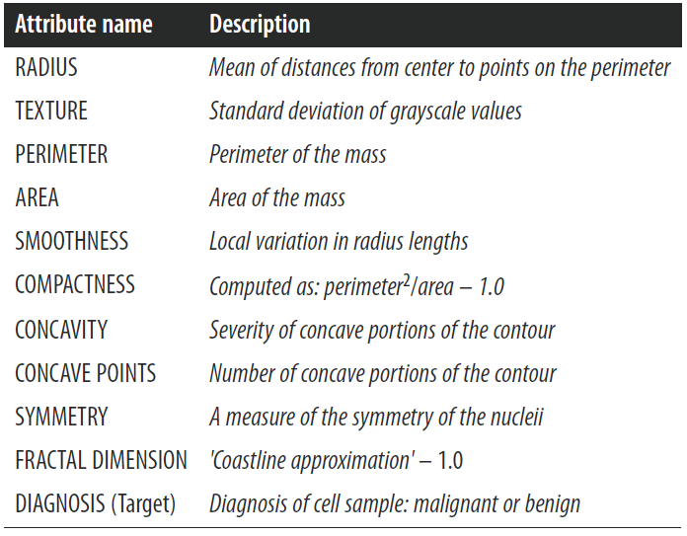
Wisconsin Breast Cancer dataset
From each of these basic characteristics, three values were computed: the mean (_mean), standard error (_SE), and “worst” or largest

Slide 22
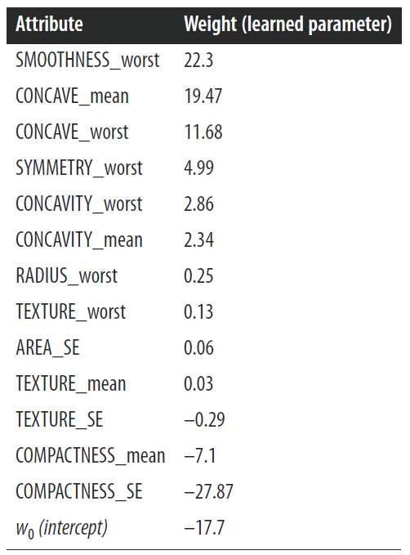
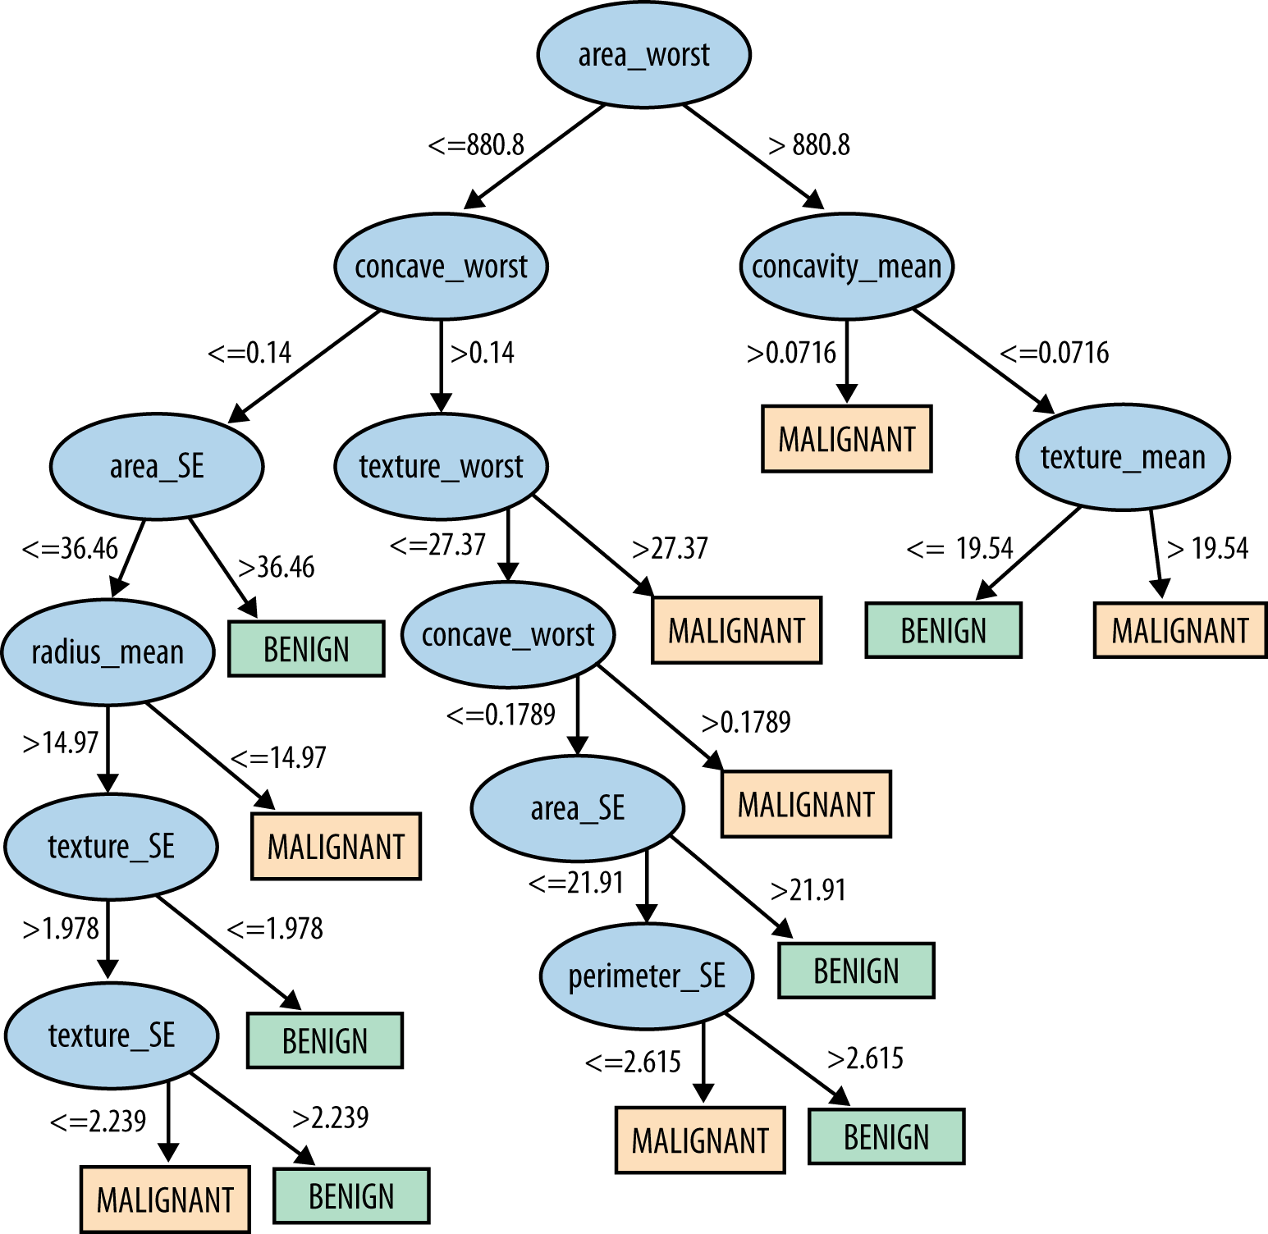
Wisconsin Breast Cancer dataset

Slide 23
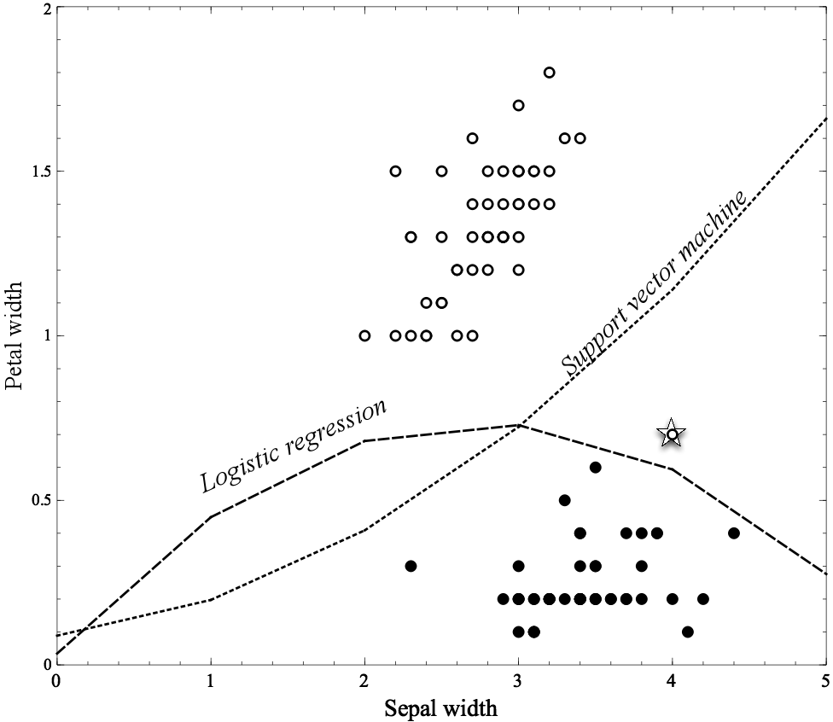
Non-linear Functions
Linear functions can actually represent nonlinear models, if we include more complex features in the functions

Slide 24
Non-linear Functions
Using “higher order” features is just a “trick”
Common techniques based on fitting the parameters of complex, nonlinear functions:
Non-linear support vector machines and neural networks
Nonlinear support vector machine with a “polynomial kernel” consider “higher-order” combinations of the original features
Squared features, products of features, etc.
Think of a neural network as a “stack” of models
On the bottom of the stack are the original features
Each layer in the stack applies a simple model to the outputs of the previous layer
Might fit data too well (..to be continued)

Slide 25
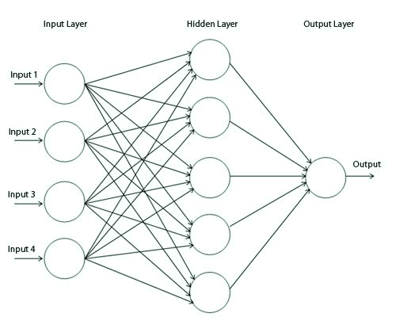
Simple Neural Network

Slide 26
Linear Models versus Tree Induction
What is more comprehensible to the stakeholders?
Rules or a numeric function?
How “smooth” is the underlying phenomenon being modeled?
Trees need a lot of data to approximate curved boundaries
How “non-linear” is the underlying phenomenon being modeled?
If very, much “data engineering” needed to apply linear models
How much data do you have?!
There is a key tradeoff between the complexity that can be modeled and the amount of training data available
What are the characteristics of the data: missing values, types of variables, relationships between them, how many are irrelevant, etc.
Trees fairly robust to these complications

Slide 27
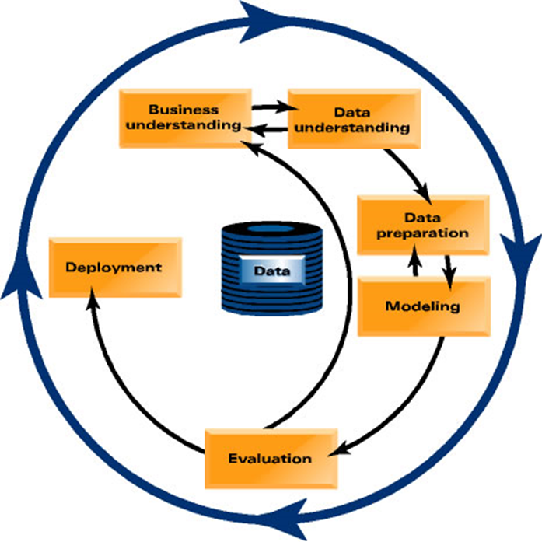
Data Mining Process

Slide 28
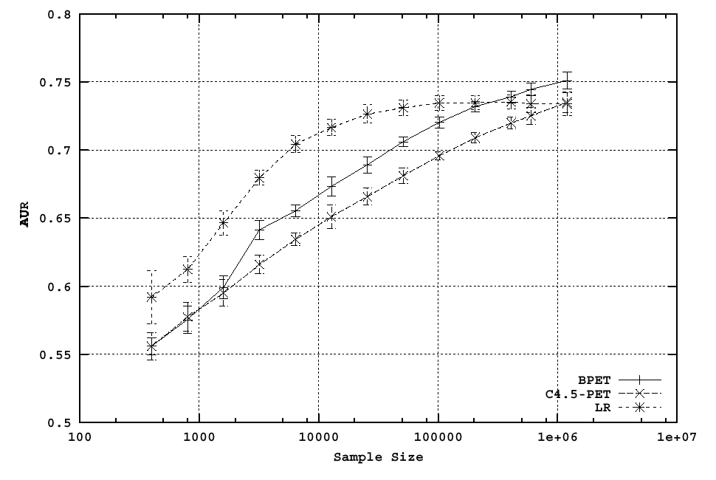
Comparing learning curves is essential

Slide 29
Comparing learning curves is essential

Slide 30
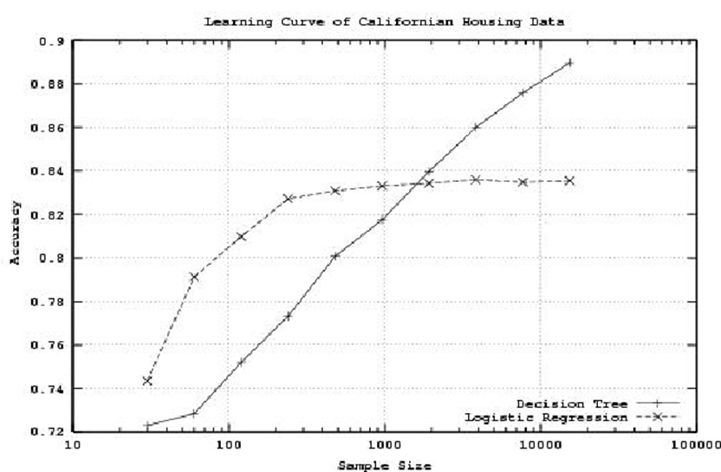
Choice of algorithm is not trivial!

Slide 31
Avoiding Over-fitting
Tree Induction:
Post-pruning
takes a fully-grown decision tree and discards unreliable parts
Pre-pruning
stops growing a branch when information becomes unreliable
Linear Models:
Feature Selection
Regularization
Optimize some combination of fit and simplicity

Slide 32
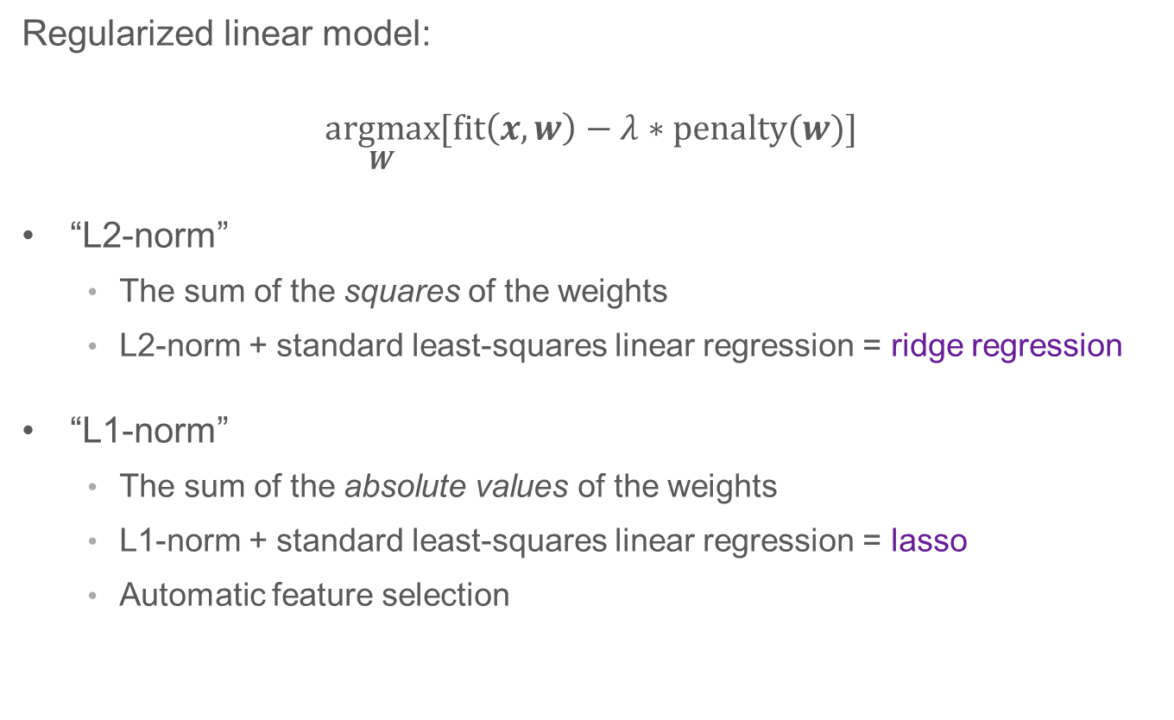
Regularization
Regularized linear model:
$$\underset{W}{argmax}{[\text{fit}\left(x,w\right)−λ∗\text{penalty}(w)]}$$
“L2-norm”
The sum of the squares of the weights
L2-norm + standard least-squares linear regression = ridge regression
“L1-norm”
The sum of the absolute values of the weights
L1-norm + standard least-squares linear regression = lasso
Automatic feature selection

Slide 33
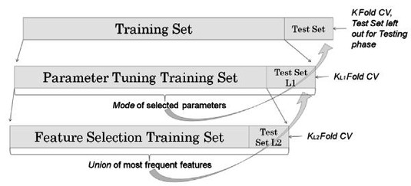
Nested Cross-Validation

Slide 34

Over-fitting in linear discriminants
$$f\left(x\right)=w_{0}+w_{1}x_{1}+w_{2}x_{2}+w_{3}x_{3}$$
$$f\left(x\right)=w_{0}+w_{1}x_{1}+w_{2}x_{2}+w_{3}x_{3}+w_{4}x_{4}+w_{5}x_{5}$$
$$f\left(x\right)=w_{0}+w_{1}x_{1}+w_{2}x_{2}+w_{3}x_{3}+w_{4}x_{4}+w_{5}x_{5}+w_{6}x_{1}^{2}$$
$$f\left(x\right)=w_{0}+w_{1}x_{1}+w_{2}x_{2}+w_{3}x_{3}+w_{4}x_{4}+w_{5}x_{5}+w_{6}x_{1}^{2}+w_{7}∗x_{2}/x_{3}$$

Slide 35
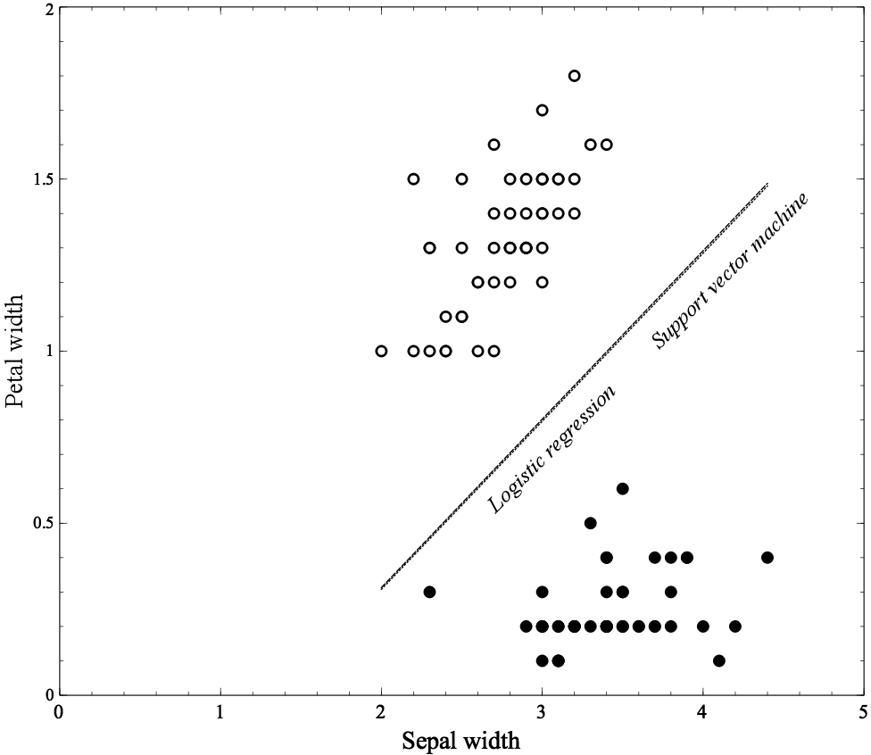
Example: Classifying Flowers

Slide 36
Example: Classifying Flowers

Slide 37
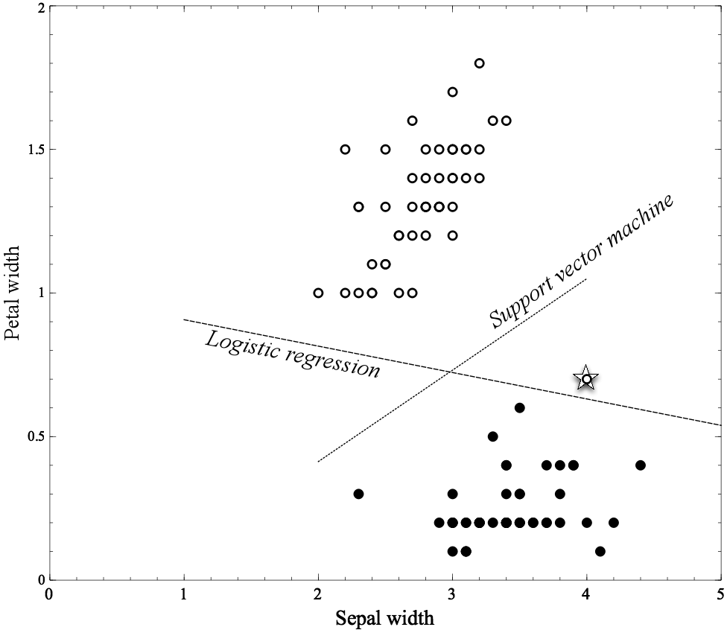
Example: Classifying Flowers

Slide 38
Example: Classifying Flowers

Slide 39
Logistic Regression vs Tree Induction
For smaller training-set sizes, logistic regression yields better generalization accuracy than tree induction
For smaller data, tree induction will tend to over-fit more
Classification trees are a more flexible model representation than linear logistic regression
Flexibility of tree induction can be an advantage with larger training sets:
Trees can represent substantially nonlinear relationships between the features and the target

Slide 40
Thanks!

