Slide 1
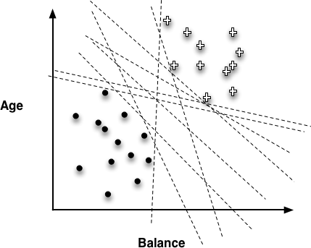
Choosing the “best” line

Slide 2
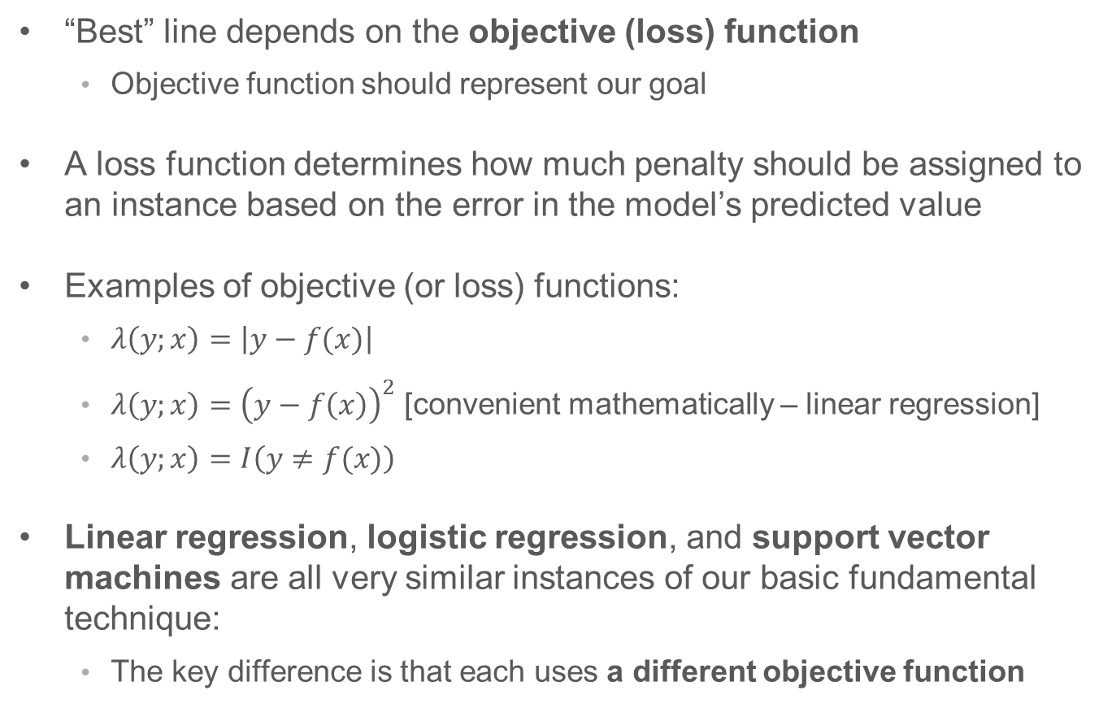
Objective Functions
“Best” line depends on the objective (loss) function
Objective function should represent our goal
A loss function determines how much penalty should be assigned to an instance based on the error in the model’s predicted value
Examples of objective (or loss) functions:
$λ\left(y;x\right)=\left|y−f(x)\right|$
$λ\left(y;x\right)={\left(y−f\left(x\right)\right)}^{2}$ [convenient mathematically – linear regression]
$λ\left(y;x\right)=I\left(y≠f(x)\right)$
Linear regression, logistic regression, and support vector machines are all very similar instances of our basic fundamental technique:
The key difference is that each uses a different objective function

Slide 3
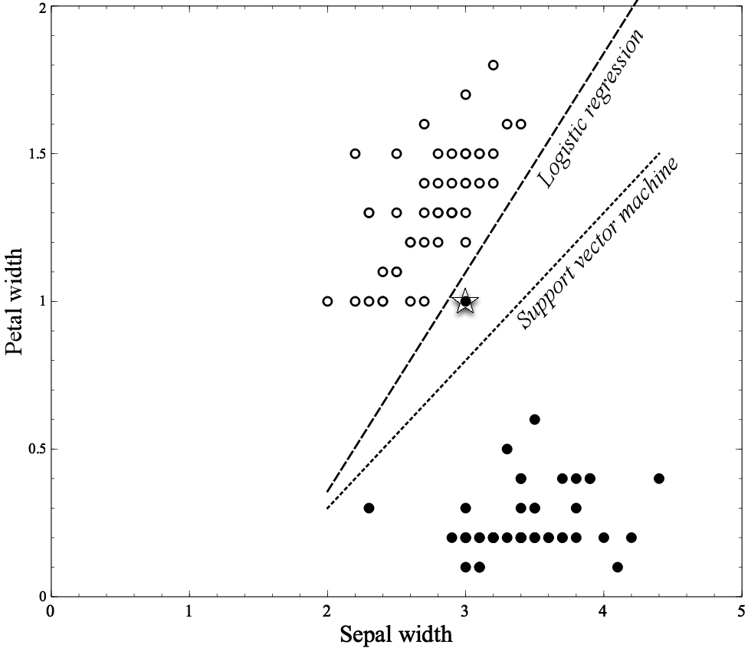
Classifying Flowers

Slide 4
Choosing the “best” line

Slide 5
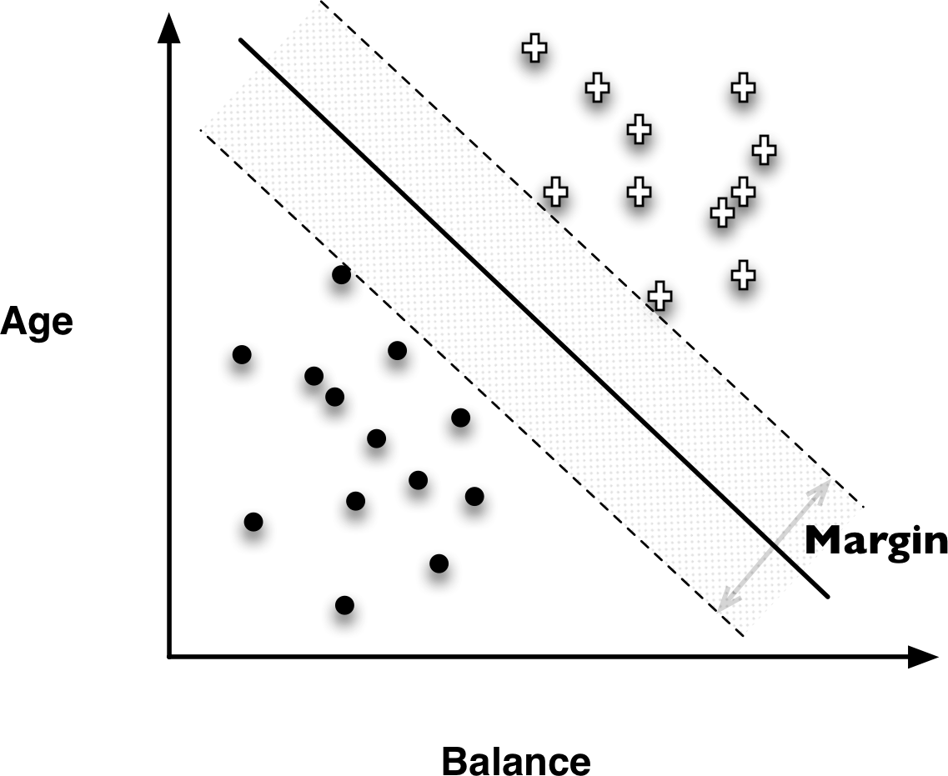
Support Vector Machines (SVMs)

Slide 6
Support Vector Machines (SVMs)
Linear Discriminants
Effective
Use “hinge loss”
Also, non-linear SVMs

Slide 7
Hinge Loss functions
Support vector machines use hinge loss
Hinge loss incurs no penalty for an example that is not on the wrong side of the margin
The hinge loss only becomes positive when an example is on the wrong side of the boundary and beyond the margin
Loss then increases linearly with the example’s distance from the margin
Penalizes points more the farther they are from the separating boundary

Slide 8
Loss Functions
Zero-one loss assigns a loss of zero for a correct decision and one for an incorrect decision
Squared error specifies a loss proportional to the square of the distance from the boundary
Squared error loss usually is used for numeric value prediction (regression), rather than classification
The squaring of the error has the effect of greatly penalizing predictions that are grossly wrong

Slide 9
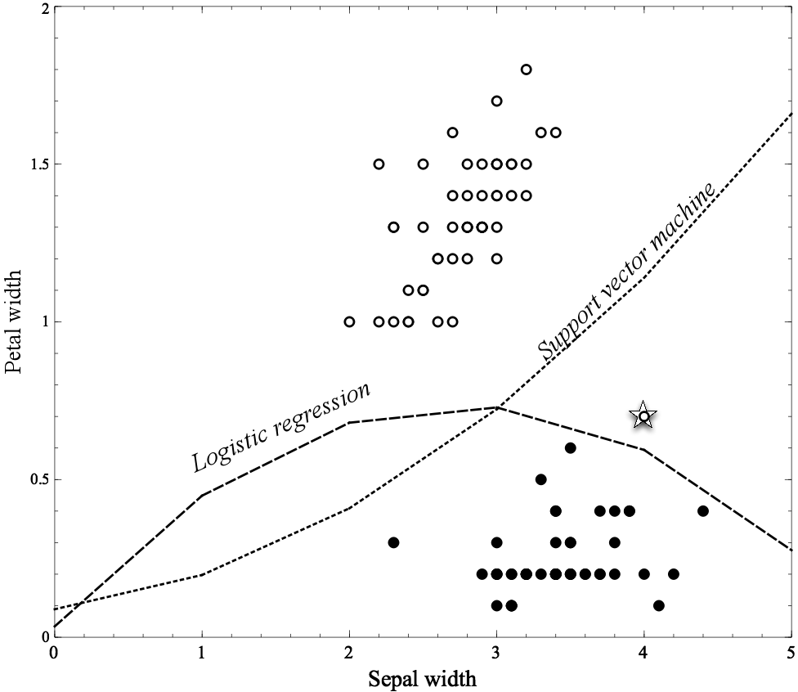
Non-linear Functions
Linear functions can actually represent nonlinear models, if we include more complex features in the functions

Slide 10
Non-linear Functions
Using “higher order” features is just a “trick”
Common techniques based on fitting the parameters of complex, nonlinear functions:
Non-linear support vector machines and neural networks
Nonlinear support vector machine with a “polynomial kernel” consider “higher-order” combinations of the original features
Squared features, products of features, etc.
Think of a neural network as a “stack” of models
On the bottom of the stack are the original features
Each layer in the stack applies a simple model to the outputs of the previous layer
Might fit data too well (..to be continued)

Slide 11
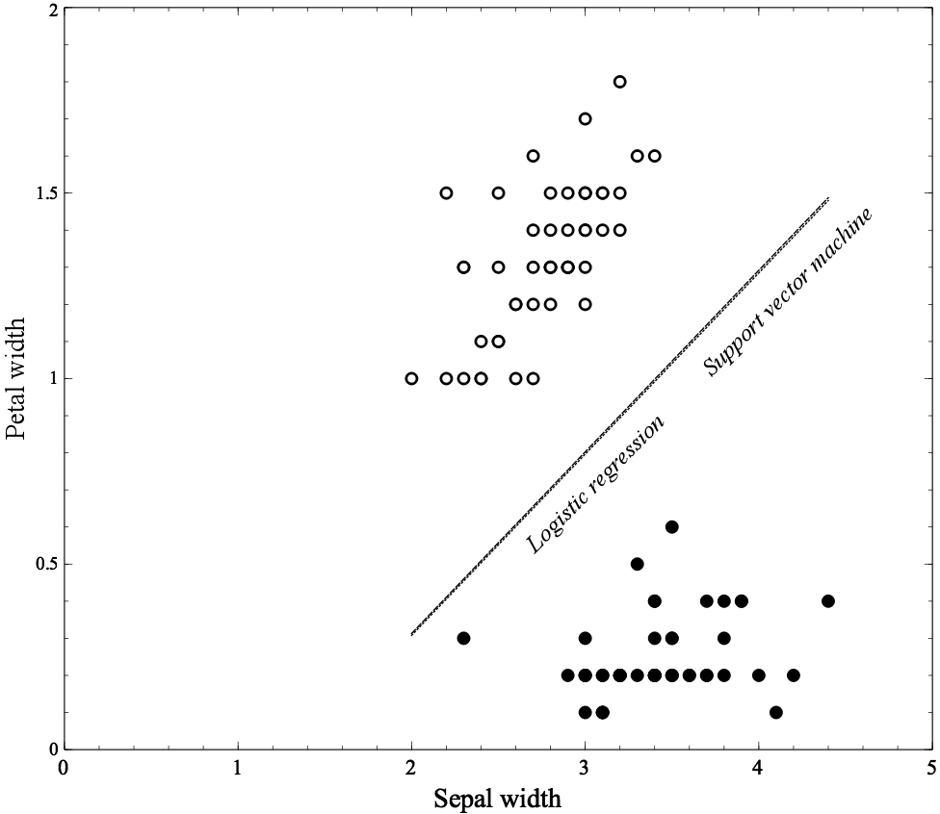
Example: Classifying Flowers

Slide 12
Example: Classifying Flowers

Slide 13
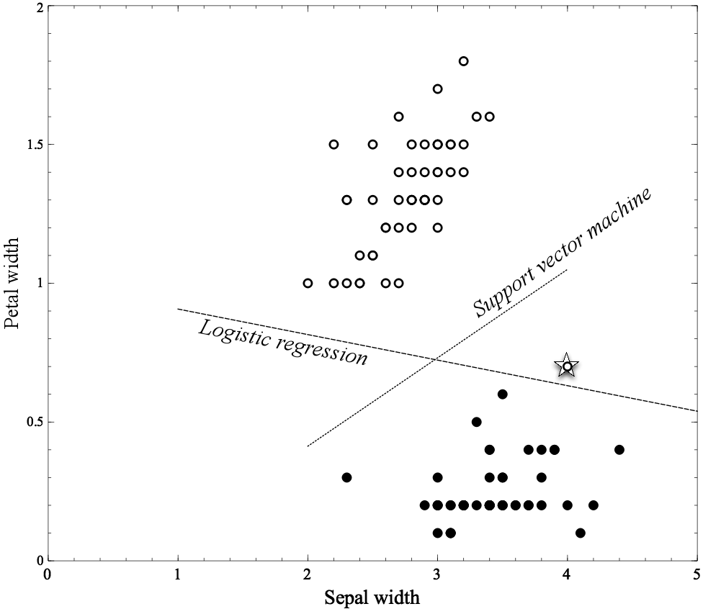
Example: Classifying Flowers

Slide 14
Avoiding Over-fitting
Tree Induction:
Post-pruning
takes a fully-grown decision tree and discards unreliable parts
Pre-pruning
stops growing a branch when information becomes unreliable
Linear Models:
Feature Selection
Regularization
Optimize some combination of fit and simplicity

Slide 15
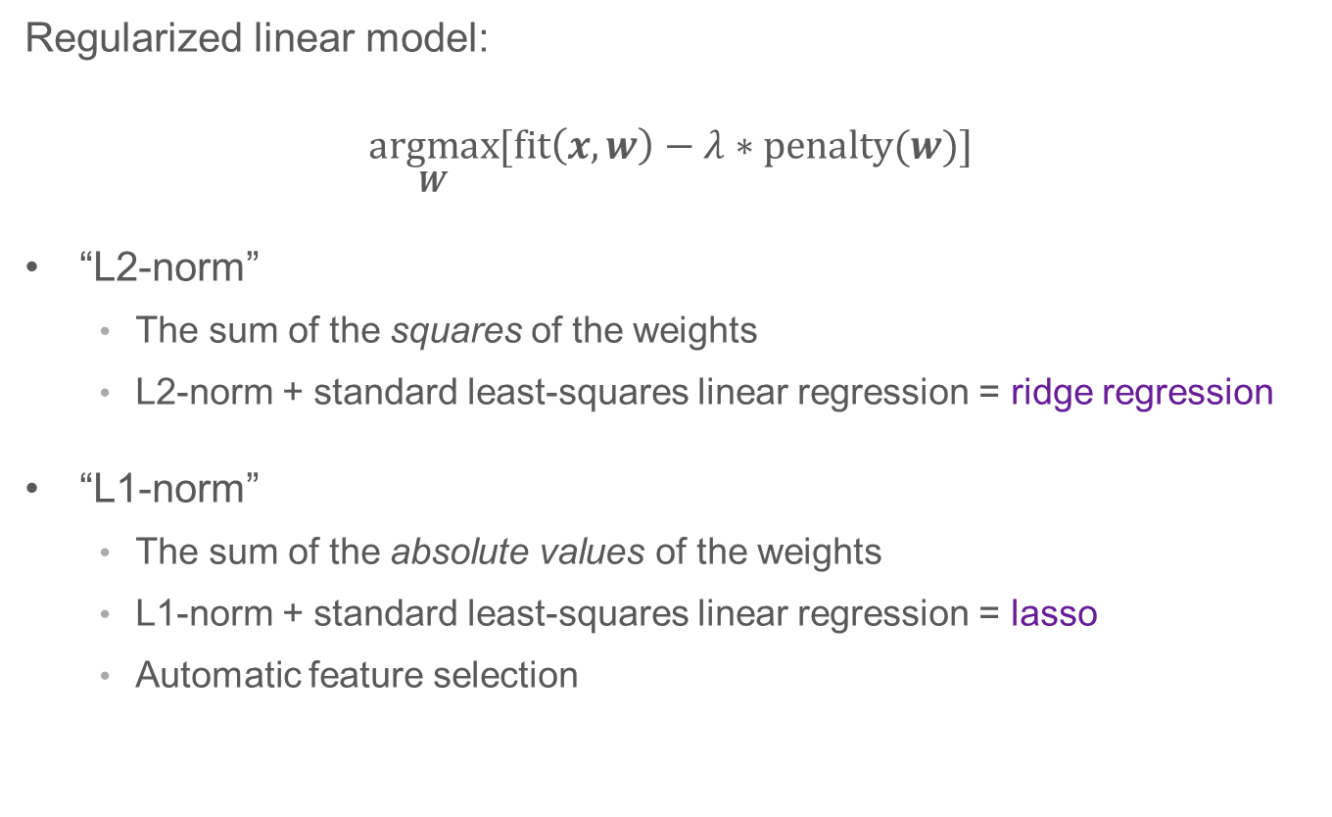
Regularization
Regularized linear model:
$$\underset{W}{argmax}{[\text{fit}\left(x,w\right)−λ∗\text{penalty}(w)]}$$
“L2-norm”
The sum of the squares of the weights
L2-norm + standard least-squares linear regression = ridge regression
“L1-norm”
The sum of the absolute values of the weights
L1-norm + standard least-squares linear regression = lasso
Automatic feature selection

