Slide 1
Online Identification of Hierarchical Heavy Hitters
Yin Zhang
yzhang@research.att.com
Joint work with
Sumeet Singh Subhabrata Sen
Nick Duffield Carsten Lund
Internet Measurement Conference 2004

Slide 2
Motivation
Traffic anomalies are common
  DDoS attacks, Flash crowds, worms, failures
Traffic anomalies are complicated
  Multi-dimensional → may involve multiple header fields
    E.g. src IP 1.2.3.4 AND port 1214 (KaZaA)
    Looking at individual fields separately is not enough!
  Hierarchical → Evident only at specific granularities
    E.g. 1.2.3.4/32, 1.2.3.0/24, 1.2.0.0/16, 1.0.0.0/8
    Looking at fixed aggregation levels is not enough!
Want to identify anomalous traffic aggregates automatically, accurately, in near real time
  Offline version considered by Estan et al. [SIGCOMM03]
Notes:
Traffic anomalies are common. While some are benign, the others may indicate perf problems …
Being common doesn’t mean they are simple. Traffic anomalies can have rather complicated structures. They tend to be …, that is, …, for example, … as a result, … not enough; they are often hierarchical, that is, … for example, …, as a result, …not enough
Despite the fact that anomalies are complicated, we still want to detect them, in an automatic fashion, and want to do so accurately, and quickly (i.e. in near real time). Note that the offline version of the problem has been considered by … This is the online version of the problem – you want to detect things as traffic streams in and you ve’only got one look.

Slide 3
Challenges
Immense data volume (esp. during attacks)
  Prohibitive to inspect all traffic in detail
Multi-dimensional, hierarchical traffic anomalies
  Prohibitive to monitor all possible combinations of different aggregation levels on all header fields
Sampling (packet level or flow level)
  May wash out some details
False alarms
  Too many alarms = info “snow” → simply get ignored
Root cause analysis
  What do anomalies really mean?
Notes:
The online streaming setting clearly makes the problem very challenging
The first challenge is generic to streaming analysis – the immense data volume. The Internet bubble is burst, but if you look at the growth of the Internet traffic, it never slows down. Today, a large network can have 1 petabyte per day, it can be expensive to inspect everything in detail, keep perflow state etc.
The second challenge is specific to the problem at hand. Given the multi-dimensional nature … you cannot afford to … for online analysis
The third challenge is a by product of the first challenge, …
The next two challenges apply to the entire network anomaly detection field

Slide 4
Approach
Prefiltering extracts multi-dimensional hierarchical traffic clusters
  Fast, scalable, accurate
  Allows dynamic drilldown
Robust heavy hitter & change detection
  Deals with sampling errors, missing values
Characterization (ongoing)
  Reduce false alarms by correlating multiple metrics
  Can pipe to external systems
Input
Prefiltering
(extract clusters)
Identification
(robust HH & CD)
Characterization
Output
Notes:
To address these challenges, we took a three step approach. In this simple diagram, arrows represent the flow of data, which the width representing the volume of the data.
The prefiltering stage …
Once u have all the candidate clusters, you can …
Finally, …

Slide 5
Prefiltering
Input
  <src_ip, dst_ip, src_port, dst_port, proto>
  Bytes (we can also use other metrics)
Output
  All traffic clusters with volume above
  (epsilon * total_volume)
    ( cluster ID, estimated volume )
  Traffic clusters: defined using combinations of IP prefixes, port ranges, and protocol
Goals
  Single Pass
  Efficient (low overhead)
  Dynamic drilldown capability
Notes:
The first step is filtering.
Input
Output
Design goals

Slide 6
Dynamic Drilldown via 1-DTrie
field
stage 1
(first octet)
0
255
stage 2
(second octet)
0
255
stage 3
(third octet)
0
255
stage 4
(last octet)
0
255
At most 1 update per flow
Split level when adding new bytes causes bucket >= T_{split}
Invariant: traffic trapped at any interior node < T_{split}
Notes:
The best way to explain our solution is to consider the 1-D scenario, where the input key is either source or dest IP address. We start with empty, …, …
Invariant: at any internal node, the amount of traffic trapped (before splitting) is …; but if u also include all the bytes below it, then it should be more than Tsplit

Slide 7
1-D Trie Data Structure
0
255
0
255
0
255
0
255
0
255
0
255
0
255
0
255
0
255
Reconstruct interior nodes (aggregates) by summing up the children
Reconstruct missed value by summing up traffic trapped at ancestors
Amortize the update cost

Slide 8
1-D Trie Performance
Update cost
  1 lookup + 1 update
Memory
  At most 1/T_{split} internal nodes at each level
Accuracy: For any given T > d*T_{split}
  Captures all flows with metric >= T
  Captures no flow with metric < T-d*T_{split}

Slide 9
Extending 1-D Trie to 2-D:
Cross-Producting
Update(k1, k2, value)
In each dimension, find the deepest interior
node (prefix): (p1, p2)
  Can be done using longest prefix matching (LPM)
Update a hash table using key (p1, p2):
  Hash table: cross product of 1-D interior nodes
Reconstruction can be done at the end
p1 = f(k1)
p2 = f(k2)
totalBytes{ p1, p2 } += value

Slide 10
Cross-Producting Performance
Update cost:
  2 X (1-D update cost) + 1 hash table update.
Memory
  Hash table size bounded by (d/T_{split})²
  In practice, generally much smaller
Accuracy: For any given T > d*T_{split}
  Captures all flows with metric >= T
  Captures no flow with metric < T- d*T_{split}

Slide 11
HHH vs. Packet Classification
Similarity
  Associate a rule for each node
  → finding fringe nodes becomes PC
Difference
  PC: rules given a priori and mostly static
  HHH: rules generated on the fly via dynamic drilldown
Adapted 2 more PC algorithms to 2-D HHH
  Grid-of-tries & Rectangle Search
  Only require O(d/T_{split}) memory
Decompose 5-D HHH into 2-D HHH problems

Slide 12
Change Detection
Data
  5 minute reconstructed cluster series
  Can use different interval size
Approach
  Classic time series analysis
Big change
  Significant departure from forecast

Slide 13
Change Detection: Details
Holt-Winters
  Smooth + Trend + (Seasonal)
    Smooth: Long term curve
    Trend: Short term trend (variation)
    Seasonal: Daily / Weekly / Monthly effects
  Can plug in your favorite method
Joint analysis on upper & lower bounds
  Can deal with missing clusters
    ADT provides upper bounds (lower bound = 0)
  Can deal with sampling variance
    Translate sampling variance into bounds
Notes:
Joint analysis used to set detection threshold

Slide 14
Evaluation Methodology
Dataset description
  Netflow from a tier-1 ISP
Algorithms tested
Trace | Duration | #routers | #records | Volume
ISP-100K | 3 min | 1 | 100 K | 66.5 MB
ISP-1day | 1 day | 2 | 332 M | 223.5 GB
ISP-1mon | 1 month | 2 | 7.5 G | 5.2 TB
Baseline (Brute-force) | Sketch | sk, sk2
 | Lossy Counting | lc
Our algorithms | Cross-Producting | cp
 | Grid-of-tries | got
 | Rectangle Search | rs

Slide 15
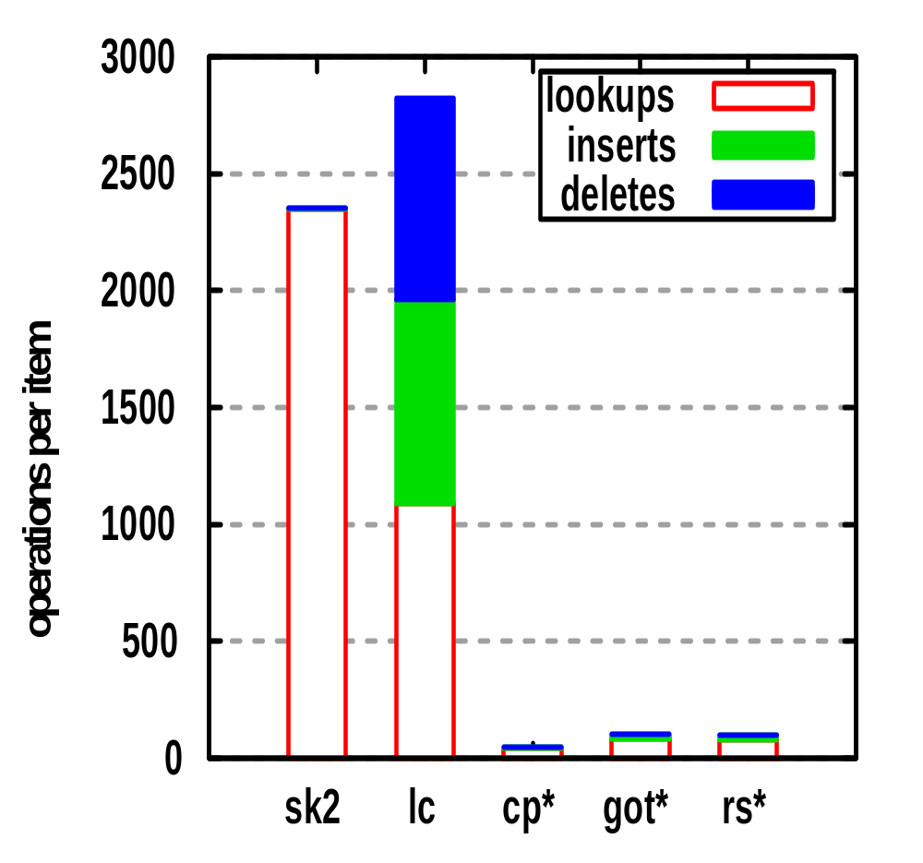
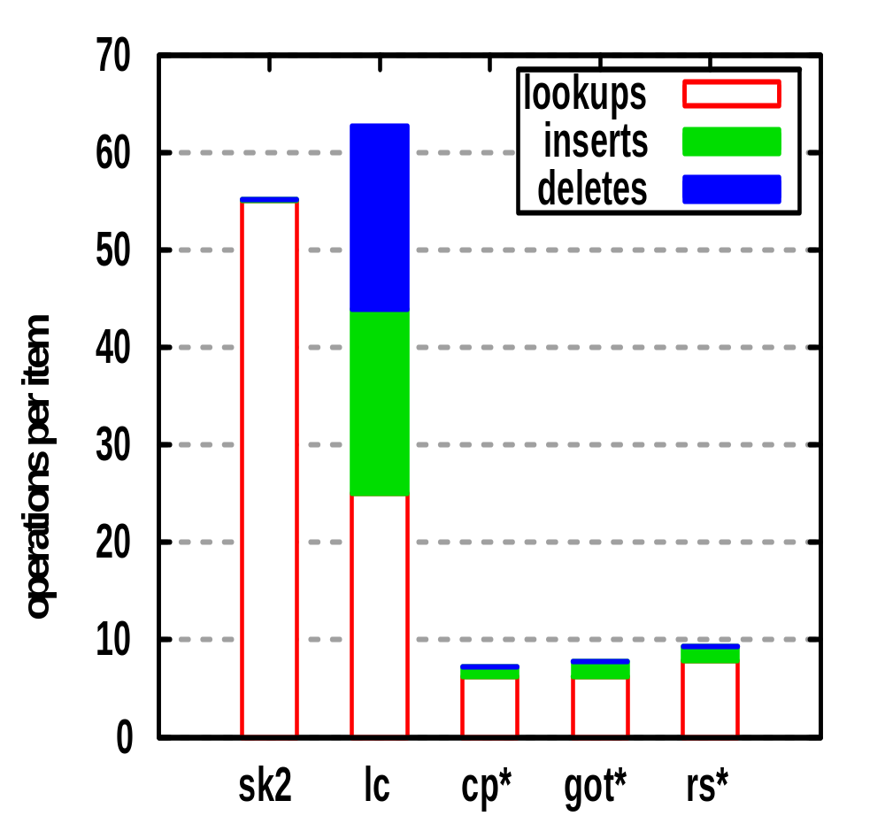
Runtime Costs
ISP-100K (gran = 1)
ISP-100K (gran = 8)
We are an order of magnitude faster
Notes:
Lookups = lookups + updates
Sk: 5 times worse than sk2

Slide 16
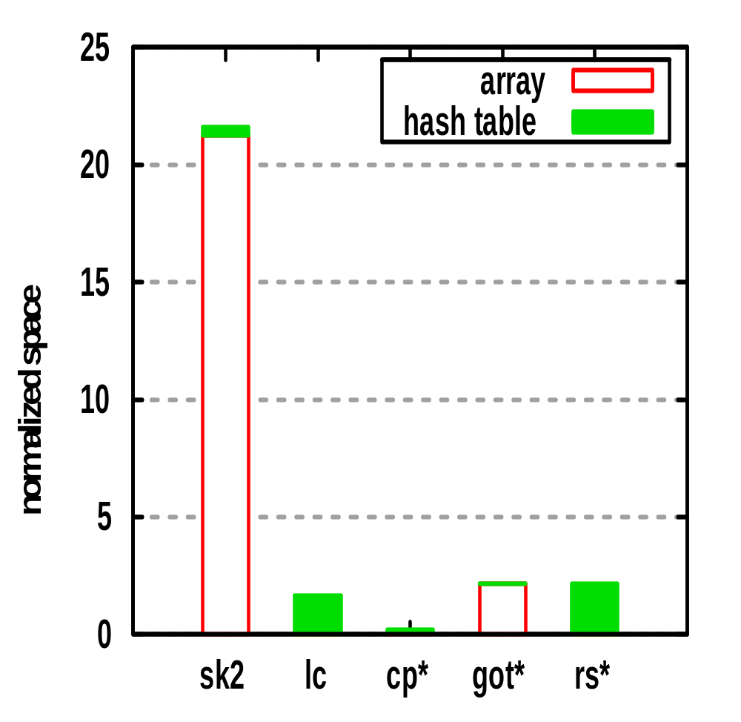
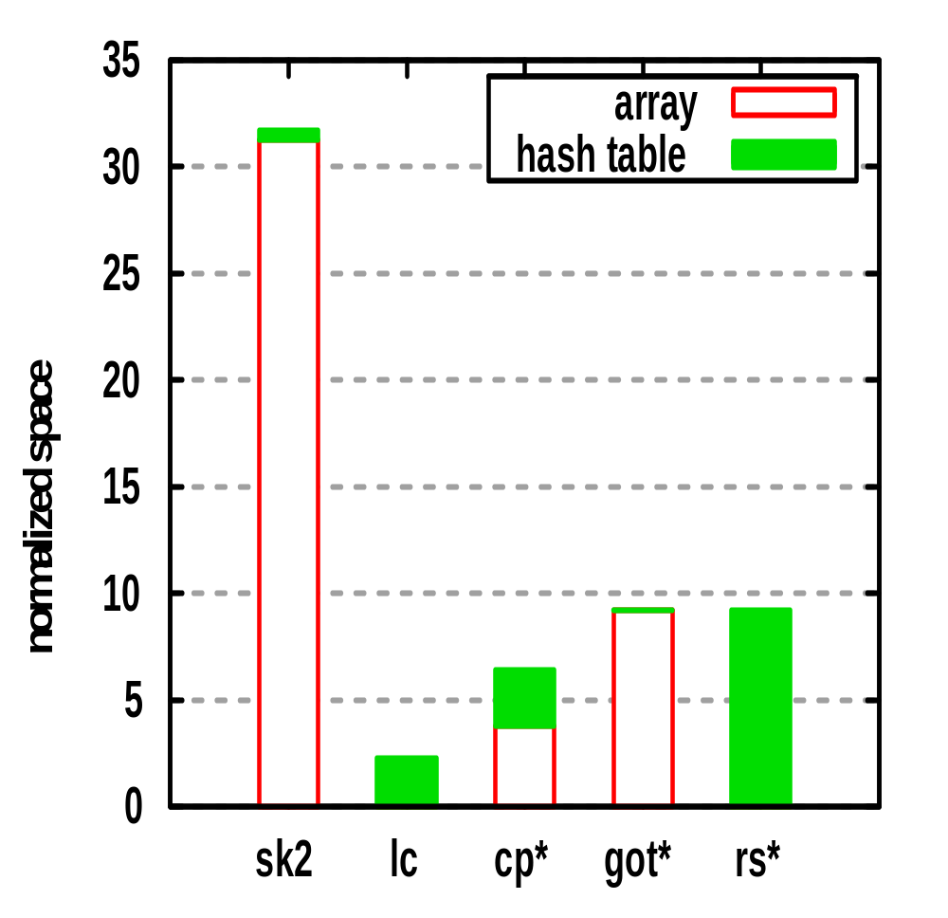
Normalized Space
ISP-100K (gran = 1)
ISP-100K (gran = 8)
normalized space = actual space / [ (1/epsilon) (32/gran)² ]
gran = 1: we need less / comparable space
gran = 8: we need more space but total space is small
Notes:
Gran = 8, epsilon = 0.001

Slide 17
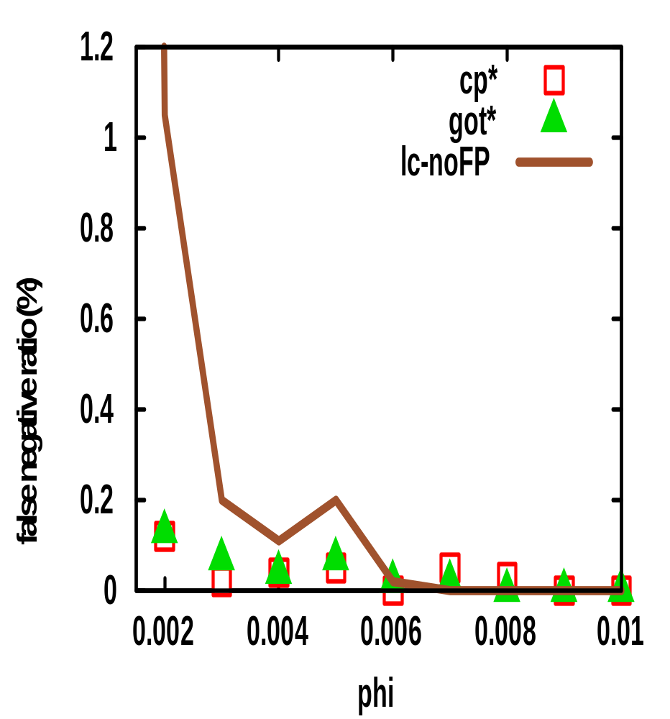
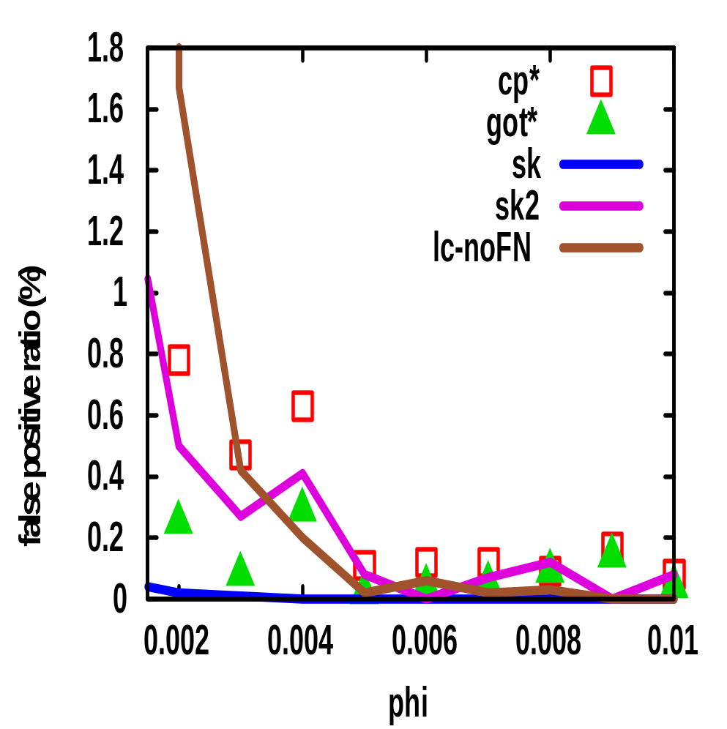
HHH Accuracy
False Negatives (ISP-100K)
False Positives (ISP-100K)
HHH detection accuracy comparable to brute-force
Notes:
Gran = 1

Slide 18
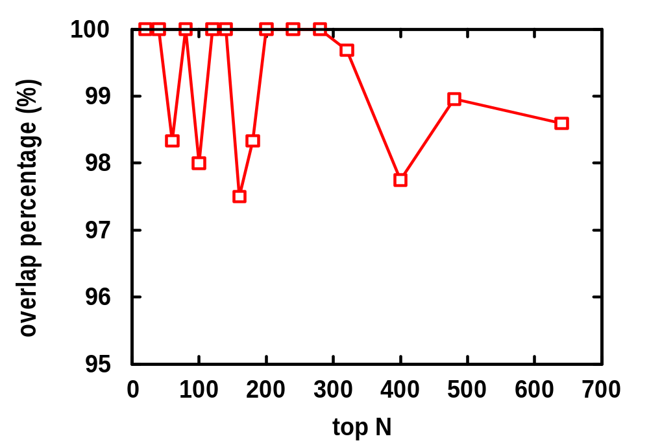
Change Detection Accuracy
ISP-1day, router 2
Top N change overlap is above 97% even for very large N
Notes:
Epsilon = 0.001, phi = 0.001, router 2

Slide 19
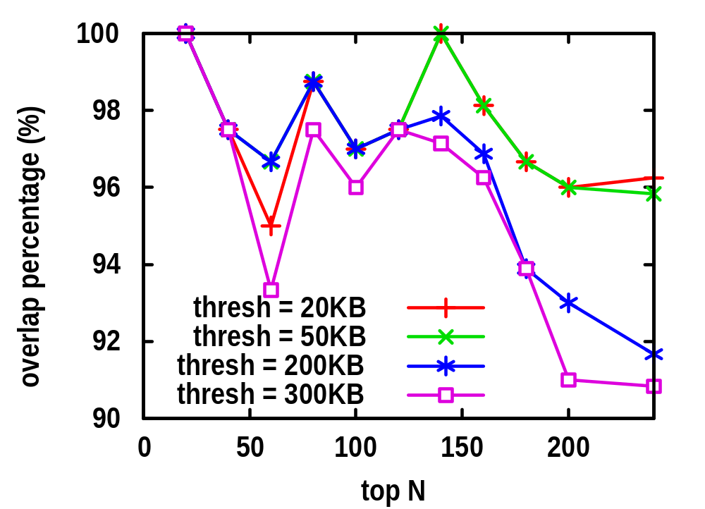
Effects of Sampling
ISP-1day, router 2
Accuracy above 90% with 90% data reduction
Notes:
Reduce number of flow records by a factor of 12, but accuracy is still above 90%

Slide 20
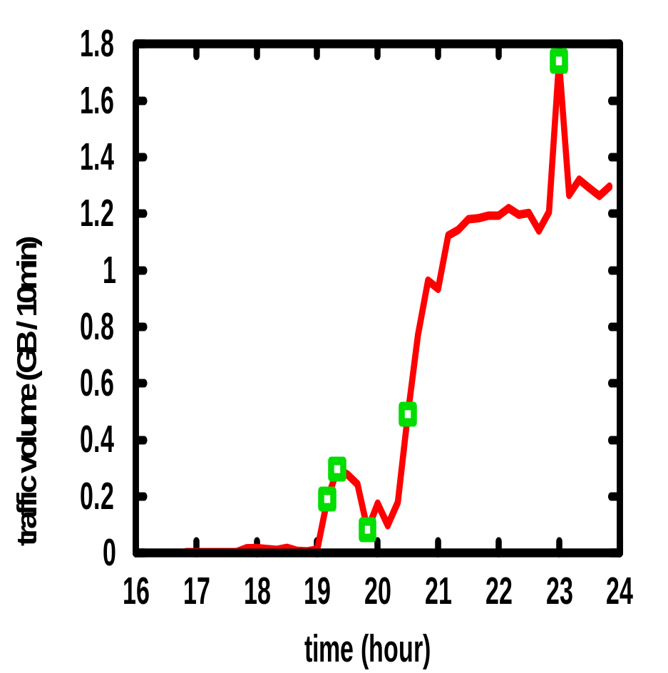
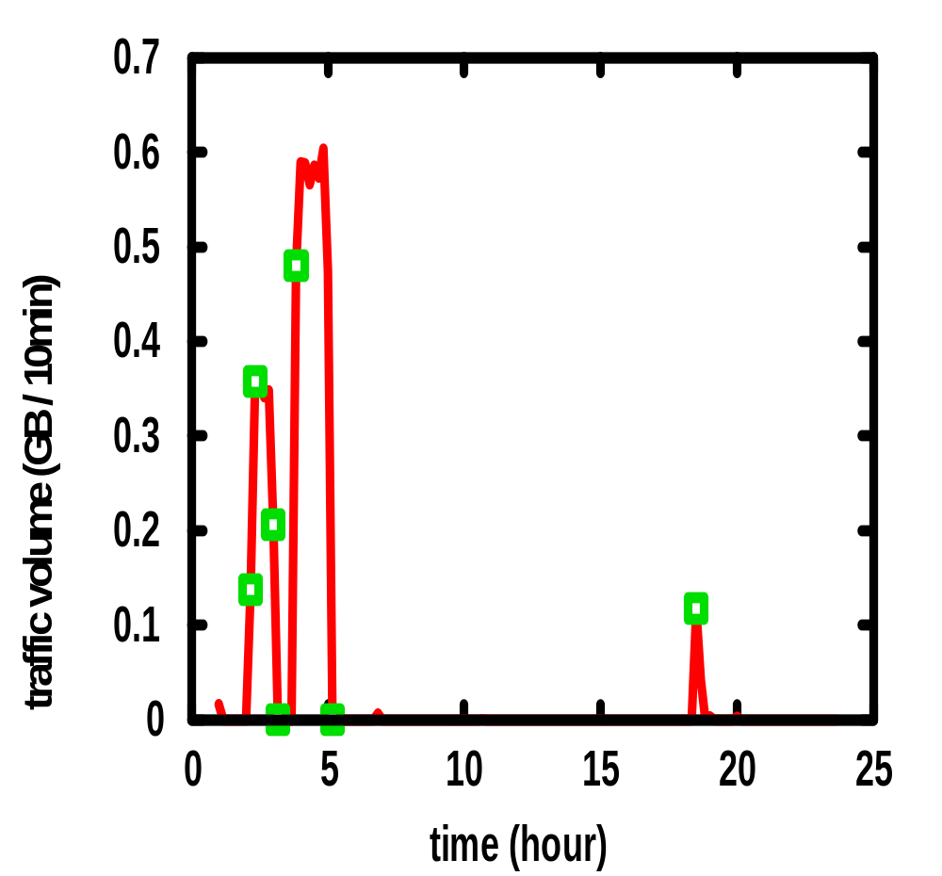
Some Detected Changes
Notes:
/32

Slide 21
Next Steps
Characterization
  Aim: distinguish events using sufficiently rich set of metrics
    E.g. DoS attacks looks different from flash crowd (bytes/flow smaller in attack)
  Metrics:
    # flows, # bytes, # packets, # SYN packets
      ↑ SYN, ↔ bytes ➔ DoS??
      ↑ packets, ↔ bytes ➔ DoS??
      ↑ packets, in multiple /8 ➔ DoS? Worm?
Distributed detection
  Our summary data structures can easily support aggregating data collected from multiple locations

Slide 22
Thank you!

Slide 23
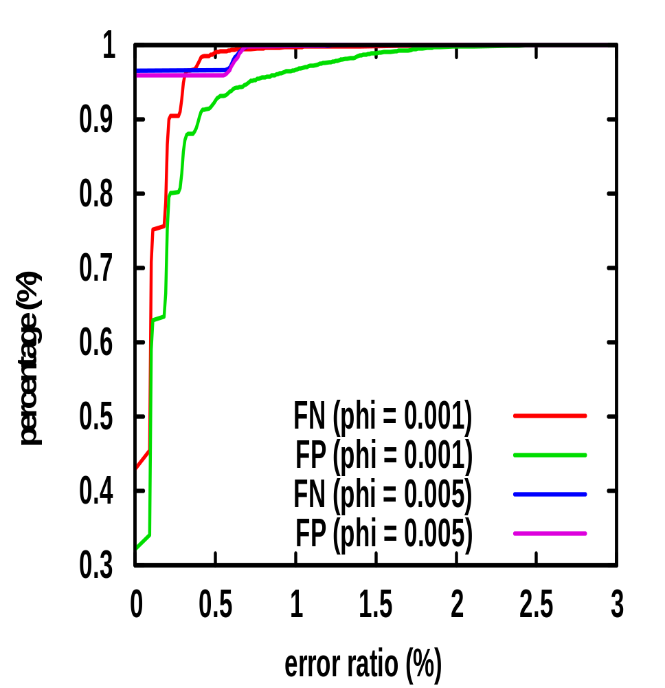
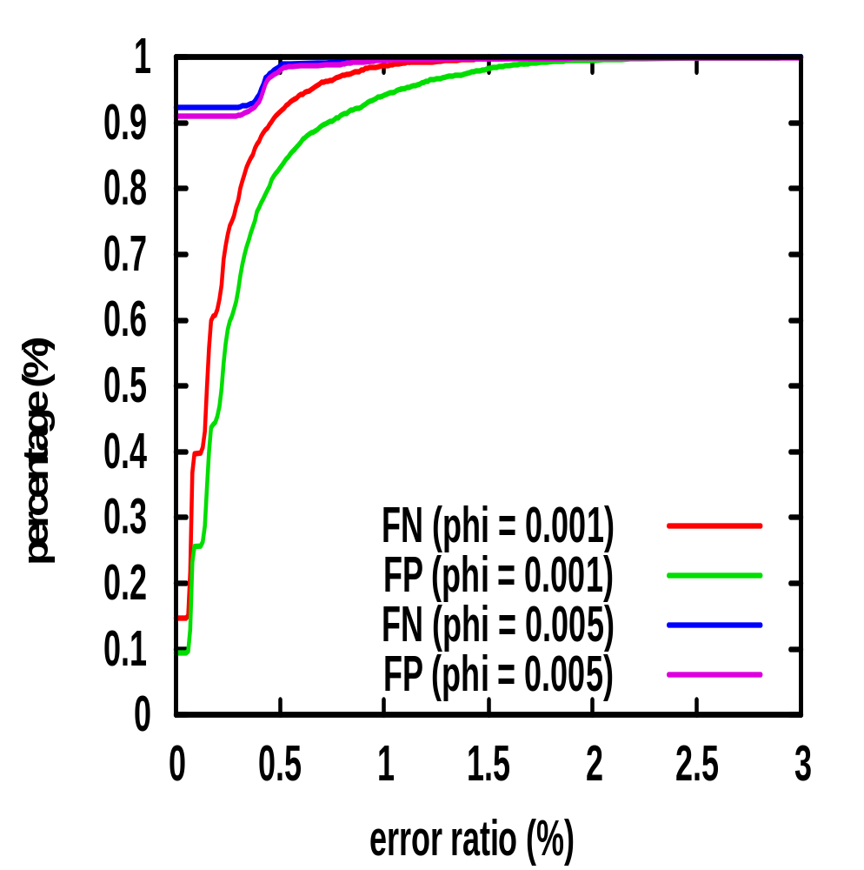
HHH Accuracy Across Time
ISP-1mon (router 1)
ISP-1mon (router 2)
Notes:
Gran = 1; epsilon = 0.001, algo: got*

