Slide 1
Sketch-based Change Detection
Balachander Krishnamurthy (AT&T)
Subhabrata Sen (AT&T)
Yin Zhang (AT&T)
Yan Chen (UCB/AT&T)
ACM Internet Measurement Conference 2003

Slide 2
Network Anomaly Detection
Network anomalies are common
  Flash crowds, failures, DoS, worms, …
Want to catch them quickly and accurately
Two basic approaches
  Signature-based: looking for known patterns
    E.g. backscatter [Moore et al.] uses address uniformity
    Easy to evade (e.g., mutating worms)
  Statistics-based: looking for abnormal behavior
    E.g., heavy hitters, big changes
    Prior knowledge not required
This talk

Slide 3
Change Detection
Lots of prior work
  Simple smoothing & forecasting
    Exponentially weighted moving average (EWMA)
  Box-Jenkins (ARIMA) modeling
    Tsay, Chen/Liu (in statistics and economics)
  Wavelet-based approach
    Barford et al. [IMW01, IMW02]

Slide 4
The Challenge
Potentially tens of millions of time series !
  Need to work at very low aggregation level (e.g., IP level)
    Changes may be buried inside aggregated traffic
  The Moore’s Law on traffic growth … ☹
Per-flow analysis is too slow / expensive
  Want to work in near real time
Existing approaches not directly applicable
  Estan & Varghese focus on heavy-hitters
Need scalable change detection

Slide 5
Sketch-based Change Detection
Sketch
module
Forecast
module(s)
Error
Sketch
Change
detection
module
(k,u) …
Sketches
Alarms
Input stream: (key, update)
Summarize input stream using sketches
Build forecast models on top of sketches
Report flows with large forecast errors

Slide 6
Outline
Sketch-based change detection
  Sketch module
  Forecast module
  Change detection module
Evaluation
Conclusion & future work

Slide 7
Sketch
Probabilistic summary of data streams
  Originated in STOC 1996 [AMS96]
  Widely used in database research to handle massive data streams
 | Space | Accuracy
Hash table | Per-key state | 100%
Sketch | Compact | With probabilistic guarantees (better for larger values)

Slide 8
K-ary Sketch
Array of hash tables: T_{j}[K] (j = 1, …, H)
  Similar to count sketch, counting bloom filter, multi-stage filter, …
Update (k, u): T_{j} [ h_{j}(k)] += u (for all j)
0
h₁(k)
…
1
K-1
1
…
h_{j}(k)
j
…
h_{H}(k)
H

Slide 9
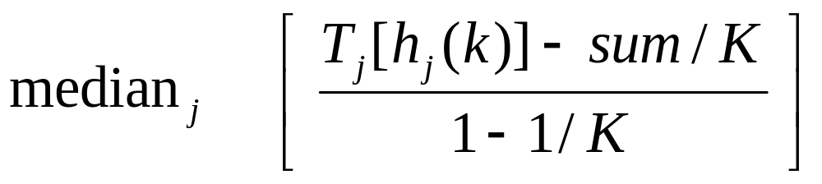
K-ary Sketch (cont’d)
Estimate v(S, k): sum of updates for key k
unbiased estimator of v(S,k) with low variance
boost
confidence
v(S, k) +
noise
compensate
for signal loss
v(S, k)/K +
E(noise)
0
h₁(k)
…
1
K-1
1
…
h_{j}(k)
j
…
h_{H}(k)
H

Slide 10
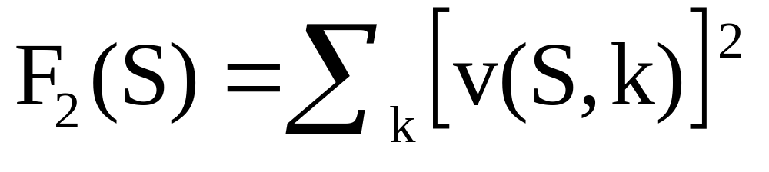
K-ary Sketch (cont’d)
Estimate the second moment (F₂)
Sketches are linear
  Can combine sketches
  Can aggregate data from different times, locations, and sources
+
=

Slide 11
Forecast Model: EWMA
Compute forecast error sketch: S_{error}
= -
S_{error}(t-1)
S_{observed}(t-1)
S_{forecast}(t-1)
Update forecast sketch: S_{forecast}
= ∗α + ∗(1−α)
S_{forecast}(t)
S_{observed}(t-1)
S_{forecast}(t-1)

Slide 12
Other Forecast Models
Simple smoothing methods
  Moving Average (MA)
  S-shaped Moving Average (SMA)
  Non-Seasonal Holt-Winters (NSHW)
ARIMA models (p,d,q)
  ARIMA 0 (p ≤ 2, d=0, q ≤ 2)
  ARIMA 1 (p ≤ 2, d=1, q ≤ 2)

Slide 13
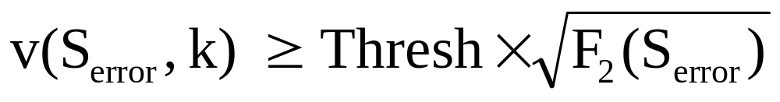
Find Big Changes
Top N
  Find N biggest forecast errors
  Need to maintain a heap
Thresholding
  Find forecast errors above a threshold

Slide 14
Evaluation Methodology
Accuracy
  Metric: similarity to per-flow analysis results
  This talk focuses on
    TopN (Thresholding is very similar)
    Accuracy on real traces (Also has data-independent probabilistic accuracy guarantees)
Efficiency
  Metric: time per operation
Dataset description
Data | Duration | #routers | #records
 |  |  | Total | Range
Netflow | 4 hours | 10 | 190M | 861K – 60M

Slide 15
Experimental parameters
Parameter | Values
H | 1, 5, 9, 25
K | 8K, 32K, 64K
N | 50, 100, 500, 1000
Interval | 1 min., 5 min.
Model | 6 forecast models
Router | 10 (this talk: Large, Medium)

Slide 16
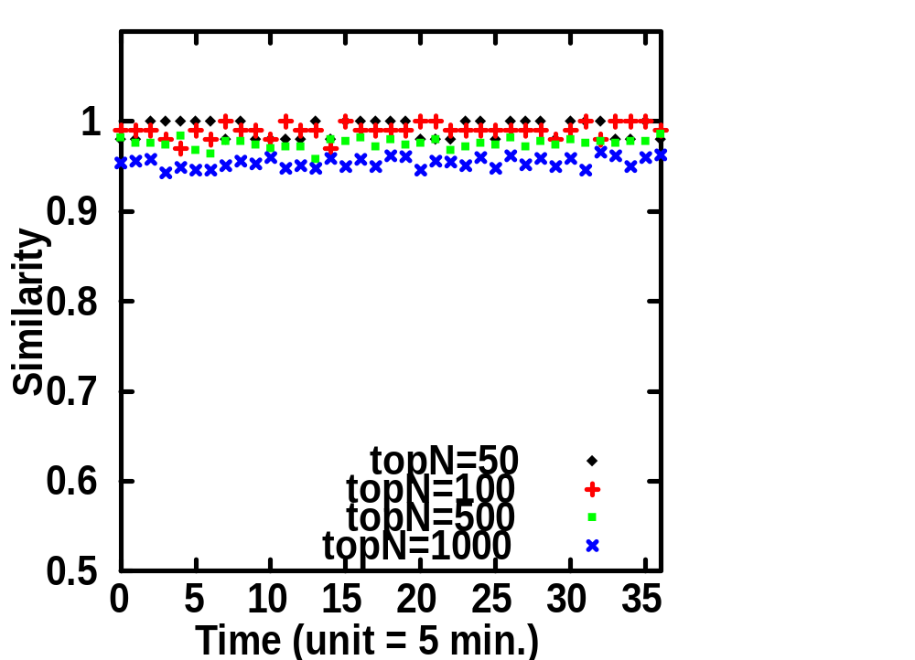
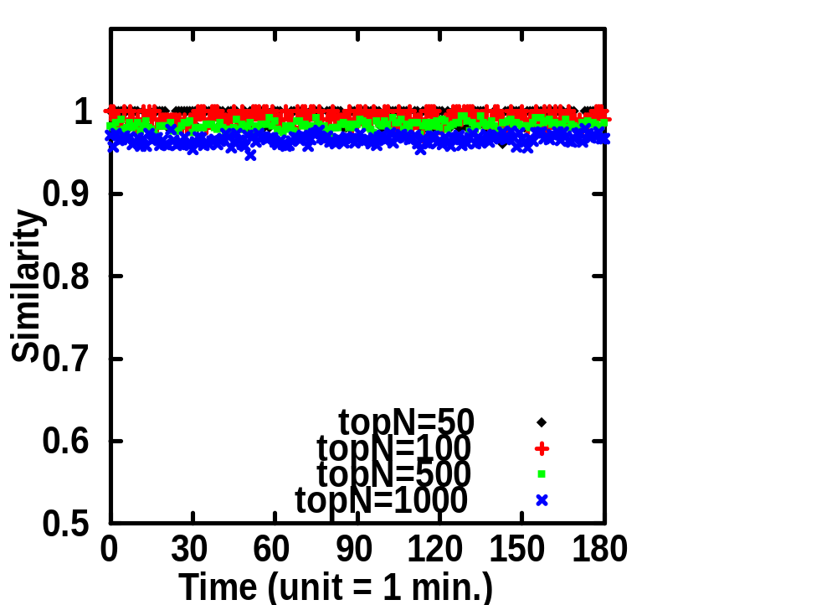
Accuracy
H = 5, K = 32768, Router = Large
Similarity = | TopN_sketch ∩ TopN_perflow | / N

Slide 17
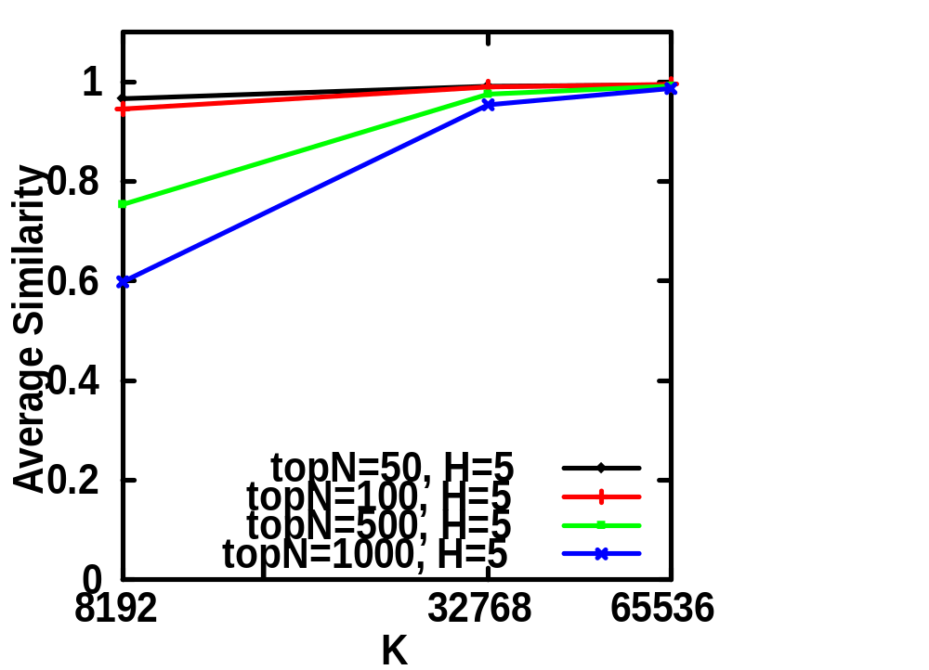
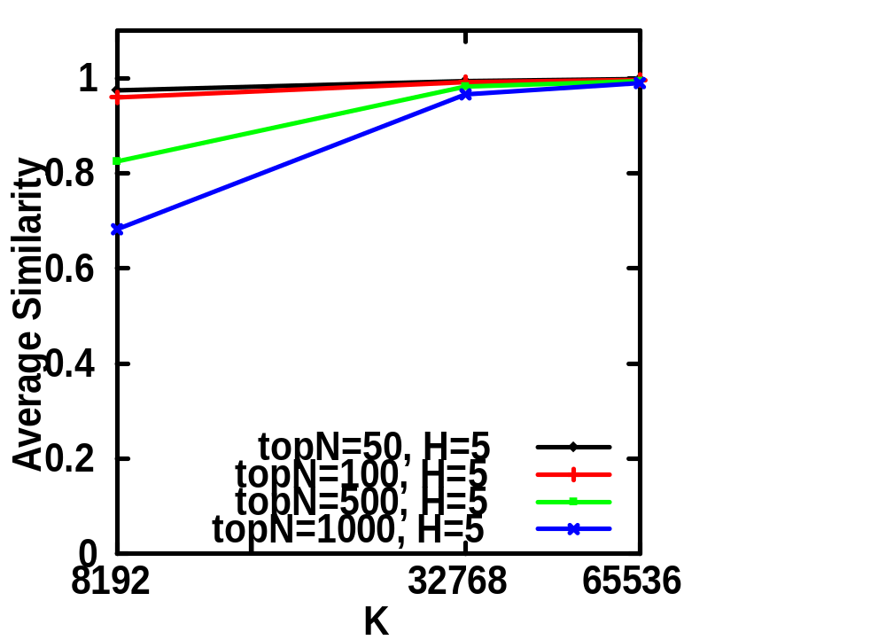
Accuracy (cont’d)
Model = EWMA, Router = Large
Interval = 5 min.
Interval = 1 min.

Slide 18
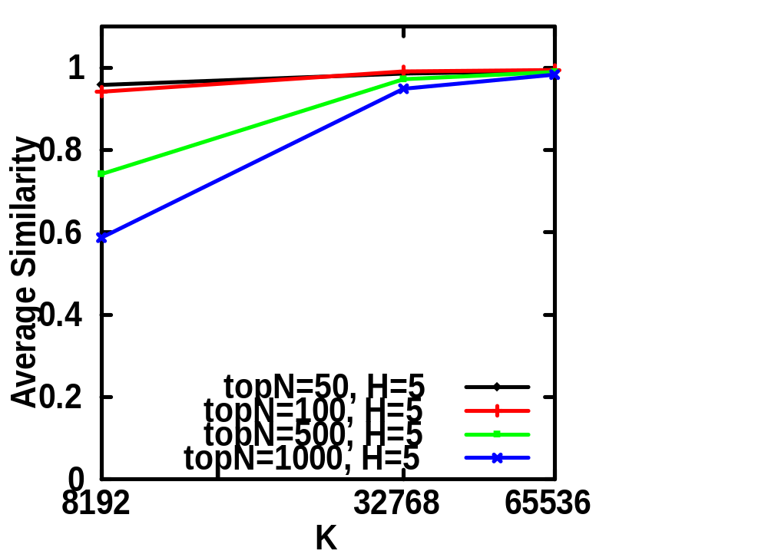
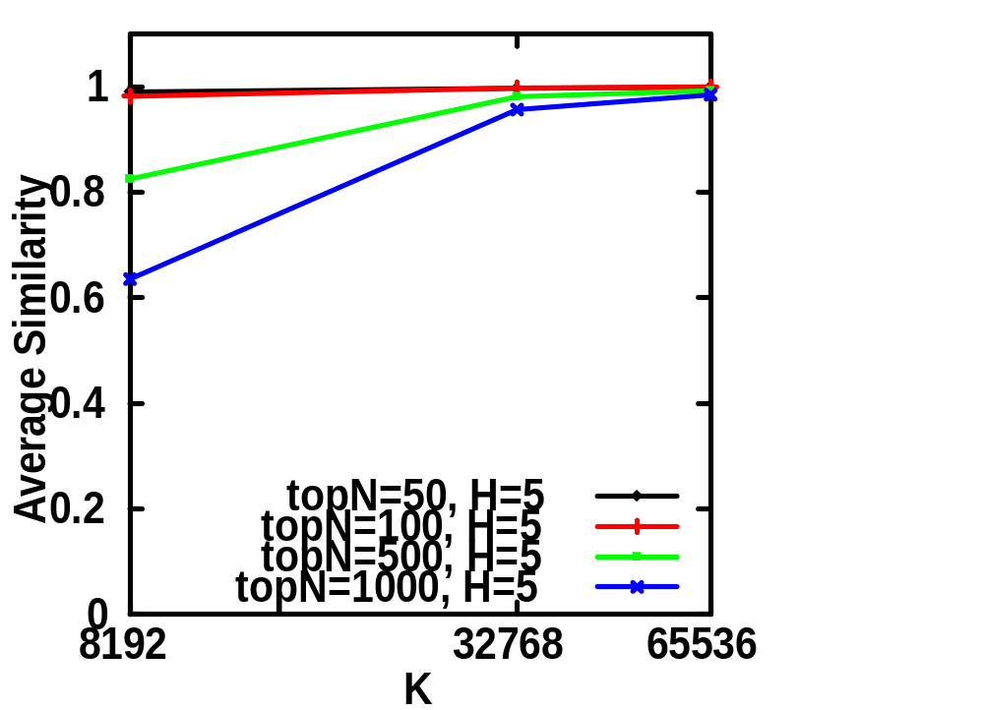
Accuracy (cont’d)
Model = ARIMA 0, Interval = 5 min.
Router = Large
Router = Medium

Slide 19
Accuracy Summary
For small N (50, 100), even small K (8K) gives very high accuracy
For large N (1000), K = 32K gives about 95% accuracy
Router, interval, and forecast model make little difference
H generally has little impact

Slide 20
Efficiency
Operation (H=5, K = 64K) | Nanoseconds per operation
 | 400MHz SGI R12k | 900MHz Ultrasparc-II
Hash computation | 34 | 89
Update cost | 81 | 45
Estimate cost | 269 | 146
1 Gbps = 320 nsec per 40-byte packet
Can potentially work in near real time.

Slide 21
Conclusion
Sketch-based change detection
Scalable
  Can handle tens of millions of time series
Accurate
  Provable probabilistic accuracy guarantees
  Even more accurate on real Internet traces
Efficient
  Can potentially work in near real time
Error
Sketch
(k,u) …
Sketch
module
Sketches
Forecast
module(s)
Change
detection
module
Alarms

Slide 22
Ongoing and Future Work
Refinements
  Avoid boundary effects due to fixed interval
  Automatically reconfigure parameters
  Combine with sampling
Extensions
  Online detection of multi-dimensional hierarchical heavy hitters and changes
Applications
  Building block for network anomaly detection

Slide 23
Thank you!

Slide 24
Heavy Hitter vs. Change Detection
Change detection for heavy hitters
  Can potentially use different parameters for different flows
  Heavy hitter ≠ big change
    Need small threshold to avoid missing changes
  Aggregation is difficult
Sketch-based change detection
  All flows share the same model parameters
  Aggregation is very easy due to linearity

