Slide 1




Toward Privacy-Preserving Interdomain Configuration Verification via Multi-Party Computation
通过多方计算实现的隐私保护域间配置验证
Huisan Xu¹, Qiuyue Qin¹, Xing Fang¹, Qiao Xiang¹, Jiwu Shu¹ ²,
¹ Xiamen University, ² Minjiang University
06/19/2023, APNet 2023

Slide 2
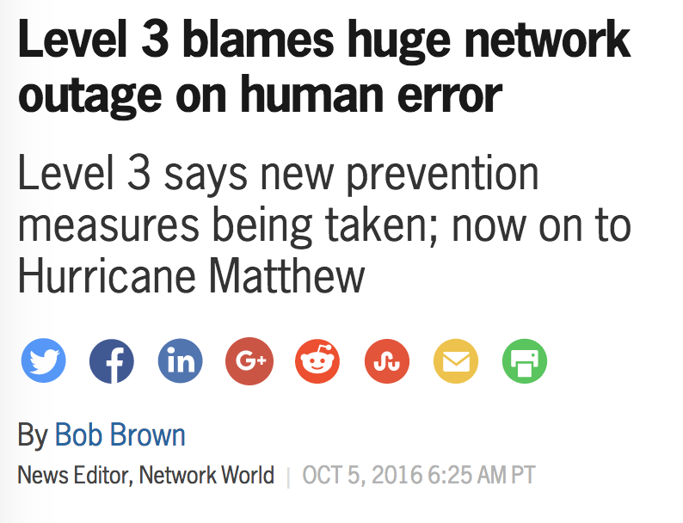

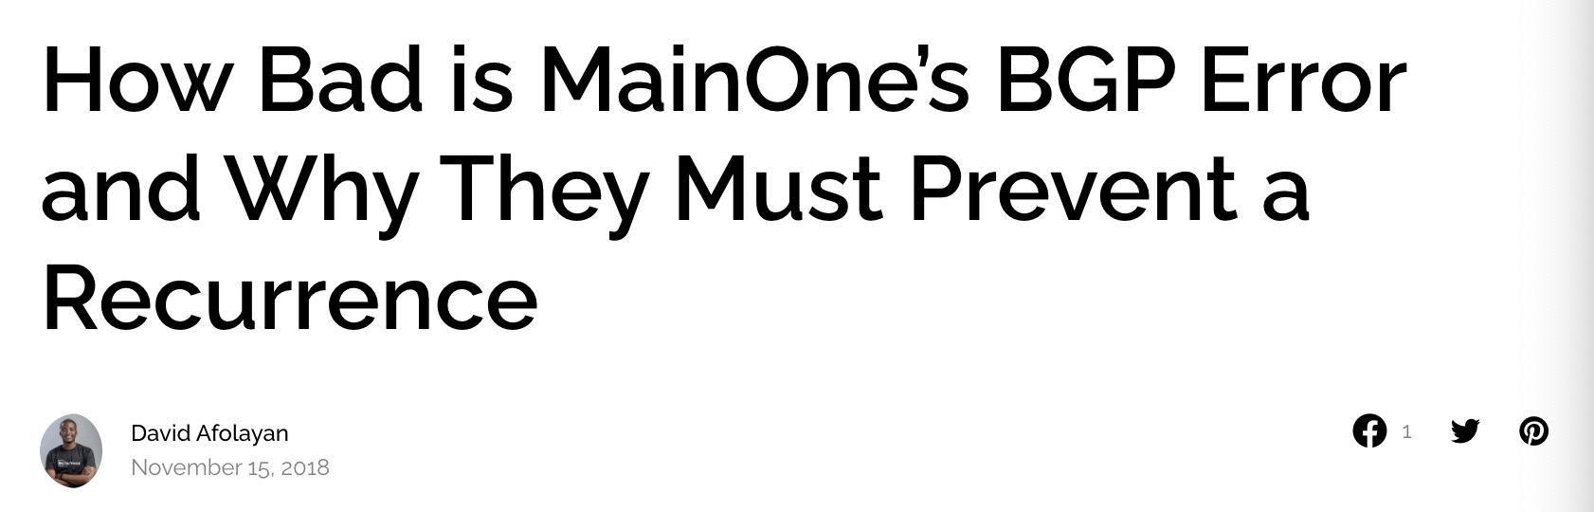
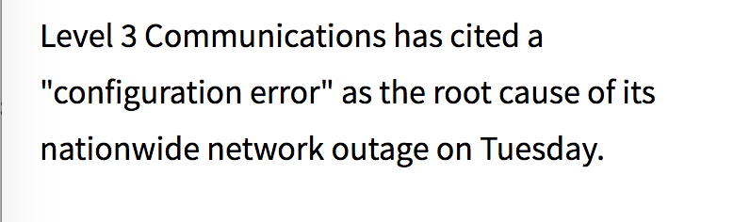
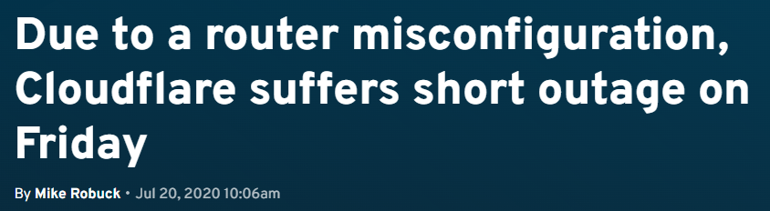
域间网络的配置错误非常普遍

Slide 3
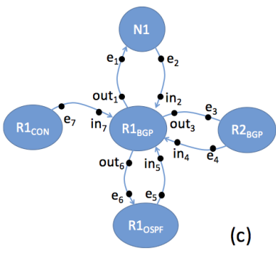
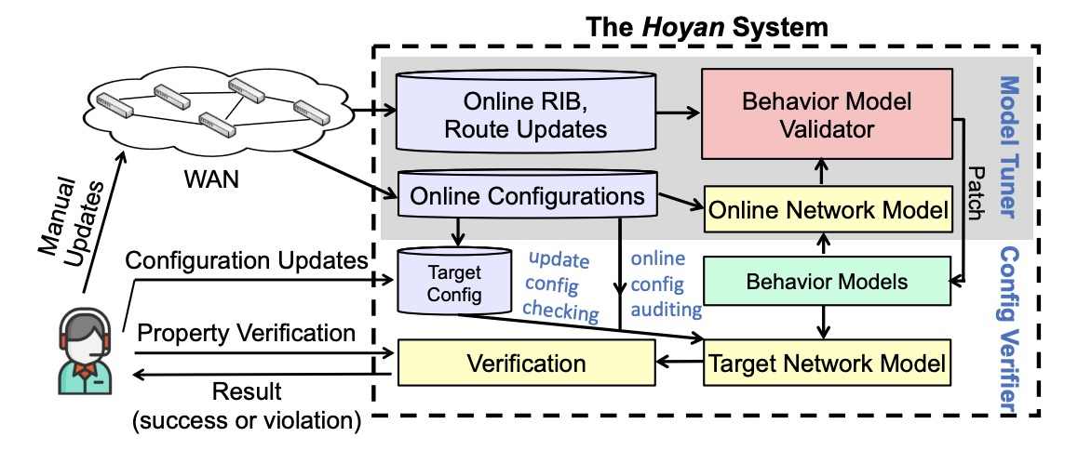
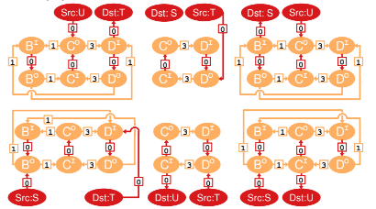
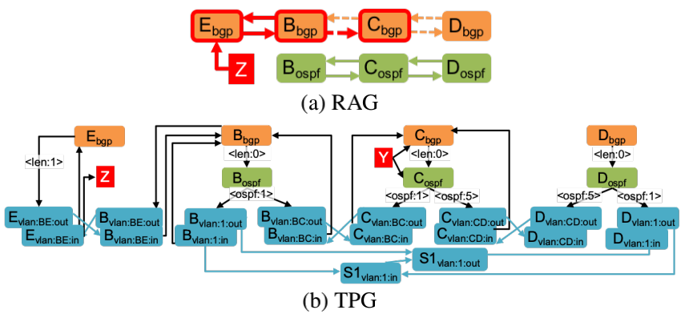
网络验证:
防配置错误于未然
ARC (SIGCOMM'16)
Minesweeper (SIGCOMM'17)
Tiramisu (NSDI'20)
Hoyan (SIGCOMM'20)
However, these tools all work
in the setting of single domain.

Slide 4

域间配置验证案例
In real-world operations, AS S can only find that it cannot reach P after all ASes deploy their configurations.
AS C
prefer E as next hop
AS S
AS A
AS B
AS E
AS D
AS F
IP prefix P
drop all paths containing E
Fundamental challenge: each AS treats its configuration as private information.

Slide 5
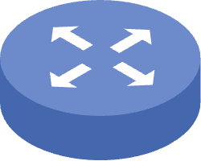
解决方案: 隐私保护的域间配置验证
Leverage secure multi-party computation to allow participating ASes to collaboratively verify their BGP configurations while keeping them private.
Secure multi-party computation
private configurations

Slide 6




lnCV: 系统架构与工作流程
√
AS’s agent A
B
D
E
(2) DO-Simulation
Topology information (public)
Secret data-plane (private)
C
(3) DO-DPV
Result (public)
Intermidiate
representation
(private)
User requirement (public)
AS A
B
D
E
(1) Configuration transformation
C

Slide 7
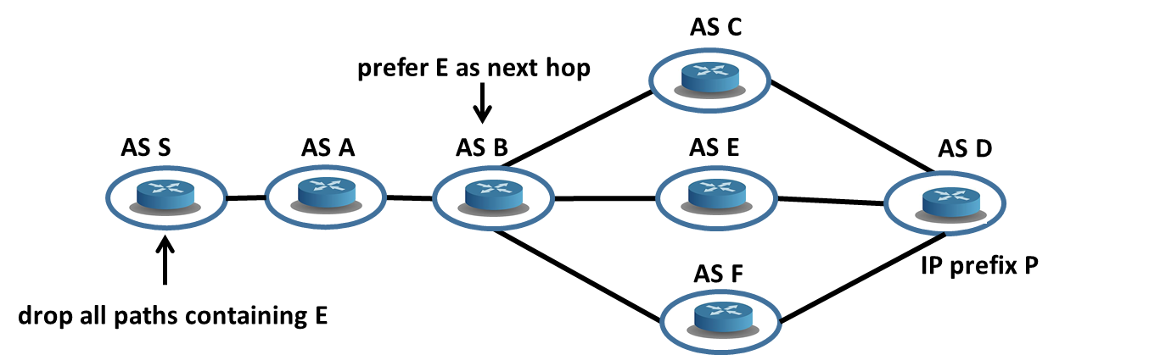

DO-simulation: BGP协议模拟
Global update status
0 | 0 | 1 | 0 | 1 | 1 | 0
Import filter
Export filter
0 | 0 | 0 | 1 | 0 | 0 | 0
Route selection
Global update status
RIB
Import filter
Export filter
Route selection
……
RIB
Select an AS to process its advertisement message.
Simulate route advertisement considering export and import filters.
Simulate route selection & update RIBs.
Import filter
Export filter
Route selection
RIB
Notes:
In each iteration, the AS whose advertisement list is not empty will be chosen.
Then, the node will send the route advertisements in the list to its neighbors. The export and import functions filter will be considered.
The compare function compares the import routes with the current best path. If the import route has higher priority according to the route attributes, the best path and advertisement list will update. There are two types of route advertisements

Slide 8
DO-simulation:
从 BGP 模拟到数据遗忘的模拟算法
SMPC-primitives: 𝑛-party SMPC primitives based on Shamir’s secret sharing.
(e.g. addition,multiplication,comparison)
Data-obliviousness:
encode key input as data-oblivious data structures (e.g., vectors and matrices).
execute both branches of conditional statements (i.e., if) to hide actual execution sequence.
SMPC
primitives
SMPC
Data-obliviousness
A data-oblivious algorithm built on SMPC
primitives makes an SMPC [1]
[1] S. Dov Gordon, Jonathan Katz. et al. 2012. Secure Two-Party Computation in Sublinear (Amortized) Time. In CCS ’12. ACM, 513–524.

Slide 9
通过全局最优的路由通告顺序加速DO-simulation
AS C
Key idea: Let ASes with global optimal route announcements send their updates first.
To support the non-monotonic networks, we implement the route withdrawal operation on top of FASTPLANE [2].
prefer E as next hop
AS S
AS A
AS B
AS E
AS D
AS F
IP prefix P
drop all paths containing E
Withdrawal
happens
ASes’ order in desecending global priority:
D C E F B A S
[2] Nuno P. Lopes and Andrey Rybalchenko. 2019. Fast BGP Simulation of Large Datacenters. In VMCAI’19. Springer, 386–408

Slide 10
DO-DPV: 数据遗忘的网络性质检验
AS C
prefer E as next hop
AS S
AS A
AS B
AS E
AS D
DFS-based traversal algorithm on the simulated data-plane [3]
For some properties (e.g. blacklisting), a linear scan on the source’s RIB would suffice.
AS F
IP prefix P
drop all paths containing E
Secret data-plane
IP prefix | AS path
… | …
Encoded by Shamir’s secret sharing.
no agent can independently know the network data plane
[3] Marina Blanton. et al. 2013. Data-Oblivious Graph Algorithms for Secure Computation and Outsourcing. In ASIA CCS’13. ACM, 207-218.

Slide 11

实验背景
Environment:
We implement our system on MP-SPDZ [4].
Topology & configurations:
27 synthesized networks ranging from 6 to 32 ASes as datasets.
~100 lines of configuration for each AS
Correctness of InCV.
Overhead of InCV.
Efficacy of simulation acceleration.
Correct in all experiments.
[4] Marcel Keller. 2020. MP-SPDZ: A Versatile Framework for Multi-Party Computation. In CCS’20. ACM, 1575–1590.

Slide 12
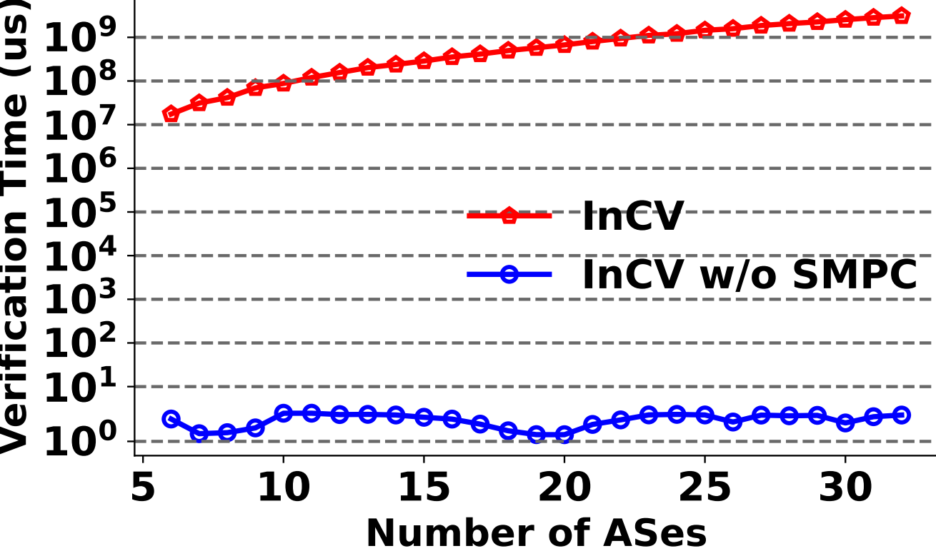
实验: InCV的计算开销
Verification time of InCV
InCV can verify a network of 32 ASes at ∼52 minutes.

Slide 13
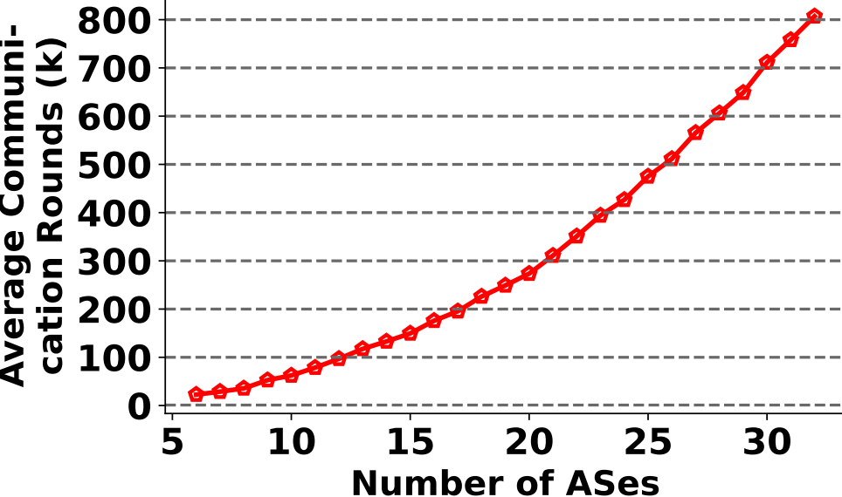
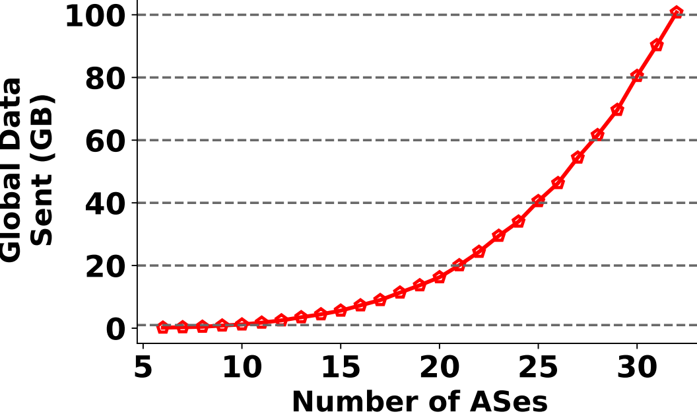
实验: InCV的计算开销
The communication overhead of agents is acceptable at ∼ 30 ASes.

Slide 14
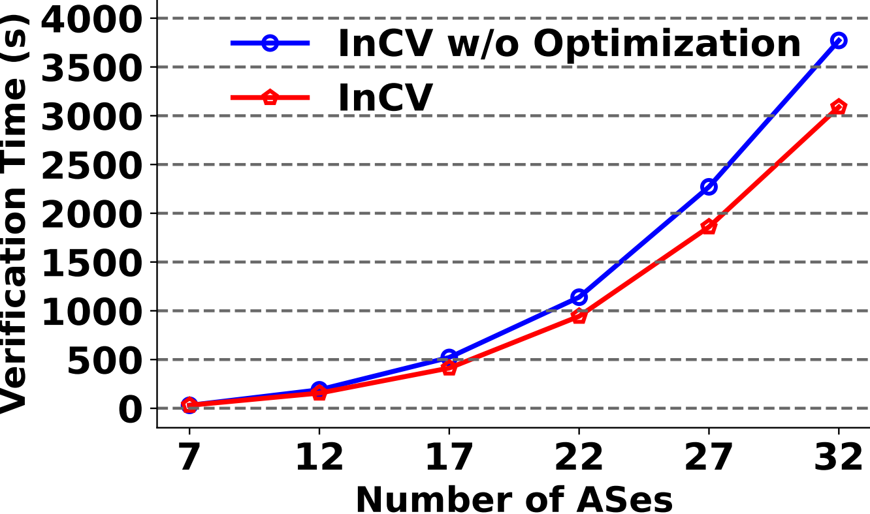
实验: 模拟加速的有效性评估
Preliminary results show interdomain verification is feasible.
The performance of simulation optimization
About 19% acceleration has been achieved for the network with 32 ASes.

Slide 15
总结
We take a first step to study interdomain network configuration verification.
We design InCV, a first privacy-preserving interdomain network configuration verification system.
We implement InCV and demonstrate the capability of InCV.

Slide 16
开放性讨论
Optimizations to scale interdomain verification for larger networks
More complex BGP route attributes and interdomain network properties
Incremental interdomain configuration verification
Incremental deployment
Stronger security model

Slide 17


Toward Privacy-Preserving Interdomain Configuration Verification via Multi-Party Computation
Thank you!
SNGroup: sngroup.tech
Contact us: sngroup.xmu@outlook.com

Slide 18
lnCV: architecture and workflow
InCV use the simulation-based verification approach. Participating
ASes send their private configurations to the cloud, then get the verification result.
(1). Configuration transformation
Intermidiate
representation
(private)
User requirement (public)
(2). DO-Simulation
Secret data-plane (private)
Result (public)
...
InCV
(3). DO-DPV
Result (public)
(1). Configuration transformation
Intermidiate
representation
(private)
Topology information (public)

