Slide 1
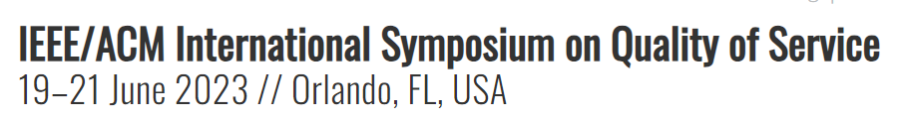






Toward a Unified Framework for Verifying and Interpreting Learning-Based Networking Systems
Yangfan Huang¹, Yuling Lin¹, Haizhou Du², Yijian Chen², Haohao Song¹, Linghe Kong³, Qiao Xiang¹, Qiang Li⁴, Franck Le⁵, Jiwu Shu¹ ⁶,
¹ Xiamen University, ² Shanghai University of Electric Power, ³ Shanghai Jiao Tong University,
⁴ Alibaba, ⁵ IBM Research, ⁶ Minjiang University
06/19/2023, IWQoS 2023

Slide 2
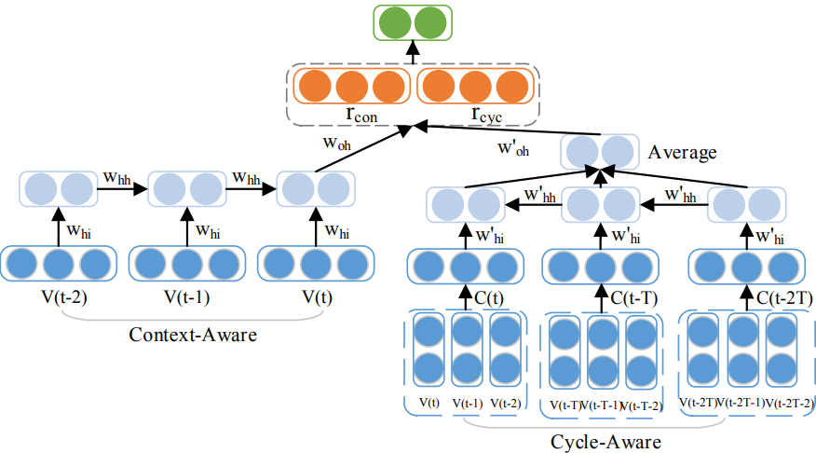
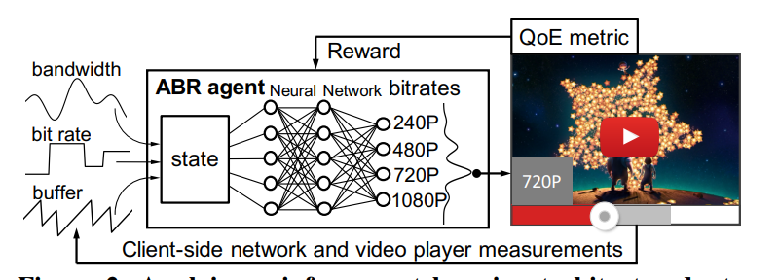
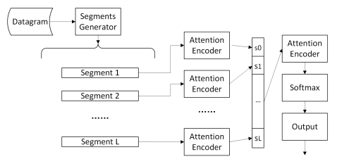
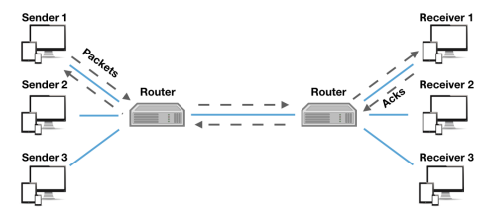
Learning-Based Networking Systems
Anomaly Prediction(IWQoS’16)
Adaptive Video Streaming(SIGCOMM’17)
Network Traffic Classification(IWQoS’18)
Congestion Control(ICML’19)

Slide 3



How to Understand Learning-Based Networking Systems?
How to judge the robustness of learning-based networking systems?
How to judge the rationality of learning-based networking systems?
How to improve the design of learning-based networking systems?
We can address these problems by verification and interpretation methods
BLACK-BOX
Input
Output
learning-based networking system

Slide 4

Related Work: Verification/Interpretation Methods
Anchor
AAAI’18
Counterfactual
Example
Harv. JL & Tech’17
Can we design a unified framework for verifying and interpreting learning-based networking systems?
Specific solutions for specific verification/interpretation problems
Verification
verify the robustness of model
Adversarial Perturbation
INFOCOM’21
Decision Rules
Extreme Value
CAV’17
A Unified Framework
Feature Importance
AAAI’21
Sensitivity Analysis
NetAI’19
Missing Features
INFOCOM’21
provide rules to explain model’s behaviors;
analyze the impact of each feature on decision
Interpretation

Slide 5



Key Insight
Verification answers whether a property holds
Always
Hold?
BLACK-BOX
They can be unified by satisfiability modulo theories (SMT)
Check
Input
Output
a set of property predicates
Interpretation answers what property holds
BLACK-BOX
Find
Input
Output
a set of property predicates
Notes:
Whether: given a learning-based system and a set of predicates on its input, examine whether a set of predicates on its output always holds.
What: given a learning-based system and a set of predicates on its output, find a set of predicates on its input satisfying certain criteria such that the predicates on the output always hold.

Slide 6
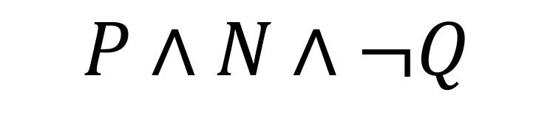
Key Insight: Unifying Verification/Interpretation Problems Using SMT
SMT formula:
$$P∧N∧¬Q$$
a set of assumption predicates
neural network model predicates
a set of property predicates
Verification
Check whether the SMT formula is unsatisfiable
Find key property that makes the SMT formula unsatisfiable
Interpretation
Notes:
given a learning-based system, a set of predicates P on system input and a set of predicates Q on system output, motivated by the recent success of computer network configuration verification and synthesis [21], [22], we can verify whether Q always holds by checking whether the SMT problem P ∧ N ∧ ¬Q is unsatisfiable, where N is an SMT formula encoding the machine learning model of the system. Moreover, given N and only the predicates Q on system output, we can find the predicates P satisfying certain criteria and guaranteeing that Q always holds by iteratively checking the satisfiability andrelated properties of multiple SMT formulas.

Slide 7
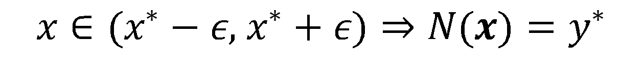
Example: Feature Perturbation
$$x∈(x^{∗}−ε, x^{∗}+ε)⇒N(x)=y^{∗}$$
input after perturbation
input before perturbation
output after perturbation
output before perturbation
Verification problem of adversarial perturbation:
Given an attack power $ε$, check whether the formula is satisfiable.
Interpretability problem of feature importance:
Change the attack power $ε$ through binary search and find the minimal $ε$ such that
the formula is unsatisfiable.
Notes:
the property of adversarial perturbation [11], [36] requires that: for a given input data with m features x∗ = [x∗1, . . . , x∗m] and its output y∗ = N (x∗), if there exists a small perturbation of no more than ε on each input feature, the output should not change. This property can be verified by checking the satisfiability of:
for example, the interpretability problem of feature importance asks to find the minimal ε such that Equation (1) of adversarial perturbation
property is unsatisfiable. Such an ε can be found by repeatedly solving Equation (1) using binary search.

Slide 8

UINT: Architecture and Workflow
UINT uses the planner to invoke the SMT engine iteratively, and returns the final verification/interpretability answer to the operator.
Call
SMT Formula
Planner
SMT Engine
Result
Answer
Notes:
rst, given a learning-based networking system, an operator specifies a verification or interpretability problem as an SMT formula, and sends it together with the learning model of this system to the UINT encoder. Second, the encoder automatically encodes the received learning model into an SMT formula and sends it together with the received problem to the UINT planner. Third, the planner analyzes the received problem and decides the corresponding SMT problems to solve. Fourth, the planner invokes the SMT engine, iteratively if necessary, to solve the received problem, and returns the final verification or interpretability answer to the operator. I

Slide 9
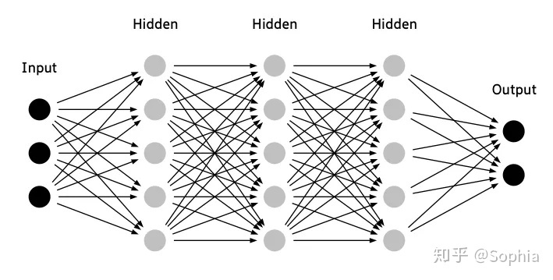
UINT: Encoding Neural Network Model
For input and output layers: encode them as predicates on their ranges.
For hidden layers: encodes the relationship between input and output variables as predicates.

Slide 10
UINT: Encoding Representative Verification Properties
Adversarial perturbation
$$∀i∈L, j∈F\backslash L, P_{l}(x_{i})∧P_{r}(x_{j})→N(x)=y^{∗}$$
Missing features
output after perturbation
output before perturbation
Features that can be perturbed.
All input features
the predicates on
perturbable input features
the predicates on
other input features.
Extreme
values

Slide 11


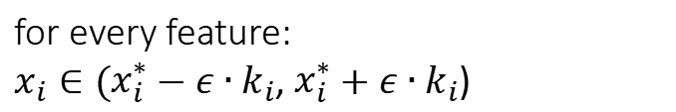


UINT: Encoding Representative Verification Properties
Adversarial perturbation
$$∀i∈L, j∈F\backslash L, P_{l}(x_{i})∧P_{r}(x_{j})→N(x)=y^{∗}$$
$$F$$
$x_{i}∈(x_{i}^{∗}−ε∙k_{i}$, $x_{i}^{∗}+ε∙k_{i}$)
for every feature:
$x_{i}∈(x_{i}^{∗}−ε∙k_{i}$, $x_{i}^{∗}+ε∙k_{i}$)
Missing features
$$x^{∗}$$
whether the output remains the same?
Extreme
values
$$y^{∗}$$
Notes:
given an (input, output) mapping (x∗, y∗), whether the output remains the same when each input feature may have a slight perturbation

Slide 12
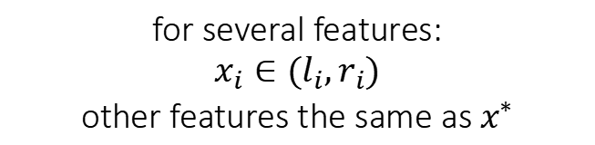


UINT: Encoding Representative Verification Properties
Adversarial perturbation
$$∀i∈L, j∈F\backslash L, P_{l}(x_{i})∧P_{r}(x_{j})→N(x)=y^{∗}$$
$x_{j}$=$x_{j}^{∗}$
a set of missing features
$$x_{i}∈(l_{i},r_{i})$$
for several features:
$$x_{i}∈(l_{i},r_{i})$$
other features the same as $x^{∗}$
Missing features
$$x^{∗}$$
whether the output remains the same?
Extreme
values
$$y^{∗}$$

Slide 13
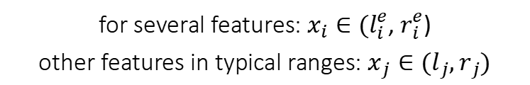


UINT: Encoding Representative Verification Properties
Adversarial perturbation
$$∀i∈L, j∈F\backslash L, P_{l}(x_{i})∧P_{r}(x_{j})→N(x)=y^{∗}$$
a set of features that take extreme values
$x_{i}∈(l_{i}^{e}$, $r_{i}^{e}$)
$$x_{j}∈(l_{j},r_{j})$$
Missing features
for several features:$x_{i}∈(l_{i}^{e}$, $r_{i}^{e}$)
other features in typical ranges:$x_{j}∈(l_{j},r_{j})$
$$x^{∗}$$
whether the output remains the same?
Extreme
values
$$y^{∗}$$

Slide 14
UINT: Encoding Reprensentative Interpretability Problems
Rule explanation
$$∀i∈L, j∈F\backslash L, P_{l}(x_{i})∧P_{r}(x_{j})∧N∧Q(N(x))$$
Features that can be perturbed
All input features
the predicates on neural network model
the predicates on output after perturbation
the predicates on
perturbable input features
the predicates on
other input features
Feature attribution

Slide 15

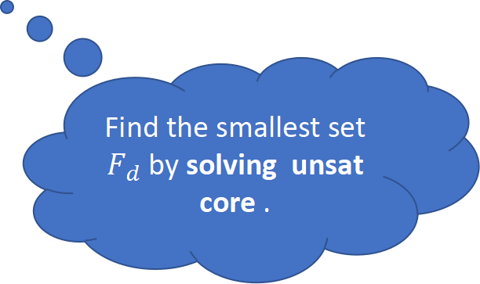


UINT: Encoding Reprensentative Interpretability Problems
Rule explanation
$$∀i∈L, j∈F\backslash L, P_{l}(x_{i})∧P_{r}(x_{j})∧N∧Q(N(x))$$
$$x_{j}=x_{j}^{∗}$$
N($x$)$≠y^{∗}$
Anchor
find the smallest set $F_{d},$
$∀j∈F_{d},x_{j}$=$x_{j}^{∗}$
$$x^{∗}$$
Find the smallest set $F_{d}$ by solving unsat core .
Feature attribution
$$y^{∗}$$

Slide 16
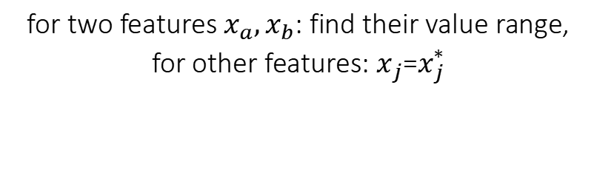



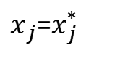
UINT: Encoding Reprensentative Interpretability Problems
Rule explanation
$$∀i∈L, j∈F\backslash L, P_{l}(x_{i})∧P_{r}(x_{j})∧N∧Q(N(x))$$
$x_{j}$=$x_{j}^{∗}$
$x_{a}$, $x_{b}$
($x_{a}∈(l_{a}, r_{a})⋀{(x}_{b}∈(l_{b},r_{b}))$
N($x$)$=y^{∗}$
Decision boundary
for two features $x_{a},x_{b}$: find their value range,
for other features:$x_{j}$=$x_{j}^{∗}$
$$x^{∗}$$
Feature attribution
Find value range by solving the SMT formula multiple times until it returns unsat .
$$y^{∗}$$

Slide 17
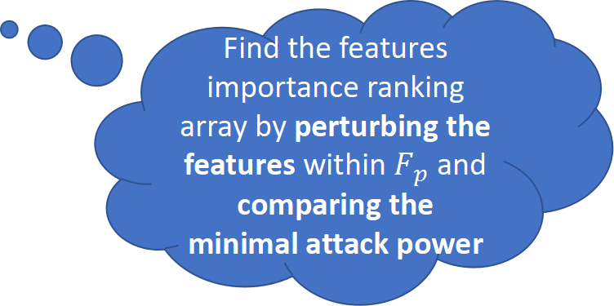
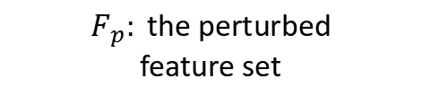

UINT: Encoding Reprensentative Interpretability Problems
Rule explanation
$$∀i∈L, j∈F\backslash L, P_{l}(x_{i})∧P_{r}(x_{j})∧N∧Q(N(x))$$
$F_{p}:$the perturbed
feature set
$$x_{j}=x_{j}^{∗}$$
N($x$)$≠y^{∗}$
$$x_{i}∈(x_{i}^{∗}−ε,x_{i}^{∗}+ε)$$
$$x^{∗}$$
Feature importance
Find the features
importance ranking array by perturbing the features within $F_{p}$ and comparing the minimal attack power
Feature attribution
$$y^{∗}$$

Slide 18

Evaluation: Setting
Learning-based networking systems:
Pensieve: An RL-based adaptive video bitrate selection system. (SIGCOMM’17)
Aurora: An RL-based congestion control protocol. (ICML’19)
Environment:
Our prototype uses Z3 as the SMT engine.
Can our framework solve common verification/interpretability questions of different learning-based networking systems, and how efficient is it?

Slide 19
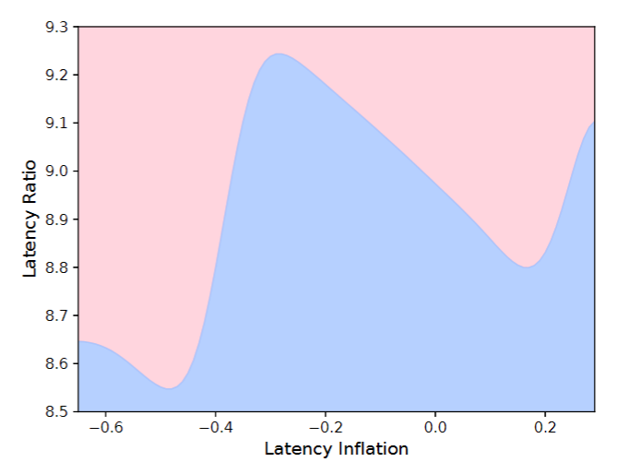
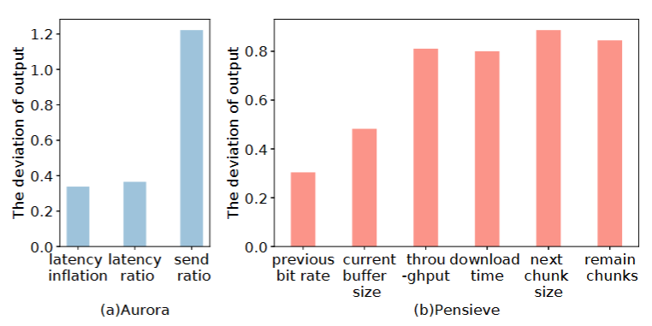
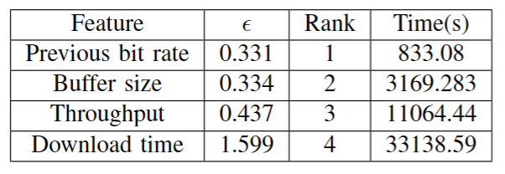
Evaluation: Representative Results
Sensitivity analysis for Aurora and Pensieve
Decison boundary for Aurora
UINT can solve common verification/interpretability problems of learning-based networking systems!
Minimal attack power of Aurora

Slide 20
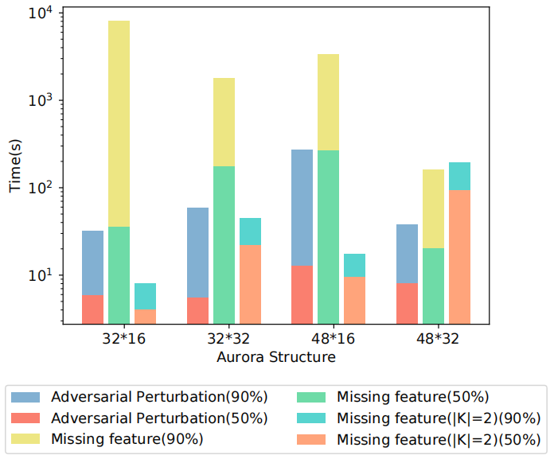
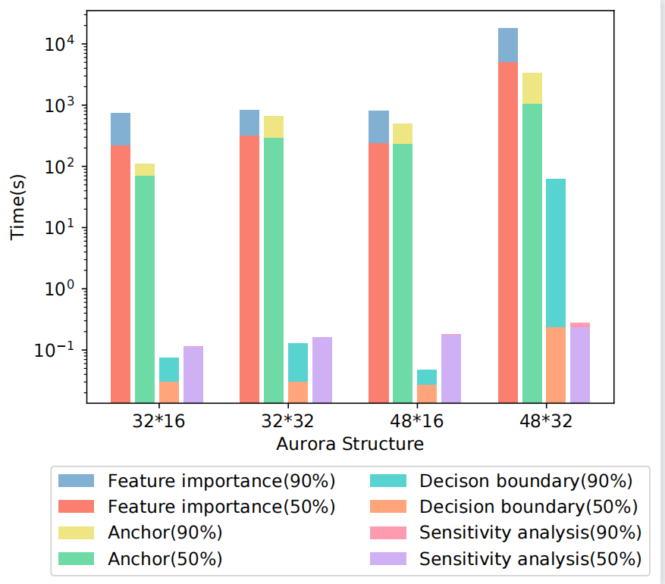
Evaluation: Results
Property verification time distribution
Interpretability running time distribution
UINT can solve verification and interpretability problems in reasonable time!

Slide 21
Conclusion and Future Works
Conclusion:
We find verification and interpretability problems can be unified by SMT.
We propose UINT, a general verification and interpretability framework for learning-based networking systems.
We implement UINT with two systems and demonstrate the efficiency and efficacy of UINT.
Future works:
We will explore the possibility of UINT to handle more complex models.

Slide 22

Toward a Unified Framework for Verifying and Interpreting Learning-Based Networking Systems
Thank you!
Code available: https://github.com/sngroup-xmu/UINT
SNGroup: sngroup.tech
Contact us: sngroup.xmu@outlook.com

Slide 23
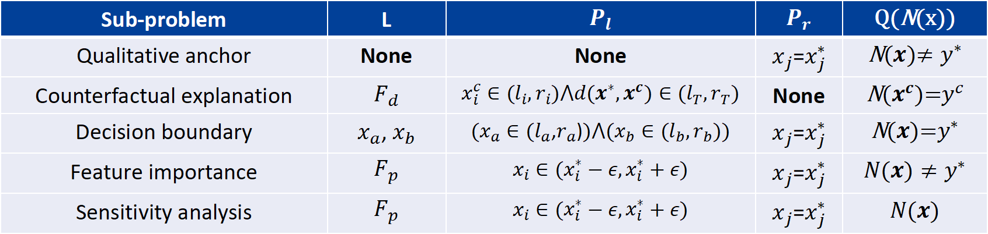
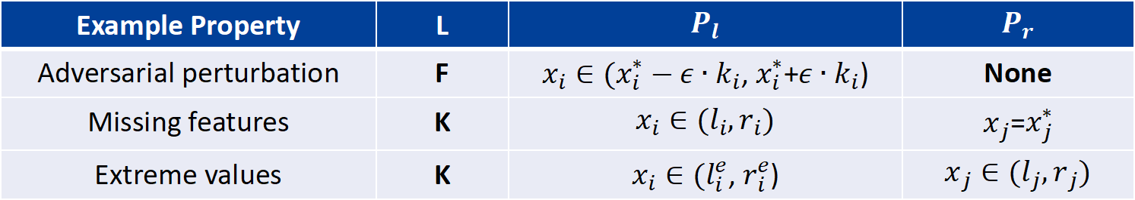
UINT: Generic Formula for V/I Problems
$$∀i∈L, j∈F\backslash L, P_{l}(x_{i})∧P_{r}(x_{j})→N(x^{∗})=y^{∗}$$
Example Property | L | $$P_{l}$$ | $$P_{r}$$
Adversarial perturbation | F | $x_{i}∈(x_{i}^{∗}−ε∙k_{i}$, $x_{i}^{∗}$+$ε∙k_{i}$) | None
Missing features | K | $$x_{i}∈(l_{i},r_{i})$$ | $x_{j}$=$x_{j}^{∗}$
Extreme values | K | $x_{i}∈(l_{i}^{e}$, $r_{i}^{e}$) | $$x_{j}∈(l_{j},r_{j})$$
$$∀i∈L, j∈F\backslash L, P_{l}(x_{i})∧P_{r}(x_{j})∧N∧Q(N(x))$$
Sub-problem | L | $$P_{l}$$ | $$P_{r}$$ | Q(N(x))
Qualitative anchor | None | None | $x_{j}$=$x_{j}^{∗}$ | N($x$)$≠y^{∗}$
Counterfactual explanation | $$F_{d}$$ | $$x_{i}^{c}∈(l_{i},r_{i})⋀d(x^{∗},x^{c})∈(l_{T},r_{T})$$ | None | N($x^{c}$)=$y^{c}$
Decision boundary | $x_{a}$, $x_{b}$ | ($x_{a}∈(l_{a}$,$r_{a}$)$)⋀{(x}_{b}∈(l_{b},r_{b}))$ | $x_{j}$=$x_{j}^{∗}$ | N($x$)=$y^{∗}$
Feature importance | $$F_{p}$$ | $$x_{i}∈(x_{i}^{∗}−ε,x_{i}^{∗}+ε)$$ | $x_{j}$=$x_{j}^{∗}$ | $$N(x)≠y^{∗}$$
Sensitivity analysis | $$F_{p}$$ | $$x_{i}∈(x_{i}^{∗}−ε,x_{i}^{∗}+ε)$$ | $x_{j}$=$x_{j}^{∗}$ | $$N(x)$$

