Slide 1
Network Applications: Operational Analysis; Load Balancing among Homogeneous Servers
Qiao Xiang
https://qiaoxiang.me/courses/cnns-xmuf22/index.shtml
10/11/2022
This deck of slides are heavily based on CPSC 433/533 at Yale University, by courtesy of Dr. Y. Richard Yang.

Slide 2
Outline
Admin and recap
HTTP
Basic design: HTTP 1.0
HTTP "acceleration"
Operational analysis
Multi-servers
Application overlays (peer-to-peer networks)

Slide 3
Admin
Lab assignment 2 due Oct. 13

Slide 4
Recap: Latency of Basic HTTP/1.0
>= 2 RTTs per object:
TCP handshake --- 1 RTT
client request and server responds --- at least 1 RTT (if object can be contained in one packet)
TCP SYN
TCP ACK
TCP/ACK; HTTP GET
base page
TCP SYN
TCP ACK
TCP/ACK; HTTP GET
image 1
Notes:
Typical approaches to reduce latency:
parallel TCP connections
persistent HTTP
cache and conditional GET

Slide 5
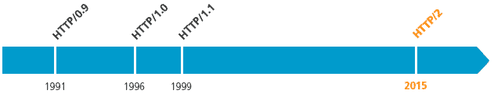
Recap: Substantial Efforts to Speedup HTTP/1.0
Reduce the number of objects fetched [Browser cache]
Reduce data volume [Compression of data]
Header compression [HTTP/2]
Reduce the latency to the server to fetch the content [Proxy cache]
Remove the extra RTTs to fetch an object [Persistent HTTP, aka HTTP/1.1]
Increase concurrency [Multiple TCP connections]
Asynchronous fetch (multiple streams) using a single TCP [HTTP/2]
Server push [HTTP/2]

Slide 6
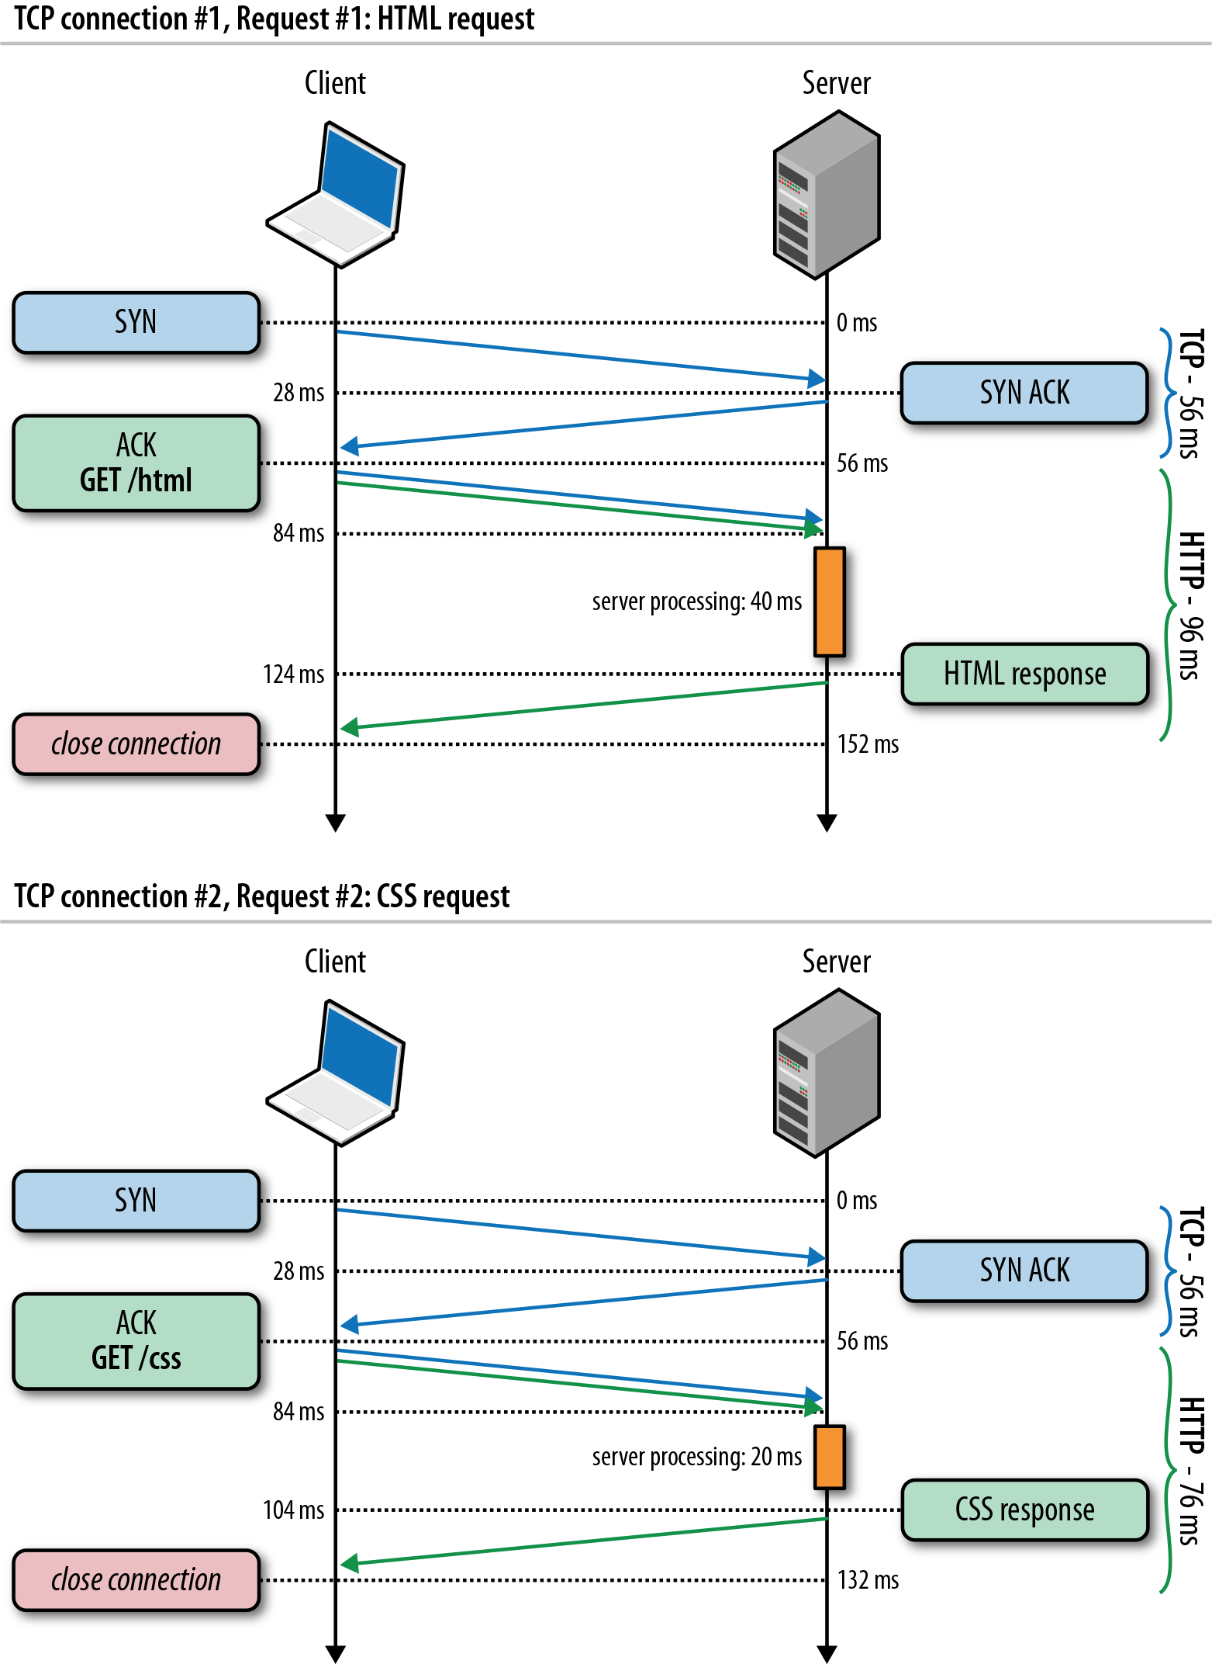
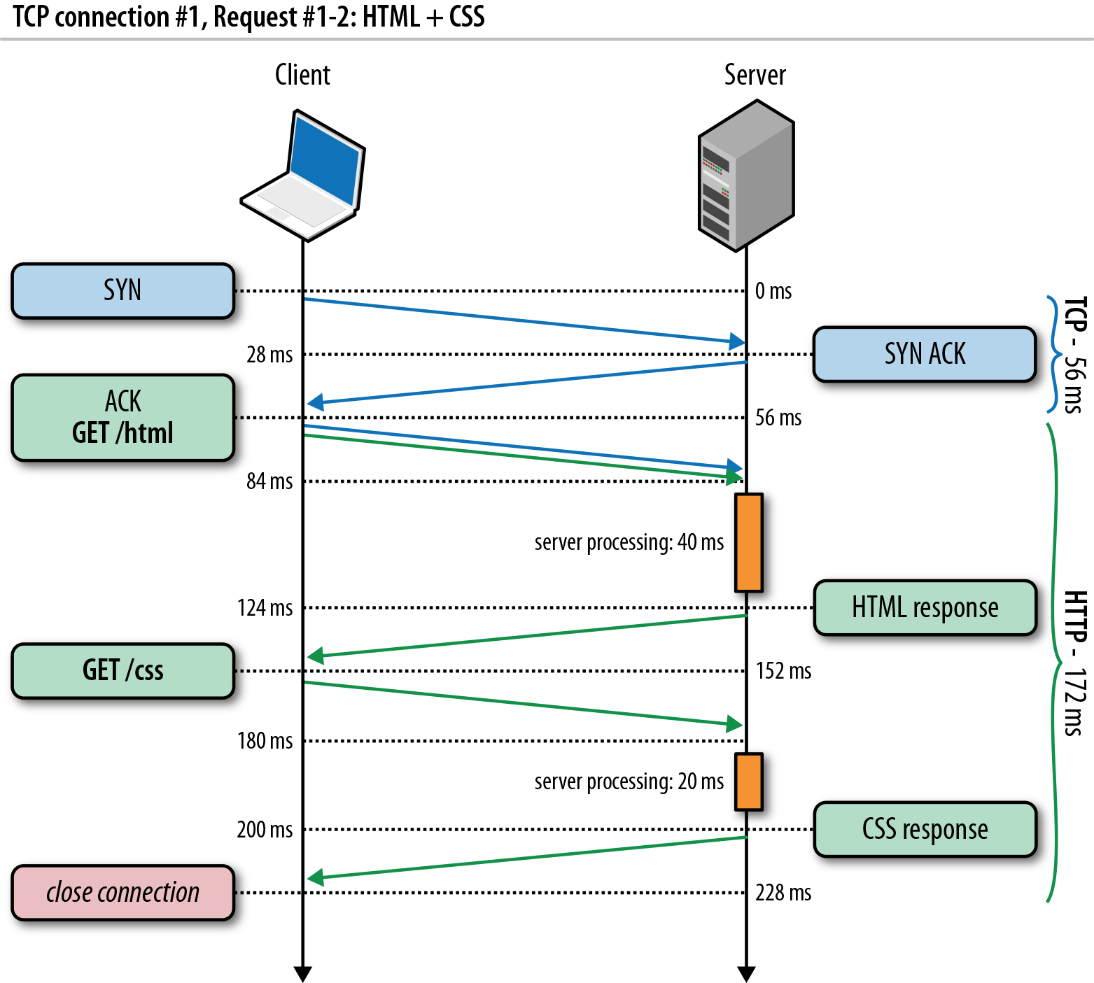
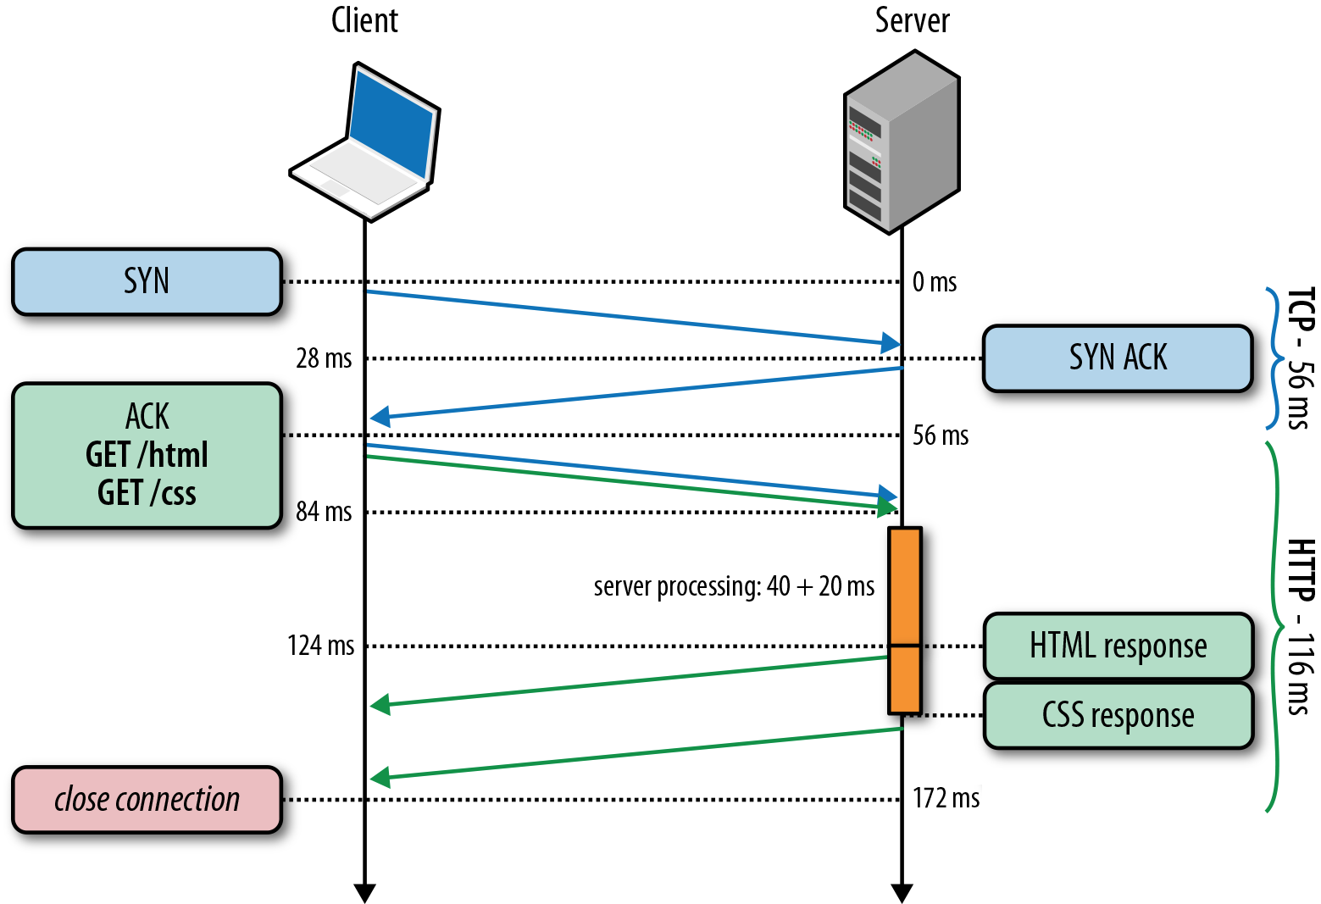
Recap: HTTP/1.0, Keep-Alive, Pipelining
Is this the best we can do?
Source: http://chimera.labs.oreilly.com/books/1230000000545/ch11.html
Notes:
https://httpd.apache.org/docs/2.2/howto/ssi.html

Slide 7
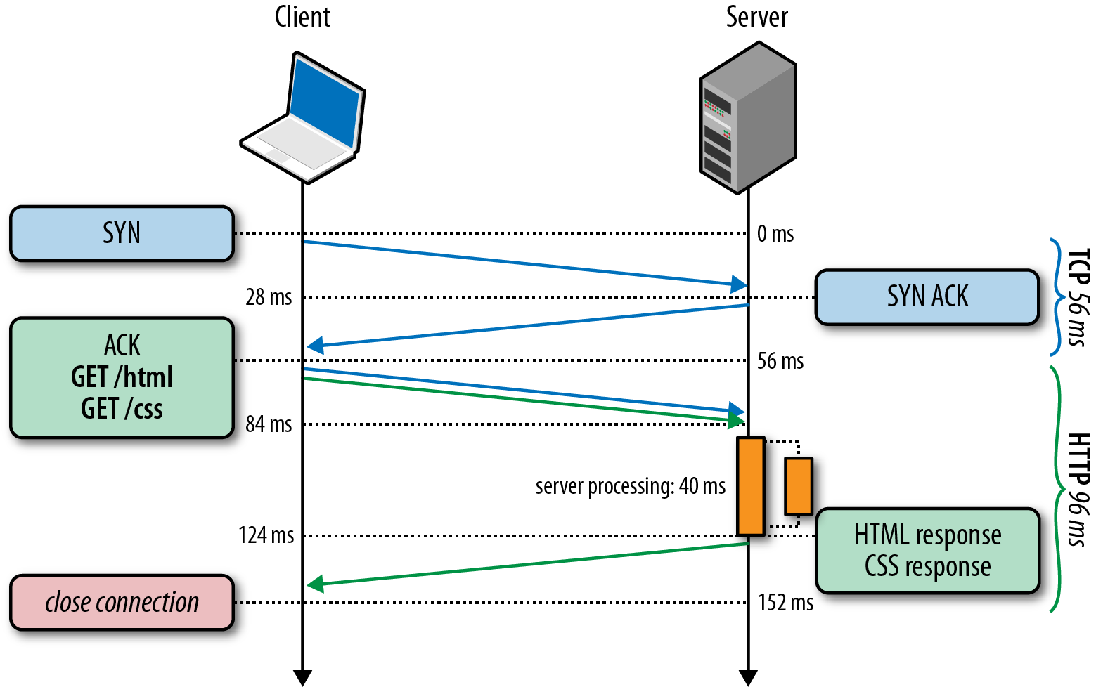
HTTP/2 Basic Idea: Remove Head-of-Line Blocking in HTTP/1.1
Data flows for sequential to parallel: two requests must be concurrent.
Demo: https://http2.akamai.com/demo
Source: http://chimera.labs.oreilly.com/books/1230000000545/ch11.html
Notes:
https://httpd.apache.org/docs/2.2/howto/ssi.html

Slide 8
Observing HTTP/2
export SSLKEYLOGFILE=/tmp/keylog.txt
Start Chrome, e.g.,
Mac: /Applications/Google Chrome.app/Contents/MacOS/Google Chrome
Ubuntu: firefox
Visit HTTP/2 pages, such as https://www.tmall.com
Wireshark:
Mac: Wireshark -> preferences -> protocol -> TSL
(pre)-master-secret log file name
Ubuntu: edit -> perferences -> protocol -> SSL
(pre)-master-secret log file name

Slide 9
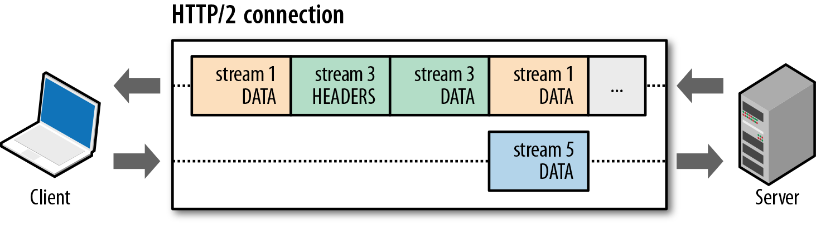
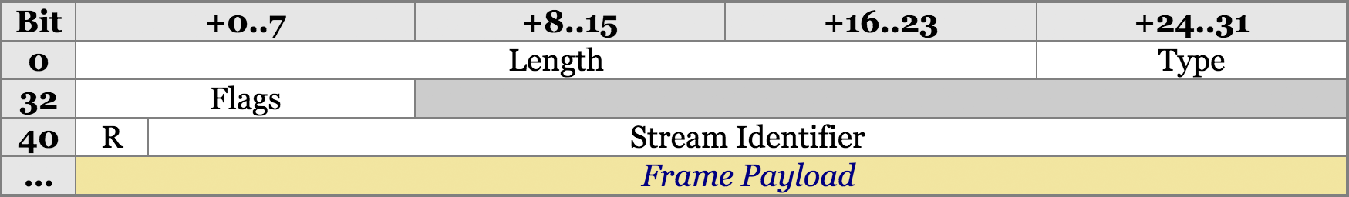
HTTP/2 Design: Multi-Streams
HTTP/2 Binary Framing
https://hpbn.co/http2/
https://tools.ietf.org/html/rfc7540

Slide 10
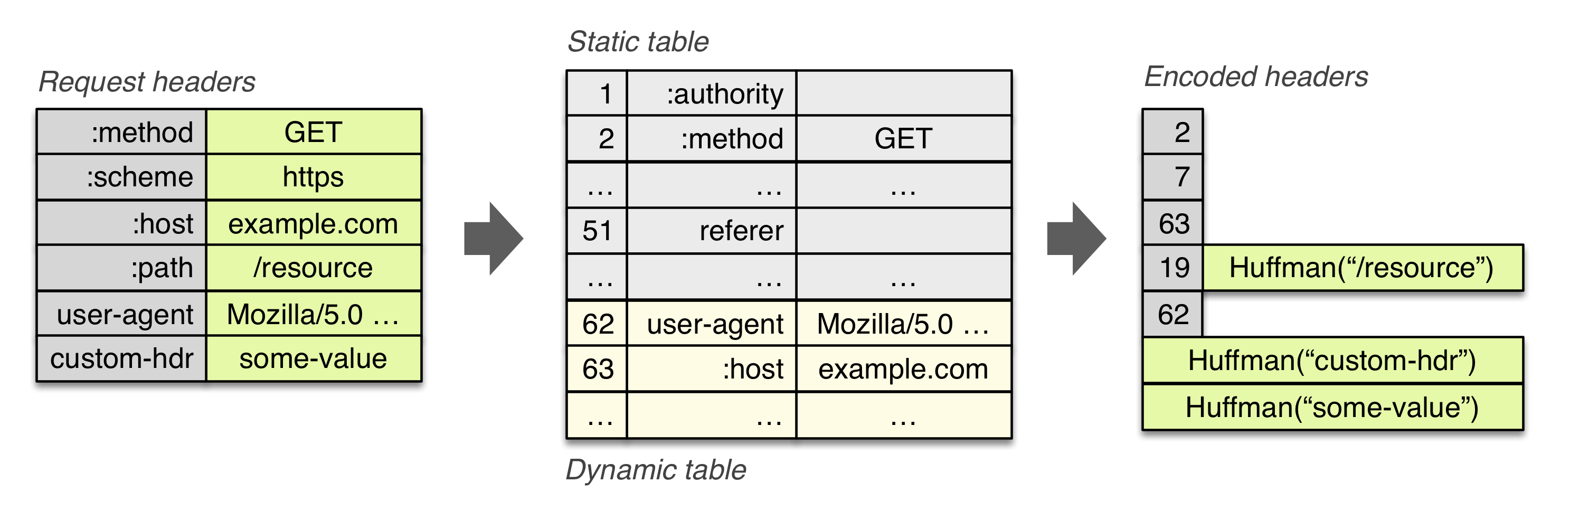
HTTP/2 Header Compression

Slide 11
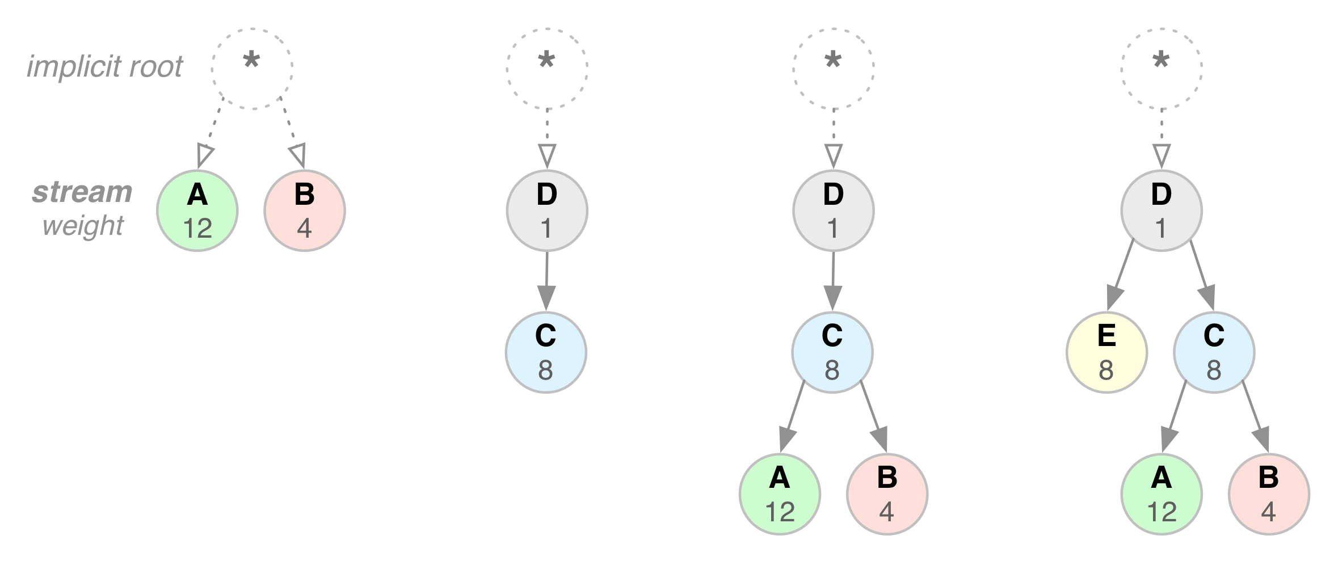
HTTP/2 Stream Dependency and Weights

Slide 12
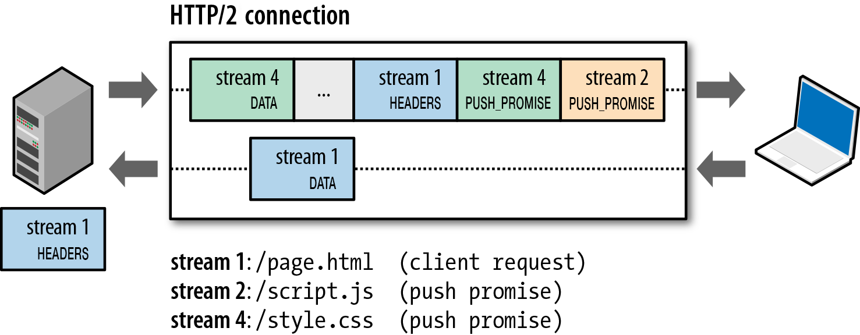
HTTP/2 Server Push

Slide 13
Outline
Admin and recap
HTTP
HTTP "acceleration"
Operational analysis

Slide 14
Goal: Best Server Design Limited Only by Resource Bottleneck
CPU
DISK
Before
NET
CPU
DISK
After
NET

Slide 15
Some Questions
When is CPU the bottleneck for scalability?
So that we need to add helper threads
How do we know that we are reaching the limit of scalability of a single machine?
These questions drive network server architecture design
Some basic performance analysis techniques are good to have

Slide 16

Background: Little’s Law (1961)
For any system with no or (low) loss.
Assume
mean arrival rate λ, mean time R at system, and mean number Q of requests at system
Then relationship between Q, λ, and R:
R, Q
λ
Example: XMU admits 3000 students each year, and mean time a student stays is 4 years, how many students are enrolled?
Notes:
Proof of Little’s Law:

Slide 17
Little’s Law: Proof
arrival
A
3
2
1
t
time

Slide 18
Operational Analysis
Relationships that do not require any assumptions about the distribution of service times or inter-arrival times
Hence focus on measurements
Identified originally by Buzen (1976) and later extended by Denning and Buzen (1978).
We touch only some techniques/results
In particular, bottleneck analysis
More details see linked reading

Slide 19
Under the Hood (An example FSM)
exit
(throughput λ until some
center saturates)
start (arrival rate λ)
CPU
I/O request
File I/O
network
Memory cache

Slide 20
Operational Analysis: Resource Demand of a Request
CPU
V_{CPU} visits for S_{CPU} units of resource time per visit
Network
V_{Net} visits for S_{Net} units of resource time per visit
Disk
V_{Disk} visits for S_{Disk} units of resource time per visit
Memory
V_{Mem} visits for S_{Mem} units of resource time per visit

Slide 21
Operational Quantities
T: observation interval Ai: # arrivals to device i
Bi: busy time of device i Ci: # completions at device i
i = 0 denotes system

Slide 22
Utilization Law
The law is independent of any assumption on arrival/service process
Example: Suppose NIC processes 125 pkts/sec, and each pkt takes 2 ms. What is utilization of the network NIC?

Slide 23
Deriving Relationship Between R, U, and S for one Device
Assume flow balanced (arrival=throughput), Little’s Law:
Assume PASTA (Poisson arrival--memory-less arrival--sees time average), a new request sees Q ahead of it, and FIFO
According to utilization law, U = XS

Slide 24
Forced Flow Law
Assume each request visits device i Vi times

Slide 25
Bottleneck Device
Define Di = Vi Si as the total demand of a request on device i
The device with the highest Di has the highest utilization, and thus is called the bottleneck

Slide 26
Bottleneck vs System Throughput

Slide 27
Example 1
A request may need
10 ms CPU execution time
1 Mbytes network bw
1 Mbytes file access where
50% hit in memory cache
Suppose network bw is 100 Mbps, disk I/O rate is 1 ms per 8 Kbytes (assuming the program reads 8 KB each time)
Where is the bottleneck?

Slide 28
Example 1 (cont.)
CPU:
D_{CPU}=
Network:
D_{Net} =
Disk I/O:
Ddisk =
10 ms ( e.q. 100 requests/s)
1 Mbytes / 100 Mbps = 80 ms (e.q., 12.5 requests/s)
0.5 * 1 ms * 1M/8K = 62.5 ms (e.q. = 16 requests/s)

Slide 29
Example 2
A request may need
150 ms CPU execution time (e.g., dynamic content)
1 Mbytes network bw
1 Mbytes file access where
50% hit in memory cache
Suppose network bw is 100 Mbps, disk I/O rate is 1 ms per 8 Kbytes (assuming the program reads 8 KB each time)
Bottleneck: CPU -> use multiple threads to use more CPUs, if available, to avoid CPU as bottleneck

Slide 30
Interactive Response Time Law
System setup
Closed system with N users
Each user sends in a request, after response, think time, and then sends next request
Notation
Z = user think-time, R = Response time
The total cycle time of a user request is R+Z
In duration T, #requests generated by each user:
T/(R+Z) requests

Slide 31
Interactive Response Time Law
If N users and flow balanced:

Slide 32
Bottleneck Analysis
Here D is the sum of Di

Slide 33
Proof
We know
Using interactive response time law:

Slide 34
Summary: Operational Laws
Utilization law: U = XS
Forced flow law: Xi = Vi X
Bottleneck device: largest Di = Vi Si
Little’s Law: Qi = Xi Ri
Bottleneck bound of interactive response (for the given closed model):

Slide 35

In Practice: Common Bottlenecks
No more file descriptors
Sockets stuck in TIME_WAIT
High memory use (swapping)
CPU overload
Interrupt (IRQ) overload
[Aaron Bannert]

Slide 36
YouTube Design Alg.
http://video.google.com/videoplay?docid=-6304964351441328559#
while (true) { identify_and_fix_bottlenecks(); drink(); sleep(); notice_new_bottleneck(); }

Slide 37
Outline
Admin and recap
HTTP: single server
Multiple network servers
Why multiple network servers

Slide 38
Why Multiple Servers?
Scalability
Scaling beyond single server throughput
There is a fundamental limit on what a single server can
process (CPU/bw/disk throughput)
store (disk/memory)
Scaling beyond single geo location latency
There is a limit on the speed of light
Network detour and delay further increase the delay
Notes:
Facebook 12 M HTTP/sec
http://www.datadoghq.com/2013/07/the-best-of-velocity-and-devopsdays-2013-part-ii/

Slide 39
Why Multiple Servers?
Redundancy and fault tolerance
Administration/Maintenance (e.g., incremental upgrade)
Redundancy (e.g., to handle failures)

Slide 40
Why Multiple Servers?
System/software architecture
Resources may be naturally distributed at different machines (e.g., run a single copy of a database server due to single license; access to resource from third party)
Security (e.g., front end, business logic, and database)
Today we focus mostly on the first benefit, for homogeneous (replica) servers

