Slide 1
Network Transport Layer: TCP
Qiao Xiang
https://qiaoxiang.me/courses/cnns-xmuf22/index.shtml
11/01/2022
This deck of slides are heavily based on CPSC 433/533 at Yale University, by courtesy of Dr. Y. Richard Yang.

Slide 2
Outline
Admin and recap
Reliable data transfer

Slide 3
Admin
Lab assignment 3 due on Nov. 8
Date for exam 1
Nov. 10 (2:30-4:10pm, lab class)

Slide 4
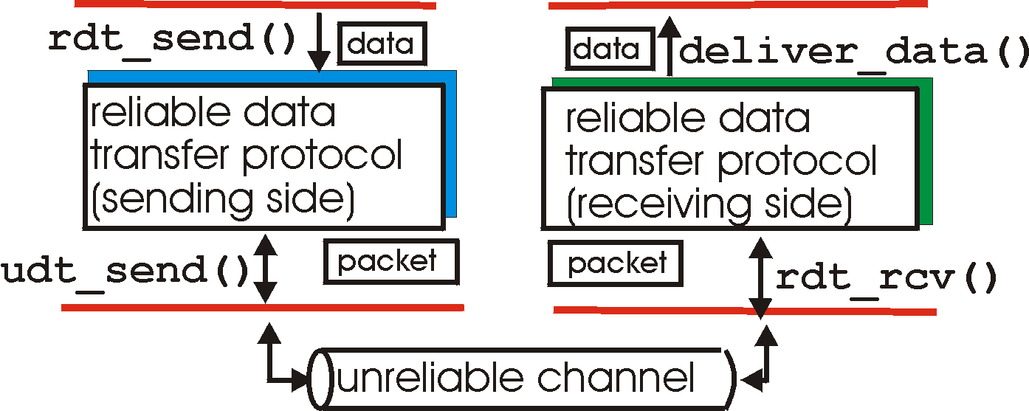
Recap: Reliable Data Transfer Context
rdt_send(): called from above, (e.g., by app.)
deliver_data(): called by rdt to deliver data to upper
send
side
receive
side
udt_send(): called by rdt,
to transfer packet over
unreliable channel to receiver
rdt_rcv(): called from below; when packet arrives on rcv-side of channel

Slide 5
Recap: Reliable Data Transfer Setting
We’ll:
incrementally develop sender, receiver sides of reliable data transfer protocol (rdt)
consider only unidirectional data transfer
but control info will flow on both directions !
use finite state machines (FSM) to specify sender, receiver
event causing state transition
actions taken on state transition
state: when in this “state” next state uniquely determined by next event
state
1
state
2
event
actions

Slide 6
rdt3.0: Channels with Errors and Loss
New assumption: underlying channel can also lose packets (data or ACKs)
checksum, seq. #, ACKs, retransmissions will be of help, but not enough
Q: Does rdt2.2 work under losses?
Approach: sender waits “reasonable” amount of time for ACK
requires countdown timer
retransmits if no ACK received in this time
if pkt (or ACK) just delayed (not lost):
retransmission will be duplicate, but use of seq. #’s already handles this
receiver must specify seq # of pkt being ACKed

Slide 7
rdt3.0 Sender
rdt_send(data)
rdt_rcv(rcvpkt) &&
( corrupt(rcvpkt) ||
isACK(rcvpkt,1) )
sndpkt = make_pkt(0, data, checksum)
udt_send(sndpkt)
start_timer
udt_send(sndpkt)
rdt_rcv(rcvpkt)
Λ
Λ
Wait for
call 0 from above
Wait for ACK0
timeout
udt_send(sndpkt)
start_timer
rdt_rcv(rcvpkt)
&& notcorrupt(rcvpkt)
&& isACK(rcvpkt,1)
rdt_rcv(rcvpkt)
&& notcorrupt(rcvpkt)
&& isACK(rcvpkt,0)
stop_timer
stop_timer
Wait for ACK1
Wait for
call 1 from above
timeout
udt_send(sndpkt)
start_timer
rdt_rcv(rcvpkt)
rdt_send(data)
Λ
rdt_rcv(rcvpkt) &&
( corrupt(rcvpkt) ||
isACK(rcvpkt,0) )
sndpkt = make_pkt(1, data, checksum)
udt_send(sndpkt)
start_timer
Λ

Slide 8
rdt3.0: Stop-and-Wait Performance
sender
receiver
first packet bit transmitted, t = 0
last packet bit transmitted, t = L / R
first packet bit arrives
RTT
last packet bit arrives, send ACK
ACK arrives, send next
packet, t = RTT + L / R
What is U_{sender}: utilization – fraction of time link busy sending?
Assume: 1 Gbps link, 15 ms e-e prop. delay, 1KB packet
8

Slide 9
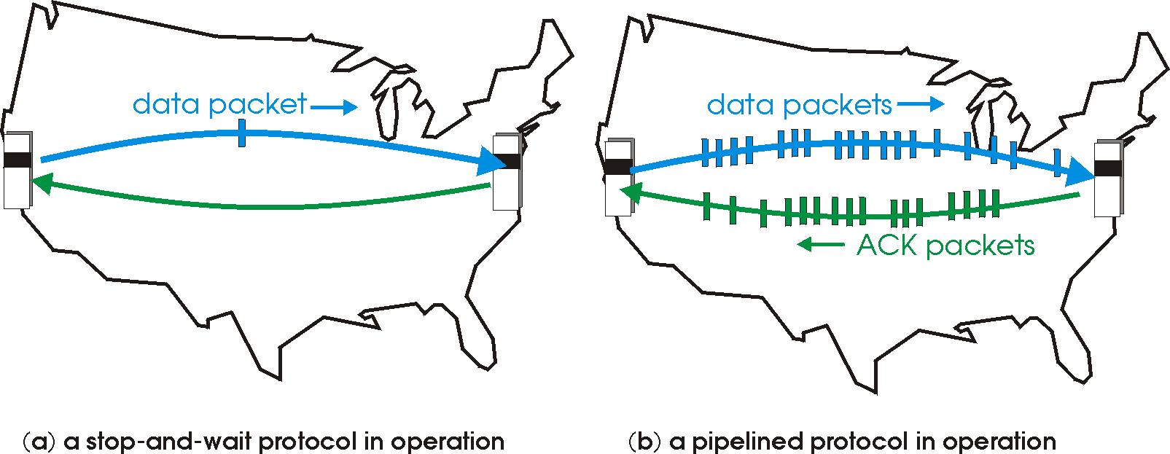
Recap: Reliable Transport
Basic structure: sliding window protocols
Realization: GBN or SR
General technique: pipelining.

Slide 10
Outline
Admin and Recap
Reliable data transfer
perfect channel
channel with bit errors
channel with bit errors and losses
sliding window: reliability with throughput
TCP reliability

Slide 11
TCP: Overview RFCs: 793, 1122, 1323, 2018, 2581
Point-to-point reliability: one sender, one receiver
Flow controlled and congestion controlled

Slide 12
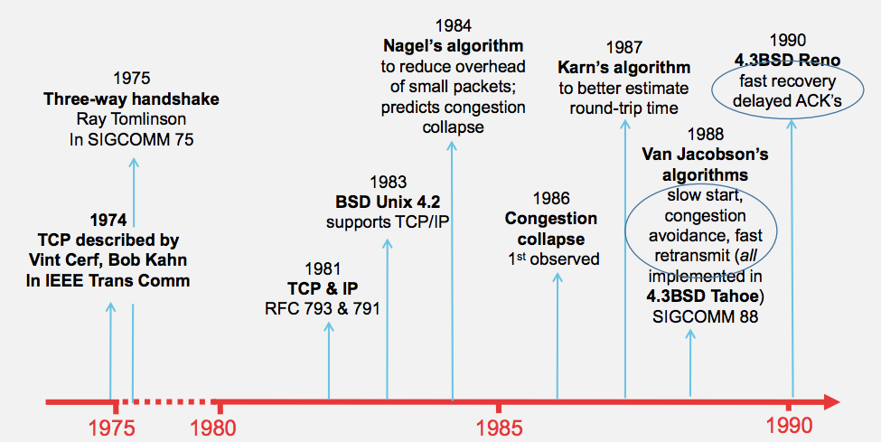
Evolution of TCP
Source: http://webcourse.cs.technion.ac.il/236341/Winter2015-2016/ho/WCFiles/Tutorial10.pdf

Slide 13
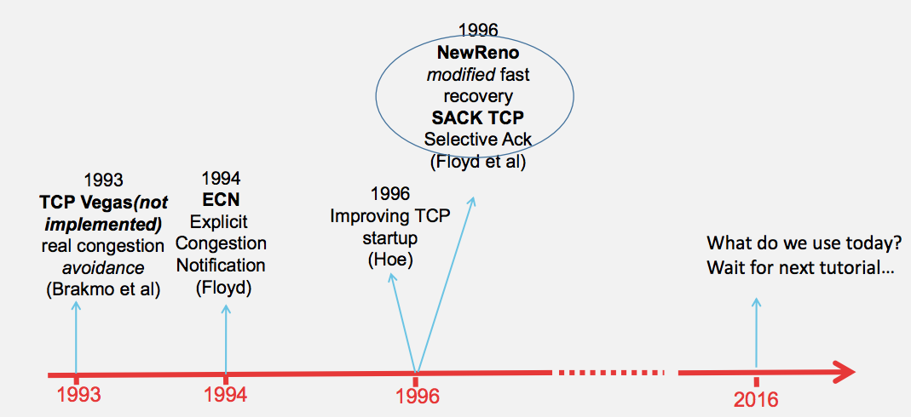
Evolution of TCP
multiple versions
Source: http://webcourse.cs.technion.ac.il/236341/Winter2015-2016/ho/WCFiles/Tutorial10.pdf

Slide 14
TCP Reliable Data Transfer
Connection-oriented:
connection management
setup (exchange of control msgs) init’s sender, receiver state before data exchange
close
Full duplex data:
bi-directional data flow in same connection
A sliding window protocol
a combination of go-back-n and selective repeat:
send & receive buffers
cumulative acks
TCP uses a single retransmission timer
do not retransmit all packets upon timeout

Slide 15
TCP Segment Structure
32 bits
URG: urgent data
(generally not used)
counting
by bytes
of data
(not segments!)
source port #
dest port #
sequence number
ACK: ACK #
valid
acknowledgement number
head
len
not
used
U
rcvr window size
A
P
R
S
PSH: push data now
(generally not used)
F
flow control
checksum
ptr urgent data
RST, SYN, FIN:
connection management
(reset, setup teardown
commands)
Options (variable length)
application
data
(variable length)
Also in UDP

Slide 16
Outline
Admin and Recap
Reliable data transfer
perfect channel
channel with bit errors
channel with bit errors and losses
sliding window: reliability with throughput
TCP reliability
data seq#, ack, buffering

Slide 17
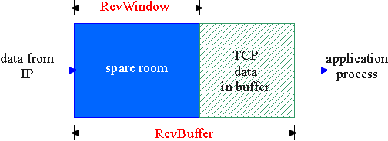
Flow Control
flow control
sender won’t overflow
receiver’s buffer by
transmitting too much,
too fast
receive side of a connection has a receive buffer:
speed-matching service: matching the send rate to the receiving app’s drain rate
app process may be slow at reading from buffer

Slide 18
TCP Flow Control: How it Works
source port #
dest port #
sequence number
acknowledgement number
head
len
not
used
U
A
rcvr window size
P
R
S
F
checksum
ptr urgent data
spare room in buffer
= RcvWindow
Options (variable length)
application
data
(variable length)

Slide 19
TCP Seq. #’s and ACKs
Seq. #’s:
byte stream “number” of first byte in segment’s data
ACKs:
seq # of next byte expected from other side
cumulative ACK in standard header
selective ACK in options
Host A
Host B
User
types
‘C’
Seq=42, ACK=79, data = ‘C’
host ACKs
receipt of
‘C’, echoes
back ‘C’
Seq=79, ACK=43, data = ‘C’
host ACKs
receipt
of echoed
‘C’
Seq=43, ACK=80
time
simple telnet scenario

Slide 20
TCP Send/Ack Optimizations
TCP includes many tune/optimizations, e.g.,
the “small-packet problem”: sender sends a lot of small packets (e.g., telnet one char at a time)
Nagle’s algorithm: do not send data if there is small amount of data in send buffer and there is an unack’d segment
the ”ack inefficiency” problem: receiver sends too many ACKs, no chance of combing ACK with data
Delayed ack to reduce # of ACKs/combine ACK with reply

Slide 21
TCP Receiver ACK Generation [RFC 1122, RFC 2581]
Event at Receiver
Arrival of in-order segment with
expected seq #. All data up to
expected seq # already ACKed
Arrival of in-order segment with
expected seq #. One other
segment has ACK pending
Arrival of out-of-order segment
higher-than-expect seq. # .
Gap detected
Arrival of segment that
partially or completely fills gap
TCP Receiver Action
Delayed ACK. Wait up to 500ms
for next segment. If no next segment,
send ACK
Immediately send single cumulative
ACK, ACKing both in-order segments
Immediately send duplicate ACK,
indicating seq. # of next expected byte
Immediate send ACK, provided that
segment starts at lower end of gap

Slide 22
Outline
Admin and Recap
Reliable data transfer
perfect channel
channel with bit errors
channel with bit errors and losses
sliding window: reliability with throughput
TCP reliability
data seq#, ack, buffering
timeout realization

Slide 23
TCP Reliable Data Transfer
Basic structure: sliding window protocol
Remaining issue: How to determine the “right” parameters?
timeout value?
sliding window size?

Slide 24
History
Key parameters for TCP in mid-1980s
fixed window size W
timeout value = 2 RTT
Network collapse in the mid-1980s
UCB ←→ LBL throughput dropped by 1000X !
The intuition was that the collapse was caused by wrong parameters…

Slide 25
Timeout: Cost of Timeout Param
Why is good timeout value important?
too short
premature timeout
unnecessary retransmissions; many duplicates
too long
slow reaction to segment loss
Q: Is it possible to set Timeout as a constant?
Q: Any problem w/ the early approach: Timeout = 2 RTT

Slide 26
Setting Timeout
Problem:
Ideally, we set timeout = RTT, but RTT is not a fixed value => using the average of RTT will generate many timeouts due to network variations
Possibility: using the average/median of RTT
Issue: this will generate many timeouts due to network variations
Solution:
Set Timeout RTO = avg + “safety margin” based on variation
freq.
RTT
TCP approach:
Timeout = EstRTT + 4 * DevRTT

Slide 27
Compute EstRTT and DevRTT
Exponential weighted moving average (EWMA)
influence of past sample decreases exponentially fast
EstRTT = (1-alpha)*EstRTT + alpha*SampleRTT
- SampleRTT: measured time from segment transmission until ACK receipt
- typical value: alpha = 0.125
DevRTT = (1-beta)*DevRTT + beta|SampleRTT-EstRTT|
(typically, beta = 0.25)

Slide 28
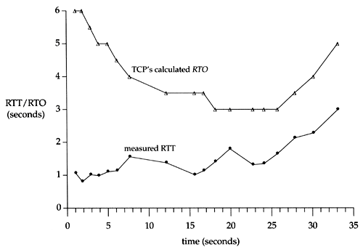
An Example TCP Session

Slide 29
Fast Retransmit
Issue: Timeout period often relatively long:
long delay before resending lost packet
Question: Can we detect loss faster than RTT?
Detect lost segments via duplicate ACKs
sender often sends many segments back-to-back
if segment is lost, there will likely be many duplicate ACKs
If sender receives 3 ACKs for the same data, it supposes that segment after ACKed data was lost:
resend segment before timer expires

Slide 30
Triple Duplicate Ack
Packets
1
2
3
4
5
6
7
Acknowledgements (waiting seq#)
2
3
4
4
4
4

Slide 31
Fast Retransmit:
event: ACK received, with ACK field value of y
if (y > SendBase) {
…
SendBase = y
if (there are currently not-yet-acknowledged segments)
start timer
…
}
else {
increment count of dup ACKs received for y
if (count of dup ACKs received for y = 3) {
resend segment with sequence number y
…
a duplicate ACK for
already ACKed segment
fast retransmit

Slide 32
TCP: reliable data transfer
00 sendbase = initial_sequence number agreed by TWH
01 nextseqnum = initial_sequence number by TWH
02 loop (forever) {
03 switch(event)
04 event: data received from application above
05 if (window allows send)
06 create TCP segment with sequence number nextseqnum
06 if (no timer) start timer
07 pass segment to IP
08 nextseqnum = nextseqnum + length(data) else put packet in buffer
09 event: timer timeout for sendbase
10 retransmit segment
11 compute new timeout interval
12 restart timer
13 event: ACK received, with ACK field value of y
14 if (y > sendbase) { /* cumulative ACK of all data up to y */
15 cancel the timer for sendbase
sendbase = y
if (no timer and packet pending) start timer for new sendbase
while (there are segments and window allow)
sent a segment;
18 }
19 else { /* y==sendbase, duplicate ACK for already ACKed segment */
20 increment number of duplicate ACKs received for y
21 if (number of duplicate ACKS received for y == 3) {
22 /* TCP fast retransmit */
23 resend segment with sequence number y
24 restart timer for segment y
25 }
26 } /* end of loop forever */
Simplified
TCP
sender

Slide 33
Outline
Admin and Recap
Reliable data transfer
perfect channel
channel with bit errors
channel with bit errors and losses
sliding window: reliability with throughput
TCP reliability
data seq#, ack, buffering
timeout realization
connection management

Slide 34
Why Connection Setup/When to Accept (Safely Deliver) First Packet?
sender
receiver
data 0
accept
ACK for 0

Slide 35
Why Connection Setup/When to Accept (Safely Deliver) First Packet?
sender
receiver
data 0 (transfer $1000 to B)
accept
ACK for 0 (n)
data 0 (transfer $1000 to B)
accept?
35
Notes:
a sender should not reuse a seq# before it is sure the packet has left the network

Slide 36
Transport “Safe-Setup” Principle
A general safety principle for a receiver R to accept a message from a sender S is the general “authentication” principle, which consists of two conditions:
Transport authentication principle:
[p1] Receiver can be sure that what Sender says is fresh
[p2] Receiver receives something that only Sender can say
We first assume a secure setting: no malicious attacks.
Exercise: Techniques to allow a receiver to check for freshness (e.g., add a time stamp)?

Slide 37
Generic Challenge-Response Structure Checking Freshness
sender
receiver
I have data to send
deliver
Challenge (nonce)
Demonstrate knowing nonce; data

Slide 38
Three Way Handshake (TWH) [Tomlinson 1975]
Host A
Host B
SYN(seq=x)
notify initial seq#. Accept?
ACK(seq=x), SYN(seq=y)
think of y as a challenge
ACK(seq=y)
accept data only after
verified y is bounced back
x is the init. seq
DATA(seq=x+1)
SYN: indicates connection setup
Notes:
Syn(seq=x) could be duplicate or malicious

Slide 39
Scenarios with Duplicate Request/SYN Attack
Host A
Host B
SYN(seq=x)
accept?
ACK(seq=x), SYN(seq=y)
no such request
REJECT(seq=y)
reject

Slide 40
Scenarios with Duplicate Request/SYN Attack
Host A
Host B
SYN(seq=x)
accept?
ACK(seq=x), SYN(seq=y)
no such request
ACK(seq=z)
reject
REJECT(seq=y)

Slide 41
Make “Challenge y” Robust
To avoid that “SYNC ACK y” comes from reordering and duplication
for each connection (sender-receiver pair), ensuring that two identically numbered packets are never outstanding at the same time
network bounds the life time of each packet
a sender will not reuse a seq# before it is sure that all packets with the seq# are purged from the network
seq. number space should be large enough to not limit transmission rate
Increasingly move to cryptographic challenge and response
Notes:
Add QUIC design: QUIC uses a cryptographic handshake
Servers
front-end servers, which collectively handle billions of requests a day from web browsers and mobile apps across a wide range of services.
On the client side, we have deployed QUIC in
Chrome,
our mobile video streaming YouTube app, and in the
Google Search app on Android
TCP connections commonly incur at least one round-trip delay of connection setup time before any application data can be sent, and TLS adds two round trips to this delay

Slide 42
Connection Close
Why connection close?
so that each side can release resource and remove state about the connection (do not want dangling socket)
client
server
init. close
release
resource?
I am done. Are you done too?
close
I am done too. Goodbye!
release
resource?
close
release
resource?

Slide 43
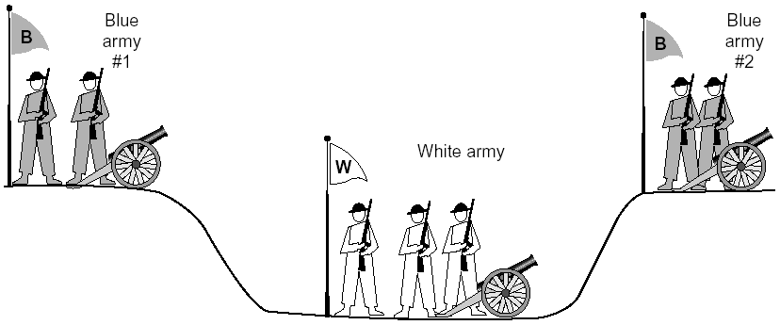
General Case: The Two-Army Problem
The gray (blue) armies need to agree on whether or not they will attack the white army. They achieve agreement by sending messengers to the other side. If they both agree, attack; otherwise, no. Note that a messenger can be captured!

Slide 44
Time_Wait
Generic technique: Timeout to “solve” infeasible problem
Instead of message-driven state transition, use a timeout based transition; use timeout to handle error cases
client
server
init. close
release
resource?
I am done. Are you done too?
Working
Closed
close
I am done too. Goodbye!
release
resource?
close
Working
Time_Waiit
Closed
release
resource?

Slide 45
Time_Wait Design Options
Design 1 (initiator time wait)
Design 2 (receiver time wait)
Host A
Host B
Host A
Host B
close
FIN
close
FIN
Time = n x timeout
Time to retry FIN after each timeout
Close after receive FIN
All states removed
ACK
Time to retransmit ACK
Close after first ACK
All states removed
ACK
All states removed
All states removed

