Slide 1
Network Transport Layer: TCP/Reno Analysis, TCP Cubic, TCP/Vegas
Qiao Xiang
https://qiaoxiang.me/courses/cnns-xmuf22/index.shtml
11/03/2022
This deck of slides are heavily based on CPSC 433/533 at Yale University, by courtesy of Dr. Y. Richard Yang.

Slide 2
Admin.
Lab assignment 5 posted, due on Dec. 31
Final exam date: 2-4pm, Jan. 5

Slide 3
Recap: Transport Design
Basic structure/reliability: sliding window protocols
Determine the “right” parameters
Timeout
mean + variation
Sliding window size
Related w/ congestion control or more generally resource allocation
Bad congestion control can lead to congestion collapse (e.g., zombie packets)
Goals: distributed algorithm to achieve fairness and efficiency

Slide 4
Three Way Handshake (TWH) [Tomlinson 1975]
Host A
Host B
SYN(seq=x)
notify initial seq#. Accept?
ACK(seq=x), SYN(seq=y)
think of y as a challenge
ACK(seq=y)
accept data only after
verified y is bounced back
x is the init. seq
DATA(seq=x+1)
SYN: indicates connection setup
Notes:
Syn(seq=x) could be duplicate or malicious

Slide 5
Time_Wait Design Options
Design 1 (initiator time wait)
Design 2 (receiver time wait)
Host A
Host B
Host A
Host B
close
FIN
close
FIN
Time = n x timeout
Time to retry FIN after each timeout
Close after receive FIN
All states removed
ACK
Time to retransmit ACK
Close after first ACK
All states removed
ACK
All states removed
All states removed

Slide 6
TCP Four Way Teardown (For Bi-Directional Transport)
Host A
Host B
propose close A->B
close
FIN
A->B closed
ACK
close
propose close B->A
A->B closed
FIN
ACK
can retransmit the ACKif its ACK is lost
timed wait
closed
all states removed
closed
all states removed

Slide 7
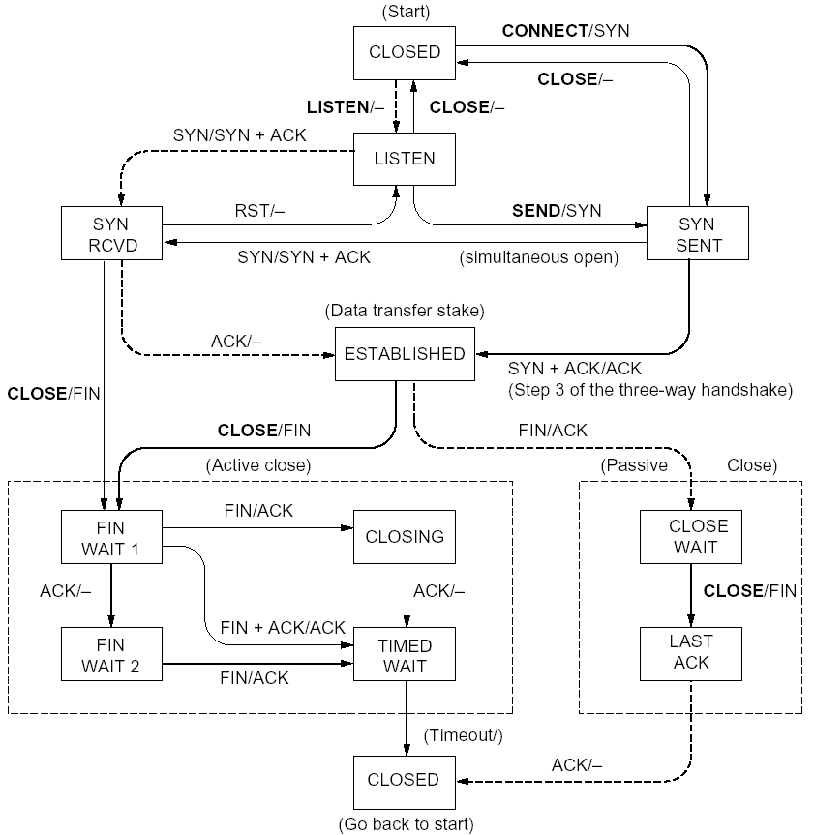
%netstat -t -a
CLOSED
SYN SENT
CLOSED
SYN
LISTEN
SYN RCVD
SYN/ACK
ESTABLSIHED
ACK
ESTABLSIHED
ESTABLSIHED
ESTABLSIHED
FIN WAIT 1
FIN
CLOSE WAIT
ACK
LAST ACK
FIN WAIT 2
FIN
TIME WAIT
ACK

Slide 8
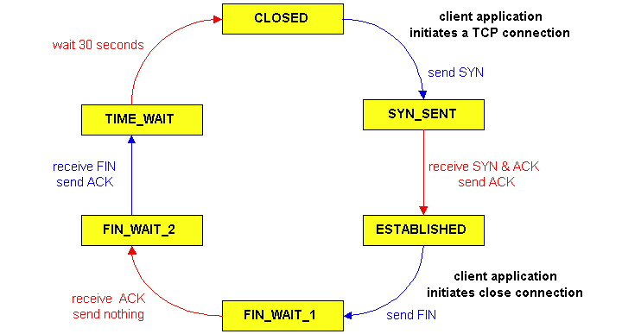
TCP Connection Management
CLOSED
SYN SENT
CLOSED
TCP lifecycle: init SYN/FIN
SYN
SYN RCVD
SYN/ACK
ESTABLSIHED
ACK
ESTABLSIHED
ESTABLSIHED
FIN WAIT 1
FIN
CLOSE WAIT
ACK
LAST ACK
FIN WAIT 2
FIN
TIME WAIT
ACK
http://dsd.lbl.gov/TCP-tuning/ip-sysctl-2.6.txt

Slide 9
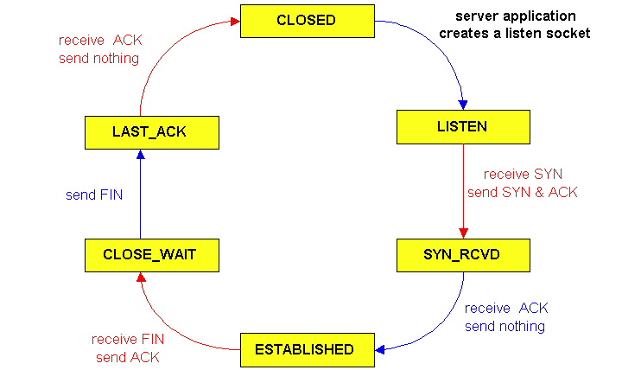
TCP Connection Management
CLOSED
SYN SENT
CLOSED
SYN
TCP lifecycle: wait for SYN/FIN
SYN RCVD
SYN/ACK
ESTABLSIHED
ACK
ESTABLSIHED
ESTABLSIHED
FIN WAIT 1
FIN
CLOSE WAIT
ACK
LAST ACK
FIN WAIT 2
FIN
TIME WAIT
ACK

Slide 10
A Summary of Questions
Basic structure: sliding window protocols
How to determine the “right” parameters?
timeout: mean + variation
sliding window size?

Slide 11
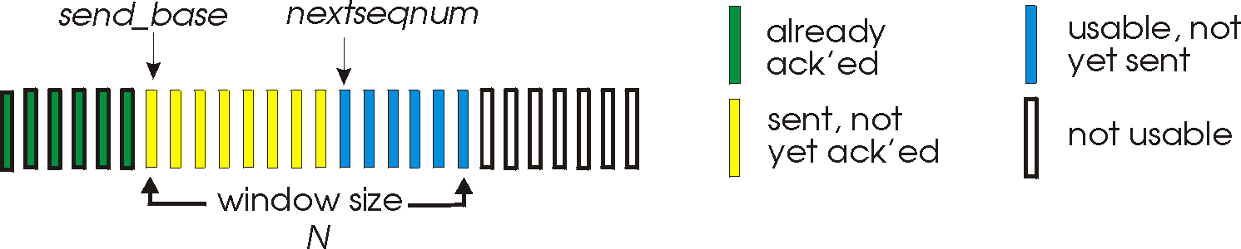
Sliding Window Size Function: Rate Control
Transmission rate determined by congestion window size, cwnd, over segments:
cwnd
cwnd segments, each with MSS bytes sent in one RTT:
cwnd * MSS
Rate =
Bytes/sec
RTT
Assume W is small enough. Ignore small details. MSS: Minimum Segment Size

Slide 12
Some General Questions
Big picture question:
How to determine a flow’s sending rate?
For better understanding, we need to look at a few basic questions:
What is congestion (cost of congestion)?
Why are desired properties of congestion control?

Slide 13
Roadmap
What is congestion
The basic CC alg
TCP/reno CC
TCP/Vegas
A unifying view of TCP/Reno and TCP/Vegas
Network wide resource allocation
Framework
Axiom derivation of network-wide objective function
Derive distributed algorithm

Slide 14
Outline
Admin and recap
TCP Reliability
Transport congestion control
what is congestion (cost of congestion)

Slide 15
Cause/Cost of Congestion: Single Bottleneck
flow 1
20 Mbps
5 Mbps
10 Mbps
flow 2 (5 Mbps)
20 Mbps
20 Mbps
router 1
router 2
- Flow 2 has a fixed sending rate of 5 Mbps
- We vary the sending rate of flow 1 from 0 to 20 Mbps
- Assume
no retransmission; link from router 1 to router 2 has infinite buffer
throughput: e2e packets delivered in unit time
Delay?
throughput of flow 1 & 2 (Mbps)
delay at central link
delay due to
randomness
10
sending rate by flow 1 (Mbps)
sending rate by flow 1 (Mbps)
5
0
5
5
0

Slide 16
Cause/Cost of Congestion: Single Bottleneck
router 3
router 5
flow 1
20 Mbps
5 Mbps
10 Mbps
flow 2 (5 Mbps)
20 Mbps
20 Mbps
router 1
router 2
router 4
router 6
Assume
no retransmission
the link from router 1 to router 2 has finite buffer
throughput: e2e packets delivered in unit time
Zombie packet: a packet dropped at the link from router 2 to router 5; the upstream transmission from router 1 to router 2 used for that packet was wasted!
throughput of flow 1 & 2 (Mbps)
10
sending rate by flow 1 (Mbps)
5
x
0
5

Slide 17
Summary: The Cost of Congestion
When sources sending rate too high for the network to handle”:
Packet loss =>
wasted upstream bandwidth when a pkt is discarded at downstream
wasted bandwidth due to retransmission (a pkt goes through a link multiple times)
High delay
packet
loss
knee
cliff
Throughput
congestion
collapse
Load
Delay
Load

Slide 18
Outline
Admin and recap
TCP Reliability
Transport congestion control
what is congestion (cost of congestion)
basic congestion control alg.

Slide 19
Rate-based vs. Window-based
Rate-based:
Congestion control by explicitly controlling the sending rate of a flow, e.g., set sending rate to 128Kbps
Example: ATM
Window-based:
Congestion control by controlling the window size of a sliding window, e.g., set window size to 64KBytes
Example: TCP
Discussion: rate-based vs. window-based

Slide 20
Sliding Window Size Function: Rate Control
Transmission rate determined by congestion window size, cwnd, over segments:
cwnd
cwnd segments, each with MSS bytes sent in one RTT:
cwnd * MSS
Rate =
Bytes/sec
RTT
Assume W is small enough. Ignore small details. MSS: Maximum Segment Size

Slide 21
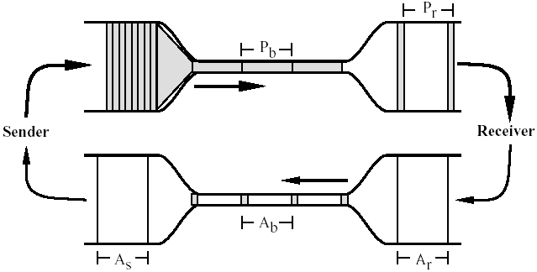
Window-based Congestion Control
Window-based congestion control is self-clocking: considers flow conservation, and adjusts to RTT variation automatically.
Hence, for better safety, more designs use window-based design.

Slide 22
The Desired Properties of a Congestion Control Scheme
Efficiency: close to full utilization but low delay
fast convergence after disturbance
Fairness (resource sharing)
Distributedness (no central knowledge for scalability)

Slide 23
Derive CC: A Simple Model
User 1
x₁
d = sum x_{i} > X_{goal}?
sum xi
User 2
x₂
x_{n}
User n
Flows observe congestion signal d, and locally take actions to adjust rates.

Slide 24
Linear Control
Proposed by Chiu and Jain (1988)
The simplest control strategy
Discussion: values of the parameters?

Slide 25
State Space of Two Flows
fairness line: x1=x2
x₂
x(0)
overload
efficiency line: x1+x2=C
underload
x₁

Slide 26
congestion
x₀
x₀
a=0
b=1
efficiency
efficiency: distributed linear rule
a=0
b=1
x₀
x₀
fairness
intersection

Slide 27
Implication: Congestion (overload) Case
In order to get closer to efficiency and fairness after each update, decreasing of rate must be multiplicative decrease (MD)
a_{D} = 0
b_{D} < 1

Slide 28
no-congestion
x₀
x₀
efficiency
efficiency: distributed linear rule
x₀
x₀
fairness
convergence

Slide 29
Implication: No Congestion Case
In order to get closer to efficiency and fairness after each update, additive and multiplicative increasing (AMI), i.e.,
a_{I} > 0, b_{I} > 1
Simply additive increase gives better improvement in fairness (i.e., getting closer to the fairness line)
Multiplicative increase may grow faster

Slide 30
Intuition: State Trace Analysis of Four Special Cases
 | Additive Decrease | Multiplicative Decrease
Additive Increase | AIAD (b_{I}=b_{D}=1) | AIMD (b_{I}=1, a_{D}=0)
Multiplicative Increase | MIAD (a_{I}=0, b_{I}>1, b_{D}=1) | MIMD (a_{I}=a_{D}=0)
Discussion: state transition trace.

Slide 31
AIMD: State Transition Trace
x₂
fairness line: x1=x2
overload
x₀
efficiency line: x1+x2=C
underload
x₁

Slide 32
Intuition: Another Look
Consider the difference or ratio of the rates of two flows
AIAD
difference does not change
MIMD
ratio does not change
MIAD
difference becomes bigger
AIMD
difference does not change
Notes:
AIAD: difference does not change
MIMD: ratio does not change
MIAD: difference becomes bigger
AIMD: difference does not change

Slide 33
Outline
Admin and recap
TCP Reliability
Transport congestion control
what is congestion (cost of congestion)
basic congestion control alg.
TCP/reno congestion control

Slide 34
TCP Congestion Control
Closed-loop, end-to-end, window-based congestion control
Designed by Van Jacobson in late 1980s, based on the AIMD alg. of Dah-Ming Chu and Raj Jain
Worked in a large range of bandwidth values: the bandwidth of the Internet has increased by more than 200,000 times
Many versions
TCP/Tahoe: this is a less optimized version
TCP/Reno: many OSs today implement Reno type congestion control
TCP/Vegas: not currently used
For more details: see TCP/IP illustrated; or read http://lxr.linux.no/source/net/ipv4/tcp_input.c for linux implementation

Slide 35
Mapping A(M)I-MD to Protocol
Basic questions to look at:
How to obtain d(t)--the congestion signal?
What values do we choose for the formula?
How to map formula to code?
Notes:
Implement d(t): loss/delay
Adjust window size
b_D: exponential backoff timeout after window size is 1

Slide 36
Obtain d(t) Approach 1: End Hosts Consider Loss as Congestion
Packets
1
2
3
4
5
6
7
Acknowledgements (waiting seq#)
2
3
4
4
4
4
Pros and Cons of endhosts using loss as congestion?
Assume loss => cong

Slide 37


Obtain d(t) Approach 2: Network Feedback (ECN: Explicit Congestion Notification)
Sender reduces rate if ECN received.
Pros and Cons of ECN?
Sender 1
Receiver bounces marker back to sender in ACK msg
Receiver
Sender 2
Network marks ECN Mark (1 bit) on pkt according to local condition, e.g., queue length > K

Slide 38
Mapping A(M)I-MD to Protocol
Basic questions to look at:
How to obtain d(t)--the congestion signal?
What values do we choose for the formula?
How to map formula to code?
Notes:
Implement d(t): loss/delay
Adjust window size
b_D: exponential backoff timeout after window size is 1

Slide 39
TCP/Reno Formulas
Multiplicative Increase (MI)
double the rate: x(t+1) = 2 x(t)
Additive Increase (AI)
Linear increase the rate: x(t+1) = x(t) + 1
Multiplicative decrease (MD)
half the rate: x(t+1) = 1/2 x(t)

Slide 40
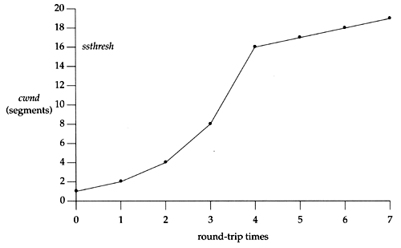
TCP/Reno Formula Switching (Control Structure)
Two “phases”
slow-start
Goal: getting to equilibrium gradually but quickly, to get a rough estimate of the optimal of cwnd
Formula: MI
congestion avoidance
Goal: Maintains equilibrium and reacts around equilibrium
Formula: AI MD

Slide 41
TCP/Reno Formula Switching (Control Structure)
Important variables:
cwnd: congestion window size
ssthresh: threshold between the slow-start phase and the congestion avoidance phase
If cwnd < ssthresh
MI
Else
AIMD
Notes:
AI: increases window by 1 per round
MD: cuts window size
to half when detecting congestion by 3DUP
to 1 if timeout
if already timeout, doubles timeout

Slide 42
MI: Slow Start
Algorithm: MI
double cwnd every RTT until network congested
Goal: getting to equilibrium gradually but quickly, to get a rough estimate of the optimal of cwnd

Slide 43
MI: Slow-start
Initially:
cwnd = 1;
ssthresh = infinite (e.g., 64K);
For each newly ACKed segment:
if (cwnd < ssthresh)
/* MI: slow start*/
cwnd = cwnd + 1;
cwnd = 1
segment 1
ACK for segment 1
cwnd = 2
segment 2
segment 3
ACK for segments 2 + 3
cwnd = 4
segment 4
segment 5
segment 6
segment 7
cwnd = 6
cwnd = 8

Slide 44
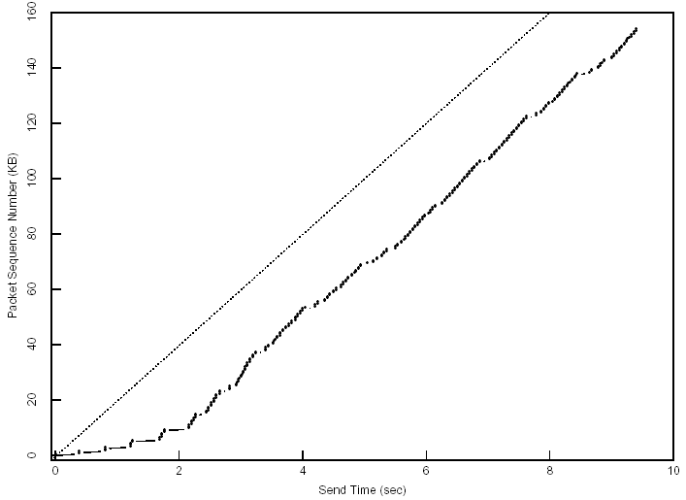
Startup Behavior with Slow-start
See [Jac89]

Slide 45
AIMD: Congestion Avoidance
Algorithm: AIMD
increases window by 1 per round-trip time (how?)
cuts window size
to half when detecting congestion by 3DUP
to 1 if timeout
if already timeout, doubles timeout
Goal: Maintains equilibrium and reacts around equilibrium

Slide 46
TCP/Reno Full Alg
Initially:
cwnd = 1;
ssthresh = infinite (e.g., 64K);
For each newly ACKed segment:
if (cwnd < ssthresh) // slow start: MI
cwnd = cwnd + 1;
else
// congestion avoidance; AI cwnd += 1/cwnd;
Triple-duplicate ACKs:
// MD
cwnd = ssthresh = cwnd/2;
Timeout:
ssthresh = cwnd/2; // reset
cwnd = 1;
(if already timed out, double timeout value; this is called exponential backoff)

Slide 47
TCP/Reno: Big Picture
cwnd
TD
TD
TD
TO
ssthresh
ssthresh
ssthresh
ssthresh
Time
slow
start (MI)
congestion
avoidance (AIMD)
congestion
avoidance
congestion
avoidance
slow
start
congestion
avoidance
TD: Triple duplicate acknowledgements
TO: Timeout

Slide 48
Outline
Admin and recap
Transport congestion control
what is congestion (cost of congestion)
basic congestion control alg.
TCP/Reno congestion control
design
analysis

Slide 49
Objective
To understand
the throughput of TCP/Reno as a function of RTT (RTT), loss rate (p) and packet size
the underlying queue dynamics
We will analyze TCP/Reno under two different setups

Slide 50
TCP/Reno Throughput Analysis
Given mean packet loss rate p, mean round-trip time RTT, packet size S
Consider only the congestion avoidance mode (long flows such as large files)
Assume no timeout
Assume mean window size is W_{m} segments, each with S bytes sent in one RTT:
W_{m} * S
Throughput =
bytes/sec
RTT

Slide 51
Outline
Admin and recap
Transport congestion control
what is congestion (cost of congestion)
basic congestion control alg.
TCP/Reno congestion control
design
analysis
small fish in a big pond
loss rate given from the environment

Slide 52
TCP/Reno Throughput Modeling (Fixed, Given Loss Rate)
=>
=>
This is called the TCP throughput sqrt of loss rate law.

Slide 53
Exercise: Application of Analysis
State of art network link can reach 100 Gbps. Assume packet size 1250 bytes, RTT 100 ms, what is the highest packet loss rate to still reach 100 Gbps?
tcp-reno-tput.xlsx

Slide 54
Outline
Admin and recap
Transport congestion control
what is congestion (cost of congestion)
basic congestion control alg.
TCP/Reno congestion control
design
analysis
small fish in a big pond
big fish in small pond
growth causes losses

Slide 55
TCP/Reno Throughput Modeling: Relating W with Loss Rate p
cwnd
TD
W
ssthresh
W/2
Time
congestion
avoidance
Total packets sent per cycle = (W/2 + W)/2 * W/2 = 3W²/8
Assume one loss per cycle
=> p = 1/(3W²/8) = 8/(3W²)
=>

Slide 56
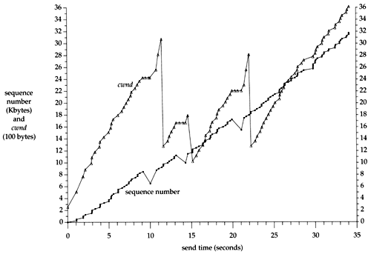
A Puzzle: cwnd and Rate of a TCP Session
Question: although cwnd fluctuates widely (i.e., cut to half), why can the sending rate stay relatively smooth?

Slide 57
TCP/Reno Queueing Dynamics
cwnd
filling buffer
TD
bottleneck
bandwidth
ssthresh
draining buffer
Time
congestion
avoidance
If the buffer at the bottleneck is large enough, the buffer is never empty (not idle), during the cut-to-half to “grow-back” process.
Exercise: How big should the buffer be to achieve full utilization?

Slide 58
Extreme: Zero Buffer
Assume
BW: 10 G
RTT: 100 ms
Packet: 1250 bytes
BDP (full window size): 100,000 packets
A loss can cut window size from 100,000 to 50,000 packets
To fully grow back
Need 50,000 RTTs => 5000 seconds, 1.4 hours
Q: What is the link utilization in one cycle?

Slide 59
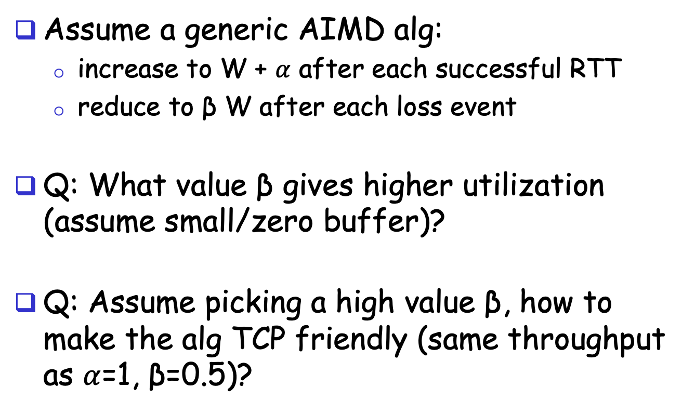
Design
Assume a generic AIMD alg:
increase to W + $α$ after each successful RTT
reduce to β W after each loss event
Q: What value β gives higher utilization (assume small/zero buffer)?
Q: Assume picking a high value β, how to make the alg TCP friendly (same throughput as $α$=1, β=0.5)?

Slide 60
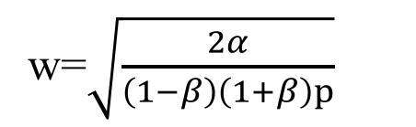

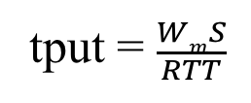
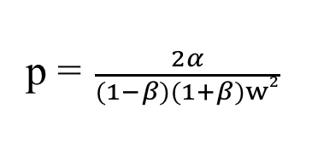

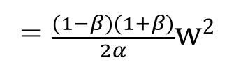
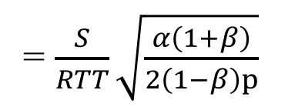

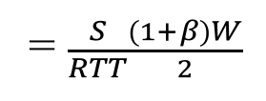
Generic AIMD and TCP Friendliness
cwnd
TD
W
ssthresh
βW
Time
congestion
avoidance
Total packets sent per cycle =
$$\frac{βW+W}{2}$$
$$\frac{(1−β)W}{α}$$
=$\frac{(1−β)(1+β)}{2α}w2$
w=$\sqrt{\frac{2α}{\left(1−β\right)\left(1+β\right)p}}$
Assume one loss per cycle
p =$\frac{2α}{(1−β)(1+β)w2}$
tput = $\frac{WmS}{RTT}$
= $\frac{S}{RTT}\sqrt{\frac{α\left(1+β\right)}{2\left(1−β\right)p}}$
= $\frac{S}{RTT}\frac{(1+β)W}{2}$
TCP friendly =>
$$α=3 \frac{1−β}{1+β}$$

Slide 61
Outline
Admin and recap
Transport congestion control
what is congestion (cost of congestion)
basic congestion control alg.
TCP/Reno congestion control
TCP Cubic

Slide 62
TCP Cubic
Designed in 2008
Default for Linux
Most sockets in MAC appear to use cubic as well
sw_vers
sysctl –a

Slide 63
TCP Cubic Goals
Improve TCP efficiency over fast, long-distance links
TCP friendliness
Fairness of flows w/ different RTTs
Smaller reduction, longer stay at BDP, faster than linear increase---cubic function
Follows TCP if TCP gives higher rate
Window growth depends on real-time (from congestion- epoch through synchronized losses)

Slide 64
TCP BIC Algorithm
cwnd
TD
TD
TD
TD
Wmax
W_{m}
Wmin
CA
CA
CA
CA
Time
Setting
W_{max} = cwnd size before reduction
Too big
W_{min} = β*W_{max} – just after reduction, where β is multiplicative decrease factor
Small
Basic idea
binary search between W_{max} and W_{min}
64

Slide 65
TCP BIC Algorithm: Issues
cwnd
TD
TD
TD
TD
Wmax
W_{m}
Wmin
CA
CA
CA
CA
Time
Pure binary search (jump from W_{min} to (W_{max} and W_{min})/2) may be too aggressive
Use a large step size Smax
What if you grow above W_{max}?
Use binary growth (slow start) to probe more
65

Slide 66
TCP BIC Algorithm
Max Probing
W_{max} + 3S_{max}
Packet loss event
W_{max} + 2S_{max}
W_{max} +S_{max}
W_{max} + S_{min}
W_{max} + S_{min}
W_{min}
(midpoint – W_{min})< S_{min}
W_{max}
W_{min}
midpoint = (W_{min} + W_{max})/2
W_{min} + S_{min}
midpoint = (W_{min} + W_{max})/2
midpoint = (W_{min} + W_{max})/2
W_{min} + S_{max}
W_{min}
W_{min} + S_{max}
midpoint – W_{min} > S_{max}
W_{min} = β*W_{max}
Additive Increase
Binary Search
Slow Start
Additive Inc.
66

Slide 67
TCP BIC Algorithm
while (cwnd < Wmax) {
if ( (midpoint - Wmin) > Smax )
cwnd = cwnd + Smax
else
if ((midpoint - Wmin) < Smin)
cwnd = Wmax
else
cwnd = midpoint
if (no packet loss)
Wmin = cwnd
else
Wmin = β*cwnd
Wmax = cwnd
midpoint = (Wmax + Wmin)/2
}
Additive Increase
Binary Search
67

Slide 68
TCP BIC Algorithm: Probe
while (cwnd >= W_{max}){
if (cwnd < W_{max} + S_{max})
cwnd = cwnd + S_{min}
else
cwnd = cwnd + S_{max}
if (packet loss)
W_{min} = β*cwnd
W_{max} = cwnd
}
Slow growth
Fast growth
Max Probing
68

Slide 69
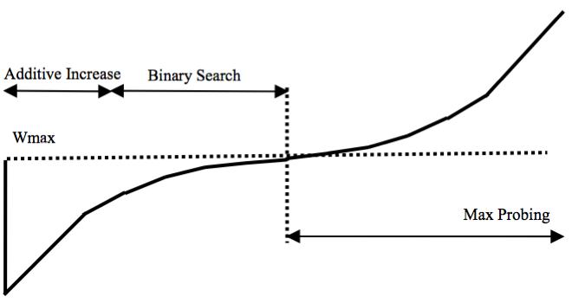
TCP BIC - Summary
Max Probing
+ S_{min}
+ S_{max}
Packet loss event
W_{max}
Time
+ S_{max}
jump to midpoint
Additive Increase
Binary Increase
Slow
Start
Additive Increase
69

Slide 70
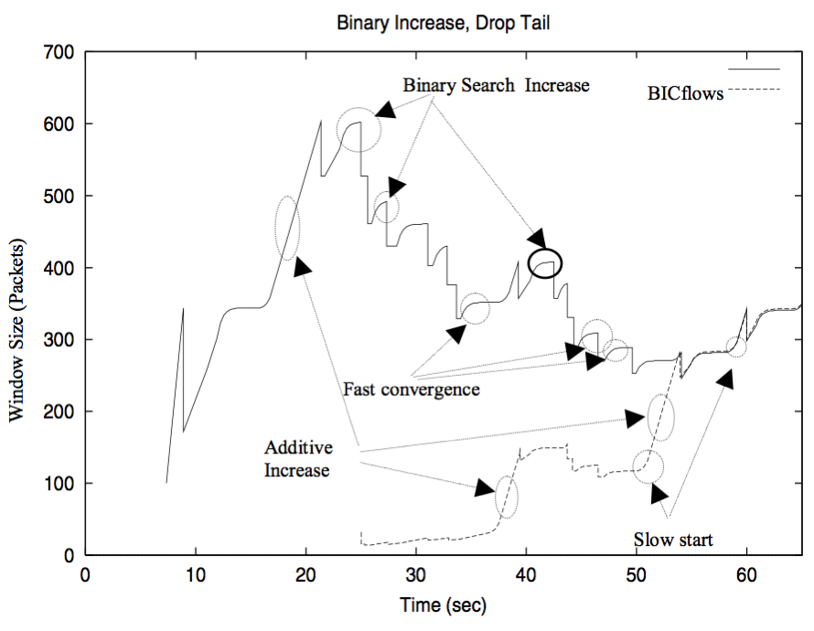
TCP BIC in Action
70

Slide 71
TCP BIC Analysis
Advantages
Faster convergence at large gap
Slower growth at convergence to avoid timeout
Issues
Still depend on RTT
Complex growth function
More details: http://www.land.ufrj.br/~classes/coppe-redes-2007/projeto/BIC-TCP-infocom-04.pdf

Slide 72
Cubic High-Level Structure
If (received ACK && state == cong avoid)
Compute W_{cubic}(t+RTT).
If cwnd < W_{TCP}
Cubic in TCP mode
If cwnd < Wmax
Cubic in concave region
If cwnd > Wmax
Cubic in convex region
72

Slide 73
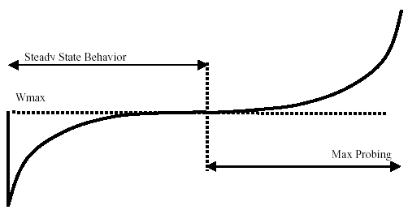


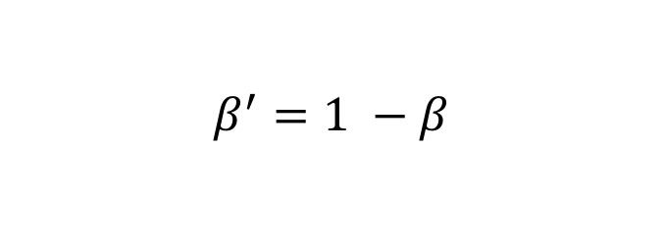
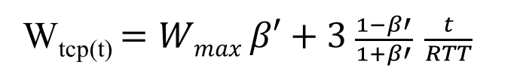
The Cubic function
$$β^{′}=1 −β$$
W_{tcp(t)} $=Wmax β′+3 \frac{1−β′}{1+β′} \frac{t}{RTT}$
convex region
slow down
concave region
where C is a scaling factor, t is the elapsed time from the last window reduction, and β is a constant multiplication decrease factor

Slide 74
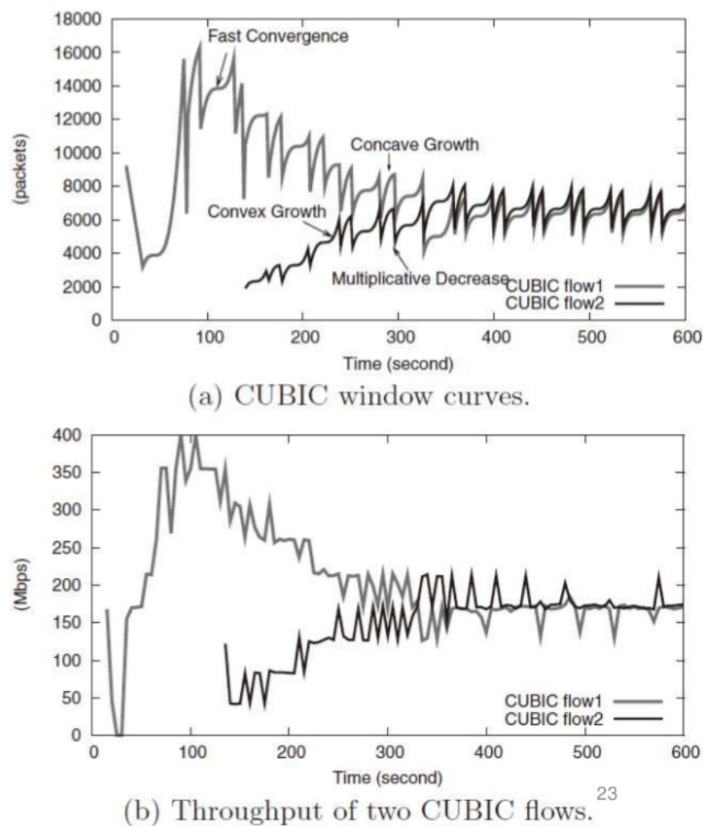

Slide 75
Outline
Admin and recap
Transport congestion control
what is congestion (cost of congestion)
basic congestion control alg.
TCP/Reno congestion control
TCP Cubic
TCP/Vegas

Slide 76
TCP/Vegas (Brakmo & Peterson 1994)
window
time
SS
CA
Idea: try to detect congestion by delay before loss
Objective: not to overflow the buffer; instead, try to maintain a constant number of packets in the bottleneck queue

Slide 77
TCP/Vegas: Key Question
How to estimate the number of packets queued in the bottleneck queue?
window
time
SS
CA

Slide 78
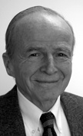
Recall: Little’s Law
For any system with no or (low) loss.
Assume
mean arrival rate X, mean service time T, and mean number of requests in the system W
Then relationship between W, X, and T:
T, W
X
Notes:
Proof of Little’s Law:

Slide 79
Estimating Number of Packets in the Queue

Slide 80
TCP/Vegas CA algorithm
T = T_{prop} + T_{queueing}
Applying Little’s Law:
x_{vegas} T = x_{vegas} T_{prop} + x_{vegas} T_{queueing}, where x_{vegas} = W / T is the sending rate
Then number of packets in the queue is x_{vegas} T_{queueing} = x_{vegas} T - x_{vegas} T_{prop}
= W – W/T T_{prop}

Slide 81
TCP/Vegas CA algorithm
window
maintain a constant number of packets in the bottleneck buffer
time
SS
CA
for every RTT
{ if W – W/RTT RTT_{min} < α then W ++
if W – W/RTT RTT_{min} > α then W -- }
for every loss
W := W/2
queue size

Slide 82
Discussions
If two flows, one TCP Vegas and one TCP reno run together, how may bandwidth partitioned among them?
Issues that limit Vegas deployment?

