Slide 1
Network Transport Layer: Reliable Data Transfer; TCP
Qiao Xiang
https://qiaoxiang.me/courses/cnns-xmuf22/index.shtml
10/25/2022
This deck of slides are heavily based on CPSC 433/533 at Yale University, by courtesy of Dr. Y. Richard Yang.

Slide 2
Outline
Admin and recap
Reliable data transfer

Slide 3
Admin
Guest lecture on Oct. 27 class (morning)
Guest lecturer: Ennan Zhai (Alibaba)
Lecture title: Intent-Based Network in Alibaba

Slide 4
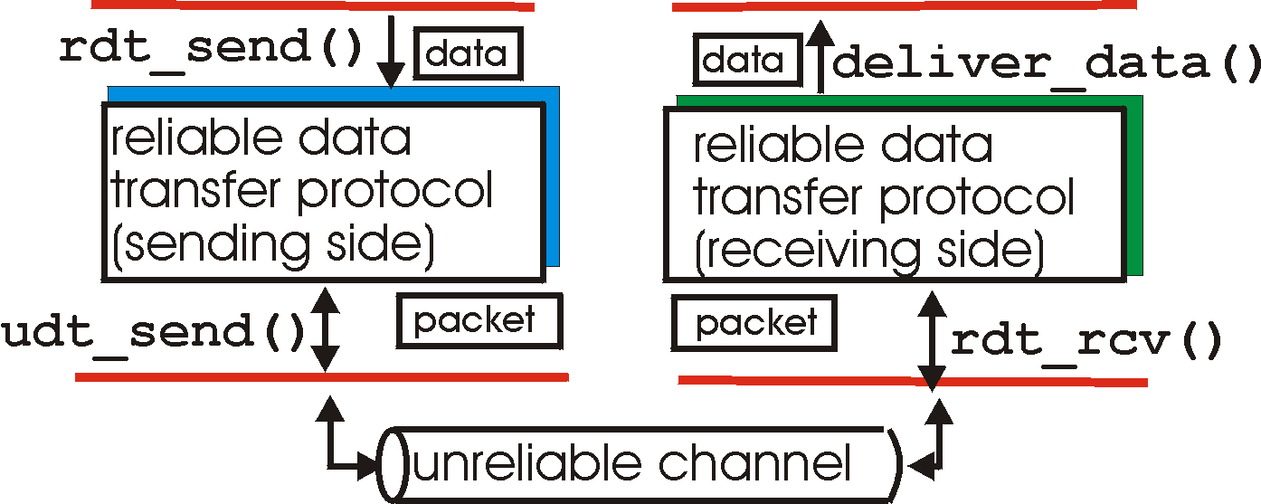
Recap: Reliable Data Transfer Context
rdt_send(): called from above, (e.g., by app.)
deliver_data(): called by rdt to deliver data to upper
send
side
receive
side
udt_send(): called by rdt,
to transfer packet over
unreliable channel to receiver
rdt_rcv(): called from below; when packet arrives on rcv-side of channel

Slide 5
Reliable Data Transfer: Getting Started
We’ll:
incrementally develop sender, receiver sides of reliable data transfer protocol (rdt)
consider only unidirectional data transfer
but control info will flow on both directions !
use finite state machines (FSM) to specify sender, receiver
event causing state transition
actions taken on state transition
state: when in this “state” next state uniquely determined by next event
state
1
state
2
event
actions

Slide 6
Rdt1.0: reliable transfer over a reliable channel
separate FSMs for sender, receiver:
sender sends data into underlying channel
receiver reads data from underlying channel
Wait for call from above
rdt_send(data)
Wait for call from below
rdt_rcv(packet)
extract (packet,data)
deliver_data(data)
packet = make_pkt(data)
udt_send(packet)
sender
receiver
Exercise: Prove correctness of Rdt1.0.
Correctness: for every single packet, one and only one copy is received by receiver correctly (no error) and in-order
Notes:
correctness: every single packet received correctly, received by one and only one at receiver, and received in-order

Slide 7
Recap: rdt2.0: Reliability allowing only Data Msg Corruption
rdt_send(data)
snkpkt = make_pkt(data, checksum)
udt_send(sndpkt)
receiver
rdt_rcv(rcvpkt) &&
isNAK(rcvpkt)
Wait for data
Wait for ACK or NAK
rdt_rcv(rcvpkt) &&
corrupt(rcvpkt)
udt_send(sndpkt)
udt_send(NAK)
rdt_rcv(rcvpkt) && isACK(rcvpkt)
Λ
Wait for data
sender
rdt_rcv(rcvpkt) &&
notcorrupt(rcvpkt)
extract(rcvpkt,data)
deliver_data(data)
udt_send(ACK)
7

Slide 8
rdt2.0 is Incomplete!
What happens if ACK/NAK corrupted?
Although sender receives feedback, but doesn’t know what happened at receiver!
sender
data (n)
waiting for N/ACK
?(N/ACK)

Slide 9
rdt2.1b: Summary
Sender:
seq # added to pkt
must check if received ACK/NAK corrupted
Receiver:
must check if received packet is duplicate
by checking if the packet has the expected pkt seq #

Slide 10
rdt2.1c: Summary
Sender:
state must “remember” whether “current” pkt has 0 or 1 seq. #
Receiver:
must check if received packet is duplicate
state indicates whether 0 or 1 is expected pkt seq #

Slide 11
rdt2.2: a NAK-free protocol
Same functionality as rdt2.1c, using ACKs only
Instead of NAK, receiver sends ACK for last pkt received OK
receiver must explicitly include seq # of pkt being ACKed
Duplicate ACK at sender results in same action as NAK: retransmit current pkt

Slide 12
rdt3.0: Channels with Errors and Loss
New assumption: underlying channel can also lose packets (data or ACKs)
checksum, seq. #, ACKs, retransmissions will be of help, but not enough
Q: Does rdt2.2 work under losses?
Approach: sender waits “reasonable” amount of time for ACK
requires countdown timer
retransmits if no ACK received in this time
if pkt (or ACK) just delayed (not lost):
retransmission will be duplicate, but use of seq. #’s already handles this
receiver must specify seq # of pkt being ACKed

Slide 13
rdt3.0 Sender
rdt_send(data)
rdt_rcv(rcvpkt) &&
( corrupt(rcvpkt) ||
isACK(rcvpkt,1) )
sndpkt = make_pkt(0, data, checksum)
udt_send(sndpkt)
start_timer
udt_send(sndpkt)
rdt_rcv(rcvpkt)
Λ
Λ
Wait for
call 0 from above
Wait for ACK0
timeout
udt_send(sndpkt)
start_timer
rdt_rcv(rcvpkt)
&& notcorrupt(rcvpkt)
&& isACK(rcvpkt,1)
rdt_rcv(rcvpkt)
&& notcorrupt(rcvpkt)
&& isACK(rcvpkt,0)
stop_timer
stop_timer
Wait for ACK1
Wait for
call 1 from above
timeout
udt_send(sndpkt)
start_timer
rdt_rcv(rcvpkt)
rdt_send(data)
Λ
rdt_rcv(rcvpkt) &&
( corrupt(rcvpkt) ||
isACK(rcvpkt,0) )
sndpkt = make_pkt(1, data, checksum)
udt_send(sndpkt)
start_timer
Λ

Slide 14
rdt3.0: Stop-and-Wait Performance
sender
receiver
first packet bit transmitted, t = 0
last packet bit transmitted, t = L / R
first packet bit arrives
RTT
last packet bit arrives, send ACK
ACK arrives, send next
packet, t = RTT + L / R
What is U_{sender}: utilization – fraction of time link busy sending?
Assume: 1 Gbps link, 15 ms e-e prop. delay, 1KB packet
14

Slide 15
Performance of rdt3.0
rdt3.0 works, but performance stinks
Example: 1 Gbps link, 15 ms e-e prop. delay, 1KB packet:
T
=
L (packet length in bits)
8kb/pkt
transmit
=
= 8 microsec
R (transmission rate, bps)
10**9 b/sec
1KB pkt every 30 msec -> 33kB/sec throughput over 1 Gbps link
network protocol limits use of physical resources !

Slide 16
A Summary of Questions
How to improve the performance of rdt3.0?
What if there are reordering and duplication?
How to determine the “right” timeout value?
16

Slide 17
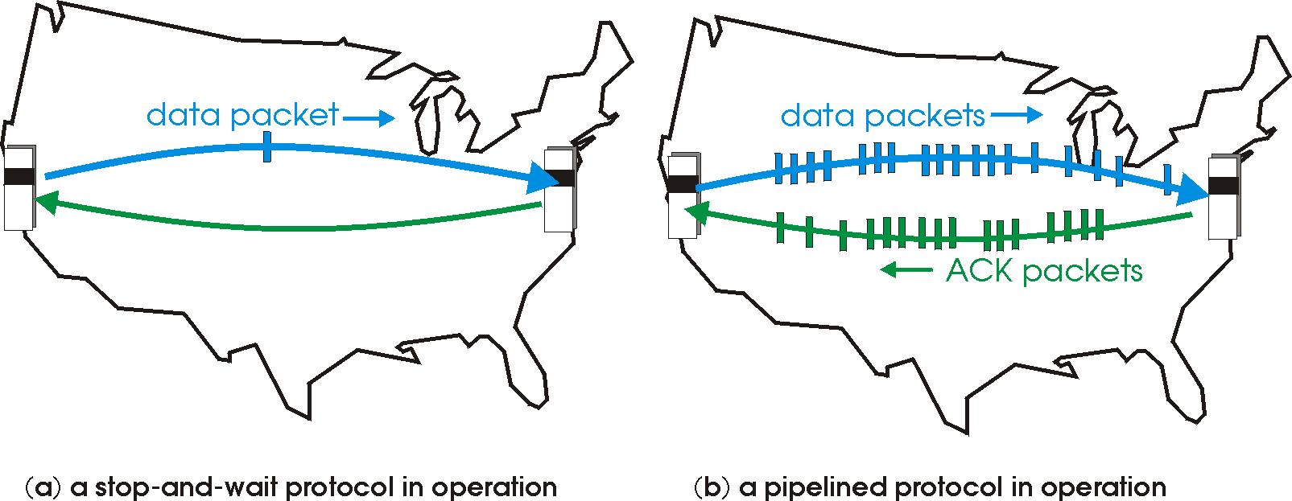
Sliding Window Protocols: Pipelining
Pipelining: sender allows multiple, “in-flight”, yet-to-be-acknowledged pkts
range of sequence numbers must be increased
buffering at sender and/or receiver
17
Notes:
Two generic forms of pipelined protocols: go-Back-N, selective repeat

Slide 18
Pipelining: Increased Utilization
sender
receiver
first packet bit transmitted, t = 0
last bit transmitted, t = L / R
first packet bit arrives
RTT
last packet bit arrives, send ACK
last bit of 2nd packet arrives, send ACK
last bit of 3rd packet arrives, send ACK
ACK arrives, send next
packet, t = RTT + L / R
increase utilization
by a factor of 3!
Question: a rule-of-thumb window size?
18

Slide 19
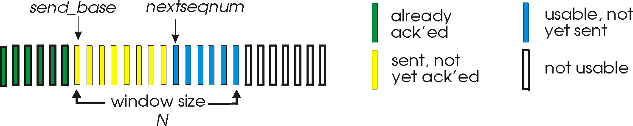
Realizing Sliding Window: Go-Back-n
Sender:
k-bit seq # in pkt header
“window” of up to W, consecutive unack’ed pkts allowed
W
ACK(n): ACKs all pkts up to, including seq # n - “cumulative ACK”
note: ACK(n) could mean two things: I have received upto and include n, or I am waiting for n
timer for the packet at base
timeout(n): retransmit pkt n and all higher seq # pkts in window
19

Slide 20
GBN: Sender FSM
rdt_send(data)
if (nextseqnum < base+W) {
sndpkt[nextseqnum] = make_pkt(nextseqnum,data,chksum)
udt_send(sndpkt[nextseqnum])
if (base == nextseqnum) start_timer
nextseqnum++
} else
block sender
Λ
base=1
nextseqnum=1
timeout
start_timer
udt_send(sndpkt[base])
udt_send(sndpkt[base+1])
…
udt_send(sndpkt[nextseqnum-1])
Wait
rdt_rcv(rcvpkt)
&& corrupt(rcvpkt)
rdt_rcv(rcvpkt) &&
notcorrupt(rcvpkt)
if (new packets ACKed) {
advance base;
if (more packets waiting) send more packets
}
if (base == nextseqnum)
stop_timer
else
start_timer for the packet at new base
20

Slide 21
GBN: Receiver FSM
default
udt_send(sndpkt)
rdt_rcv(rcvpkt)
&& notcurrupt(rcvpkt)
&& hasseqnum(rcvpkt,expectedseqnum)
Λ
Wait
extract(rcvpkt,data)
deliver_data(data)
sndpkt = make_pkt(expectedseqnum,ACK,chksum)
udt_send(sndpkt)
expectedseqnum++
expectedseqnum=1
sndpkt =
make_pkt(expectedseqnum,ACK,chksum)
Only state: expectedseqnum
out-of-order pkt:
discard (don’t buffer) -> no receiver buffering!
re-ACK pkt with highest in-order seq #
may generate duplicate ACKs
21

Slide 22
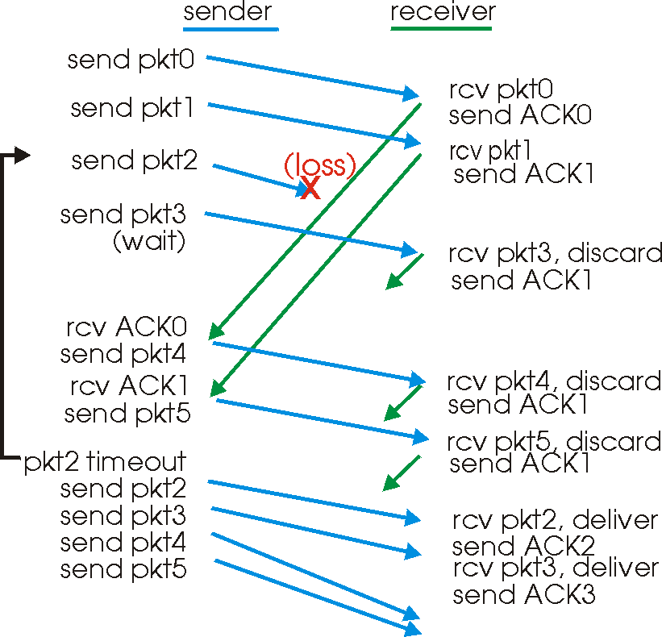
GBN in Action
window
size = 4
22

Slide 23
Analysis: Efficiency of Go-Back-n
Assume window size W
Assume each packet is lost with probability p
On average, how many packets do we send for each data packet received?
23

Slide 24
Selective Repeat
Sender window
Window size W: W consecutive unACKed seq #’s
Receiver individually acknowledges correctly received pkts
buffers out-of-order pkts, for eventual in-order delivery to upper layer
ACK(n) means received packet with seq# n only
buffer size at receiver: window size
Sender only resends pkts for which ACK not received
sender timer for each unACKed pkt
24

Slide 25
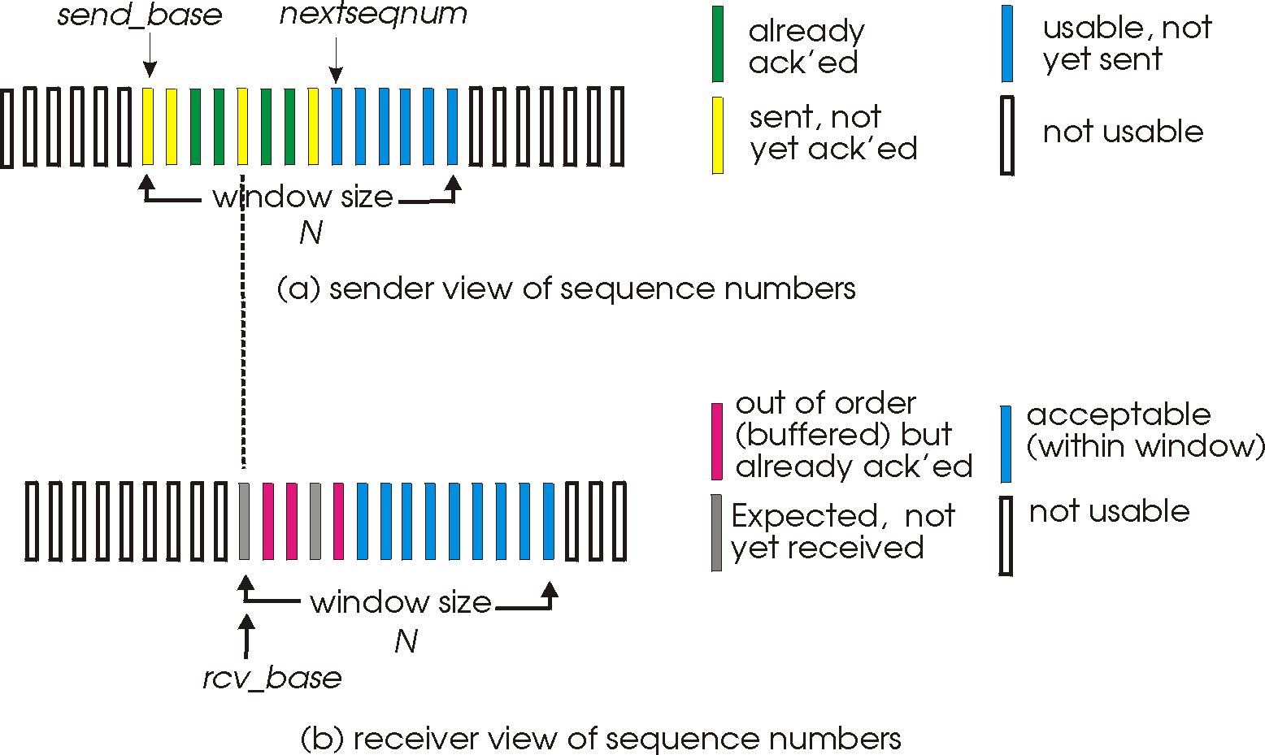
Selective Repeat: Sender, Receiver Windows
W
W
25

Slide 26
Selective Repeat
sender
receiver
data from above :
unACKed packets is less than window size W, send; otherwise block app.
timeout(n):
resend pkt n, restart timer
ACK(n) in [sendbase,sendbase+W-1]:
mark pkt n as received
update sendbase to the first packet unACKed
pkt n in [rcvbase, rcvbase+W-1]
send ACK(n)
if (out-of-order) mark and buffer pkt n else /*in-order*/
deliver any in-order packets
otherwise:
ignore
26

Slide 27
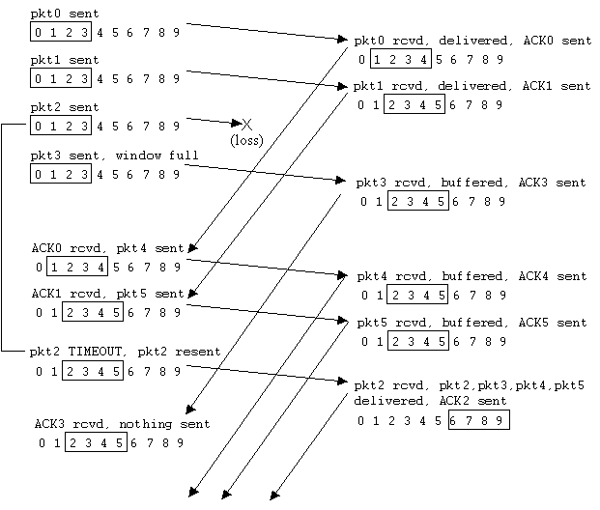
Selective Repeat in Action
27

Slide 28
Discussion: Efficiency of Selective Repeat
Assume window size W
Assume each packet is lost with probability p
On average, how many packets do we send for each data packet received?
28

Slide 29
Selective Repeat: Seq# Ambiguity
Example:
seq #’s: 0, 1, 2, 3
window size=3
Error: incorrectly passes duplicate data as new.
29

Slide 30
State Invariant: Window Location
Go-back-n (GBN)
Selective repeat (SR)
sender window
receiver window
sender window
receiver window
30

Slide 31
Q: what relationship between seq # size and window size?
Window Location
Go-back-n (GBN)
Selective repeat (SR)
sender window
receiver window
sender window
receiver window
31

Slide 32
Selective Repeat
sender
receiver
data from above :
unACKed packets is less than window size W, send; otherwise block app.
timeout(n):
resend pkt n, restart timer
ACK(n) in [sendbase,sendbase+W-1]:
mark pkt n as received
update sendbase to the first packet unACKed
pkt n in [rcvbase, rcvbase+W-1]
send ACK(n)
if (out-of-order) mark and buffer pkt n else /*in-order*/
deliver any in-order packets
pkt n in [rcvbase-W, rcvbase-1]
send ACK(n)
otherwise:
ignore
32

Slide 33
Sliding Window Protocols: Go-back-n and Selective Repeat
 | Go-back-n | Selective Repeat
data bandwidth: sender to receiver (avg. number of times a pkt is transmitted)
ACK bandwidth (receiver to sender)
Relationship between M (the number of seq#) and W (window size)
Buffer size at receiver
Complexity
Less efficient
More efficient
More efficient
Less efficient
M > W
M ≥ 2W
1
W
Simpler
More complex
p: the loss rate of a packet; M: number of seq# (e.g., 3 bit M = 8); W: window size
33

Slide 34
Outline
Admin and Recap
Reliable data transfer
perfect channel
channel with bit errors
channel with bit errors and losses
sliding window: reliability with throughput
TCP reliability

Slide 35
TCP: Overview RFCs: 793, 1122, 1323, 2018, 2581
Point-to-point reliability: one sender, one receiver
Flow controlled and congestion controlled

Slide 36
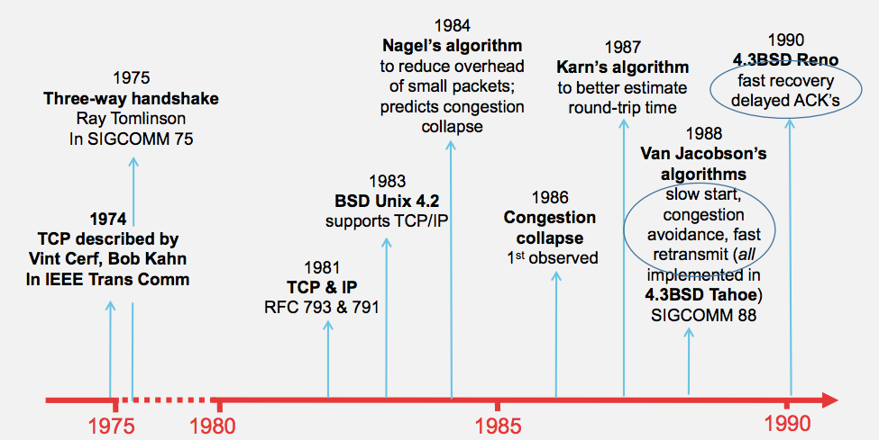
Evolution of TCP
Source: http://webcourse.cs.technion.ac.il/236341/Winter2015-2016/ho/WCFiles/Tutorial10.pdf

Slide 37
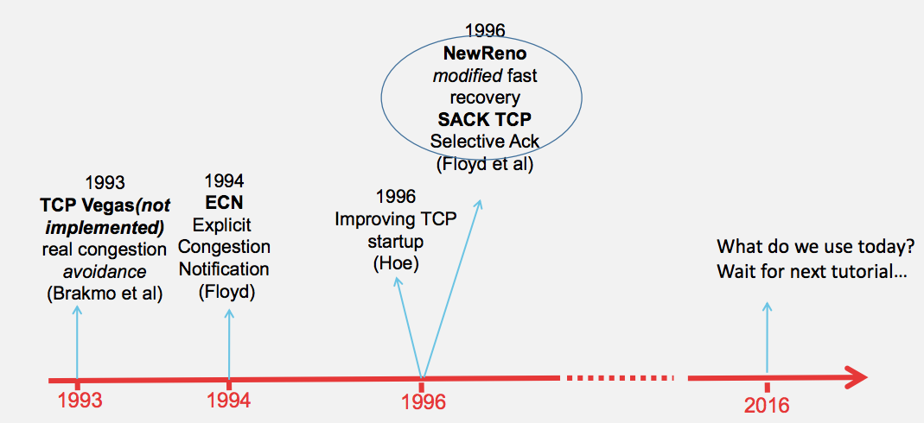
Evolution of TCP
multiple versions
Source: http://webcourse.cs.technion.ac.il/236341/Winter2015-2016/ho/WCFiles/Tutorial10.pdf

Slide 38
TCP Reliable Data Transfer
Connection-oriented:
connection management
setup (exchange of control msgs) init’s sender, receiver state before data exchange
close
Full duplex data:
bi-directional data flow in same connection
A sliding window protocol
a combination of go-back-n and selective repeat:
send & receive buffers
cumulative acks
TCP uses a single retransmission timer
do not retransmit all packets upon timeout

Slide 39
TCP Segment Structure
32 bits
URG: urgent data
(generally not used)
counting
by bytes
of data
(not segments!)
source port #
dest port #
sequence number
ACK: ACK #
valid
acknowledgement number
head
len
not
used
U
rcvr window size
A
P
R
S
PSH: push data now
(generally not used)
F
flow control
checksum
ptr urgent data
RST, SYN, FIN:
connection management
(reset, setup teardown
commands)
Options (variable length)
application
data
(variable length)
Also in UDP

Slide 40
Outline
Admin and Recap
Reliable data transfer
perfect channel
channel with bit errors
channel with bit errors and losses
sliding window: reliability with throughput
TCP reliability
data seq#, ack, buffering

Slide 41
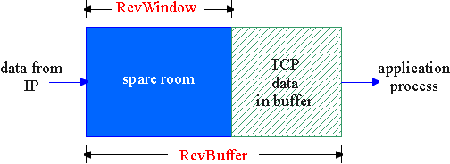
Flow Control
flow control
sender won’t overflow
receiver’s buffer by
transmitting too much,
too fast
receive side of a connection has a receive buffer:
speed-matching service: matching the send rate to the receiving app’s drain rate
app process may be slow at reading from buffer

Slide 42
TCP Flow Control: How it Works
source port #
dest port #
sequence number
acknowledgement number
head
len
not
used
U
A
rcvr window size
P
R
S
F
checksum
ptr urgent data
spare room in buffer
= RcvWindow
Options (variable length)
application
data
(variable length)

Slide 43
TCP Seq. #’s and ACKs
Seq. #’s:
byte stream “number” of first byte in segment’s data
ACKs:
seq # of next byte expected from other side
cumulative ACK in standard header
selective ACK in options
Host A
Host B
User
types
‘C’
Seq=42, ACK=79, data = ‘C’
host ACKs
receipt of
‘C’, echoes
back ‘C’
Seq=79, ACK=43, data = ‘C’
host ACKs
receipt
of echoed
‘C’
Seq=43, ACK=80
time
simple telnet scenario

Slide 44
TCP Send/Ack Optimizations
TCP includes many tune/optimizations, e.g.,
the “small-packet problem”: sender sends a lot of small packets (e.g., telnet one char at a time)
Nagle’s algorithm: do not send data if there is small amount of data in send buffer and there is an unack’d segment
the ”ack inefficiency” problem: receiver sends too many ACKs, no chance of combing ACK with data
Delayed ack to reduce # of ACKs/combine ACK with reply

Slide 45
TCP Receiver ACK Generation [RFC 1122, RFC 2581]
Event at Receiver
Arrival of in-order segment with
expected seq #. All data up to
expected seq # already ACKed
Arrival of in-order segment with
expected seq #. One other
segment has ACK pending
Arrival of out-of-order segment
higher-than-expect seq. # .
Gap detected
Arrival of segment that
partially or completely fills gap
TCP Receiver Action
Delayed ACK. Wait up to 500ms
for next segment. If no next segment,
send ACK
Immediately send single cumulative
ACK, ACKing both in-order segments
Immediately send duplicate ACK,
indicating seq. # of next expected byte
Immediate send ACK, provided that
segment starts at lower end of gap

Slide 46
Outline
Admin and Recap
Reliable data transfer
perfect channel
channel with bit errors
channel with bit errors and losses
sliding window: reliability with throughput
TCP reliability
data seq#, ack, buffering
timeout realization

Slide 47
TCP Reliable Data Transfer
Basic structure: sliding window protocol
Remaining issue: How to determine the “right” parameters?
timeout value?
sliding window size?

Slide 48
History
Key parameters for TCP in mid-1980s
fixed window size W
timeout value = 2 RTT
Network collapse in the mid-1980s
UCB ←→ LBL throughput dropped by 1000X !
The intuition was that the collapse was caused by wrong parameters…

Slide 49
Timeout: Cost of Timeout Param
Why is good timeout value important?
too short
premature timeout
unnecessary retransmissions; many duplicates
too long
slow reaction to segment loss
Q: Is it possible to set Timeout as a constant?
Q: Any problem w/ the early approach: Timeout = 2 RTT

Slide 50
Setting Timeout
Problem:
Ideally, we set timeout = RTT, but RTT is not a fixed value => using the average of RTT will generate many timeouts due to network variations
Possibility: using the average/median of RTT
Issue: this will generate many timeouts due to network variations
Solution:
Set Timeout RTO = avg + “safety margin” based on variation
freq.
RTT
TCP approach:
Timeout = EstRTT + 4 * DevRTT

Slide 51
Compute EstRTT and DevRTT
Exponential weighted moving average (EWMA)
influence of past sample decreases exponentially fast
EstRTT = (1-alpha)*EstRTT + alpha*SampleRTT
- SampleRTT: measured time from segment transmission until ACK receipt
- typical value: alpha = 0.125
DevRTT = (1-beta)*DevRTT + beta|SampleRTT-EstRTT|
(typically, beta = 0.25)

Slide 52
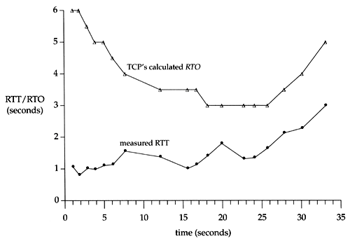
An Example TCP Session

Slide 53
Fast Retransmit
Issue: Timeout period often relatively long:
long delay before resending lost packet
Question: Can we detect loss faster than RTT?
Detect lost segments via duplicate ACKs
sender often sends many segments back-to-back
if segment is lost, there will likely be many duplicate ACKs
If sender receives 3 ACKs for the same data, it supposes that segment after ACKed data was lost:
resend segment before timer expires

Slide 54
Triple Duplicate Ack
Packets
1
2
3
4
5
6
7
Acknowledgements (waiting seq#)
2
3
4
4
4
4

Slide 55
Fast Retransmit:
event: ACK received, with ACK field value of y
if (y > SendBase) {
…
SendBase = y
if (there are currently not-yet-acknowledged segments)
start timer
…
}
else {
increment count of dup ACKs received for y
if (count of dup ACKs received for y = 3) {
resend segment with sequence number y
…
a duplicate ACK for
already ACKed segment
fast retransmit

Slide 56
TCP: reliable data transfer
00 sendbase = initial_sequence number agreed by TWH
01 nextseqnum = initial_sequence number by TWH
02 loop (forever) {
03 switch(event)
04 event: data received from application above
05 if (window allows send)
06 create TCP segment with sequence number nextseqnum
06 if (no timer) start timer
07 pass segment to IP
08 nextseqnum = nextseqnum + length(data) else put packet in buffer
09 event: timer timeout for sendbase
10 retransmit segment
11 compute new timeout interval
12 restart timer
13 event: ACK received, with ACK field value of y
14 if (y > sendbase) { /* cumulative ACK of all data up to y */
15 cancel the timer for sendbase
sendbase = y
if (no timer and packet pending) start timer for new sendbase
while (there are segments and window allow)
sent a segment;
18 }
19 else { /* y==sendbase, duplicate ACK for already ACKed segment */
20 increment number of duplicate ACKs received for y
21 if (number of duplicate ACKS received for y == 3) {
22 /* TCP fast retransmit */
23 resend segment with sequence number y
24 restart timer for segment y
25 }
26 } /* end of loop forever */
Simplified
TCP
sender

Slide 57
Outline
Admin and Recap
Reliable data transfer
perfect channel
channel with bit errors
channel with bit errors and losses
sliding window: reliability with throughput
TCP reliability
data seq#, ack, buffering
timeout realization
connection management

Slide 58
Why Connection Setup/When to Accept (Safely Deliver) First Packet?
sender
receiver
data 0
accept
ACK for 0

Slide 59
Why Connection Setup/When to Accept (Safely Deliver) First Packet?
sender
receiver
data 0 (transfer $1000 to B)
accept
ACK for 0 (n)
data 0 (transfer $1000 to B)
accept?
59
Notes:
a sender should not reuse a seq# before it is sure the packet has left the network

Slide 60
Transport “Safe-Setup” Principle
A general safety principle for a receiver R to accept a message from a sender S is the general “authentication” principle, which consists of two conditions:
Transport authentication principle:
[p1] Receiver can be sure that what Sender says is fresh
[p2] Receiver receives something that only Sender can say
We first assume a secure setting: no malicious attacks.
Exercise: Techniques to allow a receiver to check for freshness (e.g., add a time stamp)?

