Slide 1
Statistical Multiplexing; Layered Network Architecture
Qiao Xiang
https://qiaoxiang.me/courses/cnns-xmuf22/index.shtml
9/20/2022
This deck of slides are heavily based on CPSC 433/533 at Yale University, by courtesy of Dr. Y. Richard Yang.

Slide 2
Outline
Admin. and recap
A taxonomy of communication networks
datagram and virtual circuit packet switched networks
Layered network architecture

Slide 3
Admin
Questions on Assignment One

Slide 4
Recap: Summary of the Taxonomy of Communication Networks
communication network
switched network
broadcast communication
packet-switched network
circuit-switched network
datagram network
virtual circuit network

Slide 5
Recap: Circuit Switching vs. Packet Switching
 | circuit switching | packet switching
resource usage | use a single partition bandwidth | use whole link bandwidth
reservation/setup | need reservation (setup delay) | no reservation
resource contention | busy signal (session loss) | congestion (long delay and packet losses)
charging | time | packet
header | no per-pkt header | per packet header
fast path processing | fast | per packet processing

Slide 6
Recap: Queueing Theory
Model system state
Introduce state transition diagram
Focus on equilibrium: state trend neither growing nor shrinking

Slide 7
Recap: Queueing Theory Analysis of Circuit-Switching
system state: # of busy lines
0
1
k
k+1
N
p0
p1
pk
pk+1
pN

Slide 8
Equilibrium = Time Reversibility [Frank Kelly]
=
Statistically cannot distinguish
=
=
state
Play the sequence backwards
k+1
k
time

Slide 9
Recap: Queueing Theory Analysis of Circuit-Switching
system state: # of busy lines
λ
0
1
k
k+1
N
(k+1)μ
p0
p1
pk
pk+1
pN
at equilibrium (time reversibility) in one unit time: #(transitions k → k+1) = #(transitions k+1 → k)

Slide 10
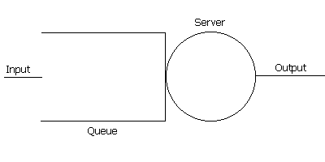
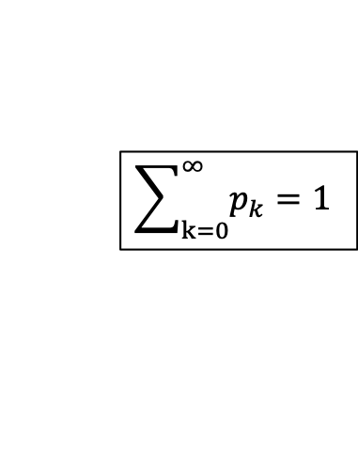
Recap: Queueing Theory Analysis of Packet Switching
system state: #packets in queue
λ
0
1
k
k+1
N
μ
p0
p1
pk
pk+1
at equilibrium (time reversibility) in one unit time: #(transitions k → k+1) = #(transitions k+1 → k)
$$\sum_{k=0}^{∞}{p_{k}}=1$$

Slide 11
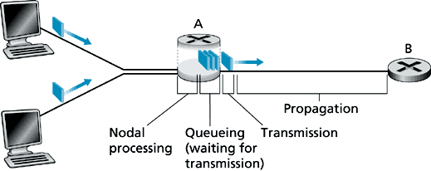
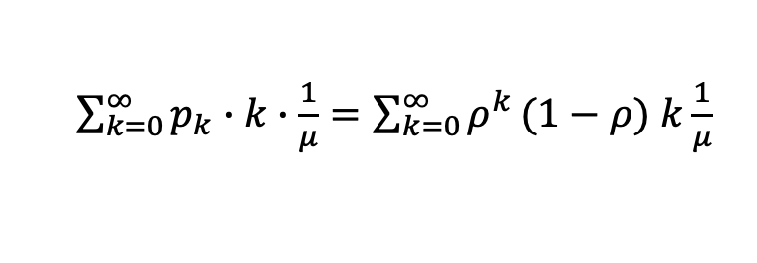
Recap: Analysis of Delay
λ
0
1
k
k+1
μ
Average queueing delay:
Transmission delay:
Queueing + transmission:
$\sum_{k=0}^{∞}{p_{k}}∙k∙\frac{1}{μ}=\sum_{k=0}^{∞}{ρ^{k}}(1−ρ)$ $k\frac{1}{μ}$

Slide 12
Recap: Analysis of Delay
For a demo of M/M/1, see: http://www.dcs.ed.ac.uk/home/jeh/Simjava/queueing/mm1_q/mm1_q.html

Slide 13

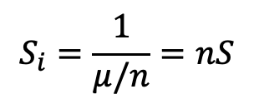
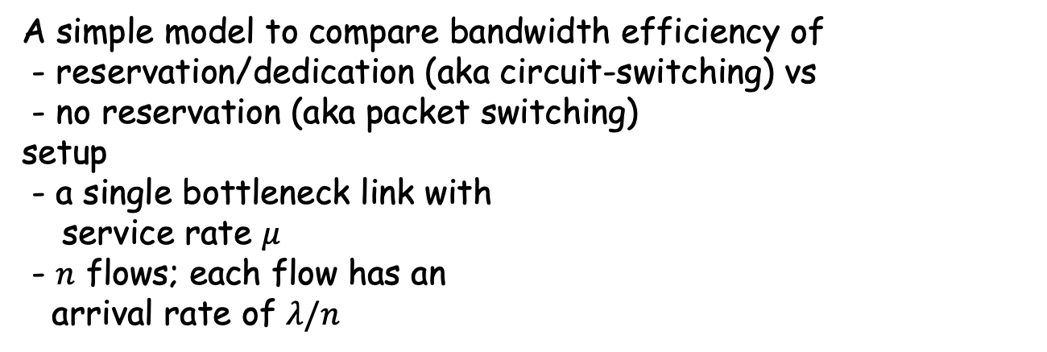
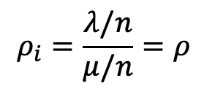
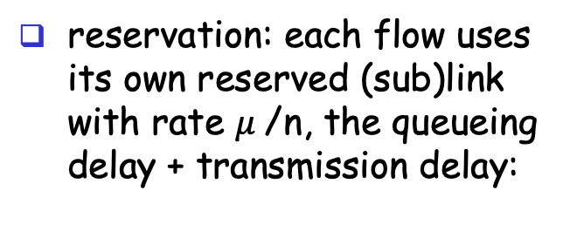
Recap: Statistical Multiplexing
A simple model to compare bandwidth efficiency of
- reservation/dedication (aka circuit-switching) vs
- no reservation (aka packet switching) setup
- a single bottleneck link with
service rate $μ$
- $n$ flows; each flow has an arrival rate of $λ/n$
no reservation: all arrivals into the single link, the queueing delay + transmission delay:
reservation: each flow uses its own reserved (sub)link with rate $μ$/n, the queueing delay + transmission delay:
For each flow i:
$$ρ_{i}=\frac{λ/n}{μ/n}=ρ$$
$$S_{i}=\frac{1}{μ/n}=nS$$

Slide 14
Summary: Packet Switching vs. Circuit Switching
Advantages of packet switching over circuit switching
most important advantage of packet-switching over circuit switching is statistical multiplexing, and therefore more efficient bandwidth usage
Disadvantages of packet switching
potential congestion: packet delay and high loss
protocols needed for reliable data transfer, congestion control
it is possible to guarantee quality of service (QoS) in packet-switched networks and still gain statistical multiplexing, but it adds much complexity
packet header overhead
per packet processing overhead

Slide 15
Outline
Admin. and recap
A taxonomy of communication networks
circuit switched networks
packet switched networks
circuit switching vs. packet switching
datagram and virtual circuit packet switched networks

Slide 16
A Taxonomy of Packet-Switched Networks According to Routing
Two types of packet switching
datagram network
each packet of a flow is switched independently
virtual circuit network:
all packets from one flow are sent along a pre-established path (= virtual circuit)

Slide 17
Datagram Packet Switching
Commonly when we say packet switching we mean datagram switching
Example: IP networks
Each packet is independently switched
each packet header contains complete destination address
receiving a packet, a router looks at the packet’s destination address and searches its current routing table to determine the possible next hops, and pick one
Analogy: postal mail system
Notes:
Disadvantages: routes may change during session
Advantage: routers do not keep any state about a flow;
thus, network architecture is
robust
scalable

Slide 18
Datagram Packet Switching
Host C
Host A
Host D
Node 1
Node 2
Node 3
Node 5
Host B
Node 7
Host E
Node 6
Node 4

Slide 19
Timing Diagram of Datagram Switching
Host A
Host B
Node 1
Node 2
Packet 1
propagation
delay from
Host A to
Node 1
transmission
time of Packet 1
at Host A
Packet 2
Packet 1
Packet 3
Packet 2
Packet 3
Packet 1
Packet 2
Packet 3

Slide 20
Virtual-Circuit Packet Switching
Example: Multiple Label Packet Switching (MPLS) in IP networks
Hybrid of circuit switching and datagram switching
fixed path determined at virtual circuit setup time, remains fixed thru flow
Implementation:
each packet carries a short local, tag (virtual-circuit (VC) #); tag determines next hop
Incoming VC# | Outgoing Interface | QoS
12 | 2
16 | 3
20 | 3
…

Slide 21
Virtual-Circuit Switching
Host C
Host A
Host D
Node 1
Node 2
Node 3
Node 5
Host B
Node 7
Host E
Node 6
Node 4

Slide 22
Virtual-Circuit Packet Switching
Three phases
VC establishment
Data transfer
VC disconnect

Slide 23
Timing Diagram of Virtual-Circuit Switching
Host 1
Host 2
Node 1
Node 2
propagation delay
between Host 1
and Node 1
VC
establishment
Packet 1
Packet 2
Packet 1
Packet 3
Packet 2
Packet 3
Packet 1
data
transfer
Packet 2
Packet 3
VC
termination

Slide 24
Discussion: Datagram Switching vs. Virtual Circuit Switching
What are the benefits of datagram switching over virtual circuit switching?
What are the benefits of virtual circuit switching over datagram switching?
Notes:
What advantages do virtual circuit have over datagram?
can treat different flows differently, if flows setup its desired treatment
Guarantees in-sequence delivery of packets
However: Packets from different virtual circuits may be interleaved

Slide 25
Summary of the Taxonomy of Communication Networks
communication network
switched network
broadcast communication
circuit-switched network
packet-switched network
datagram network
virtual circuit network

Slide 26
Summary of Progress
We have seen the hardware infrastructure, the basic communication scheme, a next key question is how to develop the software system.

Slide 27
Summary of Progress
We have seen the hardware infrastructure, the basic communication scheme, a next key question is how to develop the software system.

Slide 28
Outline
Admin. and recap
A taxonomy of communication networks
Layered network architecture
what is layering?
why layering?
how to determine the layers?
ISO/OSI layering and Internet layering

Slide 29
What is Layering?
A technique to organize a networked system into a succession of logically distinct entities, such that the service provided by one entity is solely based on the service provided by the previous (lower level) entity.
Application
Application
Transport
Transport
Network
Network
Network
Datalink
Datalink
Datalink
Physical
Physical
Physical
Physical medium

Slide 30
Outline
Admin. and recap
A taxonomy of communication networks
Layered network architecture
what is layering?
why layering?

Slide 31
Why Layering?
Networks are complex !
many “pieces”:
hardware
hosts
routers
links of various media
software
applications
infrastructure
Dealing with complex systems: explicit structure allows identification of the relationship among a complex system’s pieces
layered reference model for discussion
Modularization eases maintenance, updating of system:
change of implementation of a layer’s service transparent to rest of system, e.g., changes in routing protocol doesn’t affect rest of system

Slide 32
An Example: No Layering
Application
Telnet
FTP
HTTP
Transmission
Media
Ether-net
Fiber
optic
Wireless
No layering: each new application has to be re-implemented for every network technology !

Slide 33
An Example: Benefit of Layering
Introducing an intermediate layer provides a common abstraction for network technologies
Application
Telnet
FTP
HTTP
Transport
& Network
Transmission
Media
Ethernet
Fiber
optic
Wireless

Slide 34
ISO/OSI Concepts
ISO – International Standard Organization
OSI – Open System Interconnection
Service – says what a layer does
Interface – says how to access the service
Protocol – specifies how the service is implemented
a set of rules and formats that govern the communications between two or more peers

Slide 35
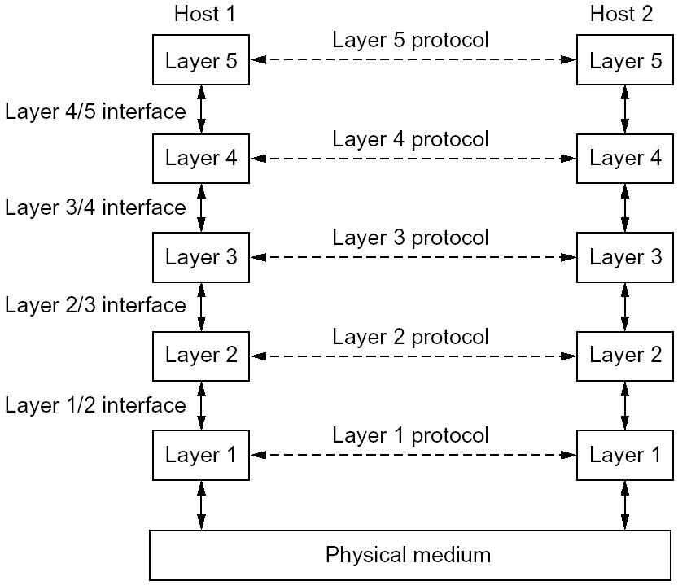
An Example of Layering

Slide 36
An Example of Layering

Slide 37
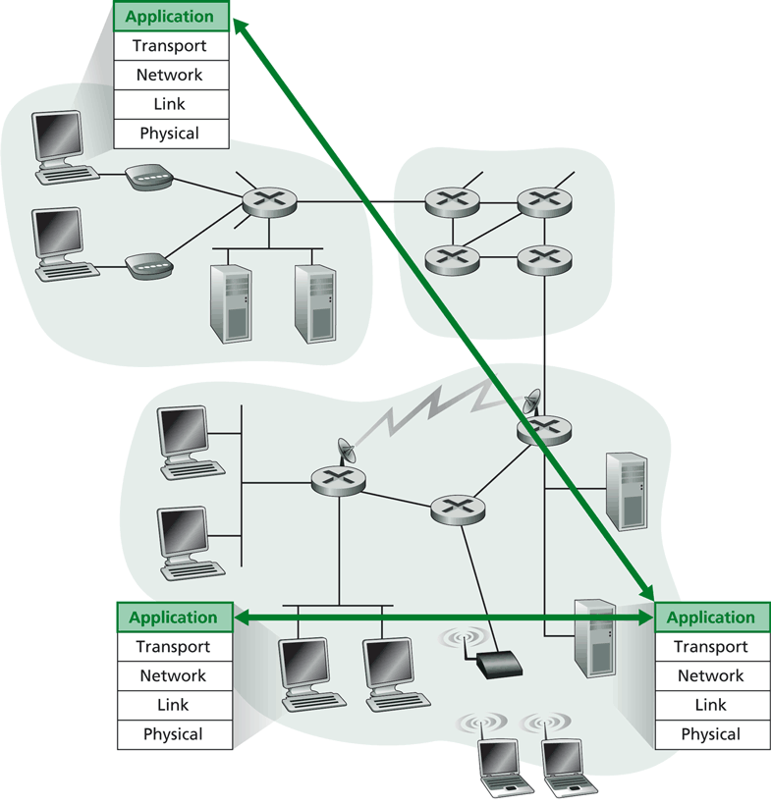
Layering -> Logical Communication
E.g.: application
provide services to users
application protocol:
send messages to peer
for example, HELO, MAIL FROM, RCPT TO are messages between two SMTP peers

Slide 38
Layering: Logical Communication
data
application
transport
network
link
physical
transport
E.g.: transport
Trans. msg for app
Transport protocol
add control info to form “segment”
send segment to peer
wait for peer to ack receipt; if no ack, retransmit
ack
network
link
physical
application
transport
network
link
physical
data
data
application
transport
network
link
physical
application
transport
network
link
physical
transport

Slide 39
Layering: Physical Communication
data
application
transport
network
link
physical
network
link
physical
application
transport
network
link
physical
data
application
transport
network
link
physical
application
transport
network
link
physical

Slide 40
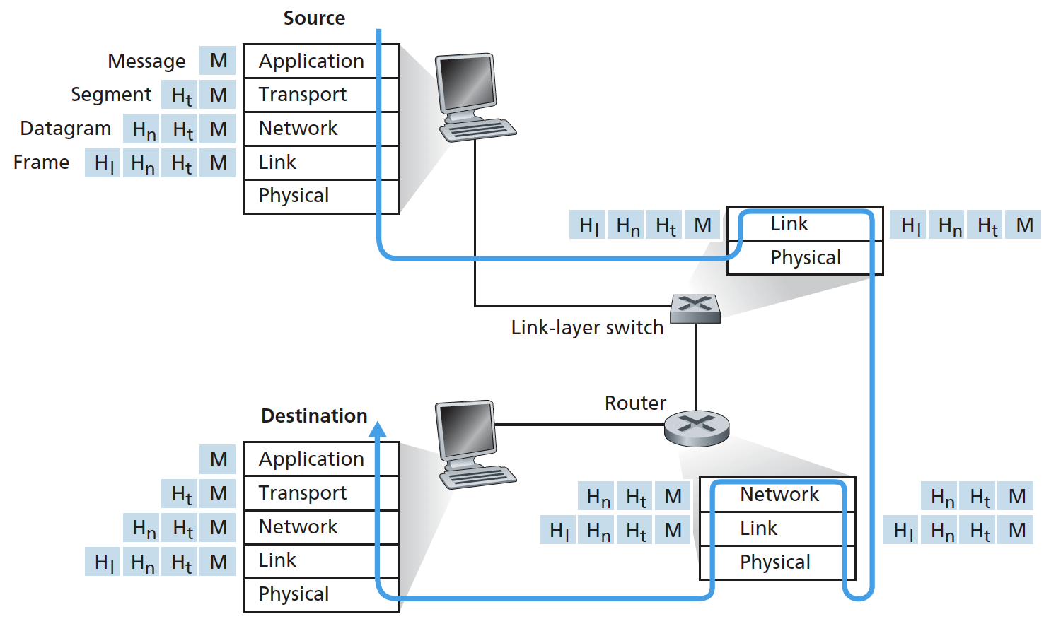
Protocol Layering and Meta Data
Each layer takes data from above
adds header (meta) information to its peer to create new data unit
passes new data unit to layer below

Slide 41
Packet as a Stack in a Layered Architecture
Application
Application
Transport
Transport
Network
Network
Network
Datalink
Datalink
Datalink
Physical
Physical
Physical
Physical medium

Slide 42
Some Implications of Layered Architecture
A packet as a stack container
Each layer needs multiplexing and demultiplexing to serve layer above
…
Hn-1
Hn
Ln
Has a field to indicate which higher layer requires the service
Ln-1

Slide 43
Key design issue:
How do you divide functionalities among the layers?

Slide 44
Outline
Admin. and recap
A taxonomy of communication networks
Layered network architecture
what is layering?
why layering?
how to determine the layers?

Slide 45
The End-to-End Arguments
The function in question can completely and correctly be implemented only with the knowledge and help of the application standing at the endpoints of the communication systems. Therefore, providing that questioned function as a feature of the communications systems itself is not possible.
J. Saltzer, D. Reed, and D. Clark, 1984

Slide 46
What does the End-to-End Arguments Mean?
The application knows the requirements best, place functionalities as high in the layer as possible
Think twice before implementing a functionality at a lower layer, even when you believe it will be useful to an application

Slide 47
Example: Where to Provide Reliability ?
S
A
R
L2
L2
L1
L1
L1
Solution 1: the network (lower layer L1) provides reliability, i.e., each hop provides reliability
Solution 2: the end host (higher layer L2) provides reliability, i.e., end-to-end check and retry

Slide 48
What are Reasons for Implementing Reliability at Higher Layer ?
The lower layer cannot completely provide the functionality
the receiver has to do the check anyway !
Implementing it at lower layer increases complexity, cost and overhead at lower layer
shared by all upper layer applications → everyone pays for it, even if you do not need it
The upper layer
knows the requirements better and thus may choose a better approach to implement it
S
A
R
L2
L2
L1
L1
L1
Notes:
First point: L1 may first ack and then crash; then the function fails; if L2 crash; the application crashes also->fate sharing

Slide 49
Are There Reasons Implementing Reliability at Lower Layer ?
Improve performance, e.g., if high cost/delay/… on a local link
improves efficiency
reduces delay
Share common code, e.g., reliability is required by multiple applications
S
A
R
L2
L2
L1
L1
L1
Notes:
S to A: San francisco to Yale router
A to R: Yale router to a wireless laptop (e.g., 10% success rate)

Slide 50
Summary: End-to-End Arguments
If a higher layer can do it, don’t do it at a lower layer -- the higher the layer, the more it knows about the best what it needs
Add functionality in lower layers iff it
(1) is used by and improves performance of a large number of (current and potential future) applications,
(2) does not hurt (too much) other applications, and
(3) does not increase (too much) complexity/overhead
Practical tradeoff, e.g.,
allow multiple interfaces at a lower layer (one provides the function; one does not)
Notes:
Issue: does not reduce complexity/cost
upper layer needs to be developed for all interfaces

Slide 51
Examples
We used reliability as an example
Assume two layers (L1: network; L2: end-to-end). Where may you implement the following functions?
security (privacy of traffic)
quality of service (e.g., delay/bandwidth guarantee)
congestion control (e.g., not to overwhelm network links or receiver)
S
A
R
L2
L2
L1
L1
L1

Slide 52
Example
Consider the presence service in a social networking system: shows which contacts are online (e.g., skype)
implementing by end user’s host app or through a third party service?
A
B
L2
L2
L1

Slide 53

Challenges
Challenges to build a good (networking) system: find the right balance between:
end-to-end arguments
reuse, interoperability, implementation effort
(apply layering concepts)
performance
No universal answer: the answer depends on the goals and assumptions!

Slide 54
Discussion: Limitations of Layered Architecture

Slide 55
Outline
Admin. and recap
A taxonomy of communication networks
Layered network architecture
what is layering?
why layering?
how to determine the layers?
ISO/OSI layering and Internet layering

Slide 56
ISO/OSI Reference Model
Seven layers
highest four layers are implemented in host
Application
Application
Presentation
Presentation
Session
Session
Transport
Transport
Network
Network
Network
Datalink
Datalink
Datalink
Physical
Physical
Physical
Physical medium

Slide 57
Internet Layering
Five layers
highest two layers are implemented in host
Application
Application
Transport
Transport
Network
Network
Network
Datalink
Datalink
Datalink
Physical
Physical
Physical
Physical medium

Slide 58
Internet Protocol Layers
Five layers
Application: applications
ftp, smtp, http, p2p, IP telephony, blockchain, MapReduce, …
Transport: host-host data transfer
tcp (reliable), udp (not reliable)
Network: routing of datagram from source to destination
ipv4, ipv6
Link: data transfer between neighboring network elements
ethernet, 802.11, cable, DSL, …
Physical: bits “on the wire”
cable, wireless, optical fiber
application
transport
network
link
physical

Slide 59
The Hourglass Architecture of the Internet
Email
WWW
FTP
Telnet
TCP
UDP
end users
IP4
network
infrastructure
Ethernet
Wireless
Cable/DSL
Notes:
How about move the line to on top of TCP/UDP?

