Slide 1
A Taxonomy of Communication Networks; Statistical Multiplexing
Qiao Xiang
https://qiaoxiang.me/courses/cnns-xmuf22/index.shtml
09/15/2022
This deck of slides are heavily based on CPSC 433/533 at Yale University, by courtesy of Dr. Y. Richard Yang.

Slide 2
Outline
Admin. and recap
A taxonomy of communication networks
Layered network architecture

Slide 3
Admin.
Readings from the textbook and additional suggested readings
All are highly recommended
Some are marked as required
Assignment one to be linked on the schedule page
Due on Sep. 29, in class or by email to the instructor

Slide 4
Recap
A protocol defines the format and the order of messages exchanged between two or more communicating entities, as well as the actions taken on the transmission or receipt of a message or other events.
Key Internet milestones and their implications:
ARPANET is sponsored by ARPA →
The initial IMPs (routers) were made by a small company →
Many networks →
Commercialization →
design should survive failures
keep the network simple
internetworking: need a network to connect networks
architecture supporting decentralized, autonomous systems

Slide 5
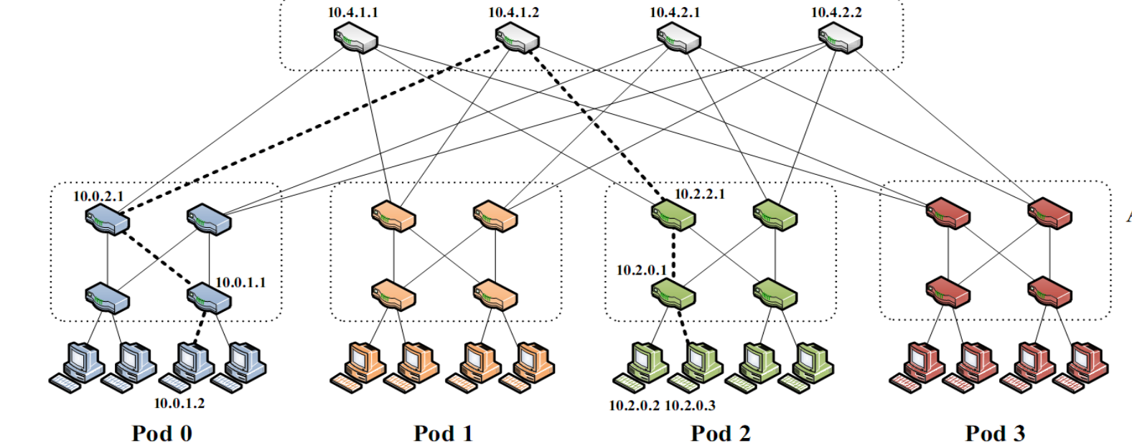
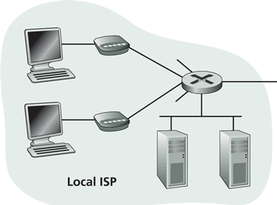
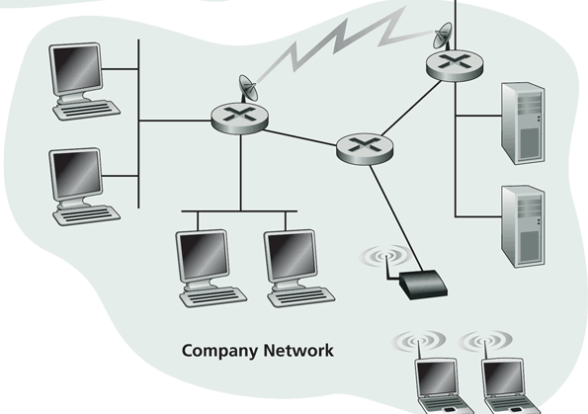
Recall: Internet Physical Infrastructure
Residential access, e.g.,
Cable, Fiber, DSL, Wireless
ISP
Backbone ISP
ISP
The Internet is a network of networks
Each individually administrated network is called an Autonomous System (AS)
~ 58000 ASes; Avg 5.7 hops; (http://bgp.potaroo.net/as2.0/bgp-active.html)
data center
Campus access, e.g.,
Ethernet, Wireless

Slide 6

Recap: Challenges - Scale
“Developers who have worked at the small scale might be asking themselves why we need to bother when we could just use some kind of out-of the-box solution. For small-scale applications, this can be a great idea. We save time and money up front and get a working and serviceable application. The problem comes at larger scales—there are no off-the-shelf kits that will allow you to build something like Amazon... There’s a good reason why the largest applications on the Internet are all bespoke creations: no other approach can create massively scalable applications within a reasonable budget.”
http://www.evontech.com/symbian/55.html

Slide 7
Recap: Challenges - General Complexity
Complexity in highly organized systems arises primarily from design strategies intended to create robustness to uncertainty in their environments and component parts.
Scalability is robustness to changes to the size and complexity of a system as a whole.
Evolvability is robustness of lineages to large changes on various (usually long) time scales.
Reliability is robustness to component failures.
Efficiency is robustness to resource scarcity.
Modularity is robustness to component rearrangements.
David Meyer

Slide 8
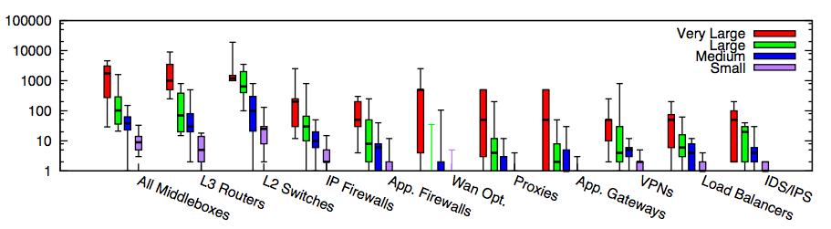
Core: Simple Forwarding to Network Functions
Modern networks contain diverse types of equipment beyond simple routing/forwarding
Enterprise networks
Small: <=1k hosts; Medium: 1k-10k; Large: 10k-100k; Very Large: >= 100k
Source: [Sherry, et. al SIGCOMM’12]

Slide 9

Centralized vs Decentralized (Price of Anarchy)
Autonomous (“Selfish”) App: Assume each link has a latency function l_{e}(x): latency of link e when x amount of traffic goes through e:
l(x) = x
total traffic
s
t
l(x) = 1

Slide 10
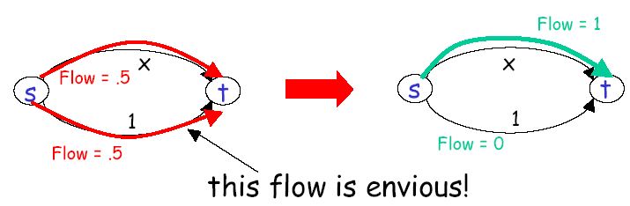
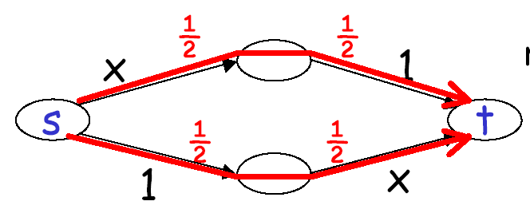
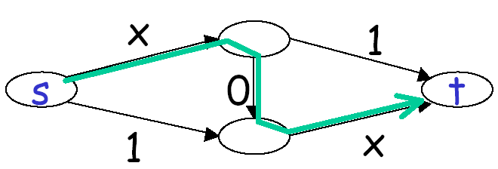
Autonomous (“Selfish”) App
Braess’s paradox
Notes:
Every increase of 20 ms in latency leads to 1% drop in click-through rate
E-commerce abandonment zone:
33% users will abandon a site takes longer than 4 sec [Jupiter]

Slide 11
Decentralized (“Selfish”) Users
preferred
2 0
2 3 0
2
4
less
preferred
0
3 1 0
3 0
1 2 0
1 0
1
3
3

Slide 12
Decentralized (“Selfish”) Users
preferred
2 3 0
2 0
2
4
less
preferred
0
3 1 0
3 0
1 2 0
1 0
1
3
3

Slide 13

Distributed vs Centralized
Distributed computing is hard, e.g.,
FLP Impossibility Theorem
Arrow’s Impossibility Theorem
Achieved good design for only few specific tasks (e.g., state distribution, leader election). Hence, a trend in networking is Software Defined Networking, which is a way of moving away from generic distributed computing, by focusing on utilizing the few well-understood primitives, in particular logically centralized state.

Slide 14
Roadmap
So far we have looked at only the topology and physical connectivity of the Internet: a mesh of computers interconnected via various physical media
A basic question: how are data (the bits) transferred through communication networks?

Slide 15
Outline
Admin. and recaps
Challenges of Internet networks and apps
A taxonomy of communication networks

Slide 16
Taxonomy of Communication Networks
communication networks
switched networks
broadcast networks
Broadcast networks
nodes share a common channel; information transmitted by a node is received by all other nodes in the network
examples: TV, radio
Switched networks
information is transmitted to a small sub-set (usually only one) of the nodes

Slide 17
A Taxonomy of Switched Networks
communication networks
switched networks
broadcast networks
circuit-switched networks (e.g., telephone)
packet-switched networks (e.g., Internet)
Circuit switching: dedicated circuit per call/session:
e.g., telephone, cellular voice
Packet switching: data sent thru network in discrete “chunks”
e.g., Internet, cellular data

Slide 18
Outline
Admin. and recaps
A brief introduction to the Internet: past and present
Challenges of Internet networks and apps
A taxonomy of communication networks
circuit switched networks

Slide 19
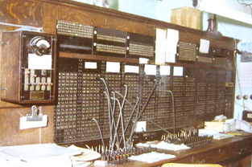
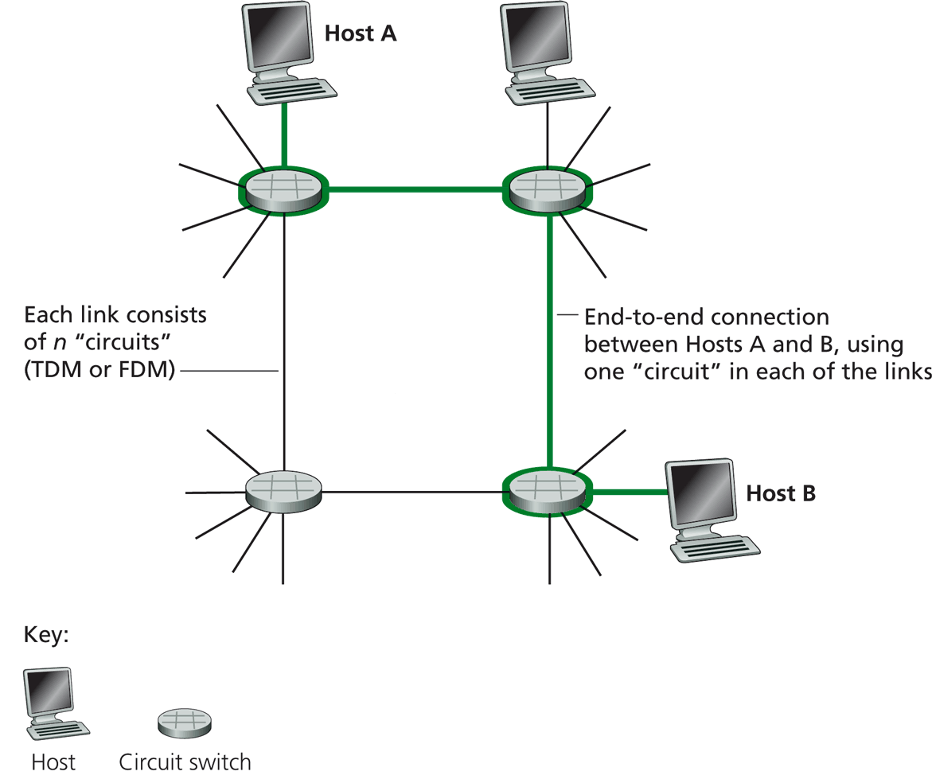
Circuit Switching
Each link has a number of “circuits”
sometime we refer to a “circuit” as a channel or a line
An end-to-end connection reserves one “circuit” at each link
First commercial telephone switchboard was opened in 1878 to serve the 21 telephone customers in New Haven
Notes:
http://www.classicrotaryphones.com/new-england-operators2_big.jpg

Slide 20
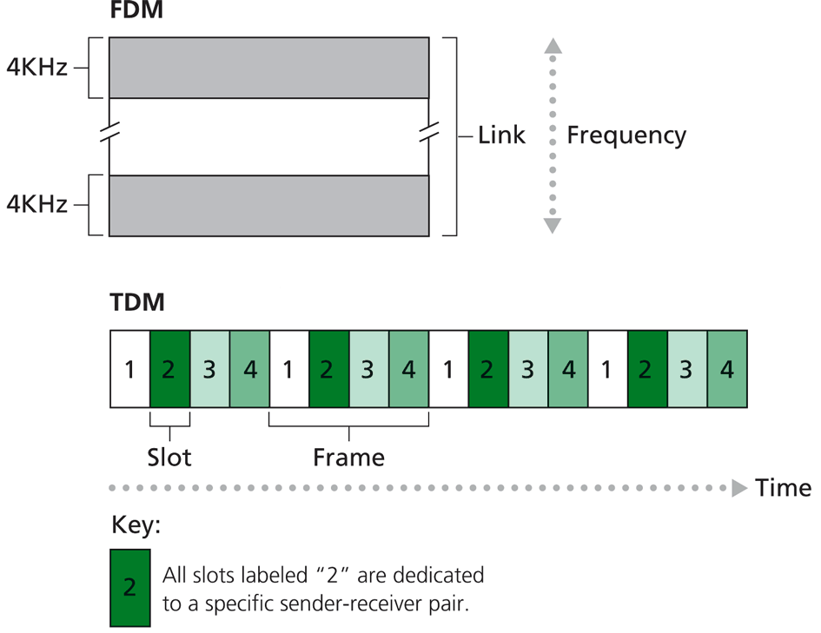
Circuit Switching: Resources/Circuits (Frequency, Time and others)
Divide link resource into “circuits”
frequency division multiplexing (FDM)
time division multiplexing (TDM)
others such as code division multiplexing (CDM), color/lambda division

Slide 21
Circuit Switching: The Process
Three phases
circuit establishment
data transfer
circuit termination

Slide 22
Timing Diagram of Circuit Switching
Host A
Host B
Node 1
Node 2
processing delay at Node 1
DATA
propagation delay
from A to Node 1
circuit establishment
propagation delay
from B To A
data transmission
circuit termination

Slide 23
Delay Calculation in Circuit Switched Networks
Propagation delay: delay for the first bit to go from a source to a destination
Propagation delay:
d = length of physical link
s = propagation speed in medium (~2x10⁵ km/sec)
prop. delay: d/s
DATA

Slide 24
Delay Calculation in Circuit Switched Networks
Transmission delay: time to pump data onto link at line rate
Transmission delay:
R = reserved bandwidth (bps)
L = message length (bits)
d/s
DATA
trans. delay = L/R

Slide 25
An Example
Propagation delay
suppose the distance between A and B is 4000 km, then one-way propagation delay is:
Transmission delay
suppose your iphone reserves a one-slot HSCSD channel
each HSCSD frame can transmit about 115 kbps
a frame is divided into 8 slots
then the transmission delay of using one reserved slot for a message of 1 Kbits:

Slide 26
An Example (cont.)
Suppose the setup message is very small, and the total setup processing delay is 200 ms
Then the delay to transfer a message of 1 Kbits from A to B (from the beginning until host receives last bit) is:
DATA
20 + 200
20
20
70

Slide 27
Outline
Admin. and recaps
A brief introduction to the Internet: past and present
Challenges of Internet networks and apps
A taxonomy of communication networks
circuit switched networks
packet switched networks

Slide 28
Packet Switching
Each end-to-end data flow (i.e., a sender-receiver pair) divided into packets
Packets have the following structure:
header and trailer carry control information (e.g., destination address, check sum)
where is the control information for circuit switching?
At each node the entire packet is received, processed (e.g., routing), stored briefly, and then forwarded to the next node; thus packet-switched networks are also called store-and-forward networks. On its turn, a packet uses full link bandwidth
Header
Data
Trailer

Slide 29
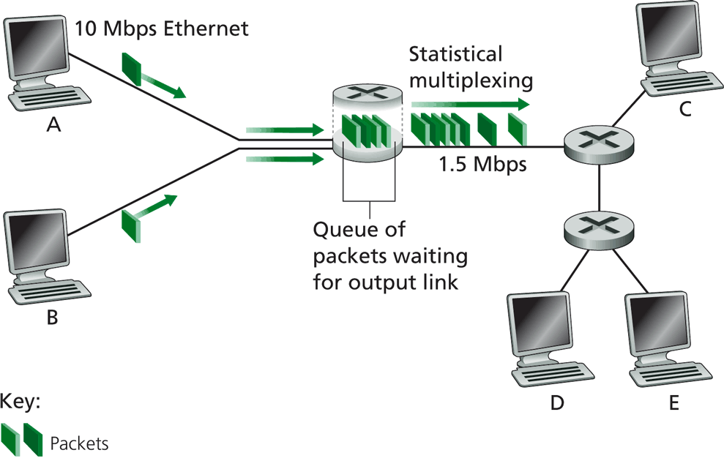
Packet Switching

Slide 30
Inside a Packet Switching Router
An output queueing switch
incoming links
node
outgoing links
Memory

Slide 31
Outline
Admin. and recaps
A brief introduction to the Internet: past and present
Challenges of Internet networks and apps
A taxonomy of communication networks
circuit switched networks
packet switched networks
circuit switching vs. packet switching

Slide 32

Packet Switching vs. Circuit Switching
The early history of the Internet was a heated debate between Packet Switching and Circuit Switching
the telephone network was the dominant network
Need to compare packet switching with circuit switching

Slide 33
Circuit Switching vs. Packet Switching
 | circuit switching | packet switching
resource usage | use a single partition bandwidth | use whole link bandwidth
reservation/setup | need reservation (setup delay) | no reservation
resource contention | busy signal (session loss) | congestion (long delay and packet losses)
charging | time | packet
header | no per-pkt header | per packet header
fast path processing | fast | per packet processing

Slide 34
Circuit Switching vs. Packet Switching
 | circuit switching | packet switching
resource usage | use a single partition bandwidth | use whole link bandwidth
reservation/setup | need reservation (setup delay) | no reservation
resource contention | busy signal (session loss) | congestion (long delay and packet losses)
charging | time | packet
header | no per-pkt header | per packet header
fast path processing | fast | per packet processing

Slide 35


Key Issue to be Settled
A key issue: what is the efficiency of resource partition?
Tool used to analyze the issue: queueing theory
Some basic results of queueing theory can be quite useful in many systems settings
5G
10G
5G
Notes:
10M bps link and 10 flows: partition into 10 1 Mbps or

Slide 36
Outline
Admin. and recaps
A brief introduction to the Internet: past and present
Challenges of Internet networks and apps
A taxonomy of communication networks
circuit switched networks
packet switched networks
circuit switching vs. packet switching
M/M queues and statistical multiplexing

Slide 37
Queueing Theory
Strategy:
model system state
if we know the fraction of time that the system spends at each state, we can get answers to many basic questions: how long does a new request need to wait before being served?
System state changes upon events:
introduce state transition diagram
focus on equilibrium: state trend neither growing nor shrinking (key issue: how to define equilibrium)
Our approach: We are not interested in extremely precise modeling, but want quantitative intuition

Slide 38
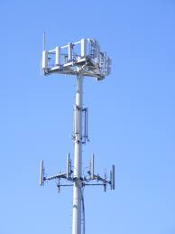

Warm up: Analysis of Circuit-Switching Blocking (Busy) Time
Assume a link has only a finite number of N circuits
Objective: compute the percentage of time that a new session (call) is blocked
Analogy in a more daily-life scenario?
Key parameters?
Notes:
Key input parameters?

Slide 39
Analysis of Circuit-Switching Blocking (Busy) Time
Consider a simple arrival pattern
client requests arrive at a rate of λ (lambda/second)
service rate: each call takes on average 1/μ second
Arrival and service patterns: memoryless (Markovian)
During a small interval Δt, the number of expected new arrivals is: λΔt
During a small interval Δt, the chance (fraction) of a current call finishes is: μΔt
This model is also called an M/M/N model

Slide 40
Analysis of Circuit-Switching Blocking (Busy) Time: State
system state: # of busy lines
0
1
k
k+1
N
p0
p1
pk
pk+1
pN
Q: How to characterize equilibrium?

Slide 41
Equilibrium = Time Reversibility [Frank Kelly]
=
Statistically cannot distinguish
=
=
state
Play the sequence backwards
k+1
k
time

Slide 42
Analysis of Circuit-Switching Blocking (Busy) Time: Sketch
system state: # of busy lines
λ
0
1
k
k+1
N
(k+1)μ
p0
p1
pk
pk+1
pN
at equilibrium (time resersibility) in one unit time: #(transitions k → k+1) = #(transitions k+1 → k)

Slide 43
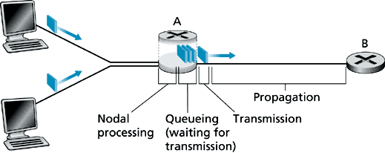
Queueing Analysis: Packet Switching Delay
Four types of delay at each hop
nodal processing delay: check errors & routing
queueing: time waiting for its turn at output link
transmission delay: time to pump packet onto a link at link speed
propagation delay: router to router propagation
The focus is on queueing and transmission delay
system state?

Slide 44
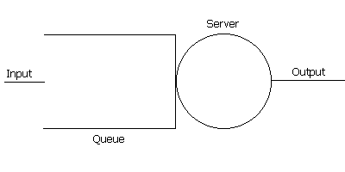
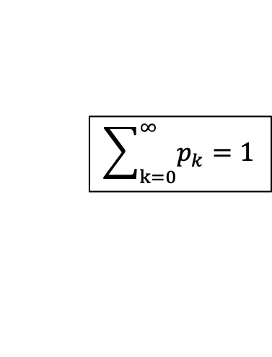
Packet Switching Delay
system state: #packets in queue
λ
0
1
k
k+1
N
μ
p0
p1
pk
pk+1
at equilibrium (time reversibility) in one unit time: #(transitions k → k+1) = #(transitions k+1 → k)
$$\sum_{k=0}^{∞}{p_{k}}=1$$

Slide 45
Summary: Queueing Theory
Model system state
Introduce state transition diagram
Focus on equilibrium: state trend neither growing nor shrinking

Slide 46




Example
Assume requests (packets) come in at a rate of one request per 50 ms
Each request (packet) takes on average 20 ms
What is the fraction of time that the system is empty?
What is the chance that a packet newly arrived needs to wait for 3 early packets?
$λ$=1/50ms =20/s
$1/μ$=20 ms, $μ$=50/s
$$P_{0}$$
$$P_{3}$$
Notes:
Rau = 2/3
(1-2/3)(2/3)^3 = 1/3 * 8/27 = 8/84 = 10%

Slide 47
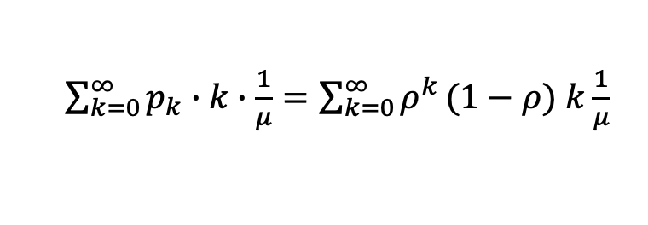
Analysis of Delay (cont’)
λ
0
1
k
k+1
μ
Average queueing delay:
Transmission delay:
Queueing + transmission:
$\sum_{k=0}^{∞}{p_{k}}∙k∙\frac{1}{μ}=\sum_{k=0}^{∞}{ρ^{k}}(1−ρ)$ $k\frac{1}{μ}$

Slide 48
Delay
For a demo of M/M/1, see: http://www.dcs.ed.ac.uk/home/jeh/Simjava/queueing/mm1_q/mm1_q.html

Slide 49
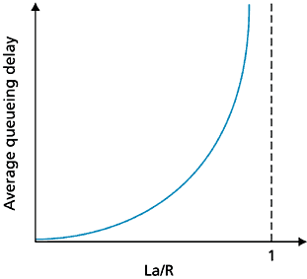
Queueing Delay as a Function of Utilization
Assume:
R = link bandwidth (bps)
L = packet length (bits)
S = L / R
a = average packet arrival rate (pkt/sec)
ρ ~ 0: average queueing delay small
ρ -> 1: delay becomes large
ρ > 1: more “work” arriving than can be serviced, average delay infinite !
ρ

Slide 50

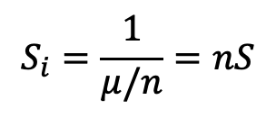
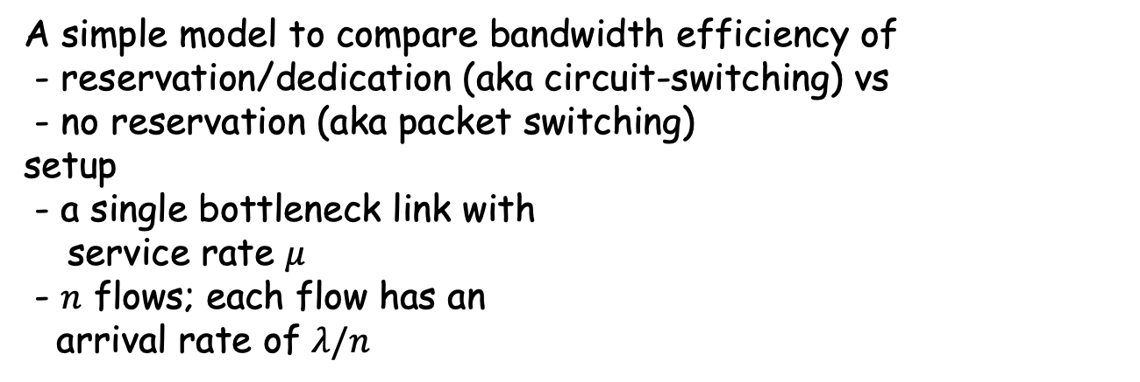
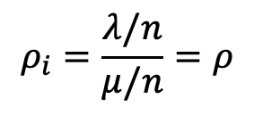
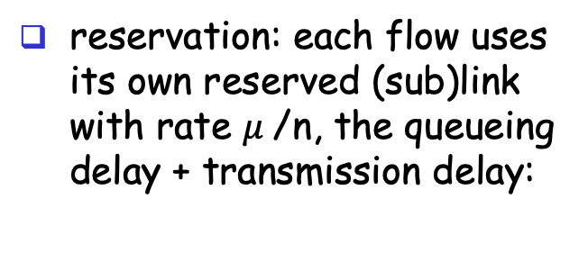
Statistical Multiplexing
A simple model to compare bandwidth efficiency of
- reservation/dedication (aka circuit-switching) vs
- no reservation (aka packet switching) setup
- a single bottleneck link with
service rate $μ$
- $n$ flows; each flow has an arrival rate of $λ/n$
no reservation: all arrivals into the single link, the queueing delay + transmission delay:
reservation: each flow uses its own reserved (sub)link with rate $μ$/n, the queueing delay + transmission delay:
For each flow i:
$$ρ_{i}=\frac{λ/n}{μ/n}=ρ$$
$$S_{i}=\frac{1}{μ/n}=nS$$

