Slide 1
Network Transport Layer: Reliable Data Transfer
Qiao Xiang
https://qiaoxiang.me/courses/cnns-xmuf22/index.shtml
10/20/2022
This deck of slides are heavily based on CPSC 433/533 at Yale University, by courtesy of Dr. Y. Richard Yang.

Slide 2
Outline
Admin and recap
Reliable data transfer

Slide 3
Recap
Applications
Client-server applications
Single server
Multiple servers load balancing
Application overlays (distributed network applications) to
scale bandwidth/resource (BitTorrent)
distribute content lookup (Freenet, DHT, Chord) [optional]
distribute content verification (Block chain) [optional]
achieve anonymity (Tor) [optional]

Slide 4
UDP: User Datagram Protocol [RFC 768]
Often used for streaming multimedia apps
loss tolerant
rate sensitive
Other UDP uses
DNS
SNMP
32 bits
Length, in
bytes of UDP segment,
including
header
source port #
dest port #
length
checksum
Application
data
(message)
UDP segment format

Slide 5
UDP Checksum
Goal: end-to-end detection of “errors” (e.g., flipped bits) in transmitted segment
Sender:
treat segment contents as sequence of 16-bit integers
checksum: addition of segment contents to be zero
sender puts checksum value into UDP checksum field
Receiver:
compute sum of segment and checksum; check if sum zero
NO - error detected
YES - no error detected. But maybe errors nonetheless?

Slide 6
UDP Checksum: Algorithm
Example checksum:
1 1 1 1 0 0 1 1 0 0 1 1 0 0 1 1 0
1 1 1 0 1 0 1 0 1 0 1 0 1 0 1 0 1
1 1 0 1 1 1 0 1 1 1 0 1 1 1 0 1 1
1 1 0 1 1 1 0 1 1 1 0 1 1 1 1 0 0
0 1 0 0 0 1 0 0 0 1 0 0 0 0 1 1
wraparound
sum
checksum
- For fast implementation of computing UDP checksum, see http://www.faqs.org/rfcs/rfc1071.html
Notes:
Common among many early computers: PDP-1 and UNIVAC 1100/2200 series

Slide 7
Outline
Admin and recap
Reliable data transfer

Slide 8
Principles of Reliable Data Transfer (RDT)
Important in app., transport, link layers
Foundation to other protocols
We use the development of RDT to also better appreciate understanding distributed protocols

Slide 9
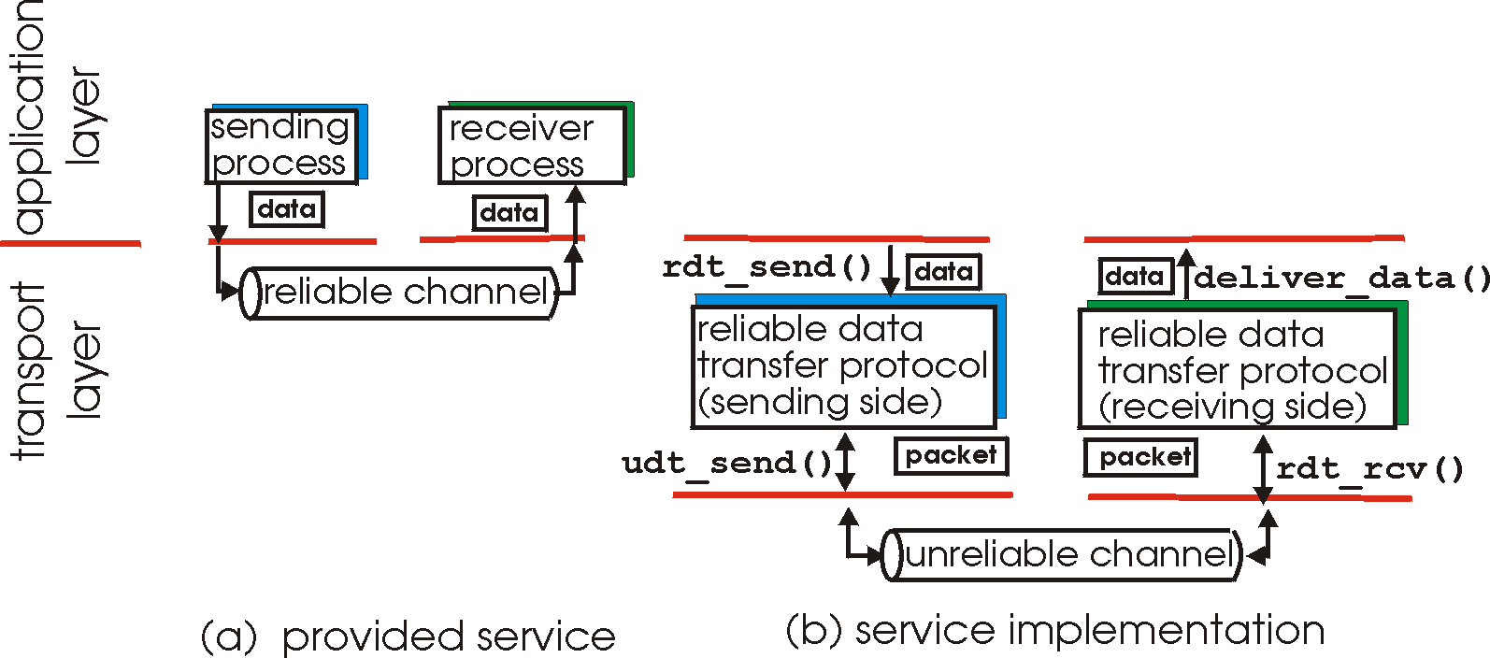
Reliable Data Transfer

Slide 10
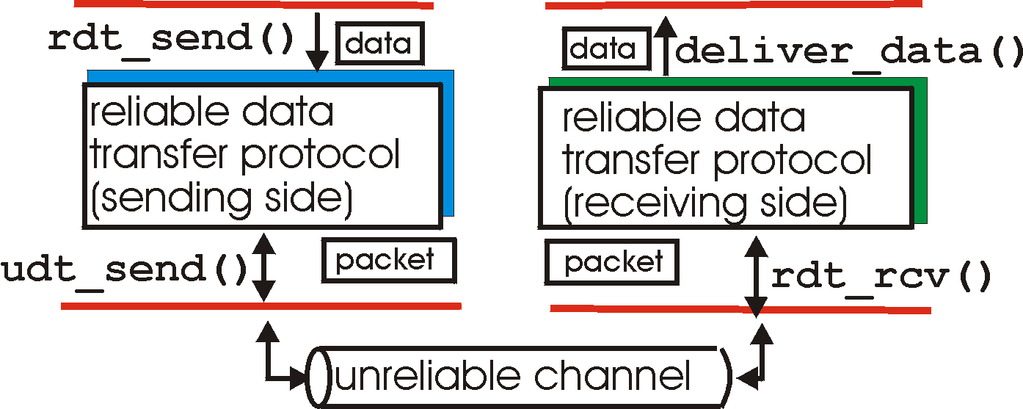
Reliable Data Transfer: Getting Started
rdt_send(): called from above, (e.g., by app.)
deliver_data(): called by rdt to deliver data to upper
send
side
receive
side
udt_send(): called by rdt,
to transfer packet over
unreliable channel to receiver
rdt_rcv(): called from below; when packet arrives on rcv-side of channel

Slide 11
Reliable Data Transfer: Getting Started
We’ll:
incrementally develop sender, receiver sides of reliable data transfer protocol (rdt)
consider only unidirectional data transfer
but control info will flow on both directions !
use finite state machines (FSM) to specify sender, receiver
event causing state transition
actions taken on state transition
state: when in this “state” next state uniquely determined by next event
state
1
state
2
event
actions

Slide 12
Outline
Admin and review
Overview of transport layer
UDP and error checking
Reliable data transfer
perfect channel

Slide 13
Rdt1.0: reliable transfer over a reliable channel
separate FSMs for sender, receiver:
sender sends data into underlying channel
receiver reads data from underlying channel
Wait for call from above
rdt_send(data)
Wait for call from below
rdt_rcv(packet)
extract (packet,data)
deliver_data(data)
packet = make_pkt(data)
udt_send(packet)
sender
receiver
Exercise: Prove correctness of Rdt1.0.
Correctness: for every single packet, one and only one copy is received by receiver correctly (no error) and in-order
Notes:
correctness: every single packet received correctly, received by one and only one at receiver, and received in-order

Slide 14
Potential Channel Errors
bit errors
loss (drop) of packets
reordering or duplication
Characteristics of unreliable channel will determine complexity of reliable data transfer protocol (rdt).

Slide 15
Outline
Admin and recap
Overview of transport layer
UDP and error checking
Reliable data transfer
perfect channel
channel with bit errors

Slide 16
rdt2.0: Channel With Bit Errors
Assume: Underlying channel may only flip bits in packet
Wait for call from above
rdt_send(data)
Wait for call from below
rdt_rcv(packet)
extract (packet,data)
deliver_data(data)
packet = make_pkt(data)
udt_send(packet)
sender
receiver
Exercise: What correctness requirement(s) rdt1.0 cannot provide?

Slide 17
rdt2.0: Channel With Bit Errors
New mechanisms in rdt2.0 (beyond rdt1.0):
receiver error detection: recall: UDP checksum/Ethernet CRC detects bit errors
receiver feedback: control msgs (ACK,NAK) rcvr->sender
acknowledgements (ACKs): receiver explicitly tells sender that pkt received OK
negative acknowledgements (NAKs): receiver explicitly tells sender that pkt had errors
sender retransmission
sender retransmits pkt on receipt of NAK

Slide 18
rdt2.0: FSM Specification
rdt_send(data)
sndpkt = make_pkt(data, checksum)
udt_send(sndpkt)
receiver
rdt_rcv(rcvpkt) &&
isNAK(rcvpkt)
Wait for data
Wait for ACK or NAK
rdt_rcv(rcvpkt) &&
corrupt(rcvpkt)
udt_send(sndpkt)
udt_send(NAK)
rdt_rcv(rcvpkt) && isACK(rcvpkt)
Λ
Wait for data
sender
rdt_rcv(rcvpkt) &&
notcorrupt(rcvpkt)
extract(rcvpkt,data)
deliver_data(data)
udt_send(ACK)

Slide 19
rdt2.0: Operation with No Errors
rdt_send(data)
snkpkt = make_pkt(data, checksum)
udt_send(sndpkt)
rdt_rcv(rcvpkt) &&
isNAK(rcvpkt)
Wait for data
Wait for ACK or NAK
rdt_rcv(rcvpkt) &&
corrupt(rcvpkt)
udt_send(sndpkt)
udt_send(NAK)
rdt_rcv(rcvpkt) && isACK(rcvpkt)
Wait for data
Λ
rdt_rcv(rcvpkt) &&
notcorrupt(rcvpkt)
extract(rcvpkt,data)
deliver_data(data)
udt_send(ACK)

Slide 20
rdt2.0: Error Scenario
rdt_send(data)
snkpkt = make_pkt(data, checksum)
udt_send(sndpkt)
rdt_rcv(rcvpkt) &&
isNAK(rcvpkt)
Wait for data
Wait for ACK or NAK
rdt_rcv(rcvpkt) &&
corrupt(rcvpkt)
udt_send(sndpkt)
udt_send(NAK)
rdt_rcv(rcvpkt) && isACK(rcvpkt)
Λ
Wait for data
rdt_rcv(rcvpkt) &&
notcorrupt(rcvpkt)
extract(rcvpkt,data)
deliver_data(data)
udt_send(ACK)

Slide 21
Rdt2.0 Analysis
sender
receiver
data (n)
Execution traces of rdt2.0: {data^ NACK}* data deliver ACK
waiting for N/ACK
NACK
data (n)
Analyzing set of all possible execution traces is a common technique to understand and analyze many types of distributed protocols.
ACK
waiting for data
data (n+1)

Slide 22
rdt2.0 is Incomplete!
What happens if ACK/NAK corrupted?
Although sender receives feedback, but doesn’t know what happened at receiver!
sender
data (n)
waiting for N/ACK
?(N/ACK)

Slide 23
Two Possibilities
sender
rdt_send(data)
snkpkt = make_pkt(data, checksum)
udt_send(sndpkt)
rdt_rcv(rcvpkt) &&
isNAK(rcvpkt)
Wait for data
Wait for ACK or NAK
udt_send(sndpkt)
rdt_rcv(rcvpkt) && isACK(rcvpkt)
Λ
sender can’t just guess NACK: if wrong, duplicate
sender can’t just guess ACK: if wrong, missing pkt
sender
receiver
sender
receiver
data (n)
data (n)
waiting for N/ACK
deliver
waiting for N/ACK
NACK
ACK
data (n)
waiting for data
deliver
data (n+1)
Fix miss guess NACK: provide info for receiver to distinguish
Home exercise: fix miss guess ACK

Slide 24
Handle Control Message Corruption
Handling ambiguity:
sender adds sequence number to each pkt
sender retransmits current pkt if ACK/NAK garbled
Guess NACK
receiver discards (doesn’t deliver up) duplicate pkt
fix effect of wrong guess
stop and wait
sender sends one packet,
then waits for receiver
response
Comment: It is always harder to deal with control message errors than data message errors

Slide 25
rdt2.1b: Sender, Handles Garbled ACK/NAKs
rdt_send(data)
sndpkt = make_pkt(n, data, checksum)
udt_send(sndpkt)
rdt_rcv(rcvpkt) &&
( corrupt(rcvpkt) ||
isNAK(rcvpkt) )
Wait for pkt n from above
Wait for ACK or NAK
udt_send(sndpkt)
rdt_rcv(rcvpkt)
&& notcorrupt(rcvpkt)
&& isACK(rcvpkt)
Λ
Wait for ACK or NAK
Wait for
pkt n+1 from above
rdt_send(data)
sndpkt = make_pkt(n+1, data, checksum)
udt_send(sndpkt)

Slide 26
rdt2.1b: Receiver, Handles Garbled ACK/NAKs
rdt_rcv(rcvpkt) && notcorrupt(rcvpkt)
&& has_seq(n, rcvpkt)
extract(rcvpkt,data)
deliver_data(data)
sndpkt = make_pkt(ACK, chksum)
udt_send(sndpkt)
rdt_rcv(rcvpkt) && corrupt(rcvpkt)
sndpkt = make_pkt(NAK, chksum)
udt_send(sndpkt)
Wait for
n from below
Wait for
n+1 from below
rdt_rcv(rcvpkt) &&
not corrupt(rcvpkt) &&
! has_seq(n,rcvpkt)
sndpkt = make_pkt(ACK, chksum)
udt_send(sndpkt)

Slide 27
rdt2.1b: Summary
Sender:
seq # added to pkt
must check if received ACK/NAK corrupted
Receiver:
must check if received packet is duplicate
by checking if the packet has the expected pkt seq #

Slide 28
rdt2.1b Analysis: Execution Traces?
sender
receiver
data (n)
waiting for n
NACK
sending n
data (n)
ACK
data (n)
waiting n+1
ACK
sending n+1
data 1 (n+1)
waiting for n+2

Slide 29
Protocol Analysis using (Generic) Execution Traces Technique
Issue: how to systematically enumerate all potential execution traces to understand and verify correctness
A systematic approach to enumerating exec. traces is to compute joint sender/receiver/channels state machine
sender state: waiting for n
receiver state: waiting for n
snd->rcv channel state
rcv d_{n} _{del}
s_{n} r_{n+1} - ACK
…
rcv>snd channel state
w_{n} r_{n} - -
snd d_{n}
s_{n} r_{n} d_{n} -
rcv d^_{n}
s_{n} r_{n} - NAK
…
Notes:
{data(n)^ NACK|NACK^}* data(n) deliver
ACK^ data(n)
ACK^ data(n)^ XXXX

Slide 30
Recap: Protocol Analysis using (Generic) Execution Traces Technique
r d_{n}
deliv
s ACK
r ACK
s d_{n}
w_{n} r_{n} - -
s_{n} r_{n} d_{n} -
s_{n} r_{n+1} - ACK
W_{n+1} r_{n+1} - -
r NAK| r NAK^ s d_{n}
r d_{n}^ s NAK
r d_{n}
s ACK
r ACK^
s d_{n}
s_{n} r_{n} - NAK
s_{n} r_{n+1} d_{n} -
r NAK| r NAK^
s d_{n}
r d_{n}^
s NAK
s_{n} r_{n+1} - NAK
Execution traces of rdt2.1b are all that can be generated by the finite state machine above.
Notes:
{data(n)^ NACK|NACK^}* data(n) deliver
ACK^ data(n)
ACK^ data(n)^ XXXX

Slide 31
rdt2.1b Analysis: State Invariants
first
time
rcvs
ack 0
W1: wait for data with seq. 1
S1: sending data with seq. 1
w0
s0
w1
s1
w2
s2
w3
sender
w0
w1
w2
w3
receiver
State invariant:
- When receiver’s state is waiting for seq #n, sender’s state can be sending either seq#n-1or seq#n, and only either #n or #n-1 packets can arrive
first
time
rcvs 0
Notes:
Receiver always enters w_n earlier than sender

Slide 32
rdt2.1c: Sender, Handles Garbled ACK/NAKs: Using 1 bit (Alternating-Bit Protocol)
rdt_send(data)
sndpkt = make_pkt(0, data, checksum)
udt_send(sndpkt)
rdt_rcv(rcvpkt) &&
( corrupt(rcvpkt) ||
isNAK(rcvpkt) )
Wait for call 0 from above
Wait for ACK or NAK
udt_send(sndpkt)
rdt_rcv(rcvpkt)
&& notcorrupt(rcvpkt)
&& isACK(rcvpkt)
rdt_rcv(rcvpkt)
&& notcorrupt(rcvpkt)
&& isACK(rcvpkt)
Λ
Λ
Wait for ACK or NAK 1
Wait for
call 1 from above
rdt_rcv(rcvpkt) &&
( corrupt(rcvpkt) ||
isNAK(rcvpkt) )
rdt_send(data)
udt_send(sndpkt)
sndpkt = make_pkt(1, data, checksum)
udt_send(sndpkt)

Slide 33
rdt2.1c: Receiver, Handles Garbled ACK/NAKs: Using 1 bit
rdt_rcv(rcvpkt) && notcorrupt(rcvpkt)
&& has_seq0(rcvpkt)
extract(rcvpkt,data)
deliver_data(data)
sndpkt = make_pkt(ACK, chksum)
udt_send(sndpkt)
rdt_rcv(rcvpkt) && (corrupt(rcvpkt)
rdt_rcv(rcvpkt) && (corrupt(rcvpkt)
sndpkt = make_pkt(NAK, chksum)
udt_send(sndpkt)
sndpkt = make_pkt(NAK, chksum)
udt_send(sndpkt)
Wait for
0 from below
Wait for
1 from below
rdt_rcv(rcvpkt) &&
not corrupt(rcvpkt) &&
has_seq1(rcvpkt)
rdt_rcv(rcvpkt) &&
not corrupt(rcvpkt) &&
has_seq0(rcvpkt)
sndpkt = make_pkt(ACK, chksum)
udt_send(sndpkt)
sndpkt = make_pkt(ACK, chksum)
udt_send(sndpkt)
rdt_rcv(rcvpkt) && notcorrupt(rcvpkt)
&& has_seq1(rcvpkt)
extract(rcvpkt,data)
deliver_data(data)
sndpkt = make_pkt(ACK, chksum)
udt_send(sndpkt)

Slide 34
rdt2.1c: Summary
Sender:
state must “remember” whether “current” pkt has 0 or 1 seq. #
Receiver:
must check if received packet is duplicate
state indicates whether 0 or 1 is expected pkt seq #

Slide 35
rdt2.2: a NAK-free protocol
Same functionality as rdt2.1c, using ACKs only
Instead of NAK, receiver sends ACK for last pkt received OK
receiver must explicitly include seq # of pkt being ACKed
Duplicate ACK at sender results in same action as NAK: retransmit current pkt

Slide 36
rdt2.2: Sender, Receiver Fragments
rdt_send(data)
sndpkt = make_pkt(0, data, checksum)
udt_send(sndpkt)
rdt_rcv(rcvpkt) &&
( corrupt(rcvpkt) ||
isACK(rcvpkt,1) )
Wait for call 0 from above
Wait for ACK 0
udt_send(sndpkt)
sender FSM
fragment
rdt_rcv(rcvpkt)
&& notcorrupt(rcvpkt)
&& isACK(rcvpkt,0)
rdt_rcv(rcvpkt) &&
(corrupt(rcvpkt) ||
has_seq1(rcvpkt))
Λ
Wait for
0 from below
receiver FSM
fragment
sndpkt= make_pkt(ACK,1, chksum)
udt_send(sndpkt)
rdt_rcv(rcvpkt) && notcorrupt(rcvpkt)
&& has_seq0(rcvpkt)
extract(rcvpkt,data)
deliver_data(data)
sndpkt = make_pkt(ACK,0, chksum)
udt_send(sndpkt)

Slide 37
Outline
Admin and review
Reliable data transfer
perfect channel
channel with bit errors
channel with bit errors and losses

Slide 38
rdt3.0: Channels with Errors and Loss
New assumption: underlying channel can also lose packets (data or ACKs)
checksum, seq. #, ACKs, retransmissions will be of help, but not enough
Q: Does rdt2.2 work under losses?
Approach: sender waits “reasonable” amount of time for ACK
requires countdown timer
retransmits if no ACK received in this time
if pkt (or ACK) just delayed (not lost):
retransmission will be duplicate, but use of seq. #’s already handles this
receiver must specify seq # of pkt being ACKed

Slide 39
rdt3.0 Sender
rdt_send(data)
rdt_rcv(rcvpkt) &&
( corrupt(rcvpkt) ||
isACK(rcvpkt,1) )
sndpkt = make_pkt(0, data, checksum)
udt_send(sndpkt)
start_timer
udt_send(sndpkt)
rdt_rcv(rcvpkt)
Λ
Λ
Wait for
call 0 from above
Wait for ACK0
timeout
udt_send(sndpkt)
start_timer
rdt_rcv(rcvpkt)
&& notcorrupt(rcvpkt)
&& isACK(rcvpkt,1)
rdt_rcv(rcvpkt)
&& notcorrupt(rcvpkt)
&& isACK(rcvpkt,0)
stop_timer
stop_timer
Wait for ACK1
Wait for
call 1 from above
timeout
udt_send(sndpkt)
start_timer
rdt_rcv(rcvpkt)
rdt_send(data)
Λ
rdt_rcv(rcvpkt) &&
( corrupt(rcvpkt) ||
isACK(rcvpkt,0) )
sndpkt = make_pkt(1, data, checksum)
udt_send(sndpkt)
start_timer
Λ

Slide 40
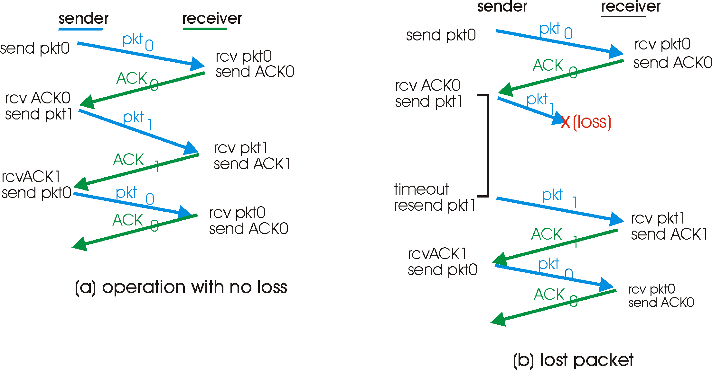
rdt3.0 in Action

Slide 41
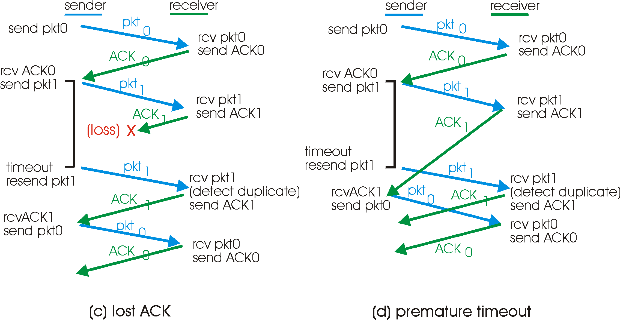
rdt3.0 in Action
Question to think about: How to determine a good timeout value?
Home exercise: What are execution traces of rdt3.0? What are some state invariants of rdt3.0?

Slide 42
rdt3.0: Protocol Analysis using State Invariants
sender
receiver
data 0 (n-1)
waiting for 0 (n-1)
State consistency:
When receiver’s state is waiting n, the state of the sender is either sending for n-1 or sending for n
When sender’s state is sending for n, receiver’s state is waiting for n or n + 1
ACK for 0 (n-1)
sending 0 (n-1)
data 0 (n-1)
waiting for 1
(n)
ACK for 0 (n-1)
data 1 (n)
sending 1 (n)
waiting for 0 (n+1)

Slide 43
rdt3.0: Stop-and-Wait Performance
sender
receiver
first packet bit transmitted, t = 0
last packet bit transmitted, t = L / R
first packet bit arrives
RTT
last packet bit arrives, send ACK
ACK arrives, send next
packet, t = RTT + L / R
What is U_{sender}: utilization – fraction of time link busy sending?
Assume: 1 Gbps link, 15 ms e-e prop. delay, 1KB packet
43

