Slide 1
Application Overlays (P2P); Network Transport Layer: Overview; UDP; Stop-and-Wait ARQ
Qiao Xiang
https://qiaoxiang.me/courses/cnns-xmuf22/index.shtml
10/18/2022
This deck of slides are heavily based on CPSC 433/533 at Yale University, by courtesy of Dr. Y. Richard Yang.

Slide 2
Outline
Admin and recap
Application overlays
Overview of transport layer
UDP
Reliable data transfer, the stop-and-go protocols

Slide 3
Admin
Lab assignment 3 due on Nov. 8
Midterm exam on Nov. 10 (during lab class)
cover from introduction to application layer
15-16 subjective questions over 100 minutes
don't forget to bring your 1-page cheat sheet

Slide 4
Recap: Direction Mechanisms
App
DNS name1
DNS name2
- cname
- hierarchy
IP1
IP2
IPn
Cluster1 in US East
Cluster2
in US West
Cluster2
in Europe
Smart switch/LB - NAT rewrite - Direct reply - NLB
Load
balancer
Proxy as a mechanism for replica content consistency
Load
balancer
proxy
servers
4

Slide 5
An Upper Bound on Scalability
Idea: use resources from both clients and the server
Assume
need to achieve same rate to all clients
only uplinks can be bottlenecks
What is an upper bound on scalability?
server
C₀
C₁
client 1
C_{n}
C₂
C₃
client 2
client n
client 3

Slide 6
The Scalability Problem
Maximum throughput
R = min{C₀, (C₀+ΣC_{i})/n}
The bound is theoretically approachable
server
C₀
C₁
client 1
C_{n}
C₂
C₃
client 2
client n
client 3

Slide 7
Theoretical Capacity: upload is bottleneck
R = min{C₀, (C₀+ΣC_{i})/n}
Assume c₀ > (C₀+ΣC_{i})/n
Tree i: server → client i: c_{i} /(n-1) client i → other n-1 clients
Tree 0: server has remaining c_{m} = c0 – (c1 + c2 + … cn)/(n-1) send to client i: c_{m}/n
c₀
c_{i} /(n-1)
c_{n}
c_{i}
c₁
c₂
C₀
c_{m} /n
C_{n}
C₁
C₂
C_{i}

Slide 8
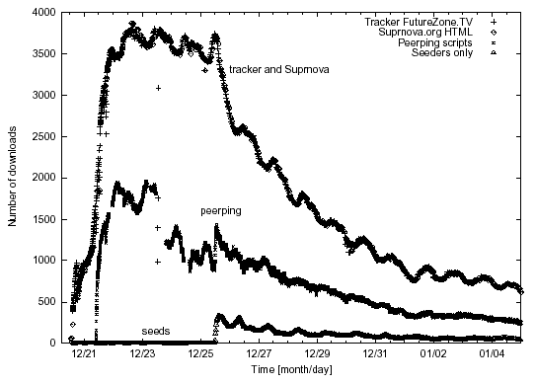
Why not Building the Trees?
servers
C₀
C₁
client 1
C_{n}
C₂
C₃
client 2
client n
Clients come and go (churns): maintaining the trees is too expensive
Each client needs N connections
client 3

Slide 9
Server+Host (P2P) Content Distribution: Key Design Issues
Robustness
Resistant to churns and failures
Efficiency
A client has content that others need; otherwise, its upload capacity may not be utilized
Incentive: clients are willing to upload
Some real systems nearly 50% of all responses are returned by the top 1% of sharing hosts
servers
C₀
C₁
client 1
C_{n}
C₂
C₃
client 2
client n
client 3

Slide 10
Discussion: How to handle the issues?
Robustness
Efficiency
Incentive
servers/ seeds
C₀
C₁
client 1
C_{n}
C₂
C₃
client 2
client n
client 3

Slide 11
Example: BitTorrent
A P2P file sharing protocol
Created by Bram Cohen in 2004
Spec at bep_0003: http://www.bittorrent.org/beps/bep_0003.html

Slide 12
BitTorrent: Lookup
HTTP GET MYFILE.torrent
MYFILE.torrent
webserver
http://mytracker.com:6969/
S3F5YHG6FEB
FG5467HGF367
F456JI9N5FF4E
…
user

Slide 13
Metadata (.torrent) File Structure
Meta info contains information necessary to contact the tracker and describes the files in the torrent
URL of tracker
file name
file length
piece length (typically 256KB)
SHA-1 hashes of pieces for verification
also creation date, comment, creator, …

Slide 14
Tracker Protocol
Communicates with clients via HTTP/HTTPS
Client GET request
info_hash: uniquely identifies the file
peer_id: chosen by and uniquely identifies the client
client IP and port
numwant: how many peers to return (defaults to 50)
stats: e.g., bytes uploaded, downloaded
Tracker GET response
interval: how often to contact the tracker
list of peers, containing peer id, IP and port
stats

Slide 15

Tracker Protocol
webserver
user
“register”
list of peers
ID1 169.237.234.1:6881
ID2 190.50.34.6:5692
ID3 34.275.89.143:4545
…
ID50 231.456.31.95:6882
tracker
…
Peer 50
Peer 1
Peer 2

Slide 16
Robustness and efficiency: Piece-based Swarming
Divide a large file into small blocks and request block-size content from different peers (why?)
If do not finish downloading a block from one peer within timeout (say due to churns), switch to requesting the block from another peer
Block: unit of download
File
Block: 16KB

Slide 17
Detail: Peer Protocol
(Over TCP)
Peers exchange bitmap representing content availability
bitfield msg during initial connection
have msg to notify updates to bitmap
to reduce bitmap size, aggregate multiple blocks as a piece
BitField/have
BitField/have
Remote Peer
Local Peer
0
1
0
1
Piece 256KB
Incomplete Piece

Slide 18

Peer Request
http://www.bittorrent.org/beps/bep_0003.html
If peer A has a piece that peer B needs, peer B sends interested to A
unchoke: indicate that A allows B to request
request: B requests a specific block from A
piece: specific data
1.interested/ 3. request
2. unchoke/ 4. piece

Slide 19
Key Design Points
request:
which data blocks to request?
unchoke:
which peers to serve?
1.interested/ 3. request
2. unchoke/ 4. piece

Slide 20
Request: Block Availability
Request (local) rarest first
achieves the fastest replication of rare pieces
obtain something of value

Slide 21
Block Availability: Revisions
When downloading starts (first 4 pieces): choose at random and request them from the peers
get pieces as quickly as possible
obtain something to offer to others
Endgame mode
defense against the “last-block problem”: cannot finish because missing a few last pieces
send requests for missing pieces to all peers in our peer list
send cancel messages upon receipt of a piece

Slide 22
BitTorrent: Unchoke
Periodically (typically every 10 seconds) calculate data-receiving rates from all peers
Upload to (unchoke) the fastest
constant number (4) of unchoking slots
partition upload bw equally among unchoked
1.interested/ 3. request
2. unchoke/ 4. piece
commonly referred to as “tit-for-tat” strategy

Slide 23
Optimistic Unchoking
Periodically select a peer at random and upload to it
typically every 3 unchoking rounds (30 seconds)
Multi-purpose mechanism
allow bootstrapping of new clients
continuously look for the fastest peers (exploitation vs exploration)

Slide 24
BitTorrent Fluid Analysis
Normalize file size to 1
x(t): number of downloaders (also known as leechers) who do not have all pieces at time t.
y(t): number of seeds in the system at time t.
λ: the arrival rate of new requests.
μ: the uploading bandwidth of a given peer.
c: the downloading bandwidth of a given peer, assume c ≥ μ.
θ: the rate at which downloaders abort download.
γ: the rate at which seeds leave the system.
η: indicates the effectiveness of downloader sharing, η takes values in [0, 1].

Slide 25



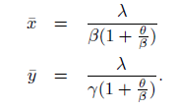
System Evolution
Solving steady state:
Define
"Modeling and Performance Analysis of BitTorrent-Like Peer-to-Peer Networks", SIGCOMM'04
https://conferences.sigcomm.org/sigcomm/2004/papers/p444-qiu1.pdf

Slide 26

System State
Q: How long does each downloader stay as a downloader?
λ
Key take-away: not scaling inverse with system size (x)
New requests comes, new bandwidth also comes

Slide 27
Recap
Applications
Client-server applications
Single server
Multiple servers load balancing
Application overlays (distributed network applications) to
scale bandwidth/resource (BitTorrent)
distribute content lookup (Freenet, DHT, Chord) [optional]
distribute content verification (Block chain) [optional]
achieve anonymity (Tor) [optional]

Slide 28
Outline
Admin and recap
Overview of transport layer
UDP
Reliable data transfer, the stop-and-go protocols

Slide 29
Overview
Provide logical communication between app’ processes
Transport protocols run in end systems
send side: breaks app messages into segments, passes to network layer
rcv side: reassembles segments into messages, passes to app layer
Transport vs. network layer services:
Network layer: data transfer between end systems
Transport layer: data transfer between processes
relies on, enhances network layer services
application
transport
network
data link
physical
network
data link
physical
network
data link
physical
network
data link
physical
logical end-end transport
network
data link
physical
network
data link
physical
application
transport
network
data link
physical

Slide 30
Transport Layer Services and Protocols
Reliable, in-order delivery (TCP)
multiplexing
reliability and connection setup
congestion control
flow control
Unreliable, unordered delivery: UDP
multiplexing
Services not available:
delay guarantees
bandwidth guarantees
Notes:
https://www.ietf.org/proceedings/99/slides/slides-99-maprg-the-quic-transport-protocol-design-and-internet-scale-deployment-01.pdf

Slide 31
Transport Layer: Road Ahead
Class 1 (today):
transport layer services
connectionless transport: UDP
reliable data transfer using stop-and-wait/alternating-bit protocol
Class 2 (Nov. 11; ready for lab assignment 5/part 1):
sliding window reliability
TCP reliability
overview of TCP
TCP RTT measurement
TCP connection management
Class 3 (Nov. 16; ready for lab assignment 5/part 2):
principles of congestion control
TCP congestion control; AIMD; TCP Reno
Class 4 (Nov. 18):
TCP Vegas, performance modeling; Nash Bargaining solution
Class 5 (Nov. 23):
primal-dual as a resource allocation and analysis framework
…

Slide 32
Outline
Admin and recap
Overview of transport layer
UDP and error checking
Reliable data transfer, the stop-and-go protocols

Slide 33
UDP: User Datagram Protocol [RFC 768]
Often used for streaming multimedia apps
loss tolerant
rate sensitive
Other UDP uses
DNS
SNMP
32 bits
Length, in
bytes of UDP segment,
including
header
source port #
dest port #
length
checksum
Application
data
(message)
UDP segment format

Slide 34
UDP Checksum
Goal: end-to-end detection of “errors” (e.g., flipped bits) in transmitted segment
Sender:
treat segment contents as sequence of 16-bit integers
checksum: addition of segment contents to be zero
sender puts checksum value into UDP checksum field
Receiver:
compute sum of segment and checksum; check if sum zero
NO - error detected
YES - no error detected. But maybe errors nonetheless?

Slide 35
One’s Complement Arithmetic
UDP checksum is based on one’s complement arithmetic
one’s complement was a common representation of signed numbers in early computers
One’s complement representation
bit-wise NOT for negative numbers
example: assume 8 bits
00000000: 0
00000001: 1
01111111: 127
10000000: ?
11111111: ?
addition: conventional binary addition except adding any resulting carry back into the resulting sum
Example: -1 + 2
Notes:
Two zeros turned out to be handy: +0 for no check sum, -0 for checksum
Add the carry back to the sum treats all bits “equally”

Slide 36
UDP Checksum: Algorithm
Example checksum:
1 1 1 1 0 0 1 1 0 0 1 1 0 0 1 1 0
1 1 1 0 1 0 1 0 1 0 1 0 1 0 1 0 1
1 1 0 1 1 1 0 1 1 1 0 1 1 1 0 1 1
1 1 0 1 1 1 0 1 1 1 0 1 1 1 1 0 0
0 1 0 0 0 1 0 0 0 1 0 0 0 0 1 1
wraparound
sum
checksum
- For fast implementation of computing UDP checksum, see http://www.faqs.org/rfcs/rfc1071.html
Notes:
Common among many early computers: PDP-1 and UNIVAC 1100/2200 series

Slide 37
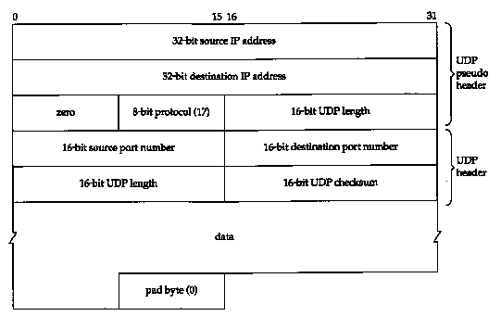
UDP Checksum: Coverage
Calculated over:
A pseudo-header
IP Source Address (4 bytes)
IP Destination Address (4 bytes)
Protocol (2 bytes)
UDP Length (2 bytes)
UDP header
UDP data

Slide 38
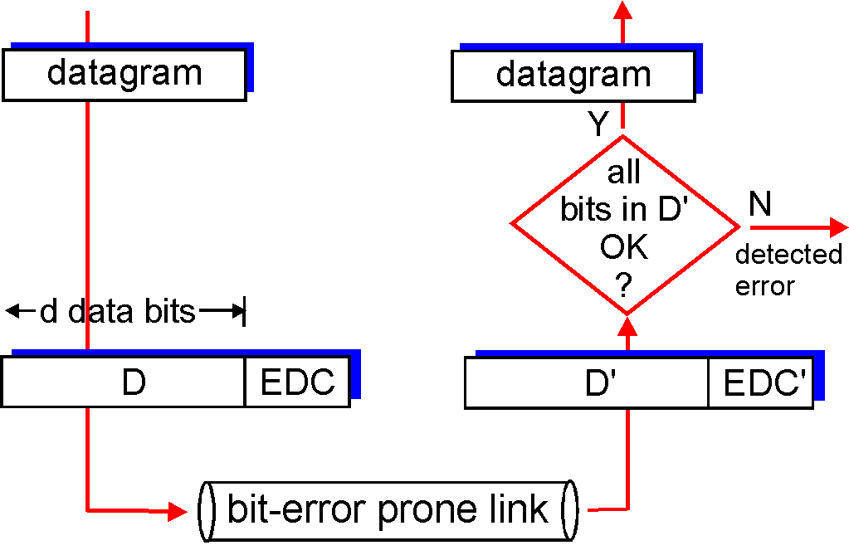
General Error Detection (Checksum)
‘
D = Data protected by error checking, may include header fields
ED = Error Detection bits (redundancy)
Error detection not 100% reliable!
a good error detector may miss some errors, but rarely
larger ED field generally yields better detection

Slide 39
Cyclic Redundancy Check: Background
Widely used in practice, e.g.,
Ethernet, DOCSIS (Cable Modem), FDDI, PKZIP, WinZip, PNG
For a given data D, consider it as a polynomial D(x)
consider the string of 0 and 1 as the coefficients of a polynomial
e.g. consider string 10011 as x⁴+x+1
addition and subtraction are modular 2, thus the same as xor
Choose generator polynomial G(x) with r+1 bits, where r is called the degree of G(x)

Slide 40
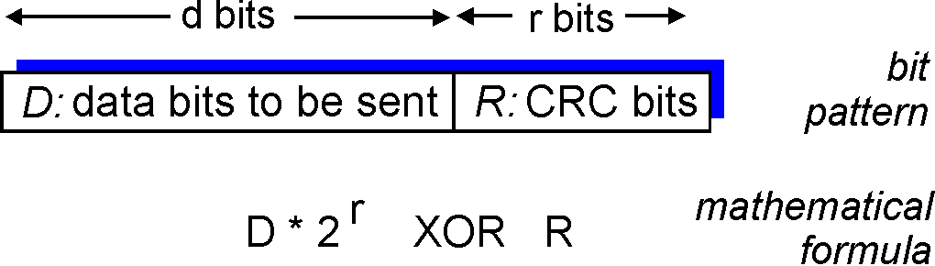
Cyclic Redundancy Check: Encode
Given data G(x) and D(x), choose R(x) with r bits, such that
D(x)x^{r}+R(x) is exactly divisible by G(x)
The bits correspond to D(x)x^{r}+R(x) are sent to the receiver
x
+

Slide 41
Cyclic Redundancy Check: Decode
Since G(x) is global, when the receiver receives the transmission T’(x), it divides T’(x) by G(x)
if non-zero remainder: error detected!
if zero remainder, assumes no error
Encode: CRC(G)
T = D(x)x^{r}+R(x)
T’
check
D

Slide 42
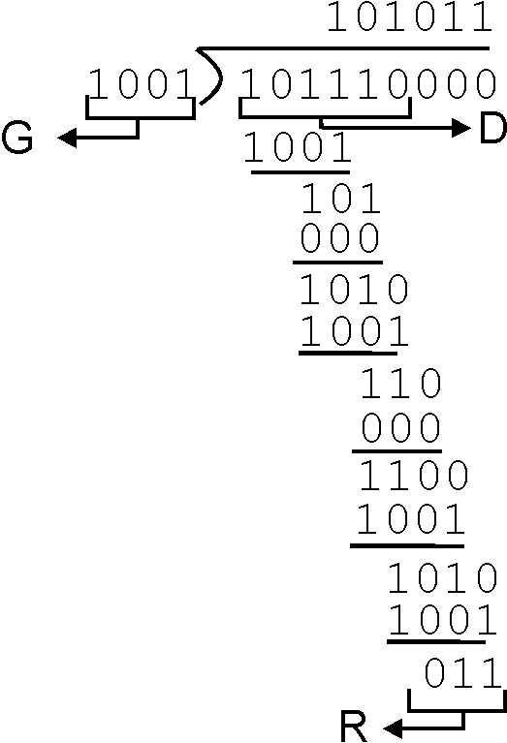
CRC: Steps and an Example
Suppose the degree of G(x) is r
Append r zero to D(x), i.e. consider D(x)x^{r}
Divide D(x)x^{r} by G(x). Let R(x) denote the reminder
Send <D, R> to the receiver

Slide 43
The Power of CRC
Let T(x) denote D(x)x^{r}+R(x), and E(x) the polynomial of the error bits
the received signal is T’(x) = T(x)+E(x)
Since T(x) is divisible by G(x), we only need to consider if E(x) is divisible by G(x)
Encode: CRC(G)
T = D(x)x^{r}+R(x)
T’
check
D

Slide 44
The Power of CRC
Detect a single-bit error: E(x) = x^{i}
if G(x) contains two or more terms, E(x) is not divisible by G(x)
Detect an odd number of errors: E(x) has an odd number of terms:
lemma: if E(x) has an odd number of terms, E(x) cannot be divisible by (x+1)
suppose E(x) = (x+1)F(x), let x=1, the left hand will be 1, while the right hand will be 0
thus if G(x) contains x+1 as a factor, E(x) will not be divided by G(x)
Many more errors can be detected by designing the right G(x)

Slide 45
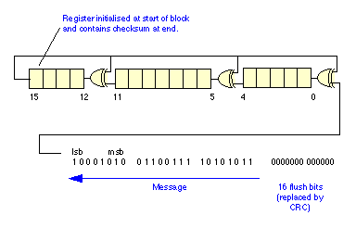
Example G(x)
16 bits CRC:
CRC-16: x¹⁶+x¹⁵+x²+1, CRC-CCITT: x¹⁶+x¹²+x⁵+1
both can catch
all single or double bit errors
all odd number of bit errors
all burst errors of length 16 or less
>99.99% of the 17 or 18 bits burst errors
CRC-16 hardware implementation
Using shift and XOR registers
http://en.wikipedia.org/wiki/CRC-32#Implementation

Slide 46



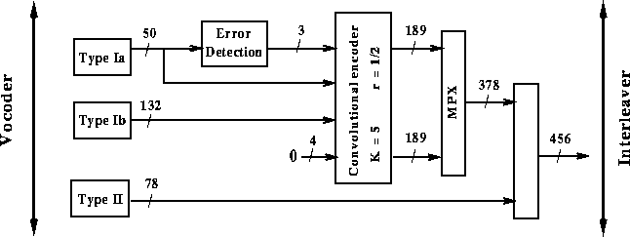
Example G(x)
32 bits CRC:
CRC32: x³² + x²⁶ + x²³ + x²² + x¹⁶ + x¹² + x¹¹ + x¹⁰ + x⁸ + x⁷ + x⁵ + x⁴ + x² + x + 1
used by Ethernet, FDDI, PKZIP, WinZip, and PNG
GSM phones
For more details see the link below and further links it contains:
http://en.wikipedia.org/wiki/Cyclic_redundancy_check
.

Slide 47
Outline
Admin and recap
Overview of transport layer
UDP and error checking
Reliable data transfer

Slide 48
Principles of Reliable Data Transfer (RDT)
Important in app., transport, link layers
Foundation to other protocols
We use the development of RDT to also better appreciate understanding distributed protocols

Slide 49
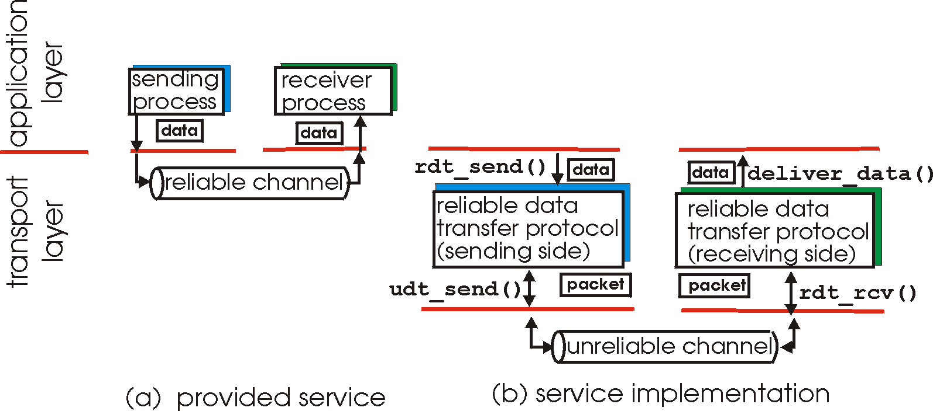
Reliable Data Transfer

Slide 50
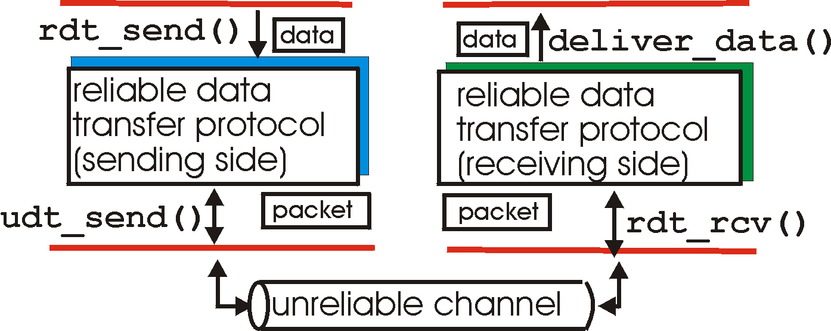
Reliable Data Transfer: Getting Started
rdt_send(): called from above, (e.g., by app.)
deliver_data(): called by rdt to deliver data to upper
send
side
receive
side
udt_send(): called by rdt,
to transfer packet over
unreliable channel to receiver
rdt_rcv(): called from below; when packet arrives on rcv-side of channel

Slide 51
Reliable Data Transfer: Getting Started
We’ll:
incrementally develop sender, receiver sides of reliable data transfer protocol (rdt)
consider only unidirectional data transfer
but control info will flow on both directions !
use finite state machines (FSM) to specify sender, receiver
event causing state transition
actions taken on state transition
state: when in this “state” next state uniquely determined by next event
state
1
state
2
event
actions

Slide 52
Outline
Admin and review
Overview of transport layer
UDP and error checking
Reliable data transfer
perfect channel

Slide 53
Rdt1.0: reliable transfer over a reliable channel
separate FSMs for sender, receiver:
sender sends data into underlying channel
receiver reads data from underlying channel
Wait for call from above
rdt_send(data)
Wait for call from below
rdt_rcv(packet)
extract (packet,data)
deliver_data(data)
packet = make_pkt(data)
udt_send(packet)
sender
receiver
Exercise: Prove correctness of Rdt1.0.

Slide 54
Potential Channel Errors
bit errors
loss (drop) of packets
reordering or duplication
Characteristics of unreliable channel will determine complexity of reliable data transfer protocol (rdt).

Slide 55
Outline
Admin and recap
Overview of transport layer
UDP and error checking
Reliable data transfer
perfect channel
channel with bit errors

Slide 56
rdt2.0: Channel With Bit Errors
Assume: Underlying channel may only flip bits in packet
Wait for call from above
rdt_send(data)
Wait for call from below
rdt_rcv(packet)
extract (packet,data)
deliver_data(data)
packet = make_pkt(data)
udt_send(packet)
sender
receiver
Exercise: What correctness requirement(s) rdt1.0 cannot provide?

Slide 57
rdt2.0: Channel With Bit Errors
New mechanisms in rdt2.0 (beyond rdt1.0):
receiver error detection: recall: UDP checksum/Ethernet CRC detects bit errors
receiver feedback: control msgs (ACK,NAK) rcvr->sender
acknowledgements (ACKs): receiver explicitly tells sender that pkt received OK
negative acknowledgements (NAKs): receiver explicitly tells sender that pkt had errors
sender retransmission
sender retransmits pkt on receipt of NAK

Slide 58
rdt2.0: FSM Specification
rdt_send(data)
snkpkt = make_pkt(data, checksum)
udt_send(sndpkt)
receiver
rdt_rcv(rcvpkt) &&
isNAK(rcvpkt)
Wait for data
Wait for ACK or NAK
rdt_rcv(rcvpkt) &&
corrupt(rcvpkt)
udt_send(sndpkt)
udt_send(NAK)
rdt_rcv(rcvpkt) && isACK(rcvpkt)
Λ
Wait for data
sender
rdt_rcv(rcvpkt) &&
notcorrupt(rcvpkt)
extract(rcvpkt,data)
deliver_data(data)
udt_send(ACK)

Slide 59
rdt2.0: Operation with No Errors
rdt_send(data)
snkpkt = make_pkt(data, checksum)
udt_send(sndpkt)
rdt_rcv(rcvpkt) &&
isNAK(rcvpkt)
Wait for data
Wait for ACK or NAK
rdt_rcv(rcvpkt) &&
corrupt(rcvpkt)
udt_send(sndpkt)
udt_send(NAK)
rdt_rcv(rcvpkt) && isACK(rcvpkt)
Wait for data
Λ
rdt_rcv(rcvpkt) &&
notcorrupt(rcvpkt)
extract(rcvpkt,data)
deliver_data(data)
udt_send(ACK)

Slide 60
rdt2.0: Error Scenario
rdt_send(data)
snkpkt = make_pkt(data, checksum)
udt_send(sndpkt)
rdt_rcv(rcvpkt) &&
isNAK(rcvpkt)
Wait for data
Wait for ACK or NAK
rdt_rcv(rcvpkt) &&
corrupt(rcvpkt)
udt_send(sndpkt)
udt_send(NAK)
rdt_rcv(rcvpkt) && isACK(rcvpkt)
Λ
Wait for data
rdt_rcv(rcvpkt) &&
notcorrupt(rcvpkt)
extract(rcvpkt,data)
deliver_data(data)
udt_send(ACK)

Slide 61
Rdt2.0 Analysis
sender
receiver
data (n)
Execution traces of rdt2.0: {data^ NACK}* data deliver ACK
waiting for N/ACK
NACK
data (n)
Analyzing set of all possible execution traces is a common technique to understand and analyze many types of distributed protocols.
ACK
waiting for data
data (n+1)

Slide 62
rdt2.0 is Incomplete!
What happens if ACK/NAK corrupted?
Although sender receives feedback, but doesn’t know what happened at receiver!
sender
data (n)
waiting for N/ACK
?(N/ACK)

Slide 63
Two Possibilities
sender
rdt_send(data)
snkpkt = make_pkt(data, checksum)
udt_send(sndpkt)
rdt_rcv(rcvpkt) &&
isNAK(rcvpkt)
Wait for data
Wait for ACK or NAK
udt_send(sndpkt)
rdt_rcv(rcvpkt) && isACK(rcvpkt)
Λ
sender can’t just guess NACK: if wrong, duplicate
sender can’t just guess ACK: if wrong, missing pkt
sender
receiver
sender
receiver
data (n)
data (n)
waiting for N/ACK
deliver
waiting for N/ACK
NACK
ACK
data (n)
waiting for data
deliver
data (n+1)
Fix miss guess NACK: provide info for receiver to distinguish
Home exercise: fix miss guess ACK

Slide 64
Handle Control Message Corruption
Handling ambiguity:
sender adds sequence number to each pkt
sender retransmits current pkt if ACK/NAK garbled
Guess NACK
receiver discards (doesn’t deliver up) duplicate pkt
fix effect of wrong guess
stop and wait
sender sends one packet,
then waits for receiver
response
Comment: It is always harder to deal with control message errors than data message errors

Slide 65
rdt2.1b: Sender, Handles Garbled ACK/NAKs
rdt_send(data)
sndpkt = make_pkt(n, data, checksum)
udt_send(sndpkt)
rdt_rcv(rcvpkt) &&
( corrupt(rcvpkt) ||
isNAK(rcvpkt) )
Wait for pkt n from above
Wait for ACK or NAK
udt_send(sndpkt)
rdt_rcv(rcvpkt)
&& notcorrupt(rcvpkt)
&& isACK(rcvpkt)
Λ
Wait for ACK or NAK
Wait for
pkt n+1 from above
rdt_send(data)
sndpkt = make_pkt(n+1, data, checksum)
udt_send(sndpkt)

Slide 66
rdt2.1b: Receiver, Handles Garbled ACK/NAKs
rdt_rcv(rcvpkt) && notcorrupt(rcvpkt)
&& has_seq(n, rcvpkt)
extract(rcvpkt,data)
deliver_data(data)
sndpkt = make_pkt(ACK, chksum)
udt_send(sndpkt)
rdt_rcv(rcvpkt) && corrupt(rcvpkt)
sndpkt = make_pkt(NAK, chksum)
udt_send(sndpkt)
Wait for
n from below
Wait for
n+1 from below
rdt_rcv(rcvpkt) &&
not corrupt(rcvpkt) &&
! has_seq(n,rcvpkt)
sndpkt = make_pkt(ACK, chksum)
udt_send(sndpkt)

Slide 67
rdt2.1b: Summary
Sender:
seq # added to pkt
must check if received ACK/NAK corrupted
Receiver:
must check if received packet is duplicate
by checking if the packet has the expected pkt seq #

Slide 68
rdt2.1b Analysis: Execution Traces?
sender
receiver
data (n)
waiting for n
NACK
sending n
data (n)
ACK
data (n)
waiting n+1
ACK
sending n+1
data 1 (n+1)
waiting for n+2

Slide 69
Protocol Analysis using (Generic) Execution Traces Technique
Issue: how to systematically enumerate all potential execution traces to understand and verify correctness
A systematic approach to enumerating exec. traces is to compute joint sender/receiver/channels state machine
sender state: waiting for n
receiver state: waiting for n
snd->rcv channel state
rcv d_{n} _{del}
s_{n} r_{n+1} - ACK
…
rcv>snd channel state
w_{n} r_{n} - -
snd d_{n}
s_{n} r_{n} d_{n} -
rcv d^_{n}
s_{n} r_{n} - NAK
…
Notes:
{data(n)^ NACK|NACK^}* data(n) deliver
ACK^ data(n)
ACK^ data(n)^ XXXX

Slide 70
Recap: Protocol Analysis using (Generic) Execution Traces Technique
r d_{n}
deliv
s ACK
r ACK
s d_{n}
w_{n} r_{n} - -
s_{n} r_{n} d_{n} -
s_{n} r_{n+1} - ACK
W_{n+1} r_{n+1} - -
r NAK| r NAK^ s d_{n}
r d_{n}^ s NAK
r d_{n}
s ACK
r ACK^
s d_{n}
s_{n} r_{n} - NAK
s_{n} r_{n+1} d_{n} -
r NAK| r NAK^
s d_{n}
r d_{n}^
s NAK
s_{n} r_{n+1} - NAK
Execution traces of rdt2.1b are all that can be generated by the finite state machine above.
Notes:
{data(n)^ NACK|NACK^}* data(n) deliver
ACK^ data(n)
ACK^ data(n)^ XXXX

Slide 71
rdt2.1b Analysis: State Invariants
first
time
rcvs
ack 0
W1: wait for data with seq. 1
S1: sending data with seq. 1
w0
s0
w1
s1
w2
s2
w3
sender
w0
w1
w2
w3
receiver
State invariant:
- When receiver’s state is waiting for seq #n, sender’s state can be sending either seq#n-1or seq#n, and only either #n or #n-1 packets can arrive
first
time
rcvs 0

Slide 72
rdt2.1c: Sender, Handles Garbled ACK/NAKs: Using 1 bit (Alternating-Bit Protocol)
rdt_send(data)
sndpkt = make_pkt(0, data, checksum)
udt_send(sndpkt)
rdt_rcv(rcvpkt) &&
( corrupt(rcvpkt) ||
isNAK(rcvpkt) )
Wait for call 0 from above
Wait for ACK or NAK
udt_send(sndpkt)
rdt_rcv(rcvpkt)
&& notcorrupt(rcvpkt)
&& isACK(rcvpkt)
rdt_rcv(rcvpkt)
&& notcorrupt(rcvpkt)
&& isACK(rcvpkt)
Λ
Λ
Wait for ACK or NAK 1
Wait for
call 1 from above
rdt_rcv(rcvpkt) &&
( corrupt(rcvpkt) ||
isNAK(rcvpkt) )
rdt_send(data)
udt_send(sndpkt)
sndpkt = make_pkt(1, data, checksum)
udt_send(sndpkt)

Slide 73
rdt2.1c: Receiver, Handles Garbled ACK/NAKs: Using 1 bit
rdt_rcv(rcvpkt) && notcorrupt(rcvpkt)
&& has_seq0(rcvpkt)
extract(rcvpkt,data)
deliver_data(data)
sndpkt = make_pkt(ACK, chksum)
udt_send(sndpkt)
rdt_rcv(rcvpkt) && (corrupt(rcvpkt)
rdt_rcv(rcvpkt) && (corrupt(rcvpkt)
sndpkt = make_pkt(NAK, chksum)
udt_send(sndpkt)
sndpkt = make_pkt(NAK, chksum)
udt_send(sndpkt)
Wait for
0 from below
Wait for
1 from below
rdt_rcv(rcvpkt) &&
not corrupt(rcvpkt) &&
has_seq1(rcvpkt)
rdt_rcv(rcvpkt) &&
not corrupt(rcvpkt) &&
has_seq0(rcvpkt)
sndpkt = make_pkt(ACK, chksum)
udt_send(sndpkt)
sndpkt = make_pkt(ACK, chksum)
udt_send(sndpkt)
rdt_rcv(rcvpkt) && notcorrupt(rcvpkt)
&& has_seq1(rcvpkt)
extract(rcvpkt,data)
deliver_data(data)
sndpkt = make_pkt(ACK, chksum)
udt_send(sndpkt)

Slide 74
rdt2.1c: Summary
Sender:
state must “remember” whether “current” pkt has 0 or 1 seq. #
Receiver:
must check if received packet is duplicate
state indicates whether 0 or 1 is expected pkt seq #

