Slide 1
Network Layer: Distance Vector Routing, Link State Routing Global Internet Routing (Interdomain, BGP)
Qiao Xiang
https://qiaoxiang.me/courses/cnns-xmuf22/index.shtml
11/24/2022
This deck of slides are heavily based on CPSC 433/533 at Yale University, by courtesy of Dr. Y. Richard Yang.

Slide 2
Outline
Admin and recap
Network control plane
Routing
Link weights assignment
Routing computation
Basic routing computation protocols
Distance vector protocols (distributed computing)
Link state protocols (distributed state synchronization)
Global Internet routing

Slide 3
Admin
Overview of projects this afternoon
2-4 persons per team, at most 3 teams per topic
FIFS signup with corresponding mentors
If you choose assignment 4 part 2 as your 2-person project, signup with TA
If not decided by the end of this week (Nov. 27), teams and topics will be assigned randomly
You have until Jan. 5 to finish your project
Code, report, slides and pre-recorded presentation
Don’t forget you also have assignment 4 and assignment 5 (to be posted)
So please do NOT procrastinate ☺

Slide 4
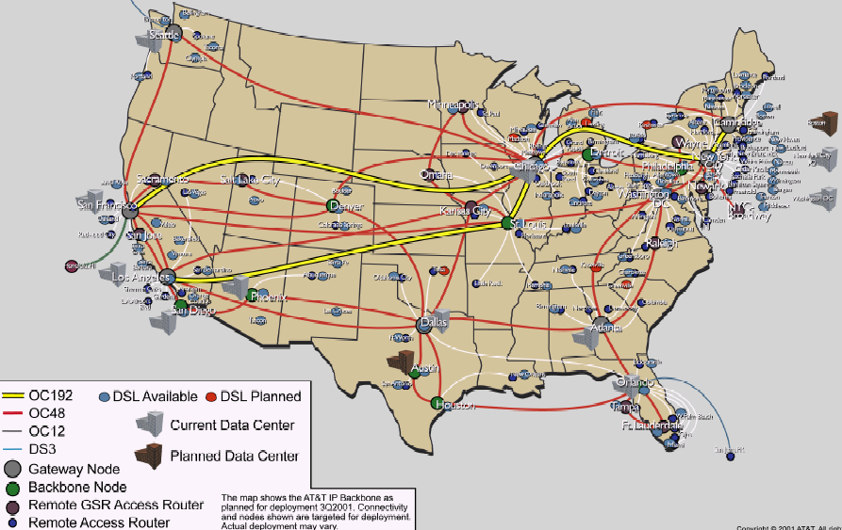
Recap: Routing Context
Routing
Goal: determine “good” paths
(sequences of routers) thru
networks from source to dest.
Often depends on a graph abstraction:
graph nodes are routers
graph edges are physical links
links have properties: delay, capacity, $ cost, policy
5
B
3
C
2
5
A
2
1
F
3
1
2
D
E
1

Slide 5
Recap: Routing Computation using Distance Vector/Bellman-Ford Routing
Distributed computation: At node i, computes
One way to understand BFA is to consider it as a dynamic programming alg, propagating from dest to other nodes
destination
j
i

Slide 6
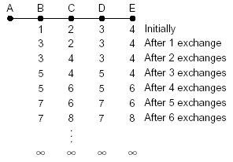
Recap: Fixing DV/BFA
Property of BFA
Bad news may propagate slowly due to loops
Techniques
Reverse poison
Avoid two-node loops
DSDV
Using destination seq to partition into epochs
A good example of analysis using global invariants
Diffusive Update Alg (DUAL)
Utilize backup routes

Slide 7
Outline
Admin and recap
Network control plane
Routing
Link weights assignment
Routing computation
Distance vector protocols (distributed computing)
synchronous Bellman-Ford (SBF)
asynchronous Bellman-Ford (ABF)
properties of DV
DV w/ loop prevention
reverse poison
destination-sequenced DV (DSDV)

Slide 8
Destination-Sequenced Distance Vector protocol (DSDV)
Basic idea: use sequence numbers to partition computation
tags each route with a sequence number
each destination node D periodically advertises monotonically increasing even-numbered sequence numbers
when a node realizes that the link it uses to reach destination D is broken, it advertises an infinite metric and a sequence number which is one greater than the previous route (i.e., an odd seq. number)
the route is repaired by a later even-number advertisement from the destination

Slide 9
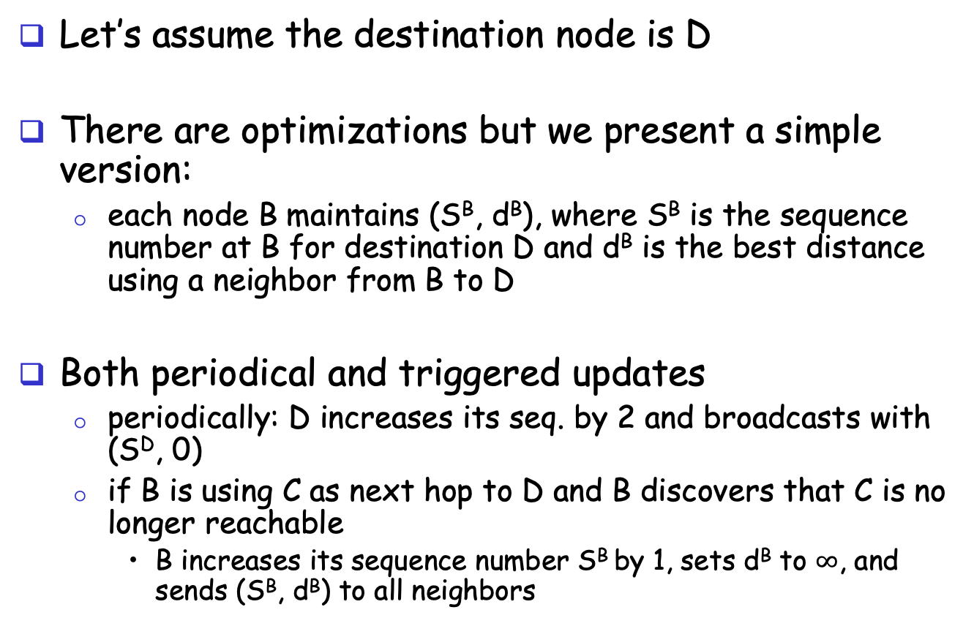
DSDV: More Detail
route update
A
B
Let’s assume the destination node is D
There are optimizations but we present a simple version:
each node B maintains (S^{B}, d^{B}), where S^{B} is the sequence number at B for destination D and d^{B} is the best distance using a neighbor from B to D
Both periodical and triggered updates
periodically: D increases its seq. by 2 and broadcasts with (S^{D}, 0)
if B is using C as next hop to D and B discovers that C is no longer reachable
B increases its sequence number S^{B} by 1, sets d^{B} to $∞$, and sends (S^{B}, d^{B}) to all neighbors
Notes:
The step if S^{A} > S^{B}, then update may not be good because it maybe a cross talk.

Slide 10
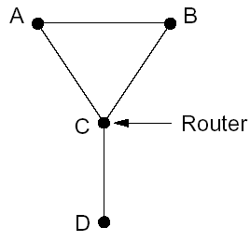
Example
1
5
X
1
1
Will this trigger an update?

Slide 11
Example
1
5
X
1
1
Will this trigger an update?

Slide 12
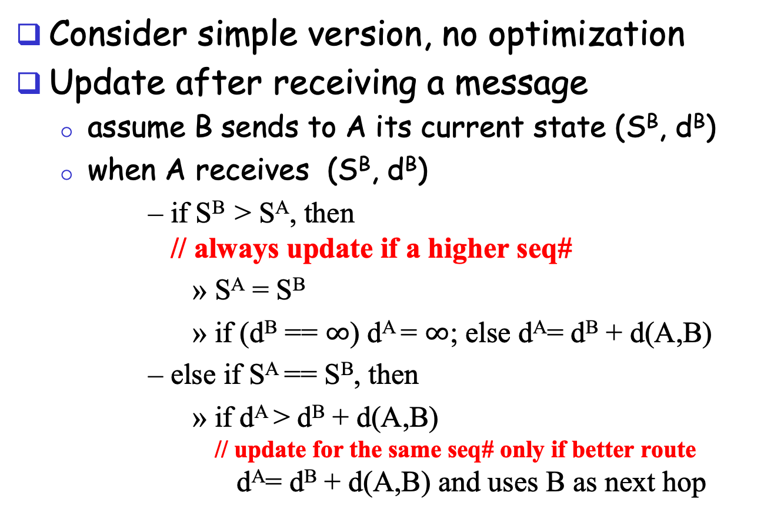
DSDV: Update Alg.
route update
A
B
Consider simple version, no optimization
Update after receiving a message
assume B sends to A its current state (S^{B}, d^{B})
when A receives (S^{B}, d^{B})
if S^{B} > S^{A}, then // always update if a higher seq#
S^{A} = S^{B}
if (d^{B} == $∞$) d^{A} = $∞$; else d^{A}= d^{B} + d(A,B)
else if S^{A} == S^{B}, then
if d^{A} > d^{B} + d(A,B) // update for the same seq# only if better route d^{A}= d^{B} + d(A,B) and uses B as next hop
Notes:
The step if S^{A} > S^{B}, then update may not be good because it maybe a cross talk.

Slide 13
Example
1
5
1
1
Exercise: update process after D increases its seq# to next even number.

Slide 14
Claim: DSDV will NEVER Form a Loop
Initially no loop (no one has next hop so no loop)
Derive contradiction if a loop forms after a node processes an update,
e.g., when A receives the update from B, A decides to use B as next hop and forms a loop
update
A
B

Slide 15
Technique: Global Invariants
Global Invariant is a very effective method in understanding safety of distributed asynchronous protocols
Invariants are defined over the states of the distributed nodes
Consider any node B.
Let’s identify some invariants over the state of node B, i.e., (S^{B}, d^{B}).

Slide 16
Invariants of a Single Node B
Some invariants about the state of a node B
[I1] S^{B} is non-decreasing
[I2] d^{B} is non-increasing for the same sequence number
time

Slide 17
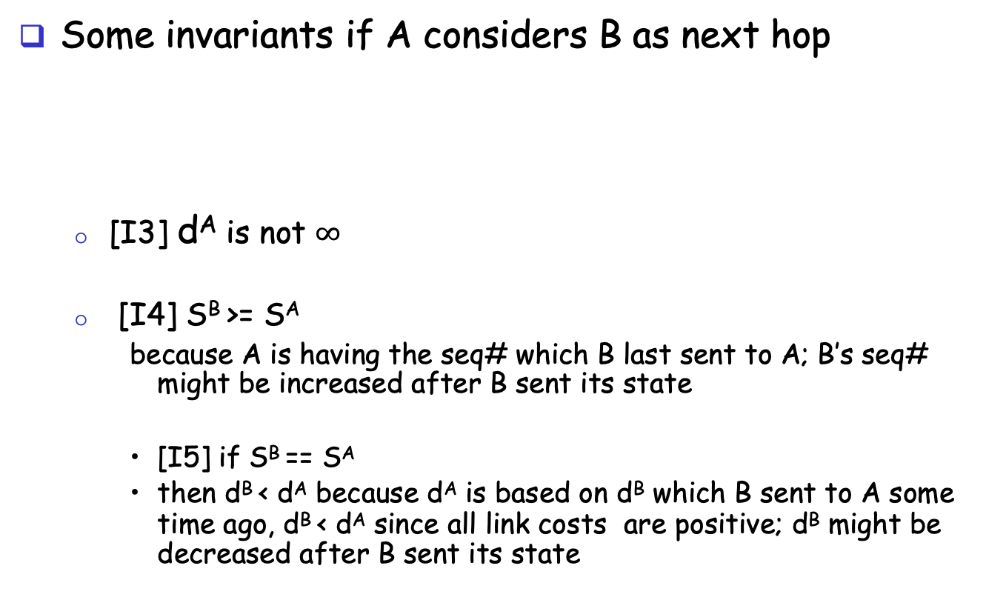
Invariants of if A Considers B as Next Hop
Some invariants if A considers B as next hop
[I3] d^{A} is not $∞$
[I4] S^{B} >= S^{A}
because A is having the seq# which B last sent to A; B’s seq# might be increased after B sent its state
[I5] if S^{B} == S^{A}
then d^{B} < d^{A} because d^{A} is based on d^{B} which B sent to A some time ago, d^{B} < d^{A} since all link costs are positive; d^{B} might be decreased after B sent its state
A
B

Slide 18
Loop Freedom of DSDV
Consider a critical moment
A starts to consider B as next hop, and we have a loop
According to invariant I4 for each link in the loop (X considers Y as next hop) : S^{Y} >= S^{X}
Two cases:
exists S^{Y} > S^{X}
by transition along the loop S^{B} > S^{B}
all nodes along the loop have the same sequence number
apply I5, by transition along the loop d^{B} > d^{B}
update
A
B
X
Y

Slide 19
Issue of DSDV
1
5
X
1
1

Slide 20
Outline
Admin and recap
Network control plane
Routing
Link weights assignment
Routing computation
Distance vector protocols (distributed computing)
synchronous Bellman-Ford (SBF)
asynchronous Bellman-Ford (ABF)
properties of DV
DV w/ loop prevention
reverse poison
destination-sequenced DV (DSDV)
diffusive update algorithm (DUAL) and EIGRP

Slide 21
Basic Idea
DSDV guarantees no loop, but at the price of not using any backup path before destination re-announces reachability.
Basic idea: Sufficient condition to guarantee no loop using backup paths (called switching)?

Slide 22
Key Idea: Feasible Successors
If the reported distance of a neighbor n is lower than the total distance using primary (current shortest), the neighbor n is a feasible successor
p
i
n

Slide 23
Intuition
Since the reported distance of B is lower than my total distance, B cannot be using me (along a path) to reach the destination
feasible successor
A
B
primary
D
Notes:
Before failure:
- dB < dA
- dB >= dC >= dD >= dE >= dA

Slide 24
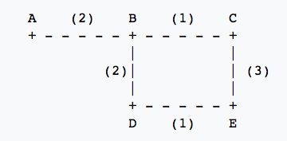
Example
Assume A is destination, consider E
 | Reported Dist. | Total Dist.
Neighbor C
Neighbor D
3
6
4
5

Slide 25
Example
1
5
1
1

Slide 26
Summary: Distance Vector Routing
Basic DV protocol
take away: use monotonicity as a technique to understand liveness/convergence
highly recommended reading of Bersekas/Gallager chapter
Fix counting-to-infinity problem
DSDV
Idea: uses sequence number to avoid routing loops
seq# partitions routing updates from different outside events
within same event, no loop so long each node only decreases its distance
Analysis: use global invariants to understand/design safety/no routing loops
EIRGP (DUAL)
Idea: introduces a sufficient condition for local recovery
Notes:
Simplicity
churns before convergence
path exploration; counting-to-infinity
not enough information when making routing decision (only next-hops and their distance estimates)
While distance-vector protocols are appropriate for small internetworks, and require much less configuration and management
- IGRP was a significant improvement over RIP, which had a hop count restriction that limited the size of an internetwork. IGRP supports internetworks with up to 255 hops.
IGRP:
Upon router startup, IGRP broadcast request messages to other routers. Upon receipt of the message, router send their routing tables to the startup router. Routing tables contain entries for each of the networks that a router can reach. At regular intervals, routers automatically transmit their routing tables to other routers which in turn update their own routing tables if there are changes in the topology. A triggered update occurs if the network topology changes. Triggered updates allow quick responses to changes in the network. When routers add entries to routing tables, 1 is added to the hop count to account for the hop between the router and the neighbor from which it received the route information. When a route is entered into the routing table, a timer is set. As routing table updates arrive and a route entry is verified to still be valid, the timer is reset. If a known router fails to appear in an update and in subsequent updates, the timer will run out and the route entry will be purged.

Slide 27
Discussion: Distance Vector Routing
What do you like about distributed, distance vector routing?
What do you not like about distributed, distance vector routing?
Notes:
Simplicity
churns before convergence
path exploration; counting-to-infinity
not enough information when making routing decision (only next-hops and their distance estimates)
While distance-vector protocols are appropriate for small internetworks, and require much less configuration and management
- IGRP was a significant improvement over RIP, which had a hop count restriction that limited the size of an internetwork. IGRP supports internetworks with up to 255 hops.
IGRP:
Upon router startup, IGRP broadcast request messages to other routers. Upon receipt of the message, router send their routing tables to the startup router. Routing tables contain entries for each of the networks that a router can reach. At regular intervals, routers automatically transmit their routing tables to other routers which in turn update their own routing tables if there are changes in the topology. A triggered update occurs if the network topology changes. Triggered updates allow quick responses to changes in the network. When routers add entries to routing tables, 1 is added to the hop count to account for the hop between the router and the neighbor from which it received the route information. When a route is entered into the routing table, a timer is set. As routing table updates arrive and a route entry is verified to still be valid, the timer is reset. If a known router fails to appear in an update and in subsequent updates, the timer will run out and the route entry will be purged.

Slide 28
Churns of DV: One Example
Message sequences
Node 2 tells 3. Node 3 tells 4…Node N tells N+1. (N-1 messages)
Node N+1 tells N+2, N+2 tells N+3,…,2N. (N-1 messages)
Now node N-1 tells node N+1
Step 2 repeats
Now node N-2 tells node N+1
…
2N
Initially converged.
All links have cost 1
Event: Cost of 1->2 reduces to 0
…
N+3
N+2
N+1
A total of O(N²) messages
1
2
3
…
N-1
N

Slide 29
Outline
Admin and recap
Network control plane
Routing
Link weights assignment
Routing computation
Distance vector protocols (distributed computing)
Link state protocols (distributed state synchronization)

Slide 30
Link-State Routing
Basic idea: Not distributed computing, only distributed state distribution
Net topology, link costs are distributed to all nodes
all nodes have same info
Each node computes its shortest paths from itself to all other nodes
standard Dijkstra’s algorithm as path compute alg
Allows multiple same-cost paths
Multiple cost metrics per link (for type of service routing)
Most commonly used routing protocol (e.g., OSPF/ISIS) by most networks in Internet

Slide 31
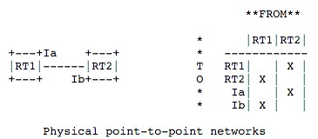
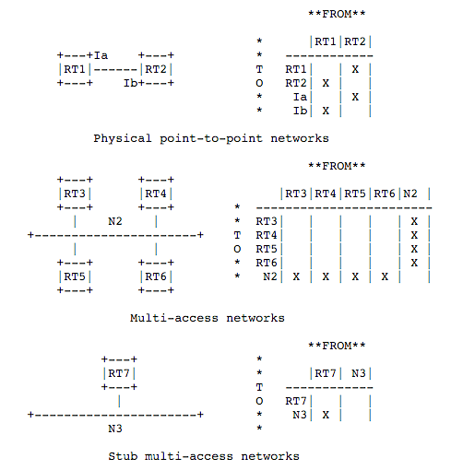
Example: Link State and Directed Graph (OSPFv2)
https://tools.ietf.org/html/rfc1583#page-12
Notes:
Need to setup order: Right after said a link is up, it became down
solution: sequence#
sequence# corruption: age
Partition: periodical rebroadcast
Failure

Slide 32
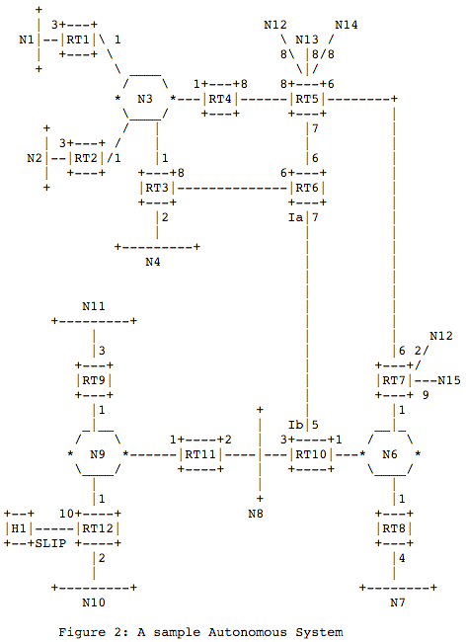
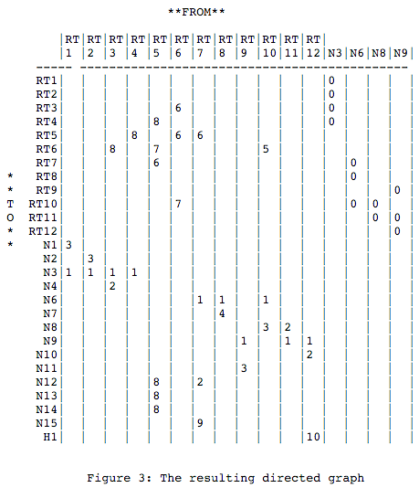
Example: Link State and Directed Graph (OSPFv2)
Notes:
Need to setup order: Right after said a link is up, it became down
solution: sequence#
sequence# corruption: age
Partition: periodical rebroadcast
Failure

Slide 33
Outline
Admin and recap
Network control plane
Routing
Link weights assignment
Routing computation
Distance vector protocols (distributed computing)
Link state protocols (distributed state synchronization)
data structure to be distributed
state distribution protocol

Slide 34
Basic Link State Broadcast Protocol
Basic event structure at node n
on initialization:
broadcast LSA[e] for each link e connected to n
on state change to a link e connected to n:
broadcast LSA[e] = new status
on receiving an LSA[e]:
if (does not have LSA[e]) forwards LSA[e] to all links except the incoming link
Notes:
Need to setup order: Right after said a link is up, it became down
solution: sequence#
ordering of events (link up and down)
network partitioning and then merge
sequence# corruption: age
Partition: periodical rebroadcast
Failure

Slide 35

Link State Broadcast
Node S updates link states connected to it.
S
E
F
B
C
M
L
J
A
G
H
D
K
I
N

Slide 36
Link State Broadcast
S
E
F
B
C
M
L
J
A
G
H
D
K
I
N
To avoid forwarding the same link state announcement (LSA) multiple times (forming a loop), each node remembers the received LSAs.
- Second LSA[S] received by E from C is discarded
- Second LSA[S] received by C from E is discarded as well
- Node H receives LSA[S] from two neighbors, and will discard one of them

Slide 37
Discussion
Issues of the basic link state protocol?
Recall: goal is to efficiently distribute to each node to a correct, complete link state map

Slide 38
Link State Broadcast: Issues
Problem: Out of order delivery
link down and then up
A node may receive up first and then down
Solution
Each link update is given a sequence number: (initiator, seq#, link, status)
the initiator should increase the seq# for each new update
If the seq# of an update of a link is not higher than the highest seq# a router has seen, drop the update
Otherwise, forward it to all links except the incoming link (real implementation using packet buffer)
Problem of solution: seq# corruption
Solution: age field (e.g., https://tools.ietf.org/html/rfc1583#page-102)

Slide 39
Link State Broadcast: Issues
Problem: network partition and then reconnect, how to sync across the reconnected components
Solution: updates are sent periodically

Slide 40
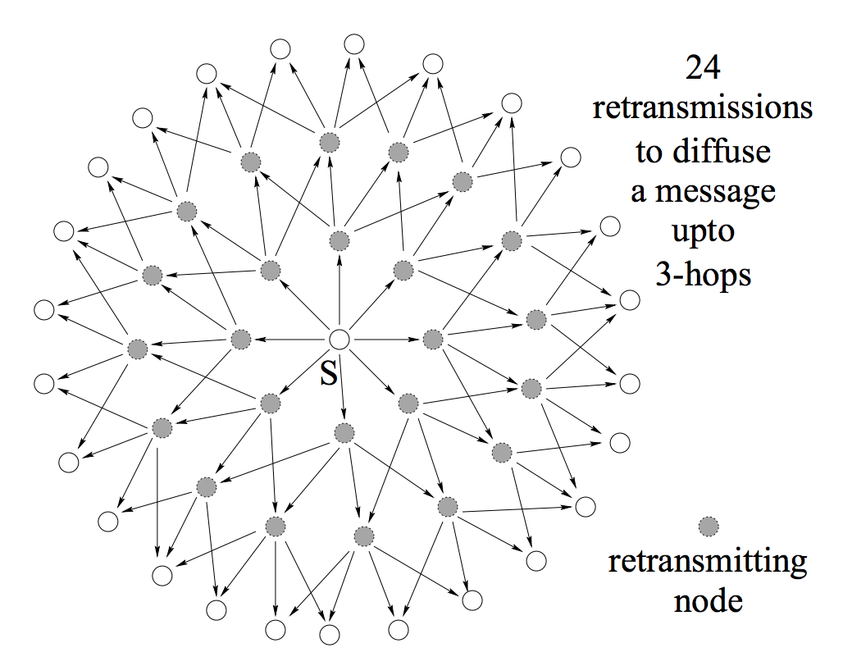
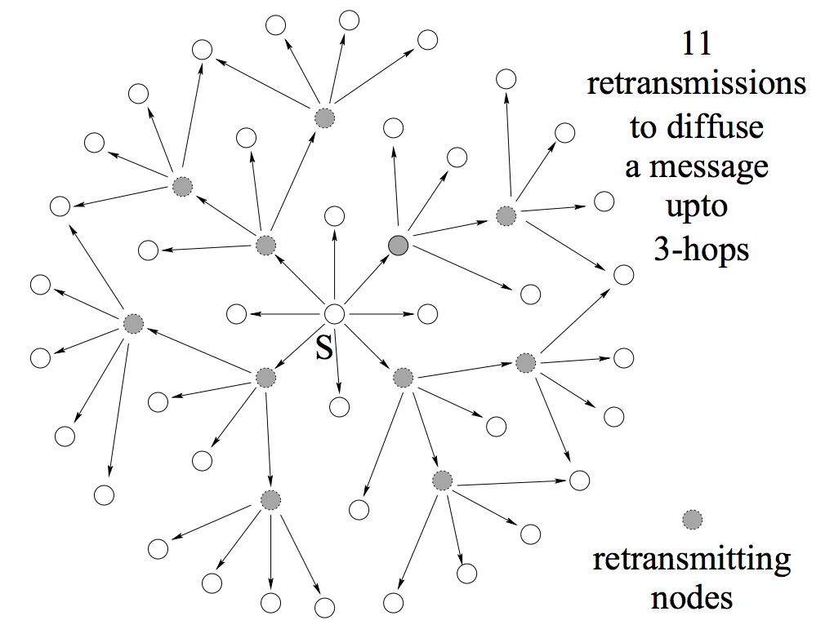
Link State Broadcast: Issues
Problem: Broadcast redundancy
https://hal.inria.fr/inria-00072756/document

Slide 41
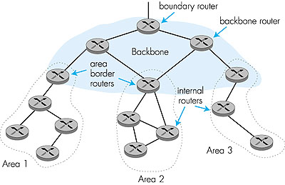
Hierarchical OSPF
“summarize” distances to nets in own area, advertise to other Area Border routers.
run OSPF routing limited to backbone.
- Link-state advertisements only in area
each nodes has detailed area topology; - only know direction (shortest path) to nets in other areas.
Two-level hierarchy: local area, backbone.

Slide 42
Summary: Link State
Basic LS protocol
take away: instead of computing routing results using distributed computing, distributed computing is for only link state distribution (synchronization)
Link state distribution can still have much complexity, e.g., out of order delivery, partition and reconnect, scalability
Notes:
Simplicity
churns before convergence
path exploration; counting-to-infinity
not enough information when making routing decision (only next-hops and their distance estimates)
While distance-vector protocols are appropriate for small internetworks, and require much less configuration and management
- IGRP was a significant improvement over RIP, which had a hop count restriction that limited the size of an internetwork. IGRP supports internetworks with up to 255 hops.
IGRP:
Upon router startup, IGRP broadcast request messages to other routers. Upon receipt of the message, router send their routing tables to the startup router. Routing tables contain entries for each of the networks that a router can reach. At regular intervals, routers automatically transmit their routing tables to other routers which in turn update their own routing tables if there are changes in the topology. A triggered update occurs if the network topology changes. Triggered updates allow quick responses to changes in the network. When routers add entries to routing tables, 1 is added to the hop count to account for the hop between the router and the neighbor from which it received the route information. When a route is entered into the routing table, a timer is set. As routing table updates arrive and a route entry is verified to still be valid, the timer is reset. If a known router fails to appear in an update and in subsequent updates, the timer will run out and the route entry will be purged.

Slide 43
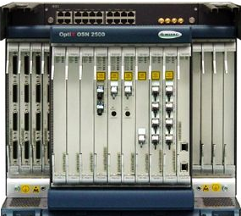
Roadmap: Routing Computation Architecture Spectrum
Dijkstra
Distributed Bellman Ford
Distributed Link State
Dijkstra
Datapath
Distributed Bellman Ford
Distributed Link State
Dijkstra
Datapath
Distributed Bellman Ford
Distributed Link State
Datapath
Notes:
RIP: 1988 RFC1058 OSFPv2: RFC2328

Slide 44
Outline
Admin and recap
Network control plane
Routing
Link weights assignment
Routing computation
Basic routing computation protocols
Distance vector protocols (distributed computing)
Link state protocols (distributed state synchronization)
Global Internet routing

Slide 45
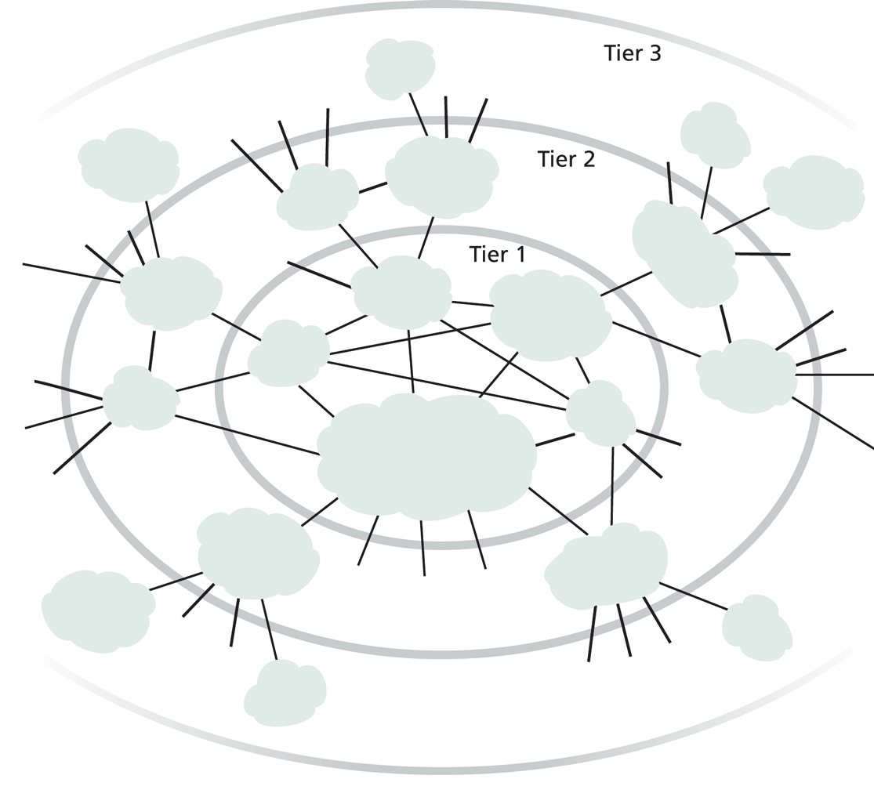
Exercise
Does it work to use DV or LS as we discussed for global Internet routing?
Notes:
DV: so many loops,
LS/DV: scalability

Slide 46
Requirements and Solution of Current Global Internet Routing
Scalability: handle network size (#devices) much higher than typical DV or LS can handle
Solution: Introduce new abstraction to reduce network (graph) size
Autonomy: allow each network to have individual preference of routing (full control of its internal routing; control/preference of routing spanning multiple networks)
Solution: hierarchical routing and policy routing
Notes:
Other than scale, what else?

Slide 47
New Abstraction: Autonomous Systems (AS)
Abstract each network as an autonomous system (AS), identified by an AS number (ASN)
Conceptually the global routing graph consists of only autonomous systems as nodes
http://www.bgplookingglass.com/list-of-autonomous-system-numbers

Slide 48
Routing with Autonomous Systems
Internet routing is divided into intra-AS routing and inter-AS routing
Intra-AS routing (also called intradomain routing)
A protocol running insides an AS is called an Interior Gateway Protocol (IGP), each AS can choose its own protocol, such as RIP, E/IGRP, OSPF, IS-IS
Inter-AS routing (also called interdomain routing)
A protocol runs among autonomous systems is also called an Exterior Gateway Protocol (EGP)
The de facto EGP protocol is BGP

Slide 49
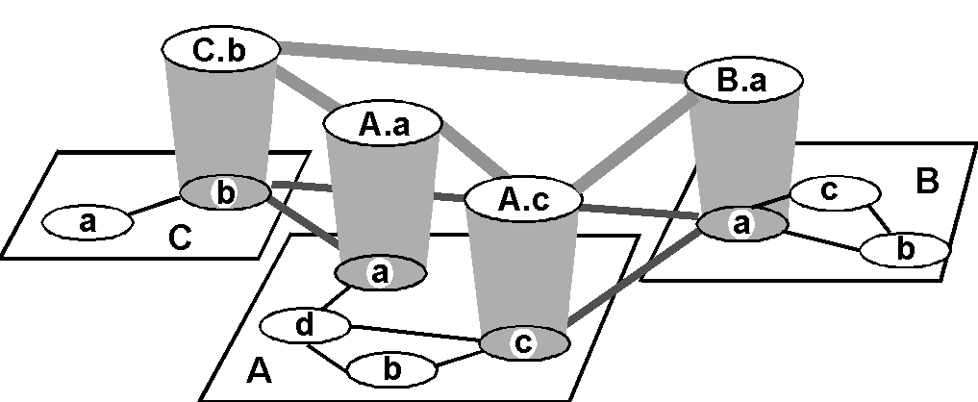
Routing with Autonomous Systems
Inter-AS routers form an overlay
Gateway routers participate in intradomain to learn internal routes.
Gateway routers of same AS share learned external routes using iBGP.
AS C
(RIP intra
AS B
(OSPF intra
AS A
(OSPF intra
routing)
routing)
routing)
i
a
b
e
eBGP
iBGP
f
g
Gateway routers of diff. auto. systems exchange routes using eBGP
d
c
h

Slide 50
Routing with Autonomous Systems
border (exterior gateway) routers
C.b
B.a
A.a
b
A.c
c
a
C
a
b
a
B
d
c
A
b
interior (gateway) routers

Slide 51
Summary: Internet Routing Architecture
Autonomous systems have flexibility to choose their own intradomain routing protocols
allows autonomy
Only a small # of routers (gateways) from each AS in the interdomain level
improves scalability
Interdomain routing using AS topology instead of detailed topology
improves scalability/privacy

Slide 52
Outline
Admin and recap
Network control plane
Routing
Link weights assignment
Routing computation
Basic routing computation protocols
Global Internet routing
Basic architecture
BGP (Border Gateway Protocol): The de facto Inter-domain routing standard

Slide 53
BGP Basic Operations
BGP is a Path Vector protocol
similar to Distance Vector protocol
a border gateway sends to a neighbor entire path (i.e., a sequence of ASNs) to a destination, e.g.,
gateway X sends to neighbor N its path to dest. Z:
path (X,Z) = X,Y1,Y2,Y3,…,Z
if N selects path(X, Z) advertised by X, then: path (N,Z) = N, path (X,Z)
Z
N
X

Slide 54
BGP Basic Operations
Establish session on
TCP port 179
AS1
BGP session
Exchange all
active routes
AS2
while (connection is ALIVE) exchange UPDATE message select best available route
if route changes, export to neigh.
Exchange incremental
updates

Slide 55
BGP Messages
Four types of messages
OPEN: opens TCP connection to peer and authenticates sender
UPDATE: advertises new path (or withdraws old)
KEEPALIVE keeps connection alive in absence of UPDATES; also ACKs OPEN request
NOTIFICATION: reports errors in previous msg; also used to close connection

Slide 56
Outline
Admin and recap
Network control plane
Routing
Link weights assignment
Routing computation
Basic routing computation protocols
Global Internet routing
Basic architecture
BGP (Border Gateway Protocol): The de facto Inter-domain routing standard
Basic operations
BGP as a policy routing framework (control interdomain routes)

Slide 57
BGP Policy Routing Framework:
Label Route Information Sources
RIP process
OSPF process
BGP process
BGP
RIP routing table
OSPF Routing table
BGP routing table
RIP
domain
OS kernel
OSPF
domain
Routing Information Base (RIB)
Forwarding Information Base (FIB)
57

Slide 58
BGP Policy Routing Framework: Decision Components
route selection policy: rank paths
1 3 0
1 0
routing cache
select best path
export policy: which paths export to which neighbors
export path to neighbors
AT&T
Qwest
Internet2
Yale
58

Slide 59
BGP Example (1)
AS D
d
E
AS A
(OSPF)
d->a2: I can reach
hosts in D; my path: D
Export to E: i->e: I can reach hosts in D; path: IAD
a2
a2->a1: I can reach
hosts in D; path: D
a1->i: I can reach hosts in D; my path: AD
a1
No export to F (effect?)
i
F
AS C
Route selection policy:
- Shortest AS Path policy:
Choose AD using a1
i2->i: I can reach hosts in D; path: BCD
b->i: I can reach hosts
in D; my path: BCD
AS B
(OSPF intra
Export policy controls ingress, i.e., who can use I
routing)
i2
b
b->i2: I can reach hosts
in D; my path: BCD
AS I
Notes:
Choose

Slide 60
BGP Example (2)
AS D
d
E
AS A
(OSPF)
d->a2: I can reach
hosts in D; my path: D
Export to E: i->e: I can reach hosts in D; path: IBCD
a2
a2->a1: I can reach
hosts in D; path: D
a1->i: I can reach hosts in D; my path: AD
a1
F
i
AS C
Selection policy: - Low local_pref for A
- Shortest AS Path
- Prefer eBGP
Called hot potato (why?)
i2->i: I can reach hosts in D; path: BCD
b->i: I can reach hosts
in D; my path: BCD
AS B
(OSPF intra
Outcome: Choose BCD using b
routing)
i2
b
b->i2: I can reach hosts
in D; my path: BCD
AS I
Notes:
Choose

Slide 61
BGP Example (3)
AS D
d
E
AS A
(OSPF)
d->a2: I can reach
hosts in D; my path: D
Export to E: i->e: I can reach hosts in D; path: IBCD
a2
a2->a1: I can reach
hosts in D; path: D
a1->i: I can reach hosts in D; my path: AD
a1
F
i
AS C
Selection policy: - Low local pref A
- Shortest AS Path
- Prefer iBGP
Called cold potato (why?)
i2->i: I can reach hosts in D; path: BCD
b->i: I can reach hosts
in D; my path: BCD
AS B
(OSPF intra
Outcome: Choose BCD using i2
routing)
i2
b
b->i2: I can reach hosts
in D; my path: BCD
AS I
Notes:
Choose

Slide 62
Observing BGP Paths
Using one of the looking glass servers: http://www.bgp4.as/looking-glasses
https://www.gin.ntt.net/looking-glass/

Slide 63
Outline
Admin and recap
Network control plane
Routing
Link weights assignment
Routing computation
Basic routing computation protocols
Global Internet routing
Basic architecture
BGP (Border Gateway Protocol): The de facto Inter-domain routing standard
Basic operations
BGP as a policy routing framework (control interdomain routes)
Policy/interdomain routing analysis

Slide 64
Motivation: Policy Routing Stability
A policy routing system can be considered as a system to aggregate local preferences, but aggregation may not be always successful.
The BAD GADGET example:
- 0 is the destination
- the route selection policy of each AS is to prefer its counter clock-wise neighbor
preferred
2 1 0
2 0
2
4
less
preferred
0
3 2 0
3 0
1 3 0
1 0
1
3
3
Policy (preferences) aggregation fails: routing instability !

Slide 65
General Framework of Preference Aggregation
Also called Social Choice
Given individual preferences, define a framework to aggregate individual preferences:
A set of choices: a, b, c, …
A set of voters 1, 2, …
Each voter has a preference (ranking) of all choices, e.g.,
voter 1: a > b > c
voter 2: a > c > b
voter 3: a > c > b
A well-specified aggregation rule (protocol) computes an aggregation of ranking, e.g.,
Society (network): a > b > c
Notes:
https://en.wikipedia.org/wiki/Arrow%27s_impossibility_theorem

Slide 66
Example: Aggregation of Global Preference
A
S
D
B
Choices (for S->D route): SAD, SBD, SABD, SBAD
Voters S, A, B, D
Each voter has a preference, e.g.,
S: SAD > SBD > SABD > SBAD
…
Notes:
https://en.wikipedia.org/wiki/Arrow%27s_impossibility_theorem

Slide 67
Arrow’s Aggregation Framework
Axioms:
Transitivity
if a > b & b > c, then a > c
Unanimity:
If all participants prefer a over b (a > b) => a > b
Independence of irrelevant alternatives (IIA)
Social ranking of a and b depends only on the relative ranking of a and b among all participants
Result:
Arrow’s Theorem: Any constitution that respects transitivity, unanimity and IIA is a dictatorship.
Notes:
https://en.wikipedia.org/wiki/Arrow%27s_impossibility_theorem

Slide 68
Proofs of Arrow’s Theorem
There are quite a few proofs, and the six-page paper linked on the Schedule page gives three simple proofs.
Below, I give the key insight of the proof using approach 1.

Slide 69
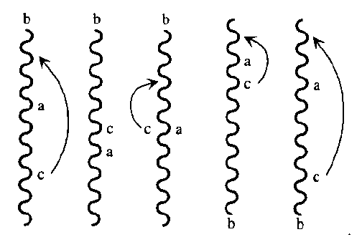
The Extremal Lemma
Let choice b be chosen arbitrarily. Assume that every voter puts b at the very top or the very bottom of his ranking. Then society must as well (even if half voters put b at the top and half at the bottom)
Proof: by contradiction.
Assume there exist a and c such that society has a >= b; b >= c.
By transitivity, a >= c
We can move c above a w/o changing ab or cb votes, leading to c > a
By unanimity, c > a

