Slide 1
Network Applications: HTTP/1.0/1.1/2; Operational Analysis
Qiao Xiang
https://qiaoxiang.me/courses/cnns-xmuf22/index.shtml
10/06/2022
This deck of slides are heavily based on CPSC 433/533 at Yale University, by courtesy of Dr. Y. Richard Yang.

Slide 2
Outline
Admin and recap
HTTP/1.0
Basic design
Dynamic content
HTTP “acceleration”
Operational analysis

Slide 3
Admin
Lab assignment 3 (HTTP server assignment) to be posted next week
Plagiarism is NOT allowed in any assignment
Discussion and reading are encouraged, but copying is NOT!
If you reuse others' (e.g., classmates, friends, Stackoverflow, CSDN) code as part of your solution, please mark it in comments.

Slide 4
Recap: FTP
A stateful protocol
state established by commands such as
USER/PASS, CWD, TYPE
Multiple TCP connections
A control connection
Data connections
Two approaches: PORT vs PASV
GridFTP: concurrent data connections; block data transfer mode
FTP
client
FTP
server
USER xxx
PASS xxx
CWD home
PORT clientip:cport
RETR index.html
Server initiates TCP data connection
server:20 clientip:cport
Notes:
A: someone (either server or client) needs to pick a new port

Slide 5
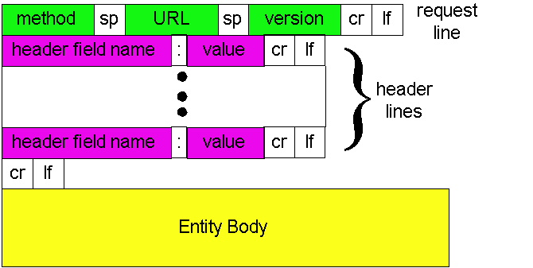
HTTP Request Message: General Format
ASCII (human-readable format)

Slide 6
Trying out HTTP (client side) for yourself
1. Telnet to your favorite Web server:
telnet qiaoxiang.me 80
Opens TCP connection to port 80
(default http server port) at qiaoxiang.me.
Anything typed in sent
to port 80 at qiaoxiang.me
2. Type in a GET http request:
GET /index.html HTTP/1.0
By typing this in (hit carriage
return twice), you send
this minimal (but complete)
GET request to http server
3. Look at response message sent by the http server.

Slide 7
Trying out HTTP (client side) for yourself
Try telnet GET on www.xmu.edu.cn

Slide 8
HTTP Request Message Example: GET
Virtual host multiplexing
request line
(GET, POST,
HEAD, PUT, DELETE, TRACE … commands)
GET /somedir/page.html HTTP/1.0 Host: www.somechool.edu Connection: close
User-agent: Mozilla/4.0
Accept: text/html, image/gif, image/jpeg
Accept-language: en
(extra carriage return, line feed)
Connection management
header
lines
Carriage return,
line feed
indicates end
of message
Content negotiation

Slide 9
HTTP Response Message
status line
(protocol
status code
status phrase)
HTTP/1.0 200 OK
Date: Wed, 23 Jan 2008 12:00:15 GMT
Server: Apache/1.3.0 (Unix)
Last-Modified: Mon, 22 Jun 1998 …...
Content-Length: 6821
Content-Type: text/html
data data data data data ...
header
lines
data, e.g.,
requested
html file

Slide 10
HTTP Response Status Codes
In the first line of the server->client response message. A few sample codes:
200 OK
request succeeded, requested object later in this message
301 Moved Permanently
requested object moved, new location specified later in this message (Location:)
400 Bad Request
request message not understood by server
404 Not Found
requested document not found on this server
505 HTTP Version Not Supported

Slide 11
Trying Use Chrome to visit Course Page

Slide 12
Design Exercise
Workflow of an HTTP server processing a GET request that maps to a file: GET /somedir/page.html HTTP/1.0 Host: www.someschool.edu

Slide 13
Basic HTTP Server Workflow
Create ServerSocket(6789)
128.36.232.5 128.36.230.2
TCP socket space
state: listening
address: {*.6789, *.*}
completed connection queue: sendbuf:
recvbuf:
connSocket = accept()
read request from connSocket
state: established
address: {128.36.232.5:6789, 198.69.10.10.1500}
sendbuf:
recvbuf:
Map URL to file
state: listening
address: {*.25, *.*}
completed connection queue:
sendbuf:
recvbuf:
Read from file/ write to connSocket
close connSocket

Slide 14
Example Code
See BasicWebServer.java
Try using telnet and real browser, and fetch
file1.html
index.html
what difference in behavior?

Slide 15
Static -> Dynamic Content
Create ServerSocket(6789)
connSocket = accept()
It does not have to be a static file
read request from connSocket
Map URL to file
Read from file/ write to connSocket
close connSocket

Slide 16
Recap: HTTP
Wide use of HTTP for Web applications
Example: RESTful API
RESTful design
http://www.ics.uci.edu/~fielding/pubs/dissertation/rest_arch_style.htm
http://docs.oracle.com/javaee/6/tutorial/doc/giepu.html
WebMail
WebApp…
HTTP
TCP
UDP
Ethernet
Wireless
Cable/DSL

Slide 17
Recap: HTTP
C-S app serving Web pages
message format
request/response line, header lines, entity body
simple methods, rich headers
message flow
stateless server, thus states such as cookie and authentication are needed in each message

Slide 18
Outline
Admin and recap
HTTP/1.0
Basic design
Dynamic content

Slide 19
Dynamic Content Pages
There are multiple approaches to make dynamic web pages:
Embed code into pages (server side include)
http server includes an interpreter for the type of pages
Invoke external programs (http server is agnostic to the external program execution)
E.g., Common Gateway Interface (CGI)
http://www.cs.yale.edu/index.shtml
http://www.cs.yale.edu/cgi-bin/ureserve.pl
http://www.google.com/search?q=Yale&sourceid=chrome

Slide 20
Example SSI
See programming/examples-java-socket/BasicWebServer/ssi/index.shtml, header.shtml, …
Notes:
https://httpd.apache.org/docs/2.2/howto/ssi.html

Slide 21
Example SSI
See programming/examples-java-socket/BasicWebServer/ssi/index.shtml, header.shtml, …
To enable ssi, need configuration to tell the web server (see conf/apache-htaccess)
https://httpd.apache.org/docs/2.2/howto/htaccess.html (Server Side Includes example)
Notes:
https://httpd.apache.org/docs/2.2/howto/ssi.html

Slide 22
CGI: Invoking External Programs
Two issues
Input: Pass HTTP request parameters to the external program
Output: Redirect external program output to socket

Slide 23
Example: Typical CGI Implementation
Starts the executable as a child process
Passes HTTP request as environment variables
http://httpd.apache.org/docs/2.2/env.html
CGI standard: http://www.ietf.org/rfc/rfc3875
Redirects input/output of the child process to the socket

Slide 24
Example: CGI
Example:
GET /search?q=Yale&sourceid=chrome HTTP/1.0
setup environment variables, in particular $QUERY_STRING=q=Yale&sourceid=chrome
start search and redirect its input/output
https://docs.oracle.com/javase/7/docs/api/java/lang/ProcessBuilder.html

Slide 25
Example
https://httpd.apache.org/docs/2.2/howto/htaccess.html (CGI Example)
http://172.28.229.215/BasicWebServer/cgi/price.cgi?appl
#!/usr/bin/perl -w
$company = $ENV{'QUERY_STRING'};
print "Content-Type: text/html\r\n";
print "\r\n";
print "<html>";
print "<h1>Hello! The price is ";
if ($company =~ /appl/) {
my $var_rand = rand();
print 450 + 10 * $var_rand;
} else {
print "150";
}
print "</h1>";
print "</html>";
Notes:
https://httpd.apache.org/docs/2.2/howto/htaccess.html

Slide 26
Client Using Dynamic Pages
See ajax.html and wireshark for client code example
http://172.28.229.215/BasicWebServer/cgi/ajax.html

Slide 27
Discussions
What features are missing in HTTP that we have covered so far?

Slide 28
HTTP: POST
If an HTML page contains forms or parameter too large, they are sent using POST and encoded in message body

Slide 29
HTTP: POST Example
POST /path/script.cgi HTTP/1.0
User-Agent: MyAgent
Content-Type: application/x-www-form-urlencoded
Content-Length: 15
item1=A&item2=B
Example using nc: programming/examples-java-socket/BasicWebServer/nc/

Slide 30
Stateful User-server Interaction: Cookies
client
server
Goal: no explicit application level session
Server sends “cookie” to client in response msg
Set-cookie: 1678453
Client presents cookie in later requests
Cookie: 1678453
Server matches presented-cookie with server-stored info
authentication
remembering user preferences, previous choices
usual http request msg
usual http response +
Set-cookie: #
usual http request msg
Cookie: #
cookie-
specific
action
usual http response msg
usual http request msg
Cookie: #
cookie-
specific
action
usual http response msg

Slide 31
Authentication of Client Request
client
server
Authentication goal: control access to server documents
stateless: client must present authorization in each request
authorization: typically name, password
Authorization: header line in request
if no authorization presented, server refuses access, sends
WWW-authenticate:
header line in response
usual http request msg
401: authorization req.
WWW-authenticate:
usual http request msg
+ Authorization:line
usual http response msg
usual http request msg
+ Authorization:line
usual http response msg
time
Browser caches name & password so
that user does not have to repeatedly enter it.

Slide 32
Example: Amazon S3
Amazon S3 API
http://docs.aws.amazon.com/AmazonS3/latest/API/APIRest.html

Slide 33
HTTP as the Thin Waist
WebMail
WebApp…
HTTP
TCP
UDP
Ethernet
Wireless
Cable/DSL

Slide 34
Protocol Flow of Basic HTTP/1.0
>= 2 RTTs per object:
TCP handshake --- 1 RTT
client request and server responds --- at least 1 RTT (if object can be contained in one packet)
TCP SYN
TCP ACK
TCP/ACK; HTTP GET
base page
TCP SYN
TCP ACK
TCP/ACK; HTTP GET
image 1
Notes:
Typical approaches to reduce latency:
parallel TCP connections
persistent HTTP
cache and conditional GET

Slide 35
Outline
Admin and recap
HTTP/1.0
HTTP “acceleration”

Slide 36
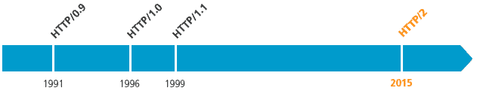
Substantial Efforts to Speedup Basic HTTP/1.0
Reduce the number of objects fetched [Browser cache]
Reduce data volume [Compression of data]
Header compression [HTTP/2]
Reduce the latency to the server to fetch the content [Proxy cache]
Remove the extra RTTs to fetch an object [Persistent HTTP, aka HTTP/1.1]
Increase concurrency [Multiple TCP connections]
Asynchronous fetch (multiple streams) using a single TCP [HTTP/2]
Server push [HTTP/2]

Slide 37
Browser Cache and Conditional GET
client
server
Goal: don’t send object if client has up-to-date stored (cached) version
client: specify date of cached copy in http request
If-modified-since: <date>
server: response contains no object if cached copy up-to-date:
HTTP/1.0 304 Not Modified
http request msg
If-modified-since: <date>
object
not
modified
http response
HTTP/1.0
304 Not Modified
http request msg
If-modified-since: <date>
object
modified
http response
HTTP/1.1 200 OK
…
<data>

Slide 38
Web Caches (Proxy)
Goal: satisfy client request without involving origin server
origin
server
Proxy
server
http request
http request
client
http response
http response
http request
http request
http response
http response
client
origin
server

Slide 39
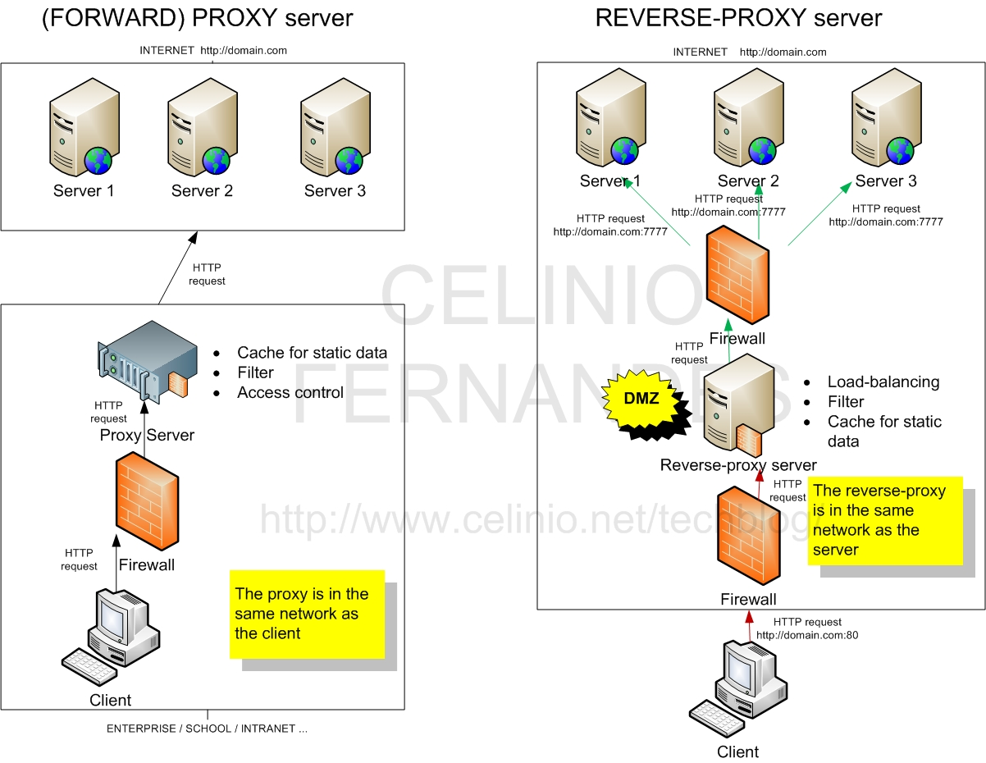
Two Types of Proxies
http://www.celinio.net/techblog/?p=1027
Typically in the same network as the client
Typically in the same network as the server

Slide 40
Benefits of Forward Proxy
origin
servers
Assume: cache is “close” to client (e.g., in same network)
smaller response time: cache “closer” to client
decrease traffic to distant servers
link out of institutional/local ISP network often is bottleneck
public
Internet
1.5 Mbps
access link
institutional
network
10 Mbps LAN
institutional
cache

Slide 41
No Free Lunch: Problems of Web Caching
The major issue of web caching is how to maintain consistency
Two ways
pull
Web caches periodically pull the web server to see if a document is modified
push
whenever a server gives a copy of a web page to a web cache, they sign a lease with an expiration time; if the web page is modified before the lease, the server notifies the cache

Slide 42
HTTP/1.1: Persistent (keepalive/pipelining) HTTP
HTTP/1.0 allows a single request outstanding, while HTTP/1.1 allows request pipelining
On same TCP connection: server parses request, responds, parses new request, …
Client sends requests for all referenced objects as soon as it receives base HTML
Benefit
Fewer RTTs
See Joshua Graessley WWDC 2012 talk: 3x within iTunes

Slide 43
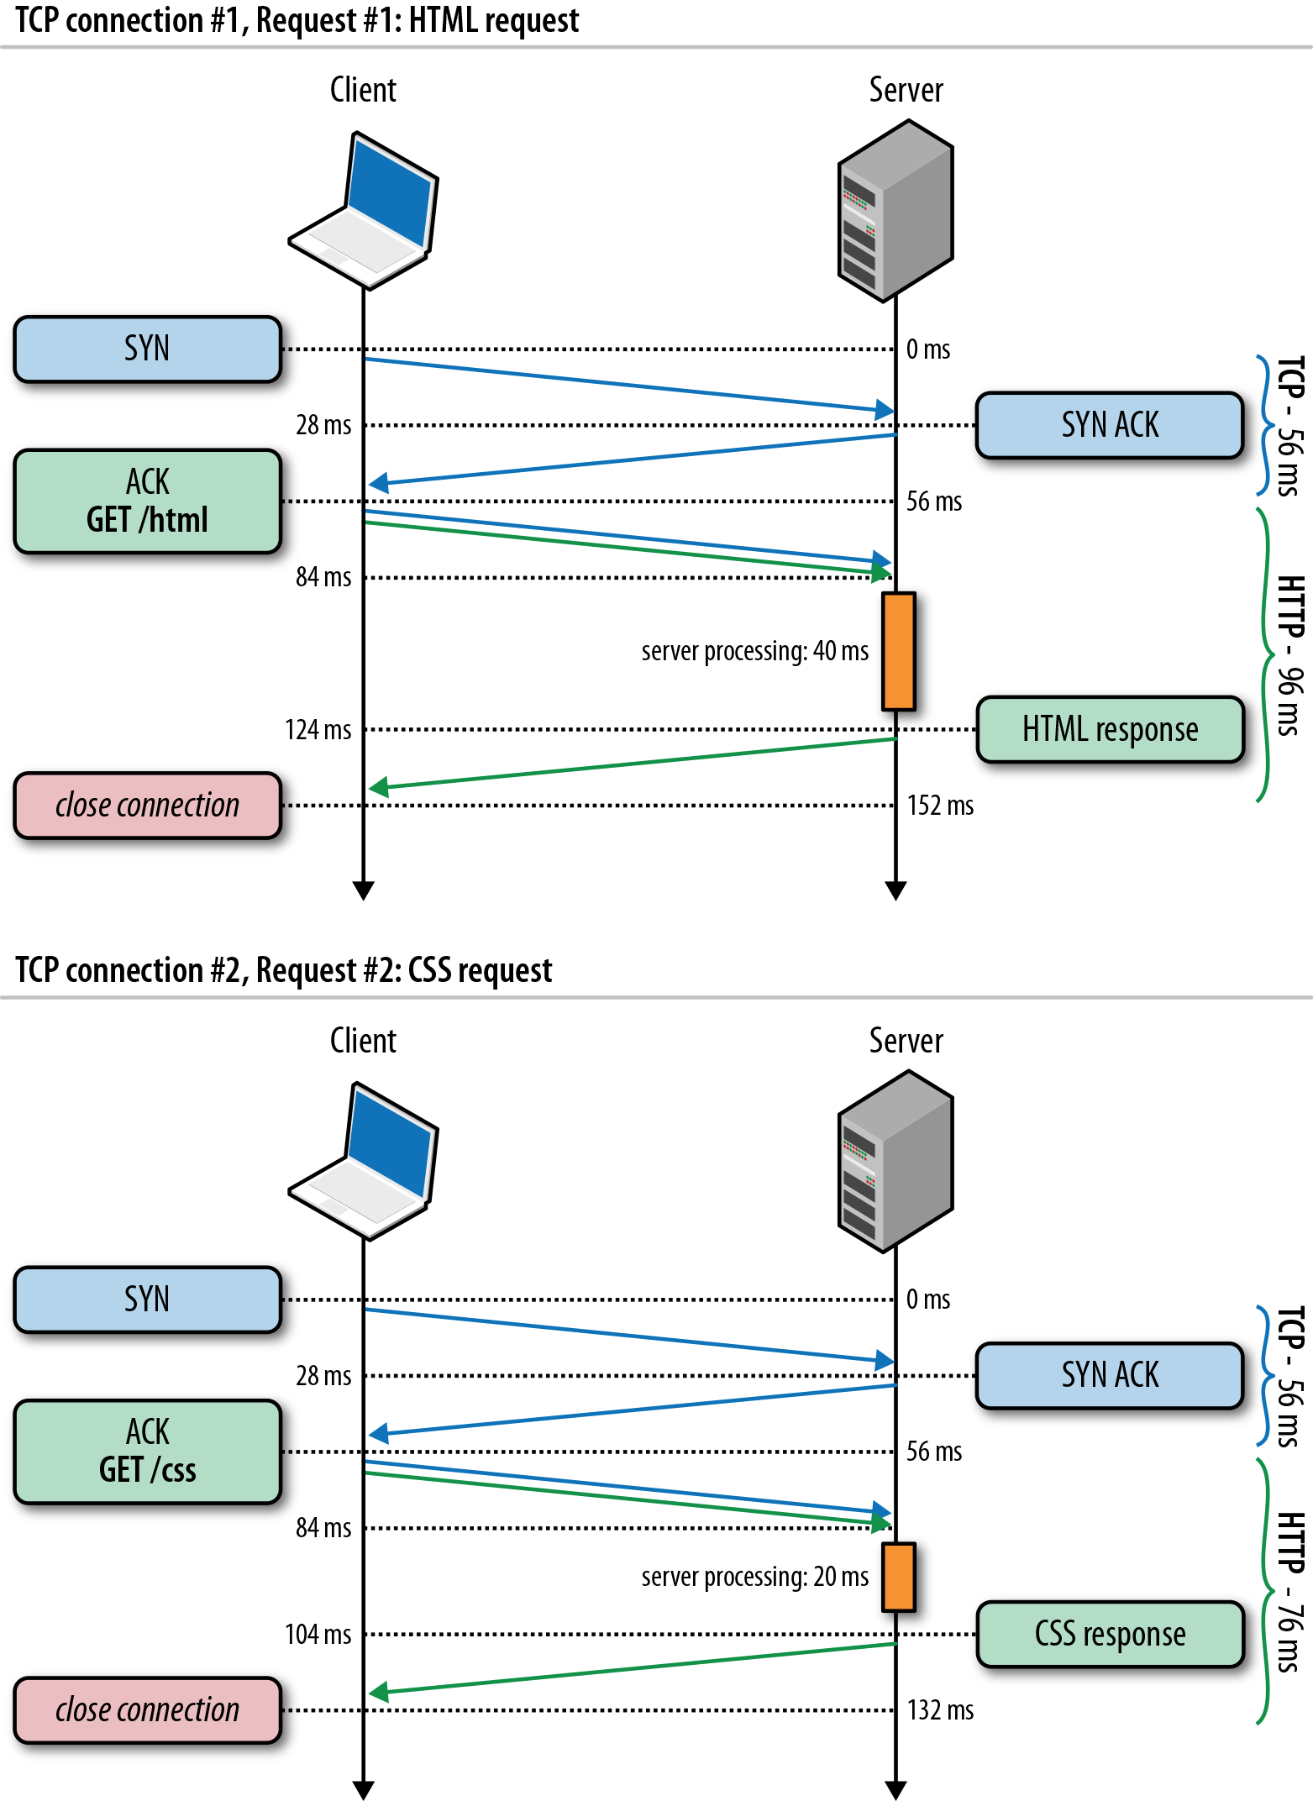
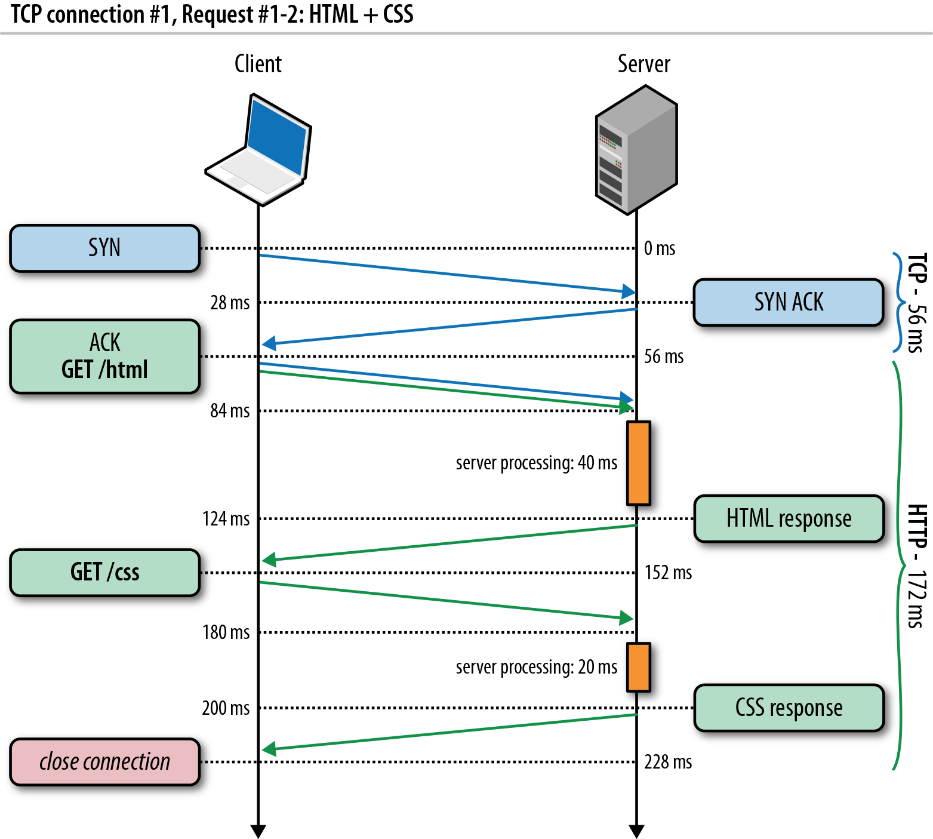
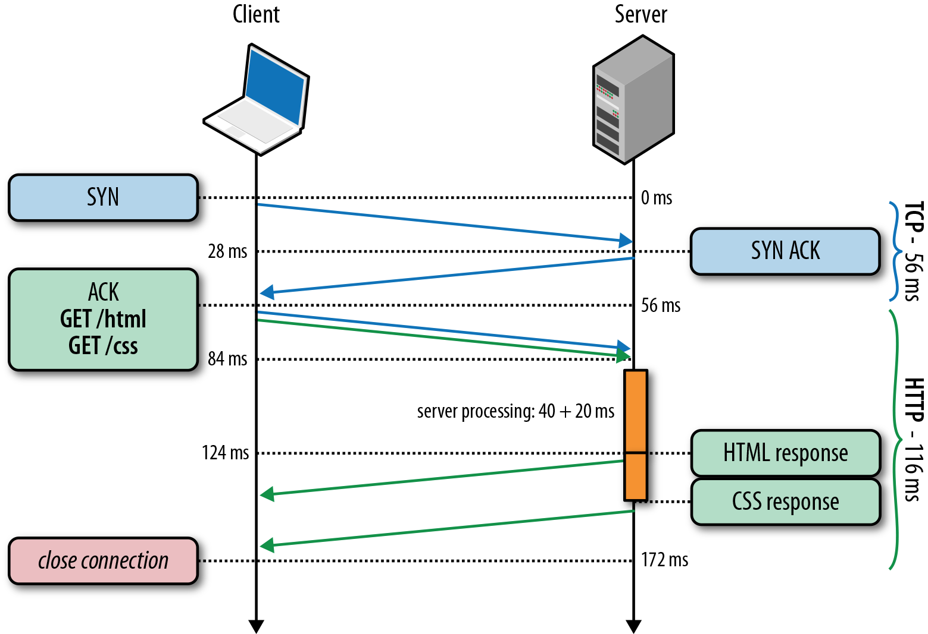
HTTP/1.0, Keep-Alive, Pipelining
Is this the best we can do?
Source: http://chimera.labs.oreilly.com/books/1230000000545/ch11.html
Notes:
https://httpd.apache.org/docs/2.2/howto/ssi.html

Slide 44
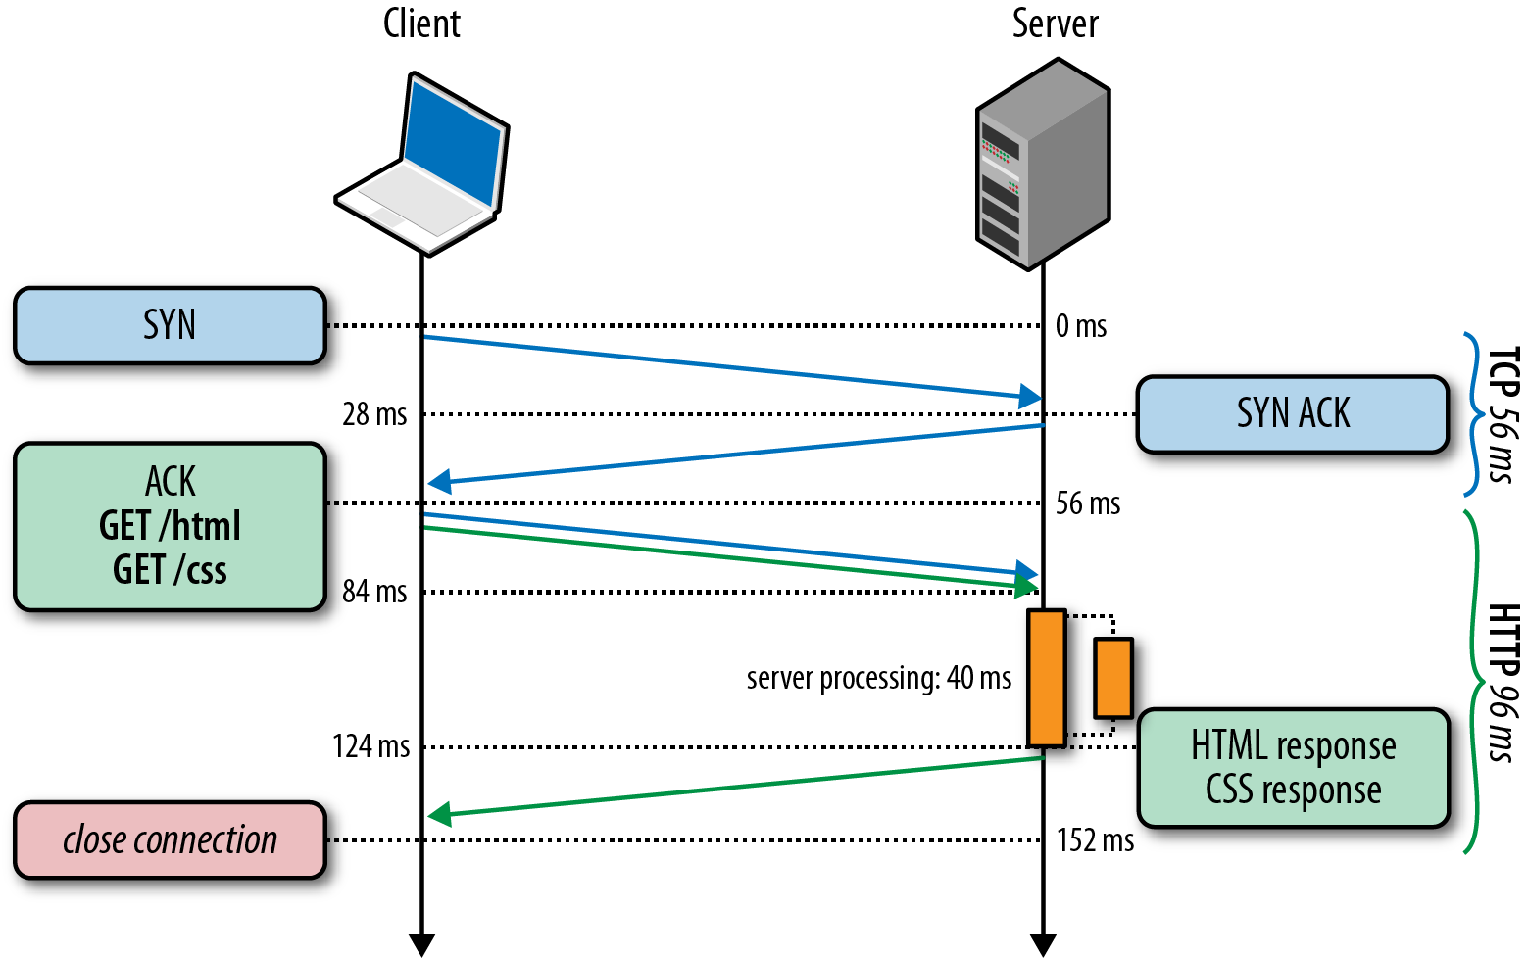
HTTP/2 Basic Idea: Remove Head-of-Line Blocking in HTTP/1.1
Data flows for sequential to parallel: two requests must be concurrent.
Demo: https://http2.akamai.com/demo
Source: http://chimera.labs.oreilly.com/books/1230000000545/ch11.html
Notes:
https://httpd.apache.org/docs/2.2/howto/ssi.html

Slide 45
Observing HTTP/2
export SSLKEYLOGFILE=/tmp/keylog.txt
Start Chrome, e.g.,
Mac: /Applications/Google Chrome.app/Contents/MacOS/Google Chrome
Ubuntu: firefox
Visit HTTP/2 pages, such as https://www.tmall.com
Wireshark:
Mac: Wireshark -> preferences -> protocol -> TSL
(pre)-master-secret log file name
Ubuntu: edit -> perferences -> protocol -> SSL
(pre)-master-secret log file name

Slide 46
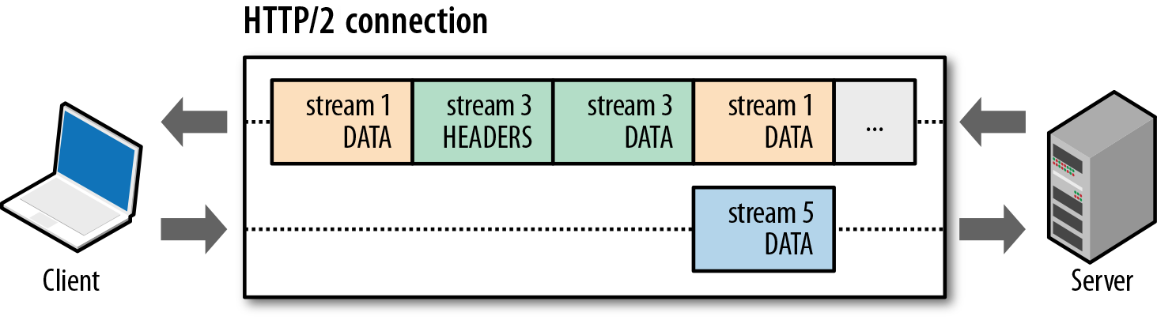
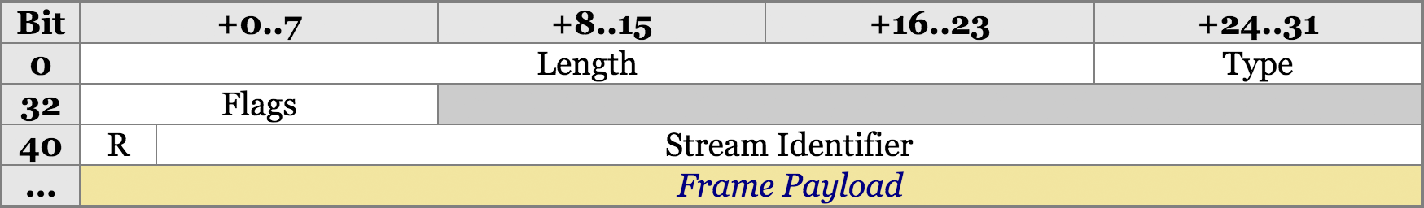
HTTP/2 Design: Multi-Streams
HTTP/2 Binary Framing
https://hpbn.co/http2/
https://tools.ietf.org/html/rfc7540

Slide 47
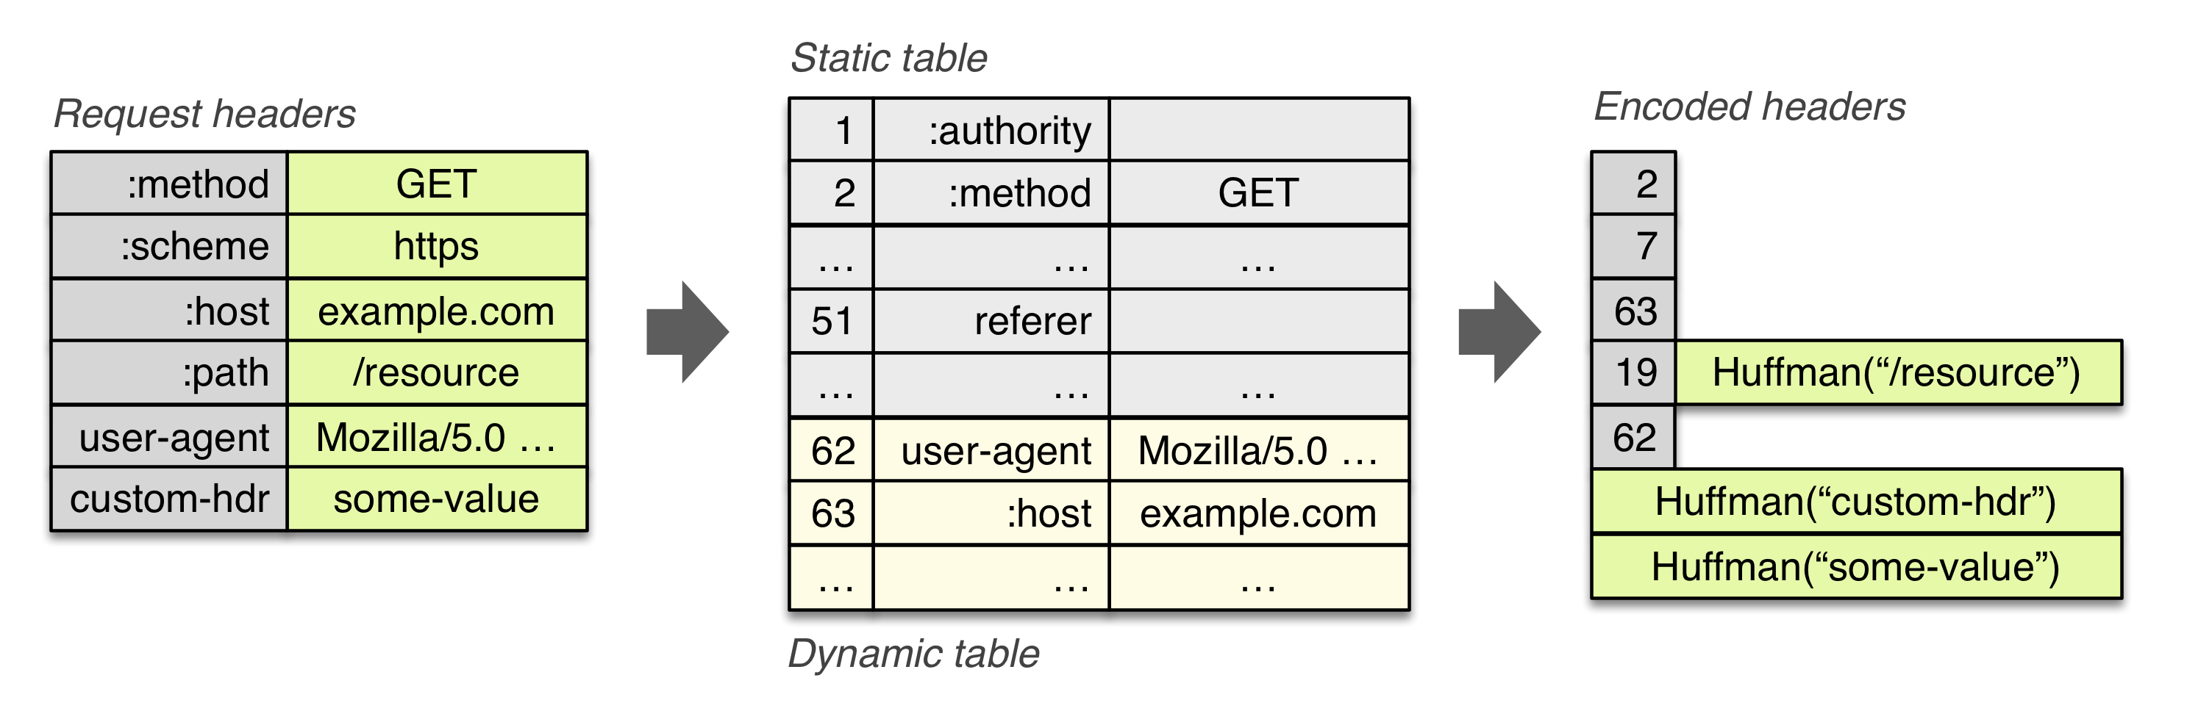
HTTP/2 Header Compression

Slide 48
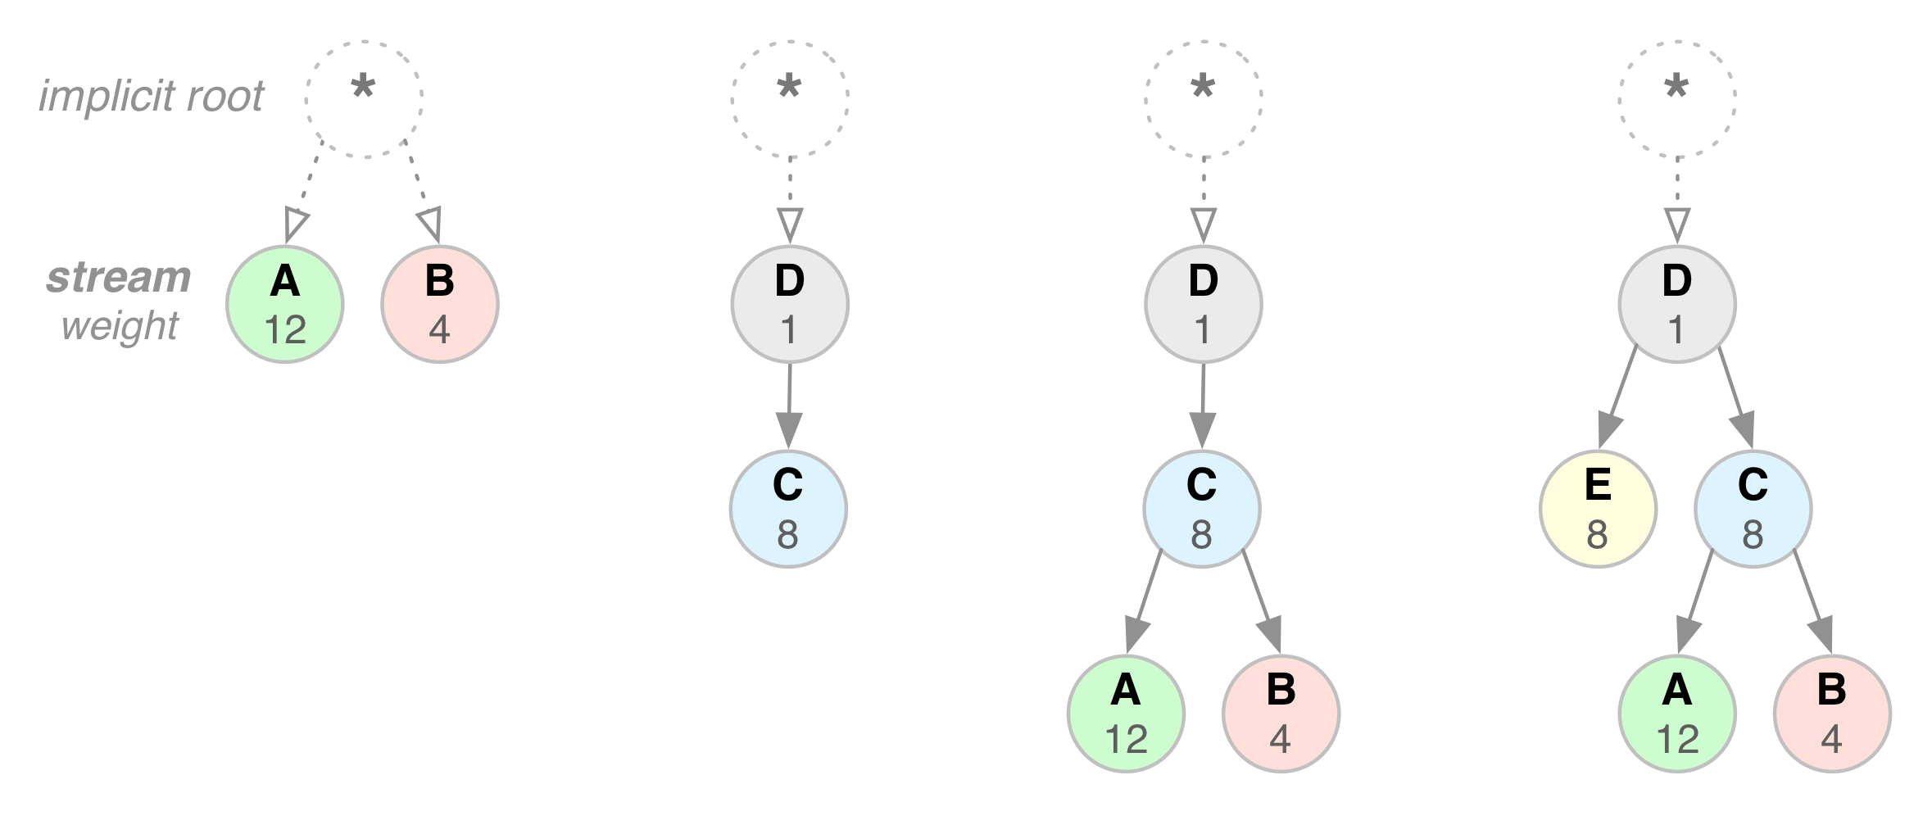
HTTP/2 Stream Dependency and Weights

Slide 49
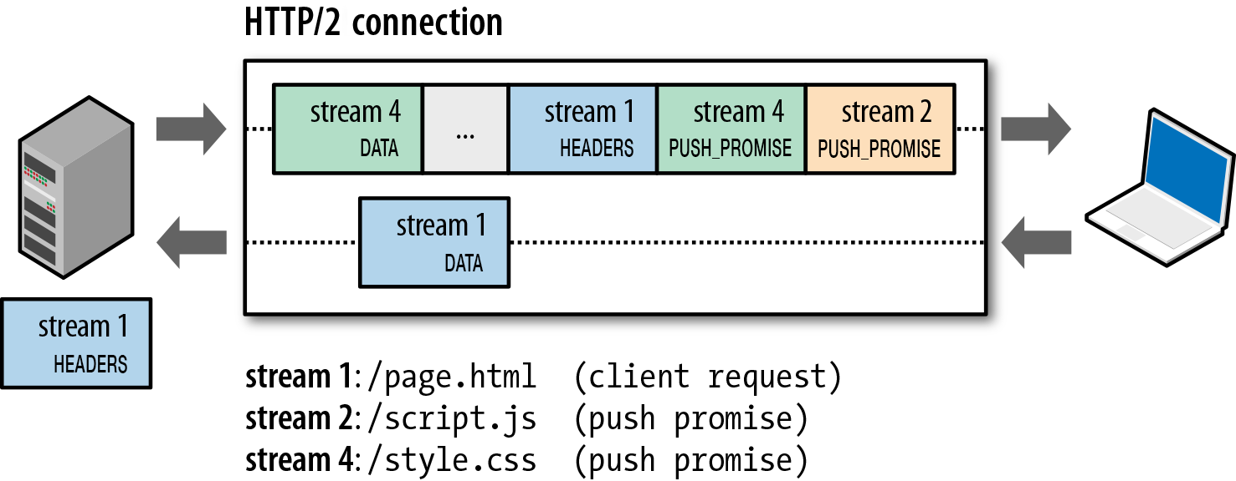
HTTP/2 Server Push

Slide 50
Outline
Admin and recap
HTTP/1.0
HTTP “acceleration”
Operational analysis

Slide 51
Goal: Best Server Design Limited Only by Resource Bottleneck
CPU
DISK
Before
NET
CPU
DISK
After
NET

Slide 52
Some Questions
When is CPU the bottleneck for scalability?
So that we need to add helper threads
How do we know that we are reaching the limit of scalability of a single machine?
These questions drive network server architecture design
Some basic performance analysis techniques are good to have

Slide 53
Outline
Admin and recap
High performance servers
Thread design
Asynchronous design
Operational analysis

Slide 54
Operational Analysis
Relationships that do not require any assumptions about the distribution of service times or inter-arrival times
Hence focus on measurements
Identified originally by Buzen (1976) and later extended by Denning and Buzen (1978).
We touch only some techniques/results
In particular, bottleneck analysis
More details see linked reading

Slide 55

Background: Little’s Law (1961)
For any system with no or (low) loss.
Assume
mean arrival rate λ, mean time R at system, and mean number Q of requests at system
Then relationship between Q, λ, and R:
R, Q
λ
Example: XMU admits 3000 students each year, and mean time a student stays is 4 years, how many students are enrolled?
Notes:
Proof of Little’s Law:

Slide 56
Little’s Law: Proof
arrival
A
3
2
1
t
time

Slide 57
Under the Hood (An example FSM)
exit
(throughput λ until some
center saturates)
start (arrival rate λ)
CPU
I/O request
File I/O
network
Memory cache

Slide 58
Operational Analysis: Resource Demand of a Request
CPU
V_{CPU} visits for S_{CPU} units of resource time per visit
Network
V_{Net} visits for S_{Net} units of resource time per visit
Disk
V_{Disk} visits for S_{Disk} units of resource time per visit
Memory
V_{Mem} visits for S_{Mem} units of resource time per visit

Slide 59
Operational Quantities
T: observation interval Ai: # arrivals to device i
Bi: busy time of device i Ci: # completions at device i
i = 0 denotes system

Slide 60
Utilization Law
The law is independent of any assumption on arrival/service process
Example: Suppose NIC processes 125 pkts/sec, and each pkt takes 2 ms. What is utilization of the network NIC?

Slide 61
Deriving Relationship Between R, U, and S for one Device
Assume flow balanced (arrival=throughput), Little’s Law:
Assume PASTA (Poisson arrival--memory-less arrival--sees time average), a new request sees Q ahead of it, and FIFO
According to utilization law, U = XS

Slide 62
Forced Flow Law
Assume each request visits device i Vi times

Slide 63
Bottleneck Device
Define Di = Vi Si as the total demand of a request on device i
The device with the highest Di has the highest utilization, and thus is called the bottleneck

Slide 64
Bottleneck vs System Throughput

Slide 65
Example 1
A request may need
10 ms CPU execution time
1 Mbytes network bw
1 Mbytes file access where
50% hit in memory cache
Suppose network bw is 100 Mbps, disk I/O rate is 1 ms per 8 Kbytes (assuming the program reads 8 KB each time)
Where is the bottleneck?

Slide 66
Example 1 (cont.)
CPU:
D_{CPU}=
Network:
D_{Net} =
Disk I/O:
Ddisk =
10 ms ( e.q. 100 requests/s)
1 Mbytes / 100 Mbps = 80 ms (e.q., 12.5 requests/s)
0.5 * 1 ms * 1M/8K = 62.5 ms (e.q. = 16 requests/s)

