Slide 1


Lab Assignment Five :
Reliable Transport and Congestion Control
Computer Networks and Network Security
Yangfan Huang, Haoyu Liu, Zhihao Zhang
2021.11. 25

Slide 2
Assignment Requirements
Tool: Fishnet (Based on the Modified Fishnet)
Design and Implement a Protocol for Reliable Transport, Flow Control and Congestion Control
Part 1: Reliability Transport
Part 2: Flow Control and Congestion Control (Optional for a 2-Person Project)
2

Slide 3
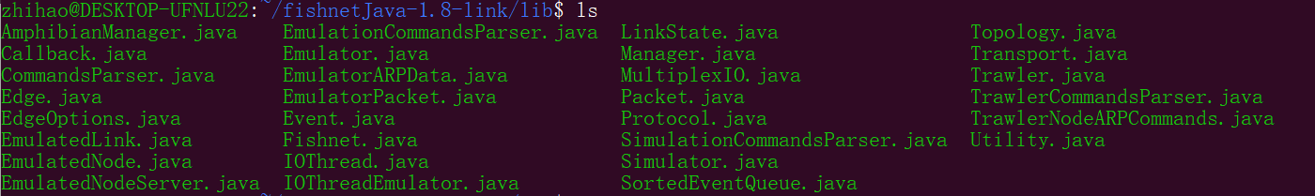
Fishnet
Network protocol simulator & emulator
Network topology (.topo) for emulator
Simulation script (.fish) for simulator
trawler.pl: emulation coordinator
fishnet.pl: interactive node emulation
Under directory proj/
These files are modifiable by students
Under directory lib/
Do NOT modify files under lib/
3

Slide 4
Fishnet - Link Model
two.topo without limited buffering and loss characteristics of physical links.
two.topo with limited buffering and loss characteristics of physical links.
The unit used in the "edge" command to specify bandwidth ("bw") has been changed to "B/s", instead of "KB/s".
The "edge" command now supports an additional option "bt", which specifies the buffering capacity of the edge, in terms of buffering time in milliseconds.
The simulator/emulator will, on exit, print out statistics about dropped packets (due to buffer overflow) and lost packets (due to loss).
4

Slide 5
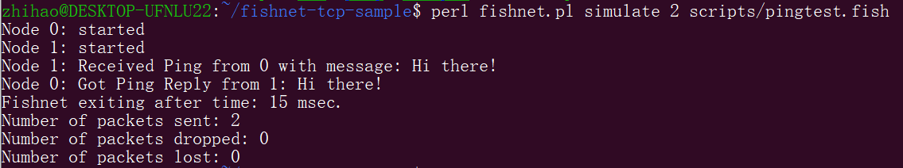
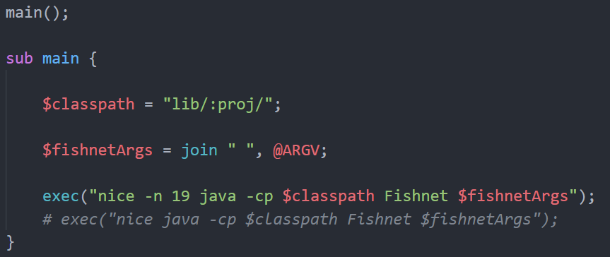
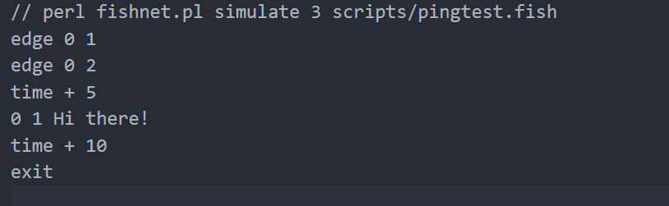
Fishnet Quick Start - Simulator
Run a simple example with ping in the simulator
fishnet.pl
pingtest.fish
5

Slide 6
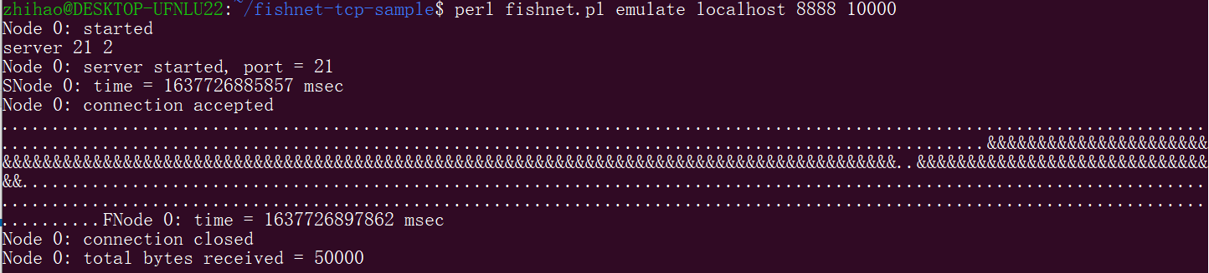
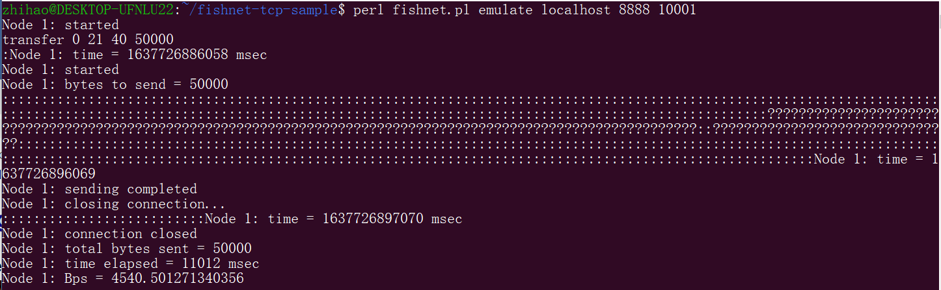
Fishnet Quick Start - Emulator
Run two nodes in the emulator with two.topo
6

Slide 7
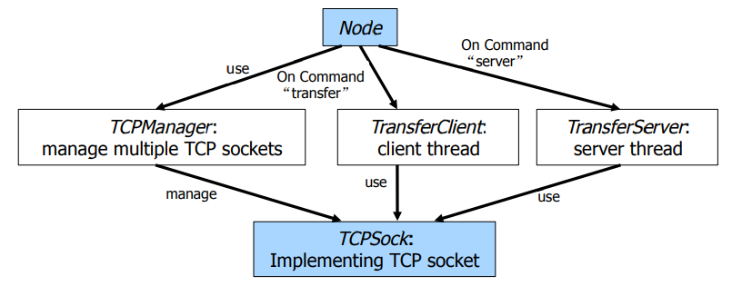
Design Sketch of Fishnet
TCPManager.java:
creates a new socket and handles connection that involves more than one socket.
TCPSock.java:
defines APIs that handles operations on a single socket,
7

Slide 8
Transfer: Client-Server
Transfer Client
Transfer Server
connection
(manager、node、sock、amount)
(manager、node、serverSock)
sock.isConnectionPending() / sock.isConnected()
!serverSock.isClosed()
Sending from buf
accept()
TransferWorker work():
server for the new connection;
when amount=0, close();
initiate closeure of connection
error: release();
close the socket immediately
Receiving
8

Slide 9
Connection Setup/Tear-down
Modify the files under directory proj/:
TCPSock.java: get the socket APIs of TCP transport service
Server
bind(): bind a socket to the port
TCPSock sock = tcpMan.getLocalSock(localAddr, localPort);
Port
Port
listen(): listen for the connection on a socket
accept(): accept a connection on a socket
connect(): initiate connection to a remote socket
write()
read()
Port
Port
close(): graceful shutdown
release(): shutdown immediately
Client
9

Slide 10
Transfer: Client-Server
Each payload packet should be transmitted reliably by using sequence/acknowledgment number field.
TCPSock.java: Use ACK
client
server
SYN
Syn.getSeqNum()
receiveSYN()
send an ACK:
rcv_wnd = rcv_top-rcv_base
tcpMan.send()
receiveACK():
snd_base = ackNum;
If state != ESTABLISHED,
ACKs in wrong states,
print “?” then discard;
ACK
ackNum=
ack.getSequm()+1
10

Slide 11
Reliable Transfer(1)
TCPSock.java
Define OnReceive() to progress a newly arrived TCP segment:
receiveSYN()
Print “S”
SYN
FIN
receiveFIN()
Print “F”
segment.getType()
ACK
receiveACK()
Print “?”/“:”
DATA
receiveDATA()
Print “.”/“&”
Based on these letter codes, we can trace the progess of the transfer.
11

Slide 12
Reliable Transfer(2)
Each payload packet should be transmitted reliably by using timeouts and retransmissions.
TCPSock.java :
Set RTO as the time interval (milliseconds)
Time
client
server
DATA
Lost
RTO
RTO changes dynamically
retransmit(seqNum)
print “!”
ACK
12

Slide 13
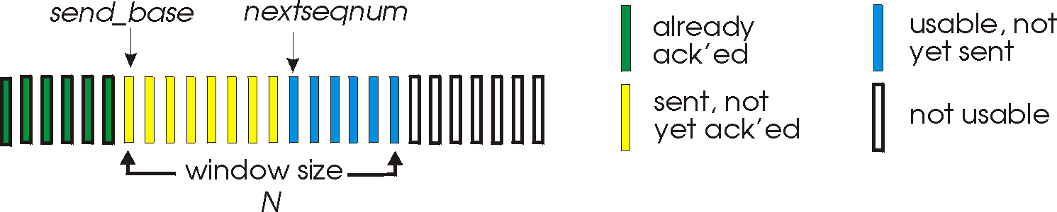
Flow Control: Sliding Window
TCPSock.java: fixed-size sliding window
Set snd_rcvWnd which represents the receiver’s advertised window in bytes.
Write():
avail = buf.length – cwnd;
cnt =min(avail, len);
int seq = snd_next;
snd_next += cnt;
send_top
cwnd
13

Slide 14
Congestion Control: Reno
TCPSock.java
Set the congestion window size in MSS: snd_cwnd.
Set the slow start threshold in MSS: snd_ssthresh.
Set the window size in bytes: snd_wnd.
Get these initial values from TCPManager.
Modified in receiveACK().
14

Slide 15
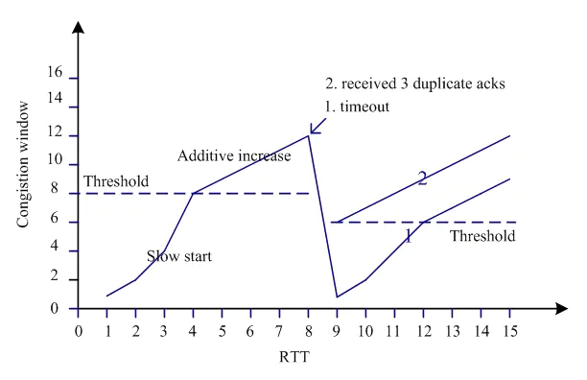
Congestion Control: Reno
TCPSock.java: receiveACK()
if (snd_cwnd < snd_ssthresh)
congestion
avoidance
snd_cwnd+=acked
set dup_ack
fast retransmission
snd_cwnd = snd_ssthresh = Math.max(snd_cwnd / 2, 1)
15

Slide 16
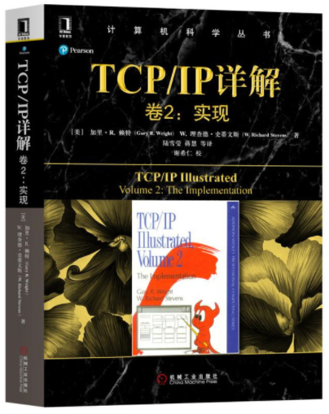
Notes
Run a two-node fishnet emulation on your own host and perform a reliable transfer of at least 100 packets. Capture the output (from both the sending node and the receiving node) and mark it up to tell us what is going on.
You submission should include:
A brief design document.
A document containing any output we have asked you to capture.
Short answers to the discussion questions below: Diss1a, Diss1b, and Diss1c for Part 1; Diss2 for the Part 2 if you are doing it as a project.
Please generate a single tar or zip file containing all of your files. Please contact the TA (zhihao AT stu.xmu.edu.cn) in time if you encounter problems.
16

Slide 17
Thank you!

