Slide 1
Network Transport Layer: TCP/Reno Analysis, TCP Cubic, TCP/Vegas
Qiao Xiang
https://qiaoxiang.me/courses/cnns-xmuf22/index.shtml
11/08/2022
This deck of slides are heavily based on CPSC 433/533 at Yale University, by courtesy of Dr. Y. Richard Yang.

Slide 2
Admin.
Lab 3 due today
By email to the TA
Midterm exam: 2:30-4:10pm, Nov. 10

Slide 3
Recap: Transport Design
Basic structure/reliability: sliding window protocols
Determine the “right” parameters
Timeout
mean + variation
Sliding window size
Related w/ congestion control or more generally resource allocation
Bad congestion control can lead to congestion collapse (e.g., zombie packets)
Goals: distributed algorithm to achieve fairness and efficiency

Slide 4
congestion
x₀
x₀
efficiency
efficiency: distributed linear rule
x₀
x₀
fairness
intersection

Slide 5
no-congestion
x₀
x₀
efficiency
efficiency: distributed linear rule
x₀
x₀
fairness
convergence

Slide 6
Mapping A(M)I-MD to Protocol
Basic questions to look at:
How to obtain d(t)--the congestion signal?
What values do we choose for the formula?
How to map formula to code?
Notes:
Implement d(t): loss/delay
Adjust window size
b_D: exponential backoff timeout after window size is 1

Slide 7
Obtain d(t) Approach 1: End Hosts Consider Loss as Congestion
Packets
1
2
3
4
5
6
7
Acknowledgements (waiting seq#)
2
3
4
4
4
4
Pros and Cons of endhosts using loss as congestion?
Assume loss => cong

Slide 8


Obtain d(t) Approach 2: Network Feedback (ECN: Explicit Congestion Notification)
Sender reduces rate if ECN received.
Pros and Cons of ECN?
Sender 1
Receiver bounces marker back to sender in ACK msg
Receiver
Sender 2
Network marks ECN Mark (1 bit) on pkt according to local condition, e.g., queue length > K

Slide 9
Mapping A(M)I-MD to Protocol
Basic questions to look at:
How to obtain d(t)--the congestion signal?
What values do we choose for the formula?
How to map formula to code?
Notes:
Implement d(t): loss/delay
Adjust window size
b_D: exponential backoff timeout after window size is 1

Slide 10
TCP/Reno Formulas
Multiplicative Increase (MI)
double the rate: x(t+1) = 2 x(t)
Additive Increase (AI)
Linear increase the rate: x(t+1) = x(t) + 1
Multiplicative decrease (MD)
half the rate: x(t+1) = 1/2 x(t)

Slide 11
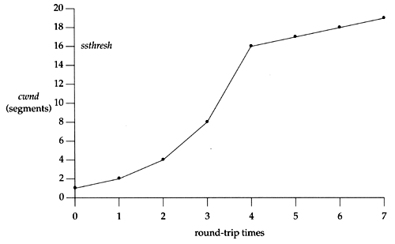
TCP/Reno Formula Switching (Control Structure)
Two “phases”
slow-start
Goal: getting to equilibrium gradually but quickly, to get a rough estimate of the optimal of cwnd
Formula: MI
congestion avoidance
Goal: Maintains equilibrium and reacts around equilibrium
Formula: AI MD

Slide 12
TCP/Reno Formula Switching (Control Structure)
Important variables:
cwnd: congestion window size
ssthresh: threshold between the slow-start phase and the congestion avoidance phase
If cwnd < ssthresh
MI
Else
AIMD
Notes:
AI: increases window by 1 per round
MD: cuts window size
to half when detecting congestion by 3DUP
to 1 if timeout
if already timeout, doubles timeout

Slide 13
MI: Slow Start
Algorithm: MI
double cwnd every RTT until network congested
Goal: getting to equilibrium gradually but quickly, to get a rough estimate of the optimal of cwnd

Slide 14
MI: Slow-start
Initially:
cwnd = 1;
ssthresh = infinite (e.g., 64K);
For each newly ACKed segment:
if (cwnd < ssthresh)
/* MI: slow start*/
cwnd = cwnd + 1;
cwnd = 1
segment 1
ACK for segment 1
cwnd = 2
segment 2
segment 3
ACK for segments 2 + 3
cwnd = 4
segment 4
segment 5
segment 6
segment 7
cwnd = 6
cwnd = 8

Slide 15
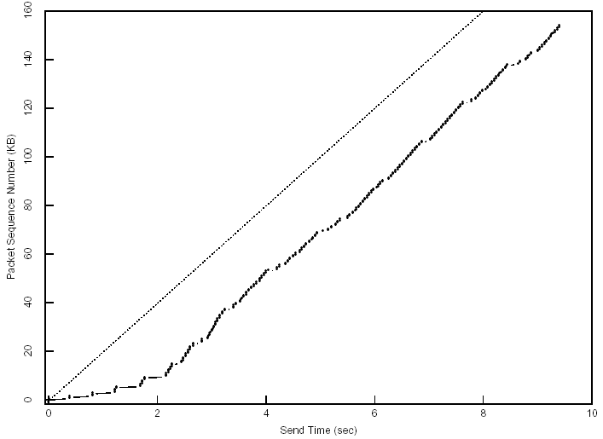
Startup Behavior with Slow-start
See [Jac89]

Slide 16
AIMD: Congestion Avoidance
Algorithm: AIMD
increases window by 1 per round-trip time (how?)
cuts window size
to half when detecting congestion by 3DUP
to 1 if timeout
if already timeout, doubles timeout
Goal: Maintains equilibrium and reacts around equilibrium

Slide 17
TCP/Reno Full Alg
Initially:
cwnd = 1;
ssthresh = infinite (e.g., 64K);
For each newly ACKed segment:
if (cwnd < ssthresh) // slow start: MI
cwnd = cwnd + 1;
else
// congestion avoidance; AI cwnd += 1/cwnd;
Triple-duplicate ACKs:
// MD
cwnd = ssthresh = cwnd/2;
Timeout:
ssthresh = cwnd/2; // reset
cwnd = 1;
(if already timed out, double timeout value; this is called exponential backoff)

Slide 18
TCP/Reno: Big Picture
cwnd
TD
TD
TD
TO
ssthresh
ssthresh
ssthresh
ssthresh
Time
slow
start (MI)
congestion
avoidance (AIMD)
congestion
avoidance
congestion
avoidance
slow
start
congestion
avoidance
TD: Triple duplicate acknowledgements
TO: Timeout

Slide 19
Outline
Admin and recap
Transport congestion control
what is congestion (cost of congestion)
basic congestion control alg.
TCP/Reno congestion control
design
analysis

Slide 20
Objective
To understand
the throughput of TCP/Reno as a function of RTT (RTT), loss rate (p) and packet size
the underlying queue dynamics
We will analyze TCP/Reno under two different setups

Slide 21
TCP/Reno Throughput Analysis
Given mean packet loss rate p, mean round-trip time RTT, packet size S
Consider only the congestion avoidance mode (long flows such as large files)
Assume no timeout
Assume mean window size is W_{m} segments, each with S bytes sent in one RTT:
W_{m} * S
Throughput =
bytes/sec
RTT

Slide 22
Outline
Admin and recap
Transport congestion control
what is congestion (cost of congestion)
basic congestion control alg.
TCP/Reno congestion control
design
analysis
small fish in a big pond
loss rate given from the environment

Slide 23
TCP/Reno Throughput Modeling (Fixed, Given Loss Rate)
=>
=>
This is called the TCP throughput sqrt of loss rate law.

Slide 24
Exercise: Application of Analysis
State of art network link can reach 100 Gbps. Assume packet size 1250 bytes, RTT 100 ms, what is the highest packet loss rate to still reach 100 Gbps?
tcp-reno-tput.xlsx

Slide 25
Outline
Admin and recap
Transport congestion control
what is congestion (cost of congestion)
basic congestion control alg.
TCP/Reno congestion control
design
analysis
small fish in a big pond
big fish in small pond
growth causes losses

Slide 26
TCP/Reno Throughput Modeling: Relating W with Loss Rate p
cwnd
TD
W
ssthresh
W/2
Time
congestion
avoidance
Total packets sent per cycle = (W/2 + W)/2 * W/2 = 3W²/8
Assume one loss per cycle
=> p = 1/(3W²/8) = 8/(3W²)
=>

Slide 27
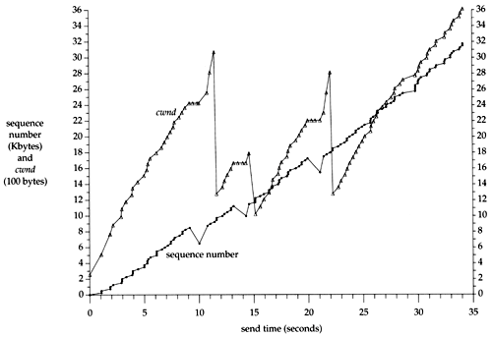
A Puzzle: cwnd and Rate of a TCP Session
Question: although cwnd fluctuates widely (i.e., cut to half), why can the sending rate stay relatively smooth?

Slide 28
TCP/Reno Queueing Dynamics
cwnd
filling buffer
TD
bottleneck
bandwidth
ssthresh
draining buffer
Time
congestion
avoidance
If the buffer at the bottleneck is large enough, the buffer is never empty (not idle), during the cut-to-half to “grow-back” process.
Exercise: How big should the buffer be to achieve full utilization?

Slide 29
Extreme: Zero Buffer
Assume
BW: 10 G
RTT: 100 ms
Packet: 1250 bytes
BDP (full window size): 100,000 packets
A loss can cut window size from 100,000 to 50,000 packets
To fully grow back
Need 50,000 RTTs => 5000 seconds, 1.4 hours
Q: What is the link utilization in one cycle?

Slide 30
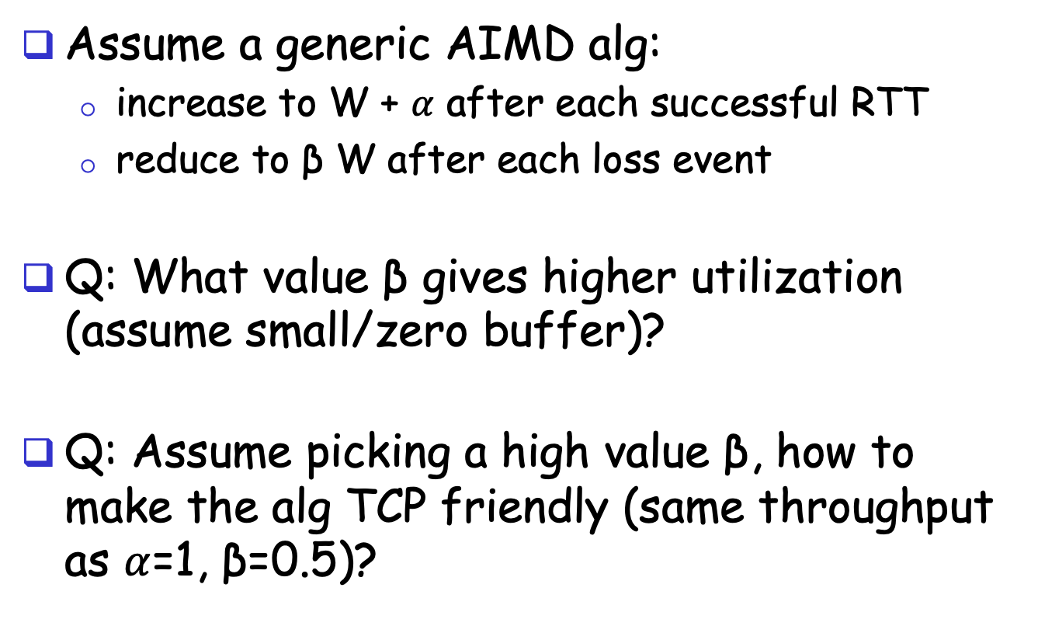
Design
Assume a generic AIMD alg:
increase to W + $α$ after each successful RTT
reduce to β W after each loss event
Q: What value β gives higher utilization (assume small/zero buffer)?
Q: Assume picking a high value β, how to make the alg TCP friendly (same throughput as $α$=1, β=0.5)?

Slide 31
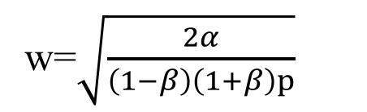

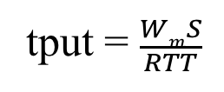
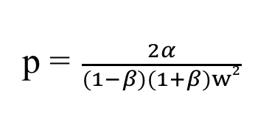

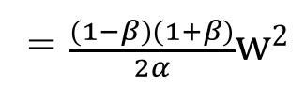
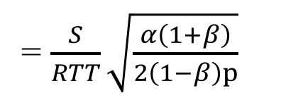

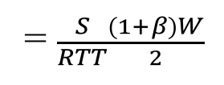
Generic AIMD and TCP Friendliness
cwnd
TD
W
ssthresh
βW
Time
congestion
avoidance
Total packets sent per cycle =
$$\frac{βW+W}{2}$$
$$\frac{(1−β)W}{α}$$
=$\frac{(1−β)(1+β)}{2α}w2$
w=$\sqrt{\frac{2α}{\left(1−β\right)\left(1+β\right)p}}$
Assume one loss per cycle
p =$\frac{2α}{(1−β)(1+β)w2}$
tput = $\frac{WmS}{RTT}$
= $\frac{S}{RTT}\sqrt{\frac{α\left(1+β\right)}{2\left(1−β\right)p}}$
= $\frac{S}{RTT}\frac{(1+β)W}{2}$
TCP friendly =>
$$α=3 \frac{1−β}{1+β}$$

Slide 32
Outline
Admin and recap
Transport congestion control
what is congestion (cost of congestion)
basic congestion control alg.
TCP/Reno congestion control
TCP Cubic

Slide 33
TCP Cubic
Designed in 2008
Default for Linux
Most sockets in MAC appear to use cubic as well
sw_vers
sysctl –a

Slide 34
TCP Cubic Goals
Improve TCP efficiency over fast, long-distance links
TCP friendliness
Fairness of flows w/ different RTTs
Smaller reduction, longer stay at BDP, faster than linear increase---cubic function
Follows TCP if TCP gives higher rate
Window growth depends on real-time (from congestion- epoch through synchronized losses)

Slide 35
TCP BIC Algorithm
cwnd
TD
TD
TD
TD
Wmax
W_{m}
Wmin
CA
CA
CA
CA
Time
Setting
W_{max} = cwnd size before reduction
Too big
W_{min} = β*W_{max} – just after reduction, where β is multiplicative decrease factor
Small
Basic idea
binary search between W_{max} and W_{min}
35

Slide 36
TCP BIC Algorithm: Issues
cwnd
TD
TD
TD
TD
Wmax
W_{m}
Wmin
CA
CA
CA
CA
Time
Pure binary search (jump from W_{min} to (W_{max} and W_{min})/2) may be too aggressive
Use a large step size Smax
What if you grow above W_{max}?
Use binary growth (slow start) to probe more
36

Slide 37
TCP BIC Algorithm
Max Probing
W_{max} + 3S_{max}
Packet loss event
W_{max} + 2S_{max}
W_{max} +S_{max}
W_{max} + S_{min}
W_{max} + S_{min}
W_{min}
(midpoint – W_{min})< S_{min}
W_{max}
W_{min}
midpoint = (W_{min} + W_{max})/2
W_{min} + S_{min}
midpoint = (W_{min} + W_{max})/2
midpoint = (W_{min} + W_{max})/2
W_{min} + S_{max}
W_{min}
W_{min} + S_{max}
midpoint – W_{min} > S_{max}
W_{min} = β*W_{max}
Additive Increase
Binary Search
Slow Start
Additive Inc.
37

Slide 38
TCP BIC Algorithm
while (cwnd < Wmax) {
if ( (midpoint - Wmin) > Smax )
cwnd = cwnd + Smax
else
if ((midpoint - Wmin) < Smin)
cwnd = Wmax
else
cwnd = midpoint
if (no packet loss)
Wmin = cwnd
else
Wmin = β*cwnd
Wmax = cwnd
midpoint = (Wmax + Wmin)/2
}
Additive Increase
Binary Search
38

Slide 39
TCP BIC Algorithm: Probe
while (cwnd >= W_{max}){
if (cwnd < W_{max} + S_{max})
cwnd = cwnd + S_{min}
else
cwnd = cwnd + S_{max}
if (packet loss)
W_{min} = β*cwnd
W_{max} = cwnd
}
Slow growth
Fast growth
Max Probing
39

Slide 40
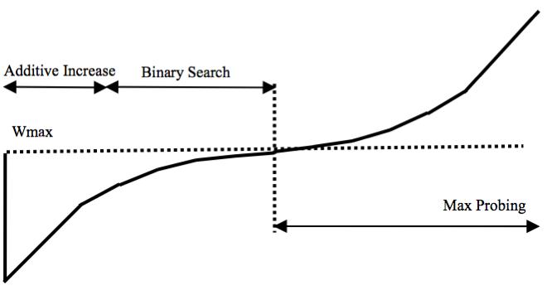
TCP BIC - Summary
Max Probing
+ S_{min}
+ S_{max}
Packet loss event
W_{max}
Time
+ S_{max}
jump to midpoint
Additive Increase
Binary Increase
Slow
Start
Additive Increase
40

Slide 41
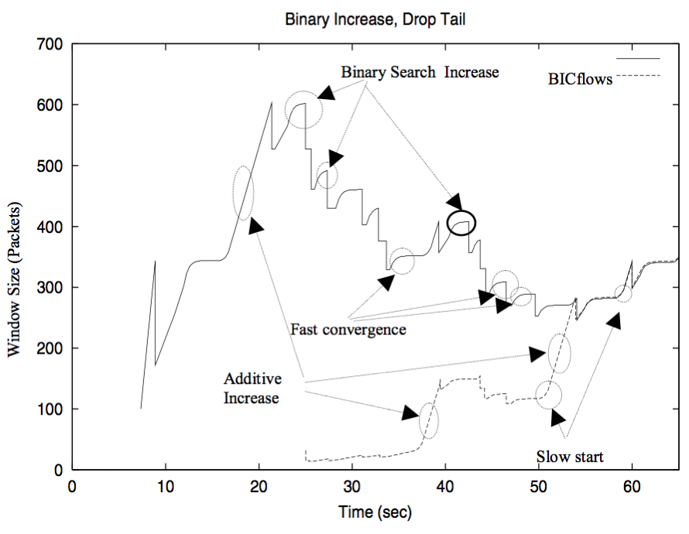
TCP BIC in Action
41

Slide 42
TCP BIC Analysis
Advantages
Faster convergence at large gap
Slower growth at convergence to avoid timeout
Issues
Still depend on RTT
Complex growth function
More details: http://www.land.ufrj.br/~classes/coppe-redes-2007/projeto/BIC-TCP-infocom-04.pdf

Slide 43
Cubic High-Level Structure
If (received ACK && state == cong avoid)
Compute W_{cubic}(t+RTT).
If cwnd < W_{TCP}
Cubic in TCP mode
If cwnd < Wmax
Cubic in concave region
If cwnd > Wmax
Cubic in convex region
43

Slide 44
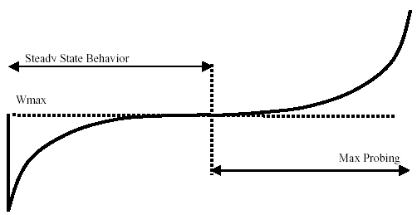


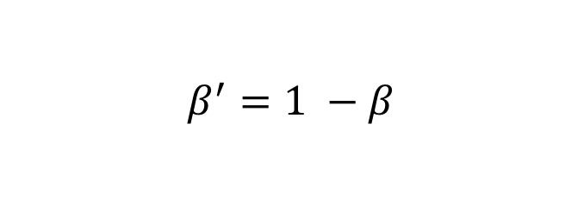
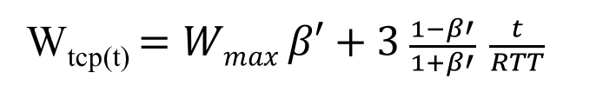
The Cubic function
$$β^{′}=1 −β$$
W_{tcp(t)} $=Wmax β′+3 \frac{1−β′}{1+β′} \frac{t}{RTT}$
convex region
slow down
concave region
where C is a scaling factor, t is the elapsed time from the last window reduction, and β is a constant multiplication decrease factor

Slide 45
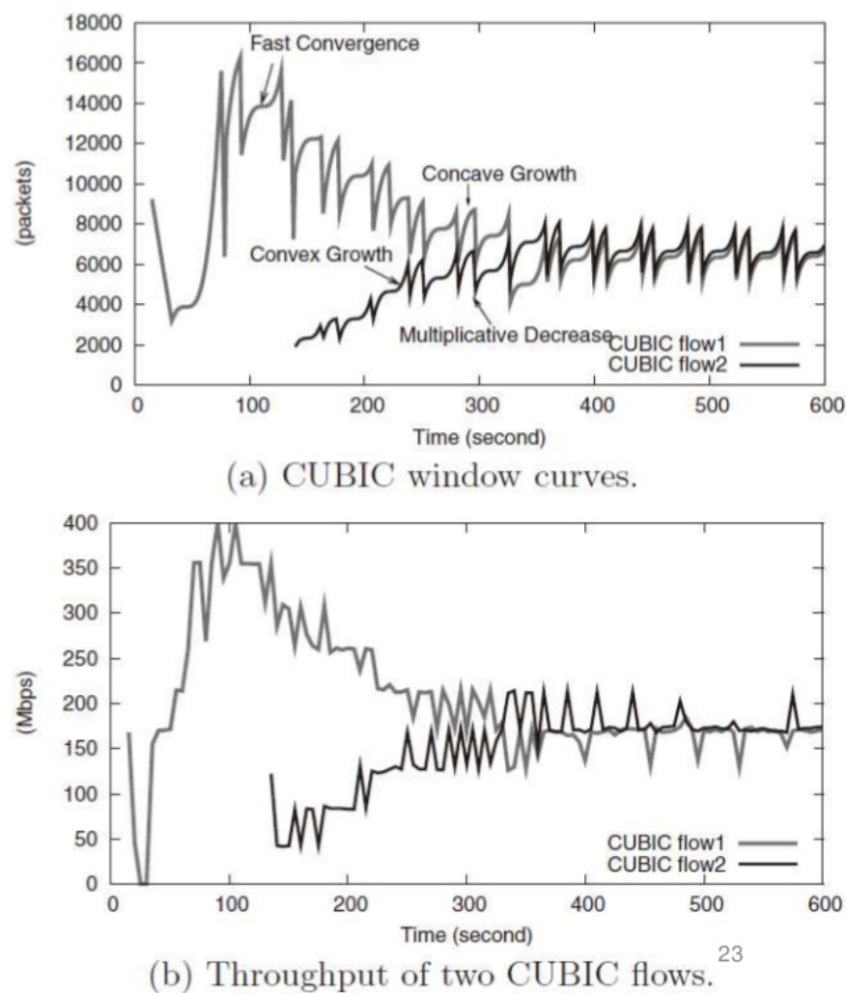

Slide 46
Outline
Admin and recap
Transport congestion control
what is congestion (cost of congestion)
basic congestion control alg.
TCP/Reno congestion control
TCP Cubic
TCP/Vegas

Slide 47
TCP/Vegas (Brakmo & Peterson 1994)
window
time
SS
CA
Idea: try to detect congestion by delay before loss
Objective: not to overflow the buffer; instead, try to maintain a constant number of packets in the bottleneck queue

Slide 48
TCP/Vegas: Key Question
How to estimate the number of packets queued in the bottleneck queue?
window
time
SS
CA

Slide 49

Recall: Little’s Law
For any system with no or (low) loss.
Assume
mean arrival rate X, mean service time T, and mean number of requests in the system W
Then relationship between W, X, and T:
T, W
X
Notes:
Proof of Little’s Law:

Slide 50
Estimating Number of Packets in the Queue

Slide 51
TCP/Vegas CA algorithm
T = T_{prop} + T_{queueing}
Applying Little’s Law:
x_{vegas} T = x_{vegas} T_{prop} + x_{vegas} T_{queueing}, where x_{vegas} = W / T is the sending rate
Then number of packets in the queue is x_{vegas} T_{queueing} = x_{vegas} T - x_{vegas} T_{prop}
= W – W/T T_{prop}

Slide 52
TCP/Vegas CA algorithm
window
maintain a constant number of packets in the bottleneck buffer
time
SS
CA
for every RTT
{ if W – W/RTT RTT_{min} < α then W ++
if W – W/RTT RTT_{min} > α then W -- }
for every loss
W := W/2
queue size

Slide 53
Discussions
If two flows, one TCP Vegas and one TCP reno run together, how may bandwidth partitioned among them?
Issues that limit Vegas deployment?

Slide 54
Outline
Admin and recap
Transport congestion control
what is congestion (cost of congestion)
basic congestion control alg.
TCP/Reno congestion control
TCP Cubic
TCP/Vegas
network wide resource allocation
general framework
54

Slide 55
Motivation
So far our discussion is implicitly on a network with a single bottleneck link; this simplifies design and analysis:
efficiency/optimality (high utilization)
fully utilize the bandwidth of the link
fairness (resource sharing)
each flow receives an equal share of the link’s bandwidth

Slide 56
Network Resource Allocation
It is important to understand and design protocols for a general network topology
how will TCP allocate resource in a general topology?
how should resource be allocated in a general topology?

Slide 57
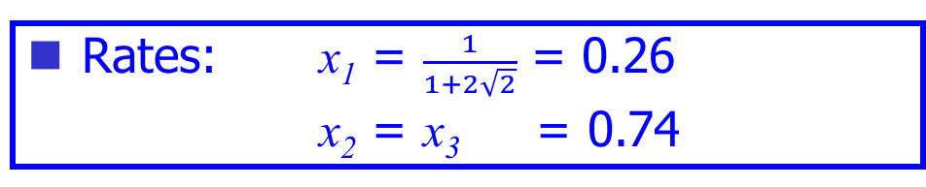
Example: TCP/Reno Rates
Rates: x₁ = $\frac{1}{1+2\sqrt{2}}$ = 0.26
x₂ = x₃ = 0.74
x₁
C= 1
C = 1
x₂
x₃

Slide 58
Example: TCP/Vegas Rates
Rates : x₁ = 1/3
x₂ = x₃ = 2/3
x₁
C= 1
C = 1
x₂
x₃

Slide 59

Example: Max-min Fairness
Max-min fairness: maximizes the throughput of the flow receiving the minimum (of resources)
Justification: John Rawls, A Theory of Justice (1971)
http://en.wikipedia.org/wiki/John_Rawls
This is a resource allocation scheme used in ATM and some other network resource allocation proposals
59

Slide 60
Example: Max-Min
Rates: x₁ = x₂ = x₃ = 1/2
x₁
C= 1
C = 1
x₂
x₃

Slide 61
Framework: Network Resource Allocation Using Utility Functions
A set of flows F
Let x_{f} be the rate of flow f, and the utility to flow f is U_{f}(x_{f}).
Maximize aggregate utility, subject to capacity constraints

Slide 62

Example: Maximize Throughput
$$Uf\left(xf\right)=xf$$
Optimal: x₁ = 0
x₂ = x₃ = 1
x₁
C= 1
C = 1
x₂
x₃

Slide 63
Example: Proportional Fairness
Optimal: x₁ = 1/3
x₂ = x₃ = 2/3
x₁
C= 1
C = 1
x₂
x₃

Slide 64
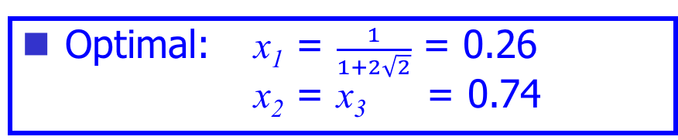
Example 3: a “Funny” Utility Function
Optimal: x₁ = $\frac{1}{1+2\sqrt{2}}$ = 0.26 x₂ = x₃ = 0.74
x₁
C= 1
C = 1
x₂
x₃

Slide 65
Summary: Allocations
Objective | Allocation (x1, x2, x3)
TCP/Reno | 0.26 | 0.74 | 0.74
TCP/Vegas | 1/3 | 2/3 | 2/3
Max Throughput | 0 | 1 | 1
Max-min | ½ | ½ | ½
Max sum log(x) | 1/3 | 2/3 | 2/3
Max sum of -1/(RTT² x) | 0.26 | 0.74 | 0.74
x₁
C= 1
C = 1
x₂
x₃

Slide 66
Questions
Forward engineering: systematically
design objective function
design distributed alg to achieve objective
Science/reverse engineering: what do TCP/Reno, TCP/Vegas achieve?
Objective | Allocation (x1, x2, x3)
TCP/Reno | 0.26 | 0.74 | 0.74
TCP/Vegas | 1/3 | 2/3 | 2/3
Max throughput | 0 | 1 | 1
Max-min | ½ | ½ | ½
Max sum log(x) | 1/3 | 2/3 | 2/3
Max sum of -1/(RTT² x) | 0.26 | 0.74 | 0.74

