Slide 1
Network Applications: Network Programming: UDP, TCP
Qiao Xiang
https://qiaoxiang.me/courses/cnns-xmuf22/index.shtml
09/29/2022
This deck of slides are heavily based on CPSC 433/533 at Yale University, by courtesy of Dr. Y. Richard Yang.

Slide 2
Outline
Admin. and recap
Basic network applications
Email
DNS
Java in a Nutshell
Network application programming

Slide 3
Admin
Assignment One due today
Assignment Two linked on the schedule page
Oct. 13, in class or by email to the instructor

Slide 4
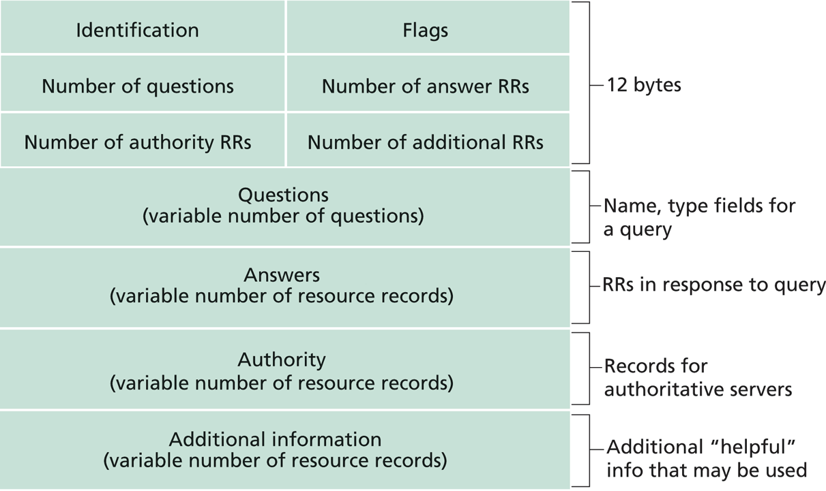
Recap: DNS Protocol, Messages
https://www.ietf.org/rfc/rfc1035.txt
Many features: typically over UDP (can use TCP); query and reply messages with the same message format; length/content encoding of names; simple compression; additional info as server push

Slide 5
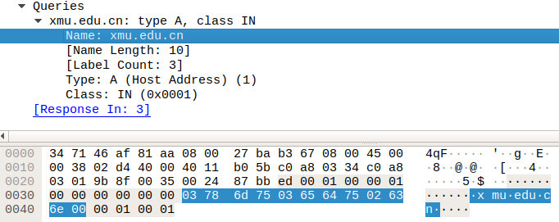
Name Encoding
cn
xmu
edu
length

Slide 6
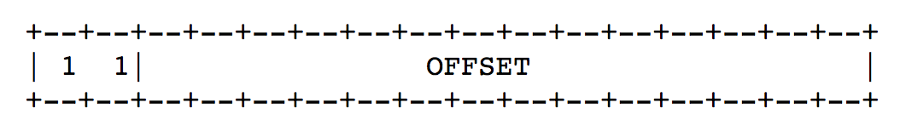
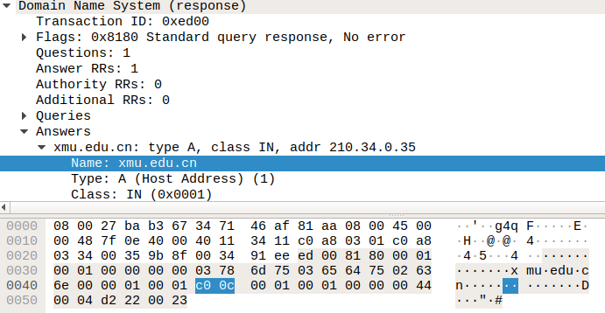
Message Compression (Label Pointer)
question
DNS start
Answer: offset 12

Slide 7
What DNS did Right?
Hierarchical delegation avoids central control, improving manageability and scalability
Redundant servers improve robustness
see http://www.internetnews.com/dev-news/article.php/1486981 for DDoS attack on root servers in Oct. 2002 (9 of the 13 root servers were crippled, but only slowed the network)
Caching reduces workload and improves robustness
Proactive answers reduce # queries on server and latency on client

Slide 8
Problems of DNS
Simple query model, relatively static resource values and types make it harder to implement generic service discovery
e.g., service discovery of all printers
Although theoretically you can update the values of the records, it is rarely enabled
Early binding (separation of DNS query from application query) does not work well in mobile, dynamic environments
e.g., load balancing, locate the nearest printer
Each local domain needs servers, but an ad hoc domain may not have a DNS server

Slide 9
Outline
Admin. and recap
DNS
High-level design
Details
Extensions/alternatives

Slide 10
Discussions
What extension(s) to standard DNS operations do we need to allow service discovery, say to implement Bonjour (discover all local printers)?
each printer needs to provide the following info: host, port, printer info (e.g., support postscript)

Slide 11

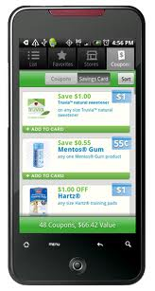
DNS-Service Discovery
Leverage DNS message format, but each node can announce its own services
169.254.1.219
Printer
Network
169.254.10.29
169.254.4.51

Slide 12
Realizing DNS-SD without Central DNS Server: mDNS
Multicast in a small world
no central address server
each node is a responder
link-local addressing
send to multicast address: 224.0.0.251
169.254.1.219
Printer
Network
169.254.10.29
169.254.4.51

Slide 13
Example
Use the avahi-publish-service command on Ubuntu as example
Advertise (register) an LPR printer on port 515 avahi-publish-service test _printer._tcp . 515 pdl=application/postscript
port
Name of instance providing the service
<type_service>. <transport>
Txt for additional data
13

Slide 14
Example
Use the dns-sd command on Mac as example
Advertise (register) an LPR printer on port 515 dns-sd -R "test" _printer._tcp . 515 pdl=application/postscript
port
Name of instance providing the service
domain (. means default, which is local
<type_service>. <transport>
Txt for additional data
14

Slide 15
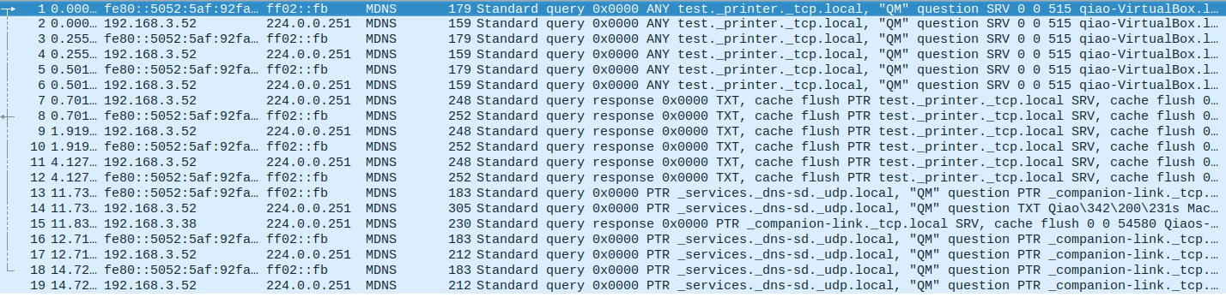

Slide 16
Offline Exercise
Use the dns-sd /avahi-publish-service command as example
Advertise (register) a web page on local machine dns-sd -R "My Test" _http._tcp . 80 path=/path-to-page.html
16

Slide 17
Issue: How to Query
Query needs a back pointer, PTR records
Exercise: Use the dns-sd / avahi-service-publish command as example
Browse web pages on local machines dns-sd -B _http._tcp
avahi-browse –rt _http._tcp

Slide 18
Network Service Discovery in Android
Based on DNS-SD/mDNS
Foundation for peer-to-peer/Wi-Fi Direct in Android
See https://developer.android.com/training/connect-devices-wirelessly/nsd.html for programming using nsd

Slide 19
Outline
Admin. and recap
Basic network applications
Email
DNS
Java in a Nutshell

Slide 20
High-level Picture
C/C++
Prog 1
Prog 2
Prog 1; Arch 1
Prog 1; Arch n
Prog 2; Arch 1
Prog 2; Arch n’

Slide 21
Java Virtual Machine
To be platform independent, Java designers introduced Java Virtual Machine (JVM), a machine different from any physical platform, but a virtual machine
The language of the virtual machine is referred to as bytecode
Thus Java actually has two programming languages
A Java compiler translates Java source code (.java files) into bytecode (in .class files)
Each Java software program needs to be compiled only once: from the Java source code to bytecode
Other languages (e.g., Jruby, Jython, Scala) may also compile to bytecode

Slide 22
Java Execution
To execute a Java program, another piece of software called an interpreter, translates between bytecode and the actual machine
an interpreter is specific to a specific platform
the interpreter understands java bytecode, and then issues instructions in the specific platform for which it is written
we also say that an interpreter provides a java virtual machine (JVM)

Slide 23
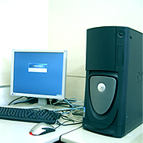
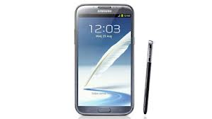


Java Translation and Execution
Java source code
Java compiler
Java bytecode
bytecode interpreter
for Windows
bytecode interpreter
for Mac
bytecode interpreter
for Android
bytecode interpreter
for Linux

Slide 24
Comparing Traditional (e.g., C/C++) and Java Software Development
Traditional, e.g., C/C++
Java
A developer writes a program in C/C++
The C/C++ source code is generally considered proprietary, and not released
The developer compiles the C/C++ program for each platform it intends to support, and distributes one version for each platform
thus each program has multiple compiled versions
each compiled version can run by itself
Platform dependency handled by each software developer
A developer writes a program in Java
The Java source code is generally considered proprietary, and not released
The developer compiles the Java program to bytecode, and distributes the bytecode version
thus each program has only one compiled version
the compiled bytecode needs an interpreter for each platform
Platform dependency handled by platform vendor

Slide 25
High-level Picture
C/C++
Prog 1
Prog 2
Prog 1; Arch 1
Prog 1; Arch n
Prog 2; Arch 1
Prog 2; Arch n’
Java
Prog 1
Prog 2
Prog 1/bytecode
Prog 2/bytecode
Interp; Arch 1
Interp; Arch n

Slide 26


Recall: Java Programming Steps
Programming in Java consists of 3 simple steps
Create and edit “Java source code” (.java files)
Compile into “Java bytecode” (.class files)
Execute bytecode with a “Java interpreter”
source code
byte code
compile
run
output
26

Slide 27
Programming in Java (Step 1): Create/Edit
The basic way is to use a text editor
Example editors: vim, sublime, Notepad, TextEdit (Format/Make Plain Text) etc.
Note: MS Word is NOT a text editor
The key is that your .java file cannot include any markup or stylistic formatting; just text.
You enter your Java code following Java Language syntax (more soon).
27
Notes:
27
:syntax on
~/.vimrc

Slide 28
Programming in Java (Step 2): Compile
Compile a Java program $ javac HelloWorld.java
Take a look to see that HelloWorld.class is generated $ ls HelloWorld.java HelloWorld.class
28
Notes:
28

Slide 29
Programming in Java (Step 3): Execute
Run Java interpreter
$ java HelloWorld
29
Notes:
29

Slide 30
First Java Program
/*************************************
* Prints “Hello World”
* Everyone’s first Java program.
*************************************/
public class Hello {
public static void main(String[] args) {
System.out.println("Hello, world!");
}
}

Slide 31
Another Java Program
public class Hello2 {
public static void main(String[] args) {
System.out.println("Hello, world!");
System.out.println();
System.out.println("This program produces");
System.out.println("four lines of output");
}
}

Slide 32
Programming in Java: Method 2
Another way is to use an Integrated Development Environment (IDE)
Example IDEs: Eclipse, IDEA, DrJava, etc.
An IDE usually presents the user with a space for text (like an editor) but layers additional features on top of the text for the user's benefit.
Note: The underlying file contains pure text, just like a text editor.
These features can be very useful and save time.
Example features are GUI compile, GUI execution, code completion, and syntax highlighting.
IDEs take more time to get started than a simple text editor, e.g.,
set up where to find the “java” and “javac” programs
find out where does the IDE save my file
32
Notes:
32

Slide 33
Java Syntax Structure: A Top-Down View
A class:
has a name, defined in a file with same name Convention we follow: capitalize each English word
starts with {, and ends with }
includes a group of methods
public class <class name> {
public static void main(String[] args) {
<statement>;
<statement>;
...
<statement>;
}
}
A method:
has a name Convention we follow: lowercase first word, capital following
starts with {, and ends with }
includes a group of statements
statement:
a command to be executed
end with ;
Notes:
The book as a program analogy: need to write chapter name, paragraph name, before you can write a sentence.

Slide 34
The System.out.println statement
A statement that prints a line of output on the console.
pronounced "print-linn”
Two ways to use System.out.println :
System.out.println(<string>);
Prints the given message <string> as output.
System.out.println();
Prints a blank line of output.
Notes:
34

Slide 35
Java program structure
A top-down view
A bottom-up view

Slide 36
Java Syntax: A Bottom-Up View
// Comment 1: A Java program
/* Comment 2: a long comment
*********************************/
public class Hello {
public static void main(String[] args) {
System.out.println("Hello, world!");
System.out.println();
System.out.println("This program produces");
System.out.println("four lines of output");
}
}
Notes:
The top-down view is good because we can read at the bigger picture. Hence small details do not change our understanding. For example, removing ; {
Computers are stupid and hence read without a bigger picture. You can think we read in 2D and computer in 1D (scan sequentially)

Slide 37
Java Syntax: A Bottom-Up View
// Comment 1: A Java program
/* Comment 2: a long comment
*********************************/
public class Hello {
public static void main(String[] args) {
System.out.println("Hello, world!");
System.out.println();
System.out.println("This program produces");
System.out.println("four lines of output");
}
}
Basic Java syntax units
white space and comments
identifiers (words)
symbols: { } “ ( ) < > [ ] ; = …
strings
numbers
Notes:
The top-down view is good because we can read at the bigger picture. Hence small details do not change our understanding. For example, removing ; {
Computers are stupid and hence read without a bigger picture. You can think we read in 2D and computer in 1D (scan sequentially)

Slide 38
Syntax: White Space
White space
includes spaces, new line characters, tabs
white space is used to separate other entities
extra white space is ignored
White space allows a Java program to be formatted in many ways, and should be formatted to enhance readability
the usage of white space forms part of programming style
38
Notes:
38

Slide 39
Syntax: Comments
comment: A note written in source code by the programmer to describe or clarify the code.
Comments are ignored by the compiler
Useful for other people (and yourself!) to understand your code
Two types of comments in Java
single-line comments use //…
// this comment runs to the end of the line
multi-lines comments use /* … */
/* this is a very long
multi-line comment */
39
Notes:
39

Slide 40
Syntax: Identifier
Identifier: A name given to an item in a program.
Syntax requirement on identifier:
must start with a letter or _ or $
subsequent characters can be any of those or a number
Important: Java is case sensitive:
Hello and hello are different identifiers

Slide 41
Three Types of Identifiers
1. Identifiers chosen by ourselves when writing a program (such as HelloWorld)
2. Identifiers chosen by another programmer, so we use the identifiers that they chose (e.g., System, out, println, main)
public class HelloWorld
{
public static void main(String[] args)
{
System.out.println(“Hello World!”);
}
}

Slide 42
Three Types of Identifiers
3. Special identifiers called keywords or reserved words: A keyword has a special meaning in Java.
abstract default if private this
boolean do implements protected throw
break double import public throws
byte else instanceof return transient
case extends int short try
catch final interface static void
char finally long strictfp volatile
class float native super while
const for new switch
continue goto package synchronized
Java reserved words: they are all lowercase!

Slide 43
Syntax: Strings
string: A sequence of characters that starts and ends with a " (quotation mark character).
The quotes do not appear in the output.
Examples: "hello" "This is a string. It is very long!”
Restrictions:
May not span multiple lines "This is not a legal String."
Notes:
43

Slide 44
Examples
Which of the following are legal strings in Java?
"This is a string. It’s very long!"
"This cool string spans two lines. "
"It is a great thing when children cry, "I want my mommy"! "
Notes:
44

Slide 45
Escape Sequences
escape sequence: A special sequence of characters used to represent certain special characters in a string.
\b backspace
\t tab character
\n new line character
\" quotation mark character
\\ backslash character
Example: System.out.println("\\hello\nhow\tare \"you\"?\\\\");
Output: \hello how are "you"?\\

Slide 46
Comment on syntax errors
A syntax/compile error: A problem in the structure of a program that causes the compiler to fail, e.g.,
Missing semicolon
Too many or too few { } braces
Class and file names do not match
…
Compilers can’t (DO not) read minds.
Compilers don’t make mistakes.
If the program is not doing what you want, do NOT blame the computer---it’s YOU who made a mistake.

Slide 47
Outline
Admin. and recap
Basic network applications
Email
DNS
Java in a Nutshell
Network application programming

Slide 48
Socket Programming
Socket API
introduced in BSD4.1 UNIX, 1981
Two types of sockets
connectionless (UDP)
connection-oriented (TCP)
socket
an interface (a “door”) into which one
application process can both send and
receive messages to/from another (remote or
local) application process

Slide 49
Services Provided by Transport
User data protocol (UDP)
multiplexing/demultiplexing
Transmission control protocol (TCP)
multiplexing/demultiplexing
reliable data transfer
rate control: flow control
and congestion control
Host A
Host B
Hello
I am ready
DATA
ACK

Slide 50
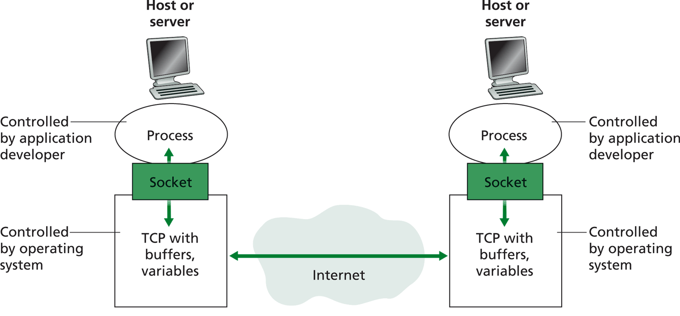
Big Picture: Socket
buffers,
states
buffers,
states

Slide 51
Outline
Admin. and recap
Basic network application programming
Overview
UDP (Datagram Socket)

Slide 52
DatagramSocket(Java) (Basic)
DatagramSocket()
constructs a datagram socket and binds it to any available port on the local host
DatagramSocket(int lport)
constructs a datagram socket and binds it to the specified port on the local host machine.
DatagramPacket(byte[] buf, int length)
constructs a DatagramPacket for receiving packets of length length.
DatagramPacket(byte[] buf, int length, InetAddress address, int port)
constructs a datagram packet for sending packets of length length to the specified port number on the specified host.
receive(DatagramPacket p)
receives a datagram packet from this socket.
send(DatagramPacket p)
sends a datagram packet from this socket.
close()
closes this datagram socket.

Slide 53
Connectionless UDP: Big Picture (Java version)
Server (running on serv)
Client
create socket,
port=x, for
incoming request:
create socket,
clientSocket =
DatagramSocket()
serverSocket =
DatagramSocket( x )
Create datagram using (serv, x) as (dest addr. port), send request using clientSocket
read request from
serverSocket
generate reply, create datagram using client
host address, port number
write reply to
serverSocket
read reply from
clientSocket
close
clientSocket

Slide 54
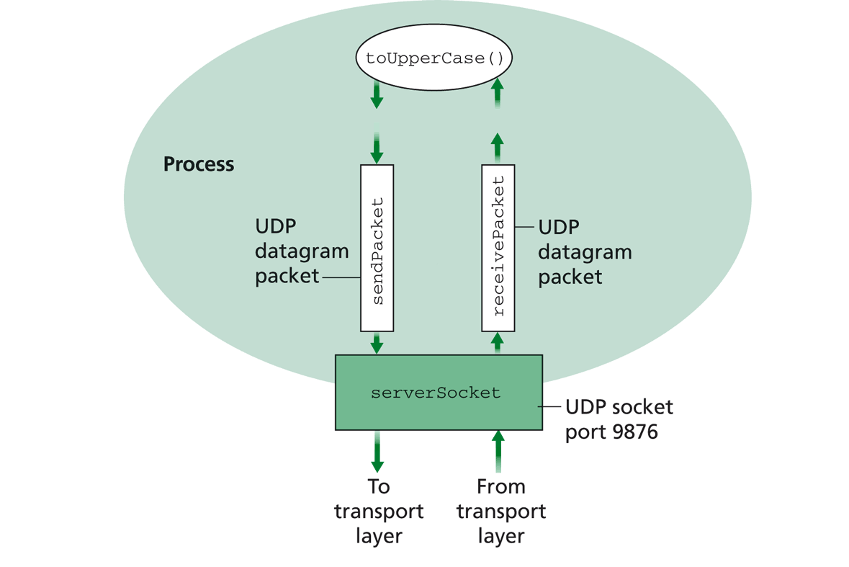
Example: UDPServer.java
A simple UDP server which changes any received sentence to upper case.

Slide 55
Java Server (UDP): Create Socket
import java.io.*;
import java.net.*;
class UDPServer {
public static void main(String args[]) throws Exception
{
DatagramSocket serverSocket = new DatagramSocket(9876);
Create
datagram socket
bind at port 9876
Check socket state:
%netstat –a –u –n

Slide 56
System State after the Call
server
128.36.232.5 128.36.230.2
UDP socket space
“*” indicates that the socket binds to all IP addresses of the machine: % ifconfig -a
address: {*:9876}
snd/recv buf:
local port
local address why shown as “*”?
address: {128.36.232.5:53}
snd/recv buf:

Slide 57
Binding to Specific IP Addresses
server
Public address: 128.36.59.2 Local address: 127.0.0.1
UDP socket space
InetAddress sIP1 =
InetAddress.getByName(“localhost”);
DatagramSocket ssock1 = new DatagramSocket(9876, sIP1);
InetAddress sIP2 = InetAddress.getByName(“128.36.59.2”);
DatagramSocket ssock2 = new DatagramSocket(9876,sIP2);
DatagramSocket serverSocket = new DatagramSocket(6789);
address: {127.0.0.1:9876}
snd/recv buf:
address: {128.36.59.2:9876}
snd/recv buf:
address: {*:6789}
snd/recv buf:
address: {128.36.232.5:53}
snd/recv buf:

Slide 58
UDP Demultiplexing
client
on server
server
P1
SP: x
Public address: 128.36.59.2 Local address: 127.0.0.1
DP: 9876
UDP socket space
S-IP: A
address: {127.0.0.1:9876}
snd/recv buf:
D-IP: 127.0.0.1
address: {128.36.59.2:9876}
snd/recv buf:
P2
SP: y
DP: 9876
S-IP: B
D-IP: 128.36.59.2
address: {128.36.232.5:53}
snd/recv buf:
client
IP: B
UDP demutiplexing is based on matching (dst address, dst port)

Slide 59
UDP Demultiplexing
Client
on server
server
P1
SP: x
Public address: 128.36.59.2 Local address: 127.0.0.1
DP: 9876
UDP socket space
S-IP: A
address: {127.0.0.1:9876}
snd/recv buf:
D-IP: 127.0.0.1
address: {128.36.59.2:9876}
snd/recv buf:
P3
address: {*:6789}
snd/recv buf:
SP: y
DP: 6789
S-IP: C
D-IP: 128.36.59.2
address: {128.36.232.5:53}
snd/recv buf:
client
IP: C
UDP demutiplexing is based on matching (dst address, dst port)

Slide 60
Per Socket State
Each Datagram socket has a set of states:
local address
send buffer size
receive buffer size
timeout
traffic class
See http://download.java.net/jdk7/archive/b123/docs/api/java/net/DatagramSocket.html
Example: socket state after clients sent msgs to the server

Slide 61
Java Server (UDP): Receiving
import java.io.*;
import java.net.*;
class UDPServer {
public static void main(String args[]) throws Exception
{
DatagramSocket serverSocket = new DatagramSocket(9876);
byte[] receiveData = new byte[1024];
byte[] sendData = null;
while(true)
{
DatagramPacket receivePacket =
new DatagramPacket(receiveData, receiveData.length);
serverSocket.receive(receivePacket);
Create space for
received datagram
Receive
datagram

Slide 62
DatagramPacket
Receiving
DatagramPacket(byte[] buf, int length)
constructs a DatagramPacket for receiving packets of length length.
DatagramPacket(byte[] buf, int offset, int length)
constructs a DatagramPacket for receiving packets starting at offset, length length.
Sending
DatagramPacket(byte[] buf, int length, InetAddress address, int port) constructs a datagram packet for sending packets of length length to the specified port number on the specified host.
DatagramPacket(byte[] buf, int offset, int length, InetAddress address, int port)

Slide 63
Java Server (UDP): Processing
getData() returns a pointer to an underlying buffer array; for efficiency, don’t assume receive() will reset the rest of the array
import java.io.*;
import java.net.*;
class UDPServer {
public static void main(String args[]) throws Exception {
…
// process data
String sentence = new String(receivePacket.getData(), 0, receivePacket.getLength());
String capitalizedSentence = sentence.toUpperCase();
sendData = capitalizedSentence.getBytes();
getLength() returns how much data is valid.

Slide 64
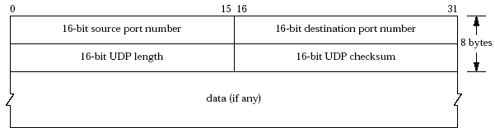
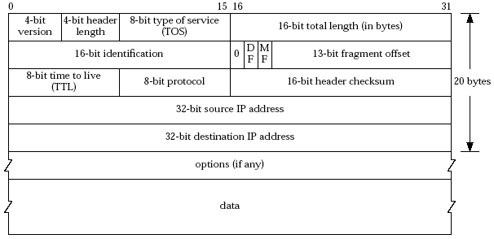
Java Server (UDP): Response
Java DatagramPacket:
getAddress()/getPort() returns the source address/port

Slide 65
Java server (UDP): Reply
InetAddress IPAddress = receivePacket.getAddress();
int port = receivePacket.getPort();
DatagramPacket sendPacket =
new DatagramPacket(sendData, sendData.length, IPAddress, port);
serverSocket.send(sendPacket);
}
}
}
Get IP addr
port #, of
sender
Create datagram
to send to client
Write out
datagram
to socket
End of while loop,
loop back and wait for
another datagram

Slide 66
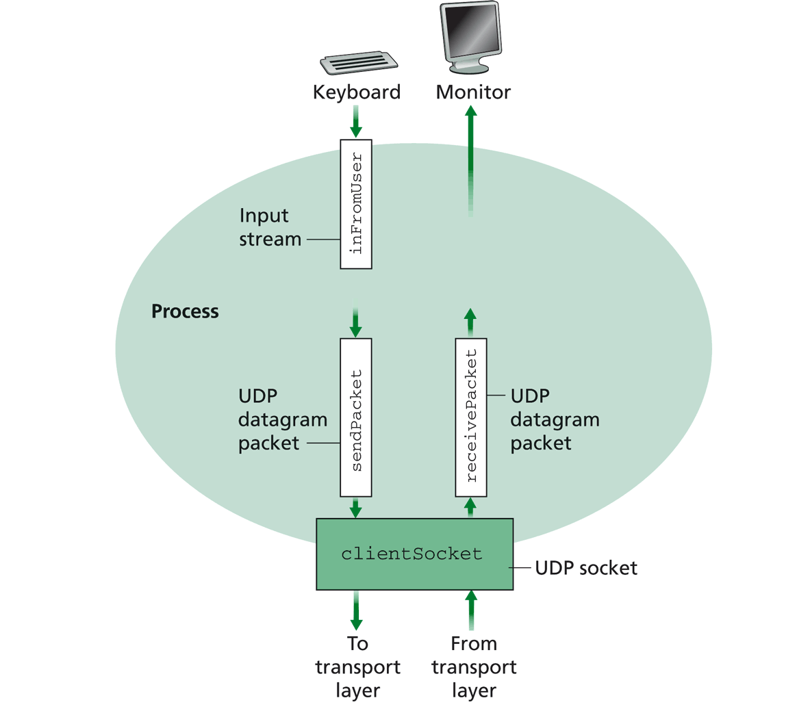
Example: UDPClient.java
A simple UDP client which reads input from keyboard, sends the input to server, and reads the reply back from the server.

Slide 67
Example: Java client (UDP)
import java.io.*;
import java.net.*;
class UDPClient {
public static void main(String args[]) throws Exception
{
BufferedReader inFromUser =
new BufferedReader(new InputStreamReader(System.in));
String sentence = inFromUser.readLine(); byte[] sendData = sentence.getBytes();
DatagramSocket clientSocket = new DatagramSocket();
InetAddress sIPAddress = InetAddress.getByName(“servname");
Create
input stream
Create
client socket
Translate
hostname to IP
address using DNS

Slide 68
Example: Java client (UDP), cont.
Create datagram with data-to-send,
length, IP addr, port
DatagramPacket sendPacket =
new DatagramPacket(sendData, sendData.length, sIPAddress, 9876);
clientSocket.send(sendPacket);
byte[] receiveData = new byte[1024];
DatagramPacket receivePacket =
new DatagramPacket(receiveData, receiveData.length);
clientSocket.receive(receivePacket);
String modifiedSentence =
new String(receivePacket.getData());
System.out.println("FROM SERVER:" + modifiedSentence);
clientSocket.close();
}
}
Send datagram
to server
Read datagram
from server

Slide 69
Demo
%ubuntu: java UDPServer
%netstat to see buffer
%ubuntu: java UDPClient <server>
%wireshark to capture traffic
Notes:
System.out.println(clientSocket.getLocalAddress());
System.out.println(clientSocket.getLocalPort());
System.out.println(clientSocket.getReceiveBufferSize());
System.out.println(clientSocket.getSendBufferSize());
System.out.println(clientSocket.getSoTimeout());
System.out.println( java.nio.charset.Charset.defaultCharset() );

Slide 70
Discussion on Example Code
A simple upper-case UDP echo service is among the simplest network service.
Are there any problems with the program?
Notes:
System.out.println(clientSocket.getLocalAddress());
System.out.println(clientSocket.getLocalPort());
System.out.println(clientSocket.getReceiveBufferSize());
System.out.println(clientSocket.getSendBufferSize());
System.out.println(clientSocket.getSoTimeout());
System.out.println( java.nio.charset.Charset.defaultCharset() );

Slide 71
Data Encoding/Decoding
Rule: ALWAYS pay attention to encoding/decoding of data
if not careful, query sent != query received (how?)
client
server
query
result
encoding
decoding
byte
array

Slide 72
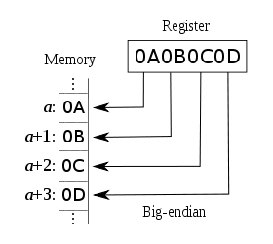
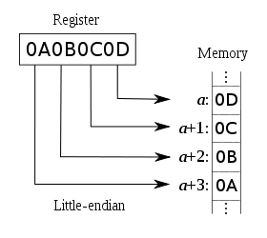
Example: Endianness of Numbers
int var = 0x0A0B0C0D
sent != received: take an int on a big-endian machine and send a little-endian machine
ARM, Power PC, Motorola 68k, IA-64
Intel x86

Slide 73
Example: String and Chars
Will we always get back the same string?
client
server
String
String
(UTF-16)
(UTF-16)
String.getBytes()
String(rcvPkt, 0, rcvPkt.getLength());
byte
array
Depends on default local platform char set : java.nio.charset.Charset.defaultCharset()

Slide 74
Example: Charset Troubles
Try
java EncodingDecoding US-ASCII UTF-8
Notes:
System.out.println(clientSocket.getLocalAddress());
System.out.println(clientSocket.getLocalPort());
System.out.println(clientSocket.getReceiveBufferSize());
System.out.println(clientSocket.getSendBufferSize());
System.out.println(clientSocket.getSoTimeout());
System.out.println( java.nio.charset.Charset.defaultCharset() );

Slide 75
Encoding/Decoding as a Common Source of Errors
Please read chapter 2 (Streams) of Java Network Programming for more details
Java stream, reader/writer can always be confusing, but it is good to finally understand
Common mistake even in many (textbook) examples:
http://www.java2s.com/Code/Java/Network-Protocol/UseDatagramSockettosendoutandreceiveDatagramPacket.htm
Notes:
System.out.println(clientSocket.getLocalAddress());
System.out.println(clientSocket.getLocalPort());
System.out.println(clientSocket.getReceiveBufferSize());
System.out.println(clientSocket.getSendBufferSize());
System.out.println(clientSocket.getSoTimeout());
System.out.println( java.nio.charset.Charset.defaultCharset() );

Slide 76

Exercise: UDP/DNS Server Pseudocode
Modify the example UDP server code to implement a local DNS server.
root name server
2
3
4
7
local name server
130.132.1.9
TLD name server
6
5
1
8
authoritative name server
dns.cs.umass.edu
requesting host
cyndra.cs.yale.edu
gaia.cs.umass.edu

Slide 77
UDP/DNS Implementation
Standard UDP demultiplexing (find out return address by src.addr/src.port of UDP packet) does not always work
DNS solution: identification: remember the mapping

Slide 78
Outline
Admin. and recap
Network application programming
Overview
UDP
Basic TCP

Slide 79
TCP Socket Design: Starting w/ UDP
server
client1
128.36.232.5 128.36.230.2
P1
Socket socket space
address: {*:9876}
snd/recv buf:
client2
P2
local port
Issue: If a single socket, data can be mixed, but TCP is designed to provide a pipe abstraction: server reads an ordered sequence of bytes from each individual client.
local address
sock.nextByte(client1)?
Issue 2: How to notify an app that a new client is connected?
newClient = sock.getNewClient()?

Slide 80
BSD TCP Socket API Design
server
socket for new connected clients
128.36.232.5 128.36.230.2
TCP socket space
address: {*:9876}
snd/recv buf:
client1
An individual socket for client 1
P1
address: {*:9876; client 1 IP/port}
snd/recv buf:
client2
An individual socket for client 2
address: {*:9876; client 2 IP/port}
snd/recv buf:
P2
Q: How to decide where to put a new TCP packet?
A: Packet demutiplexing is based on four tuples: (dst addr, dst port, src addr, src port)

Slide 81
TCP Connection-Oriented Demux
TCP socket identified by 4-tuple:
source IP address
source port number
dest IP address
dest port number
recv host uses all four values to direct segment to appropriate socket
different connections/sessions are automatically separated into different sockets

Slide 82
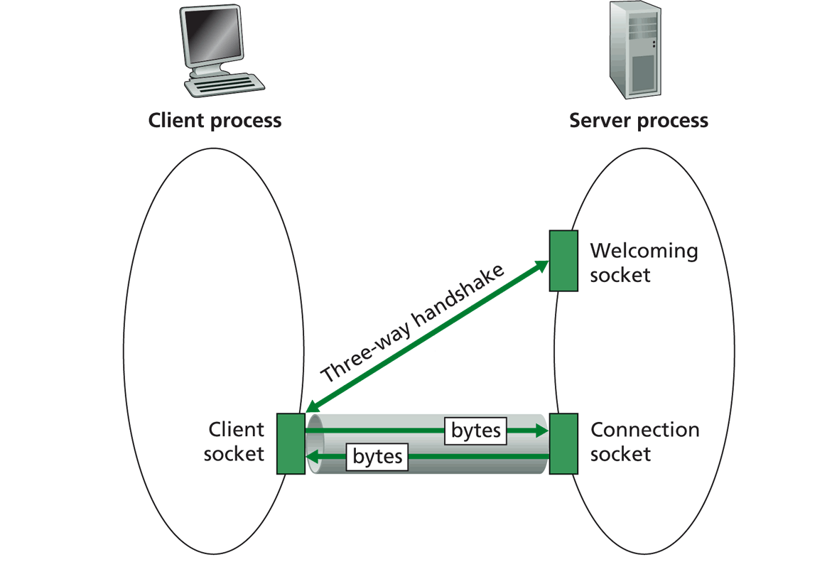
TCP Socket Big Picture
Welcome socket: the waiting room
connSocket: the operation room

Slide 83
Client/server Socket Workflow: TCP
Server (running on hostid)
Client
create socket,
port=x, for
incoming request:
welcomeSocket =
ServerSocket(x)
TCP
connection setup
create socket,
connect to hostid, port=x
wait for incoming
connection request
connectionSocket =
welcomeSocket.accept()
clientSocket =
Socket()
send request using
clientSocket
read request from
connectionSocket
write reply to
connectionSocket
read reply from
clientSocket
close
connectionSocket
close
clientSocket

Slide 84
Server Flow
Create ServerSocket(6789)
connSocket = accept()
read request from connSocket
Welcome socket: the waiting room
connSocket: the operation room
Serve the request
close connSocket

Slide 85
ServerSocket
ServerSocket()
creates an unbound server socket.
ServerSocket(int port)
creates a server socket, bound to the specified port.
ServerSocket(int port, int backlog)
creates a server socket and binds it to the specified local port number, with the specified backlog.
ServerSocket(int port, int backlog, InetAddress bindAddr)
creates a server with the specified port, listen backlog, and local IP address to bind to.
bind(SocketAddress endpoint)
binds the ServerSocket to a specific address (IP address and port number).
bind(SocketAddress endpoint, int backlog)
binds the ServerSocket to a specific address (IP address and port number).
Socket accept()
listens for a connection to be made to this socket and accepts it.
close()
closes this socket.

Slide 86
(Client)Socket
Socket(InetAddress address, int port)
creates a stream socket and connects it to the specified port number at the specified IP address.
Socket(InetAddress address, int port, InetAddress localAddr, int localPort)
creates a socket and connects it to the specified remote address on the specified remote port.
Socket(String host, int port)
creates a stream socket and connects it to the specified port number on the named host.
bind(SocketAddress bindpoint)
binds the socket to a local address.
connect(SocketAddress endpoint)
connects this socket to the server.
connect(SocketAddress endpoint, int timeout)
connects this socket to the server with a specified timeout value.
InputStream getInputStream()
returns an input stream for this socket.
OutputStream getOutputStream()
returns an output stream for this socket.
close()
closes this socket.

Slide 87
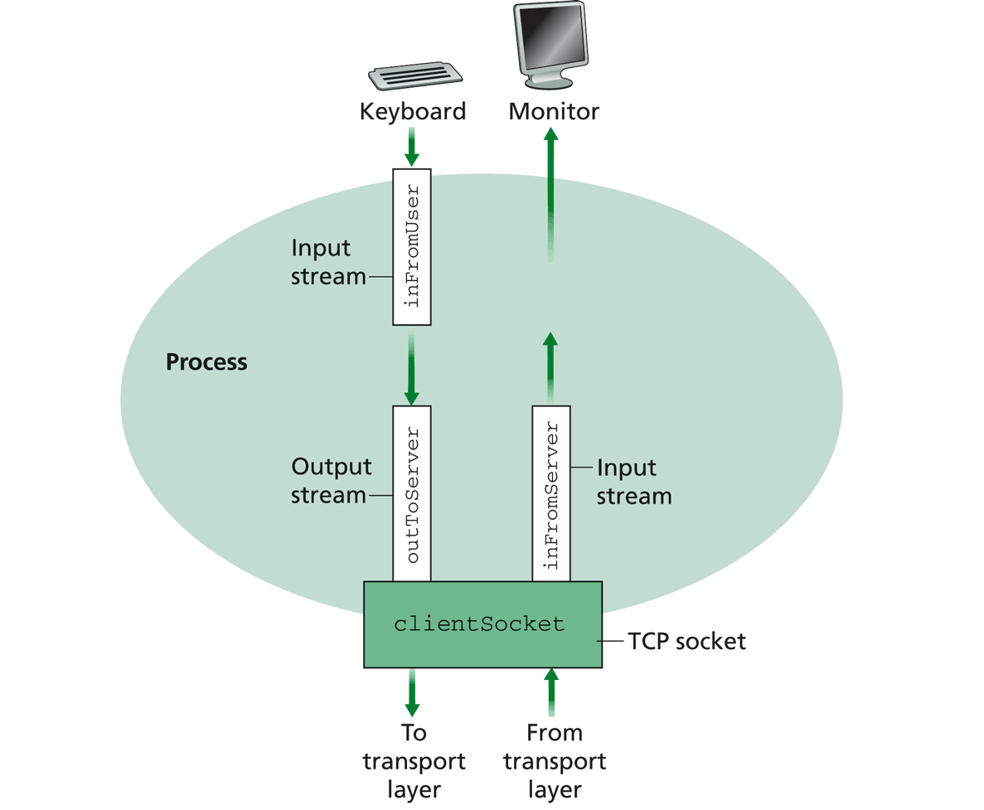
Simple TCP Example
Example client-server app:
1) client reads line from standard input (inFromUser stream) , sends to server via socket (outToServer stream)
2) server reads line from socket
3) server converts line to uppercase, sends back to client
4) client reads, prints modified line from socket (inFromServer stream)

Slide 88
Example: Java client (TCP)
import java.io.*;
import java.net.*;
class TCPClient {
public static void main(String argv[]) throws Exception
{
String sentence;
String modifiedSentence;
BufferedReader inFromUser =
new BufferedReader(new InputStreamReader(System.in));
sentence = inFromUser.readLine();
Socket clientSocket = new Socket(“server.name", 6789);
DataOutputStream outToServer =
new DataOutputStream(clientSocket.getOutputStream());
Create
input stream
Create
client socket,
connect to server
Create
output stream
attached to socket

Slide 89
OutputStream
public abstract class OutputStream
public abstract void write(int b) throws IOException
public void write(byte[] data) throws IOException
public void write(byte[] data, int offset, int length) throws IOException
public void flush( ) throws IOException
public void close( ) throws IOException

Slide 90
InputStream
public abstract class InputStream
public abstract int read( ) throws IOException
public int read(byte[] input) throws IOException
public int read(byte[] input, int offset, int length) throws IOException
public long skip(long n) throws IOException
public int available( ) throws IOException
public void close( ) throws IOException

Slide 91
Example: Java client (TCP), cont.
Send line
to server
outToServer.writeBytes(sentence + '\n');
BufferedReader inFromServer =
new BufferedReader(new
InputStreamReader(clientSocket.getInputStream()));
modifiedSentence = inFromServer.readLine();
System.out.println("FROM SERVER: " + modifiedSentence);
clientSocket.close();
}
}
Create
input stream
attached to socket
Read line
from server

Slide 92
Example: Java server (TCP)
import java.io.*;
import java.net.*;
class TCPServer {
public static void main(String argv[]) throws Exception
{
String clientSentence;
String capitalizedSentence;
ServerSocket welcomeSocket = new ServerSocket(6789);
while(true) {
Socket connectionSocket = welcomeSocket.accept();
BufferedReader inFromClient =
new BufferedReader(new
InputStreamReader(connectionSocket.getInputStream()));
Create
welcoming socket
at port 6789

Slide 93
Demo
% on MAC
start TCPServer
wireshark to capture our TCP traffic tcp.srcport==6789 or tcp.dstport==6789

Slide 94
Under the Hood: After Welcome (Server) Socket
server
client
128.36.232.5 128.36.230.2
198.69.10.10
TCP socket space
TCP socket space
state: listening
address: {*:6789, *:*}
completed connection queue:
sendbuf:
recvbuf:
state: starting
address: {198.69.10.10:1500, *:*}
sendbuf:
recvbuf:
local port
local addr
remote port
remote addr
state: listening
address: {*:25, *:*}
completed connection queue:
sendbuf:
recvbuf:
state: listening
address: {*:25, *:*}
completed connection queue:
sendbuf:
recvbuf:
%netstat –p tcp –n -a

Slide 95
After Client Initiates Connection
server
client
128.36.232.5 128.36.230.2
198.69.10.10
TCP socket space
TCP socket space
state: listening
address: {*:6789, *.*}
completed connection queue:
sendbuf:
recvbuf:
state: connecting
address: {198.69.10.10:1500, 128.36.232.5:6789}
sendbuf:
recvbuf:
state: listening
address: {*.25, *.*}
completed connection queue:
sendbuf:
recvbuf:
state: listening
address: {*.25, *.*}
completed connection queue:
sendbuf:
recvbuf:
%ubuntu java TCPClient <server> 6789

Slide 96
Example: Client Connection Handshake Done
server
client
128.36.232.5 128.36.230.2
198.69.10.10
TCP socket space
TCP socket space
state: listening
address: {*:6789, *:*}
completed connection queue: {128.36.232.5.6789, 198.69.10.10.1500}
sendbuf:
recvbuf:
state: connected
address: {198.69.10.10:1500, 128.36.232.5:6789}
sendbuf:
recvbuf:
state: listening
address: {*:25, *:*}
completed connection queue:
sendbuf:
recvbuf:
state: listening
address: {*:25, *:*}
completed connection queue:
sendbuf:
recvbuf:

Slide 97
Example: Client Connection Handshake Done
server
client
128.36.232.5 128.36.230.2
198.69.10.10
TCP socket space
TCP socket space
state: listening
address: {*.6789, *:*}
completed connection queue: sendbuf:
recvbuf:
state: connected
address: {198.69.10.10.1500, 128.36.232.5:6789}
sendbuf:
recvbuf:
state: established
address: {128.36.232.5:6789, 198.69.10.10.1500}
sendbuf:
recvbuf:
state: listening
address: {*.25, *:*}
completed connection queue:
sendbuf:
recvbuf:
state: listening
address: {*.25, *:*}
completed connection queue:
sendbuf:
recvbuf:
Packet demutiplexing is based on (dst addr, dst port, src addr, src port)
Packet sent to the socket with the best match!

Slide 98
Demo
What if more client connections than backlog allowed?
We continue to start java TCPClient

Slide 99
Example: Java server (TCP)
import java.io.*;
import java.net.*;
class TCPServer {
public static void main(String argv[]) throws Exception
{
String clientSentence;
String capitalizedSentence;
ServerSocket welcomeSocket = new ServerSocket(6789);
while(true) {
Socket connectionSocket = welcomeSocket.accept();
BufferedReader inFromClient =
new BufferedReader(new
InputStreamReader(connectionSocket.getInputStream()));
Wait, on welcoming
socket for contact
by client

Slide 100
Example: Server accept()
server
client
connectionSocket
128.36.232.5 128.36.230.2
198.69.10.10
TCP socket space
TCP socket space
state: listening
address: {*.6789, *:*}
completed connection queue: sendbuf:
recvbuf:
state: connected
address: {198.69.10.10.1500, 128.36.232.5:6789}
sendbuf:
recvbuf:
state: established
address: {128.36.232.5:6789, 198.69.10.10.1500}
sendbuf:
recvbuf:
state: listening
address: {*.25, *:*}
completed connection queue:
sendbuf:
recvbuf:
state: listening
address: {*.25, *:*}
completed connection queue:
sendbuf:
recvbuf:

Slide 101
Example: Java server (TCP): Processing
BufferedReader inFromClient =
new BufferedReader(new
InputStreamReader(connectionSocket.getInputStream()));
clientSentence = inFromClient.readLine();
capitalizedSentence = clientSentence.toUpperCase() + '\n'; DataOutputStream outToClient =
new DataOutputStream(connectionSocket.getOutputStream());
outToClient.writeBytes(capitalizedSentence);
}
}
}
Create input
stream, attached
to socket
Read in line
from socket

Slide 102
Example: Java server (TCP): Output
BufferedReader inFromClient =
new BufferedReader(new
InputStreamReader(connectionSocket.getInputStream()));
clientSentence = inFromClient.readLine();
capitalizedSentence = clientSentence.toUpperCase() + '\n'; DataOutputStream outToClient =
new DataOutputStream(connectionSocket.getOutputStream());
outToClient.writeBytes(capitalizedSentence);
}
}
}
Create output
stream, attached
to socket
Write out line
to socket
End of while loop,
loop back and wait for
another client connection

Slide 103
Backup Slides (General Service/Naming Discovery)

Slide 104
General Service/Naming Discovery Paradigm: Linda
“Distributed workspace” by David Gelernter in the 80’s at Yale
Very influential in naming and resource discovery
Key issues
How to name services/resources
How to resolve names

Slide 105
The Linda Paradigm
Naming scheme:
arbitrary tuples (heterogeneous-type vectors)
Name resolution:
Nodes write into shared memory
Nodes read matching tuples from shared memory
exact matching is required for extraction

Slide 106
Linda: Core API
out(): writes tuples to shared space
example: out("abc", 1.5, 12).
result: insert (“abc”, 1.5, 12) into space
read(): retrieves tuple copy matching arg list (blocking)
example: read(“abc”, ? A, ? B)
result: finds (“abc”, 1.5, 12) and sets local variables A = 1.5, B = 12. Tuple (“abc”, 1.5, 12) is still resident in space.
in(): retrieves and deletes matching tuple from space (blocking)
example: same as above except (“abc”, 1.5, 12) is deleted
eval(expression): similar to out except that the tuple argument to eval is evaluated
example: eval("ab",-6,abs(-6)) creates tuple (“ab”, -6, 6)
Notes:
eval()
evaluates a tuple on the server

Slide 107
Linda Extension: JavaSpaces
Industry took Linda principles and made modifications
add transactions, leases, events
store Java objects instead of tuples
a very comprehensive service discovery system
Definitive book, “JavaSpaces Principles, Patterns, and Practice”

