Slide 1
Network Applications: Network Programming: UDP, TCP
Qiao Xiang
https://qiaoxiang.me/courses/cnns-xmuf21/index.shtml
10/12/2021
This deck of slides are heavily based on CPSC 433/533 at Yale University, by courtesy of Dr. Y. Richard Yang.

Slide 2
Outline
Admin. and recap
Network application programming
UDP sockets
TCP sockets

Slide 3
Admin.
Lab assignment 1 due on Oct. 14
By email or in class

Slide 4
Recap: Connectionless UDP: Big Picture (Java version)
Server (running on serv)
Client
create socket,
port=x, for
incoming request:
create socket,
clientSocket =
DatagramSocket()
serverSocket =
DatagramSocket( x )
Create datagram using (serv, x) as (dest addr. port), send request using clientSocket
read request from
serverSocket
generate reply, create datagram using client
host address, port number
write reply to
serverSocket
read reply from
clientSocket
close
clientSocket

Slide 5
Recap: UDP Sockets
server
Public address: 128.36.59.2 Local address: 127.0.0.1
UDP socket space
InetAddress sIP1 =
InetAddress.getByName(“localhost”);
DatagramSocket ssock1 = new DatagramSocket(9876, sIP1);
InetAddress sIP2 = InetAddress.getByName(“128.36.59.2”);
DatagramSocket ssock2 = new DatagramSocket(9876,sIP2);
DatagramSocket serverSocket = new DatagramSocket(6789);
address: {127.0.0.1:9876}
snd/recv buf:
address: {128.36.59.2:9876}
snd/recv buf:
address: {*:6789}
snd/recv buf:
address: {128.36.232.5:53}
snd/recv buf:
UDP demutiplexing is based on matching (dst address, dst port)

Slide 6
Java Server (UDP): Processing
A simple upper-case UDP echo service is among the simplest network service. Are there any problems with the processing?
class UDPServer {
public static void main(String args[]) throws Exception {
… DatagramPacket receivePacket = new DatagramPacket(receiveData, receiveData.length);
serverSocket.receive(receivePacket);
// process
String sentence = new String(receivePacket.getData(), 0, receivePacket.getLength());
String capitalizedSentence = sentence.toUpperCase();
sendData = capitalizedSentence.getBytes();
// send DatagramPacket sendPacket = new DatagramPacket(sendData, sendData.length, IPAddress, port);
serverSocket.send(sendPacket);

Slide 7
Example: Java client (UDP)
import java.io.*;
import java.net.*;
class UDPClient {
public static void main(String args[]) throws Exception
{
BufferedReader inFromUser =
new BufferedReader(new InputStreamReader(System.in));
String sentence = inFromUser.readLine(); byte[] sendData = sentence.getBytes();
DatagramSocket clientSocket = new DatagramSocket();
InetAddress sIPAddress = InetAddress.getByName(“servname");
Create
input stream
Create
client socket
Translate
hostname to IP
address using DNS

Slide 8
Example: Java client (UDP), cont.
Create datagram with data-to-send,
length, IP addr, port
DatagramPacket sendPacket =
new DatagramPacket(sendData, sendData.length, sIPAddress, 9876);
clientSocket.send(sendPacket);
byte[] receiveData = new byte[1024];
DatagramPacket receivePacket =
new DatagramPacket(receiveData, receiveData.length);
clientSocket.receive(receivePacket);
String modifiedSentence =
new String(receivePacket.getData());
System.out.println("FROM SERVER:" + modifiedSentence);
clientSocket.close();
}
}
Send datagram
to server
Read datagram
from server

Slide 9
Demo
%ubuntu: java UDPServer
%netstat to see buffer
%ubuntu: java UDPClient <server>
%wireshark to capture traffic
Notes:
System.out.println(clientSocket.getLocalAddress());
System.out.println(clientSocket.getLocalPort());
System.out.println(clientSocket.getReceiveBufferSize());
System.out.println(clientSocket.getSendBufferSize());
System.out.println(clientSocket.getSoTimeout());
System.out.println( java.nio.charset.Charset.defaultCharset() );

Slide 10
Discussion on Example Code
A simple upper-case UDP echo service is among the simplest network service.
Are there any problems with the program?
Notes:
System.out.println(clientSocket.getLocalAddress());
System.out.println(clientSocket.getLocalPort());
System.out.println(clientSocket.getReceiveBufferSize());
System.out.println(clientSocket.getSendBufferSize());
System.out.println(clientSocket.getSoTimeout());
System.out.println( java.nio.charset.Charset.defaultCharset() );

Slide 11
Data Encoding/Decoding
Rule: ALWAYS pay attention to encoding/decoding of data
if not careful, query sent != query received (how?)
client
server
query
result
encoding
decoding
byte
array

Slide 12
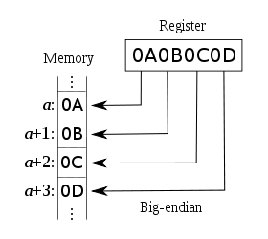
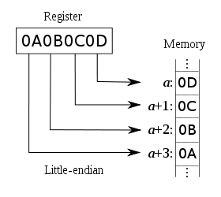
Example: Endianness of Numbers
int var = 0x0A0B0C0D
sent != received: take an int on a big-endian machine and send a little-endian machine
ARM, Power PC, Motorola 68k, IA-64
Intel x86

Slide 13
Example: String and Chars
Will we always get back the same string?
client
server
String
String
(UTF-16)
(UTF-16)
String.getBytes()
String(rcvPkt, 0, rcvPkt.getLength());
byte
array
Depends on default local platform char set : java.nio.charset.Charset.defaultCharset()

Slide 14
Example: Charset Troubles
Try
java EncodingDecoding US-ASCII UTF-8
Notes:
System.out.println(clientSocket.getLocalAddress());
System.out.println(clientSocket.getLocalPort());
System.out.println(clientSocket.getReceiveBufferSize());
System.out.println(clientSocket.getSendBufferSize());
System.out.println(clientSocket.getSoTimeout());
System.out.println( java.nio.charset.Charset.defaultCharset() );

Slide 15
Encoding/Decoding as a Common Source of Errors
Please read chapter 2 (Streams) of Java Network Programming for more details
Java stream, reader/writer can always be confusing, but it is good to finally understand
Common mistake even in many (textbook) examples:
http://www.java2s.com/Code/Java/Network-Protocol/UseDatagramSockettosendoutandreceiveDatagramPacket.htm
Notes:
System.out.println(clientSocket.getLocalAddress());
System.out.println(clientSocket.getLocalPort());
System.out.println(clientSocket.getReceiveBufferSize());
System.out.println(clientSocket.getSendBufferSize());
System.out.println(clientSocket.getSoTimeout());
System.out.println( java.nio.charset.Charset.defaultCharset() );

Slide 16

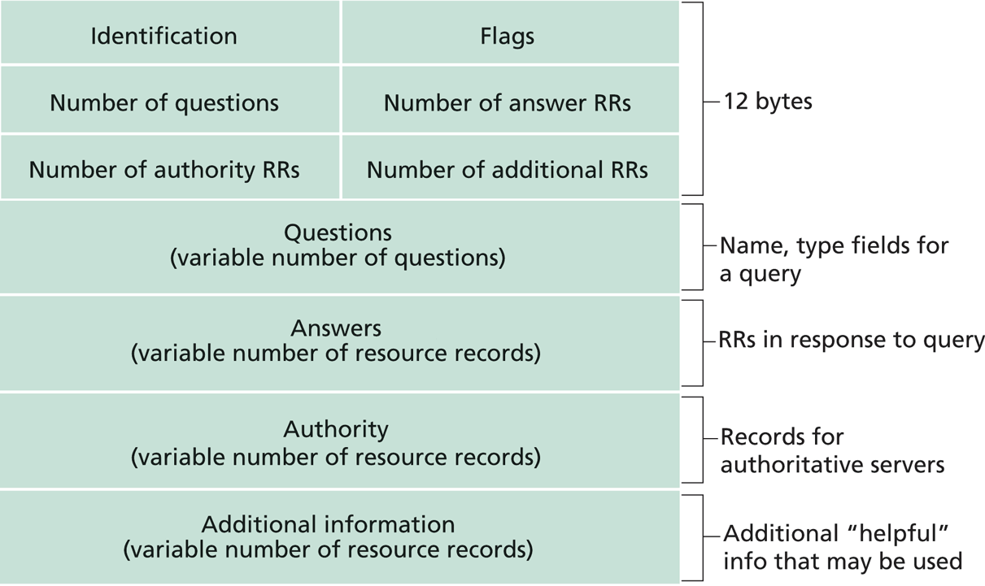
Exercise: UDP/DNS Server Pseudocode
Modify the example UDP server code to implement a local DNS server.
root name server
2
3
4
7
local name server
130.132.1.9
TLD name server
6
5
1
8
authoritative name server
dns.cs.umass.edu
requesting host
cyndra.cs.yale.edu
gaia.cs.umass.edu

Slide 17
UDP/DNS Implementation
Standard UDP demultiplexing (find out return address by src.addr/src.port of UDP packet) does not always work
DNS solution: identification: remember the mapping

Slide 18
Outline
Admin. and recap
Network application programming
Overview
UDP
Basic TCP

Slide 19
TCP Socket Design: Starting w/ UDP
server
client1
128.36.232.5 128.36.230.2
P1
Socket socket space
address: {*:9876}
snd/recv buf:
client2
P2
local port
Issue: If a single socket, data can be mixed, but TCP is designed to provide a pipe abstraction: server reads an ordered sequence of bytes from each individual client.
local address
sock.nextByte(client1)?
Issue 2: How to notify an app that a new client is connected?
newClient = sock.getNewClient()?

Slide 20
BSD TCP Socket API Design
server
socket for new connected clients
128.36.232.5 128.36.230.2
TCP socket space
address: {*:9876}
snd/recv buf:
client1
An individual socket for client 1
P1
address: {*:9876; client 1 IP/port}
snd/recv buf:
client2
An individual socket for client 2
address: {*:9876; client 2 IP/port}
snd/recv buf:
P2
Q: How to decide where to put a new TCP packet?
A: Packet demutiplexing is based on four tuples: (dst addr, dst port, src addr, src port)

Slide 21
TCP Connection-Oriented Demux
TCP socket identified by 4-tuple:
source IP address
source port number
dest IP address
dest port number
recv host uses all four values to direct segment to appropriate socket
different connections/sessions are automatically separated into different sockets

Slide 22
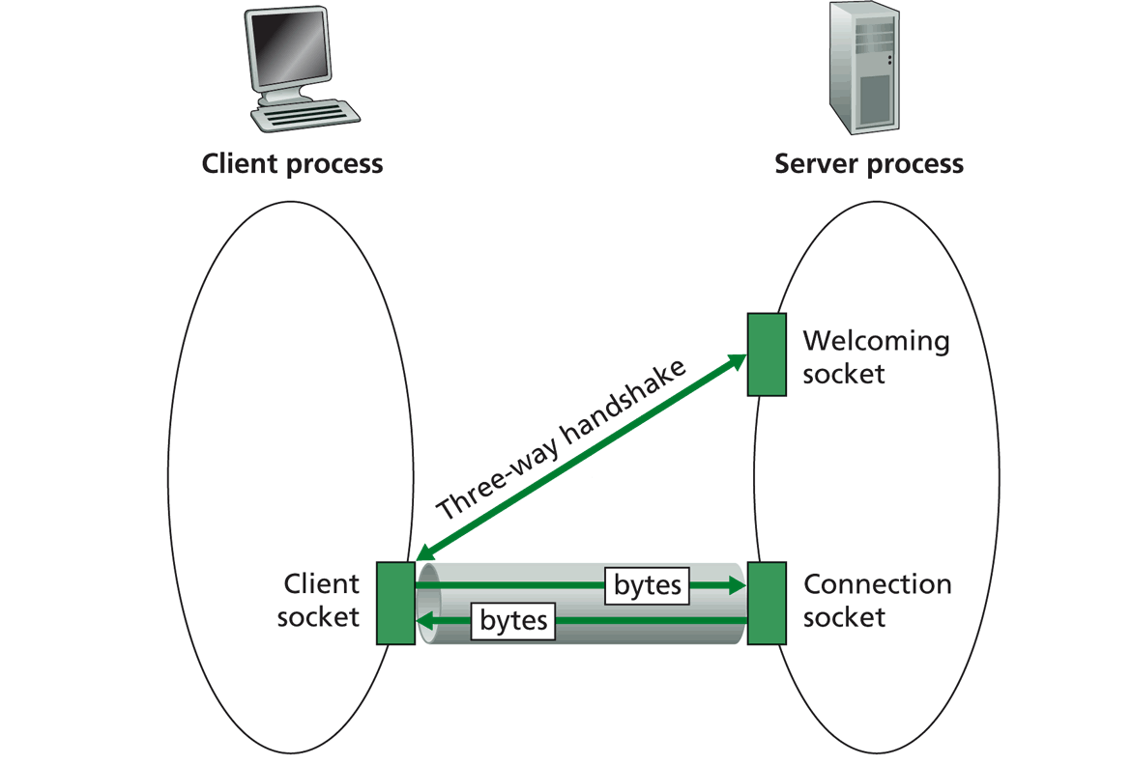
TCP Socket Big Picture
Welcome socket: the waiting room
connSocket: the operation room

Slide 23
Client/server Socket Workflow: TCP
Server (running on hostid)
Client
create socket,
port=x, for
incoming request:
welcomeSocket =
ServerSocket(x)
TCP
connection setup
create socket,
connect to hostid, port=x
wait for incoming
connection request
connectionSocket =
welcomeSocket.accept()
clientSocket =
Socket()
send request using
clientSocket
read request from
connectionSocket
write reply to
connectionSocket
read reply from
clientSocket
close
connectionSocket
close
clientSocket

Slide 24
Server Flow
Create ServerSocket(6789)
connSocket = accept()
read request from connSocket
Welcome socket: the waiting room
connSocket: the operation room
Serve the request
close connSocket

Slide 25
ServerSocket
ServerSocket()
creates an unbound server socket.
ServerSocket(int port)
creates a server socket, bound to the specified port.
ServerSocket(int port, int backlog)
creates a server socket and binds it to the specified local port number, with the specified backlog.
ServerSocket(int port, int backlog, InetAddress bindAddr)
creates a server with the specified port, listen backlog, and local IP address to bind to.
bind(SocketAddress endpoint)
binds the ServerSocket to a specific address (IP address and port number).
bind(SocketAddress endpoint, int backlog)
binds the ServerSocket to a specific address (IP address and port number).
Socket accept()
listens for a connection to be made to this socket and accepts it.
close()
closes this socket.

Slide 26
(Client)Socket
Socket(InetAddress address, int port)
creates a stream socket and connects it to the specified port number at the specified IP address.
Socket(InetAddress address, int port, InetAddress localAddr, int localPort)
creates a socket and connects it to the specified remote address on the specified remote port.
Socket(String host, int port)
creates a stream socket and connects it to the specified port number on the named host.
bind(SocketAddress bindpoint)
binds the socket to a local address.
connect(SocketAddress endpoint)
connects this socket to the server.
connect(SocketAddress endpoint, int timeout)
connects this socket to the server with a specified timeout value.
InputStream getInputStream()
returns an input stream for this socket.
OutputStream getOutputStream()
returns an output stream for this socket.
close()
closes this socket.

Slide 27
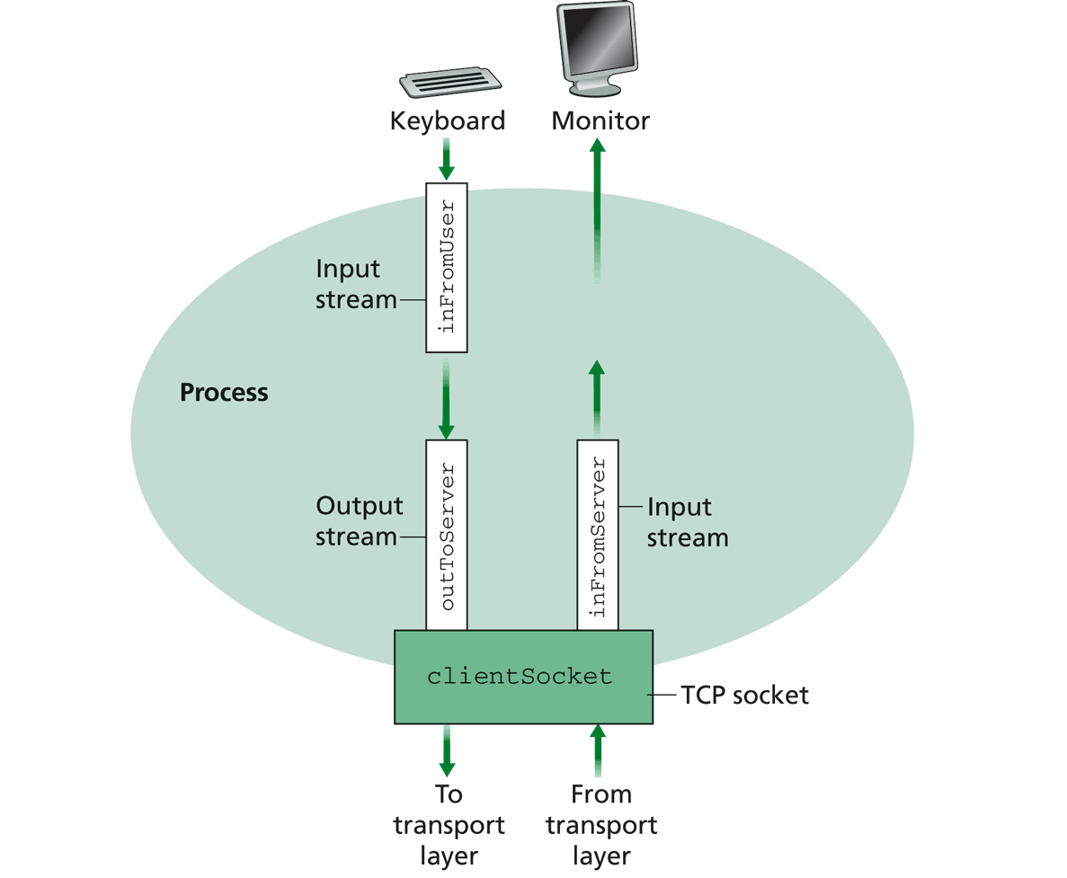
Simple TCP Example
Example client-server app:
1) client reads line from standard input (inFromUser stream) , sends to server via socket (outToServer stream)
2) server reads line from socket
3) server converts line to uppercase, sends back to client
4) client reads, prints modified line from socket (inFromServer stream)

Slide 28
Example: Java client (TCP)
import java.io.*;
import java.net.*;
class TCPClient {
public static void main(String argv[]) throws Exception
{
String sentence;
String modifiedSentence;
BufferedReader inFromUser =
new BufferedReader(new InputStreamReader(System.in));
sentence = inFromUser.readLine();
Socket clientSocket = new Socket(“server.name", 6789);
DataOutputStream outToServer =
new DataOutputStream(clientSocket.getOutputStream());
Create
input stream
Create
client socket,
connect to server
Create
output stream
attached to socket

Slide 29
OutputStream
public abstract class OutputStream
public abstract void write(int b) throws IOException
public void write(byte[] data) throws IOException
public void write(byte[] data, int offset, int length) throws IOException
public void flush( ) throws IOException
public void close( ) throws IOException

Slide 30
InputStream
public abstract class InputStream
public abstract int read( ) throws IOException
public int read(byte[] input) throws IOException
public int read(byte[] input, int offset, int length) throws IOException
public long skip(long n) throws IOException
public int available( ) throws IOException
public void close( ) throws IOException

Slide 31
Example: Java client (TCP), cont.
Send line
to server
outToServer.writeBytes(sentence + '\n');
BufferedReader inFromServer =
new BufferedReader(new
InputStreamReader(clientSocket.getInputStream()));
modifiedSentence = inFromServer.readLine();
System.out.println("FROM SERVER: " + modifiedSentence);
clientSocket.close();
}
}
Create
input stream
attached to socket
Read line
from server

Slide 32
Example: Java server (TCP)
import java.io.*;
import java.net.*;
class TCPServer {
public static void main(String argv[]) throws Exception
{
String clientSentence;
String capitalizedSentence;
ServerSocket welcomeSocket = new ServerSocket(6789);
while(true) {
Socket connectionSocket = welcomeSocket.accept();
BufferedReader inFromClient =
new BufferedReader(new
InputStreamReader(connectionSocket.getInputStream()));
Create
welcoming socket
at port 6789

Slide 33
Demo
% on MAC
start TCPServer
wireshark to capture our TCP traffic tcp.srcport==6789 or tcp.dstport==6789

Slide 34
Under the Hood: After Welcome (Server) Socket
server
client
128.36.232.5 128.36.230.2
198.69.10.10
TCP socket space
TCP socket space
state: listening
address: {*:6789, *:*}
completed connection queue:
sendbuf:
recvbuf:
state: starting
address: {198.69.10.10:1500, *:*}
sendbuf:
recvbuf:
local port
local addr
remote port
remote addr
state: listening
address: {*:25, *:*}
completed connection queue:
sendbuf:
recvbuf:
state: listening
address: {*:25, *:*}
completed connection queue:
sendbuf:
recvbuf:
%netstat –p tcp –n -a

Slide 35
After Client Initiates Connection
server
client
128.36.232.5 128.36.230.2
198.69.10.10
TCP socket space
TCP socket space
state: listening
address: {*:6789, *.*}
completed connection queue:
sendbuf:
recvbuf:
state: connecting
address: {198.69.10.10:1500, 128.36.232.5:6789}
sendbuf:
recvbuf:
state: listening
address: {*.25, *.*}
completed connection queue:
sendbuf:
recvbuf:
state: listening
address: {*.25, *.*}
completed connection queue:
sendbuf:
recvbuf:
%ubuntu java TCPClient <server> 6789

Slide 36
Example: Client Connection Handshake Done
server
client
128.36.232.5 128.36.230.2
198.69.10.10
TCP socket space
TCP socket space
state: listening
address: {*:6789, *:*}
completed connection queue: {128.36.232.5.6789, 198.69.10.10.1500}
sendbuf:
recvbuf:
state: connected
address: {198.69.10.10:1500, 128.36.232.5:6789}
sendbuf:
recvbuf:
state: listening
address: {*:25, *:*}
completed connection queue:
sendbuf:
recvbuf:
state: listening
address: {*:25, *:*}
completed connection queue:
sendbuf:
recvbuf:

Slide 37
Example: Client Connection Handshake Done
server
client
128.36.232.5 128.36.230.2
198.69.10.10
TCP socket space
TCP socket space
state: listening
address: {*.6789, *:*}
completed connection queue: sendbuf:
recvbuf:
state: connected
address: {198.69.10.10.1500, 128.36.232.5:6789}
sendbuf:
recvbuf:
state: established
address: {128.36.232.5:6789, 198.69.10.10.1500}
sendbuf:
recvbuf:
state: listening
address: {*.25, *:*}
completed connection queue:
sendbuf:
recvbuf:
state: listening
address: {*.25, *:*}
completed connection queue:
sendbuf:
recvbuf:
Packet demutiplexing is based on (dst addr, dst port, src addr, src port)
Packet sent to the socket with the best match!

Slide 38
Demo
What if more client connections than backlog allowed?
We continue to start java TCPClient

Slide 39
Example: Java server (TCP)
import java.io.*;
import java.net.*;
class TCPServer {
public static void main(String argv[]) throws Exception
{
String clientSentence;
String capitalizedSentence;
ServerSocket welcomeSocket = new ServerSocket(6789);
while(true) {
Socket connectionSocket = welcomeSocket.accept();
BufferedReader inFromClient =
new BufferedReader(new
InputStreamReader(connectionSocket.getInputStream()));
Wait, on welcoming
socket for contact
by client

Slide 40
Example: Server accept()
server
client
connectionSocket
128.36.232.5 128.36.230.2
198.69.10.10
TCP socket space
TCP socket space
state: listening
address: {*.6789, *:*}
completed connection queue: sendbuf:
recvbuf:
state: connected
address: {198.69.10.10.1500, 128.36.232.5:6789}
sendbuf:
recvbuf:
state: established
address: {128.36.232.5:6789, 198.69.10.10.1500}
sendbuf:
recvbuf:
state: listening
address: {*.25, *:*}
completed connection queue:
sendbuf:
recvbuf:
state: listening
address: {*.25, *:*}
completed connection queue:
sendbuf:
recvbuf:

Slide 41
Example: Java server (TCP): Processing
BufferedReader inFromClient =
new BufferedReader(new
InputStreamReader(connectionSocket.getInputStream()));
clientSentence = inFromClient.readLine();
capitalizedSentence = clientSentence.toUpperCase() + '\n'; DataOutputStream outToClient =
new DataOutputStream(connectionSocket.getOutputStream());
outToClient.writeBytes(capitalizedSentence);
}
}
}
Create input
stream, attached
to socket
Read in line
from socket

Slide 42
Example: Java server (TCP): Output
BufferedReader inFromClient =
new BufferedReader(new
InputStreamReader(connectionSocket.getInputStream()));
clientSentence = inFromClient.readLine();
capitalizedSentence = clientSentence.toUpperCase() + '\n'; DataOutputStream outToClient =
new DataOutputStream(connectionSocket.getOutputStream());
outToClient.writeBytes(capitalizedSentence);
}
}
}
Create output
stream, attached
to socket
Write out line
to socket
End of while loop,
loop back and wait for
another client connection

