Slide 1


Lab Assignment Three (Part 1): HTTP
Protocol and Web Server
Computer Networks and Network Security
Zhihao Zhang
2021.11.18

Slide 2
Assignment Requirements
Testbed for Performance Evaluation
Part 1a: Simple Client
Part 1b: Sequential and Per-thread HTTP Server
2

Slide 3
Connecting to the Server
Please Using ssh or other tools (Xshell) to connect to the server
59.77.13.187:7120 --- Server
Username: your initials in lowercase
Password: the last 4 digits of your student ID
59.77.13.187:7130 --- Client
Username: your initials in lowercase
Password: the last 4 digits of your student ID
3

Slide 4
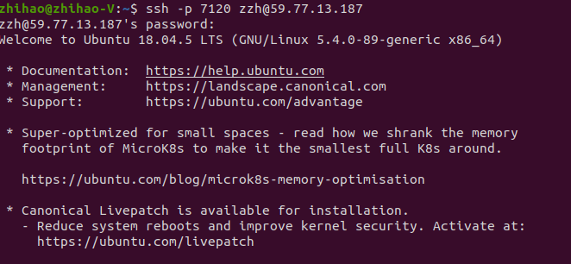
Connecting to the Server
Using ssh to connect to the server
Please using Git and Github (Gitee) to push or pull your code between the server and your host.
4

Slide 5
SSH-Key
The rsa_username file is in your folder (/home/username/).
Please downloading the rsa_username file to your host. The rsa_username file should be placed in the .ssh of your host.
You should use chmod to change the permissions of the file.
Then you can use ssh with ssh-key to connect to the server.
5

Slide 6
Testbed
192.168.0.120
192.168.0.130
Apache Web Server
Curl
Student1 Web Server
Student1 Client
Student2 Web Server
Student2 Client
...
...
StudentN Web Server
StudentN Client
Performance Evaluation: You need to measure the performance of using curl to access (Get Method) the web server you designed, and the performance of the client you designed to access (Get Method) the web server you designed.
6

Slide 7
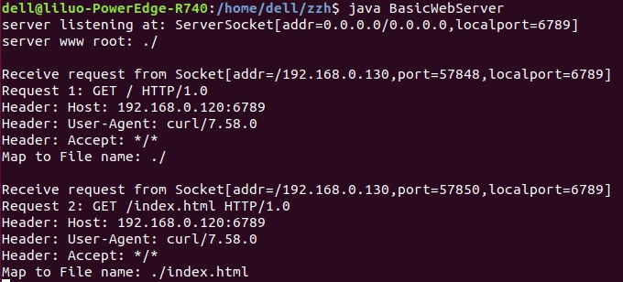
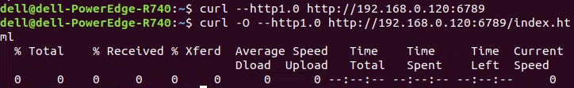
Testbed
192.168.0.120 Server
192.168.0.130
Client
It is recommended to use the last 4 digits of the student ID as the port.
7

Slide 8
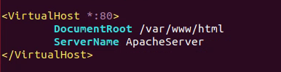
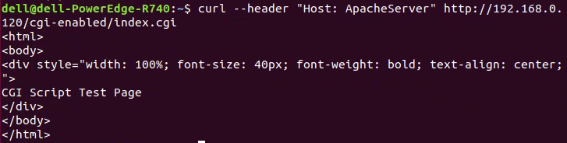
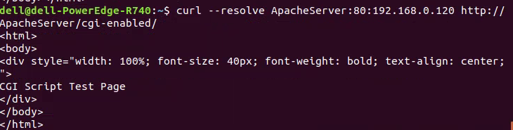
Testbed
192.168.0.120 Server
192.168.0.130
Client
Server: 192.168.0.120
VirtualHost:
Server name: ApacheServer
8

Slide 9

Simple Client
Client
Parameters(URL, # of threads, time of test)
Thread 1
……
Thread N
java SHTTPTestClient -server <server> -servname <server name>
GetMethod
Statistics
GetMethod
Statistics
IP address
Your server name of virtual host
Get Request
Get Request
Response Message
Response Message
The client simply discards the received reply.
The client stops after <time of test in seconds>.
Printing out the information of performance evaluation.
Server
9

Slide 10
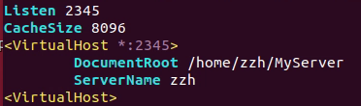
HTTP Server: Configuration
Listen yourPort
CacheSize 8096
<VirtualHost *:yourPort>
DocumentRoot yourDocument
ServerName yourServerName
<VirtualHost>
Config file of Apache Server
httpd.conf
Servername: “zzh”
HashMap
Using curl with server name to connect to the Apache Server.
Server
10

Slide 11
HTTP Server: Response Message
Client
Get Request
httpd.conf
Response Message
HashMap
HttpResponse
HTTP Response Message
Last-Modified: <date>
responseMessage
Server
send
11

Slide 12
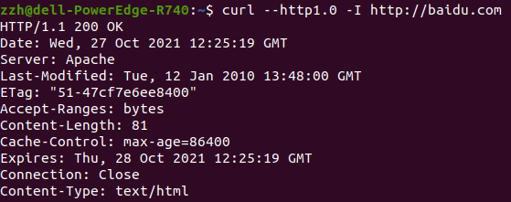
HTTP Server: Last-Modified
Last-Modified: <day-name>, <day> <month> <year> <hour>:<minute>:<second> GMT
<day-name>: One of "Mon", "Tue", "Wed", "Thu", "Fri", "Sat", or "Sun" (case-sensitive).
<day>: 2 digit day number, e.g. "04" or "23".
<month>: One of "Jan", "Feb", "Mar", "Apr", "May", "Jun", "Jul", "Aug", "Sep", "Oct", "Nov", "Dec" (case sensitive).
<year>: 4 digit year number, e.g. "1990" or "2016".
<hour>: 2 digit hour number, e.g. "09" or "23".
<minute>: 2 digit minute number, e.g. "04" or "59".
<second>: 2 digit second number, e.g. "04" or "59".
GMT: Greenwich Mean Time. HTTP dates are always expressed in GMT, never in local time.
12

Slide 13

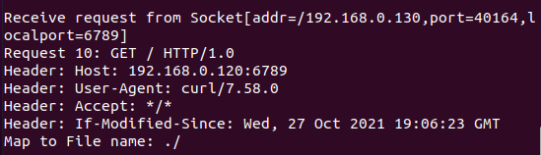
HTTP Server: Get Method
Curl with ‘If-Modified-Since’
Client
Printed after the HTTP server receives the request
Get Request
Response Message
HashMap
HttpRequest
getMethod
HTTP Request Message: GET
GET /somedir/page.html HTTP/1.0
User-agent: Mozilla/4.0
If-Modified-Since: <date>
parseHeader
Server
13

Slide 14
HTTP Server: If-Modified-Since
If-Modified-Since: <day-name>, <day> <month> <year> <hour>:<minute>:<second> GMT
<day-name>: One of "Mon", "Tue", "Wed", "Thu", "Fri", "Sat", or "Sun" (case-sensitive).
<day>: 2 digit day number, e.g. "04" or "23".
<month>: One of "Jan", "Feb", "Mar", "Apr", "May", "Jun", "Jul", "Aug", "Sep", "Oct", "Nov", "Dec" (case sensitive).
<year>: 4 digit year number, e.g. "1990" or "2016".
<hour>: 2 digit hour number, e.g. "09" or "23".
<minute>: 2 digit minute number, e.g. "04" or "59".
<second>: 2 digit second number, e.g. "04" or "59".
GMT: Greenwich Mean Time. HTTP dates are always expressed in GMT, never in local time.
14

Slide 15
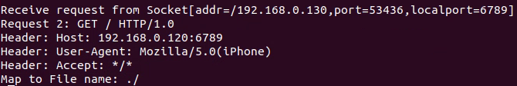
HTTP Server: User-Agent
User-Agent: <product> / <product-version> <comment>
<product>: A product identifier.
<product-version>: Version number of the product.
<comment>: Zero or more comments containing more details.
For example:
Mozilla/5.0 (Windows NT 10.0; Win64; x64) AppleWebKit/537.36 (KHTML, like Gecko) Chrome/91.0.4472.124 Safari/537.36 Edg/91.0.864.59
Mozilla/5.0 (iPhone; CPU iPhone OS 13_5_1 like Mac OS X) AppleWebKit/605.1.15 (KHTML, like Gecko) Version/13.1.1 Mobile/15E148 Safari/604.1
Curl with ‘User-Agent’
Printed after the HTTP server receives the request
15

Slide 16
HTTP Server: URL Mapping
Client
Get Request
httpd.conf
Response Message
http_URL = "http:" "//" host [ ":" port ] [ abs_path ]
If the User-Agent header indicates that the request is from a mobile handset (e.g., it should at least detect iphone by detecting iPhone in the User-Agent string), it should return index_m.html.
HashMap
HttpRequest
parseURL
Server
16

Slide 17
HTTP Server: Caching
Client
CacheSize <cache size in KBytes>
Get Request
httpd.conf
Response Message
HashMap
HttpRequest
HttpResponse
HashMap
Checker(…)
......
There is no cache replacement; i.e., when the cache is full, no addition to the cache.
HttpCache
Server
Disk
17

Slide 18
HTTP Server: CGI
Client
Get Request
httpd.conf
Response Message
HashMap
HttpRequest
HttpResponse
URL without parameters
cgiProcess
CGIProgram
URL with parameters
Server
Environment
18

Slide 19

HTTP Server: CGI
CGI: Invoking External Programs
Most of the information needed by CGI programs is made available via Unix environment variables.
The table below lists environment variables that you need to implement.
Environment Variable | Description
QUERY_STRING | The query information passed to the program. It is appended to the URL following a question mark (?).
REMOTE_ADDR | The remote IP address from which the user is making the request.
REMOTE_HOST | The remote hostname from which the user is making the request.
REMOTE_IDENT | The user making the request.
REMOTE_USER | The authenticated name of the user making the query.
REQUEST_METHOD | The method with which the information request was issued (e.g., GET).
SERVER_NAME | The server's hostname or IP address.
SERVER_PORT | The port number of the host on which the server is running.
SERVER_PROTOCOL | The name and revision number of the server protocol.
SERVER_SOFTWARE | The name and version of the server software that is answering the client request.
19

Slide 20
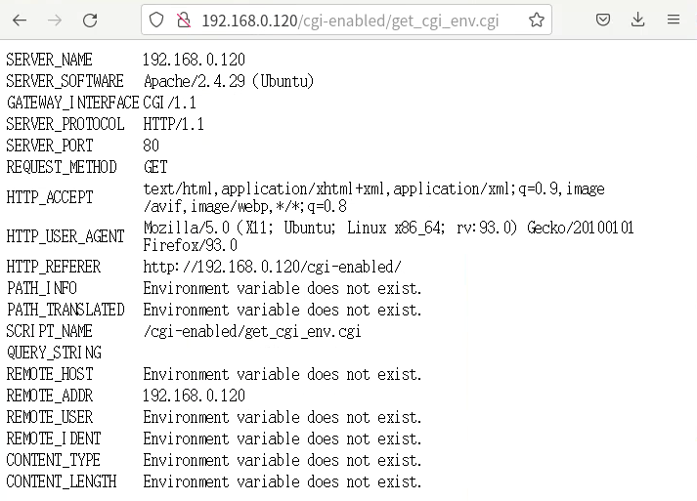
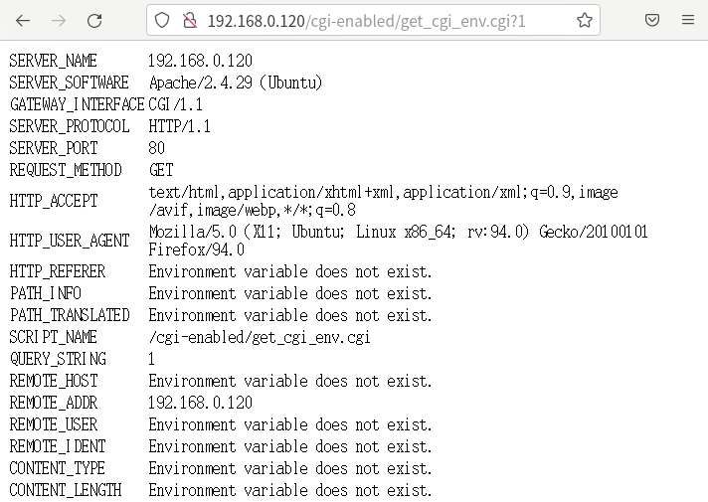

HTTP Server: CGI
20

Slide 21
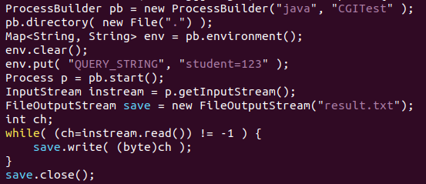

HTTP Server: CGI
The java.lang.System class provides the getenv static method to access a process's environment.
System.out.println("method = " + System.getenv("REQUEST_METHOD"));
System.out.println("query = " + System.getenv("QUERY_STRING"));
Class ProcessBuilder
21

Slide 22
HTTP Server: Heartbeat Monitoring
Client
Monitor <MyCoolMonitorClassName>
Get Request
httpd.conf
Response Message
Epoch-based Monitor:
HealthChecker(…): Checking the number of get requests once after a period of time.
HashMap
CoolMonitor
HttpResponse
503
200
HttpRequest
Server
22

Slide 23
Notes
Please using CamelCase style to name your classes, functions and variables. Standard English spelling and grammar make it easy for others to read and understand.
Please include a README in your submission to tell the TA the directory structure. Please generate a single tar or zip file containing all of your files.
Please contact the TA (zhihao AT stu.xmu.edu.cn) in time if you encounter problems such as not being able to connect to the server.
23

Slide 24
Thank you!

