Slide 1






Flash: Fast, Consistent Data Plane Verification for Large-Scale Network Settings
Dong Guo*, Shenshen Chen*, Kai Gao⁺,
Qiao Xiang^, Ying Zhang#, Y. Richard Yang† ﻿
* Tongji University, ⁺ Sichuan University, ^Xiamen University, #Meta Inc., † Yale University
SIGCOMM’22, August 24, 2022, Amsterdam, Netherlands
Notes:
Flash: Fast, consistent data plane verification for large-scale network settings.

Slide 2

Workflow of Data Plane Verification
Requirements
E.g., packets with dstIP 10.0.0.0/8 must reach C
Data plane verification system
Results
FIB updates
A
C
10.0.0.0/8
B
Notes:
Data plane verification is an important technique to reduce network disruptions. In a nutshell, $ the data plane verification system collects the FIB snapshot and monitors the FIB updates from the network devices, $ the system takes a set of network requirements, $ then checks the validity of the requirements and generates the results.
EOF
current data plane verification systems are usually built in the following way, A data plane verification system collects the FIB snapshot and FIB updates from the network devices, then checks requirements and generates the verification results incrementally.
$ a server or a cluster of servers collects the FIB snapshot and FIB updates from the network devices, and constructs a network model.
$ A requirement checker is responsible for checking the network requirements on the network model, and generating the verification results.
$ To achieve fast data plane verification, it is essential to speed up the process of the model construction and requirement checker.
$ Existing work mainly use two types of representations for the model, one is the rule based model, such as HSA and NetPlumber, another is equivalence classes based model. Since the eq
State of the art use the following workflow
+ related work, ap,apkeep,delta-net,veriflow,has,netplumber, libra,drdc
Previous based on rule, new based on EC with different format

Slide 3
Workflow of Data Plane Verification
Construct a network model
Requirements
Rule based model:
E.g., HSA (Kazemian et.al, NSDI’12), NetPlumber (Kazemian et.al, NSDI’13)
Equivalence classes (EC) based model:
E.g., APV (Yang et.al, ICNP’13), Veriflow (Khurshid et.al, NSDI’13), Libra (Zeng et.al, NSDI’14), Delta-net (Horn et.al, NSDI’17), APKeep (Zhang et.al, NSDI’20)
Model
Requirement checker
Results
FIB updates
Check requirements on the network model
Notes:
The state of the art data plane verification systems build a network model from the collected FIBs, $ and then check the network requirements on the network model.
$ To speedup the verification process, existing work mainly uses two types of representations for the model,
$ one is the rule based model, such as HSA and NetPlumber,
$ another is equivalence classes based model. Since the equivalence classes distinguish the header spaces by network behaviors, it is easy to construct a forwarding graph for each equivalence class and makes the requirement checking efficient.
EOF
$ To achieve fast data plane verification, it is essential to speed up the process of the model construction and requirement checker.
Data plane verification is an important technique to reduce network disruptions, current data plane verification systems are usually built in the following way,
$ a server or a cluster of servers collects the FIB snapshot and FIB updates from the network devices, and constructs a network model.
$ A requirement checker is responsible for checking the network requirements on the network model, and generating the verification results.
$ To achieve fast data plane verification, it is essential to speed up the process of the model construction and requirement checker.
$ Existing work mainly use two types of representations for the model, one is the rule based model, such as HSA and NetPlumber, another is equivalence classes based model. Since the eq
State of the art use the following workflow
+ related work, ap,apkeep,delta-net,veriflow,has,netplumber, libra,drdc
Previous based on rule, new based on EC with different format

Slide 4
Problems of Existing Tools in Large-Scale Network Settings
Extremes in large-scale network settings
Update storms: A large number of data plane updates arrive in a short time
Requirements
Example: Rollout a new Pod in a K-ary Fat tree network, each Pod has P prefixes
Model
Requirement checker
Results
Existing tools (e.g., APKeep (Zhang et.al, NSDI’20), Delta-net (Horn et.al, NSDI’17)) are designed to process a single update each time
Update storm
Notes:
However, when we apply the existing data plane verification tools to large-scale networks, two problems arise due to two extremes.
$ First, existing techniques cannot handle too-fast arrivals, which we call update storms, when a large number of data plane updates arrive in a short time
$ For example, when we roll out a new POD in a K-ary fat tree network where each POD has P prefixes, we can see that with the growth of network scale, the number of FIB updates is also rapidly increasing.
$Existing tools have a bad performance in such scenarios because they are designed to handle a single update each time.

Slide 5
Problems of Existing Tools in Large-Scale Network Settings
Extremes in large-scale network settings
Long-tail arrivals: Take a long time to collect the updates from all devices
Requirements
Model
Existing tools (e.g., APKeep (Zhang et.al, NSDI’20) , Delta-net (Horn et.al, NSDI’17)):
Wait for all updates to arrive
Or proceed with a transient and potentially inconsistent data plane state
Requirement checker
Results
Incast congestion
Long-tail arrival
Insufficient computational resources
FIB computation crash
Dampened FIB computation due to unstable links
Notes:
Second, existing techniques cannot handle well too-slow arrivals, which we call long-tail arrivals, when it takes a long time to collect the updates from all devices. Long-tail arrivals can happen for multiple reasons, such as
$ Fib computation crash
$ Insufficient computational resources
$ Dampened FIB computation due to unstable links
$ Or incast congestion
Existing tools are designed with complete information of the data plane, and hence they either:
$ Wait for all updates to arrive, which can result in a long delay
$ Or proceed with transient, potentially inconsistent data plane state, which can result in wrong results

Slide 6
High-level Ideas of Flash
Update storms
Process a block of updates rather than a single update each time
Long-tail arrivals
Verify with incomplete data plane state
Requirements
Model
Requirement checker
Results
Verify with incomplete data plane state
Update block
Realizing these ideas is not trivial
FIB updates
Notes:
Flash designs two mechanisms to address the above issues.
$ First, for update storms, the core idea is that we take and process a block of updates rather than a single update each time.
$ For long-tail arrivals, we verify the requirements with incomplete data plane state
$ However, realizing the ideas is not trivial

Slide 7
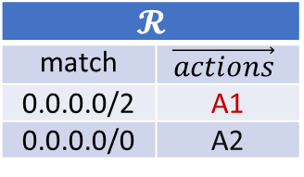
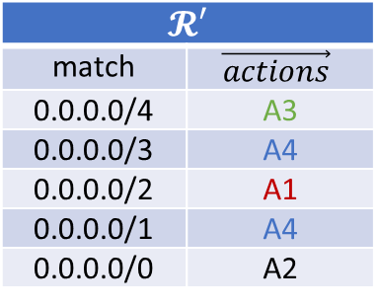
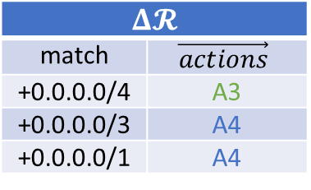
Challenges of Processing a Block of Updates
Naively aggregating rule updates can be incorrect
FIB updates
Final data plane
Data plane of an IPv4 network
$$𝓡′$$
match | $$\vec{actions}$$
0.0.0.0/4 | A3
0.0.0.0/3 | A4
0.0.0.0/2 | A1
0.0.0.0/1 | A4
0.0.0.0/0 | A2
$$𝓡$$
match | $$\vec{actions}$$
0.0.0.0/2 | A1
0.0.0.0/0 | A2
$$Δ𝓡$$
match | $$\vec{actions}$$
+0.0.0.0/4 | A3
+0.0.0.0/3 | A4
+0.0.0.0/1 | A4
0.0.0.0/2
0.0.0.0/1
EC1
EC2
EC4
EC3
EC1
EC3
EC2
0.0.0.0/0
0.0.0.0/4
16.0.0.0/4
32.0.0.0/3
64.0.0.0/2
Equivalence classes
Equivalence classes
Notes:
First, for processing a block of updates, simply aggregating rule updates can be in incorrect.
For example, $ R is the data plane of an IPv4 network that using longest prefix match, and each device have two rules.
$ And there are two equivalence classes for the network.
$ When we insert three rules on each device as shown in the delta R,
$ This will create two more equivalence classes for the network model

Slide 8
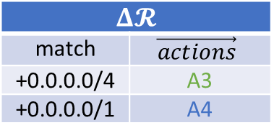
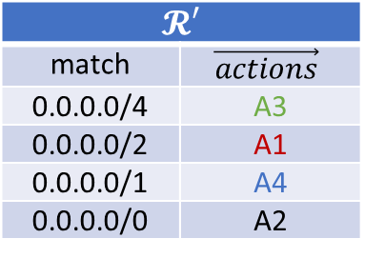
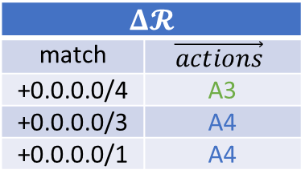
Challenges of Processing a Block of Updates
Naively aggregating rule updates can be wrong
FIB updates
Data plane of an IPv4 network
$$Δ𝓡$$
match | $$\vec{actions}$$
+0.0.0.0/4 | A3
+0.0.0.0/3 | A4
+0.0.0.0/1 | A4
Final data plane
$$𝓡$$
match | $$\vec{actions}$$
0.0.0.0/2 | A1
0.0.0.0/0 | A2
$$𝓡′$$
match | $$\vec{actions}$$
0.0.0.0/4 | A3
0.0.0.0/2 | A1
0.0.0.0/1 | A4
0.0.0.0/0 | A2
$$Δ𝓡$$
match | $$\vec{actions}$$
+0.0.0.0/4 | A3
+0.0.0.0/1 | A4
0.0.0.0/2
0.0.0.0/1
Incorrect
EC1
EC2
EC4
EC1
EC3
EC3
EC2
0.0.0.0/0
0.0.0.0/3
32.0.0.0/3
64.0.0.0/2
Equivalence classes
Equivalence classes
Notes:
However, if we aggregate the rule updates, for example, we aggregate the last two updates since they have the same action, $ we will get an incorrect model.

Slide 9
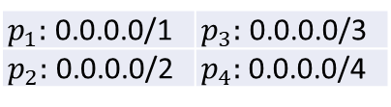
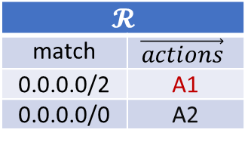
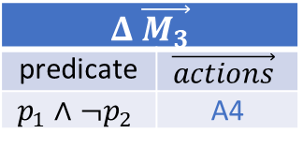
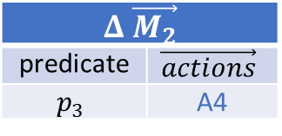
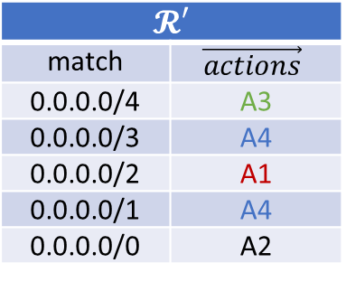
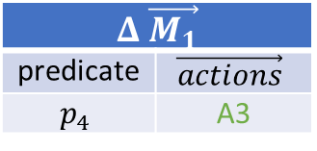
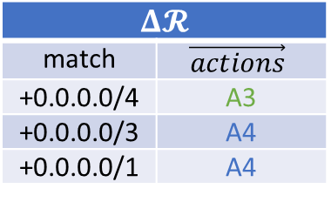
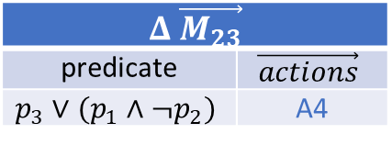
Challenges of Processing a Block of Updates
Aggregate updates from per-rule transformation also can be wrong
$$𝓡′$$
match | $$\vec{actions}$$
0.0.0.0/4 | A3
0.0.0.0/3 | A4
0.0.0.0/2 | A1
0.0.0.0/1 | A4
0.0.0.0/0 | A2
$$𝓡$$
match | $$\vec{actions}$$
0.0.0.0/2 | A1
0.0.0.0/0 | A2
$$Δ𝓡$$
match | $$\vec{actions}$$
+0.0.0.0/4 | A3
+0.0.0.0/3 | A4
+0.0.0.0/1 | A4
$$Δ \vec{M_{1}}$$
predicate | $$\vec{actions}$$
$$p_{4}$$ | A3
$$Δ \vec{M_{2}}$$
predicate | $$\vec{actions}$$
$$p_{3}$$ | A4
$$Δ \vec{M_{3}}$$
predicate | $$\vec{actions}$$
$$p_{1}∧¬p_{2}$$ | A4
$$Δ \vec{M_{23}}$$
predicate | $$\vec{actions}$$
$$p_{3}∨{(p_{1}∧¬p}_{2})$$ | A4
$p_{1}:$ 0.0.0.0/1 | $p_{3}:$ 0.0.0.0/3
$p_{2}:$ 0.0.0.0/2 | $p_{4}:$ 0.0.0.0/4
Not conflict-free
0.0.0.0/2
0.0.0.0/1
Incorrect
EC1
EC2
EC3
EC1
EC3
EC2
0.0.0.0/0
0.0.0.0/3
32.0.0.0/3
64.0.0.0/2
Notes:
In addition, Aggregate updates from per-rule transformation also can be wrong. For example,
$ We first computes the model updates for each rule update.
$ If we aggregate the last two model updates since they have the same network behavior,
$ Applying these model updates will still get an incorrect model.
$ The reason is that the model updates are not conflict-free, thus we cannot simply compose these model updates.

Slide 10
Challenges of Verifying with Incomplete Data Plane State
The verification results can be incorrect
10.0.0.0/8 -> A
10.0.0.0/8 -> S2
10.0.0.0/8 -> A
10.0.0.0/8 -> S1
A
S1
S3
B
A
S1
S3
B
S2
S2
S3 updates FIB before S2
Link down
No loop
10.0.0.0/8 -> S1
10.0.0.0/8 -> S3
Receive updates from S2 first due to the asynchrony of the update collection
A
S1
S3
B
A
S1
S3
B
S2
S2
Loop
Forwarding graph for header space 10.0.0.0/8
Forwarding graph after receiving updates from S2
Notes:
There are also challenges for verification with incomplete and inconsistent data plane state,
$ first, the verification result can be incorrect.
$ For example, in this three nodes topology, each node has a forwarding rule for prefix 10.0/8.
$ The forwarding graph for the header space is shown in the bottom.
$ When the link between S1 and S2 is down, S2 and S3 will update its FIB as shown in the green rectangles.
$ If S3 updates its FIB before S2, there will be no loop in the network.
$ However, if the verification system receives the updates from S2 first due to the asynchrony of the update collection, we will get a forwarding graph that has a loop between S2 and S3.

Slide 11
Challenges of Verifying with Incomplete Data Plane State
The verification results may come from an inconsistent data plane state
10.0.0.0/8 -> S1
10.0.0.0/8 -> S1
10.0.0.0/8 -> A
S3
10.0.0.0/8 -> S1
10.0.0.0/8 -> A
S3
10.0.0.0/8 -> S2
A
S1
S4
B
A
S1
S4
B
S2
S2
Update for link event S1-S4
Update for link event S1-S2
10.0.0.0/8 -> S4
10.0.0.0/8 -> S1
Will quickly change when the network is converging
S3
S3
A
S1
S4
B
A
S1
S4
B
S2
S2
Loop
Forwarding graph for header space 10.0.0.0/8
Forwarding graph for header space 10.0.0.0/8
Notes:
In addition, The verification results may come from an inconsistent data plane state.
$ For example, in this four nodes network along with the forwarding graph for header space 10.0/8
$ when there are two links down in a short time, the devices may have different view of the network state.
$ For example, S2 sees the link S1-S2 is down first, and updates its FIB to send the prefix to S4.
$ While S4 sees the link S1-S4 down first, and updates its FIB to send the prefix to S2.
$ After processing these updates, the forwarding graph for this inconsistent data plane state will contain a loop between S2 and S3.
$ However, the result could be useless because the result will quickly change when the network is converging.

Slide 12
Flash: Fast, Consistent Data Plane Verification for Large-Scale Network Settings
Notes:
Now we introduce the Flash design to address the above issues

Slide 13
Flash Overview
Model manager
Requirements
Model 1
Model 2
Model N
Incremental
requirement checker
Results
…
Fast IMT:
Fast Inverse Model Transformation
…
Update blocks
Update dispatcher
CE2D:
Consistent, Efficient Early Detection
Tagged FIB updates
Agent
Agent
Agent
Notes:
We first give an overview of Flash
$ Specifically, Flash augments the routing software on each device with an agent, the agent monitors the FIB updates, and associates the updates with network states using tags
$ The tagged FIB updates are then sent to an update dispatcher
$ The dispatcher batches the updates according to the tags and generates update blocks
$ Then, the update blocks are sent to the model manager to update models.
$ Finally, Flash adopts an incremental requirement checker to verify the requirements on the models.
This workflow reveals two important and novel techniques in Flash,
$ First, Flash introduces Fast Inverse Model Transformation to achieve fast model construction and update.
$ Second, the workflow enables Flash to achieve Consistent, Efficient Early Detection to efficiently detect consistent errors with incomplete data plane state.
EOF
Flash introduces a coherent system that can efficiently handle update-storms, long-tail arrivals, or both.

Slide 14
Fast IMT: Fast Inverse Model Transformation
Model manager
Requirements
Model 1
Model 2
Model N
Incremental
requirement checker
Results
…
Fast IMT:
Fast Inverse Model Transformation
…
Update blocks
Update dispatcher
CE2D:
Consistent, Efficient Early Detection
Tagged FIB updates
Agent
Agent
Agent
Notes:
We first introduce how Flash achieves fast model construction and update using Fast IMT, especially in update-storm settings.

Slide 15
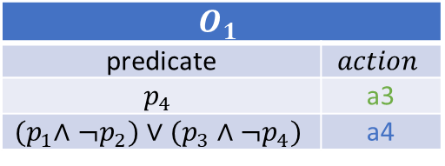
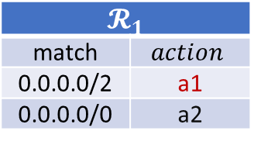
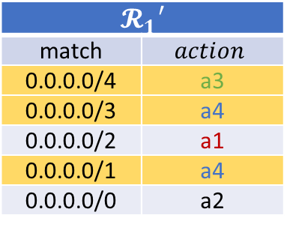

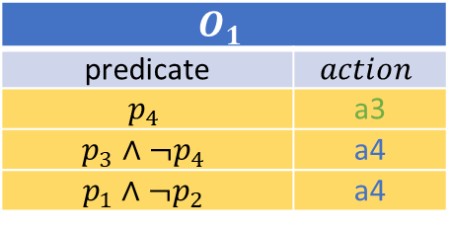
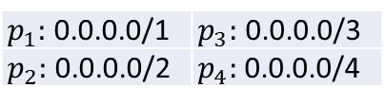
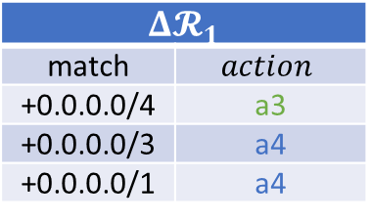
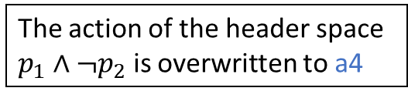
Fast IMT: Fast Inverse Model Transformation
Core idea: Transform native rule updates to conflict-free overwrites
FIB of a switch
FIB updates
$$𝓡_{1}$$
match | $$action$$
0.0.0.0/2 | a1
0.0.0.0/0 | a2
$$Δ𝓡_{1}$$
match | $$action$$
+0.0.0.0/4 | a3
+0.0.0.0/3 | a4
+0.0.0.0/1 | a4
The conflict-free overwrites are order independent and allow composition
1. Find expanding rules while applying $ΔR_{1}$ to $R_{1}$
2. Compute conflict-free overwrites for the expanding rules
3. Aggregate by action
$$𝓡_{1}′$$
match | $$action$$
0.0.0.0/4 | a3
0.0.0.0/3 | a4
0.0.0.0/2 | a1
0.0.0.0/1 | a4
0.0.0.0/0 | a2
$$O_{1}$$
predicate | $$action$$
$$p_{4}$$ | a3
$$p_{3}∧¬p_{4}$$ | a4
$$p_{1}∧¬p_{2}$$ | a4
$$O_{1}$$
predicate | $$action$$
$$p_{4}$$ | a3
$${(p}_{1}∧¬p_{2})∨(p_{3}∧¬p_{4})$$ | a4
Expanding rules
No overlap
The action of the header space $p_{1}∧¬p_{2}$ is overwritten to a4
$p_{1}:$ 0.0.0.0/1 | $p_{3}:$ 0.0.0.0/3
$p_{2}:$ 0.0.0.0/2 | $p_{4}:$ 0.0.0.0/4
Notes:
The core idea for Fast IMT is transforming the native rule updates of an update block to conflict-free overwrites.
Specifically, Flash first computes the conflict-free overwrites for each switches.
$ In this example, we show the FIB and the updates for a switch,
$ Flash first finds the expanding rules while applying delta R to R, where each expanding rule indicates the header space that hits the rule may be expanded.
$ Then Flash computes the conflict-free overwrites for each expanding rule, each predicate in the conflict-free overwrites is the header space that hits a rule,
$ thus the predicates do not overlap each other, therefore we call them conflict-free overwrites.
$ This conflict-free property indicates the overwrites are order independent, thus we can do composition.
$ For example, we can aggregate the conflict-free overwrites by action.

Slide 16

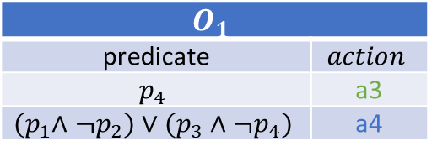
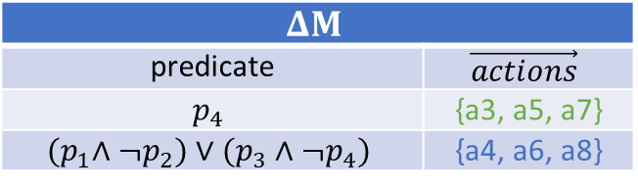
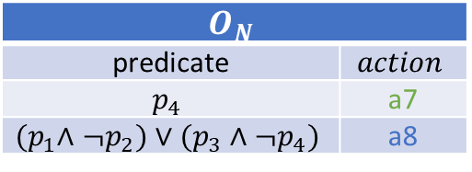
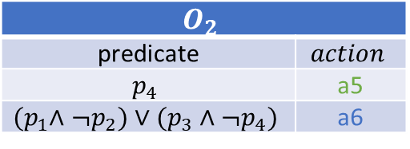
Fast IMT: Fast Inverse Model Transformation
Aggregate conflict-free overwrites of all devices
$$O_{1}$$
predicate | $$action$$
$$p_{4}$$ | a3
$${(p}_{1}∧¬p_{2})∨(p_{3}∧¬p_{4})$$ | a4
4. Aggregate by predicate
$$ΔM$$
predicate | $$\vec{actions}$$
$$p_{4}$$ | {a3, a5, a7}
$${(p}_{1}∧¬p_{2})∨(p_{3}∧¬p_{4})$$ | {a4, a6, a8}
$$O_{2}$$
predicate | $$action$$
$$p_{4}$$ | a5
$${(p}_{1}∧¬p_{2})∨(p_{3}∧¬p_{4})$$ | a6
Implementation:
A MapReduce (MR2) framework
Optimizations:
Efficient data structures for prefixed rules and persistent action tree
…
$$O_{N}$$
predicate | $$action$$
$$p_{4}$$ | a7
$${(p}_{1}∧¬p_{2})∨(p_{3}∧¬p_{4})$$ | a8
5. Apply to model
0.0.0.0/1
0.0.0.0/2
EC1
EC2
EC4
EC3
EC1
EC3
EC2
0.0.0.0/0
0.0.0.0/4
16.0.0.0/4
32.0.0.0/3
64.0.0.0/2
Notes:
Then Flash aggregates the conflict-free overwrites by predicate across all devices to derive the model updates.
$ By applying this model updates to the original model, we get the correct final model.
$ Moreover, Flash uses a map reduce framework which is called MR2 to implement the above process. And, we also implement the efficient data structures for prefixed rules and action vectors, please refer to our paper for implementation details and correctness proof.

Slide 17
CE2D: Consistent, Efficient Early Detection
Model manager
Requirements
Model 1
Model 2
Model N
Incremental
requirement checker
Results
…
Fast IMT:
Fast Inverse Model Transformation
…
Update blocks
Update dispatcher
CE2D:
Consistent, Efficient Early Detection
Tagged FIB updates
Agent
Agent
Agent
Notes:
Now we introduce how flash achieves consistent efficient early detection using CE2D.

Slide 18
CE2D: Consistent, Efficient Early Detection
10.0.0.0/8 -> S1
Core idea: Construct models for consistent data plane states
10.0.0.0/8 -> A
S3
10.0.0.0/8 -> S1
A
S1
S4
B
S2
10.0.0.0/8 -> S1
Timeline
S2: 10.0.0.0/8 -> S4
S4: 10.0.0.0/8 -> S2
S4: 10.0.0.0/8 -> S3
Two links are down
S1: 10.0.0.0/8 -> A
S3: 10.0.0.0/8 -> S1
S2: 10.0.0.0/8 -> S4
S1: 10.0.0.0/8 -> A
Network state: S1-S2 is down
Network state: S1-S4 is down
S3: 10.0.0.0/8 -> S1
Network state: S1-S2 and S1-S4 are down
Unsynchronized nodes
Synchronized nodes
S3
S3
S3
A
S1
S4
A
S1
S4
A
S1
S4
B
B
B
S2
Consistent models
S2
S2
Notes:
The core idea of CE2D is constructing models for consistent data plane states.
$ In this example, when two links are down in a short time, we use a timeline to show a sample FIB updates.
$ The devices may see different view of the network and generates updates according to their local view, in this example, there can be three network states.
$ For each network state, we construct a model and only applies the updates that are computed from the same network state.
$ When all of the updates for a network state are received from a device, we apply the updates to the corresponding model, and mark the device as synchronized. And we check requirements only among the synchronized nodes.
$ Since the models are constructed from a consistent network state, we call them consistent models.

Slide 19
Consistent Model Construction
Flash augments the routing software to associate the network states with updates using tags.
Consistent models
S1
Agent
Model 1
S2
Agent
Model 2
…
S3
Agent
Model N
Tagged rule updates (tags are differentiate by color)
Notes:
Specifically, to construct consistent models,
$ Flash augments the routing software with an agent to associate the network states with updates using tags

Slide 20
Consistent Model Construction
Flash augments the routing software to associate the network states with updates using tags
Flash dispatches the rule updates computed from different network states by dividing them into epochs.
Consistent models
Updates in epoch 1
S1
Agent
Model 1
{S1}
Updates in epoch 2
Agent
Dispatcher
Model 2
{S2}
Synchronized
nodes
S2
Updates in epoch N
…
S3
Agent
Model N
{S1}
Tagged rule updates (tags are differentiate by color)
Notes:
Then, Flash dispatches the rule updates computed from different network states by dividing them into epochs,
$ when all the updates from a switch for an epoch are received, the updates are applied to the model, and the switch is marked as synchronized

Slide 21
Incremental Requirement Checking
Regular expression based requirements:
Incremental reachability query on decremental verification graphs
W
E
Verification graph
S
A
B
C
D
A2
10/8
E1
Topology
Y
Update 1:
dstIP=10/8: [S -> A]
W1
Y1
S1
A1
B1
C1
D1
.
.
S
W|Y
D
Update 2:
dstIP=10/8: [A->B, B->E, E->C]
E2
Y2
Automata
Requirement:
Packets with dstIP 10/8 from S must follow path S.*(W|Y).*D
Incremental loop check:
Hyper node abstraction with incremental traversal
Notes:
Flash incrementally checks requirements on the consistent models.
$ For general regular expression-based requirements, Flash performs incremental reachability query on a decremental verification graph.
$ Specifically, Flash constructs a verification graph for each requirement as shown in the example.
$ $ When more and more devices become synchronized, $ $ the number of edges and nodes in the verification graph will reduce.
$ Besides the general regular expression requirements, Flash also develops efficient incremental loop detection using a hyper node abstraction. Please refer to the paper for details.

Slide 22
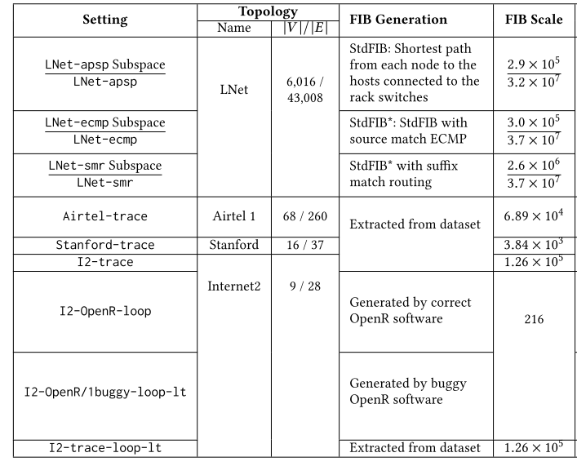
Evaluation
Settings
Update-storm settings
3 large-scale networks using a real Facebook data center topology
3 small-scale networks from the open datasets
Long-tail arrival settings
2 real OpenR deployments using the Internet2 topology
1 small-scale simulation using the Internet2 open dataset
Notes:
We evaluate Flash under various update-storm and long-tail arrival settings with networks of different scales. Please refer to our paper for details.

Slide 23
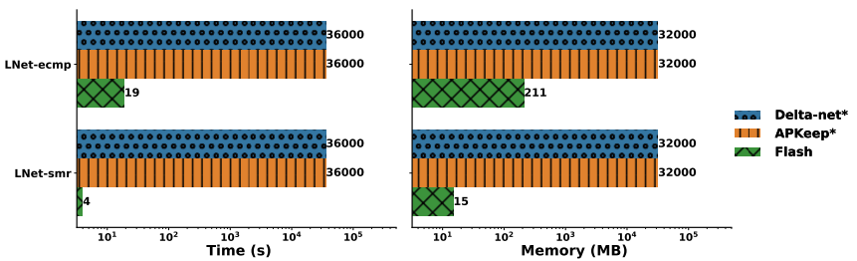
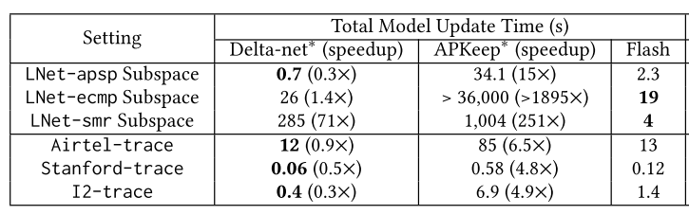
Effects of Fast IMT
Baseline: Update storms in 2 large-scale networks with complex forwarding behaviors
Compare with APKeep* and Delta-net* (self-implemented)
9000x speed-up
Subspace partition
Small-scale networks
Notes:
We first evaluate the effects of Fast IMT using the update-storm settings.
$ The baseline is chosen as the two large-scale networks with complex forwarding behaviors.
$ We compare Flash with APKeep and Delta-net, since their source code is not released, we implement their core algorithms according to their papers.
$ From the results, we see that both APKeep and Delta-net cannot finish processing the update storms within ten hours, and the memory consumption also reaches to the server capacity. However, Flash can successfully process the update-storms in 19 and 4 seconds for two large-scale settings, yielding a 9000 times speedup, and the memory consumption is also low.
Note that Flash adopts header space partition. Then we use the same partition strategy for APKeep and Delta-net, and also evaluate them on the small-scale networks.
$ From the result, we can see that Flash is faster than APKeep in all settings, but for some settings, Delta-net is relatively faster than Flash. The efficiency of Delta-net comes from its simple, efficient data structure, which works efficiently for prefix-based rules.
$ However, this representation can suffer significant performance degradation for non-prefix rules, as shown in the third settings in the table.

Slide 24
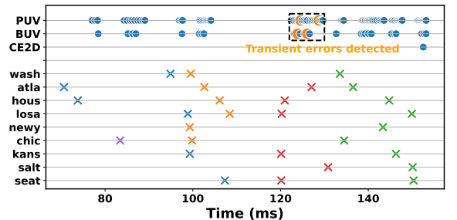
Ability to Achieve Consistent Detection
OpenR network with Internet2 topology
Report no loops
Report a loop
Transient loops
Bring down links chic-atla and chic-kans
Per-update verification (PUV):
Check loops after processing a single rule update
Block-update verification (BUV):
Check loops after processing a block of updates
Cross point (x, y):
The verifier receives updates at time x from a switch y
Notes:
Then we evaluate the ability of Flash to achieve consistent detection.
Specifically, $ we construct a network with the Internet2 topology with real OpenR instances. And the verifier is configured to check loops.
$ Then we trigger the FIB updates by bringing down two links consecutively.
$ Each switch generates tagged rule updates and sends the updates to the verifier. As shown in the figure, each cross point indicates the verifier receives rule updates from a device, and different color indicates different tags of the updates
And we compare CE2D with two strategies:
$ One is Per-update verification (PUV) which checks loops after processing each rule update
$ Another is Block-update verification (BUV) which checks loops after processing a block of updates
$ From the result, The dot points represent that the verifier reports a deterministic result, where orange indicates a loop and blue indicates no loops.
$ We see that both PUV and BUV report transient loop errors, which are inconsistent with the final verification results, while Flash does not report false-positive errors and guarantees that the verification result is consistent.

Slide 25
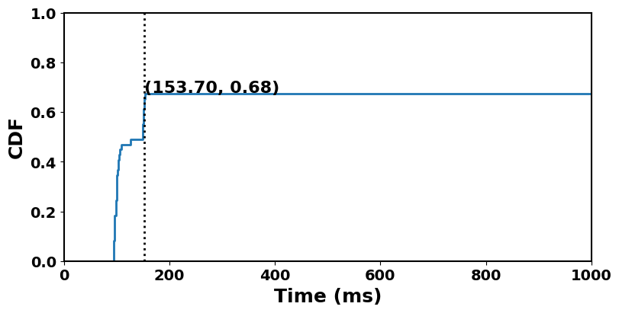
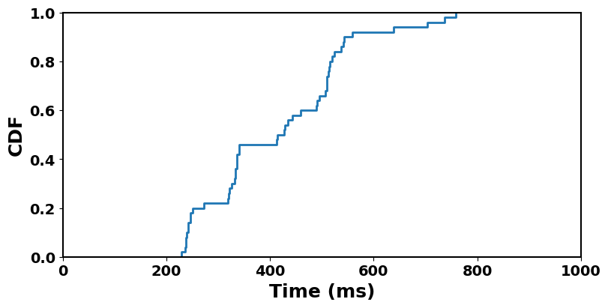
Benefits of CE2D upon Long-tail Arrivals
OpenR network with Internet2 topology
Random buggy instance
Replay the Internet2 dataset with one random dampened switch (60s back-off)
Random dampened instance
(60s FIB computation back-off)
(759.03, 1)
Detect loops in <153.7ms in 68% of the trials, >390x faster than the 60s baseline
Detect loops within 760ms in all the trials,
yielding a 79x speed-up
Notes:
Then we evaluate the Benefits of CE2D upon Long-tail Arrivals
$ we configure the OpenR network with one random buggy instance that generates incorrect FIB and one random dampened instance which has 60 seconds back-off for FIB computation. Flash is configured to check loops and we run 50 independent random trials
$ From the result, we see that Flash can detect the loop in less than 153ms in 68% of the trials, which is 390x faster than the 60s baseline.
$ To further evaluate CE2D on real dataset, we replay the Internet2 dataset with one random dampened switch.
$ From the results, Flash can detect the loop early within 760ms in all the trials, yielding a 79x speed-up.

Slide 26
Conclusion
Flash is a fast and scalable data plane verification system that addresses two issues in large-scale networks:
Update storms
Long-tail arrivals
Flash contributes two new ideas:
Fast inverse model transformation (Fast IMT) that achieves throughput-optimized block update processing
Consistent, efficient early detection (CE2D) that enables consistent verification with incomplete data plane state
Thanks!
Q&A
Notes:
$ To conclude, We present Flash, a fast and scalable system that addresses two important issues in data plane verification for large-scale networks: $ the update storms and $ the long-tail arrivals
$ And Flash contributes two new ideas:
$ Fast inverse model transformation that achieves throughput-optimized block update processing and
$ Consistent, efficient early detection that enables consistent verification with incomplete data plane state
$ Thanks!

