Slide 1




Diagnosing Distributed Routing Configurations Using Sequential Program Analysis
Rulan Yang¹ , Xing Fang¹, Lizhao You¹, Qiao Xiang¹, Hanyang Shao¹, Gao Han¹, Ziyi Wang¹, Jiwu Shu^{1, 2}, Linghe Kong³
¹ Xiamen University, ² Minjiang University, ³ Shanghai Jiao Tong University 2023/6/29

Slide 2

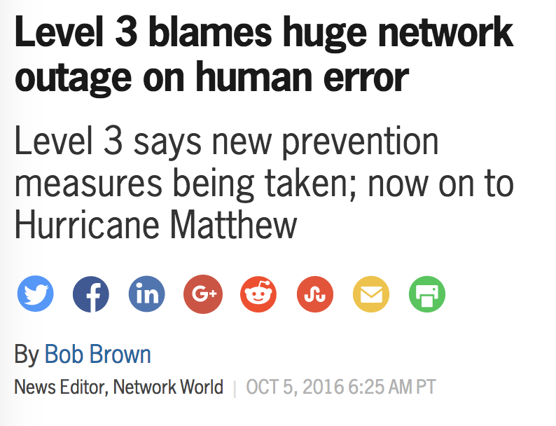
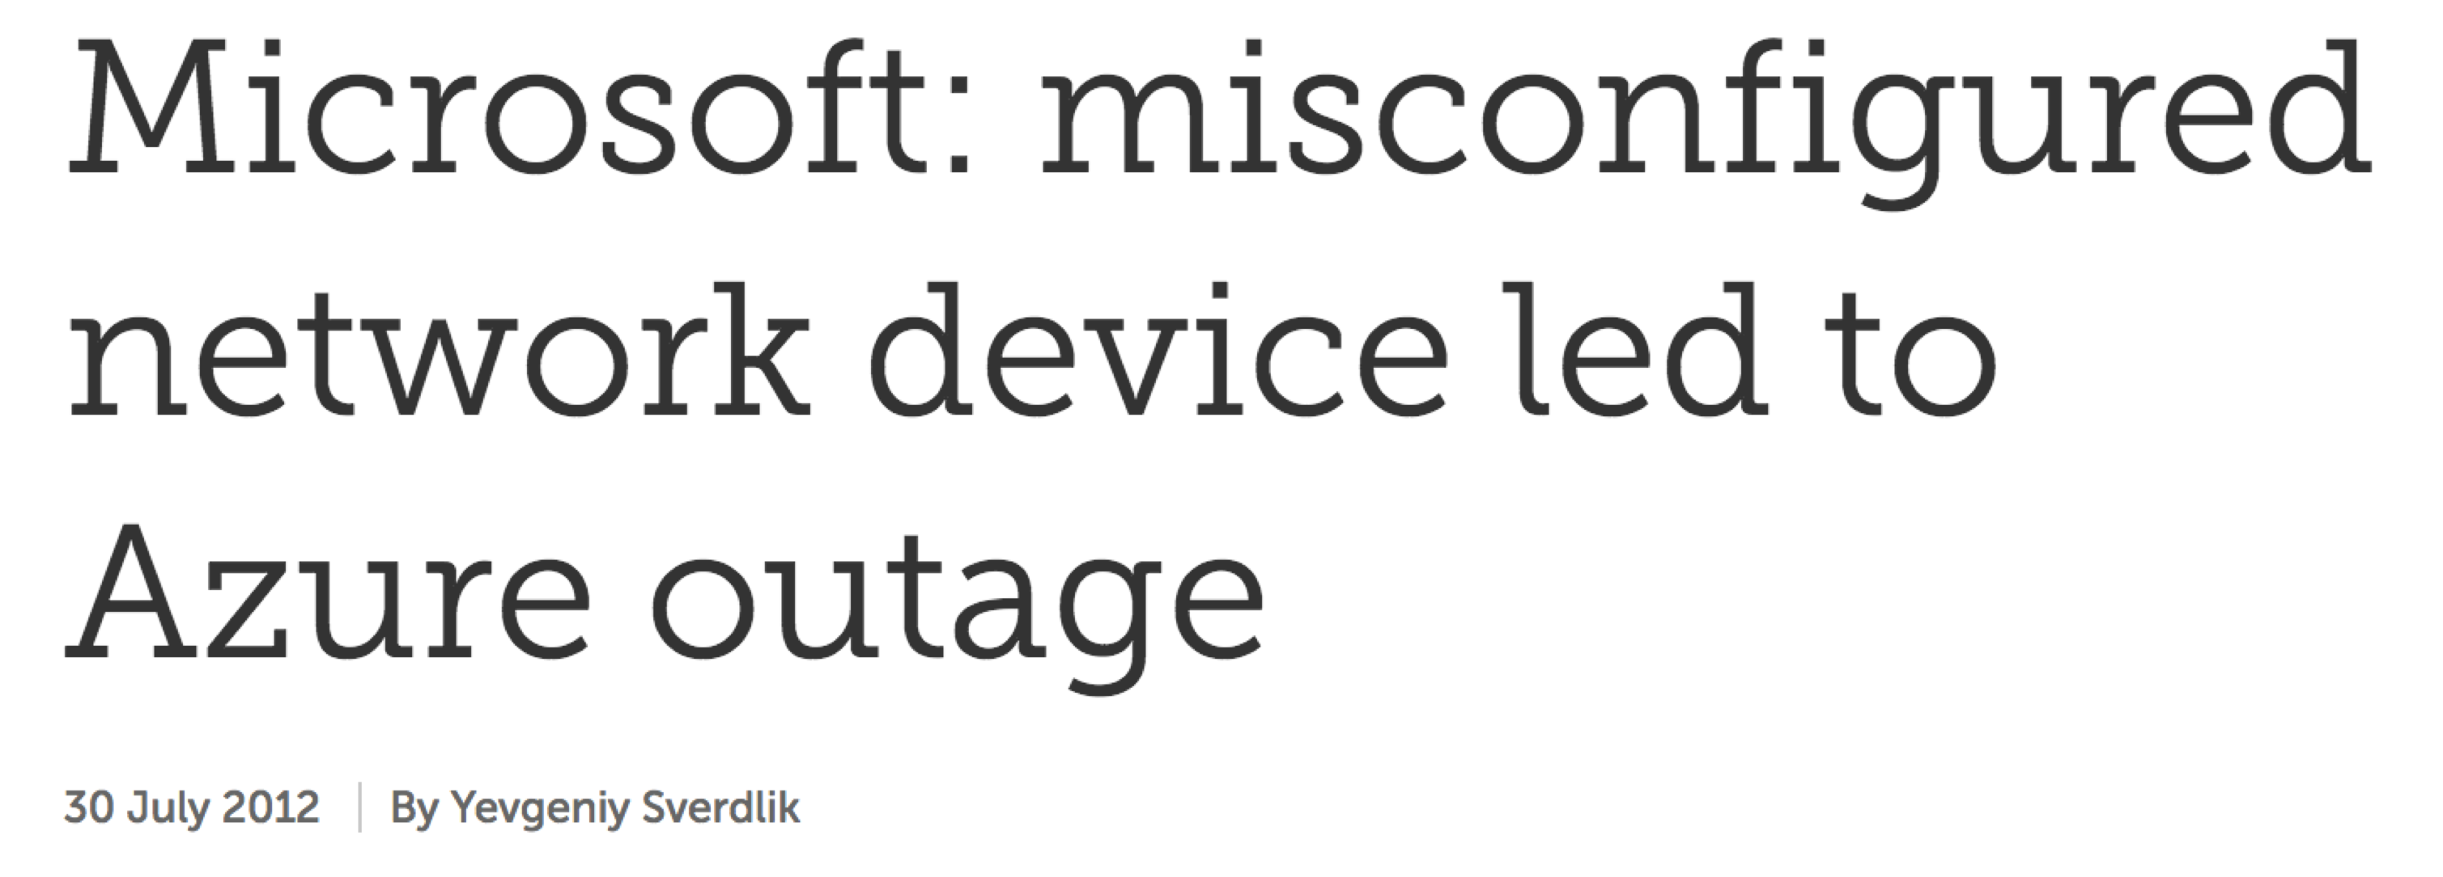
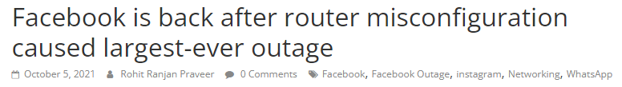
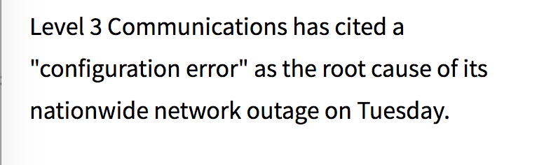
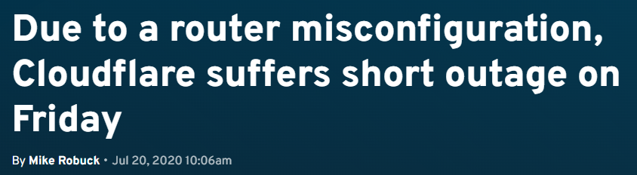
Router configuration errors are common
Notes:
network configuration errors are common, and it’s important to find them and fix them before the deployment.

Slide 3

What does network verification do?
Detecting if configurations are erroneous:
reachability ?
waypoint ?
...
Configurations
Results
Notes:
network verification tools can proactively check if the configurations are erroneous.
Check if some properties like reachability, waypoint hold for the configs

Slide 4

What does network verification do?
Detecting if configurations are erroneous:
Configurations
Network model
translate the configuration to another representation
Verification tools | Network model they generate
Simulation-based tools (e.g., Batfish) | RIB/FIBs (i.e., The data plane)
Graph-based tools (e.g., ARC) | Abstraction graph
SMT-based tools (e.g., Minesweeper) | Logic formula
Notes:
they first translate the config to another representation, some kind of network model.
Like simulation-based tools will concretely generate the RIBs of each router, that is the data plane,
and like SMT-based tools model both the config and network property as logic formula

Slide 5
What does network verification do?
Detecting if configurations are erroneous: answer the YES/NO question
reachability √
waypoint ×
...
Configurations
Network model
Results
translate the configuration to another representation
check if properties hold for the model
Verification tools | Network model they generate | The way they verify properties
Simulation-based tools (e.g., Batfish) | RIB/FIBs (i.e., The data plane) | Data plane verification → Compute and verify the data plane
Graph-based tools (e.g., ARC) | Abstraction graph | Compute graph invariants
SMT-based tools (e.g., Minesweeper) | Logic formula | Check the satisfiability of the formula
Notes:
Such as simulation based-tools, they compute and verify the data plane
SMT-based tools, they model the network and properties as a logic formula and check the satisfiability of the formula.
It is still up to operators to diagnosis and repair

Slide 6
Why diagnosis is hard?
Network is a (complex) distributed system
Configuration errors on one router will lead to the property violation of other routers
Property: S-B-D
Reality: S reaches D through “S-A-D”
A
([A, D])
S
([S, A, D])
D
match tag 1
set local-pref 130
B
add tag 1
([B, A, D])
B prefers A as the next-hop
Notes:
But the root cause is that B was configured to

Slide 7
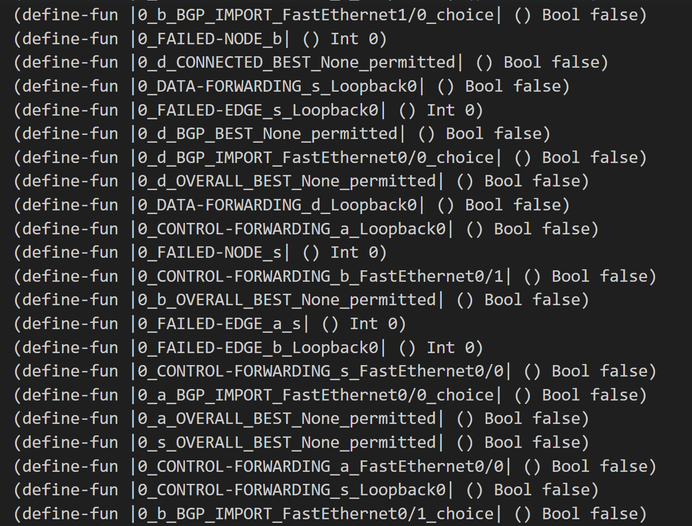
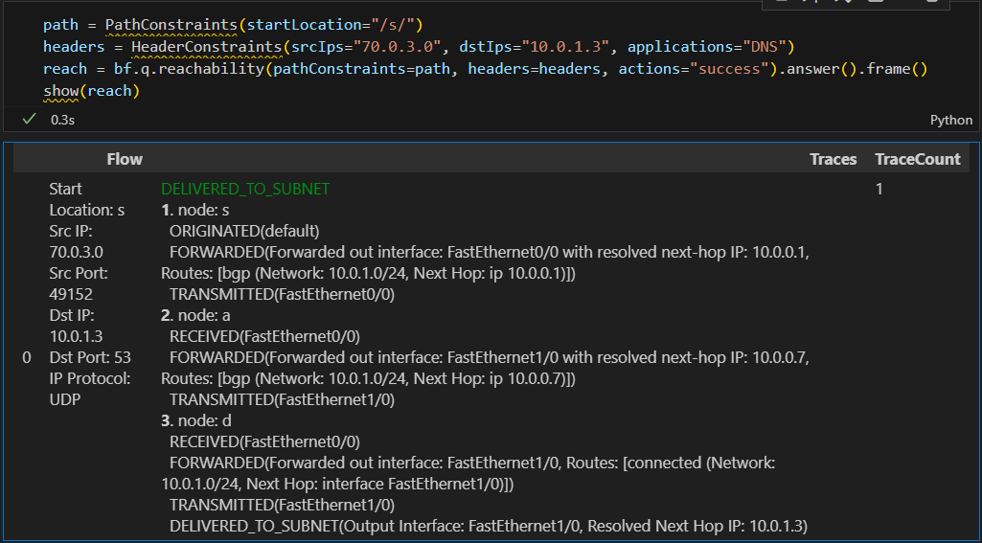
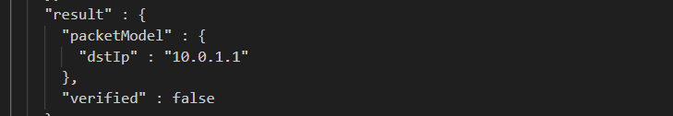
Verification is not enough
The counter-example:
Verification can tell us:
The error flow: s->a->d
The error result: false
Batfish
However, they cannot diagnose:
How do the configuration errors contribute to the results?
Minesweeper
Notes:
If we use verification tools to verify this network,
let’s see, the left one is the result return from Batfish, a state-of-the-art simulation-based tool, we can know that the flow will go through S-A-D,
and the right one is minesweeper’s output, we only know the true/false result, furthermore, MS doesn’t support AS-path regular expression.
but we still don’t know How do the configuration errors contribute to the results, it needs manual efforts.

Slide 8
Key insight: understanding the distributed routing as a sequential program
Distributed network execution
Distributed routing processes
…
A
receive ([D])
S
D
select ([D])
T1
send ([A, D])
T0
B
…
A
[A, D]
receive ([A, D])
Running the routing process
…
S
D
T1
…
receive ([B, A, D])
Receive routes
…
B
[S, A, D]
send ([D])
Route selection
…
receive ([A, D])
[D]
Send routes
receive ([D])
select ([A, D])
send ([B, A, D])
…
Distributed routing is a program consisting of the three parts
[B, A, D]
8
Notes:
We consider the execution trace is deterministic for the same network configuration.

Slide 9
Key insight: understanding the distributed routing as a sequential program
Distributed network execution → The causal relationship graph (CRG)
receive ([D])
Using (sender, receiver) and timestamp to capture the causal relationship
send ([D])@D
select ([D])
send ([A, D])
receive ([D])@A
…
A
[A, D]
select ([D])@A
receive ([A, D])
S
D
send ([A, D])@A
receive ([D])@B
receive ([B, A, D])
T1
receive ([D])@B
…
B
receive ([A, D])@B
[S, A, D]
send ([D])
receive ([A, D])@B
…
receive ([A, D])@S
receive ([A, D])@S
select ([A, D])@B
select ([A, D])@B
receive ([A, D])
[D]
select ([A, D])@B
receive ([D])
send ([B, A, D])@B
send ([B, A, D])@B
send ([B, A, D])@B
select ([A, D])
send ([B, A, D])
receive ([B, A, D])@S
…
receive ([B, A, D])@S
[B, A, D]
…
…
Notes:
Next, I will introduce how we transform such distributed execution trace into a centralized, sequential program using causal relationships.
We know that receiving function will be called whenever a route comes, so we say that the incoming route is the cause of that function call, and then the router selects the best route, the best one will be downloaded to the RIB, and if there is any update of RIB, the new route in the RIB will be the input of receiving functions on other routing processes, and those are actions of the cause route.
So there exist causal relationships between them, and we use (receiver, sender) and timestamp to capture such relationships, which we called CRG.

Slide 10
Key insight: understanding the distributed routing as a sequential program
Transforming the distributed program into a linear trace
send ([D])@D
send ([D])@D
send ([D])@D
receive ([D])@A
receive ([D])@A
receive ([D])@A
receive ([D])@A
topological traversal
select ([D])@A
select ([D])@A
receive ([D])@B
receive ([D])@B
select ([D])@A
send ([A, D])@A
select ([D])@A
…
send ([A, D])@A
receive ([D])@B
or
receive ([D])@B
receive ([D])@B
send ([A, D])@A
receive ([A, D])@B
receive ([A, D])@B
receive ([A, D])@S
receive ([A, D])@B
receive ([A, D])@S
receive ([A, D])@S
receive ([A, D])@B
select ([A, D])@B
receive ([A, D])@B
select ([A, D])@B
select ([A, D])@B
select ([A, D])@B
select ([A, D])@B
send ([B, A, D])@B
select ([A, D])@B
send ([B, A, D])@B
send ([B, A, D])@B
send ([B, A, D])@B
receive ([A, D])@S
send ([B, A, D])@B
receive ([B, A, D])@S
receive ([B, A, D])@S
receive ([B, A, D])@S
receive ([B, A, D])@S
…
…
…
…
Notes:
Then we can transform the distributed program into a sequential program using the CRG, it is to topologically traverse the graph to get the linear sequence.
Like this, or …
And we demonstrate that each topological traversal of the CRG will produce the same output.

Slide 11
Analyzing the trace
Input: Configurations
Configurations are input to the program
Network properties are assertions that the program need to hold
send ([D])@D
receive ([D])@A
receive ([D])@A
select ([D])@A
select ([D])@A
send ([A, D])@A
Verification executes the configurations
executing
receive ([D])@B
Diagnosis reasons about the execution
receive ([A, D])@B
reasoning
select ([A, D])@B
send ([B, A, D])@B
receive ([A, D])@S
receive ([B, A, D])@S
…
assert Property == true
Notes:
So far, we get the sequential program,
The input of the program is configurations, verification is just executing it and output the data plane.
And the property we try to verify are some assertions at the end of the program
But Diagnosis needs reasoning, That is to analyze the program, to find why the program failed, and why it outputs the wrong dataplane.

Slide 12

Analyzing the trace
Input: Configurations
For observable errors (ones with traces that generate erroneous paths):
We diagnose errors by analyzing the data dependency
send ([D])@D
receive ([D])@A
receive ([D])@A
select ([D])@A
select ([D])@A
send ([A, D])@A
[A, D]
executing
receive ([D])@B
A
receive ([A, D])@B
reasoning
S
D
[D]
select ([A, D])@B
[S, A, D]
B
send ([B, A, D])@B
[B, A, D]
receive ([A, D])@S
receive ([B, A, D])@S
…
assert Property == true
How erroneous paths were computed?
Notes:
We define observable errors are such errors that have erroneous paths, as the example shows.
We analyze the data dependency of these paths using data-flow analysis to know how erroneous paths were computed, and which part of the program contribute to them.

Slide 13
Data-flow analysis using MUC&EI
Get the data dependency with explanation:
Minimal Unsatisfiable Core (MUC):
A minimal set of statements leading to the error
Error Invariants:
Key program states of statements
send ([D])@D
receive ([D])@A
receive ([D])@A
D(Static)->D(BGP)
D sent [D] to A and B
select ([D])@A
select ([D])@A
send ([A, D])@A
D->A
A received [D], selected it and sent it to S and B
receive ([D])@B
D->B
B received [D] and [A, D], selected [A, D] since that B prefers A
receive ([A, D])@B
select ([A, D])@B
A->B
send ([B, A, D])@B
A->S
S received [A, D] and [B, A, D], selected [A, D] since it has the shorter as-path length
receive ([A, D])@S
B->S
receive ([B, A, D])@S
…
Notes:
The data-flow analysis is to explain why the program failed, the explanation consists of two parts.
First is MUC, here is the MUC of the example,
then we compute ei for the MUC, they are some transient program states that will eventually lead to the error state.
In this example, they explained why S chooses [S, A, D], …, then we know the modification of [B, A, D] is the configuration error.

Slide 14



Data-flow analysis has limitations
(have exponential searching space)
Unobservable errors
Latent errors
(need repeated DF diagnosis)
Property: S-*-D
The trace:
Reality: There is no path from S to D
D(Static)
A
S
($∅$)
S drops routes from both A and B
D
($∅$)
B
D doesn’t redistribute the route to BGP process
($∅$)
Notes:
Unfortunately, there are limitations of DFA,
let’s see this example.
…
there are two errors in this network

Slide 15
Control-flow analysis using symbolic execution
Collect more traces with their path conditions to analyze:
A path condition is a predicate that a symbolic execution trace needs to hold
How to diagnose?
Differentiate these traces
Errors
…
…
…
…
…
Program
Correct execution path
Incorrect execution path
Notes:
so we turn to CFA to get the control dependency of the program
Using symbolic execution we can explore other execution paths of the program.
after that we get the correct execution path, also the incorrect path, then we differentiate them to localize the different path conditions as errors.

Slide 16
Control-flow analysis using symbolic execution
Collect more traces with their path conditions to analyze:
Pruning: Selective symbolic execution
Selectively applying symbolic execution on these branches:
route selection
export/import for target routes
peer connection establishment
…
…
…
…
Program
Program
Notes:
to avoid exploring huge searching space, we use SSE to prune some paths.
It means We only apply SE to the route selection, export/import and peer connection branches.

Slide 17
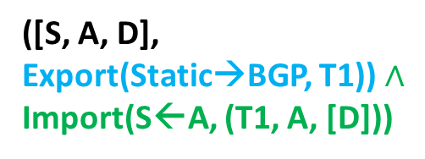
Control-flow analysis using symbolic execution
Collect more traces with their path conditions to analyze:
Program
Data plane simulation
…
Export(Static→BGP, T1)?
([A, D], Export(Static→BGP, T1))
F
T
D(Static)
->D(BGP)
A
S
D
([D], Export(Static→BGP, T1))
([S, A, D],
Export(Static→BGP, T1)) $∧$ Import(S←A, (T1, A, [D]))
B
D->A
([B, D], Export(Static→BGP, T1))
D->B
Import (S←A, (T1, A, [D]))?
T
F
Conditions are attached as symbols with route announcements during the data plane simulation
A->S
…
Errors are configurations that deviate from those path conditions !
Notes:
when D executes to the export branch, it supposes to go to the false branch, which means not to redistribute the static route to its BGP process, but the true branch is what we want to explore, so we make the export value as true and attach it as a symbol to the route
then keep executing using the symbolic route.
later we executes to the Import branch at S and we find that it will go to the false branch too, so we

Slide 18
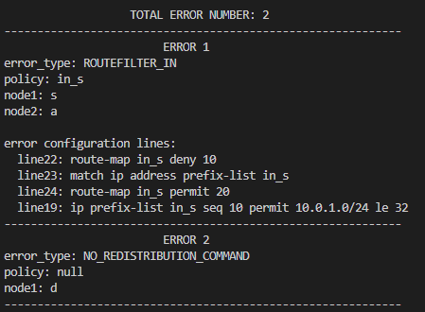
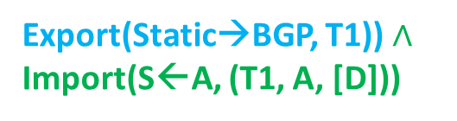
Diagnosis results
Property: S-*-D
Reality: There is no path from S to D
A
S
Error1: The route-map in S (line 19, 22-24) filtered routes from A
D
Error path conditions :
Export(Static→BGP, T1)) $∧$ Import(S←A, (T1, A, [D]))
Error2: There was no redistribution command in node D
Notes:
we report all errors and related configuration lines of them, which is helpful for operators to fix the error.

Slide 19
Evaluation
Evaluate Scalpel on synthetic configurations
Routing protocols: BGP, static route
Protocol features: redistribution, route filters
Networks size: O(10)~O(100) routers
O(100) lines of configuration per router
Errors injection: wrong-local-pref error, propagation-deny error, origin-deny error

Slide 20
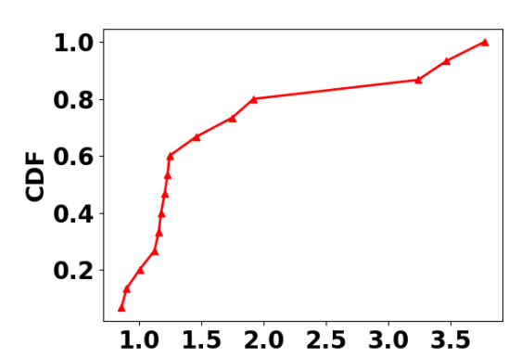
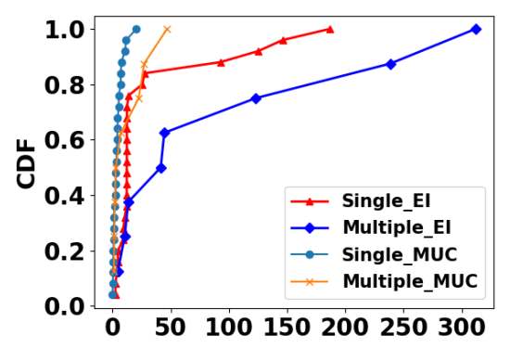
Evaluation: observable error diagnosis
For observable errors, all error traces can be generated < 4s
For observable errors, we diagnose all errors within several minutes
CRG generation time (s)
MUC and EI computation time (s)

Slide 21
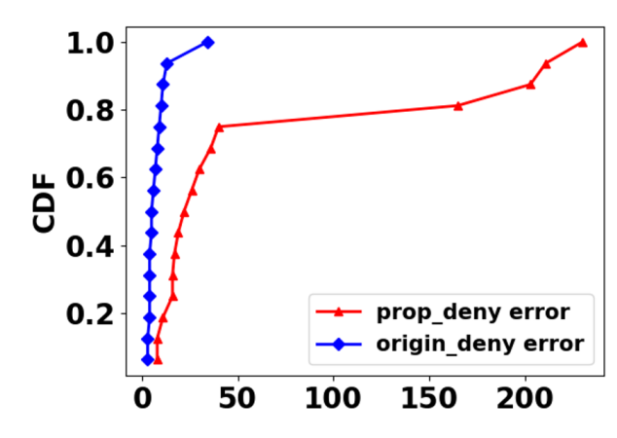
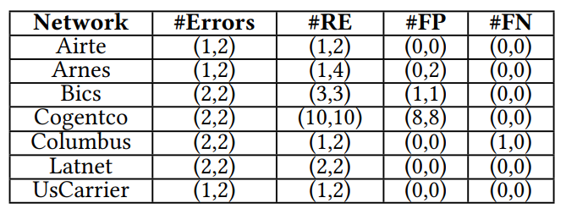
Evaluation : unobservable error diagnosis
For unobservable errors, we diagnose 74% of them within 50ms
Diagnosis time on unobservable errors (ms)
Table: Diagnosis results on unobservable errors

Slide 22
Summary
We take the first step to apply program analysis to distributed router configuration diagnosis.
We design Scalpel, an automated router configuration diagnosis tool.
We implement Scalpel and demonstrate the capability of Scalpel.
Notes:
questions 可以直接列

Slide 23

Open questions
Non-deterministic execution (e.g., leveraging Hoyan’s design)
Supporting more protocols (e.g., link state protocols)
Scaling control-flow analysis for large networks (e.g., slicing)
Automatic repair based on diagnosis (e.g., constraint-based repair)
WeChat QR code
SNGroup site: http://sngroup.tech/
Contact us: sngroup.xmu@outlook.com
Notes:
questions 可以直接列

