Slide 1
Building Reliable Infrastructure for Edge Intelligence: A Formal Method Perspective
Qiao Xiang
12/10/2022

Slide 2
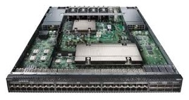
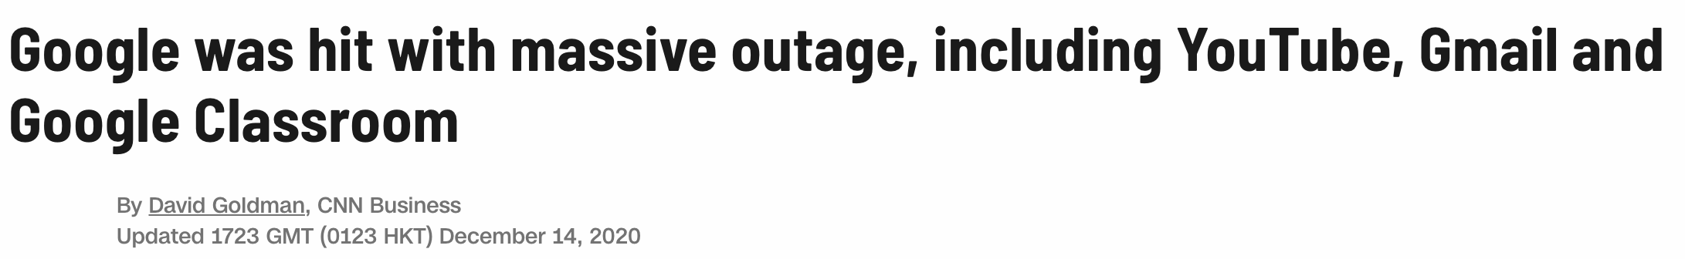
Edge intelligence requires reliable networks
Networks are becoming larger and complex
Heterogeneous devices
Frequent outages lead to cost

Slide 3
Network reliability: formal specification
Reachability: Two hosts can communicate with each other while complying security policies
Example 1：There are no forwarding loops or black holes in forwarding paths between devices.
Example 2：Isolation among different tenants in datacenters.
Waypointing: The traffic should traverse a chain of devices m₁, . . . ,m_{k}
Path consistency: The reachability of the same traffic should always be satisfied when it enters the same network from different border devices.
Network verification:
Examine whether the forwarding behaviors of the network satisfied
pre-defined reliability requirements.

Slide 4
Network verification: current progress
Control plane/Configuration
Data plane
Configuration
FIB
(RIB/ACL…)
Execute
Configuration
What Happens After Verification?
FIB
(RIB/ACL…)
FIB
(RIB/ACL…)
Configuration
Control plane/Configuration verification
Batfish [NSDI'15]
Bagpipe [OOPSLA'16]
Minesweeper [SIGCOMM'17]
Bonsai [SIGCOMM'18]
Hoyan [SIGCOMM'21]
SRE [SIGCOMM'22]…
Data plane verification
HSA [NSDI'12]
Veriflow [NSDI'13]
Atomic Predicates [ICNP'13]
APKeep [NSDI'20]
Flash [SIGCOMM'22]
Coral [HotNets'22]…
Notes:
Traditional operators don’t use verification
That may be changing with new tools like HSA, Veriflow
Still, there is simulation in the mix, because the control plane will be simulated

Slide 5
Vision: automating edge network configuration management using formal methods
Key insight: many formal method techniques are becoming increasingly efficient.
Network Verification
Inter-
domain configuration management
Configuration Repair
Error Diagnosis

Slide 6
Challenges and open questions
Accuracy: no false negative, low false positive
Scalability: O(1000) devices, minute-level verification/diagnosis/repair
Interpretability: operators need to be able to understand the results
Privacy: reliable network requires collaboration from multiple networks

Slide 7
Our progress so far
Control plane verification
A-Graph [INFOCOM'21]
CCoral [WIP]
Network Verification
Inter-
domain configuration management
Inter-domain synthesis
SDI [INFOCOM'20]
Data plane verification
Coral [HotNets'22]
Flash [SIGCOMM'22]
Inter-domain
verification
IVeri [arXiv'21]
ICoral [WIP]
IVeriNG [WIP]
Configuration Repair
Error Diagnosis
Inter-domain repair
IRepair [WIP]
Configuration diagnosis and repair: Scalpel [WIP]

