Slide 1
Network Layer: Distance Vector Protocols Variations Link-State Protocol
Qiao Xiang
https://qiaoxiang.me/courses/cnns-xmuf22/index.shtml
11/22/2022
This deck of slides are heavily based on CPSC 433/533 at Yale University, by courtesy of Dr. Y. Richard Yang.

Slide 2
Outline
Admin and recap
Network overview
Network control plane
Routing
Link weights assignment
Routing computation
Distance vector protocols (distributed computing)
Link state protocols (distributed state synchronization)

Slide 3
Admin
Guest lectures are important ☺
Upcoming guest lectures
December 1, Dr. Linghe Kong@SJTU,
Internet of Things
December 8, Dr. Zaoxing (Alan) Liu@Boston Univ.,
Programmable Networks
December 15, Dr. Zhenhua Li@THU,
5G Network
Schedule is tentative

Slide 4
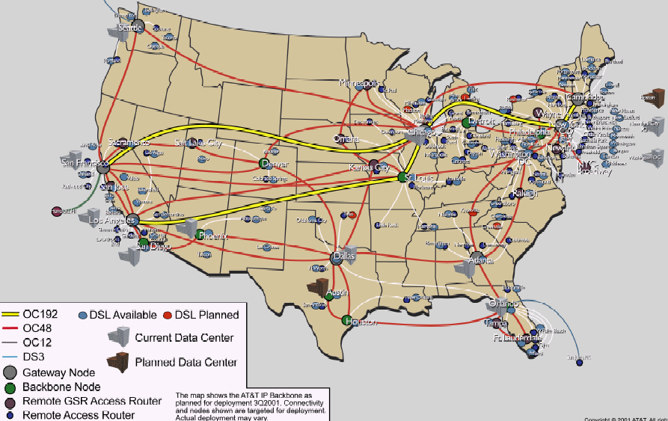
Recap: Routing Context
Routing
Goal: determine “good” paths
(sequences of routers) thru
networks from source to dest.
Often depends on a graph abstraction:
graph nodes are routers
graph edges are physical links
links have properties: delay, capacity, $ cost, policy
5
B
3
C
2
5
A
2
1
F
3
1
2
D
E
1

Slide 5
Recap: Routing Design Space
Routing has a large design space
who decides routing?
source routing: end hosts make decision
network routing: networks make decision
how many paths from source s to destination d?
multi-path routing
single path routing
what does routing compute?
network cost minimization (shortest path routing)
QoS aware
will routing adapt to network traffic demand?
adaptive routing
static routing
…
5
B
3
C
2
5
A
2
1
F
1
3
D
E
2
1

Slide 6
Recap: Distance Vector Routing: Basic Idea (Bellman-Ford Alg)
At node i, the basic update rule
where
- d_{i} denotes the distance estimation from i to the destination,
- N(i) is set of neighbors of node i, and
- d_{ij} is the distance of the direct link from i to j
destination
j
i

Slide 7
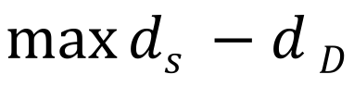
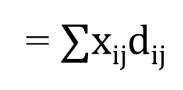
Understanding BFA and an Exercise of Primal-Dual
$$\max_{}{ds −d}D$$
$$for any edge i→j: di−dj≤dij$$
$$di≥0$$
D$ual:D\left(x\right)=\max{(ds −dD+∑xij\left(di−dj−dij\right))}$
= $∑xijdij$
x_{ij} is a flow from s to D
https://en.wikipedia.org/wiki/Shortest_path_problem#Linear_programming_formulation

Slide 8
Recap: Synchronous Bellman-Ford (SBF)
Nodes update in rounds:
there is a global clock;
at the beginning of each round, each node sends its estimate to all of its neighbors;
at the end of the round, updates its estimation
A
B
E
C
D

Slide 9

Recap: SBF/$∞$
7
B
1
C
A
8
2
10
E
D
2
Initialization (time 0):

Slide 10
Example
B
1
C
7
A
8
2
10
Consider D as destination; d(t) is a vector consisting of estimation of each node at round t
E
D
2
A B C E D
d(0)
$∞$ $∞$ $∞$ $∞$ 0
d(1)
$∞$ $∞$ 2 2 0
d(2)
12 3 2 2 0
d(3)
10 3 2 2 0
d(4)
10 3 2 2 0
Observation: d(0) $≥$ d(1) $≥$d(2) $≥$d(3) $≥$ d(4) =d*

Slide 11
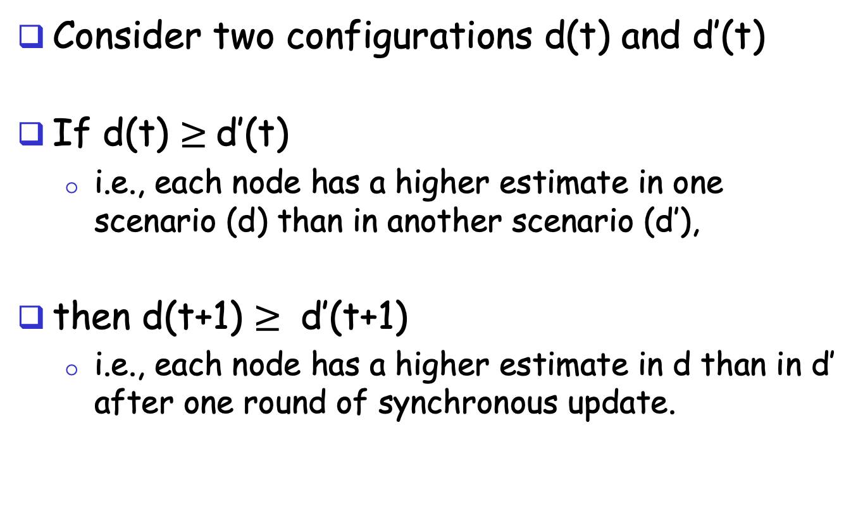
A Nice Property of SBF: Monotonicity
Consider two configurations d(t) and d’(t)
If d(t) $≥$d’(t)
i.e., each node has a higher estimate in one scenario (d) than in another scenario (d’),
then d(t+1) $≥$ d’(t+1)
i.e., each node has a higher estimate in d than in d’ after one round of synchronous update.

Slide 12
Correctness of SBF/$∞$
Claim: d_{i}(h) is the length L_{i}(h) of a shortest path from i to the destination using ≤ h hops
base case: h = 0 is trivially true
assume true for ≤ h, i.e., L_{i}(h)= d_{i}(h), L_{i}(h-1)= d_{i}(h-1), …

Slide 13
Correctness of SBF/$∞$
consider ≤ h+1 hops:
since d_{i}(h) ≤ d_{i}(h-1)

Slide 14
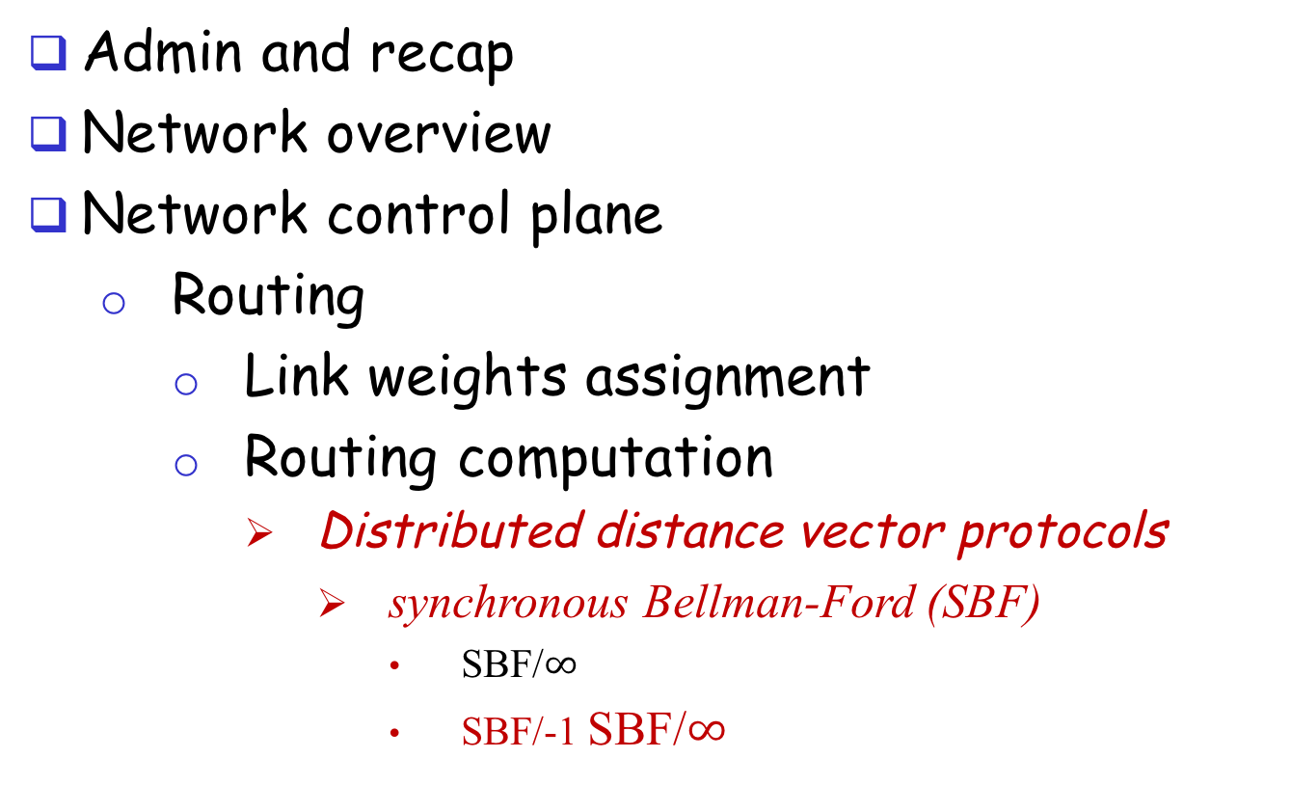
Outline
Admin and recap
Network overview
Network control plane
Routing
Link weights assignment
Routing computation
Distributed distance vector protocols
synchronous Bellman-Ford (SBF)
SBF/$∞$
SBF/-1 SBF/$∞$

Slide 15
SBF at another Initial Configuration: SBF/-1
7
B
1
C
A
8
2
10
E
D
2
Initialization (time 0):

Slide 16
Example
B
1
C
7
A
8
2
10
Consider D as destination
E
D
2
A B C E D
d(0)
-1 -1 -1 -1 0
d(1)
6 0 0 2 0
d(2)
7 1 1 2 0
d(3)
8 2 2 2 0
d(4)
9 3 3 2 0
d(5)
10 3 3 2 0
d(6)
10 3 3 2 0
Observation: d(0) $≤$d(1) $≤$d(2) $≤$d(3) $≤$ d(4) $≤$ d(5) = d(6) = d*

Slide 17
Correctness of SBF/-1
SBF/-1 converges due to monotonicity
Remaining question:
Can we guarantee that SBF/-1 converges to shortest path?

Slide 18
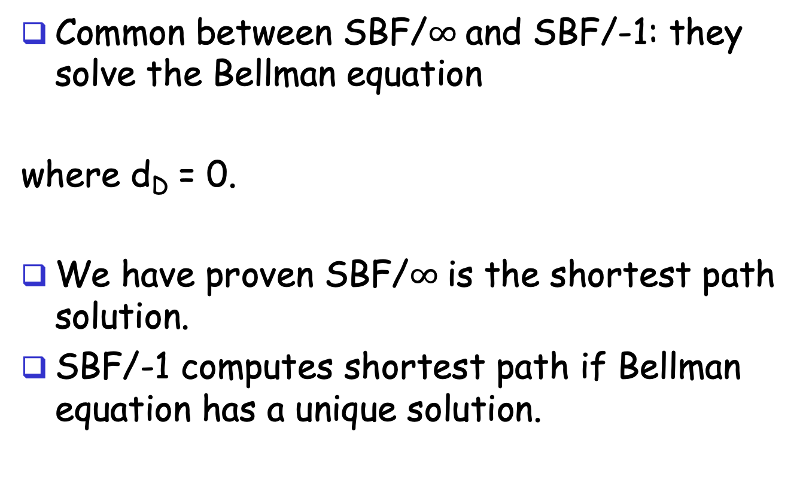
Correctness of SBF/-1
Common between SBF/$∞$and SBF/-1: they solve the Bellman equation
where d_{D} = 0.
We have proven SBF/$∞$is the shortest path solution.
SBF/-1 computes shortest path if Bellman equation has a unique solution.

Slide 19

Uniqueness of Solution to BE
Assume another solution d, we will show that d = d*
case 1: we show d $≥$d*
Since d is a solution to BE, we can construct paths as follows: for each i, pick a j which satisfies the equation; since d* is shortest, d $≥$ d*
3
2
7
B
1
C
10
A
8
2
10
E
D
2
2

Slide 20
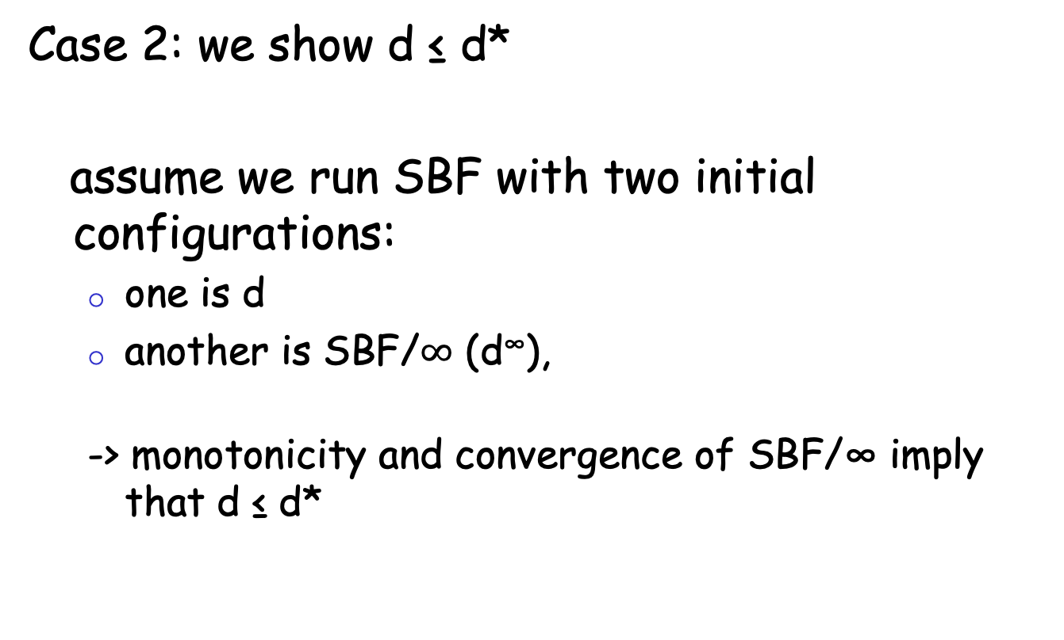
Uniqueness of Solution to BE
Case 2: we show d ≤ d*
assume we run SBF with two initial configurations:
one is d
another is SBF/$∞$ (d∞),
-> monotonicity and convergence of SBF/∞ imply that d ≤ d*

Slide 21
Discussion
Will SBF converge under other non-negative initial conditions?
Problems of running synchronous BF?

Slide 22
Outline
Admin and recap
Network overview
Network control plane
Routing
Link weights assignment
Routing computation
Distributed distance vector protocols
synchronous Bellman-Ford (SBF)
asynchronous Bellman-Ford (ABF)

Slide 23
Asynchronous Bellman-Ford (ABF)
No notion of global iterations
each node updates at its own pace
Asynchronously each node i computes
using last received value d^{i}_{j} from neighbor j.
Asynchronously node j sends its estimate to its neighbor i:
We assume that there is an upper bound on the delay of estimate packet
Notes:
Ti infinite
T^i_j infinite

Slide 24
ABF: Example
B
1
C
7
A
8
2
Below is just one step! The protocol repeats forever!
10
E
D
2
distance tables from neighbors
computation
E’s
distance table
distance table E sends to its neighbors
d ()
A
B
C
D
A B D
A B D
A: 10
B: 8
C: 4
D: 2
E: 0
E
0 7 $∞$
10 15 $∞$
A: 10
7 0 $∞$
17 8 $∞$
B: 8
destinations
$∞$ 1 2
$∞$ 9 4
D: 4
$∞ ∞$ 0
$∞ ∞$ 2
D: 2
10 8 2

Slide 25
Asynchronous Bellman-Ford (ABF)
ABF will eventually converge to the shortest path
links can go down and come up – but if topology is stabilized after some time t and connected, ABF will eventually converge to the shortest path !

Slide 26
ABF Convergence Proof Complexity: Complex System State
j
i
What is system state?
Notes:
There are three types of distance estimates from node i:
d_i: current distance estimate at node i
- d^j_i: last d_i that neighbor j received
- d^j_i: d_i that are in transit to neighbor j

Slide 27
System State
three types of distance state from node j:
d_{j}: current distance estimate state at node j
- d^{i}_{j}: last d_{j} that neighbor i received
- d^{i}_{j}: those d_{j} that are still in transit to neighbor i
dj
d^{i}_{j}
d^{i}_{j}
d_{i}

Slide 28
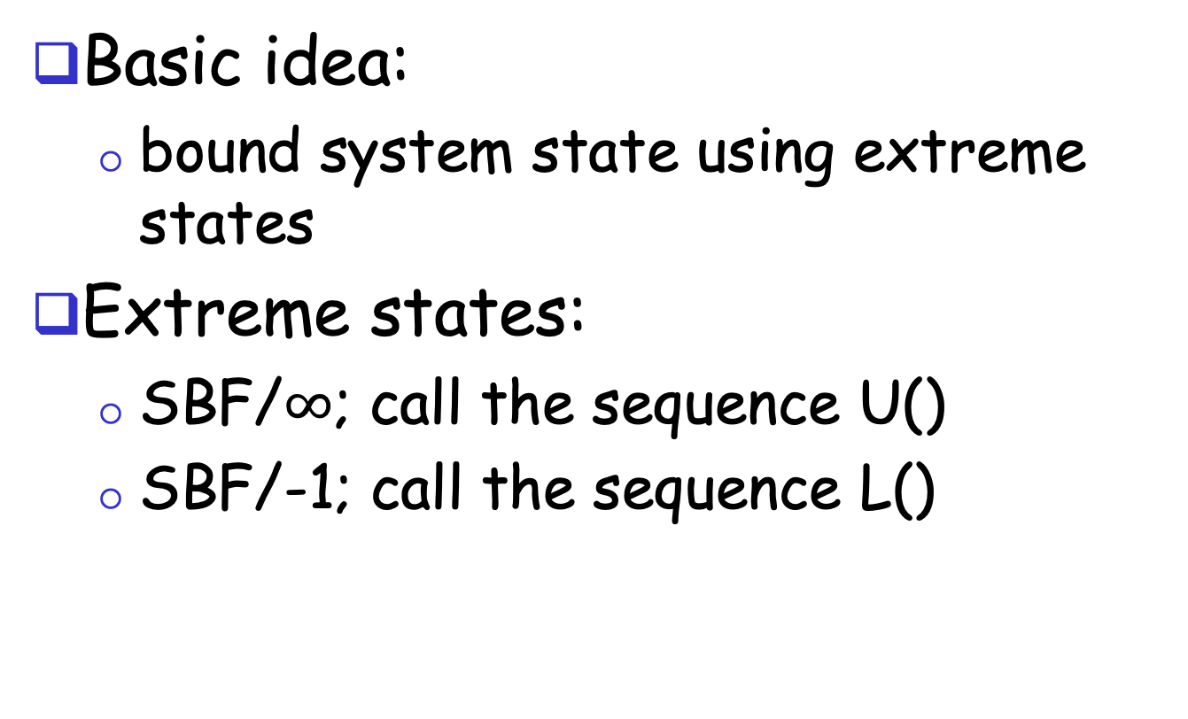
ABF Convergence Proof: The Sandwich Technique
Basic idea:
bound system state using extreme states
Extreme states:
SBF/$∞$; call the sequence U()
SBF/-1; call the sequence L()
Notes:
The state includes di, di_j, and messages containing di_j

Slide 29
ABF Convergence
Consider the time when the topology is stabilized as time 0
U(0) and L(0) provide upper and lower bounds at time 0 on all corresponding elements of states
L_{j} (0) ≤ d_{j} ≤ U_{j} (0) for all d_{j} state at node j
L_{j} (0) ≤ d^{i}_{j} ≤ U_{j} (0)
L_{j} (0) ≤ update messages d^{i}_{j} ≤ U_{j} (0)
Notes:
The state includes di, di_j, and messages containing di_j

Slide 30
ABF Convergence
d_{j}
after at least one update at node j: d_{j} falls between L_{j} (1) ≤ d_{j} ≤ U_{j} (1)
d^{i}_{j} :
eventually all d^{i}_{j} that are only bounded by L_{j} (0) and U_{j} (0) are replaced with in L_{j}(1) and U_{j}(1)
dj
d^{i}_{j}
d^{i}_{j}
d_{i}
Notes:
The state includes di, di_j, and messages containing di_j

Slide 31
Asynchronous Bellman-Ford: Summary
Distributed
each node communicates its routing table to its directly-attached neighbors
Iterative
continues periodically or when link changes, e.g. detects a link failure
Asynchronous
nodes need not exchange info/iterate in lock step!
Convergence
in finite steps, independent of initial condition if network is connected

Slide 32
Summary: Distributed Distance-Vector
Tool box: a key technique for proving convergence (liveness) of distributed protocols: monotonicity and bounding-box (sandwich) design
Consider two configurations d(t) and d’(t):
if d(t) <= d’(t), then d(t+1) <= d’(t+1)
Identify two extreme configurations to sandwich any real configurations

Slide 33
Outline
Admin and recap
Network control plane
Routing
Link weights assignment
Routing computation
Distance vector protocols (distributed computing)
synchronous Bellman-Ford (SBF)
asynchronous Bellman-Ford (ABF)
properties of DV

Slide 34
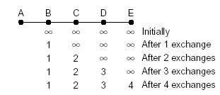
Properties of Distance-Vector Algorithms
Good news propagate fast

Slide 35
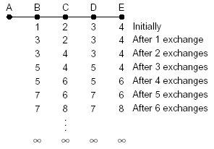
Properties of Distance-Vector Algorithms
Bad news propagate slowly
This is called the counting-to-infinity problem
Q: what causes counting-to-infinity?
A-B link down

Slide 36
Counting-To-Infinity is Because of Routing Loop
Counting-to-infinity is caused by a routing loop, which is a global state (consisting of the nodes’ local states) at a global moment (observed by an oracle) such that there exist nodes A, B, C, … E such that A (locally) thinks B as next hop, B thinks C as next hop, … E thinks A as next hop

Slide 37
Discussion
Why avoid routing loops is hard?
Any proposals to avoid routing loops?

Slide 38
Outline
Admin and recap
Network control plane
Routing
Link weights assignment
Routing computation
Distance vector protocols (distributed computing)
synchronous Bellman-Ford (SBF)
asynchronous Bellman-Ford (ABF)
properties of DV
DV w/ loop prevention
reverse poison

Slide 39
The Reverse-Poison (Split-horizon) Hack
B
1
C
7
A
8
2
If the path to dest is through neighbor h, report ∞ to neighbor h for dest.
1
E
D
2
distance tables from neighbors
computation
E’s
distance table
distance table E sends to its neighbors
E
D
$$∞$$
$$∞$$
4
2
D ()
A
B
C
D
A
0
7
$$∞$$
$$∞$$
1
c(E,A)
B
7
0
1
$$∞$$
8
c(E,B)
D
$$∞$$
$$∞$$
2
0
2
c(E,D)
A
1
8
$$∞$$
$$∞$$
B
15
8
9
$$∞$$
1, A
8, B
4, D
2, D
To A
A: $∞$
B: 8
C: 4
D: 2
E: 0
To B
A: 1
B: $∞$
C: 4
D: 2
E: 0
To D
A: 1
B: 8
C: $∞$
D: $∞$
E: 0
destinations
distance
through
neighbor
39

Slide 40
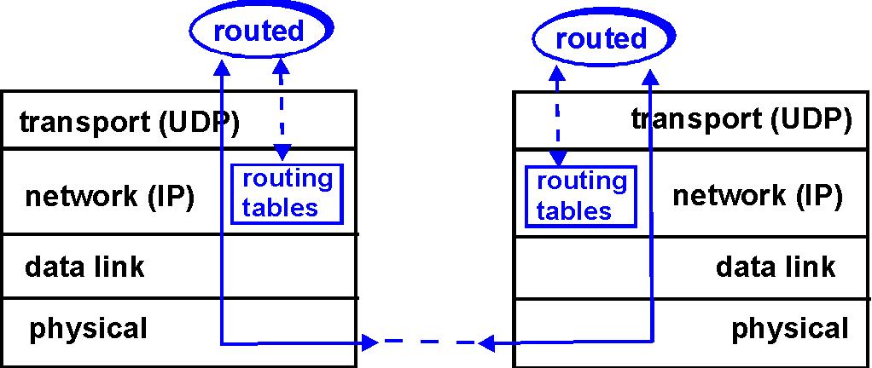
DV+RP => RIP ( Routing Information Protocol)
Included in BSD-UNIX Distribution in 1982
Link cost: 1
Distance metric: # of hops
Distance vectors
exchanged every 30 sec via Response Message (also called advertisement) using UDP
each advertisement: route to up to 25 destination nets
40

Slide 41
RIP: Link Failure and Recovery
If no advertisement heard after 180 sec --> neighbor/link declared dead
routes via neighbor invalidated
new advertisements sent to neighbors
neighbors in turn send out new advertisements (if tables changed)
link failure info quickly propagates to entire net
reverse-poison used to prevent ping-pong loops
set infinite distance = 16 hops (why?)
41

Slide 42
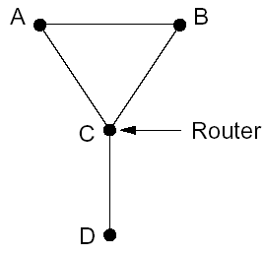
General Routing Loops and Reverse-poison
Exercise: Can Reverse-poison guarantee no loop for this network?

Slide 43
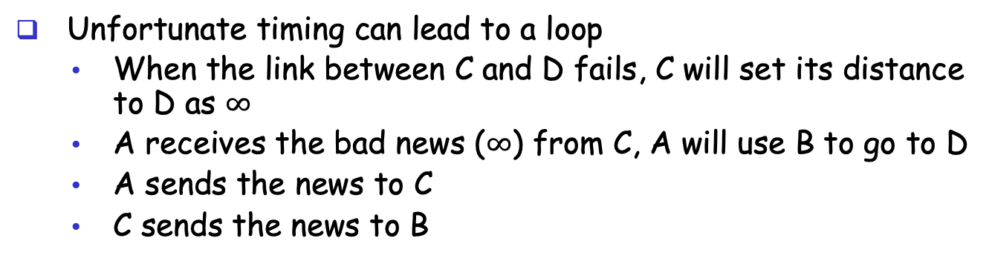
General Routing Loops and Reverse-poison
Reverse-poison removes two-node loops but may not remove more-node loops
I can reach D w/ cost 3
Unfortunate timing can lead to a loop
When the link between C and D fails, C will set its distance to D as $∞$
A receives the bad news ($∞$) from C, A will use B to go to D
A sends the news to C
C sends the news to B

Slide 44
Outline
Admin and recap
Network control plane
Routing
Link weights assignment
Routing computation
Distance vector protocols (distributed computing)
synchronous Bellman-Ford (SBF)
asynchronous Bellman-Ford (ABF)
properties of DV
DV w/ loop prevention
reverse poison
destination-sequenced DV (DSDV)

Slide 45
Destination-Sequenced Distance Vector protocol (DSDV)
Basic idea: use sequence numbers to partition computation
tags each route with a sequence number
each destination node D periodically advertises monotonically increasing even-numbered sequence numbers
when a node realizes that the link it uses to reach destination D is broken, it advertises an infinite metric and a sequence number which is one greater than the previous route (i.e., an odd seq. number)
the route is repaired by a later even-number advertisement from the destination

Slide 46
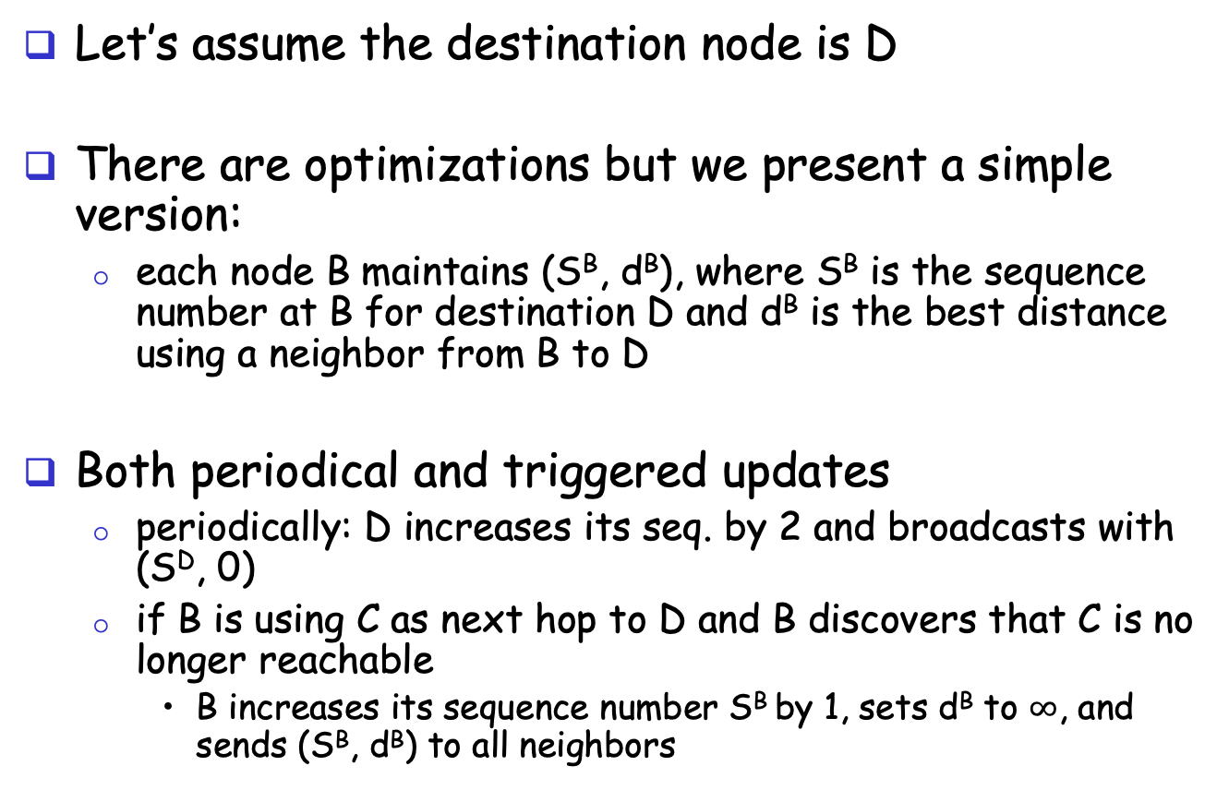
DSDV: More Detail
route update
A
B
Let’s assume the destination node is D
There are optimizations but we present a simple version:
each node B maintains (S^{B}, d^{B}), where S^{B} is the sequence number at B for destination D and d^{B} is the best distance using a neighbor from B to D
Both periodical and triggered updates
periodically: D increases its seq. by 2 and broadcasts with (S^{D}, 0)
if B is using C as next hop to D and B discovers that C is no longer reachable
B increases its sequence number S^{B} by 1, sets d^{B} to $∞$, and sends (S^{B}, d^{B}) to all neighbors
Notes:
The step if S^{A} > S^{B}, then update may not be good because it maybe a cross talk.

Slide 47
Example
1
5
X
1
1
Will this trigger an update?

Slide 48
Example
1
5
X
1
1
Will this trigger an update?

Slide 49
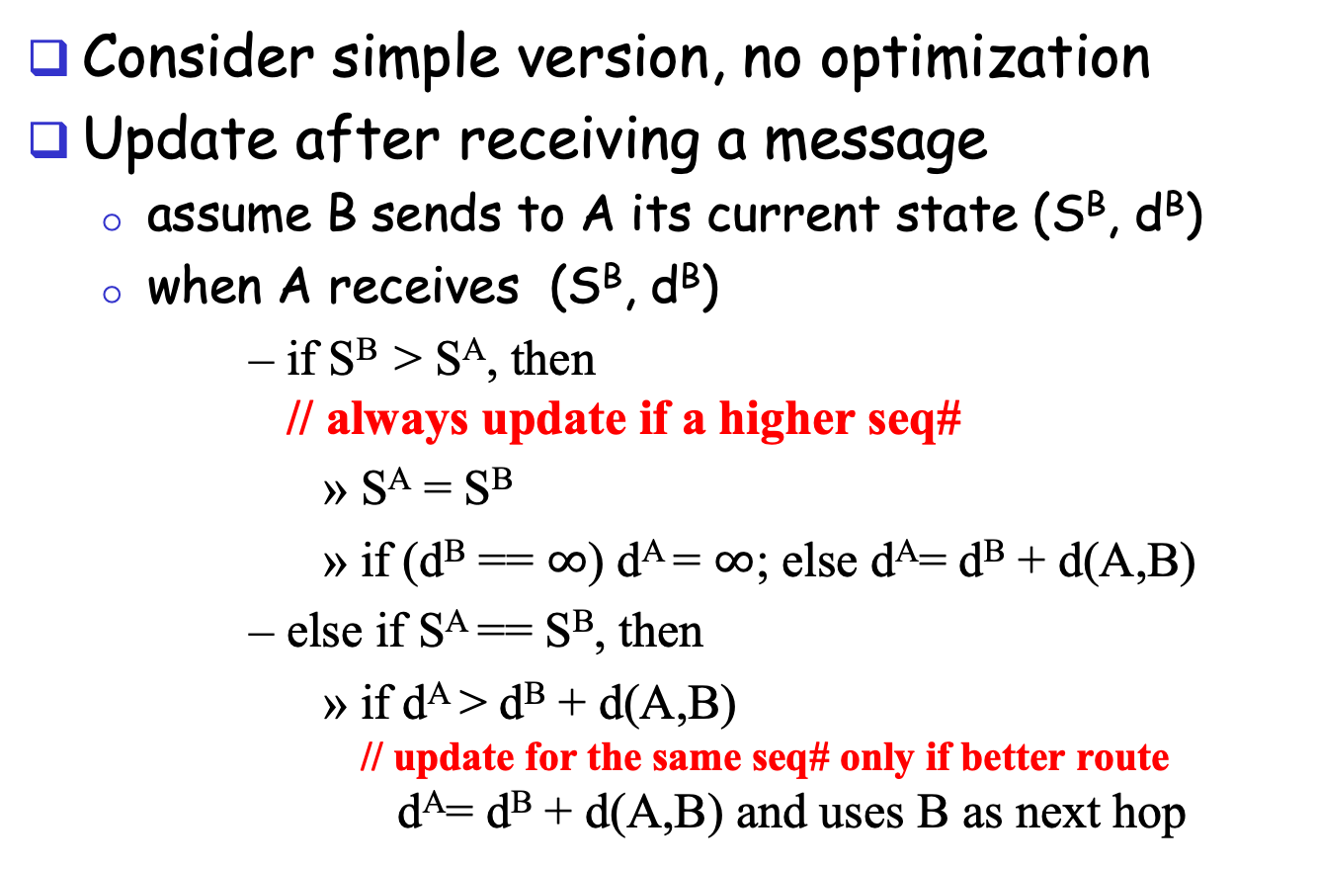
DSDV: Update Alg.
route update
A
B
Consider simple version, no optimization
Update after receiving a message
assume B sends to A its current state (S^{B}, d^{B})
when A receives (S^{B}, d^{B})
if S^{B} > S^{A}, then // always update if a higher seq#
S^{A} = S^{B}
if (d^{B} == $∞$) d^{A} = $∞$; else d^{A}= d^{B} + d(A,B)
else if S^{A} == S^{B}, then
if d^{A} > d^{B} + d(A,B) // update for the same seq# only if better route d^{A}= d^{B} + d(A,B) and uses B as next hop
Notes:
The step if S^{A} > S^{B}, then update may not be good because it maybe a cross talk.

Slide 50
Example
1
5
1
1
Exercise: update process after D increases its seq# to next even number.

Slide 51
Claim: DSDV will NEVER Form a Loop
Initially no loop (no one has next hop so no loop)
Derive contradiction if a loop forms after a node processes an update,
e.g., when A receives the update from B, A decides to use B as next hop and forms a loop
update
A
B

Slide 52
Technique: Global Invariants
Global Invariant is a very effective method in understanding safety of distributed asynchronous protocols
Invariants are defined over the states of the distributed nodes
Consider any node B.
Let’s identify some invariants over the state of node B, i.e., (S^{B}, d^{B}).

Slide 53
Invariants of a Single Node B
Some invariants about the state of a node B
[I1] S^{B} is non-decreasing
[I2] d^{B} is non-increasing for the same sequence number
time

Slide 54
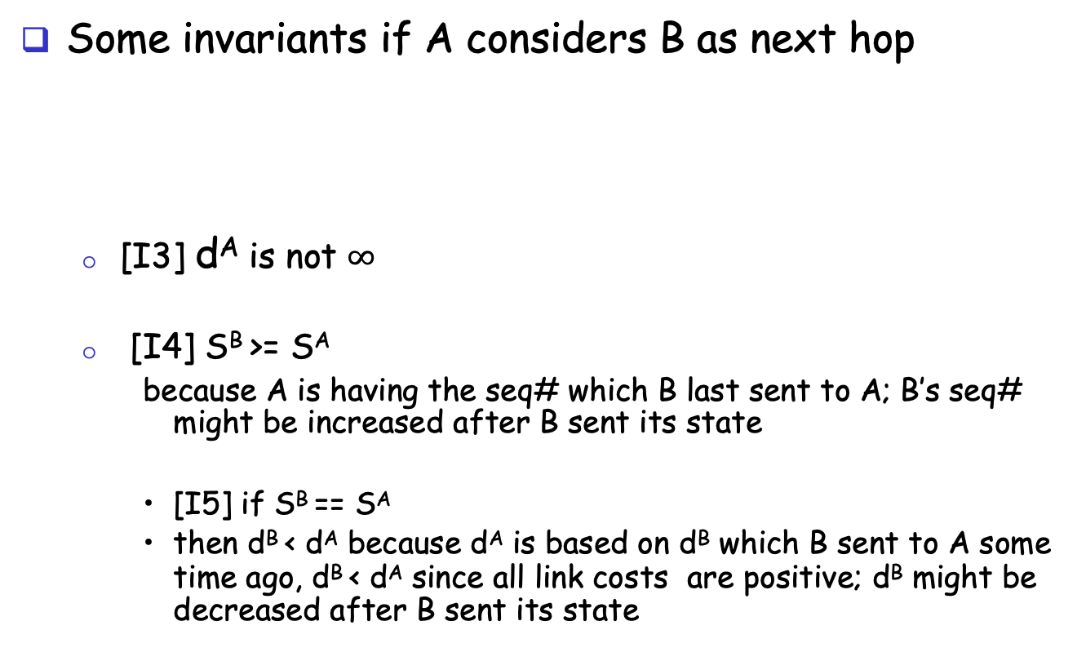
Invariants of if A Considers B as Next Hop
Some invariants if A considers B as next hop
[I3] d^{A} is not $∞$
[I4] S^{B} >= S^{A}
because A is having the seq# which B last sent to A; B’s seq# might be increased after B sent its state
[I5] if S^{B} == S^{A}
then d^{B} < d^{A} because d^{A} is based on d^{B} which B sent to A some time ago, d^{B} < d^{A} since all link costs are positive; d^{B} might be decreased after B sent its state
A
B

Slide 55
Loop Freedom of DSDV
Consider a critical moment
A starts to consider B as next hop, and we have a loop
According to invariant I4 for each link in the loop (X considers Y as next hop) : S^{Y} >= S^{X}
Two cases:
exists S^{Y} > S^{X}
by transition along the loop S^{B} > S^{B}
all nodes along the loop have the same sequence number
apply I5, by transition along the loop d^{B} > d^{B}
update
A
B
X
Y

Slide 56
Issue of DSDV
1
5
X
1
1

Slide 57
Outline
Admin and recap
Network control plane
Routing
Link weights assignment
Routing computation
Distance vector protocols (distributed computing)
synchronous Bellman-Ford (SBF)
asynchronous Bellman-Ford (ABF)
properties of DV
DV w/ loop prevention
reverse poison
destination-sequenced DV (DSDV)
diffusive update algorithm (DUAL) and EIGRP

Slide 58
Basic Idea
DSDV guarantees no loop, but at the price of not using any backup path before destination re-announces reachability.
Basic idea: Sufficient condition to guarantee no loop using backup paths (called switching)?

Slide 59
Key Idea: Feasible Successors
If the reported distance of a neighbor n is lower than the total distance using primary (current shortest), the neighbor n is a feasible successor
p
i
n

Slide 60
Intuition
Since the reported distance of B is lower than my total distance, B cannot be using me (along a path) to reach the destination
feasible successor
A
B
primary
D
Notes:
Before failure:
- dB < dA
- dB >= dC >= dD >= dE >= dA

Slide 61
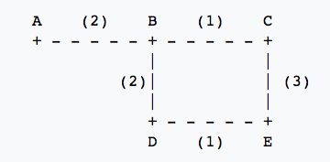
Example
Assume A is destination, consider E
 | Reported Dist. | Total Dist.
Neighbor C
Neighbor D
3
6
4
5

Slide 62
Example
1
5
1
1

Slide 63
Summary: Distance Vector Routing
Basic DV protocol
take away: use monotonicity as a technique to understand liveness/convergence
highly recommended reading of Bersekas/Gallager chapter
Fix counting-to-infinity problem
DSDV
Idea: uses sequence number to avoid routing loops
seq# partitions routing updates from different outside events
within same event, no loop so long each node only decreases its distance
Analysis: use global invariants to understand/design safety/no routing loops
EIRGP (DUAL)
Idea: introduces a sufficient condition for local recovery
Notes:
Simplicity
churns before convergence
path exploration; counting-to-infinity
not enough information when making routing decision (only next-hops and their distance estimates)
While distance-vector protocols are appropriate for small internetworks, and require much less configuration and management
- IGRP was a significant improvement over RIP, which had a hop count restriction that limited the size of an internetwork. IGRP supports internetworks with up to 255 hops.
IGRP:
Upon router startup, IGRP broadcast request messages to other routers. Upon receipt of the message, router send their routing tables to the startup router. Routing tables contain entries for each of the networks that a router can reach. At regular intervals, routers automatically transmit their routing tables to other routers which in turn update their own routing tables if there are changes in the topology. A triggered update occurs if the network topology changes. Triggered updates allow quick responses to changes in the network. When routers add entries to routing tables, 1 is added to the hop count to account for the hop between the router and the neighbor from which it received the route information. When a route is entered into the routing table, a timer is set. As routing table updates arrive and a route entry is verified to still be valid, the timer is reset. If a known router fails to appear in an update and in subsequent updates, the timer will run out and the route entry will be purged.

Slide 64
Discussion: Distance Vector Routing
What do you like about distributed, distance vector routing?
What do you not like about distributed, distance vector routing?
Notes:
Simplicity
churns before convergence
path exploration; counting-to-infinity
not enough information when making routing decision (only next-hops and their distance estimates)
While distance-vector protocols are appropriate for small internetworks, and require much less configuration and management
- IGRP was a significant improvement over RIP, which had a hop count restriction that limited the size of an internetwork. IGRP supports internetworks with up to 255 hops.
IGRP:
Upon router startup, IGRP broadcast request messages to other routers. Upon receipt of the message, router send their routing tables to the startup router. Routing tables contain entries for each of the networks that a router can reach. At regular intervals, routers automatically transmit their routing tables to other routers which in turn update their own routing tables if there are changes in the topology. A triggered update occurs if the network topology changes. Triggered updates allow quick responses to changes in the network. When routers add entries to routing tables, 1 is added to the hop count to account for the hop between the router and the neighbor from which it received the route information. When a route is entered into the routing table, a timer is set. As routing table updates arrive and a route entry is verified to still be valid, the timer is reset. If a known router fails to appear in an update and in subsequent updates, the timer will run out and the route entry will be purged.

Slide 65
Churns of DV: One Example
Message sequences
Node 2 tells 3. Node 3 tells 4…Node N tells N+1. (N-1 messages)
Node N+1 tells N+2, N+2 tells N+3,…,2N. (N-1 messages)
Now node N-1 tells node N+1
Step 2 repeats
Now node N-2 tells node N+1
…
2N
Initially converged.
All links have cost 1
Event: Cost of 1->2 reduces to 0
…
N+3
N+2
N+1
A total of O(N²) messages
1
2
3
…
N-1
N

Slide 66
Outline
Admin and recap
Network control plane
Routing
Link weights assignment
Routing computation
Distance vector protocols (distributed computing)
Link state protocols (distributed state synchronization)

Slide 67
Link-State Routing
Basic idea: Not distributed computing, only distributed state distribution
Net topology, link costs are distributed to all nodes
all nodes have same info
Each node computes its shortest paths from itself to all other nodes
standard Dijkstra’s algorithm as path compute alg
Allows multiple same-cost paths
Multiple cost metrics per link (for type of service routing)
Most commonly used routing protocol (e.g., OSPF/ISIS) by most networks in Internet

Slide 68
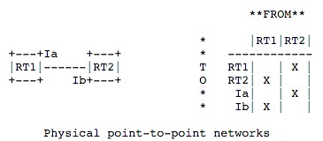
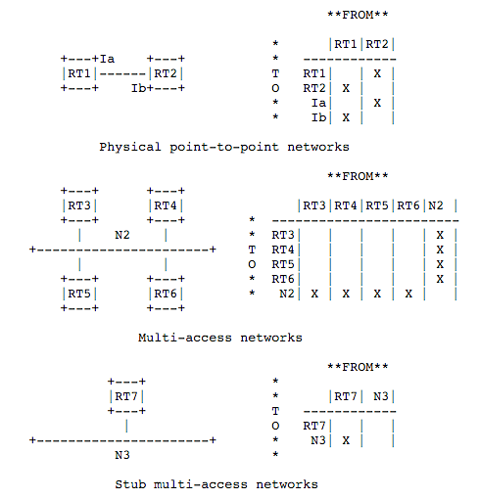
Example: Link State and Directed Graph (OSPFv2)
https://tools.ietf.org/html/rfc1583#page-12
Notes:
Need to setup order: Right after said a link is up, it became down
solution: sequence#
sequence# corruption: age
Partition: periodical rebroadcast
Failure

Slide 69
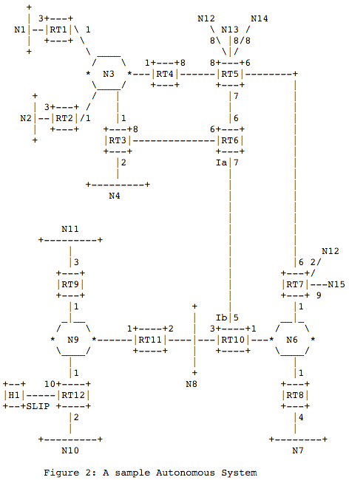
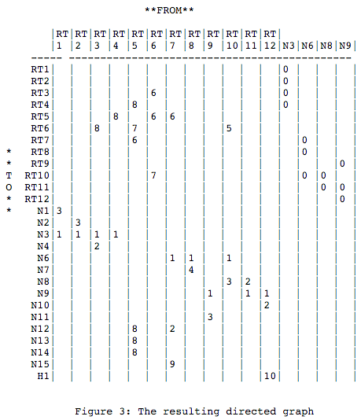
Example: Link State and Directed Graph (OSPFv2)
Notes:
Need to setup order: Right after said a link is up, it became down
solution: sequence#
sequence# corruption: age
Partition: periodical rebroadcast
Failure

Slide 70
Outline
Admin and recap
Network control plane
Routing
Link weights assignment
Routing computation
Distance vector protocols (distributed computing)
Link state protocols (distributed state synchronization)
data structure to be distributed
state distribution protocol

Slide 71
Basic Link State Broadcast Protocol
Basic event structure at node n
on initialization:
broadcast LSA[e] for each link e connected to n
on state change to a link e connected to n:
broadcast LSA[e] = new status
on receiving an LSA[e]:
if (does not have LSA[e]) forwards LSA[e] to all links except the incoming link
Notes:
Need to setup order: Right after said a link is up, it became down
solution: sequence#
ordering of events (link up and down)
network partitioning and then merge
sequence# corruption: age
Partition: periodical rebroadcast
Failure

Slide 72

Link State Broadcast
Node S updates link states connected to it.
S
E
F
B
C
M
L
J
A
G
H
D
K
I
N

Slide 73
Link State Broadcast
S
E
F
B
C
M
L
J
A
G
H
D
K
I
N
To avoid forwarding the same link state announcement (LSA) multiple times (forming a loop), each node remembers the received LSAs.
- Second LSA[S] received by E from C is discarded
- Second LSA[S] received by C from E is discarded as well
- Node H receives LSA[S] from two neighbors, and will discard one of them

Slide 74
Discussion
Issues of the basic link state protocol?
Recall: goal is to efficiently distribute to each node to a correct, complete link state map

Slide 75
Link State Broadcast: Issues
Problem: Out of order delivery
link down and then up
A node may receive up first and then down
Solution
Each link update is given a sequence number: (initiator, seq#, link, status)
the initiator should increase the seq# for each new update
If the seq# of an update of a link is not higher than the highest seq# a router has seen, drop the update
Otherwise, forward it to all links except the incoming link (real implementation using packet buffer)
Problem of solution: seq# corruption
Solution: age field (e.g., https://tools.ietf.org/html/rfc1583#page-102)

Slide 76
Link State Broadcast: Issues
Problem: network partition and then reconnect, how to sync across the reconnected components
Solution: updates are sent periodically

Slide 77
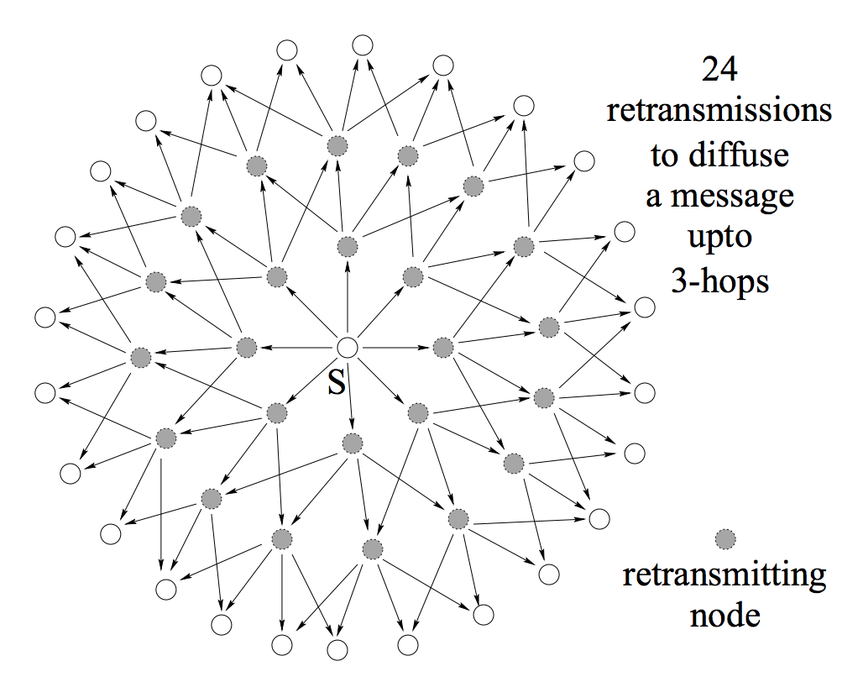
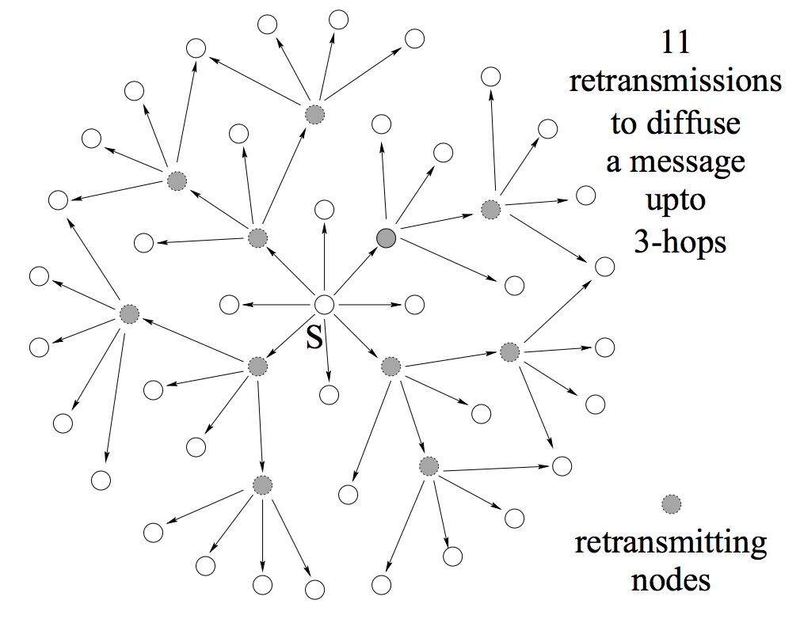
Link State Broadcast: Issues
Problem: Broadcast redundancy
https://hal.inria.fr/inria-00072756/document

Slide 78
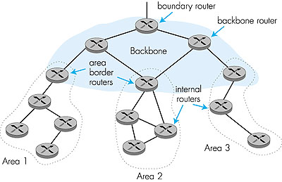
Hierarchical OSPF
“summarize” distances to nets in own area, advertise to other Area Border routers.
run OSPF routing limited to backbone.
- Link-state advertisements only in area
each nodes has detailed area topology; - only know direction (shortest path) to nets in other areas.
Two-level hierarchy: local area, backbone.

Slide 79
Summary: Link State
Basic LS protocol
take away: instead of computing routing results using distributed computing, distributed computing is for only link state distribution (synchronization)
Link state distribution can still have much complexity, e.g., out of order delivery, partition and reconnect, scalability
Notes:
Simplicity
churns before convergence
path exploration; counting-to-infinity
not enough information when making routing decision (only next-hops and their distance estimates)
While distance-vector protocols are appropriate for small internetworks, and require much less configuration and management
- IGRP was a significant improvement over RIP, which had a hop count restriction that limited the size of an internetwork. IGRP supports internetworks with up to 255 hops.
IGRP:
Upon router startup, IGRP broadcast request messages to other routers. Upon receipt of the message, router send their routing tables to the startup router. Routing tables contain entries for each of the networks that a router can reach. At regular intervals, routers automatically transmit their routing tables to other routers which in turn update their own routing tables if there are changes in the topology. A triggered update occurs if the network topology changes. Triggered updates allow quick responses to changes in the network. When routers add entries to routing tables, 1 is added to the hop count to account for the hop between the router and the neighbor from which it received the route information. When a route is entered into the routing table, a timer is set. As routing table updates arrive and a route entry is verified to still be valid, the timer is reset. If a known router fails to appear in an update and in subsequent updates, the timer will run out and the route entry will be purged.

